Slide 1
Copyright Workshop
for the
Select Committee on Trade and Industry, Economic Development, Tourism, Employment and Labour
“Copyright exceptions and limitations”
18 October 2022 Dr. Tobias Schonwetter,
A/Prof, Dep. of Commercial Law (UCT)
Director: UCT IP Unit I Director iNtaka Centre for Law & Technology

Slide 2
Outline for this session
[Recap: Copyright 101]
Exceptions & Limitations
Lawmaker checklist

Slide 3
Recap: Copyright Basics

Slide 4
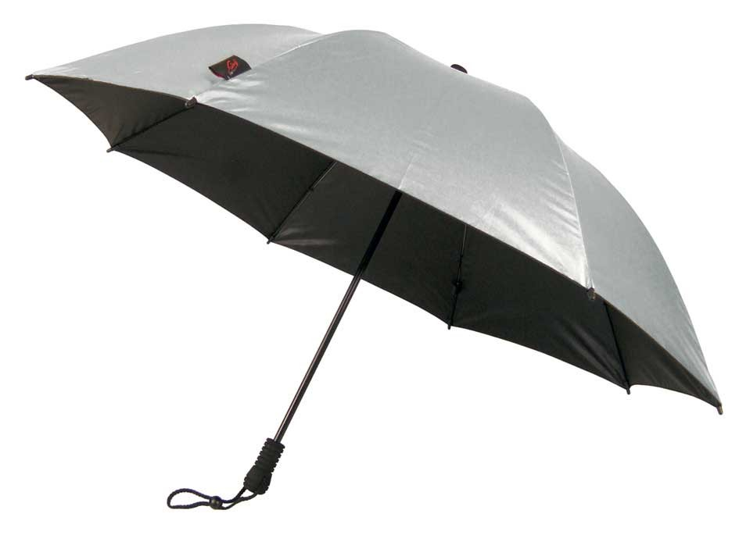
Different forms of Intellectual Property protection
Patents
Copyright (& Performers Protection)
Trade Marks
Geographical indications
Designs
Traditional Knowledge
Plant Variety Protection
Trade Secrets

Slide 5
Copyright – Protected works (in SA)
Literary, musical and artistic works;
Cinematograph films;
Sound recordings;
Broadcasts;
Published editions
Programme-carrying signals
Computer programs
Creative materials / cultural goods

Slide 6
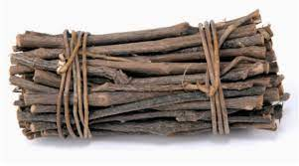
Exclusive (economic) rights (“certain acts”)
reproduce
make adaptations
broadcast
distribute
perform
display in public
…

Slide 7
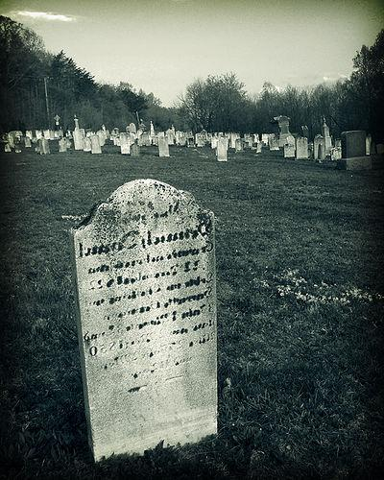
Duration of copyright protection in SA
depending on the nature of work
rule of thumb: end of the year in which author dies + 50 years (literary, musical, artistic works),
10
20
30
40
50
60
70

Slide 8
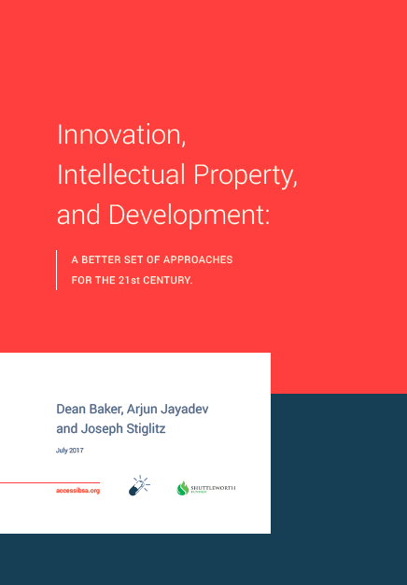
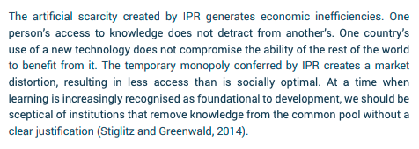
Baker, Jayadev, Stiglitz Innovation, intellectual Property and Development: A Better Set of Approaches for the 21st Century (2017); Available at: http://bit.ly/2tTB3JD

Slide 9
2018
Available at:
www.gov.za/sites/default/files/gcis_document/201808/ippolicy2018-phasei.pdf

Slide 10
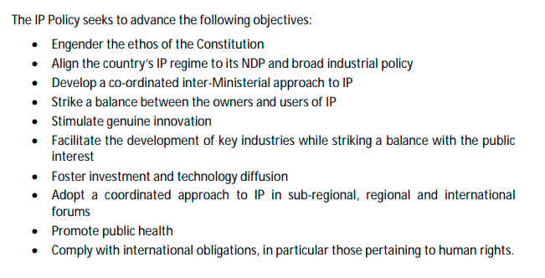
2018

Slide 11
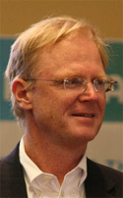
Welfare Theory
Copyright promotes the interests of society as a whole and favours the greatest good for the greatest number of people. Incentives to create are balanced with mechanisms to make works widely available for the benefit of all.
Fairness Theory
The law ought to give authors what they deserve; in other words, hard work should be rewarded and authors should retain control of the fruits of their labour.
Culture Theory
The law should cultivate a just and attractive culture. Works should be encouraged for the greater good of humanity and the law should encourage people to behave accordingly.
Personality Theory
Copyright seeks to protect the emotional bond between the artist and her creation. Moral rights derive primarily from personality theory

Slide 12
To reward innovation & creativity
👍
To maximise (domestic) innovation / creativity & net social welfare
(utilitarian approach – not an end in itself)
❗️
Further reading:
Fisher W ‘Theories of Intellectual Property’ in Munzer S (ed) New Essays in Legal and Political Theory of Property (2001) Cambridge University Press UK (http://tfisher.org/)

Slide 13
The aim must be to strike an optimal balance between rights and © exceptions and limitations
A balance that considers the context of the country, and one that needs to be adjusted from time to time to appropriately cater for, e.g., technological advances.

Slide 14
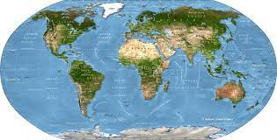
All countries have copyright exceptions & limitations
(allowing the use of copyrighted works in certain circumstances without the permission of the rights holder)

Slide 15
Copyright exceptions and limitations
Copyright e&l curtail the exclusive rights assigned by copyright law to the copyright holder. They do this to promote the public interest and to respect users’ legitimate interests in using copyright protected material in certain circumstances without the permission of the rights holder.

Slide 16
Permission is required for most uses of most works!
Notes:
.

Slide 17
3 legislative approaches

Slide 18
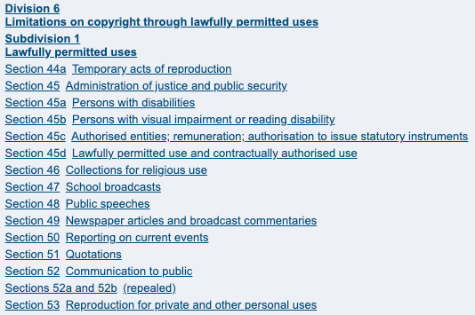
3 legislative approaches

Slide 19
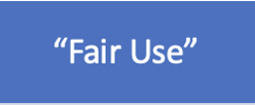
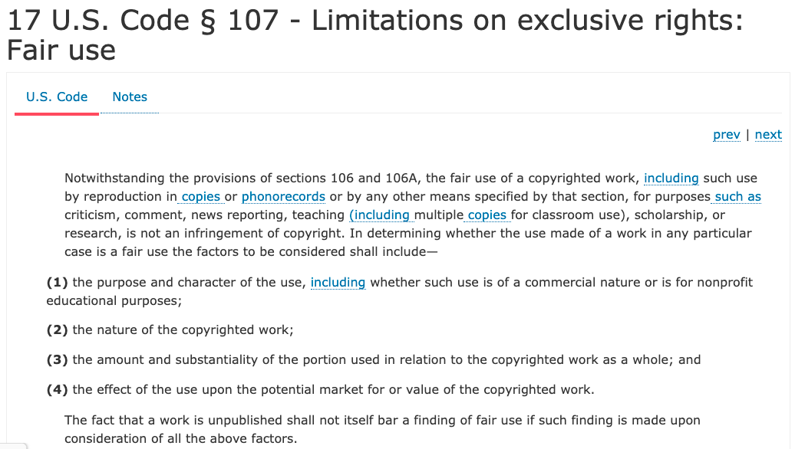
3 legislative approaches

Slide 20
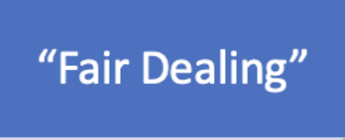
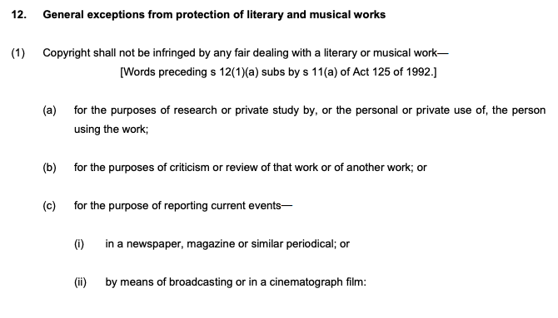
3 legislative approaches

Slide 21
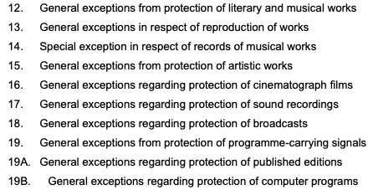
3 legislative approaches
Other e & l in SA Copyright Law

Slide 22
Some key pros & cons of the existing approaches to © e&l
Long lists of e&l
+ Legal certainty
- Inflexible & need for regular updating
“Fair Use”
+ Flexible and tailored towards case to case application
- Less legal certainty than long lists
“Fair Dealing”
+/- More flexible than long lists but significantly less flexible than fair use

Slide 23
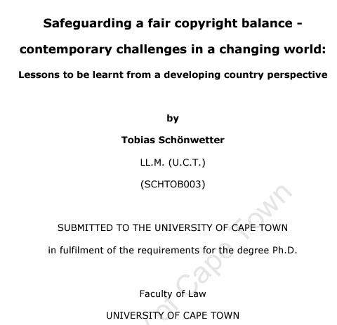
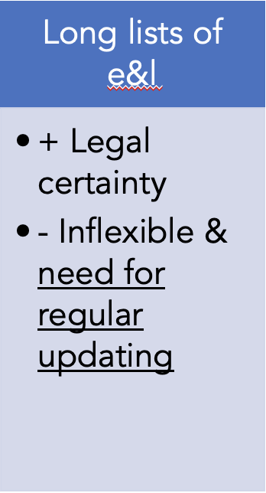
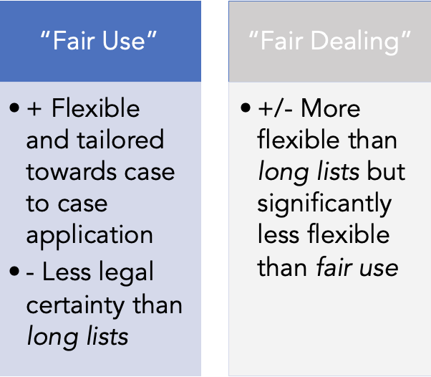
Concluding remarks

Slide 24
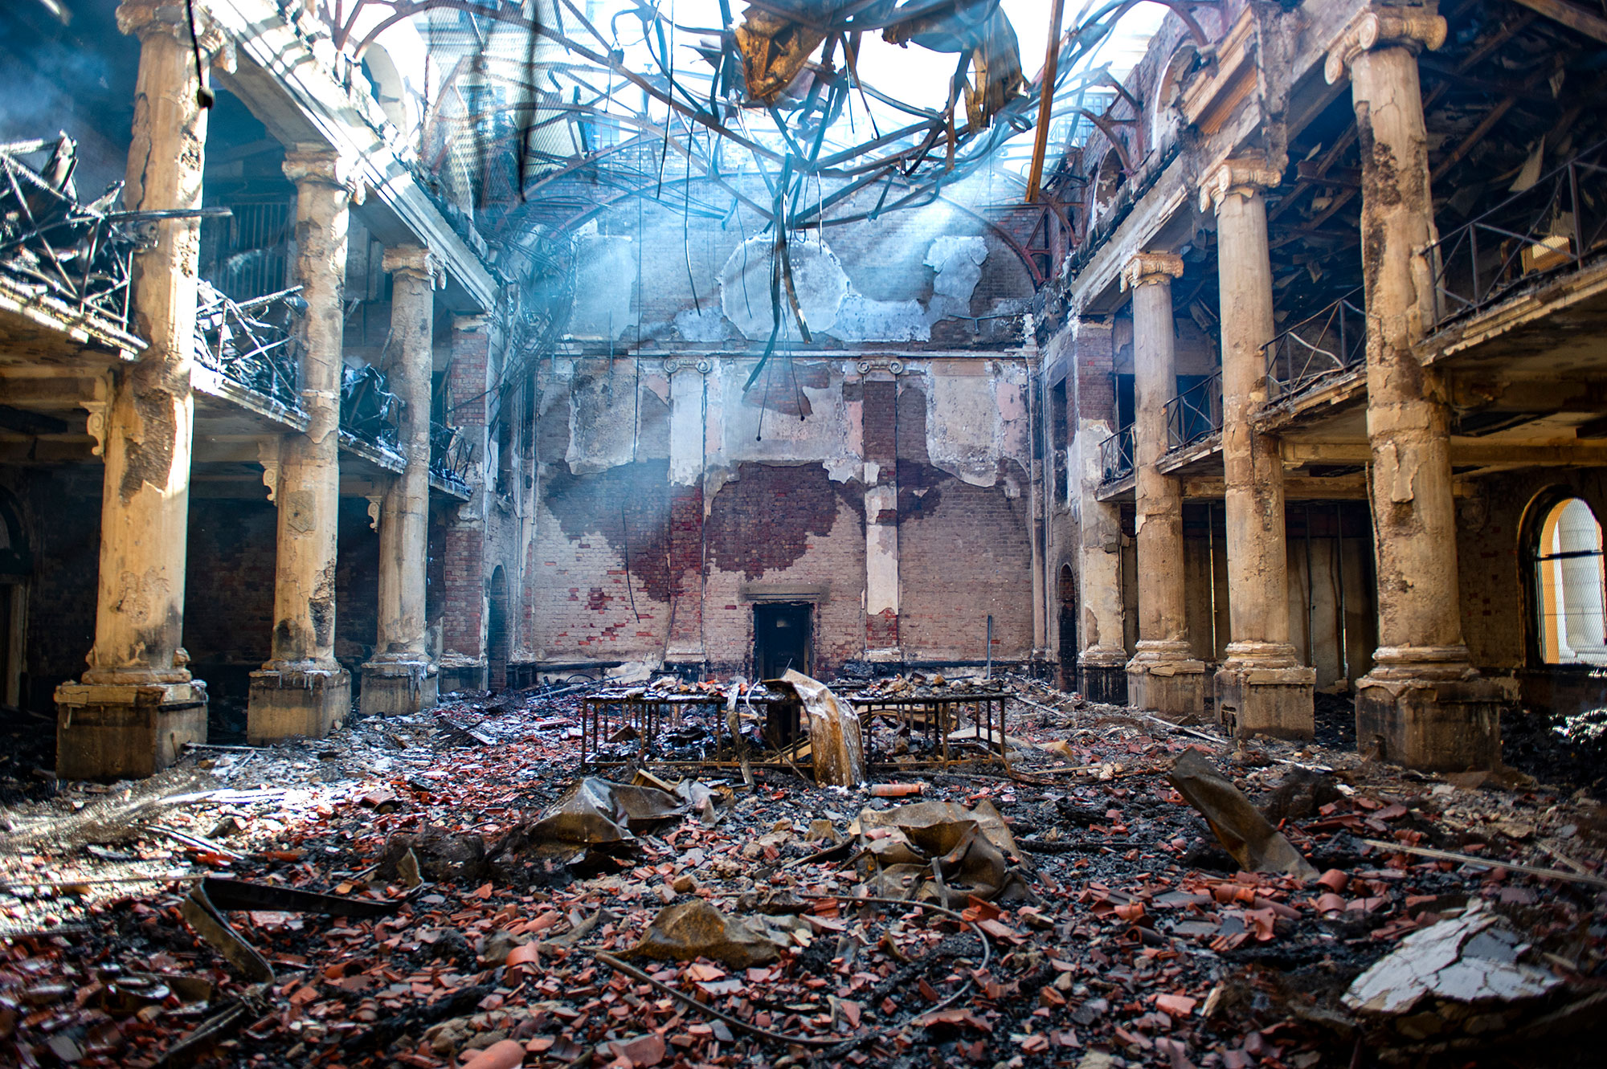
Concluding remarks

Slide 25
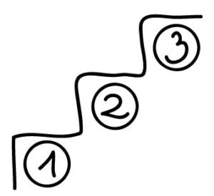
The three-step test

Slide 26
Lawmaker checklist

Slide 27
Lawmaker checklist for the upcoming hearings
Engage with the actual wording of the Bill – not what you have heard or read (eg, in op-eds) what the Bill supposedly says (or doesn’t say)
Distinguish substantiated arguments from mere (lobby) claims/ assertions
Also acknowledge utilitarian rationales of IP protection that requires balancing of interests to maximise innovation, creativity and net social welfare
Be guided by SA’s IP Policy (and the NDP)
Legislate in a context-sensitive manner
Make this a priority - delays can be costly if the current legislative framework is inadequate (and many say the current © law is)

Slide 28
Q&A

Slide 29
Appendix: : The three-step test
So would a fair use provisions [“such as”] comply with the test?
“The ALRC considers that fair use is consistent with the three-step test.”
18 month enquiry, 100 consultation, ~900 submission

Slide 30
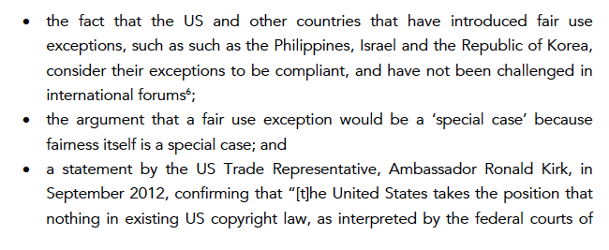
The three-step test
So would a fair use provisions [“such as”] comply with the test?
…

Slide 31
The three-step test
Additional Readings:
Australian Law Reform Commission Report (2014), available at https://www.alrc.gov.au/sites/default/files/pdfs/publications/final_report_alrc_122_2nd_december_2013_.pdf
P Samuelson Is the U.S. Fair Use Doctrine Compatible with Berne and TRIPS Obligations? (2018), available at
https://papers.ssrn.com/sol3/papers.cfm?abstract_id=3228052
C Geiger; D Gervais and M Senftleben The Three-Step-Test Revisited: How to Use the Test’s Flexibility in National Copyright Law (2014), available at https://bit.ly/2pYExLa

