Slide 1
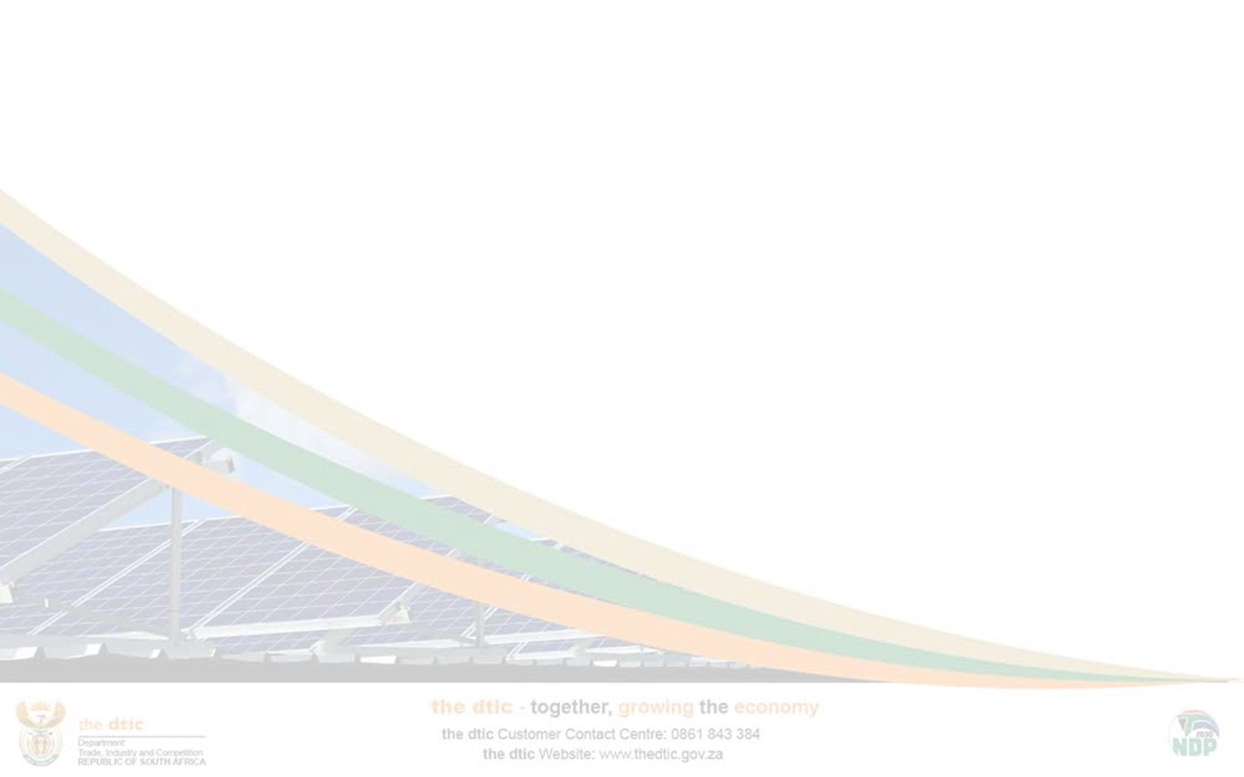
Department of Trade, Industry & Competition (the dtic)
Annual Performance Plan (APP) 2020/2021
Presentation to Select Committee on Trade and Industry, Economic Development,
Small Business Development, Tourism, Employment and Labour
10 July 2020

Slide 2
PRESENTATION OUTLINE
Global Economic Overview
Government interventions
SP and APP Key Interventions
Strategic Imperatives
the dtic Organisational Structure
Programme: Outcomes, Outputs, Performance Indicators and Targets
Budget Allocation

Slide 3
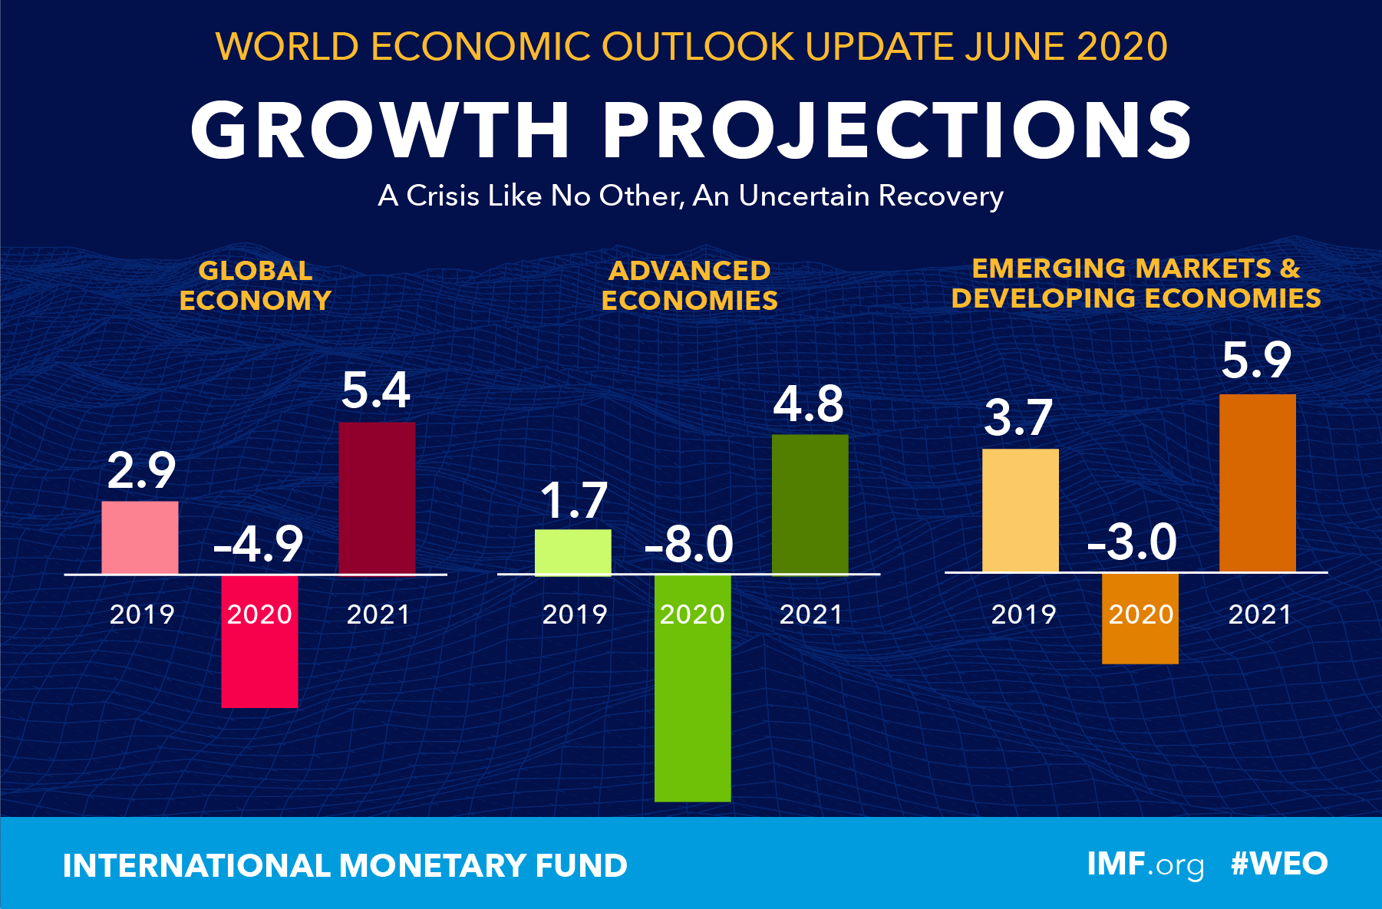
GLOBAL ECONOMIC CONTEXT
Outlook
The global growth is projected at -4.9% in 2020 rebounding to 5.4% in 2021.
Risks to the Outlook
Outbreaks could recur requiring the re-imposition of some containment measures;
A prolonged economic decline that could lead to further firm closures and job losses;
Tighter financial conditions exposing vulnerabilities among borrowers that could tip some economies into debt crises;
Premature withdrawal of policy responses to the resultant economic crisis; and
Cross-border spill-overs from weaker external demand and tighter financial conditions could further magnify the impact of country- or region-specific shocks on global growth.

Slide 4
THE GDP RECORDS A STEEPER DECLINE
The Gross Domestic Product (GDP)
In the first quarter of 2020, the real GDP declined by 2%;
The key drivers were: mining and quarrying (-21.5%); manufacturing (-8.5%); electricity, gas and water (-5.6%); construction (-4.7%); and trade (-1.2%);
Mining and manufacturing were the hardest hit due to the subdued global demand taking a toll on the developed world, and most notably China;
As a result, all the manufacturing subsectors declined, with the exception of the furniture subsector that recorded 2.8% growth; and
The biggest declines were in the petroleum, chemical products, rubber and plastic products; motor vehicle, parts and accessories and other transport equipment; and the basic iron and steel, non-ferrous metal products, metal products and machinery.

Slide 5
SA’S GDP GROWTH PROJECTIONS REVISED DOWNWARD
Risks to Domestic Growth
National Treasury in the supplementary budget released on 24 June 2020 estimates the real GDP growth for 2020 to be -7.2%:
International Monetary Fund (IMF) and World Bank (WB) (April 2020 publications), reduced South Africa’s GDP growth prospects for 2020 to -5.8% and to 4.0% in 2021;
The South African Reserve Bank (SARB) in its Monetary Policy Statement released in May 2020 also revised its growth projections down to -7.0% in 2020 but expected a rebound of 3.8% in 2021 and 2.9% in 2022; and
Against the backdrop of weaker global growth fundamentals and significant domestic constraints such as the outbreak of the Coronavirus [COVID-19]; constrained fiscal outlook; and higher tariff increases, South Africa’s real GDP growth is set to remain under pressure for the foreseeable future.

Slide 6
REAL GROSS FIXED CAPITAL FORMATION (GFCF) DIPPED
GFCF contracted sharply by 20.5% in the first quarter of 2020;
This is for the second consecutive quarter after declining by 10% (q-on-q) in the fourth quarter of 2019;
The main contributors to the decrease were machinery and other equipment, transport equipment and other assets;
This decline was primarily driven by public corporations and the private business enterprises declining by 20.9% and 25.3% respectively; and
Consequently, domestic investment as a ratio of GDP also declined from 19.4%(q-on-) in the third quarter to 19% in the fourth quarter of 2019 before further falling to 18% in the first quarter of 2020.

Slide 7
THE SA ECONOMY LOST JOBS IN Q1 2020
The South African economy lost 38 000 jobs in Q1 2020;
This reduces the total number of the employed from 16,42 million people in Q4 2019 to 16,38 million in Q1 2020;
Of the 10 industries, only three registered increases, namely, trade with 71 000 employees, households 30 000, mining with 6 000; and
The biggest job losers in Q1 2020 were the finance; community and social services; and Agriculture losing 50 000; 33 000; and 21 000 jobs respectively.

Slide 8
UMEMPLOYMENT IS WORSE FOR WOMEN AND YOUTH
South Africa is facing a rise in youth and women unemployment due to uneven access to economic opportunities;
The unemployment rate for youth, age groups 15-24 years and 25-34 years rose from 46.3% and 26.3% in Q1 2008 to 59.0% and 37.3% in Q1 2020, respectively;
One third of this age group (15-24) is most vulnerable since they are not in education, employment or training;
Regarding women unemployment, there is a significant increase in the rate of unemployment from 36.7 % in Q1 2008 to 43.4% in Q1 2020;
However, Government has measures in place such as the Youth Employment Service and IDC transformation fund targeting both youth and women; and
Also, Government Departments are required to ensure that their programs expedite social and economic transformation such as gender equality, youth employment and inclusive growth.

Slide 9
SA REGISTERS A TRADE SURPLUS WITH THE WORLD
South Africa’s trade balance with the rest of the world recorded a surplus of R87 billion in Q4 2019 from R32.9 billion in Q3 2019;
The trade surplus resulted from an increase in the value of net gold and merchandise exports, alongside a contraction in merchandise imports;
Exports increased driven largely by the demand for citrus in the European market and also a sharp rise in the international prices of PGMs and iron ore; and
Imports contracted as a result of the decline in the value of imported minerals, in particular, crude oil amongst others.

Slide 10
SA TRADE DOMINANCE WITH AFRICA CONTINUES
Exports to Africa amounted to R93 billion in Q4 of 2019 while imports from the region amounted to R41 billion resulting in a trade surplus of R51 billion;
However, South African exports to the continent were largely driven by preferential trade arrangements in the Southern Africa region (SADC & SACU);
With opening of markets in Africa through the Continental Free Trade Area, higher export penetration to other sub-Saharan African economies is anticipated; and
To expand trade beyond the SADC region, the government, amongst others, is developing master plans for key industries to be implemented to take advantage of opportunities the continental free trade area brings along.

Slide 11
SA TRADE DEFICIT WITH BRICS WIDENED
South Africa’s trade with BRICS has been dominated by China: exports (R35 billion) and imports (R58 billion) followed by India: exports and imports same value of R16 billion each in Q4 2019;
As a result, SA recorded a huge trade deficit with its BRICS counterparts valued at R26 billion in Q4 2019;
The increase in imports, particularly manufactured imports from BRICS remains four times greater than that of exports on average;
This disparity is reflected in the country’s trade balance, which has been consistently negative; and
With stronger and more effective interaction at the governmental level and greater private sector participation, intra-BRICS trade could increase significantly.

Slide 12
GOVERNMENT INTERVENTIONS
To improve growth prospects for the domestic economy, interventions include amongst others:
Implementation of the R500 billion COVID-19 economic recovery package;
The implementation of the automotive sector, poultry industry and retail - clothing, textiles, leather and footwear industries Master Plans, while others are being developed;
The implementation of the Integrated Resource Plan 2019, which will open the way for considerable investments in renewable energy generation (particularly wind power) and related components manufacturing;
The implementation of investment projects announced at the second Investment Conference in 2018 and 2019;

Slide 13
GOVERNMENT INTERVENTIONS
Taking advantage of opportunities brought about by the coming into effect of the African Continental Free Trade Area (AfCFTA);
The implementation of the public sector’s localisation drive, including improved enforcement of product designations;
The implementation of the Re-imagined Industrial Strategy;
The implementation of the Special Economic Zones (SEZs) policy and the revitalisation of Industrial Parks; and
The implementation of the Black Industrialist Programme.

Slide 14
SP AND APP KEY INTERVENTIONS
the dtic’s priorities were refined given the impact of COVID-19 on the global economy, the domestic socio-economic environment and Government’s limited fiscal resources.
Broad priorities and institutional enablers that will underpin a new – more efficient and cost-effective – way of working are summarised in the sections below.

Slide 15
EXECUTIVE SUMMARY OF STRATEGIC IMPERATIVES
the dtic Impact Statement:
“Reimagined industrial strategy towards economic growth”
the dtic’s MTSF commitments are captured under:
Priority 2: Economic Transformation and Job Creation.
Priority 7: A better Africa and World
Re-imagined Industrial Strategy is a key element of Priority 2
MEDIUM-TERM STRATEGIC
FRAMEWORK (MTSF) PRIORITIES
2
The 10 Programmes of the Department contribute to growing and transforming the economy; Creating jobs; and Protecting consumers, workers and enterprises.
the dtic PROGRAMMES
10
the dtic’s Budget was reduced by 16% or R1.77 billion. Consequently, the performance indicators and targets have been revised.
BUDGET ADJUSTMENT
-16%
The number of output indicators increased by 5. The department will deliver on 35 output indicators compared to 30 previously projected.
APP OUTPUT INDICATORS
35
the dtic is responsible for 17 entities and 45 pieces of legislation, covering a substantial part of South Africa’s economic policy landscape
the dtic ENTITIES
17

Slide 16
the dtic BROAD PRIORITIES
01
Expanding and Deepening South Africa’s industrial opportunities
Localisation; Trade Measures
Transformation Tools; Strategic Investment
02
South Africa’s Key Trade Relations, Export Strategy and Export Tools
Trade Relations; Export Measures
Competition policy and tools for structural transformation
Advancing Public Interest Commitments
Pursuing Sectoral Structural Change
Alignment and Coordination
03
Resource mobilisation
Improve effectiveness of the dtic spend and resources
Coordinated actions to reduce import leakages which has a relatively low budget cost for Government
Programme restructuring to improve results and Changes to incentive regime
04
Master Plans
Resourcing the four approved Master Plans for implementation
Furniture and Steel Master Plans to be prioritised, postpone others
Building equity for the Master Plan ‘brand’
05

Slide 17
the dtic ORGANISATIONAL STRUCTURE
Director-General
Consumer and Corporate Regulation
Trade Policy, Negotiations and Cooperation
Spatial Industrial Development and Economic Transformation
Industrial Competitive-ness and Growth
Administration
Industrial Financing
Inward Investment Attraction, Facilitation and Aftercare
Minister
Export Development, Promotion and Outward Investments
Economic Research and Coordination
Competition
Policy and Economic Planning
Deputy Minister
Deputy Minister

Slide 18
PROGRAMME 1: ADMINISTRATION
Purpose: Provide strategic leadership, management and support services to the department.
Outcomes:
Implement transformation through Employment Equity (EE) and Broad-Based Black Economic Empowerment (B-BBEE)
Youth Empowerment
Promote a professional, ethical, dynamic, competitive and customer-focused working environment that ensures effective and efficient service delivery
  Reduction in the transmission of COVID-19 at the workplace (New)
Aligned institutional capabilities and capacity (NMOG PHASE2) (New)
Implementation of shared services for the dtic portfolio of entities to ensure long-term sustainability through increased efficiencies and effectiveness (New)
Outputs:
Increase in the employment of People with a Disability
Increase in the employment of women at Senior Management Service level
Increase the number of interns appointed for experiential learning for a two-year contract
100% eligible creditors’ payments made within 30 days
Implementation Plan for the Protocol on new working arrangements (New)
NMOG Phase 2 Implementation Plan (New)
Optimisation of resources within the dtic portfolio of entities through the implementation of a shared services model for the dtic entities (New)

Slide 19
PROGRAMME 1: ADMINISTRATION
OUTPUT INDICATORS | CHANGES TO INDICATORS | 2020/21 ANNUAL TARGET | FIVE YEAR TARGET
Percentage (%) of People with a Disability employed | - | 3.5% | 3.5%
Percentage (%) of women at Senior Management Service level | - | 50% | 50%
Number (No.) of interns appointed | - | 54 | 162
Percentage (%) of eligible creditors payments processed within legal timeframes | - | 100% eligible creditors’ payments made within 30 days | 100% eligible creditors’ payments made within 30 days
Percentage(%) implementation of the COVID-19 Plan | New Indicator | 100% | 100%
Number (No.) of COVID-19 reports produced | New Indicator | 10 | 58 ( Monthly from June 2020)
Report on Implementation of the NMOG Phase 2 Plan | New Indicator | Report covering achievement of no less than 30% of target | 100% Implementation of the NMOG Phase 2 Plan
A report on the Implementation of the Shared Services Framework | New Indicator | Development of a Framework on Shared Services | A report on the Implementation of the Shared Services Framework

Slide 20
PROGRAMME 2: TRADE POLICY, NEGOTIATIONS AND COOPERATION
Purpose: Build an equitable global trading system that facilitates development by strengthening trade and investment links with key economies and fostering African development, including regional and continental integration and development cooperation in line with the AU Agenda 2063.
Outcomes:
Increased intra-Africa trade to support Africa regional development
Outputs:
Africa regional development programme implemented
Implementation of trade agreements to facilitate market access
Global rule- making to enable policy space to support and grow priority sectors
Strategic considerations in current context, which will inform the allocation of resources and expertise in the period ahead, within the outputs and performance indicators: (New)
Develop options to fast-track the operationalisation of the AfCFTA, broadening participation and ensuring potential benefits are delivered more rapidly.
Strengthen coordination capabilities to support trade and protect South Africa’s industrial base through the work of ITAC.
Report on output indicators will also report on progress against these matters.

Slide 21
PROGRAMME 2: TRADE POLICY, NEGOTIATIONS AND COOPERATION
OUTPUT INDICATORS | CHANGES TO INDICATORS | 2020/21 ANNUAL TARGET | FIVE YEAR TARGET
Number of status reports on regional economic integration | - | 1 status reports produced on progress for Tripartite Free Trade Agreement (T-FTA) Previous Target: 2 Status reports | 90% of tariff lines reduced by 20% per year over a 5 year period
 |  | 4 status reports produced on tariff and trade related matters under the AfCFTA
Number of status reports on implementation of trade Agreements | - | 2 status reports on implementation of SADC-European Union (EU) Economic Partnership Agreement (EPA)
 |  | 2 status reports on implementation of SACU-Mozambique EPA with the United Kingdom (UK)
 |  | 2 status reports on implementation of the African Growth and Opportunity Act, 2000 (AGOA)
Number of status reports on engagements in BRICS, G20 and the WTO | - | 6 status reports produced on engagements in BRICS, G20 and the WTO

Slide 22
PROGRAMME 3: SPATIAL INDUSTRIAL DEVELOPMENT & ECONOMIC TRANSFORMATION
Purpose: Drive economic transformation and increase participation in industrialisation.
Outcomes:
Increased and enhanced instruments for spatial development of targeted regions and economic transformation
Industrialisation, localisation and exports
Investing for accelerated inclusive growth
Outputs:
Number of implementation reports on SEZ and the National SEZ Capacity Support (Project Management Unit) submitted to Minister (Amended)
Number of implementation reports on the industrial parks submitted to Minister
Number of implementation reports on the economic transformation submitted to the Minister
Strategic considerations (New)
National government will be actively involved in the planning and development of SEZs and Industrial Parks. This urgent intervention is a result of limited budgets across government and the lack of requisite skills to plan, develop and manage SEZs in provinces.
Creation of the National SEZ Capacity Support Unit that will be based at the IDC.
Coordinate and mobilise resources and expertise at all levels to fast-track the development of infrastructure and also assist in investment promotion.

Slide 23
PROGRAMME 3: SPATIAL INDUSTRIAL DEVELOPMENT & ECONOMIC TRANSFORMATION
OUTPUT INDICATORS | CHANGES TO INDICATORS | 2020/21 ANNUAL TARGET | FIVE YEAR TARGET
Number of implementation reports on SEZ and the National SEZ Capacity Support (Project Management Unit) submitted to Minister | Amended | 2 | 10 implementation reports on SEZs 10 implementation reports on Industrial Parks
Number of implementation reports on the industrial parks submitted to Minister | - | 2 | 27 Industrial Parks revitalised based on the current budget, should budget increase, the target will be revised
Number of implementation reports on the economic transformation submitted to the Minister | - | 2 | 10 implementation reports on B-BBEE legislation

Slide 24
PROGRAMME 3: PROVINCIAL PROGRAMMES
INDUSTRIAL PARKS REVITALISATION PROGRAMME (IPRP)
The implementation of the IPRP is in its 4th year.
The programme has expanded from 10 to 27 Industrial Parks.
Phase 1 has been completed in 12 Industrial Parks.
To date a total of R760 million has been approved for funding of Phase 1 and Phase 2 revitalisation.
A total of 1429 job opportunities have been created since inception of the programme.
The Parks host both heavy and light industrial businesses in various sectors and currently employ 65 000 people.

Slide 25
PROGRAMME 3: PROVINCIAL PROGRAMMES
PHASE 2 IMPLEMENTATION
Province | Industrial Park | Amount Approved
Eastern Cape | Vulindlela Eastern Cape Development Corporation (ECDC) | R49,028,742.00
KwaZulu-Natal | iSithebe Ithala Bank | R49,998,637.00
Free State | Botshabelo Free State Development Corporation (FDC) | R49,984,884.00
North West | Babelegi North West Development Corporation (NWDC) | R49,999,661.00
 | TOTAL | R 199,011,924.00

Slide 26
DIGITAL HUBS
PROGRAMME 3: PROVINCIAL PROGRAMMES
Digital Hubs under implementation include:
1. Botshabelo Digital Hub – Free State; and
2. iSithebe Digital Hub – KZN.
the dtic’s Digital Hub is a platform that provides access to technology, digital training, shared facilities and work spaces.
It is a central point of service offering access to digital expertise, experimentation and testing facilities.
The Hub will foster an atmosphere of creativity and support.

Slide 27
Digital Hub Offering
Digital skills development
Digital literacy; E-mail, Internet; Google; Microsoft; Adobe; Coding; App development
Access
Free access on determined days for members of the public to use internet and email, printing and fax, as required
Entrepreneur support and other training
Shared manufacturing/repair/servicing space
Other as determined by needs
Training for the youth on various aspects
Shared administrative support services, accounts/communications/email/marketing/other
Office and meeting space
Acceleration services where viable.
Training centre for other support initiatives

Slide 28
ISITHEBE DIGITAL HUB
PROGRAMME 3: PROVINCIAL PROGRAMMES
The Digital Hub site has been provided by iSithebe (Ithala Dev Corporation);
Revitalisation scope and funding approved; and
Operational partner is Moses Kotane Institute.

Slide 29
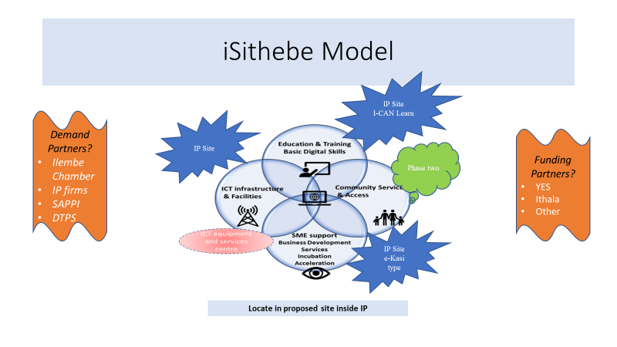

Slide 30
BOTSHABELO DIGITAL HUB
PROGRAMME 3: PROVINCIAL PROGRAMMES
The Botshabelo Digital Hub site has been revitalised and is ready to be commissioned.
The Hub is within the Botshabelo Industrial park and within walking distance from the Township and will be implemented in partnership with SEDA and SoftStart.
The Digital hub will provide the youth and the unemployed population with:
  access to information and communication technology access to internet connectivity;
  access to facilities and equipment for conducting economic activities in the digital domain;
  access to business development services; and
  shared work spaces.

Slide 31
DIGITAL HUBS PROGRAMME
PROGRAMME 3: PROVINCIAL PROGRAMMES
    The following have earmarked properties for the establishment of the Digital Hubs:
  Seshego Industrial Park – Limpopo
  Nkowankowa Industrial Park - Limpopo
  Babelegi Industrial Park - Gauteng
  Ekandustria Industrial Park- Gauteng
  Fort Jackson Industrial Park – Eastern Cape

Slide 32
PROGRAMME 4: INDUSTRIAL COMPETITIVENESS AND GROWTH
Purpose: Design and implement policies, strategies and programmes for the development of manufacturing and related economic sectors, and contribute to the direct and indirect creation of decent jobs, value addition and competitiveness, in both domestic and export markets.
Outcomes:
  Increased industrialisation through the development of Master Plans in National Priority sectors
  Increased localisation through additional support measures and designation of products
Outputs:
  Developed Master Plans in national priority sectors in order to foster industrialisation with a view to bring about economic transformation and job creation
  Progress reports on Implementation of Master Plans
  Progress reports on the support measures to increase localisation of various Personal Protective Equipment (PPE) and other products (New)
  Designation requests prepared for Minister

Slide 33
PROGRAMME 4: INDUSTRIAL COMPETITIVENESS AND GROWTH
OUTPUT INDICATORS | CHANGES TO INDICATORS | 2020/21 ANNUAL TARGET | FIVE YEAR TARGET
Number of Master plans as per Re-imagined Industrial Strategy submitted to Minister by March 2021 | - | 3 Master Plans as per the Re-imagined Industrial Strategy submitted to the Minister per year Previous Target: 5 Master Plans | 5 Master Plans developed between 2020/21 and 2021/22 20 Progress reports on the implementation of the Master Plans 10 products designated by 2025
Number of progress reports on Implementation of Master Plans | - | 4 Quarterly progress reports on Implementation of Master Plans
Number of progress reports on the support measures to industry to increase localisation of PPE and other products | New Indicator | 4 quarterly progress reports on the support measures to industry to increase localisation of PPE and other products
Number of designation requests prepared for Minister per year | - | 2 Designations prepared for Minister for year
Master Plans to be completed in 2020/21 include: Sugar, Steel and Furniture.
Chemicals & Plastics Master Plans will be prioritised in 2021/22.
Output indicator on Number of monitoring reports on the percentage of adverts that comply with local content requirements across designated products, was removed from APP.

Slide 34
PROGRAMME 5: CONSUMER AND CORPORATE REGULATION
Purpose: Develop and implement coherent, predictable and transparent regulatory solutions that facilitate easy access to redress and efficient regulation for economic citizens.
Outcomes:
  Improved regulatory environment conducive for consumers and companies as well as providing access to redress
Outputs:
  Progress reports developed for Minister’s approval
Strategic Consideration (Amended)
  The Consumer and Corporate Regulation branch will promote faster and more inclusive economic growth by focusing on:
    Reviewing legislation in the areas of: companies, credit, copyright, performers’ protection and gambling;
    Development of policies to close gaps and unlock growth opportunities in the areas of companies, gambling, liquor, credit, consumer protection and lotteries; and
    Regulations on the reviewed legislation that include the National Credit Amendment Act.

Slide 35
PROGRAMME 5: CONSUMER AND CORPORATE REGULATION
OUTPUT INDICATORS | CHANGES TO INDICATORS | 2020/21 ANNUAL TARGET | FIVE YEAR TARGET
Number of progress reports on the development or review of legislation developed for Minister’s approval | Amended | 4 progress reports on the development or review of the Companies, Liquor and National Gambling legislation developed for Minister’s approval | Development or review of legislation in the areas of Gambling, Liquor Companies, Copyright, Performers’ Protection, Consumer Protection, Credit and Lotteries or any legislation announced by Minister at SONA.
Output indicator on Number of education and awareness sessions on policies and legislation conducted and report produced for Minister’s approval, was removed from the revised APP.

Slide 36
PROGRAMME 6: INDUSTRIAL FINANCING
Purpose: Stimulate and facilitate the development of sustainable and competitive enterprises, through the efficient provision of effective and accessible incentive measures, that support national priorities.
Outcomes:
  Increased accessible industrial finance measures to support investment in priority sectors in line with approved Master Plans
Outputs:
  Private-sector investment leveraged across all incentives
  Economic Recovery Programme developed to support greenfield and brownfield investments and companies in distress in order to retain jobs and industrial capacity (New)
  Enhancement of domestic industrial finance system which includes DFIs and other funders to crowd in more funding to enterprises and streamline industrial support (New)

Slide 37
PROGRAMME 6: INDUSTRIAL FINANCING
OUTPUT INDICATORS | CHANGES TO INDICATORS | 2020/21 ANNUAL TARGET | FIVE YEAR TARGET
Value (Rand) of projected investments to be leveraged from projects/enterprises approved | - | R5 Billion Previous Target: R15 billion | R25 billion private sector investment leveraged and annual targets on jobs and enterprises achieved. Previous Target: R75 billion
Economic Recovery Programme submitted for approval | New Indicator | Economic recovery Programme developed and implemented with greater focus on saving and expanding jobs and retaining/protecting industrial assets
Enhancement of domestic industrial finance system to crowd in more funding to enterprises and streamline industrial support | New Indicator | 1 Report on developing a more integrated assessment system between the dtic grants and DFI approvals, to reduce overhead costs and enhance impact and effectiveness
The following output indicators were removed:
Projected number of new jobs supported from enterprises/projects approved;
Projected number of jobs retained from approved enterprises/projects; and
Number of enterprises/projects approved for financial support across all incentives.

Slide 38
PROGRAMME 7: EXPORT DEVELOPMENT, PROMOTION AND OUTWARD INVESTMENTS
Purpose: Increase export capacity and support direct investment flows, through targeted strategies, and an effectively managed network of foreign trade offices.
Outcomes: (New)
  Grow the manufacturing sector to promote industrial development, job creation, investment and exports
  Diversify and grow the exporter base as a contribution to inclusion and transformation of the economy
  Promote the growth of exports in the economy as a generator of jobs and contributor to GDP growth
Outputs: (New)
  Number of new companies participating for the first time in Export Promotion Initiatives provided by the dtic
  Number of companies benefitted from Export Development and Support (EDS)
  Identify and resolve priority export barriers
  Develop tools that empower evidence-based export policymaking
The Programme will refocus its work to more actively secure outcomes in the following areas (New)
  Strengthening exports to the rest of the African continent.
  Identifying and supporting new export markets (outside of Africa) and new products for export.
  Progress in relation to this will be reported for each of the indicators set out below.

Slide 39
PROGRAMME 7: EXPORT DEVELOPMENT, PROMOTION AND OUTWARD INVESTMENTS
OUTPUT INDICATORS | CHANGES TO INDICATORS | 2020/21 ANNUAL TARGET | FIVE YEAR TARGET
Number of new companies financially benefitted from Export, Marketing and Investment Assistance (EMIA) support for digital export promotion initiatives | New indicator | 25 | Export growth in constant Rands to grow 1% faster than GDP growth in constant Rands for primary and secondary sectors, based on a five year rolling average. Markets share/ penetration in South –South Trade (BRICS) AfCFTA Re-imagined trade and investment offices abroad. 1000 companies capacitated in 5 years per Export Development and Support (EDS) strategy.
Number of companies assisted under Export Development and Support (EDS) inclusive of WYPD | Amended | 100 Previous Target: 850
Number of barriers processed by the Export Barriers Monitoring Mechanism | New indicator | 50
Number of new applications developed or improved on the Export Data Assistant (EDA) platform | New indicator | 3
Number of research reports produced | New indicator | 3
The following output indicators were removed or revised:
Value of Export Sales projected;
Number of companies assisted under EMIA; and
Number of Companies benefitted from EDS inclusive of Women, Youth and People with Disability (WYPD).

Slide 40
2020/2021 Export Awareness Seminars & GEPP Training Programmes
PROGRAMME 7: PROVINCIAL PROGRAMMES
Outcome: Diversify and grow the exporter base as a contribution to inclusion and transformation of the economy.
the dtic planned events outlined in the following sections are moving to digital platforms as a result of COVID-19.
Export Awareness Workshops (Q2)
Province | City/ Town | Quarter | Date
Limpopo | Makhado | 2 | Jul-20
 | Polokwane
 | Mokopane
KwaZulu-Natal | Richards bay |  | Aug-20
 | eThekwini
Western Cape | Oudtshoorn |  | Sep-20
 | George
 | Knysna
Gauteng | Tshwane |  | Sep-20

Slide 41
Export Awareness Workshops (Q3 & Q4)
PROVINCIAL PROGRAMMES
Province | City/ Town | Quarter | Date
Free State | Parys | 3 | Oct-20
 | Phuthaditjhaba
 | Harrismith
Gauteng | Johannesburg |  | Nov-20
 | Magale City
Free State | Bloemfontein
 | Kimberly
 | Upington
Gauteng | Vereeniging
 | Tshwane | 4 | Feb-21
Limpopo | Mesina
 | Thohoyandou
Free State | Welkom
North West | Klerksdorp |  | Mar-21
 | Rustenburg
Eastern Cape | Umtata
 | Queenstown
Gauteng | Brakpan

Slide 42
Global Exporter Passport Programme
PROGRAMME 7: PROVINCIAL PROGRAMMES
Province | City | Phase 1 Introduction to Exporting | Phase 2 Planning for Exports | Phase 3 Market Entry | Phase 4 Global Exporting
Duration of the training |  | 4 days | 4 days | 2 days | 1 day
Limpopo | Tzaneen | Sept 2020 | Oct 2020 | Nov 2020
Mpumalanga | Middelburg/Mbombela | Sept 2020 | Oct 2020 | Dec 2020
Free State | Parys | Aug 2020 | Sept 2020 | Nov 2020
Northern Cape | Kimberly | July 2020 | Sept 2020 | Nov 2020
Gauteng | Johannesburg | On hold | On hold | On hold
North West | Mahikeng |  | Sept 2020 | Jan 2021
Gauteng | Pretoria |  | Sept 2020 | Jan 2021 | Feb-21
Eastern Cape | East London |  | Oct 2020 | Feb 2021
 | Port Elizabeth |  | Aug 2020 | Feb 2021
KwaZulu-Natal | Richards Bay |  | Oct 2020 | Feb 2021
 | Durban |  | Oct 2020 | Feb 2021
Western Cape | Cape Town |  | Nov 2020 | Feb 2021 | Mar-21
 | George |  | Nov 2020 | Feb 2021

Slide 43
PROGRAMME 8: INWARD INVESTMENT ATTRACTION, FACILITATION AND AFTERCARE
Purpose: Support foreign direct investment flows and promote domestic investment by providing one stop shops for investment promotion, investor facilitation and aftercare support for investors.
Outcomes:
  Increased strategic investment
Outputs:
  Investment facilitation in targeted sectors
  Improve ease of doing business through improved turnaround time for company registrations
  Strategic Considerations: (Amended)
  Endeavour to mobilise R250 billion in domestic and foreign direct investment over the five-year reporting period.
  Strengthen its investment facilitation service to fast-track and unblock investment impediments to retain, expand existing and attract new investment.
  Endeavour to implement the commitments of projects announced at the 2018 and 2019 South African Investment Conference.
  Continue with the rollout of the One Stop Shops in provinces to support and capacitate investment facilitation.

Slide 44
PROGRAMME 8: INWARD INVESTMENT ATTRACTION, FACILITATION AND AFTERCARE
OUTPUT INDICATORS | CHANGES TO INDICATORS | 2020/21 ANNUAL TARGET | FIVE YEAR TARGET
Value (Rand) of investment projects facilitated in pipelines | - | R40 Billion Previous Target: R 100 billion | R 250 billion in domestic and foreign direct investment Previous Target: R 500 billion
Preserve investments and implement investment projects of 2018 and 2019 investment conference | New Indicator | 24 unblocking’s and fast tracking of investor issues
Number of statistical reports on company registration within one day | - | 4 statistical reports on company registration within one day

Slide 45
PROGRAMME 9: COMPETITION POLICY AND ECONOMIC PLANNING
Purpose: Develop and roll out policy interventions that promote competition issues, through effective economic planning, spatial implementation and aligned investment and development policy tools.
Outcomes:
  Policy tools and implementation strategies which contribute to an efficient, competitive economic environment, balancing the interests of workers, owners and consumers and focused on economic development
Outputs:
  Reports on policy and statutory initiatives in support of Ministry
  Analysis reports on public interest matters
  Reports on coordination efforts of recommendations, commitments and orders
Strategic Considerations: (Amended)
  Re-focus content of work to three key areas, during the 2020/21 financial year:
    Supporting regulatory work with regard to preventing unfair pricing and abuse of dominance;
    Closer scrutiny of mergers and acquisitions in relation to strategic considerations; and
    Protection of public interest commitments made in the past.
  Progress in relation to these three areas will be contained in reports to the Ministry.

Slide 46
PROGRAMME 9: COMPETITION POLICY AND ECONOMIC PLANNING
OUTPUT INDICATORS | CHANGES TO INDICATORS | 2020/21 ANNUAL TARGET | FIVE YEAR TARGET
Number of reports on policy and statutory initiatives in support of Ministry | - | 4 | 20 Competition Oversight Reports 20 Reports on Strategic participation in competition matters 20 Reports on impact of coordination efforts with regard to recommendations, commitments and orders Total: 60 Reports
Number of analysis reports on public interest matters | - | 4
Number of reports on coordinated actions in implementing Competition policy commitments, recommendations and orders | - | 4

Slide 47
PROGRAMME 10: ECONOMIC RESEARCH AND COORDINATION
Purpose: Design and oversee socio-economic research, assess policy options and engage stakeholders to facilitate inclusive economic growth.
Outcomes:
  Socio, macro and microeconomic policy options developed and assessed to promote inclusive growth
  Policymakers and stakeholders have access to policy-relevant, high-quality economic analysis
Outputs:
  Economic Policy Reports
  Policy-relevant and high quality economic research
Strategic Considerations: (Amended)
  This work will focus more actively on supporting and enhancing the core outputs of Programme 2 to 9.
  Propose policy options through careful socio-economic research and policy assessment to facilitate inclusive growth with impacts at local, district, metro, provincial and national level.
  Socio-economic research, policy assessments and interventions will be developed through stakeholder dialogue with social partners.

Slide 48
PROGRAMME 10: ECONOMIC RESEARCH AND COORDINATION
OUTPUT INDICATORS | CHANGES TO INDICATORS | 2020/21 ANNUAL TARGET | FIVE YEAR TARGET
Number of analytical policy reports produced | - | 8 | Over the next 5 year period, 86 high quality policy research and analysis reports are envisaged to achieve the nominated outcomes
Number of research reports produced | - | 6

Slide 49
the dtic Allocated Budget

Slide 50
SPECIAL ADJUSTMENT BUDGETS AT A GLANCE – 2020/21 TO 2022/23
Description | 2020/21 R’000 | 2021/22 R’000 | 2022/23 R’000 | TOTAL R’000
Baseline | 11,082,138 | 10,098,297 | 10,489,142 | 31,669,577
Revised baseline | 9,310,710 | 10,098,297 | 10,489,142 | 29,898,149
Change to the indicative baseline | (1,771,428) | - | - | (1,771,428)

Slide 51
BUDGET AT A GLANCE ON ECONOMIC CLASSIFICATION – 2020/21
Description | Original budget 2020/21 R’000 | Special adjusted budget 2020/21 R’000 | Variance | % variance
Transfers and subsidies, which consist of : | 9,070,428 | 7,350,353 | (1,720,075) | (19%)
Public corporations and private enterprises | 6,936,152 | 5,524,002 | (1,412,150) | (20.4%)
Departmental entities | 1,934,932 | 1,646,943 | (287,989) | (14.9%)
Non profit institutions | 156,536 | 140,882 | (15 654) | (10%)
Foreign governments and international organisations | 42,808 | 38,526 | (4,282) | (10%)
Operational expenditure, which consists of: | 2,011,710 | 1,960,357 | (51,353) | (2.6%)
Compensation of employees | 1,171,420 | 1,171,420 | - | 0.0%
Goods and services | 805,227 | 753,874 | (51,353) | (2.6%)
Payments for capital assets | 34,121 | 34,121 | - | 0.0%
Households | 942 | 942 | - | 0.0%
TOTAL | 11,082,138 | 9,310,710 | (1,771,428) | (16%)

Slide 52
2020/21 BUDGET SUMMARY
Following the tabling of the Special Adjusted Budget by the Minister of Finance on 24 June 2020, the dtic’s budget was reduced by 16% or R1.77 billion to R9.31 billion. The original total budget was R11 billion.
Approximately 59% or R5.52 billion will be disbursed to companies across the various incentive programmes.
Transfers to the departmental entities is 18% or R1.65 billion of the adjusted budget.
Operational expenditure, which comprises mainly of compensation of employees, and goods and services is 21% or R1.96 billion of the total budget. The main cost drivers are PPP agreement for office accommodation at the dtic campus and foreign economic offices.

Slide 53
SPECIAL ADJUSTMENTS 2020/21 BUDGET – CATEGORIES OF THE BUDGET
External programmes
- IDC: Clothing, Textile, Leather and Footwear: Competitiveness Improvement Programme
- CSIR: National Cleaner Production Centre
- CSIR :National Foundry Technology Network
- CSIR: Aerospace Industry
- CSIR: Fibre and Textile
- Protechnik Laboratories
NPOs
- Proudly South African
- Intsimbi Future Production Technologies Initiatives
- Automotive Supply Chain Competitiveness Initiative
- Trade and Industrial Policy Strategies (TIPS)

Slide 54
Thank You

