Slide 1



PORTFOLIO COMMITTEE
2020-2025 STRATEGIC PLAN
2020-2021 ANNUAL PERFORMANCE PLAN

Slide 2
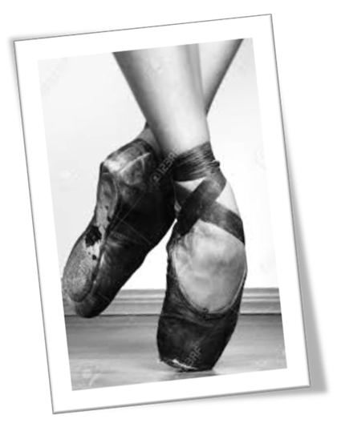
STRATEGIC POSITIONING
STRATEGIC PLAN
Vision, Mission and Values
The DSAC Storyline
A case for priority outcomes
Outcome Indicators
Outcomes to Outputs Linkage
ANNUAL PERFORMANCE PLAN
Output Indictors
PRIORITY DISTRICTS
PUBLIC ENTITIES
BUDGET AND EXPENDITURE PLAN
Outline

Slide 3
Strategic positioning
-the strategy of Department is informed by a plethora of international, national and sectorial prescripts, some of which are outlined below.

Slide 4

Sustainable Development Goals

Slide 5
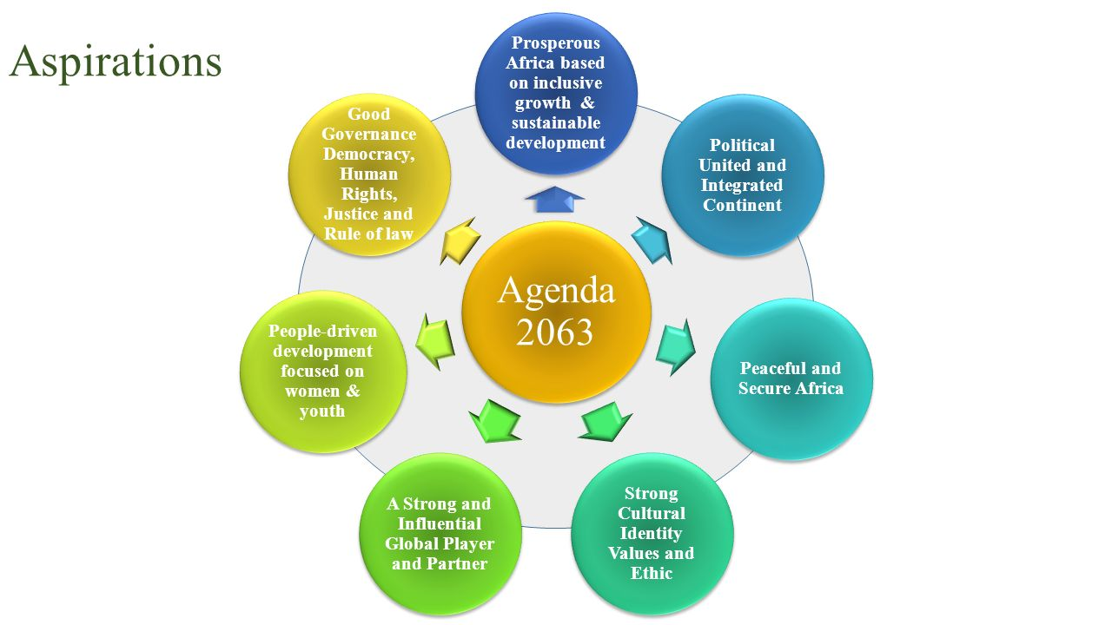
AU Agenda 2063

Slide 6


National Development Plan – Sport & Recreation Focus
Promote the sharing of public spaces and common experiences.
Ensure that the demographics of each sporting code approximates the demographics of the country.
Adequately resource school sport.
Provide adequate facilities and ensure that these are maintained.
Encourage communities to organise sporting events, leagues and championships.
Encourage corporate investments in grassroots sports.

Slide 7

National Development Plan – Arts and Culture Focus
Sustained campaigns against racism, sexism, homophobia and xenophobia.
Gender equality legislation, programming and monitoring and evaluating
Improving public services and spaces as well as building integrated housing and sport, arts and culture facilities in communities to ensure sharing of common spaces across race and class.
Incentivising the production and distribution of all art forms that facilitate healing, nation building and dialogue.
All South Africans to learn at least one indigenous language, business to encourage and reward employees who do so.
Promote citizen participation in forums such as Integrated Development Plans, Ward Committees, School Governing Boards and Community Policing Forums.
Broaden economic participation and continue with Employment Equity.

Slide 8
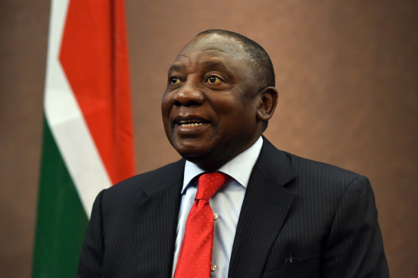
7 Government Priorities
Economic transformation and job creation
Education, skills and health
Consolidating the social wage through reliable & quality basic services
Spatial integration, human settlements and local government
Social cohesion and safe communities
A better Africa and world.
Building a capable, ethical and developmental State

Slide 9

Fostering constitutional values
Equal opportunities, inclusion and redress
Promoting social cohesion across society
Active citizenry and leadership
Fostering a social compact

Slide 10
Legal Framework
Heraldry Act (No. 18 of 1962)
Culture Promotion Act (No. 35 of 1983)
Pan South African Language Board Act (No. 59 of 1995)
National Archives and Record Service of South Africa Act (No. 43 of 1996)
South African Institute for Drug-free Sport Act (No. 14 of 1997 as amended)
Legal Deposit Act (No. 54 of 1997)
National Arts Council Act (No. 56 of 1997)
National Film and Video Foundation Act (No. 973 of 1997)
South African Library for the Blind Act (No. 91 of 1998)
National Library of South Africa Act (No. 92 of 1998)
National Sport and Recreation Act (No. 110 of 1998 as amended)
South African Geographical Names Council Act (No. 118 of 1998)
Cultural Institutions Act (No. 119 of 1998)
National Heritage Council Act (No. 11 of 1999)
National Heritage Resources Act (No. 25 of 1999)
National Council for Library and Information Services Act (No. 6 of 2001)
South African Boxing Act (No. 11 of 2001)
Cultural Laws Amendment Act (No. 36 of 2001)
Cultural Laws Second Amendment Act (No. 69 of 2001)
Safety at Sports and Recreational Events Act (No. 2 of 2010)
Use of Official Languages Act (No. 12 of 2012)
South African Language Practitioners Council Act (No. 8 of 2014)

Slide 11
Other Applicable Prescripts
Sport, Arts and Culture White Papers
Sport, Arts and Culture Policies
Sport, Arts and Culture Plans
Compliance prescripts
Other relevant prescripts

Slide 12


Slide 13
Mandate
The mandate and/or function of the national Department responsible for sport, arts and culture is derived from the Constitution of the Republic of South Africa, Act 108 of 1996 hereafter referred to as the Constitution, including the Preamble and Founding Provisions, and in particular sections:
  16(1) Freedom of expression
  30. Language and culture - Everyone has the right to use the language and to participate in the cultural life of their choice, but no one exercising these rights may do so in a manner inconsistent with any provision of the Bill of Rights. and;
  32. Access to information
Further, the Constitution affirms the democratic values of human dignity and equality. In line with these Constitutional imperatives, the national Department has been assigned the powers and functions to develop and implement national policies and programmes relating to sport, arts, culture, heritage and recreation in the country.

Slide 14
International Imperatives
National Prescripts
Sectorial Prescripts and Imperatives
SONA
Strategic Sessions
SP
APP
Operational Plans
Performance Agreements

Slide 15


Slide 16

Vision
AN ACTIVE,
CREATIVE,
WINNING
AND SOCIALLY COHESIVE
NATION

Slide 17

Mission
TO PROVIDE AN ENABLING ENVIRONMENT
FOR THE SPORT, ARTS AND CULTURE SECTOR
TO FOSTER AN ACTIVE, CREATIVE, WINNING AND SOCIALLY COHESIVE NATION.
In achieving this mission the objective will be:
To develop, transform, preserve, protect and promote sport, arts and culture.

Slide 18
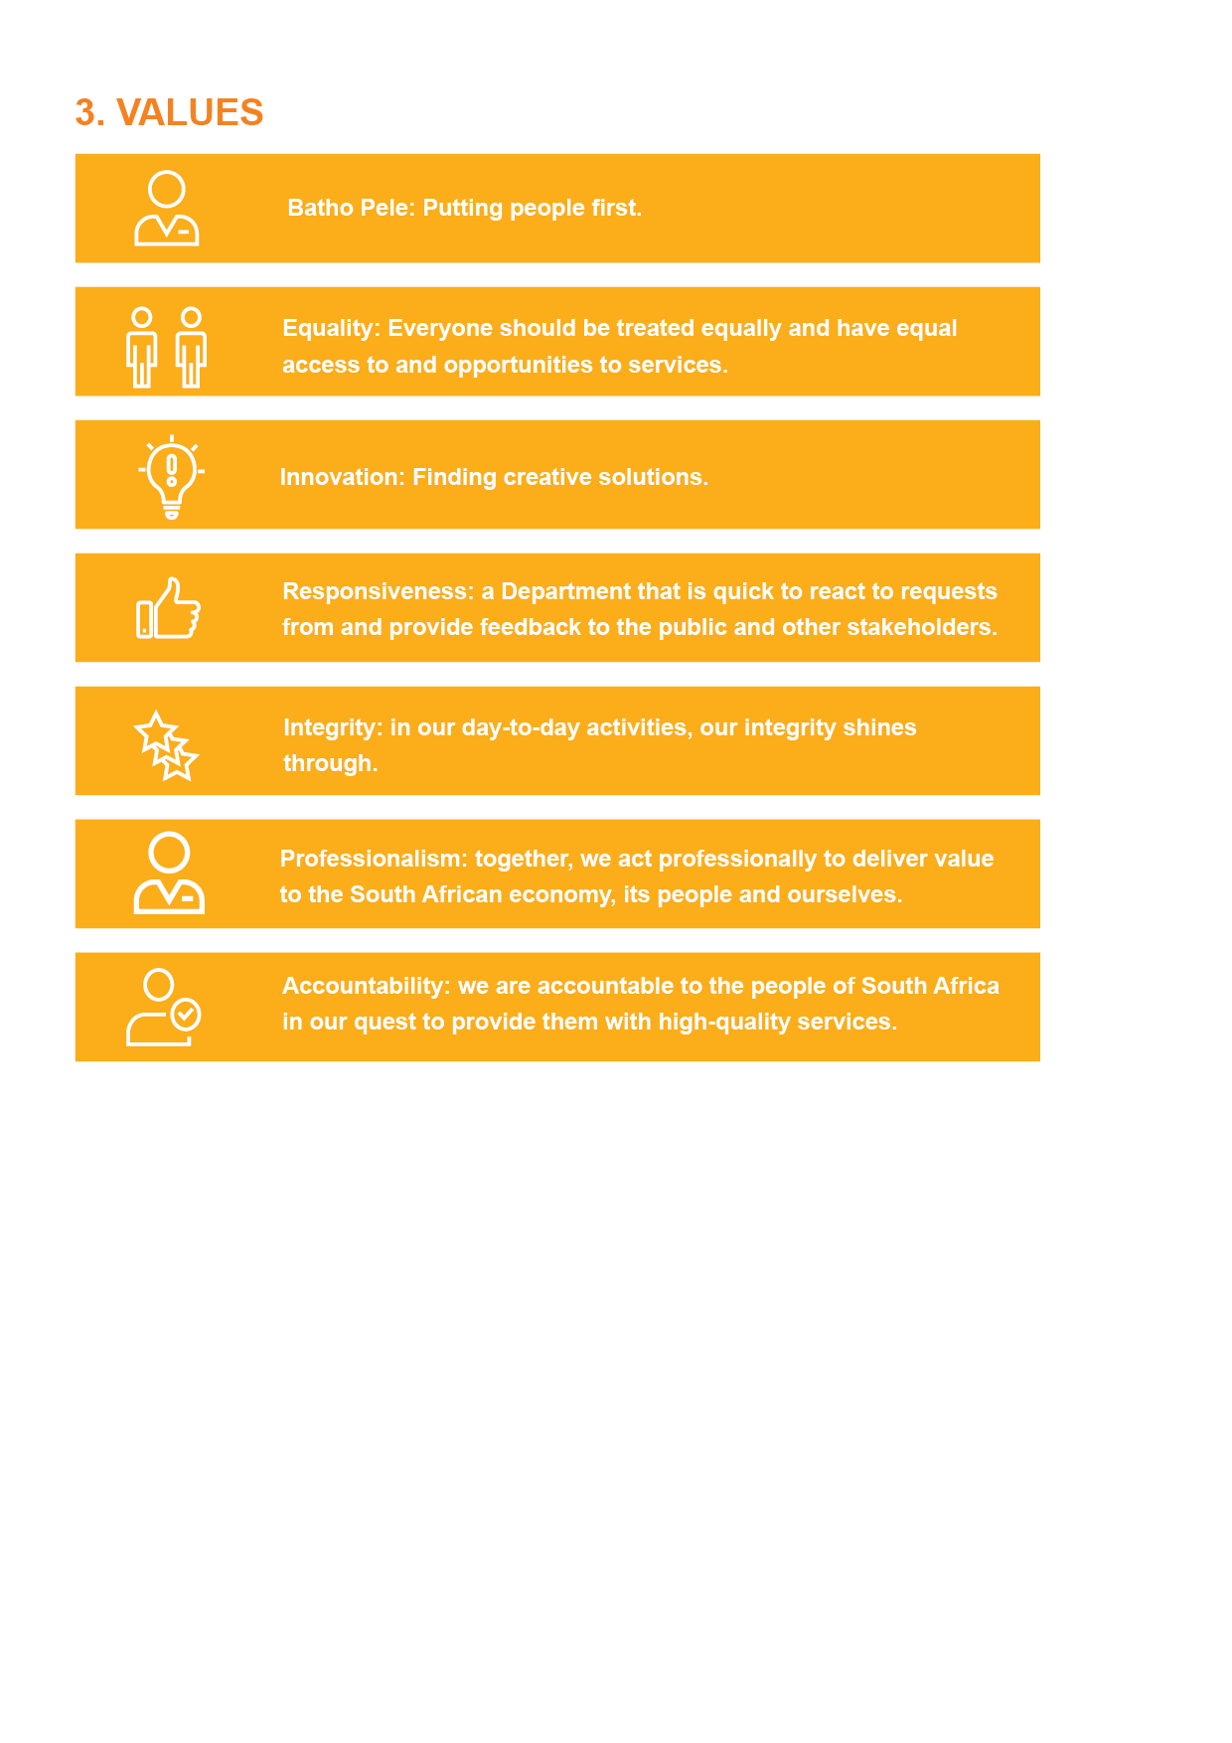
Values

Slide 19
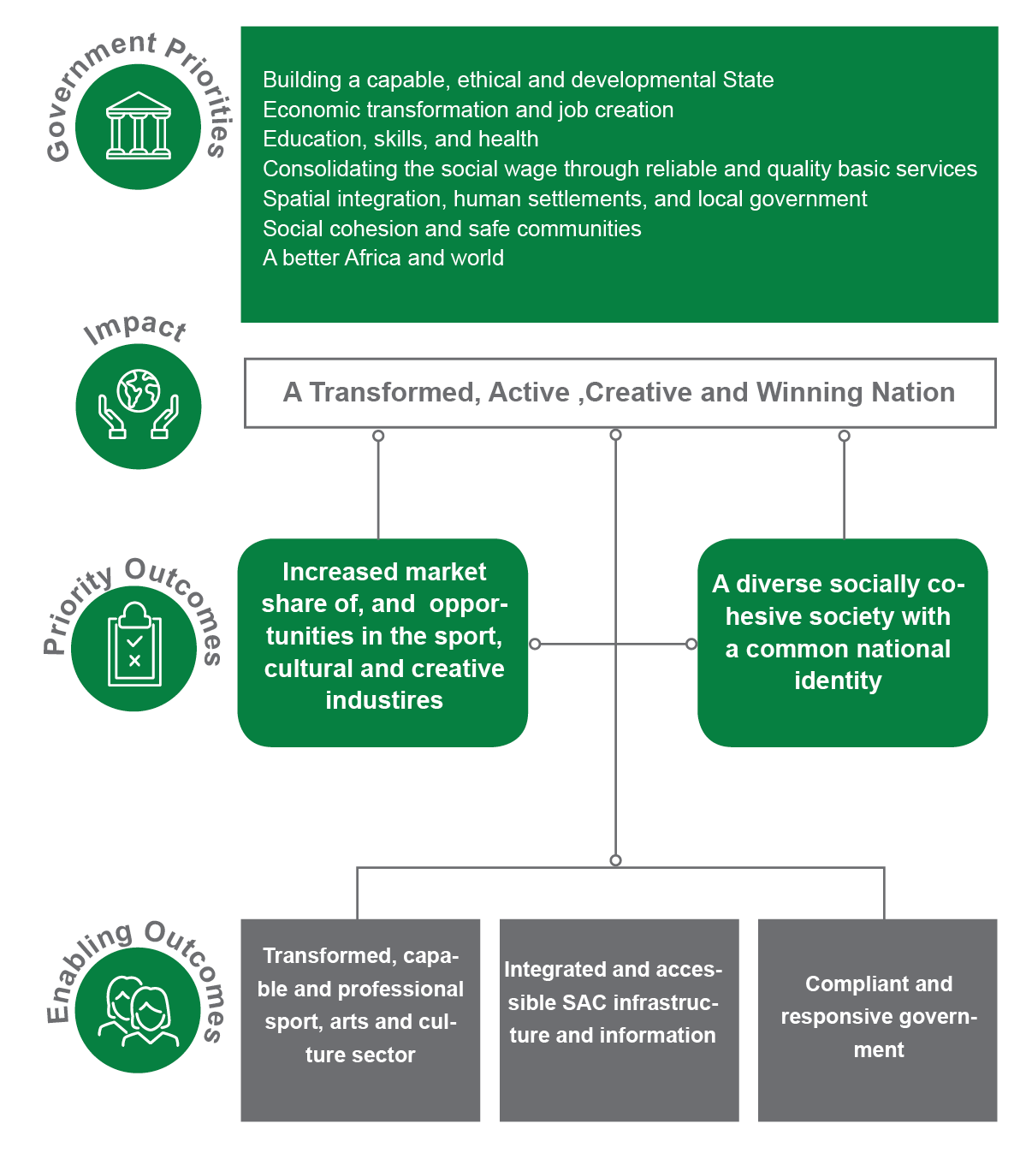
The DSAC Storyline

Slide 20
A Case for Priority Outcome 1 –
Increased market share of, and job opportunities created in sport, cultural and creative industries.
The Creative and Cultural Industries (CCIs) are one of the fastest growing industries and should be at the centre of national strategic priority to unlock wider economic participation and inclusivity in the mainstream economy.
There is an urgent need to explore the opportunities presented by sport economy, including the computation and/or quantification of its contribution to the gross domestic product (GDP) and job creation.
In order to realise the potential of sport and cultural and creative industries to create growth and jobs, South Africa needs to identify and invest in new sources of smart, sustainable and inclusive growth drivers.
Much of our future prosperity will depend on how we use our resources, knowledge and creative talent to spur innovation. For example, there are huge opportunities to use sport and recreation as a medium to attract tourists to South Africa.

Slide 21
A Case for Priority Outcome 1 –
Increased market share of, and job opportunities created in sport, cultural and creative industries.
People in cultural occupations make up about 3% of all jobs in South Africa, rising to nearly 7% (1 million jobs) when people working in creative industries support occupations are included.
The domains that offer most jobs in the cultural sector include:
  Visual Arts and Crafts (44,3%)
  Intangible Cultural Heritage (23,3%). This includes traditional chiefs and heads of villages, religious professionals, traditional medicine practitioners, faith healers and religious associate professionals
  Design and creative services (12,8%), and
  Books, Information and Press (12,8%).

Slide 22
A Case for Priority Outcome 1 –
Increased market share of, and job opportunities created in sport, cultural and creative industries.
The majority (86%) of those in cultural occupations in South Africa are black (including black Africans, coloured people and people of Indian/Asian origin), although white people are still over-represented when comparing the demographic make-up of the country.
Youth in cultural occupations are more transformed than older workers, with 87% being black people.
The increasingly diverse make-up of younger workers indicates that the cultural sector is transforming and is likely to become more representative over time

Slide 23
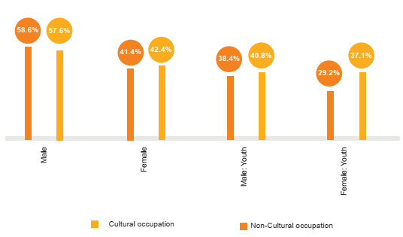
A Case for Priority Outcome 1 –
Increased market share of , and job opportunities created in sport, cultural and creative industries.
The percentage of women in cultural occupations is considerably lower than that of men.

Slide 24
A Case for Priority Outcome 2 –
A diverse socially cohesive society with a common identity
Underpinning the NDP vision are social cohesion and nation building, which are
critical to the objectives of the developmental state.
At the heart of social cohesion is the extent to which there is social integration and inclusion among people and within communities.
Various initiatives, plans, and polices are being pursued in order to manifest a sense of belonging and affiliation to the community and larger South African society. These include inclusion on an equal basis in all social activities and rights, equal access to all life opportunities; participation and active involvement in civic activities; acknowledgment and value of differences without discrimination; etc.
In order to gauge our progress on nation building and social cohesion, proxy indicators that aim to measure the impact of various initiatives are used, and include the few outlined below.

Slide 25
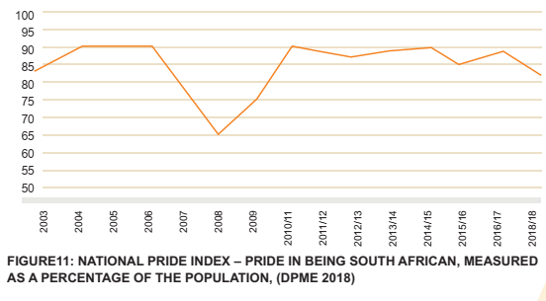
A Case for Priority Outcome 2 –
A diverse socially cohesive society with a common identity
The national pride index was at its highest between 2004 and 2006, with above 90% of the population taking pride in being South African. However, there was a steep decline in 2007 with the lowest level (65%) in 2008. This has since improved to 81% in the 2017/18 financial year.

Slide 26
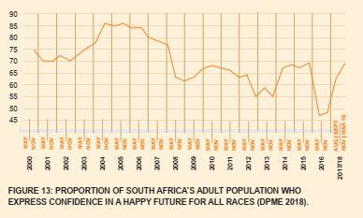
A Case for Priority Outcome 2 –
A diverse socially cohesive society with a common identity
About 68% of South Africans are confident of a happy future. This is an improvement from the early 2000’s with the highest confidence level between 2005 and 2006. The nation experienced a decline around 2008 with the confidence level below 60% during the year of the economic crises. The lowest level (46%) was experienced in 2016

Slide 27
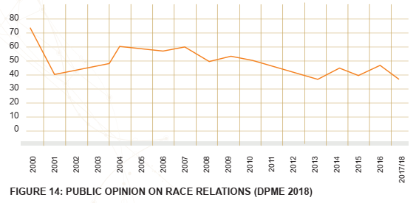
A Case for Priority Outcome 2 –
A diverse socially cohesive society with a common identity
Race is still a divider in South Africa. It is a dominant variable in terms of the high levels of distrust in society. In 2017 only 38% of the population were of the opinion that race relations were improving. The country experienced the lowest (36%) race relations in 2013, which is the lowest in the post-apartheid era.

Slide 28
A Case for Priority Outcome 2 –
A diverse socially cohesive society with a common identity
In terms of the baseline survey, 44% of adults have no trust, none whatsoever, in people of other race groups.
Only 56% indicated some level of trust in people of other race groups and even here, 28% of adults can be classified in the low trust category, with 15% in the medium trust category. Those that indicated unreserved trust of the other were only a mere 13% of the sample.
This high level of distrust by race is further corroborated by the research findings from the “general mood in the country” question. When asked whether things were getting better or worse, 47% indicated that things were getting worse, while 53% thought that things were getting better or remaining the same.
Further, 45% of those that indicated that they had experienced some kind of discrimination cited racism as the sole reason.
Slow economic transformation, poor service delivery, poor quality of public good such as education and health, and campaigns such as the “white monopoly capital” campaign could have contributed to further divide a society that was already divided.

Slide 29
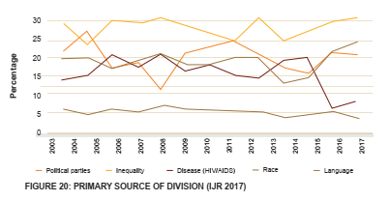
A Case for Priority Outcome 2 –
A diverse socially cohesive society with a common identity
Twenty-five years since democracy, inequality, race, politics and language are still the primary sources of social division stemming from the structural legacies from colonial and
apartheid rule.

Slide 30

MEASURING OUTCOMES

Slide 31
Measuring Outcomes –
Increased market share of, and job opportunities created in sport, cultural and creative industries.
OUTCOME INDICATOR | BASELINE | FIVE-YEAR TARGET | SOURCE OF INFORMATION
CCI growth index | 4.9% | 5% | SACO; StatsSA – Annual Financial Statistics; Updated Social Accounting Matrix
Exports of cultural goods and services as a percentage of all exports. | -0.45% | 0.6% | SACO; SARS Customs and Excise Database
Percentage of Gross Domestic Product attributable to private and formal cultural production. | 1.7% | 2% | SACO; StatsSA
Number of people employed in the cultural and creative sectors and cultural occupations as a percentage of overall employment for the latest year. | 2.52% | 4% | SACO; Employment Survey - StatsSA
% of Broad-Based Economic Empowerment (BBBEE) procurement spend | 78% | 70% | DSAC Annual Report
% employment equity These targets are the minimum expected – a higher percentage equity is more favourable | 45% woman at senior management service (SMS) level; 2.1% people with disabilities | 50% woman at senior management service (SMS) level; 2% people with disabilities | DSAC Annual Report

Slide 32
Measuring Outcomes –
A diverse socially cohesive society with a common identity
OUTCOME INDICATOR | BASELINE | FIVE-YEAR TARGET | SOURCE OF INFORMATION
Pride in being South African | 83% | 90% | GCIS National Tracker Survey
Public opinion on race relations | 42% (2018/19) | 60% | GCIS based on Ipsos data
Social Cohesion Index | 61.4% | 70% | BrandSA Annual National Omnibus Survey
% of citizens who show a strong devotion to their country | 82% | 95% | STATSSA: Governance, Public Safety and Justice Survey Institute of Justice and Reconciliation SA Reconciliation Barometer

Slide 33
Measuring Outcomes –
Enablers
OUTCOME | OUTCOME INDICATOR | BASELINE | FIVE-YEAR TARGET | SOURCE
Transformed, capable and professional SAC Sector | Arts and Culture Sector organised into councils affiliated under the CCIFSA | Councils not affiliated under the CCIFSA | Councils for sector genres established | DSAC
 | Improvement in Olympic and Paralympic medal status | Total number of 2020 Olympic and Paralympic medals | An increase of 10 medals | DSAC
Integrated and accessible SAC infrastructure and information | Number of sport and recreation facilities compliant with norms and standards | 137 | 175 | DSAC
Compliant and responsive governance | Audit outcome | Unqualified | Clean | DSAC Annual Report

Slide 34

OUTCOME TO OUTPUT LINKAGE

Slide 35
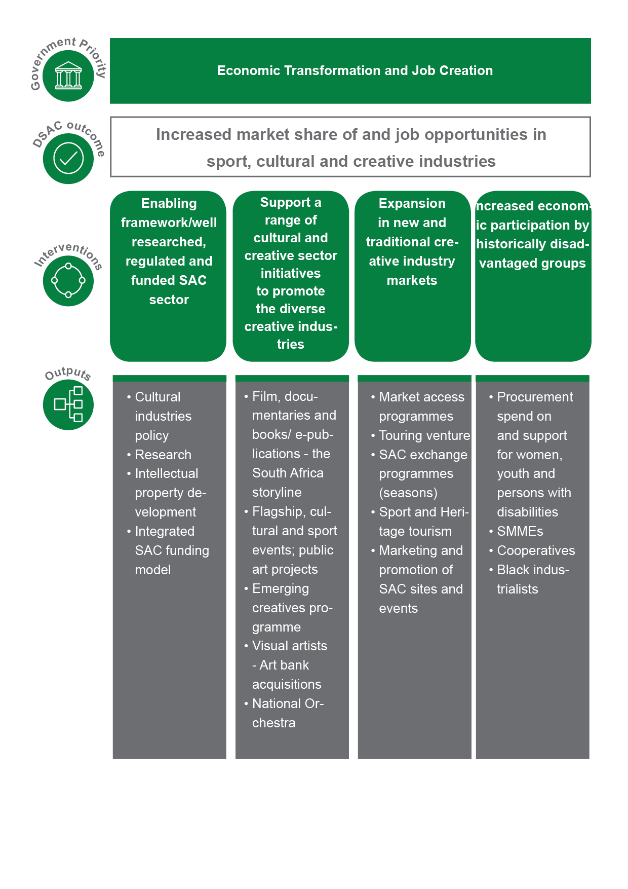
Outcome – Output Linkages

Slide 36
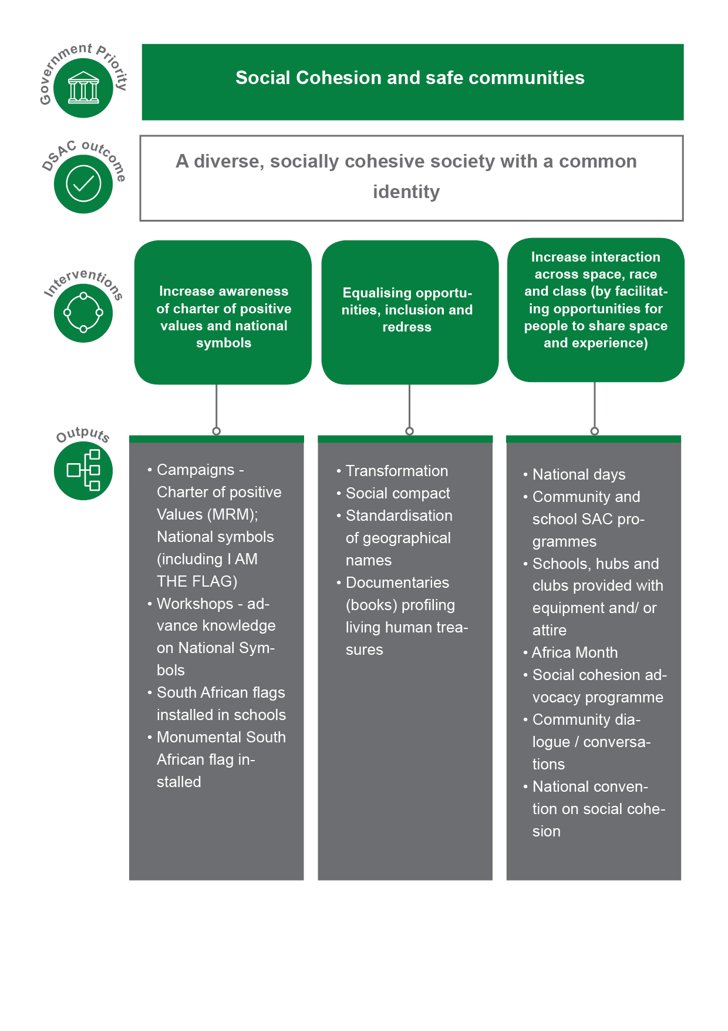
Outcome – Output Linkages

Slide 37
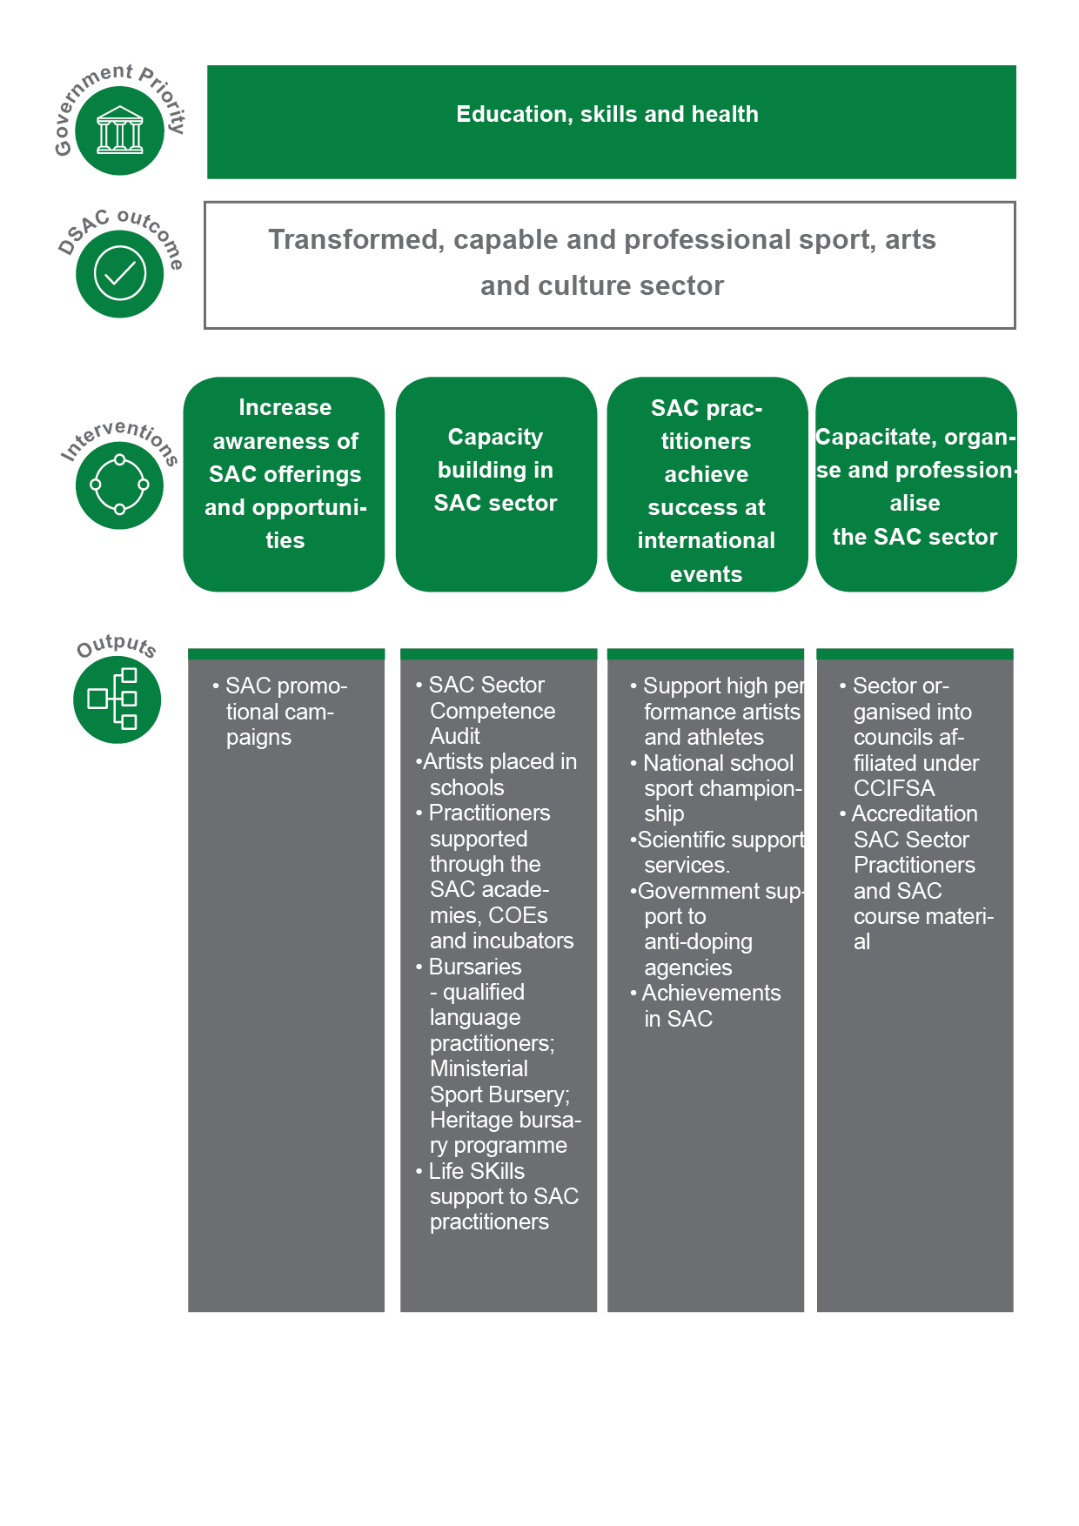
Outcome – Output Linkages

Slide 38
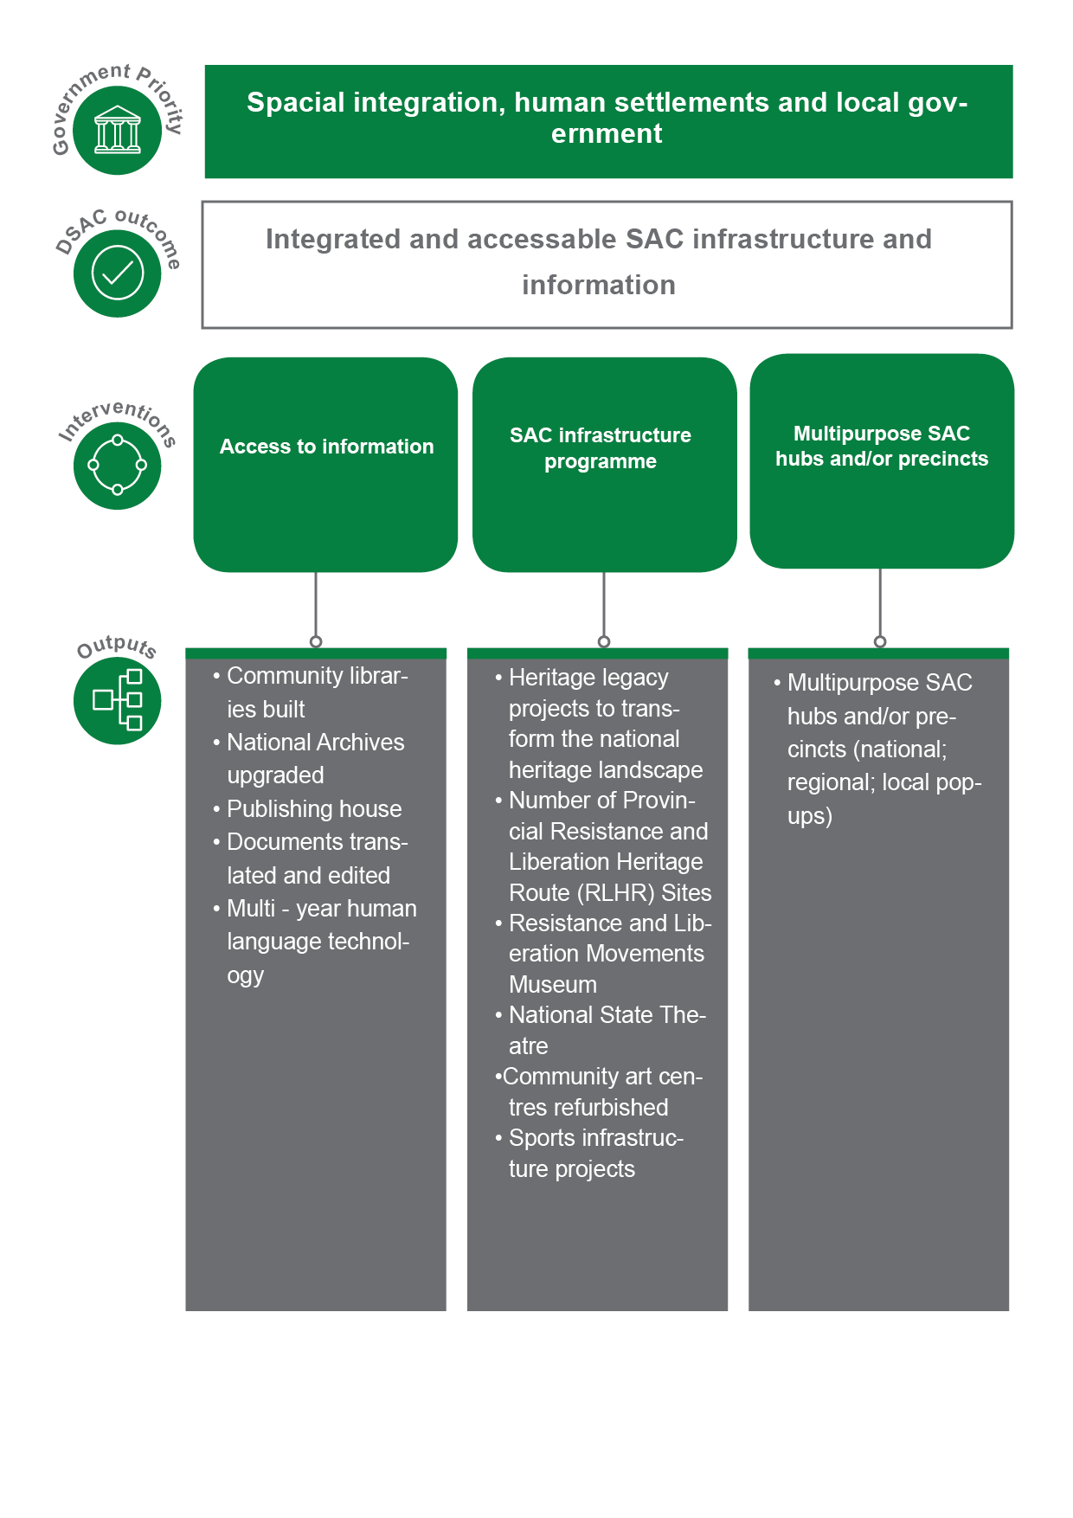
Outcome – Output Linkages

Slide 39
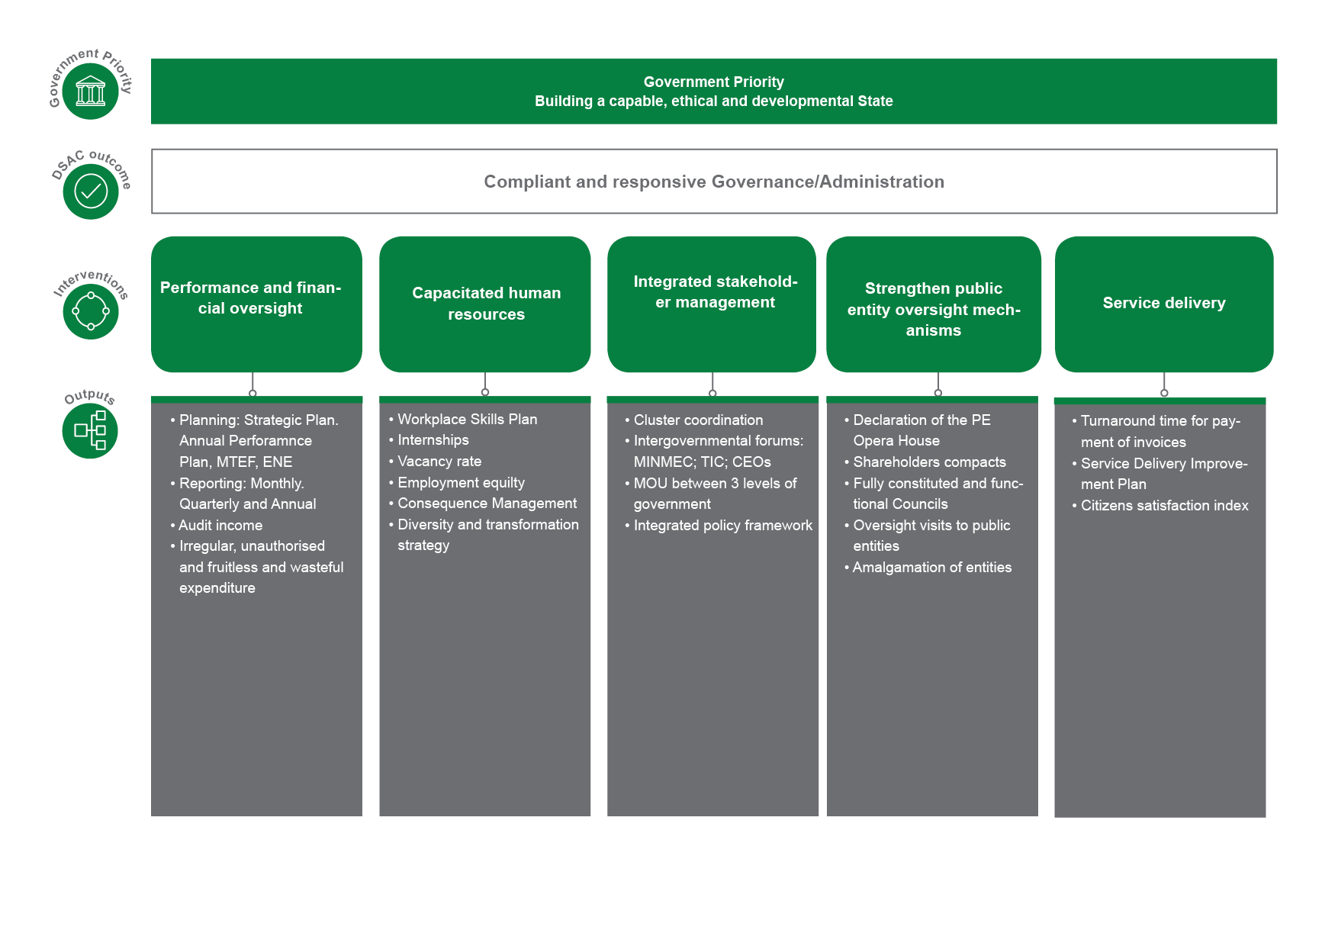
Outcome – Output Linkages

Slide 40
Covid-19 adjusted ANNUAL OUTPUTS

Slide 41

THE CONTEXT FOR DSAC WORK
The work of DSAC and its delivery agents centers around Social Cohesion and Nation Building – encouraging the coming together of people from different walks of life, to share common spaces.
Does not necessarily encourage social distancing – both at the level of participants and spectators/live consumers of the sport, arts and/or culture products.
It involves regular travelling, both nationally and internationally.
It is reliant on other sectors being functional (e.g. the education sector) and
Also relies on delivery agents such as provinces.
Many DSAC beneficiaries, such as artists and athletes derive their sole source of income from engaging in DSAC supported programmes.
The easing of COVID-19 lockdown has had little effects on improving the situation of the SAC sector

Slide 42
THE CONTEXT FOR DSAC WORK
CONSEQUENTLY, this has resulted in
Overall scaling down of services on the DSAC service delivery mandate.
Planned medium-term outcomes not being achieved within initial time frames.
Stagnation of projects already under-implementation.
Athletes and artists not adequately prepared to compete/perform internationally.
Economic hardship/loss of income for professional athletes and artists. The increased need for relief, thus further cutting off from the budget allocated to activities of the Department.

Slide 43
A survey on the impact of COVID 19 on Cultural Creative Industries
95% of respondents report that they have experienced cancellation or indefinite postponement of work that was to have taken place this year.
About 11% of businesses and freelancers said that they could probably continue with 60% of more of their normal business activities, and 45% said that they couldn’t continue at all.
Of those who are employers, 38% said that they were ending the employment of short-term contract or informal employees as a way of coping with the crisis.

Slide 44
A survey on the impact of COVID 19 on Sport
83.7% of respondents believe they will only be able to survive for 6 months or less in the current lockdown environment
89.8% of respondents believe the government is not doing enough to support sports federations during the current pandemic
42.9% of respondents indicated that relief funding is their key priority in terms of more support from government
34.7% of respondents indicated that an early return to play is their key priority in terms of more support from government

Slide 45
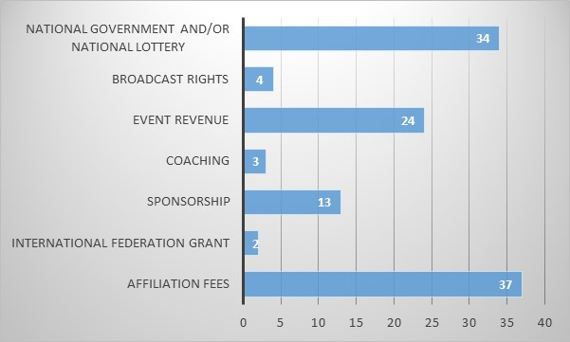
Sports Federations’ Main Source of Income to meet operational costs
The information provided below is based on responses received from 49 sport federations (respondents)

Slide 46

FACTORS THAT WILL INFORM THE REVISION OF THE ANNUAL PERFORMANCE PLAN

Slide 47
KEY CONSIDERATION WHEN REVISING THE APP
A thorough situational analysis for each indicator and target to determine and justify what can be salvaged, scaled down, deferred or abandoned
What new indicators to include that account for the funds re-directed towards the relief efforts
Projections of delivery based on COVID-19 lockdown level i.e. at what lockdown level will we achieve optimum delivery, including considerations of areas identified as hotspots
Capacity to deliver i.e. linkage between lockdown level and staff returning to work, including dependencies on our partners and the reconfiguration of our workforce for optimal delivery of services

Slide 48
KEY CONSIDERATION WHEN REVISING THE APP
Alternative modes of delivery i.e. explore technological solutions like live streaming, virtual meetings, etc.
Continuation of Relief and Recovery efforts
Re-engineering of existing programmes to be more labour intensive (and thus respond to the President’s call to create work opportunities)
Budget adjustments i.e. our budget has been reduced by R956 million

Slide 49
AN EXTENSIVE SITUATIONAL ANALYSIS
A case for Programme 1

Slide 50

SITUATIONAL ANALYSIS - ADMINISTRATION
INDICATOR 1: PERCENTAGE OF INTERNS ENROLLED AGAINST FUNDED POSTS
Situational Analysis
The At the time when state of disaster was proclaimed, the process of recruiting interns was not yet started.
The placement on interns is targeted to recruit at the fourth quarter of this financial
Due to the easing of lockdown restrictions, the process of recruiting interns will commence towards the end of second quarter.
Therefore there will be no scaling down of this target due to COVID-19. The target will remain as is since its delivery will be finalised during the fourth quarter.
Budget associated with this target has not been reduced.

Slide 51
SITUATIONAL ANALYSIS - ADMINISTRATION
INDICATOR: 2 NO. OF SERVICES MODERNIZED (PROCESSES AUTOMATED)
Situational Analysis
The advent of the Covid-19 pandemic means that the department will be dependent on ICT to function going forward. As such, the ICT unit will have to prioritise the automation of various business processes to ensure that DSAC business units can operate remotely and on-site during the various lockdown levels
Systems will continue to be put in place to enable the department to liaise with various stakeholders and for service delivery to continue through technological means.
There will be no scaling down of this target due to COVID-19. The target will remain as is since its delivery can be undertaken during the current lockdown phase.
Budget associated with this target has not been reduced.
Alternative mode of delivery
The ICT Unit is using the following technologies amongst others to enable alternative modes of service delivery:- virtual meetings (MsTeams and Zoom) teleconference facilities, Office 365 and Mimecast to enable employees to access emails and productivity tools from anywhere, Access Point Name (APN) to access central data to work remotely, Enterprise Content Management with digital signatures to enable decision making by signing documents digitally
Capacity to deliver
The increased demand for ICT support means the ICT unit will have to fill all vacant positions and also recruit ICT Cadets/Interns to bolster current staff capacity

Slide 52
SITUATIONAL ANALYSIS - ADMINISTRATION
INDICATOR: 3 NUMBER OF SAC AWARENESS CAMPAIGNS TO PROFILE THE WORK OF THE DEPARTMENT
Situational Analysis
At the time when state of disaster was proclaimed, the Department was implementing National Days and other commemorations in stadiums with an audience of more than 10 000 people. The target could therefore not be delivered during Levels 5 lockdown as normal. Even with the easing of lockdown restrictions, the events cannot be done as was the norm.
Budget associated with this target has not been reduced. Instead there will be a savings as we are no longer attend meetings in the Provinces that would have hosted the celebrations.
Two targets cannot be fulfilled, namely, the Big Walk as well as the National Recreation day as they involve a large number of participants
Alternative mode of delivery
To deal with minimising the spread of COVID 19, the events are done virtually. They are live-streamed on all our digital platforms and the Television broadcasters are also on-board in flighting these events. Opinion pieces are placed in newspapers and adverts on radio stations

Slide 53
SITUATIONAL ANALYSIS - ADMINISTRATION
INDICATOR 4: PERCENTAGE OF INVOICES PAID WITHIN 30 DAYS
Situational Analysis
The Covid-19 pandemic have negatively affected the economy country wide. Many companies are voluntarily, and some are forced into liquidation due to cash flow challenges
Although the regulation states that payment should be settled within 30 days, it very important that invoices are settled within 30 days to honor our commitment and improve viability of the SMME’s
Projections of delivery based on COVID-19 Lockdown
The target can be achieved at all lockdown levels. Relevant officials to be available all time to process payments
Alternative mode of delivery
A document tracking system will be developed to assist in tracking invoice from receipts until payment is processed
To develop security, safety and risk so that remote payment may be introduced

Slide 54
SITUATIONAL ANALYSIS - ADMINISTRATION
INDICATOR: 5 PERCENTAGE OF COUNCILS/BOARDS THAT ARE FULLY CONSTITUTED
Situational Analysis
At the time when state of disaster was proclaimed, process to reconstitute the Council of the National Film and Video Foundation had commenced. The target could therefore not be delivered during Level 5 lockdown. A gazette was issued by the Minister extending the Council term of Councils expiring within the lockdown period.
Due to the easing of lockdown restrictions, a process to reconstitute Councils which expire on 30 November 2020 has commenced.
Therefore there will be no scaling down of this target due to COVID-19. The target will remain as is since its delivery can be undertaken during the current lockdown phase.
Budget associated with this target has not been reduced.
Projections of delivery based on COVID-19 Lockdown
The highest level to achieve this target is Level 3. This is due to the fact that the process can be managed though electronic means.
Alternative mode of delivery
To deal with minimising the spread of COVID 19, the process will be managed electronically. Advertisement will be placed on websites, social media and to a lesser extent on a national newspaper. Nominations from public will be received electronically, as only e-mail nominations will be accepted. Virtual interviews and virtual induction of Councils will be held.

Slide 55
SITUATIONAL ANALYSIS - ADMINISTRATION
INVOLVEMENT OF OUR PUBLIC ENTITIES
Public entities have been brought on board to assist the Department with implementation of the relief efforts directed to the Creative sector.
To this end, funds have been approved for transfer to the National Arts Council, National Film and Video Foundation and Business and Arts South Africa to manage the disbursement of COVID-19 relief funds to beneficiaries on behalf of the Department.
The funds will be allocated as follows:
  National Arts Council: R20 000 000
  National Film and Video Foundation: R48 000 000
  Business and Arts South Africa: R27 000 000
In addition, the Department has requested entities to contribute to job creation as per the call made by the President, to deal with the impact of COVID-19. The entity have made commitment to creation of job opportunities from short to medium term and also prioritising filling of vacant positions.

Slide 56

PROGRAMME 1 COVID – 19 DECISION MATRIX
APP INDICATOR | ORIGINAL TARGET | ADJUSTED TARGET | APP | ENE Narrative | BUDGET REDUCTION | HIGHEST LOCKDOWN LEVEL OF DELIVERY | ECONOMIC ACTIVITY | CONTRACTUAL | OTHER IMPLICATIONS & NEW METHODS OF DELIVERY
1.1 Percentage of interns enrolled against funded posts. | 5% | 5% | X | 0 | No budget Reduction | 3 | 0 | No Contract | The project will be implemented according to the original plan.
1.2 No. of services modernized (processes automated) | 2 | 2 | X | 0 | No budget reduction | 5 | 0 | No contract | Increased business process automation and rollout of digital platforms to enable the department to achieve its service delivery mandate.
1.3 Number of SAC awareness campaigns to profile the work of the Department | 9 | 4 | X | 0 | No budget reduction | 5 | 0 | No contract | The awareness is done virtually through live streaming and also the traditional way of advertising
1.4 Percentage of invoices paid within 30 days | 100% | 100% | X | 0 | No budget reduction | 5 | 0 | No contract | Invoices will be centralise. We will continue to benchmark with Statistics South Africa who are using invoice tracking system to identify the delay of invoices and responsible person who delay the process. However, the process will need the assistance of ICT.
1.5 Percentage of councils/boards that are fully constituted | 100% | 100% | X | 0 | No budget reduction | 3 | 0 | No Contract | Advertisement will be done mainly on electronic platforms including social media posts. Interviews through teams, skype, zoom & telephone. Induction of newly appointed Council to be done virtually depending on the lockdown level

Slide 57
AN EXTENSIVE SITUATIONAL ANALYSIS
A case for Programme 2

Slide 58
SITUATIONAL ANALYSIS - RDSP
The Recreation Development and Sport Promotion Programme is structured in line with the National Sport and Recreation Plan, that is based on the pillars of: Active Nation, Winning Nation, Enabling Environment, and Cross-cutting issues. The programme has an immense value of using sport and recreation to promote social cohesion across society through increased interaction across race and class.
The social benefits derived from physical activity are numerous and sport programmes can also empower and promote the inclusion of marginalised groups, especially women, the youth, rural communities and people with disabilities.
The enormous potential of sport, its global reach, its universal language, its contribution to healthier lives, its impact on communities in general, and young people in particular, is a fact that is increasingly being recognised around the world.
Equally, the National Development Plan (NDP) recognises that sport plays an important role in promoting wellness and social cohesion.

Slide 59
SITUATIONAL ANALYSIS - RDSP
FINANCIAL RESOURCES
In order to contribute positively towards reaching of DSAC’s planned outcomes, the programme requires in the main, both financial and human resources.
In 2020/2021, the programme was allocated R1 460 320 000.00. This budget allocation has however been reduced to R1 099 987.00 because of the effect of Covid-19.
In addition, an amount of R120 000 000.00 was re-allocated for Covid-19 relief funding both at a national and provincial levels. The relief funding is meant to alleviate the effect of Covid-19 on the affected parties within the sector. This comes in the form of supporting athletes, coaches, and technical personnel, who would have otherwise gained an income if there were no Covid-19 restrictions relating to sport.
The reduction of the budget means that targets have to be re-adjusted to consider these situations.

Slide 60
SITUATIONAL ANALYSIS - RDSP
FINANCIAL RESOURCES
Also due to the Covid-19 pandemic, the Mass Participation and Sport Development Grant was reduced by R 224m. Since the grant is regulated through the Mass Participation and Sport Development Grant Framework that enables the drawing of business plans, a reduction of the grant amount means that the provinces have to request a deviation from National treasury through DSAC, or the sector reviews the framework and related business plans.
A total of R107 million was cut from the ‘transfers of infrastructure grants to entities’, for purpose of infrastructure development.
As a result, the overall impact will be shortfalls of the budget in outer years of project implementation, and the achievement of the initial infrastructure plans.

Slide 61
SITUATIONAL ANALYSIS - RDSP
Dependencies
Apart from the activities that the DSAC undertakes directly through this programme, there is dependency on several delivery agents such as provinces, sport and recreation bodies, municipalities, and other partners such as the Department of Basic Education (DBE).
DSAC financially support the activities of the delivery agents through the mass participation and sport development grant and transfers to sport and recreation bodies. Therefore, the effect of a national crisis such as Covid-19, on the operations of the Department broadly and the programme specifically, is likely to also affect the delivery agents.
Also affected, are the practitioners, administrators, and other stakeholder, who make a living out of supporting sport, arts and culture.

Slide 62
SITUATIONAL ANALYSIS - RDSP
Decision to adjust, defer, abandon
The declaration of the State of Disaster, the lockdown and its restrictions on mass gatherings, travel, physical labour, the need for social distancing and the cancellation of events, have had a severe impact on the delivery of sport, arts and culture activities in the envisaged format as well as implementation of infrastructure projects.
It had a negative impact on the achievement of targets as committed in the Annual Performance Plan and Operational Plans.

Slide 63
SITUATIONAL ANALYSIS - RDSP
Level of optimum Delivery
While funds may be available, or targets be adjusted in line with the cuts/reallocations, the nature of sport, arts and culture is such that most activities, especially those that relate to events and participation may, if possible, only be able to take place at Lockdown level 1.
With the ease of lockdown at Level 3, professional non-contact sport and professional contact sport will resume for training, and matches and training respectively. This means that any developmental or recreational activities are still not permissible at this level of restrictions.
Capacity to Deliver
The relation of optimum delivery and the lockdown level, means that some of the officials who could be implementing projects, may not be available due to consideration of the DPSA directives and protocol relating to the employees within the vulnerable groups.
The employees at 60yrs and above, and those with underlying health problems, are expected to work from home with the provision of the tools of trade, in order to reduce the risk of infection to them.
Other employees are to return to the office on a rotational basis. Task teams will deliver on projects.

Slide 64
SITUATIONAL ANALYSIS - RDSP
Continuation of Social Relief efforts
The major impact of Covid-19 is in the lost chances for the creation of economic opportunities through the staging of events and tournaments, creation of social cohesion through SAC programmes.
The Covid-19 relief applications at both national and provincial level, will provide a temporary relief to some of the practitioners coming from various districts within provinces. The effect of this is however, not only economic, but also, the quality of opportunities that the SAC programmes were meant to provide for many people of these people.
Because of the fluid nature of the environment created by Covid-19, the determination of Lockdown levels cannot be estimated with accuracy. To manage this, the Department has introduced an output indicator that relates to social relief of practitioners, coaches, and technical personnel in sport.
The indicator is “Percentage of Covid-19 relief applications from practitioners and technical personnel processed – Target: 100%

Slide 65
SITUATIONAL ANALYSIS - RDSP
DISTRICT DEVELOPMENT MODEL
The cancellation of events in provinces, has had a huge impact on the provincial plans within the programme. Some of the planned projects within districts include participation in Indigenous Games, Club Development, School Sport Tournaments, Youth Olympiad, Move-for-Health and many other province-specific programmes.
The total number of people participating, based on various demographic profiles will reduce drastically. The current lockdown measures do not allow any gathering of people and until such time that the regulations have been lifted; there will be a major impact of the delivery of programmes in the districts.
The effects go beyond economic. This includes the improvement of the quality of health of members of the communities, including the strengthening of community-based structures of sport within the districts.
Equally, the socialization aspect that SAC provide within the communities is lost during this period, especially in disadvantaged communities, who would use SAC as a relief to deal with their socio-economic environment.

Slide 66
SITUATIONAL ANALYSIS - RDSP
THE RESPONSE TO GENDER-BASED VIOLENCE
The Department had planned to respond to the scourge of gender-based violence mainly through awareness raising activations at the mass participation events.
There were campaigns that had been planned as messages around that. As a result of cancellation of these events, we could not deliver on this promise. However there are still two other programmes remaining where we will still be able to implement these campaigns, ie. Ministerial Outreach Programme and Andrew Mlangeni Golf tournaments.
The Provincial Programmes will also be used to deliver the message of aware for Gender-Based Violence.
Partners to the Department like Lovelife and Sport for Social Change will also assist in delivering programmes.
Considerations have been also made to use practitioners as Anti –Gender based violence ambassadors to convey messages

Slide 67
SITUATIONAL ANALYSIS - RDSP
SUB-PROGRAMME WORK
In giving effect to the need of the programme to increase levels of participation in sport and recreation, as well as achieving success at an international level, its core work is consolidated into three sections, namely:
Active Nation,
Winning Nation, and
Infrastructure Support.
WINNING NATION AND SPORT SUPPORT
The sub-programme is responsible for three APP indicators:
Number of athletes supported through the scientific support per year
Number of athletes supported by the sports academies
Sport and Recreation Bodies meeting transformation targets

Slide 68
SITUATIONAL ANALYSIS - RDSP
WINNING NATION AND SPORT SUPPORT
Many local and international sporting events were cancelled and some postponed until further notice, due to the COVID-19 pandemic. Therefore, athletes will not be competing nor participating at a larger scale as previously anticipated, except for those in non-contact sport. To this effect, the budget has been reduced by R2m. This led to the reduction of the target on athletes supported through the scientific support, from 80 to 40 per year. It is envisaged that full-service delivery will resume at Level 1 of the lockdown. The nature of the affected support is such that it would not add value to be considering alternative methods of delivery.
The method of delivery remains unchanged. The budget supporting the indicator on the number of athletes supported by sport academies, has been reduced by R10.3million. This led to the reduction of the target from 3700 to 1850.
The transformation indicator is supported by the submission of data sheets by the National Federations. While this may not be affected by participation restrictions because the information being collected is not for the current financial year. The restriction on movement of people, may affect the employees of the Federations’ access to their offices to undertake this exercise. The risk of negative impact on delivery is therefore not as major as that of the other indicators.

Slide 69
SITUATIONAL ANALYSIS - RDSP
Support to Sport and Recreation Bodies
The sport and recreation bodies primarily draw their revenue from affiliation / members fees, events, broadcast rights, sponsorship, and for a very few, from International Federations Grant.
All these revenue streams are dependent on sport and recreation activities being undertaken. The restrictions due to COVID-19 have therefore decimated these revenue streams leaving sport and recreation bodies in dire financial situation.
Adjustment
Given the limited financial resources for sport and recreation bodies, the grants under normal circumstances are allocated towards projects and programmes.
However, with the prevailing financial situation within the federations, consideration is made to provide for more allocation towards operational and administrative costs to keep the sport and recreation bodies afloat.
This intervention seeks to prevent the collapse of the sport and recreation bodies and to prevent job losses in the sector.
Approximately 60 to 70 sport and recreation bodies will have to share R112,652,000 which is the amount earmarked for them this year.

Slide 70
SITUATIONAL ANALYSIS - RSDP
ACTIVE NATION
The NSRP asserts that “no country can expect to achieve and sustain success at the elite level without a strong participation base in the community, because that is the beginning for every champion”.
The Active Nation sub-programme has five indicators in the APP, viz:
Number of sport and recreation promotion campaigns and events implemented
Number of people actively participating in sport and recreation promotion campaigns and events per year.
Number of people actively participating in sport and recreation promotion campaigns and events per year.
Number of learners in the National School Sport Championships per year
Number of schools, hubs and clubs provided with equipment and/or attire as per the established norms and standards
Sport and recreation promotion campaigns and events at community and school level, are about mass participation of people sharing common spaces. It is only when they reach national level, that only selected few participate because of the excellence they displayed at district and provincial levels. Through these events, people of different genders, ages, and disability are enabled to participate in sport and recreation.

Slide 71
SITUATIONAL ANALYSIS - RSDP
The Covid-19 lockdown and related restrictions on mass gatherings, meant that these events could not take place. To this effect, the number of events were reduced from 8 to 2 and the number of people actively participating was reduced from 46 964 to 2400.
The budget supporting the events and consequent participation, was reduced by R61m. While the DSAC communication services undertake the campaigns through online platforms, the two supporting events are only anticipated in level 1.
The number of people actively participating in organised sport and active recreation events was reduced from 355 000 to 70 000. The 70 000 will be reached through events held in all provinces, accommodating smaller numbers. It is anticipated that these events, among them, outreach programmes, could take place in quarter 3 and 4.
The participation here is impacted through the grant reduction amount of R224 million. However, this reduction also covers other items of the grant.

Slide 72
SITUATIONAL ANALYSIS - RSDP
Participation in sport and recreation needs to be supported through provision of equipment and attire, especially to needy schools, clubs, and hubs. The delivery of sport equipment and attire involves procurement and delivery. This indicator may still be implemented as it does not involve lots of human contact.
While meetings to establish school sport structures may still take place virtually, Sport in Schools will be affected by lack of activities. This is because the league activities will not take place as competition and games are completely prohibited in schools due the DBE focus on curricula matters. However, virtual training of teachers as coaches and managers can still take place. This can be funded by reallocation emanating from the three (3) seasonal schools’ championships that will not take place.
The budget for school activities was reduced by R90million. Any school activity will resume at Lockdown level 1. As a result, for the 2020/2021, the national school sport championship programme is cancelled.

Slide 73
SITUATIONAL ANALYSIS - RDSP
INFRASTRUCTURE SUPPORT
The Infrastructure Support sub-programme have adjusted its budget in response to the R123 million cut from its projects’ allocation, due to COVID 19. The said projects are mainly covered within the four APP indicators of the sub-programme, viz:
Number of municipalities provided with technical and management support during construction
Number of community gyms and children’s play parks constructed
Number of heritage legacy projects implemented
Number of Provincial Resistance and Liberation Heritage Route (RLHR)
DSAC is required to conduct site visits for inspections to ensure that MIG funded sport infrastructure projects are compliant with Technical Norms and Standards for Sport and Recreation Infrastructure Provision (2010) and convene meetings with municipalities, consultants and contracts for overall monitoring and overall project management support.
Effective implementation of this output involves travelling to municipalities and project sites but under Lockdown, this has not been possible. Projects were also stopped in municipalities until the beginning of Lockdown level 3. While projects have resumed, the completions will be significantly delayed due to lockdown, and may lead to cost escalation in some areas. Most projects are located outside of COVID -- -19 hotspots

Slide 74
SITUATIONAL ANALYSIS - RDSP
INFRASTRUCTURE SUPPORT
Since MIG is a direct transfer to municipalities from COGTA, determination of sport infrastructure allocation budget adjustments by municipalities is still to be made by DSAC. This output indicator, set for quarter 1, could not be achieved due to COVID-19 lockdown regulations.
There is a three-year contract with the Service Provider for construction of outdoor gyms and children play parks .The contract is for a period of 2019/20 – 2021/22 and has not been affected by budget cuts and the APP target of 10 remains the same.
The implementation of heritage legacy projects suffered a budget cut of R14 million. This cut affects more, the infrastructure projects that are not part of the APP targets, but rather, the Operational Plan of the programme. As such, the APP target of 2 Legacy Projects (i.e. Sarah Baartman and Enyokeni) will remain. The only impact will be the delayed implementation and completion of these projects.
The Department primarily provides financial and technical support through the National Heritage Council to enable provinces to develop and manage Resistance Heritage and Liberation Routes (RLHR)sites.
Three projects are at implementation stage and no budget cuts have been effected. DSAC will continue to monitor these projects and other projects funded through the NHC under this output.

Slide 75
P 2 COVID-RELIEF DECISION MATRIX
APP INDICATOR | ORIGINAL TARGET | ADJUSTED TARGET | APP | ENE Narrative | BUDGET REDUCTION | HIGHEST LOCKDOWN LEVEL OF DELIVERY | ECONOMIC ACTIVITY | CONTRACTUAL | OTHER IMPLICATIONS & NEW METHODS OF DELIVERY
2.1 Number of athletes supported through the scientific support per year | 80 | 40 | X | X | R2m | 1 | Procurement of equipment. Loss of income for coaches (coaches fees) | New intake | No new method of delivery
2.2 Number of athletes supported by the sports academies | 3700 | 1850 | X | X | R10.3m | 1 | Living expenses, Scientific and medical support, coaching | Equipment and attire | No new method of delivery
2.3 Number of sport and recreation promotion campaigns and events implemented | 8 | 2 | X | 0 | R61m | 2 | Procurement of Goods and Services Travel services | Equipment and attire | Online promotion of events and activities No mass gatherings
2.4 Number of people actively participating in sport and recreation promotion campaigns and events per year | 46 964 | 2400 | X | 0 | R61m | 1 | Procurement of equipment and attire for communities Catering Entertainment Travel services | Equipment and attire | Online promotion of events and activities No mass gatherings
2.5 Number of people participating in organised sport and active recreation events | 355 000 | 5 000 | X | 0 |  | 1 | Procurement of equipment and attire for communities Catering Entertainment | Equipment and attire | Ministerial Outreach Programmes with less people in 3rd Quarter
2.6 Number of schools, hubs and clubs provided with equipment and/or attire as per the established norms and standards | 2 500 | 2 500 | X | X | 0 | 4 | Procurement of equipment and attire for Schools, Clubs and Hubs | Equipment and attire | No changes here. Procurement of Equipment and attire can still go on

Slide 76
P 2 COVID-RELIEF DECISION MATRIX
APP INDICATOR | ORIGINAL TARGET | ADJUSTED TARGET | APP | ENE Narrative | BUDGET REDUCTION | HIGHEST LOCKDOWN LEVEL OF DELIVERY | ECONOMIC ACTIVITY | CONTRACTUAL | OTHER IMPLICATIONS & NEW METHODS OF DELIVERY
2.7 Number of learners in the National School Sport Championships per year | 5 000 | 0 | X | X | 90m | 1 | add | Equipment and attire | Opportunity for Talent search and development have been missed Delays in addressing Transformation in School Sport Sport development will lag behind Missed opportunity to showcase talent in School Sport
2.8 % of sport and recreation bodies meeting 50% or more of all prescribed Charter transformation targets | 68.4% (13/19) | No change | X | 0 | N/A | N/A | N/A | N/A | N/A
2.9 Number of municipalities provided with technical and management support during construction | 35 | 35 | X | x | N/A | 3 | Procurement of Consultants and Contractors. Construction of facilities | As per each municipal SCM process | N/A
2.10 Number of community gyms and children’s play parks constructed | 10 | 10 | X | x | N/A | 3 | Construction of facilities | Active contract | N/A
2.11 Number of heritage legacy projects implemented | 2 | 2 | X | 0 | N/A | 3 | Consulting services Construction | Active contracts | N/A
2.12 Number of Provincial Resistance and Liberation Heritage Route (RLHR) | 9 | 3 | X | x | N/A | 3 | Procurement of Professional Service Provider. Construction | 3 projects are still Active contracts | N/A
2.13 % of Covid relief applications from athletes, coaches and technical personnel processed | 100% | New indicator | New indicator | - | 0 | 5 | Economic relief to the people affected in the sector. | Government commitment to provide relief where needed | The relief funding comes from funding already allocated to the budget of DSAC. Continued Covid-19 lockdowns will mean the continued need to assist the affected parties

Slide 77
AN EXTENSIVE SITUATIONAL ANALYSIS
A case for Programme 3

Slide 78
SITUATIONAL ANALYSIS - Arts and Culture Promotion and Development
Budget Cuts
The main appropriation for Programme 3 – ACPD branch was reduced by R 225,213,000 from R 1,295,143 to R1,099,987,000.
Mzansi Golden Economy (MGE) was reduced from R 322,449,000 to R105,449,000
Cultural & Creative Industry Development (CCID) from R 90,659,000 to R62,895,000 and
National Language Service Budget from R 60,017,000 to R56,861,000
R95 000 000 has been allocated to compensate the arts and culture sector for loss of income due to the restrictions on economic activity.
Decision to adjust, defer, abandon
The declaration of the State of Disaster, the lockdown and its restrictions on mass gatherings, travel ,the need for social distancing and the closing of theatres and performing arts institutions have had a severe impact on the delivery of cultural events and related activities. The announcement by the Minister of the disaster relief fund also for artists had a major impact on our branch as a big chunk of our planned budget was reprioritized for the disaster fund. The closing of schools also had an impact on some our projects that we had planned in collaboration with the Department of Basic Education.

Slide 79
SITUATIONAL ANALYSIS - Arts and Culture Promotion and Development
Dependencies
The department is dependent on its’ strategic partners, Provincial departments, Sector organisations and Performing arts institutions in delivering on their mandate and programming. All of which where affected under the lock down regulations
Level of optimum delivery
Most of our project’s optimum level of delivery will occur under lockdown level 1 and 2, however there are quite a few that can happen online, virtually or through live streaming that can be optimally delivered under level 3 lockdown regulations.
Capacity to deliver
The initial hard lockdown regulations had a severe impact on the branch’s capacity to deliver optimally . Restriction in movement locally and internationally also hampered the branch to deliver on their planned projects. Many projects were either cancelled or postponed. Initially many project managers did not have all the tools to work from home. Connectivity and data issues were rife. Gradually the capacity increased as the lock down regulations decreased.

Slide 80
SITUATIONAL ANALYSIS - Arts and Culture Promotion and Development
GBV response activities
The programmes will contribute to the fight against GBV in messaging, discussions/dialogues and empowering women. They will have raised awareness of being able to detect GBV (in all its forms) and be empowered to deal with it earlier on. During the implementation of these projects, campaigns and activities to support the fight against GBV, boys, young men and older men will participate as influencers and agents of change. The programme can also use the Community Art Centre programmes to do industrial Theatre that raised awareness on the scourge GBV. We have also received online application for GBV programme's which we are looking at.
Economic activity / Jobs
The indicators within the Branch are such that the creation of jobs is central to delivering against the objectives of each. Long term plans will be developed to focus on job creation and to come up with sustainable intervention against loss of income experienced in the sector. The fact that many of the flagship and Open call projects have been cancelled had a major impact on the programmes ability to create job opportunities. Most of these Flagships were big Music festivals which cannot happen due to the Covid-19 lockdown regulations hence it reduced the number of job opportunities that the programme can create to almost nothing.

Slide 81
SITUATIONAL ANALYSIS - Arts and Culture Promotion and Development
INTERNATIONAL COOPERATION
The impact of COVID-19 pandemic has put a major hold on our international programme. We will not be able to honor our various international engagements and projects and we will need to look at various alternative ways to sustain our international programmes and partnerships as most of our events take place involving a large number of artists, performers, experts and cultural and creative industry practitioners, as well as international sporting events such as the Olympics and Paralympic games. Most, if not all of our planned engagements, will be pushed back by at least several months. We will only be able to resume normal service delivery at Level 1 of the lockdown when international travel and mass participation are permitted.
In response to how to mitigate the spread and impact of COVID-19 pandemic, international solidarity and partnership has become critical not only to stop COVID-19 pandemic in the short and medium terms but also to resume cooperation and reset the cultural diplomacy and economy in the future long term.

Slide 82
SITUATIONAL ANALYSIS - Arts and Culture Promotion and Development
INTERNATIONAL COOPERATION
South Africa, as the AU Chair for 2020, is also task with the responsibility of ensuring that we end violence and conflict on the continent by 2020, through its current theme of “Silencing the Gun by 2020”. This AU theme talks directly to inter and intra state conflict and as a sector we can use this theme to address our domestic mandate relating to the scourge of gender based violence and crime in our continent and communities.
At the multilateral level, we also need to look at our international Human Rights treaties and obligations in addressing the issue of Gender Based Violence (GBV). Through cultural diversity and human rights programmes, it is imperative to implement various educational and advocacy projects supported by the AU and UN to address GBV in our communities.

Slide 83
SITUATIONAL ANALYSIS - Arts and Culture Promotion and Development
Indicator 3.1: Number of multi-year human language technology projects supported
Original Target of 6 remains
Indicator 3.2 : Percentage of documents received that are translated and edited
Original target of 100% remains
Indicator 3.3 :Number of bursaries awarded for the development of qualified language practitioners
Original target of 300 remains
The rationale for the non-adjustment of NLS APP targets and budgets:
Language Bursary and multi-year HLT projects are committed through signed MOAs with the beneficiaries. Moreover, COVID-19 did not pose any negative impact on the execution of the said projects by beneficiaries because they work on line. In Translation and Editing, translators are able to translate and edit documents from home.

Slide 84
SITUATIONAL ANALYSIS - Arts and Culture Promotion and Development
Indicator 3.4: Number of local and international market access platforms financially supported.
Original target 12 – Revised target 6
Originally there were 12 projects planned and were reduced to 6. The projects will be implemented through different platforms whereby some will be through Virtual Digital platforms and others only possible when lockdown has been lifted.
The Budget has been reduced to R10,150,000. The cancellation of the other 6 projects was that they attract large crowds, participants etc. which were not allowed and some were scheduled at the beginning of the higher levels of the COVID 19 Lockdown period.

Slide 85
SITUATIONAL ANALYSIS - Arts and Culture Promotion and Development
Indicator 3.5 Number of capacity building projects financially supported .
Original target 20- Revised target 14
Many incubator projects were cancelled and some postponed until further notice due to the COVID-19 pandemic. This target relies largely on gatherings and therefore, due to the COVID19 pandemic medium to large scale gatherings will only happen from level 3.
The target for indicator 3.5 has been reduced from 20 to 14. The budget has been reduced by R9.1m. The method of delivery will migrate to the online virtual platform.
The general implication on the creative sector is the job opportunity losses that came as a result of cancelling the staging of these incubator projects in the performing arts institutions and in other independent venues.

Slide 86
SITUATIONAL ANALYSIS - Arts and Culture Promotion and Development
Indicator 3.6: Number of provincial community arts development programmes implemented per year.
Original target 9 – Revised target 9.
Community Arts Programmes are in their nature mass based, and cutting of and limiting the numbers of participants will be denying some members of the communities their right to access and participate in the arts. This is supported by reports from some Provincial Community Arts Centres Associations and Forums who have recommended that community arts programmes should be implemented at Level 1 of the Covid or when it is safe to do so.
The decision to keep the target at 9 was because of the 9 Provinces. We have however reduced the budget per Province and as a result will do fewer projects within each programme per Province

Slide 87
SITUATIONAL ANALYSIS - Arts and Culture Promotion and Development
Indicator 3.7: Number of International engagements coordinated
Original Target: 20 Revised target: 7 (Noteworthy, there is an additional four that was supposed to be implemented in the first quarter bringing the total number to 11)
The target for our international engagements indicator has been reduced from 20 to 7. The budget has been reduced by R10, 400 000m. The method of delivery for some of our international engagements has been changed and virtual platforms are being explored to implement our international projects and programmes. The following projects are listed for coordinating our international engagements:
Canada Cultural Week
Benchmarking on Performing Arts Academy- Cuba
Boys and Girls Championships – Jamaica
Africa Month (Culture and Sport)
Digitization of Mayibuye Archives (Robben Island Museum) in partnership with France
International Theatre Conference – Kenya
Virtual Seminar during the Gothenburg Book Fair in Sweden
BRICS Cultural Programme
PPEM – SA Chair 2020
UNESCO 1970 Convention experts meeting
AU Region 5 Executive Committee Meeting on Sport

Slide 88
SITUATIONAL ANALYSIS - Arts and Culture Promotion and Development
Indicator 3.8: Number of Moral Regeneration Movement projects financially supported
Original Target: 5 (No change)
Though the COVID-19 regulations have restricted public gatherings, there had been no need to adjust this APP output indicator given that the implementing agency i.e. the Moral Regeneration Movement, is still contracted to the Department till the end of the current financial year – which will mark the three-year duration of the standing Memorandum of Agreement between the Department and the Moral Regeneration Movement
The annual budget of R4 million remains unchanged as per contractual obligations in the Memorandum of Agreement
There are a total of 5 projects which must be covered in the R4 million annual transfer to MRM of financial assistance
Given the current regulations that prohibit public gatherings, the mode of delivery has had to revised, with virtual contact, virtual meeting, and media advertisements to be explored in all the moral regeneration advocacy campaigns, including those on gender based violence in general and femicide in particular
5 Projects supported: Anti-Femicide Campaign; Community dialogues on the Charter of Positive Values; Charter of Election Ethics; Ethical Leadership Workshops and the MRM Restructuring Project

Slide 89
SITUATIONAL ANALYSIS - Arts and Culture Promotion and Development
Indicator 3.9: Number of community conversations / dialogues held to foster social interaction
Original Target: 20 Adjusted target: 10
The community conversations is one of the key levers to promote social cohesion, nation building and reconciliation
Part of the plan with the initial 20 conversations in the current financial year was that organizations skilled and experienced in mediation and facilitation would be engaged to fostering the “sustained dialogue methodology” to the planned series of conversations
Given the COVID-19 restrictions, envisaged community engagements have had to be adjusted down given the restrictions in gatherings i.e. from the initial 20 to just 10 – with most envisaged for the 3rd and 4th quarter of the financial year
There is no dedicated budget for community conversations – the conversations are organised and paid for from the goods and services budget
The mode of delivery has had to be revised – with more resources set aside for media platforms, and other virtual platforms of engagement

Slide 90
SITUATIONAL ANALYSIS - Arts and Culture Promotion and Development
Indicator: 3.10 Number of youth focused arts development programmes
Original Target: 4 Adjusted target: 3
The 2020 Youth Month Programme which includes the staging of youth concert and educational heritage tour for young people to participate in, were cancelled this year. This is because local and international arts events, visits to museums were cancelled; some postponed until further notice and as levels ease out, due to measures to reduce the spread of COVID-19 pandemic. The Youth Month programme, which is one of the four (4) programmes has had to be cancelled. The funds were
Budget reduction
The funds for this target for indicator 3.10 have been reduced by R2,600,000. 00, which was reprioritised to COVID-19 relief fund, from R8,054,000.00 to R5,454,000.00.
Targets reductions in 2020/21
The number of targets have also been reduced from 4 to 3 for this financial year.
The method of delivery of the remaining 3 targets will be based on virtual, live-streaming and online platforms as well as developing tool-kits. This method is also popular at the moment and used by many young people.

Slide 91
SITUATIONAL ANALYSIS - Arts and Culture Promotion and Development
Indicator 3.11: Number of advocacy platforms on social cohesion by social cohesion advocates
Original Target: 20 Adjusted target: 15
The social cohesion advocates program came as a result of the 2012 national social cohesion summit that all sectors of society must be mobilised and play a role in social cohesion and nation building
The 2012 resolution was cognisant of the fact that government alone cannot achieve the goal of a socially integrated and inclusive society
Given that most of the advocacy work involve people to people contact and much against current COVID-19 regulations, the target has had to be adjusted down from 20 advocacy platforms to just 15
In the event that some of the influential social cohesion advocates are able to command their own resources and institutional support to conduct most of this envisaged advocacy work, it is conceivable that the projected 15 platforms annually can be surpassed
The mode of engagement has had to be adjusted and would now involve various media platforms and a series of virtual platforms to support person to person engagement

Slide 92
SITUATIONAL ANALYSIS - Arts and Culture Promotion and Development
Indicator 3.12: Overarching social compact
Original Target: 4 reports Adjusted: 2 reports
In terms of the initial plan submitted, there was supposed to be follow-up engagements with key leaders of the different sectors post the social compact summit of 2020. These follow-up engagements were two-fold in purpose.
The first purpose was to enable implementation of the broad agreements reached at the summit
Secondly, while broad agreements were being implemented as the different sectors and key leaders were being engaged further, this would to have led into a progressive realisation of a composite social compact
Given the restrictions in contact meetings, the target has had to be revised from 4 reports on the implementation of the social compact to just 2 reports (per semester) on the implementation of the broad agreements of the social compact summit
The mode of delivery in engaging the sectors has had to be revised – now having to rely on virtual contact consultations with key sectors and role players that attended the 2020 social compact summit
Social compact milestone is a deliverable in the NDP and thus cannot be forgone on account of current restrictions
The current budget from goods and services would be sufficient in terms of implementing key milestones on the social compact – while noting that there has been reduction in the goods and services budget

Slide 93
SITUATIONAL ANALYSIS - Arts and Culture Promotion and Development
Indicator 3.13: Number of Gender-based Violence and Femicide Programmes
Original Target: New Indicator Adjusted target: 1
The Programme is comprised of various projects focussed on children; youth; men and women

Slide 94
SITUATIONAL ANALYSIS - Arts and Culture Promotion and Development
Indicator 3.14 Number of projects in the creative industry supported through the Mzansi Golden Economy Programme.
Original target 88- Revised target 12
Many Flagships Projects, Cultural Events, Public Art, Touring Ventures productions and the Africa Month programme were cancelled and some postponed until further notice due to the COVID-19 pandemic. This target relies largely on gatherings and therefore due to the COVID19 pandemic large scale gathering will only happen at level 1.
The target for indicator 3.14 has been reduced from 88 to 12. The budget has been reduced by R79m. The method of delivery will migrate to the online virtual platform.
The general implication on the creative sector the job opportunity losses would come as a result of the cancellation of Africa Month Programme, Flagship programmes, Touring Ventures Programme and Public Art Programme.
The Original target of 88 was broken down as follows:
Flagships 18 and currently only 2 are done via live streaming and other online platforms namely Innibos and the National Arts festival.
30 Cultural Events and 20 Touring Ventures and 15 Public projects from the Open call process were cancelled as a recommended by the NT to halt the process due to budget cuts as a result of the disaster relief fund. Only 5 public art projects were recommended because they can happened online or on other virtual platforms. They are: 1. Tswelopele park 2. My body my Space 3. Public Art Provincial Gateway National Flag 4. International public Art Festival 5. Ours School Emblem, our flag, Our Heritage.

Slide 95
SITUATIONAL ANALYSIS - Arts and Culture Promotion and Development
ARTISTS IN SCHOOLS PROJECT
Indicator 3.15 Number of artists placed in schools per year
Original target 360 – Revised target 100
The National State of Disaster Management Act , in response to the Covid -19 pandemic had a huge and devastating impact on the majority of sectors in South Africa.
Further, formal educational systems such as the schools were the first sub-sector to be affected as they were closed much earlier than the rest. The AiS project, as one of DSAC’s interventions that contribute towards the improvement of quality of the Creative Arts subject in the public schools and in line with Curriculum Assessment Policy Statement (CAPS) was also immediately suspended as a result.
The target for indicator 3.15 has been reduced from placement of 360 to 200. The budget has also been reduced by R8m. The method of delivery will remain more or less unchanged with the practitioners required to be adhering to available Covid – 19 Social Distancing Protocols in the schools. In addition, the DSAC through its Agencies will ensure that all participating arts practitioners and support personnel will be equipped with necessary Personal Protective Equipment (PPEs). Implementation of the programme through virtual means have the propensity to exclude most of the disadvantaged rural and peri –urban township schools hence biasness towards the current status quo.

Slide 96
SITUATIONAL ANALYSIS - Arts and Culture Promotion and Development
3.16 Number of reports produced by SACO
Original target: 16 Adjusted target: 13
Since the operations of the South African Cultural Observatory are predominantly research based, it is able to continue its work as most of the statistics collected and data analyzed are available online and through desktop research.
The use of surveys, questionnaires, telephonic discussions and use of social media platforms are already integrated in the way they operate. Information and capacity building workshops will continue online.
The annual updating of the research agenda enables a built-in mechanism to adapt to current research concerns and encourages a responsiveness to the research needs of the fluid COVID-19 environment. Current first quarter research targets have been met.

Slide 97
Ops PLAN INDICATOR | ORIGINAL TARGET | ADJUSTED TARGET | APP | ENE Narrative | BUDGET REDUCTION | HIGHEST LOCKDOWN LEVEL OF DELIVERY | ECONOMIC ACTIVITY | CONTRACTUAL | OTHER IMPLICATIONS & NEW METHODS OF DELIVERY
3.1 Number of multi-year human language technology projects supported | 6 | 6 | X | X | 0 | 4 | 0 | X | N/a
3.2 Percentage of documents received that are translated and edited | 100% | 100% | X | 0 | 0 | 4 | 0 | 0 | N/a
3.3 Number of bursaries awarded for the development of qualified language practitioners | 300 | 300 | X | X | 0 | 4 | 0 | X | N/a
3.4 Number of local and international market access platforms financial supported. | 12 | 6 | X | X | R10,150,000 | 1 | X | 0 | Some of the projects will utilize streaming and others only possible when lockdown has been lifted.
3.5 Number of capacity building projects financially supported. | 20 | 14 | X | X | R9,100,000 | 3 | X | Some | Online platforms and e-Learning

Slide 98
Ops PLAN INDICATOR | ORIGINAL TARGET | ADJUSTED TARGET | APP | ENE Narrative | BUDGET REDUCTION | HIGHEST LOCKDOWN LEVEL OF DELIVERY | ECONOMIC ACTIVITY | CONTRACTUAL | OTHER IMPLICATIONS & NEW METHODS OF DELIVERY
3.6 Number of Provincial Community Arts Development Programmes implemented per year. | 9 | 9 | X | X | R4,200,000 | 1 | X | 0 | Only possible when lockdown has been lifted.
3.7 Number of International engagements coordinated | 20 | 7 | X | X | R9,9 Million | 1 | X | 0 | Yes, Virtual platforms may be explored depending on partners and where the work has been done the Embassy can assume the role of the Department depending on the status of the lockdown
3.8 Number of Moral Regeneration Movement projects financially supported | 5 | 5 | X | X | No | 3 | X | X | Virtual Contact, Virtual Meeting, Media Advertisement
3.9 Number of community conversations / dialogues held to foster social interaction | 20 | 10 | X | X | R1.2m | 3 | 0 | None | Media platforms, virtual platforms of engagement
3.10 Number of youth focused arts development programmes. | 4 | 3 | X | X | R2,600,000 | 1 | X | 0 | Online platforms , Live streaming
3.11Number of advocacy platforms on social cohesion by social cohesion advocates | 20 | 15 | X | X | No | 3 | Yes | None | Media platforms, virtual platforms of engagement (target subject to further review)

Slide 99
Ops PLAN INDICATOR | ORIGINAL TARGET | ADJUSTED TARGET | APP | ENE Narrative | BUDGET REDUCTION | HIGHEST LOCKDOWN LEVEL OF DELIVERY | ECONOMIC ACTIVITY | CONTRACTUAL | OTHER IMPLICATIONS & NEW METHODS OF DELIVERY
3.12 Overarching social compact (Number of social compact monitoring reports) | 4 reports | 2 reports | X | X | No | 3 | X | None | Virtual contact consultations with sectors that attended the 2020 social compact summit,
3.13 Number of Gender Based Violence and Femicide programmes | NEW | 1 | X | 0 | No | 4 | No | No | The GBV programme is comprised of various projects
3.14 Number of projects in the creative industry supported through the Mzansi Golden Economy Programme. | 88 | 12 | X | X | R79,100,000 | 3 | X | Some | Online platforms , Live streaming
3.15 Number of artists placed in schools per year. | 360 | 100 | X | X | R8,000,000 | 2 | X | X | Contact but adhering to the Schools Social Distancing Protocols/ Instruction Manuals/ AV material on A&C
3.16 Number of reports produced by SACO. | 16 | 13 | X | X | 0 | 4 | X | X | Possible through Desktop Research

Slide 100
AN EXTENSIVE SITUATIONAL ANALYSIS
A case for Programme 4

Slide 101
SITUATIONAL ANALYSIS - HPP
A national state of disaster was declared by the President on 15 March 2020 following the outbreak of Coronavirus.
The declaration of the national state of disaster enabled government to have an integrated and coordinated disaster management mechanisms that will focus on preventing and reducing the outbreak of COVID-19.
As part of the COVID-19 response plan, the President announced a reprioritization process which would redirect R130 billion from baseline allocations to the response package.
Consequently, the Heritage Promotion and Preservation budget allocation was reduced by R387 256 000 from R2 512 839 000 to R2 135 583 000. An amount of R10 million has been re-prioritized for decontaminating libraries and purchasing PPE for staff
These budget cuts, together with the lockdown, accompanying restrictions and likely increased restrictions are severely impacting negatively on the implementation of heritage preservation and promotion programmes and the achievement of APP and OP targets.

Slide 102
SITUATIONAL ANALYSIS - HPP
OUTPUT: WORKSHOPS TO ADVANCE KNOWLEDGE ON NATIONAL SYMBOLS
R2 380 000 has been cut from R6 590 000 Bureau of Heraldry Goods and Services budget. The 9 workshops to advance knowledge on National Symbols including the flag in all provinces will no longer be possible. Optimum conditions for this indicator require inter-provincial travel and gatherings. Indications that the pandemic is still to reach its peak in the country make it impossible to predict when the optimum level will be reached. Video and other awareness platforms and campaigns will be utilized to advance knowledge. Mass Media communications are planned to advance knowledge on National Symbols including the national flag. Dependencies include the type of media platform and availability and affordability of media space and responsiveness of potential partners.
OUTPUT: FLAGS IN SCHOOLS
The 90 flags planned to be installed in schools will not happen as access to schools is limited as a result of restrictions. Access is likely to become even more limited as infections and the spread of the virus increases and DBE intervenes with tighter controls.
The 100 000 handheld flags planned to be distributed will no longer happen as public gatherings are likely to remain prohibited as the spread of the virus increases.
Under the circumstances, a project to utilize unemployed graduates, youth and women to conduct an audit of flags on National and Provincial Government Administrative Buildings is being planned to inform interventions going forward. The success of this intervention will depend on responsiveness from Provinces and the extent of restrictions in different localities depending on the prevalence of infections

Slide 103
SITUATIONAL ANALYSIS - HPP
OUTPUT: STANDARDIZATION AND TRANSFORMATION OF GEOGRAPHICAL NAMES
R2 229 000 has been cut from R3 552 000 Living Heritage Goods and Services budget. R2 432 000 has been cut from R5 107 000 South African Geographical Names Council budget. The 3 Government Gazette notices on standardization and transformation of geographical names will not be published as the SAGNC will have no names to consider if PGNC’s are unable to meet and do public consultations. Alternative modes of public consultations will increase the risk of court challenges based on insufficient consultation.
PGNC’s likely to only do meaningful consultations in lockdown level 1. Staff with and without underlying conditions may be working from home for longer as GP increasingly becomes a hotspot province.
Under the circumstances, greater focus will be the development of Geographical names awareness campaign video and public awareness material to be used for public broadcasting and procurement and setting up geographic names database and online map interactive platform. Staff are working on this.
OUTPUT: BOOKS DOCUMENTING LIVING HUMAN TREASURES
The target of publishing 2 books documenting Living Human Treasures by the end of the financial year will now be achieved in the first quarter of the next financial year as bid committees could not meet to appoint the service provider in the first quarter. The annual target for the current year has been adjusted to compiling, assessing and designing publications and their content. A big dependency is the uncertainty about restrictions as the target requires inter-provincial travel to interview and research the lives and work of living human treasures.
A new programme of heritage graduates, students, unemployed youth and women to audit and document South Africa’s indigenous knowledge and custodians and practitioners in all nine provinces is being planned which will make it easier to identify candidates for books going forward. Dependencies will include responsiveness of provinces and other potential partners.

Slide 104
SITUATIONAL ANALYSIS - HPP
OUTPUT: HERITAGE BURSARIES AND POLICY
R2 054 000 has been cut from the R3 000 000 goods and services budget of Heritage Policy and bursaries. Payment of the 65 Heritage Bursaries planned for Q2 will now only be done in Q3 as universities begin to become administratively more functional. Increased telephone and email follow-up to obtain supporting documents and liaise with universities on applications.
Policy development consultations takes place optimally under conditions with no restrictions or at least level 1. The one stakeholder workshop on the Digitization of heritage resources policy planned for Q1 was cancelled and draft policy was circulated to stakeholders for written inputs instead. Further, cancellation of Cabinet Committee meetings affected the presentation of the Repatriation and Restitution of Human Remains Policy to these committees. Alternative meeting options were explored, i.e. Microsoft Teams for presentation of the policy to both Technical Working Group and Social Protection Community and Human Development Cluster (SPCHD).

Slide 105
SITUATIONAL ANALYSIS - HPP
OUTPUT: HERITAGE LEGACY PROJECTS
As a result of the complete lockdown under level four and the inability of procurement committees to meet, only the appointment of exhibition service providers will be achieved instead of the planned development and installation of exhibitions for the Winnie Madikizela-Mandela Brandfort Museum, the OR Tambo Garden of Remembrance and the Sarah Baartman Center of Remembrance.
The planned engagement towards reaching agreement with Mozambique Government on the operationalization of Matola and Mbuzini will not happen as these require cross border travel.
For the same reason, the planned conceptualization of the Botswana and Angola RLHR Monuments through engagement with these countries will no longer happen.

Slide 106
SITUATIONAL ANALYSIS - HPP
OUTPUT: COMMUNITY LIBRARIES
Similarly, the Conditional Grant for public libraries was accordingly reduced by R312 million. The reduction necessitated a review of planned targets and deliverables on planned infrastructure and the purchasing of library materials. As a result the number of new library projects to be funded has been reduced from 29 to 12. The remaining grant funding will continue to maintain compensation for contract employees.
There are currently 1956 positions across provinces funded through the conditional grant.
The current capacity in the National Department will continue to coordinate planning and provide oversight over the implementation of the grant.
OUTPUT: NATIONAL ARCHIVES INFRASTRUCTURE UPGRADED
The budget for the planned upgrading of the National Archives has been reduced by R30 million. However, the Department will appoint a service provider who will undertake a feasibility to determine the accommodation needs of the National Archives. This project has been moved to the operational plan due to expected delays during the lockdown regulations.
The current capacity in the National Department will continue to coordinate planning and the implementation of the project.

Slide 107

ADJUSTED Targets
Ops PLAN INDICATOR | ORIGINAL TARGET | ADJUSTED TARGET | APP | ENE Narrative | BUDGET REDUCTION | HIGHEST LOCKDOWN LEVEL OF DELIVERY | ECONOMIC ACTIVITY | CONTRACTUAL | OTHER IMPLICATIONS & NEW METHODS OF DELIVERY
(4.1) Number of students awarded with heritage bursaries | 65 Heritage Bursaries awarded Payments done by Q2 | 65 Heritage Bursaries awarded Payments done by Q3 | Yes | Yes | R400 000 | 4 | Yes | - | Telephones, Email correspondence
(4.2) Number of books documenting Living Human Treasures drafted | 2 books on selected living human treasures published | 2 books on selected living human treasures published | Yes | Yes | No | 2 | Yes | X | Drive for interviews etc. instead of fly.
(4.3) Monumental flag installed | 1 Feasibility Study on Monumental Flag conducted | First draft Feasibility Study Report on the Monumental Flag produced by the appointed service provider | Yes | No | No | 2 | Yes | X
(4.4) Number of records digitised. | New Indicator | 50 | Yes | No | - | O | Yes | X

Slide 108
COVID ADJUSTMENT MATRIX
Ops PLAN INDICATOR | ORIGINAL TARGET | ADJUSTED TARGET | APP | ENE Narrative | BUDGET REDUCTION | HIGHEST LOCKDOWN LEVEL OF DELIVERY | ECONOMIC ACTIVITY | CONTRACTUAL | OTHER IMPLICATIONS & NEW METHODS OF DELIVERY
(4.5) Number of heritage policies developed | 1 Repatriation and Restitution of Humans Remains and Heritage Objects policy developed. | 1 Repatriation and Restitution of Humans Remains and Heritage Objects policy developed. | Yes | Yes | R450 000 | 4 | No | No | Microsoft Teams Zoom meetings or Skype
(4.6) National Archives Infrastructure Upgraded: Feasibility Study Report on the upgraded infrastructure for National Archives submitted to DG | 1 | No feasibility study | Yes | Yes | R30 000 000 | 1 | No | No | Delays envisaged due to lockdown and other issues This indicator should be removed from the APP to OPs plan.
(4.7) No. of Newly Built and/or Modular Libraries Supported Financially per year | 29 | 12 | Yes | Yes | R312 000 000 | 1 | Yes | No | Budget reduction and lockdown delays.
(4.8) No. of Gazette notices on standardised geographical names published | 3 government gazettes published | No government gazettes published | Yes | Yes |  | 1 | No | No | SAGNC will have no names to consider if PGNC’s are unable to meet and do consultations. Will use budget for video and other platforms awareness campaign

Slide 109
SUMMARY OF THE PROCESS
Consider budget reductions
Develop a COVID Matrix
Revise the Annual Operational Plans
Revise the 2020/21 Annual Performance Plan
Situational analysis
109

Slide 110
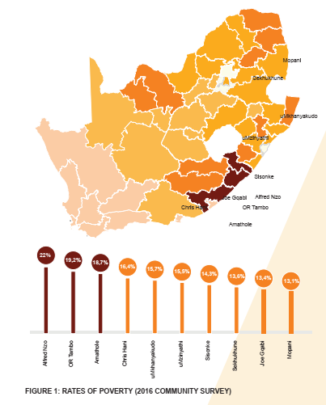
Priority Districts
Since 2001, there have been positive developments in terms of poverty reduction in South Africa, as reported by Statistics South Africa (StatsSA).
Nevertheless, there are still districts living in abject poverty.
The highest rates of poverty are in the OR Tambo, Alfred Nzo and Amathole districts of the Eastern Cape, as measured in the 2016 Community Survey.
Details of provincial spread of DSAC interventions are provided as ANNEXURE A to this presentation.

Slide 111








Public Entities
NGOs

Slide 112
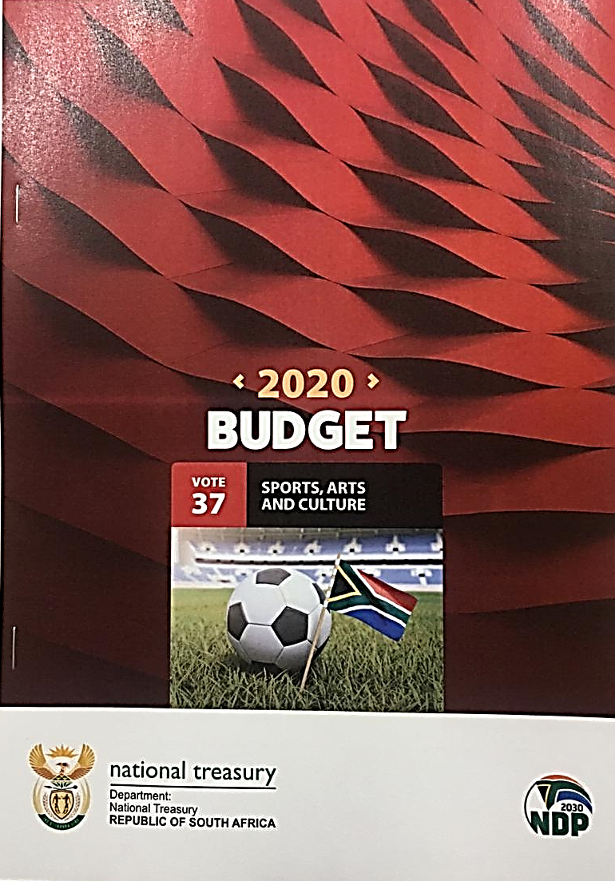
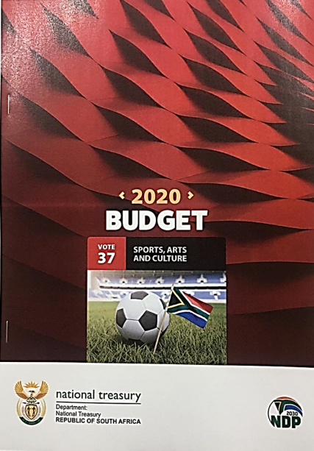



Slide 113

2020 special adjustment budget
    Presented by: Mr M Matlala
    Chief Financial Officer

Slide 114
PRESENTATION OUTLINE
1. Introduction
1.1 Reprioritisation towards COVID-19 by DSAC
1.2 Actual Adjustments implemented by DSAC

Slide 115
INTRODUCTION
On 15 March 2020 the president declared a national state of disaster in South Africa in terms of the Disaster Management Act, 2002, following the declaration of the global COVID-19 pandemic by the World Health Organisation (WHO).
Government had to act swiftly to minimize the economic impact of the pandemic, this implies a redirection of resources.

Slide 116
INTRODUCTION
The Special Adjustment Budget seeks to modify the 2020/21 budget to utilize current baseline allocations to provide for the rapidly changing economic conditions and enable spending on the COVID-19 response.
A revised fiscal framework will also be presented, to account for substantial revenue losses emanating from the economic shock of the pandemic and subsequent lockdown.
Just to note that all other adjustments not included in this Special Adjustment Budget will be tabled in the October Adjustment Budget.

Slide 117
REPRIORITISATION TOWARDS COVID-19 BY DSAC

Slide 118
REPRIORITISATION TOWARDS COVID-19
The Department has 5 sites which must be supplied with Personal Protective Equipment (PPEs).
R5 million has been reprioritised by the Department within Programme 1: Administration to cover for COVID-19 procurement of Personal Protective Equipment (PPEs), and funds has been made available from the Travel and Subsistence line item.

Slide 119
REPRIORITISATION TOWARDS COVID-19
The Department has reprioritised R130 mil. R62 mil has been re-allocated at nationally, R68 mil to be transferred to provinces (i.e. R58 mil for mass participation grant and R10 mil for community library services grant). Funds will be utilised for COVID-19 related transactions.
A virements and shifts approval of R120 mil has been granted by National Treasury/Parliament. The following two tables depicts a detailed allocation for sports, arts and culture sectors:

Slide 120
REPRIORITISATION TOWARDS COVID-19
SPORTS, ARTS AND CULTURE SECTOR/DEPARTMENTAL
Programme /Line Item | Available Amount | Transferred Amount | Remark
 | R'000 | R’000
Prog 1: Goods & Services | 5 000 | - | The amount will be used by the Department for the procurement of PPEs. Approval granted.
Prog 2: Sports Trust | 10 000 | 10 000 | Sports sector beneficiaries. Approval granted.
Prog 3: BASA | 27 000 | 27 000 | Arts and Culture sector beneficiaries. Approval granted.
Prog 3: NFVF | 30 000 | - | Arts & Culture sector beneficiaries for Digital Solution. Approval granted.
Prog 3: Goods & Services | 10 000 | - | Amount to be used by the Department for Digital/Virtuals. Approval granted.
Prog 3: NFVF | 18 000 | - | Arts and Culture sector beneficiaries. Approval granted.
Prog 3: NAC | 20 000 | - | Arts and Culture sector beneficiaries. Approval granted.
Total | 120 000 | 37 000

Slide 121
REPRIORITISATION TOWARDS COVID-19
SPORTS, ARTS AND CULTURE SECTOR/DEPARTMENTAL
Programme / Line Item | Available Amount | Transferred Amount | Remark
 | R'000 | R’000
Prog 2: Transfer to Provinces | 58 000 | - | Provincial conditional grant (Mass participation and sport development grant).
Prog 2: Amount allocated under NPI’s (Sports Trust) | 62 000 | - | Sports sector beneficiaries. Approval granted.
Prog 4: Transfer to Provinces | 10 000 | - | Provincial conditional grant (Community library service grant)
Total | 130 000

Slide 122
ACTUAL ADJUSTMENTS IMPLEMENTED BY DSAC

Slide 123
ACTUAL ADJUSTMENTS IMPLEMENTED
SUMMARY PER PROGRAMME
Economic Classification | Main Appropriation | Virements & Shifts | Suspension of funds | Allocation of funds | Adjusted Appropriation
 | R'000 | R'000 | R’000 | R’000 | R'000
Administration | 451 862 | - | (2 500) | - | 449 362
Recreation Dev & Sport Promotion | 1 460 320 | - | (480 333) | 120 000 | 1 099 987
Arts & Culture Promotion & Dev | 1 295 143 | - | (225 213) | - | 1 069 930
Heritage Promotion & Preservation | 2 512 839 | - | (387 256) | 10 000 | 2 135 583
Total | 5 720 164 | - | (1 095 302) | 130 000 | 4 754 862

Slide 124
ACTUAL ADJUSTMENTS IMPLEMENTED
SUMMARY PER ECONOMIC CLASSIFICATION
Economic Classification | Main Appropriation | Virements & Shifts | Suspension of funds | Allocation of funds | Adjusted Appropriation
 | R'000 | R'000 | R’000 | R’000 | R'000
Compensation of Employees | 407 765 | - | (10 000) | - | 397 765
Goods & Services | 610 929 | (42 000) | (86 855) | - | 482 074
Provinces & Municipalities Grant | 2 075 710 | - | (604 491) | 68 000 | 1 539 219
Dept Agencies & Acc (Cur) | 1 640 252 | 35 000 | (82 096) | - | 1 593 156
Dept Agencies & Acc (Cap) | 219 516 | - | (85 017) | - | 134 499
Higher Education Institutions (Cur) | 6 791 | - | - | - | 6 791
Foreign Govn & International Org | 5 327 | - | - | - | 5 327
Non Profit Institutions (Cur) | 385 489 | 30 000 | (97 830) | 62 000 | 379 659
Non Profit Institutions (Cap) | 14 663 | - | (10 239) | - | 4 424
Households | 31 500 | - | (9 671) | - | 21 829
Public Corporations (Cur) | 112 319 | (23 000) | (41 400) | - | 47 919
Public Corporations (Cap) | 582 | - | - | - | 582
Heritage Assets (Legacy projects) | 197 799 | - | (67 703) | - | 130 096
Machinery & Equipment | 11 522 | - | - | - | 11 522
Total | 5 720 164 | - | (1 095 302) | 130 000 | 4 754 862

Slide 125
ACTUAL ADJUSTMENTS IMPLEMENTED
PROGRAMME 1: ADMINISTRATION
Economic Classification | Main Appropriation | Virements & Shifts | Suspension of funds | Allocation of funds | Adjusted Appropriation
 | R'000 | R'000 | R’000 | R’000 | R'000
Compensation of Employees | 193 235 | - | (2 500) | - | 190 735
Goods and Services: Office Accommodation | 121 964 | - | - | - | 121 964
Goods and Services | 125 041 | - | - | - | 125 041
Machinery and Equipment | 11 522 | - | - | - | 11 522
Dept Agencies & Acc (Cur) | 100 | - | - | - | 100
Total | 451 862 | - | (2 500) | - | 449 362

Slide 126
ACTUAL ADJUSTMENTS IMPLEMENTED
PROGRAMME 2: RECREATION DEVELOPMENT & SPORT PROMOTION
Economic Classification- | Main Appropriation | Virement & Shifts | Suspension of Funds | Allocation of funds | Adjusted Apropriation
 | R'000 | R'000 |  |  | R'000
Compensation of Employees | 49 829 | - | (2 500) | - | 47 329
Goods and Services | 139 253 | (10 000) | (23 374) | - | 105 879
Dept Agencies & Acc (Cur) | 45 082 | - | - | - | 45 082
Dept Agencies & Acc (Cap) | 219 516 | - | (85 017) | - | 134 499
Heritage Assets (Legacy Projects) | 197 799 | - | (67 703) | - | 130 096
Households | 7 518 | - | (1 500) | - | 6 018
Non Profit Institutions (Cur) | 189 461 | 10 000 | (8 000) | 62 000 | 253 461
Non Profit Institutions (Cap) | 14 663 | - | (10 239) | - | 4 424
Provincial & Local Government | 596 617 | - | (282 000) | 58 000 | 372 617
Public Corporations (Cap) | 582 | - | - | - | 582
Total | 1 460 320 | - | (480 333) | 120 000 | 1 099 987

Slide 127
ACTUAL ADJUSTMENTS IMPLEMENTED
PROGRAMME 3: ARTS & CULTURE PROMOTION & DEVELOPMENT
Economic Classification | Main Appropriation | Virements & Shifts | Suspension of funds | Allocation of funds | Adjusted Appropriation
 | R'000 | R'000 | R’000 | R’000 | R'000
Compensation of Employees | 94 903 | - | (2 500) | - | 92 403
Goods and Services | 171 501 | (32 000) | (47 216) | - | 92 285
Dept Agencies & Acc (Cur) | 708 892 | 35 000 | (36 096) | - | 707 796
Higher Education Institutions (Cur) | 6 791 | - | - | - | 6 791
Foreign Govn & International Org | 3 191 | - | - | - | 3 191
Non Profit Institutions (Cur) | 180 163 | 20 000 | (89 830) | - | 110 333
Households | 17 383 | - | (8 171) | - | 9 212
Public Corporations (Cur) | 112 319 | (23 000) | (41 400) | - | 47 919
Total | 1 295 143 | - | (225 213) | - | 1 069 930

Slide 128
ACTUAL ADJUSTMENTS IMPLEMENTED
PROGRAMME 4: HERITAGE PROMOTION & PRESERVATION
Economic Classification | Main Appropriation | Virements & Shifts | Suspension of funds | Allocation of funds | Adjusted Appropriation
 | R'000 | R'000 | R’000 | R’000 | R'000
Compensation of Employees | 69 798 | - | (2 500) | - | 67 298
Goods and Services | 53 170 | - | (16 265) | - | 36 905
Dept Agencies & Acc (Cur) | 886 178 | - | (46 000) | - | 840 178
Foreign Govn & International Org | 2 136 | - | - | - | 2 136
Non Profit Institutions (Cur) | 15 865 | - | - | - | 15 865
Households | 6 599 | - | - | - | 6 599
Provinces & Municipalities Grant | 1 479 093 | - | (322 491) | 10 000 | 1 166 602
Total | 2 512 839 | - | (387 256) | 10 000 | 2 135 583

Slide 129



