Slide 1
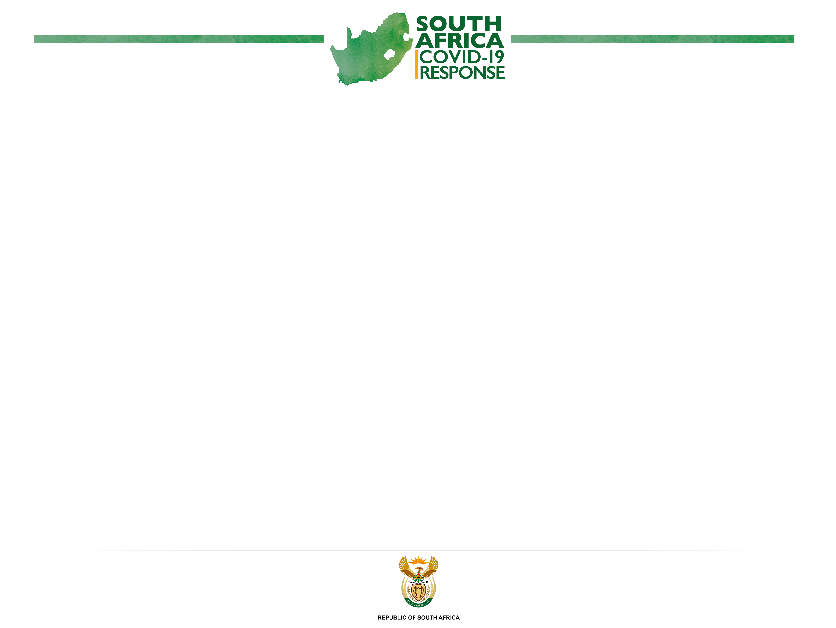
Ongoing Measures to Manage the
Spread of COVID-19 in the Provinces through the Implementation of a Risk Adjusted Strategy
DR NC DLAMINI ZUMA, MP
Minister of Cooperative Governance and Traditional Affairs
NCOP, 26 May 2020

Slide 2

OUTLINE
Introduction
Context
South Africa’s Covid-19 Reality
Socio Economic Impact
Economic Impact Implications for local government
Socio Economic Impact Mediation
Covid-19 Structures & Institutional Systems
Strategic Response to Covid-19
Risk Adjusted Strategy: Alert System
Differentiated Risk Adjusted Approach Alert Levels
COGTA Key areas of work
Challenges
Lessons learnt

Slide 3
INTRODUCTION
COVID-19: Our greatest health and economic challenge
                Faced with stark reality of the living conditions
                We’re easing the lockdown, the virus hasn’t eased its infection
Our measures: “allowed us to achieve our objective of delaying the spread of Covid-19 and avoid a massive surge in infections
that would’ve overwhelmed our healthcare system”.
Hunger at 6million people could increase to 9 million
Unemployment is +29% could increase to 50%
(1.9million new UIF applicants in first two weeks of lockdown)
High risk of business closures in tourism, entertainment,
leisure, aviation, start ups, small and informal businesses
Gender dimensions: more women infected, more men deaths
and increase GBV

Slide 4
CONTEXT
Worldwide 25 May 2020 | over 5, 517, 034 mil infections 349, 949 deaths 2, 310, 249 mil recoveries
Economic impact | Expected fall in global economy -3% Sharp fall in global trade - up to 33% Fall in export prices & reversal of capital flow Job losses, Malaysia est 20% reduction Africa economy decline 5-7%
Global Response | Mix of ‘stimulus packages’; ‘unconventional’ social security Strain on multilateralism; greater nationalism emphasis
Economic impact | Centre for International Climate & Environment Research est 0.3% drop in global emissions

Slide 5
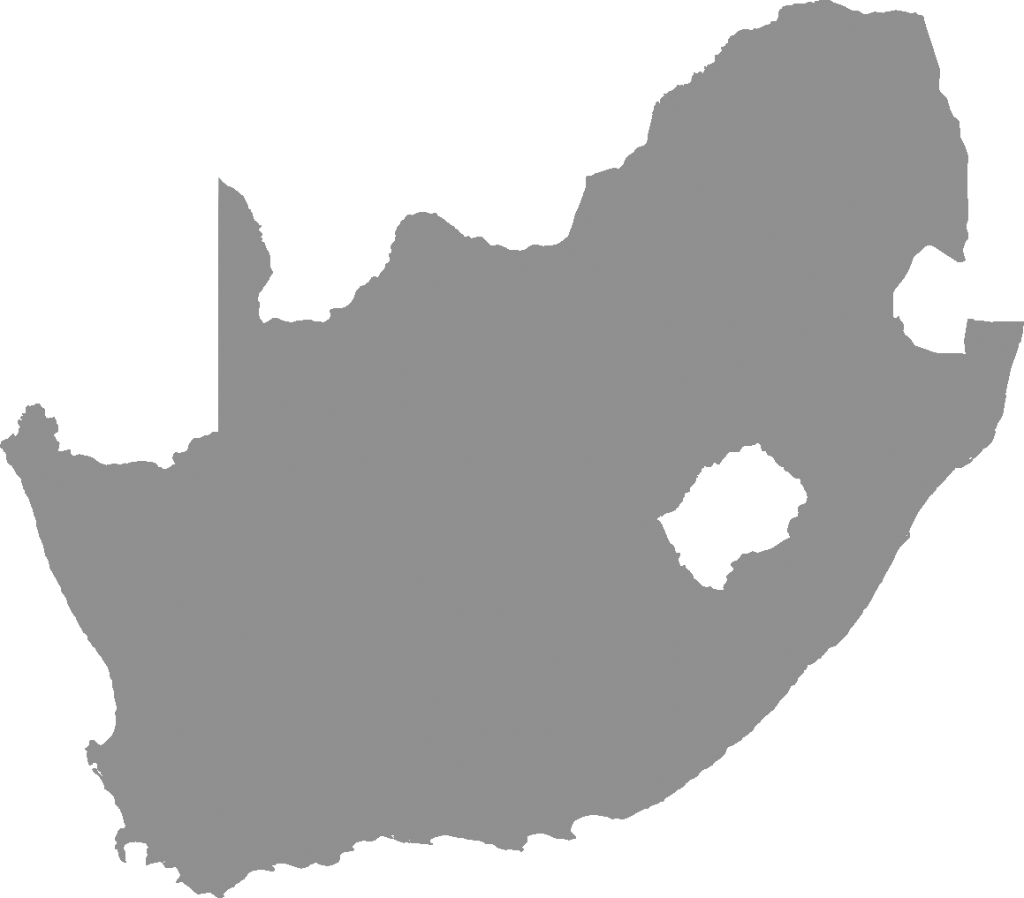
SA’s COVID-19 REALITY
5 March: First case
25 May: 22583 and 429 deaths
Virus showed realities of existing fault lines
Poverty, unemployment, hunger, inequality may worsen
Crisis accompanied by ratings’ agencies downgrades
Exposed conventional measures shortcomings – GDP
(Despite SA’s relatively high per capita GDP ranking, citizens
do not have the requisite coping and resilience mechanisms.
Thus the need to explore ‘wellbeing’ related measurement)

Slide 6
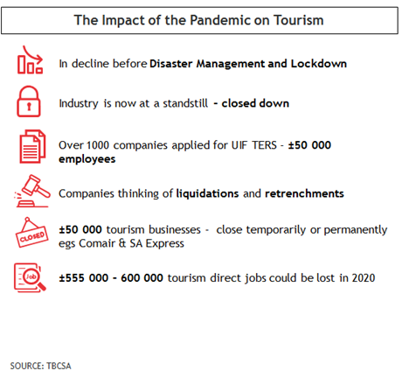
ECONOMIC IMPACT AND DOWNGRADES
SOURCE:TBCSA

Slide 7
ECONOMIC IMPACT ON BUSINESSES
Turnover: The second survey showed that nine in ten (90%) responding businesses’ turnover was lower than their normal expected range,
Workforce: Just over one-third (36%) of firms indicated that they were laying off staff in the short term as a measure to cope with the COVID-19 pandemic.
Trading activity: Almost half (48%) of businesses reported a pause in trading in the period 14 April 2020–30 April 2020,
Business survival without turnover: 30% of respondents indicated they can survive less than a month without any turnover, while over half (55%) indicated that they can survive between 1 and 3 months. Only 7% can survive for a period longer than 3 months.

Slide 8

IMPLICATIONS FOR LOCAL GOVERNMENT
Unemployment rate in SA could reach 50%
SARS projecting revenue loss of R250 billion
in tax collection
Loss of income of vulnerable households
- up to 75%
Devastating impact on informal traders
High levels of poverty and increased of indigent households
Decline in municipal revenue, intergovernmental transfers – 20-30%
Increased demand for infrastructure services
Exposed fault-lines: 2 economies, apartheid spatial patterns, inequality

Slide 9
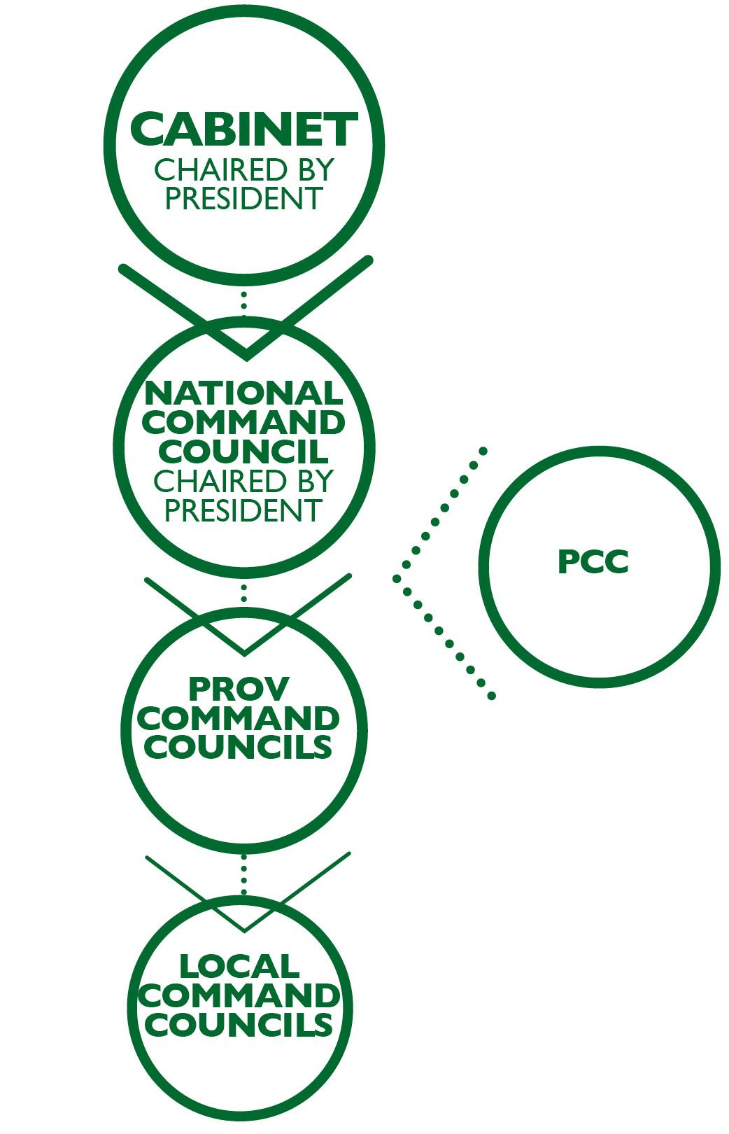
STRUCTURES & INSTITUTIONAL SYSTEMS
The National Corona Virus Command Council (NCCC) led by the President coordinates and guides government’s response
NATJOINTS provides overall coordination of response.
Presidential Coordinating Council (PCC) and MinMec structures used to coordinate issues.
The Minister of COGTA chairs meetings with relevant Cabinet Members to discuss disaster management
Provinces have similar structures, Provincial Command Councils chaired by Premiers
All provinces, metros, districts have activated
Disaster Operation Centres
COGTA activated Disaster Operations Centre: daily 12hr shift

Slide 10
STRATEGIC RESPONSE
Aggressive communication strategy to adjust behaviour.
Consultations with private, religious,
labour, civil society and
traditional leaders
Extraordinary measures including health, hygiene, social distancing and Lockdown
Socio Economic Impact Mediation Measures
1
Flattening
the Curve
2
Risk-Adjusted Strategy for
Economic
Activity
3
Building Resilience of Communities and the Economy

Slide 11
1
Flattening
the Curve
Initial lockdown had
to be extended
Continued need to
flatten the curve
Balance between
health, capacity & need to reopen
the economy
2
Risk-Adjusted Strategy for
Economic
Activity
3
Building Resilience of Communities and the Economy

Slide 12
RISK ADJUSTED STRATEGY: ALERT SYSTEM
SYSTEM 1 Alert system to determine the level of restrictions in place nationally, in provinces and in districts
SYSTEM 2 Industry classification for readiness to return at each level based on criteria, together with restrictions that should remain after the lockdown regardless of the alert level
SYSTEM 3 Enhanced public health and social distancing arrangements at workplaces and public spaces
L5 | High virus spread and/or low health system readiness | Lockdown
L4 | Moderate to high virus spread with low to moderate readiness | High restrictions
L3 | Moderate virus spread with moderate readiness | Moderate restrictions
L2 | Moderate virus spread with high readiness | Reduced restrictions
L1 | Low virus spread with high readiness | Minimum restrictions

Slide 13
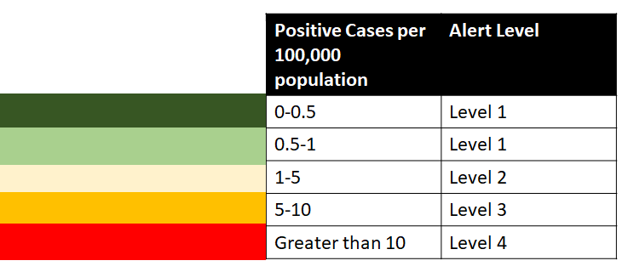
ALERT LEVELS
Differentiated Alert levels be adopted district by district

Slide 14
HOTSPOT AREAS
Metros and Districts with high rates of infections will have more and tighter restrictions, while non-Hotspots will have minimal restrictions
WHOLE OF GOVERNMENT APPROACH
          Health Response
          Socio-Economic – map businesses, social distancing & operations, hygiene
          & protocol implementation and monitoring, directing social relief measures
          Food security & social support
          – Department of Agriculture, Social Development & municipalities
          Places and Spaces – Water, Sanitation and Human Settlements
          Transport – Public transport
          Resource management – finance and human resources
          Provision of water and sanitation facilities
          Safety and Security: Intensified law enforcement to ensure compliance; implementation of Safer City Pilot Project in hotspot Metros

Slide 15
HOTSPOT AREAS
INTENSIFIED HEALTH INTERVENTION
Reinforcement of community health workers with the support of
Health professionals, SANDF health personnel & EHW personnel
Screening & Testing – Task team (National and Provincial)
Contact identification and tracing – 100% - Task team
Active surveillance for cases and contacts in the hotspot
Expanding laboratory capacity for testing all suspect cases,
high risk contacts and severe acute respiratory infection cases
Dedicated isolation, quarantine and field hospitals
Strengthen capacity of the health system (ICU and High Care beds and HR
  SANDF Health personnel to support NDoH testing and screening and Engineers
  to support Water and sanitation building
INTEGRATED ROLE OF SOCIAL PARTNERS INCLUDING:
  Social Mobilization & Comms, behaviour change & focus: Citizen accountability
  Intensification of risk communication through audio, social and visual media
  Mobilisation: Councilors & Community Leaders, FBO, CBOs, NGOs, Private Sector

Slide 16
NON-HOTSPOT: SURVEILLANCE & VIGILANCE
  Districts and metros with low infection rates or significant decrease in the number of positive cases:
  the approach will be “vigilance”
Focus:
  Prevent new infections
  Ensure the number of new positive cases are consistently low
  Rapidly find and isolate cases
  Monitoring Ab levels, Administer vaccine and ongoing surveillance: new cases
Establish multi-sectoral, multi-department, community, response teams for each affected community
Focus:
  Community education
  Surveillance
  Wearing masks
  Handwashing and sanitizing
  Social distancing
  Monitoring implementation of containment measures
  Ensure behavior change

Slide 17

COGTA KEY AREAS OF WORK
Regulatory Framework
The Disaster Operations Centre
Service Delivery & Infrastructure Delivery
Service Delivery Support to Municipalities
Water supply interventions in municipalities
Communication
Implementation of the District Development Model

Slide 18
REGULATORY FRAMEWORK
Section 26(2)(a) of the Disaster Management Act, 2002
requires the national executive to deal with a national disaster in terms of existing legislation and contingency arrangements as augmented by Regulations or directions made or issued in terms of section 27(2) of the Disaster Management Act, 2002 if a national state of disaster has been declared.
Since 15 March 2020,
the declaration of the national state of disaster, the Minister of COGTA issued a number of Regulations and authorised Cabinet members to issue Directions within the areas of their mandate. These are continuously being reviewed in line with the implementation of the risk adjusted approach.
A government webpage has been set up to provide information to the public
www.gov.za/coronavirus/guidelines

Slide 19
THE DISASTER OPERATIONS CENTRE (DOC)
COGTA DOC operates daily 12hour shift (07:00-19:00) staffed primarily
by COGTA Senior Managers, NDMC Managers & ICT support staff
Since its activation on 26 March 2020, COGTA DOC has contributed significantly to response of local government to COVID-19.
DOC interfaces with PDMCs, Metro and District Disaster Management Centres, NATJOINTS, government departments & private sector
COGTA DOC receives reports from PDMCs who interface with the
provincial and district coordinating structures.
DOC produces a national report based on reports and inputs from
provinces and relevant sector departments.
Dashboards are produced on a daily basis
Reports prepared by COGTA DOC provides an indication of progress
made in implementation of Regulations and Directions issued

Slide 20
DOC DASHBOARDS
Daily Infections
Cumulative Infections

Slide 21

SERVICE & INFRASTRUCTURE DELIVERY
KEY PERFORMANCE AREAS
Identification of critical infrastructure
to address the COVID19 pandemic
Mobilisation of resources through the reprioritization
& repurposing of existing grants (MIG, Disaster Relief)
Mobilisation of resources through partnerships & donors
Acceleration of infrastructure delivery
Implications of the directions regarding
IDPs and Budgets on service delivery

Slide 22
SERVICE DELIVERY SUPPORT
TO MUNICIPALITIES
COGTA, WITH SOCIAL PARTNERS IS PROVIDING
SHORT- TO MEDIUM-TERM SUPPORT BY
Distributing hygiene packs and antiseptic bath soaps
Development of sustainable water sources
such as drilling and equipping of boreholes
Fixing water & sanitation infrastructure to ensure long term sustainability of infrastructure and provision of water services
Mobilising R2.4 billion towards COVID-19 service delivery

Slide 23


        TIRISANO CONSTRUCTION FUND R50M DONATED IN KIND TOWARDS:
DEVELOPMENT BANK OF SOUTHERN AFRICA (DBSA)
R56M DONATED IN KIND:
`
                Purchasing and distribution of 60 000 hygiene packs across the country. Completed 16 April 2020
                Drilling and equipping 30 boreholes in KZN and GAU*
                Fix water and sanitation infrastructure in GAU, KZN, NW*
R15m strengthen NDMC capacity.
8 people started working at DOC, April 2020. 18 more positions advertised. Interviews commenced 25 May 2020
                Drilling and equipping 40 boreholes
                in NW, LP, MP, FS, EC.*
                Refurbishment of 20 boreholes
                in NW and LPO.*
                Purchasing 5 water tankers for LP
                (3 for Mopani) and MP
                (2 for Bushbuckridge).*
                Fixing pump stations in NW
                (Maluti-a-Phofung)*
                *Busy with procurement of service providers.

Slide 24


MUNICIPAL INFRASTRUCTURE SUPPORT AGENT (MISA)
R22.7M TOWARDS:
`
MUNICIPAL INFRASTRUCTURE SUPPORT AGENT (MISA)
R19M TOWARDS:
`
Drilling and equipping 21 boreholes in KZN; EC and NC. Drilling completed, water quality tested & currently equipping the boreholes.
Set of 24 boreholes, in Newcastle (KZN), were drilled, equipped & handed over to community on 16 April 2020.
14 of the boreholes developed with water purification treatment plants, to achieve acceptable water quality standards. Project started before COVID-19 outbreak.
Water infrastructure reticulation,
with a reservoir, to provide water to
250 households in the Bhokwe and Enyathi communities in KZN. The Project started before COVID-19 outbreak. Completed in April 2020 and handed over to the community.

Slide 25




`
MUNICIPAL INFRASTRUCTURE GRANT (MIG): R1.4BN IN REPRIORITISED FUNDS TOWARDS:
PROVINCIAL DISASTER RELIEF GRANT R138M TOWARDS:
`
Drilling and equipping of boreholes in municipalities across all the provinces, except WC. Registering projects on
MIG-MIS and procuring service providers.
Fixing water and sanitation infrastructure. Registering the projects on the MIG-MIS and procuring service providers.
Drought relief. Department of Agriculture, Land Reform and Rural Development working on applications & implementation plans to enable DCOG to process funding.
`
MUNICIPAL DISASTER RELIEF GRANT R252M TOWARDS:
PROVINCIAL DISASTER RELIEF GRANT R466M TOWARDS:
Temporary sanitation, cleansing & decontamination of selected public spaces, and waste & refuse removal. R151m transferred to municipalities, excl Metros, on 08 May 2020. Balance will be disbursed once 2020/21 DORA finalised.
`
Personal protective equipment (PPE) and ventilators for health sector. Funds transferred March 2020 to 9 provinces.

Slide 26
MUNICIPALITIES:
WATER SUPPLY INTERVENTIONS
DWS, provinces, municipalities and other donors/ partners providing water carting services through provision of tankers (trucks) and water tanks as emergency measure.
DWS in process of securing additional funding
from National Treasury to focus on long-term water provision, incl conversion of some tanks into community rudimentary water schemes.
Need to augment the water carting services through sustainable measures, such as development of water sources and fixing of water infrastructure, in order to build long-term resilience of communities.

Slide 27

COMMUNICATION
National Communication Core Team – led by GCIS (reporting to NATJOINTS) and Provincial Comms Core Teams – led by Office of the Premier & GCIS (reporting to PROVJOINTS).
Media handling, citizen-focus engagement & continuous dialogue
Community engagements
(Led by National, Provincial, Local & Traditional leadership)
Coverage on screening - ongoing in communities
Media Releases issued (CoGTA; Province and LG).
Interviews by all spheres - on various platforms
(Government and Traditional leadership)
Sharing of flyers in communities
Digital & Social Media – (#COVID19; #stayhome; #staysafeSA)
Urgent, instant, up-to-the minute news and messages
(24hrs News channels; Social Media; Community Media)

Slide 28

DISTRICT DEVELOPMENT MODEL APPROACH
PRINCIPLES
Implement a differentiated approach through the DDM
Spatial mapping of Virus & health facilities readiness
All Covid-19 Response plans spatially mapped in 52 Districts
Use & enhance current Intergovernmental Structures established to coordinate response, incl Provincial Disaster Management Centres.
Improve quality and credibility of data, reporting & monitoring

Slide 29
PRIORITY ACTION PLANS
Use current district profiles as a baseline information
Overlay district profile with district health profiles on spread of Covid-19, spatially mapped per local municipality
National and Provincial Departments to submit
district Covid-19 response plans:
                Spatially mapped, differentiated and targeting hotspots within the district
                Reflect sector departments programmes and projects,
                i.e. water, human settlements, food parcels
                Total quantum government Covid-19 spent per district
National and provincial sector departments to implement their relief measures within district.
Assess, determine impact to inform easing of the levels

Slide 30
PROCESS PLAN
Covid-19 Relief funds/stimulus packages from national sector deps presented by district, submitted to COGTA,15 June 2020
National & provincial sector deps submit Covid-19 compliant reprioritised projects and budgets month after presentation
of revised budget, July 2020
Municipalities reprioritise budgets as part of IDP process
Districts to submit reprioritised projects and budgets,
coordinated amongst municipalities by end of July
National COGTA present reprioritised plans consolidation,Sep
USING INTERGOVERNMENTAL RELATIONS STRUCTURES
Use current Covid-19 structure for reporting & coordination
to enhance DDM implementation
Improve political participation of Members of Parliament, Traditional Leaders in District Command Councils
Establish nerve centres across three spheres of government
Use District hubs as District nerve centres to ensure quality
of data, reporting and information

Slide 31

CHALLENGES: REGULATIONS COMPLIANCE
Interprovincial travel which poses a further risk (funerals)
Complaints related to exercise
Initial tests only related to those with symptoms who can afford, now mass screening and accelerated testing
Disregard by taxi owners to maximum taxi capacities
Illegal border crossing.
Litigation
Most infections in most populated areas, and economic hubs
Structural fault lines have people shop/work far from homes
Social grant recipients; payment and disbursement methods
Poverty and increased unemployment means lower
revenue for local government

Slide 32


More responsive, integrated, coherent,
agile government
Government communication accelerated:
brings it closer to people, changed societal behaviour
Take up of technology enables quick, effective decisions
Quality, disaggregated data supports
effective, evidence-based decision-making
Presence of security apparatus reduced crime levels
by -69,4 in 1st 21 days of lockdown
SA Medical Research Council reported 70% reduction trauma cases incl. est -9 000 alcohol-related admission
Vast majority heeded the call to stay at home with
less movement and traffic, but not all
Regulations were adapted where need dictated
e.g. funerals, children and emergency repairs
Self regulatory becomes vital as we move down
the levels of the risk adjusted approach
LESSONS
LEARNT

Slide 33
KEY RECOMMENDATIONS
IT IS RECOMMENDED THAT THE NCOP
Notes the ongoing measures to manage the spread
of COVID-19 in the Provinces through the Implementation of a Risk Adjusted Strategy
Supports the COVID-19 structures that have been established to manage the governments response

Slide 34
THANK YOU
Siyabonga | Realeboga | Ro livhuwa

