Slide 1
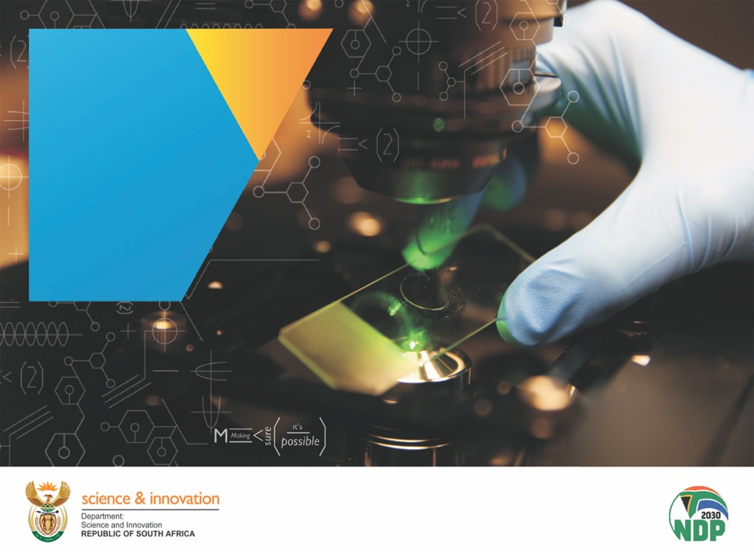
Contents
DSI QUARTER 2 and 3(2021/22)
PERFORMANCE
AND FINANCIAL
REPORTS
DG: Dr Phil Mjwara
Date: 4 March 2022
Portfolio
Committee
Chapter 01
Chapter 01
Chapter 01
Chapter 01
Chapter 01
Chapter 01
Chapter 01

Slide 2
Presentation Outline
Alignment of the DSI work to national priorities
Highlights for the Quarter
Performance Information Overview (Q2 & Q3)
Performance Information per programme
Targets not achieved
Financial Report
Progress on the implementation of the Audit Plan

Slide 3
Alignment of the DSI work to national priorities
The Department contributes to and reports on the following MTSF outcomes:
A transformed, inclusive, responsive coordinated and efficient NSI.
Knowledge utilisation for inclusive development.
Knowledge utilisation for economic development.
Human capabilities and skills for the economy and for development.
Innovation in support of a capable and developmental state
Increased knowledge generation and innovation outputs.

Slide 4

Highlights for Quarters 2 & 3

Slide 5
Outcome 1: A transformed, inclusive, responsive and coherent NSI
RESEARCH DEVELOPMENT AND SUPPORT
A draft of the National Open Science Policy was approved by the Open Science Advisory Board (OSAB) for stakeholder consultation.
  The National Open Science Policy aims to democratise access to knowledge by fostering open science practices in South Africa, which is useful for teaching and training, the economy, public policy, citizens and society as a whole.

Slide 6
Outcome 2: Human capabilities and skills for the economy and for development
RESEARCH DEVELOPMENT AND SUPPORT
The Research and Development unit completed the hosting of South African Women in Science Awards (SAWISA) webinars. Four months (August to November with a total of 1 209 registrations and 548 unique viewers). Topics explored;
  Women and the Changing Nature of Work (Thursday, 26 August 2021);
  Women and their Role in debunking myths about COVID-19 Vaccines (Wednesday, 22 September 2021);
  Technopreneurs: A Gendered Perspective (Wednesday, 20 October 2021);
  Advancing Diversity through the Inclusion of Women in STEM fields (Wednesday, 24 November 2021).

Slide 7
Outcome 2: Human capabilities and skills for the economy and for development (Q2)
DSI Human capital development (HCD) targeted interventions:
The NDP envisaged HCD as central in addressing South Africa’s unemployment, poverty and inequality challenges.
Postgraduate Bursaries and Internships awarded through NRF and other agencies
 | Total Beneficiaries | Black | Women | Black Women | People with Disabilities | South Africans
BTech/Honours and master’s students | 8 610 | 7 151 | 5 346 | 4 525 | 18 | 8 309
Doctoral students | 2 961 | 1 882 | 1 653 | 1 148 | 29 | 2 442
Total no of students funded | 11 571 | 9 033 | 6 999 | 5 673 | 47 | 10 751
Interns | 619 | 446 | 366 | 294 | 0 | 502
Performance indicator |  | Women | Youth | Disability
Number of trainees upskilled in intellectual property management and technology transfer | 162 | 26 | 54 | 0
Number of South African students participating in international training programmes | 48 | 48 | 36 | 0

Slide 8
Outcome 2: Human capabilities and skills for the economy and for development (Q3)
DSI Human capital development (HCD) targeted interventions:
Postgraduate Bursaries and Internships awarded through NRF and other agencies
Current transformation Interventions;
Task team established within the DSI to;
  co-create a robust and evidence-based transformation agenda for the next 10 years and
  identify reforms and actions to be implemented over the 2020-2025 cycle by DSI and its entities to enhance transformation outcomes.
 | Total Beneficiaries | Black | Women | Black Women | People with Disabilities | South Africans
BTech/Honours and master’s students | 5 356 | 4 550 | 3 418 | 2 944 | 11 | 5 067
Doctoral students | 2 474 | 1 772 | 1 006 | 1 123 | 19 | 2 166
Total no of students funded | 7 830 | 6 322 | 4 424 | 4 067 | 30 | 7 233
Interns | 1 115 | 1 099 | 694 | 683 | 3 | 1 115

Slide 9
Outcome 3: Increased knowledge generation and innovation outputs
DSI co-funded SAMRC Waster Water Surveillance and Research programme that monitors the non-infectious SARS-CoV-2 RNA and the fragments of the virus that causes COVID-19.
By testing wastewater weekly, the SARS-CoV-2 RNA signal can be measured to see whether it is increasing or decreasing. This can be used as an early indicator of COVID-19 case trends within a community. The recent outbreak and spread of the Omicron variant were detected using this programme.

Slide 10
Outcome 3: Increased knowledge generation and innovation outputs
Ministerial Plenary on Integrating the Humanities and Social Sciences into the COVID-19 response was convened by the DSI in December 2021. The plenary;
Identified knowledge gaps and evidence needs that can be addressed through interdisciplinary research.
Reviewed the social science expertise gained through local, regional, and national approaches, strategies and initiatives for inclusive, people and community-centred responses to the COVID-19 pandemic.
Inspired new perspectives to tackle the challenges of the pandemic through citizen engagement and participation.
Underscored the critical importance of knowledge integration and synthesis.

Slide 11
Outcome 4: Knowledge utilisation for economic development
HySA
Completed a feasibility study on the Hydrogen Valley in partnership with Anglo American Platinum (Pty) Limited, Bambili Energy Group (Bambili) and ENGIE
The study explored opportunities that will transform the Bushveld complex and the larger regions around Johannesburg, Mogalakwena and Durban into a Hydrogen valley.
Focus on the conversion of diesel heavy-duty trucks to fuel cell heavy-duty trucks while supporting the upscaling of Hydrogen consumption in the transport sector.
Identified nine promising projects across the mobility, industrial and buildings sectors that could be used as a springboard for the establishment of a South African Hydrogen Valley corridor, which could contribute up to $100 million to the Platinum industry in South Africa by 2030.
Projected that the Hydrogen demand along the corridor could reach up to 185 000 tons by 2030.
In terms of the improvement of the socio-economic conditions of South Africans, the implementation of the South African Hydrogen Valley corridor could potentially contribute $3.9 to $8.8 billion to GDP (direct & indirect contributions) by 2050 and create approximately 14 000 to 30 000 plus direct and indirect jobs per year by 2030.

Slide 12
Outcome 4: Knowledge utilisation for economic development
A DSI and TIA funded project, managed by the South African Medical Research Council, to locally develop COVID-19 Rapid Antigen Tests had its first success, with the approval by the South African Health Products Regulatory Authority (SAHPRA) of the Cape Town Based Medical Diagnostech's COVID-19 Antigen Rapid Acute Infection Test.
The cost per test is around R50 and will greatly reduce the expenses around testing to allow people back to work.
This follows the successful SAHPRA approval of the COVID-19 PCR Test Kits developed by CapeBio in collaboration with the CSIR.

Slide 13
Outcome 4: Knowledge utilisation for economic development
Industry & Environment
The artificial intelligence (AI) biomanufacturing platform by CapeBio (Pty) Ltd (one of the DSI supported start-ups) was completed. It seeks to enhance the country's capabilities in bioprospecting of indigenous microbial resources for new commercial opportunities
Mechanical engineering masters and doctoral students at the University of KwaZulu-Natal's (UKZN) Aerospace Systems Research Group (ASReG) have designed and successfully tested a powerful liquid-propellant rocket engine as the first step towards developing a launch vehicle for placing satellites into Earth orbit.

Slide 14
Outcome 5: Knowledge Utilisation for inclusive development
Inclusive innovation
DSI and its entities accelerated the implementation of initiatives supporting the commercialisation of innovations by youth entrepreneurs through the Grassroots Innovation Programme (GIP), as well as through the Technology Acquisition and Deployment Fund (TADF), a strategy designed to increase the uptake and commercialisation of locally developed technologies.
The Grassroots Innovation Programme facilitated access to multi-tiered support packages to 111 beneficiaries.
  This support for commercialisation benefitted unemployed graduates emerging as entrepreneurs. It received a massive boost through partnerships forged with other government and private sector agencies in tourism and the insurance sector.
Total beneficiaries | Black | Women | Disabled | Area
111 | 99 | 33 | 0 | National

Slide 15
Outcome 5: Knowledge utilisation for inclusive development
TECHNOLOGY INNOVATION
In December 2021, the Deputy Minister of Higher Education, Science and Innovation in the Vhembe District Municipality in the Limpopo province
A: Launched a media Lab at Mogoidwa Secondary School
The project comprises a containerised media laboratory with 30 computers powered by solar photo-voltaic (PV) with an MLT inverter. It contributes to the 'Future-proof education and skills' Societal Grand Challenges of the Decadal Plan. MLT Inverters (Pty) Ltd (MLT) was funded by the Department of Science and Innovation (DSI) in the past, to develop a control system for its inverter.
B: Hosted the Masia Village Deployment Project Kick-off Ceremony
The Masia multi-purpose center in the village has provided an opportunity for the deployment of renewable and sustainable energy technologies. The project contributes to the 'Innovation for energy security' Societal Grand Challenges of the Decadal Plan, focusing on energy for poor and rural communities, renewable clean energy and a just transition.

Slide 16
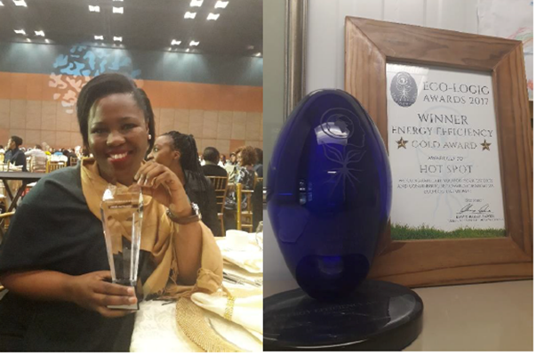
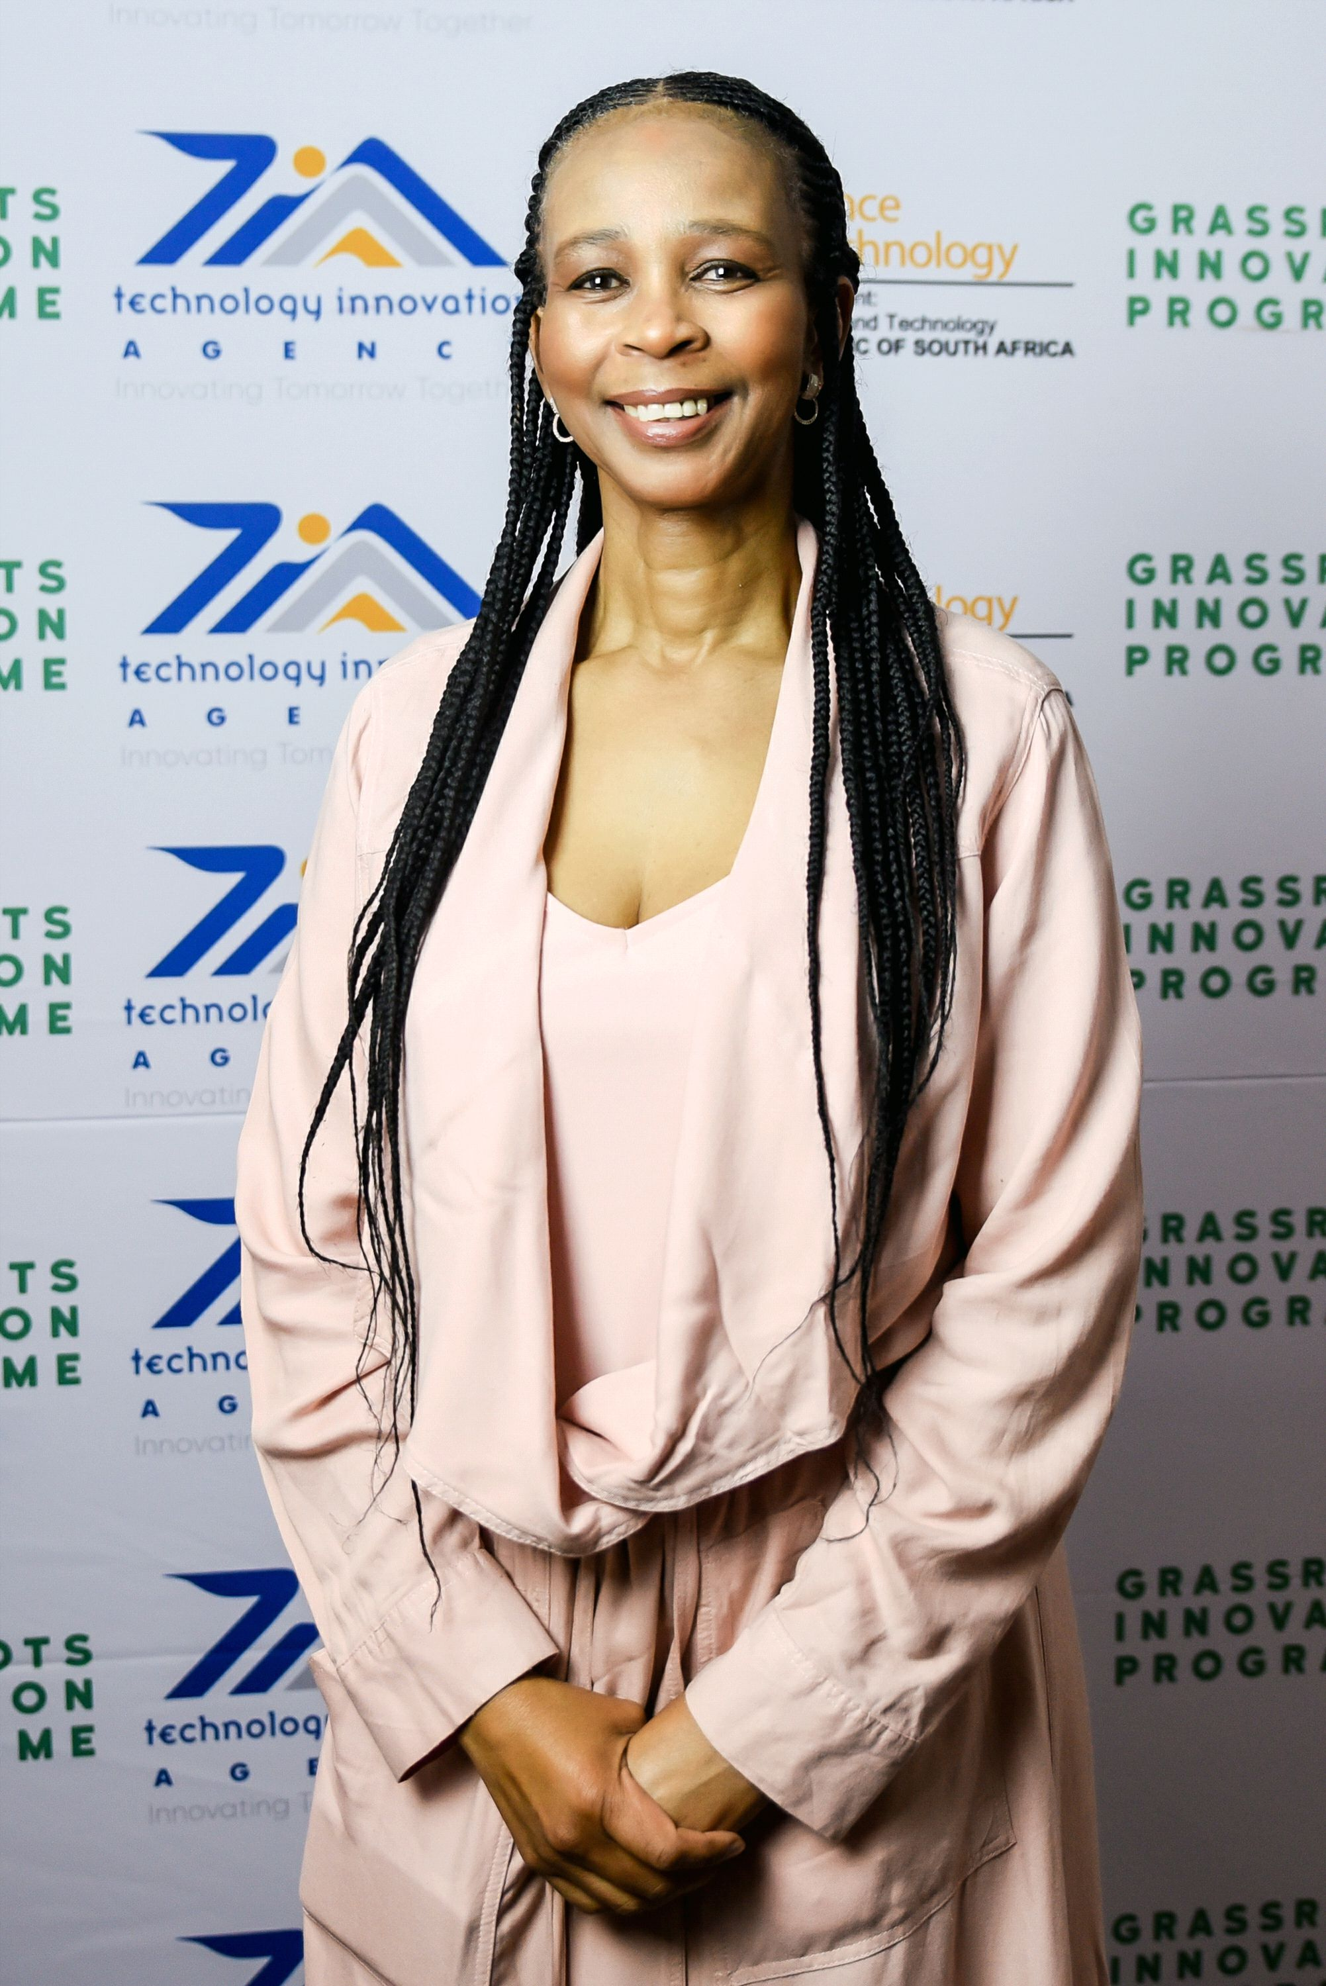
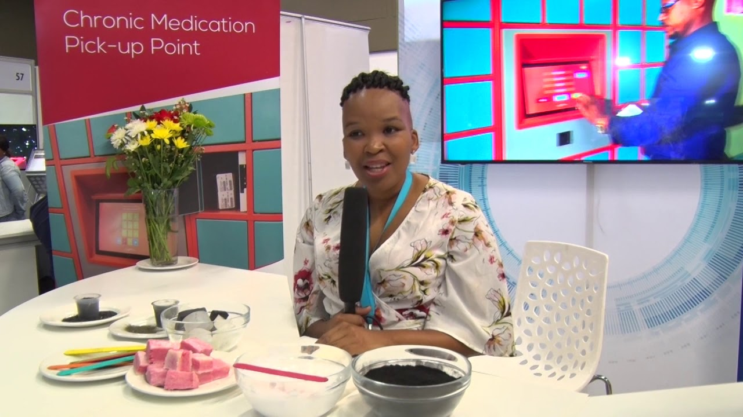
Grassroots Innovation Programme: Support for Gender Responsive Planning: women, youth and people with disability
Grassroots Innovation Programme
Facilitated access to multi-tiered support packages to 111 beneficiaries.
Commercialisation benefitted unemployed graduates emerging as entrepreneurs participating on the programme.
Partnerships forged with other government and private sector agencies in tourism, and the insurance sector.
10 innovative products from the Grassroots Innovation programme were successfully launched into the market during the youth month.
5 of the successfully commercialised products are owned by women innovators under the age of 35,
Provided market solutions to real life problems in areas such as skincare, wellness and personal tracking devices to counter human trafficking and kidnapping in schools etc.

Slide 17
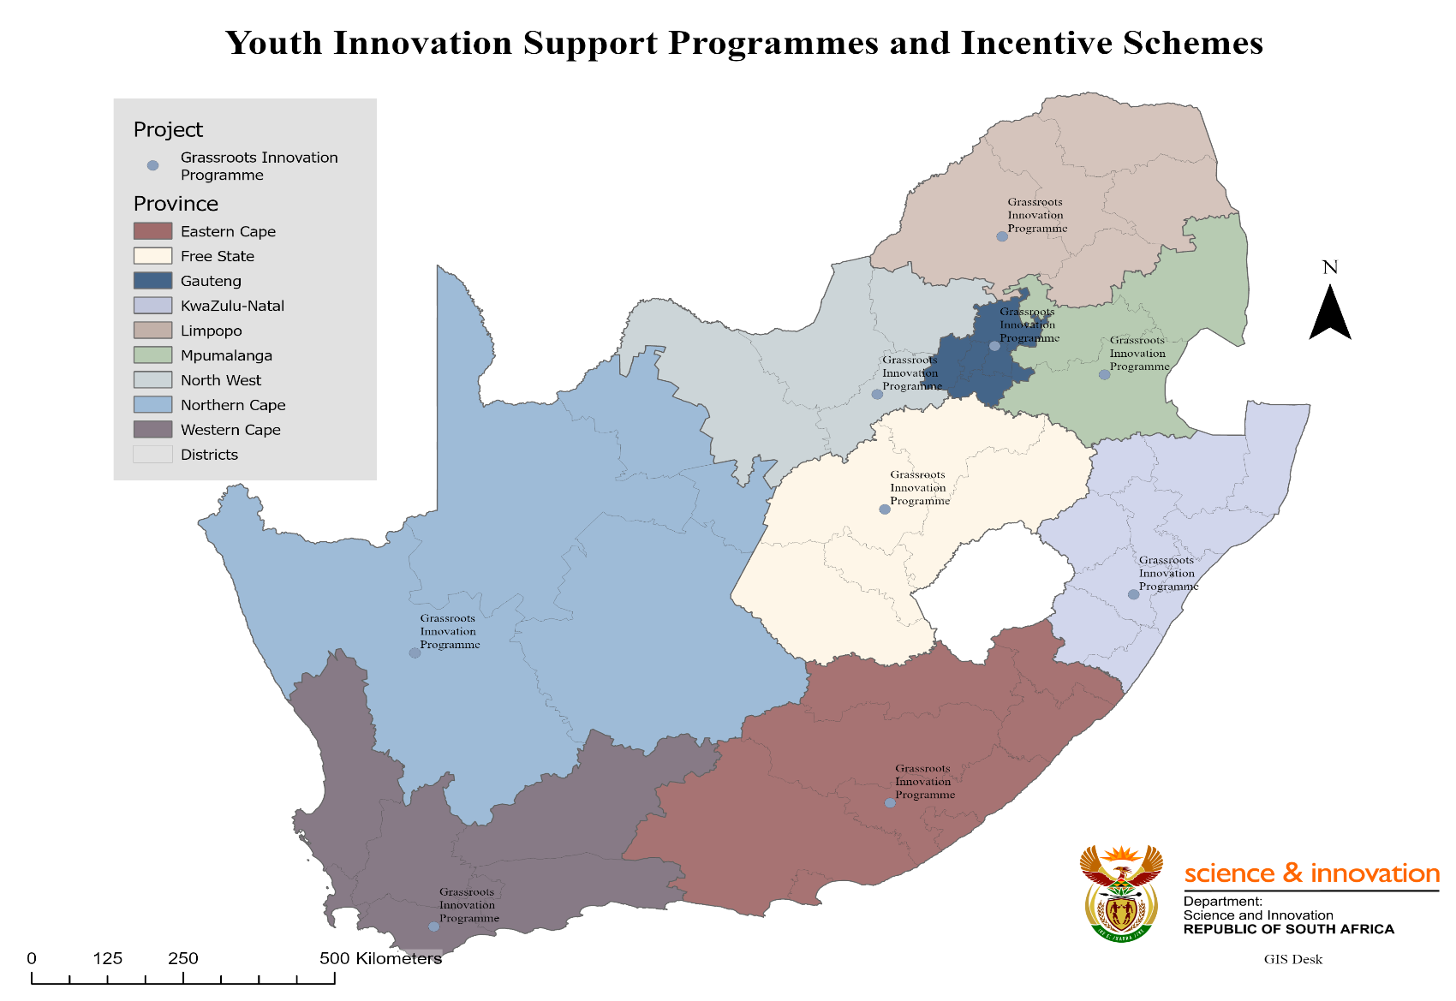
Grassroots Innovation Programme by Provinces

Slide 18
Outcome 5: Knowledge Utilisation for inclusive development
Inclusive innovation
Other DSI initiatives designed to support youth entrepreneurship skills and create business opportunities and technology products for youth business include:
  mLab;
  Imvelisi Enviropreneur Programme
  ICT Enabled Agriculture;
  Science and Technology Youth Journalist Programme (STYJP);
  Youth Technology Innovation Programme (YTIP);
  Water Technologies Demonstration Programme (WADER);
  Photonics Prototyping Facility (PPF);
  Technology Stations Programme (TSP)

Slide 19
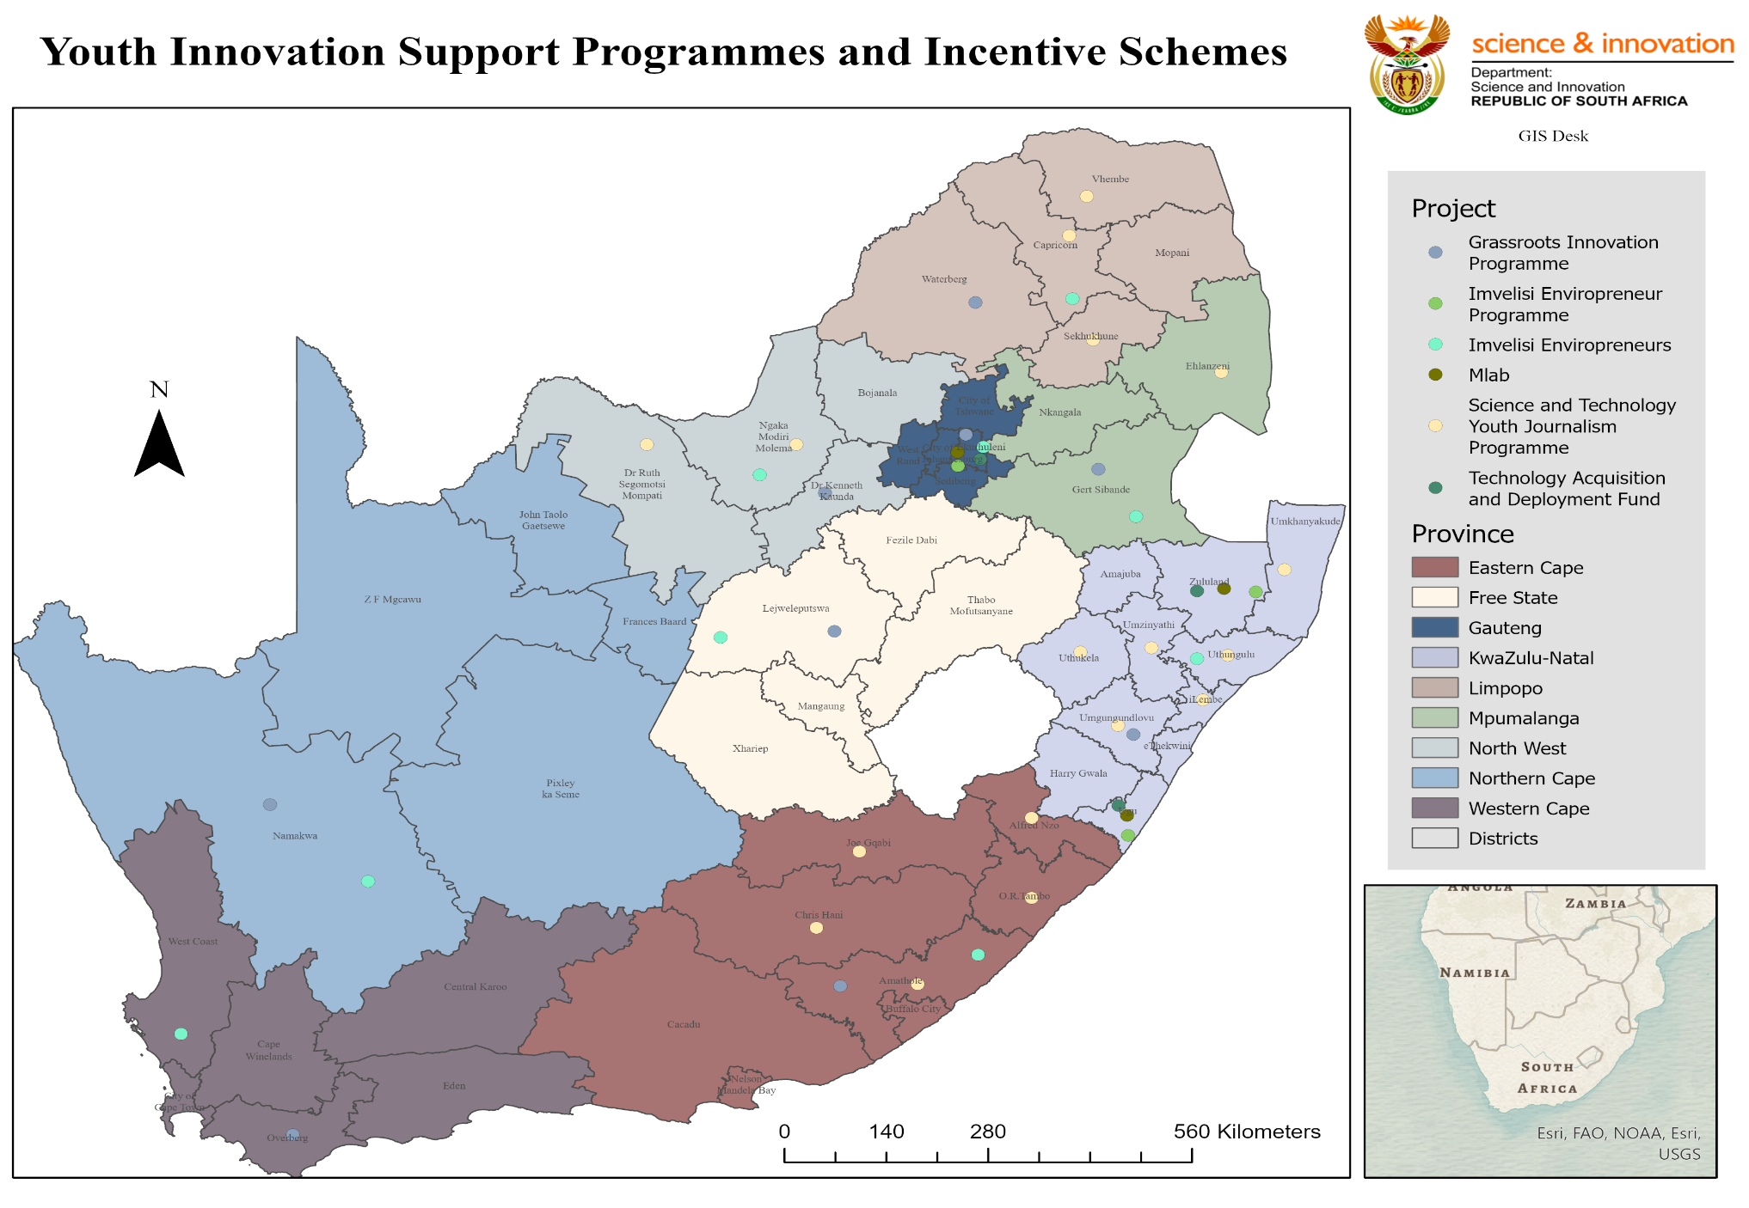
Other DSI Youth Innovation Entrepreneurship Support Programme

Slide 20
Outcome 6: Innovation in support of a capable and developmental state
In search of an innovation-based system to improve the delivery of human settlements, the DSI supported the demonstration of 3D printing of houses through the use of additive materials technologies.
The initiative:
  aligns to the countries effort to transition sustainable human settlements to smart, green and sustainable settlements in the context of 4IR and climate change.
  was boosted by the launch of the Science, Technology and Innovation for Sustainable Human Settlements (STI4SHS) Roadmap which established a multi-stakeholder innovation compact for the sector for the next 10 years in support of the Decadal Plan resulting in the coordination of various actors between civil society, government, academia and industry in support of innovation in the sector.
25 housing units have been earmarked for the demonstration through 3D printing technology in partnership with the KwaZulu-Natal Department of Human Settlements.

Slide 21
INTERNATIONAL COOPERATION AND RESOURCE (ICR)
Vaccine Manufacturing Project
The third Project Steering Committee of the Vaccine Manufacturing Project between the African Renaissance Fund, DSI and Biovac played a critical role in positioning South Africa to submit a successful bid to the World Health Organisation to fund an mRNA pilot plant in South Africa.
EUREKA
The ICR Programme is involved with the EUREKA Network secretariat to attract more African countries to join the network and is in contact with the European and Developing Countries Clinical Trails Partnership (EDCTP) Headquarters for the implementation of the Global Health Partnerships, which is a replacement of the EDCTP2.
This working group will place the SA NSI closer to working with other African countries on an international basis with the rest of the world, thus growing innovation capabilities.

Slide 22
INTERNATIONAL COOPERATION AND RESOURCE (ICR)
Coordinated joint activities between the South African National Space Agency (SANSA), and the China Satellite Navigation Office (CSNO) in China, to discuss joint collaboration focusing on navigation satellite systems to build infrastructures for high-precision spatial and temporal information services.
Exchanges were held to introduce the Beidou Navigation Satellite System Service, followed by a webinar to share the achievements of Global Navigation Satellite Systems (GNSS), which is expected to better serve the economic and social development of South Africa and other African countries.
Participated in the launch of the Kenya Innovation Week conference held in December 2021, and delivered a presentation on the South African experience in the Eureka network.

Slide 23
INTERNATIONAL COOPERATION AND RESOURCE (ICR)
United Nations Development Programme (UNDP)
The Department signed a Memorandum of Understanding (MoU) with the United Nations Development Programme (UNDP) in November 2021 to provide a framework for non-exclusive cooperation and facilitate and strengthen collaboration between the two entities in areas of common interest that have been identified.
This partnership will also focus on:
  incorporating cross-cutting issues of gender and youth, and collaborating on policy development within the Presidential Employment Stimulus;
  supporting the DSI’s Science Technology and Innovation Diplomacy Framework with African countries through technical expertise; and
  drawing on the networks and stakeholder relationships of the UNDP country offices.

Slide 24
INTERNATIONAL COOPERATION AND RESOURCE (ICR)
As part of the France-South Africa Innovation Partnership in Agriculture, the AgTech Innovation Challenge took place in collaboration between DSI, the French Embassy, the World Bank, and the UNDP.
Five winners received awards for their outstanding Innovation in the agricultural space, while three innovators received awards in the applied agricultural research space.
A student from the University of Limpopo supported by the FSAGRI Programme studying for her Master of Science Agrofoodchain at ENSFEA Toulouse and Toulouse INP in France received the INP 2020 international award.
The DSI successfully hosted the Science Forum South Africa in December 2021.
The ICR Programme jointly coordinated the 2021 Joint Call with BiodivClim and included the involvement of all HDI's in all proposals as part of the South African eligibility.

Slide 25
INTERNATIONAL COOPERATION AND RESOURCE (ICR)
SKA
The international SKA Observatory signed agreements with the governments of Australia and South Africa to host its telescopes and associated infrastructures in October 2021.
The signing event followed unanimous approval of the agreements by the seven Member States represented at the Council.
Water & Energy for Food (WE4F)
The DSI signed a Memorandum of Agreement with the Water & Energy for Food (WE4F) Grand Challenge partners to be part of the Southern and Central Regional Innovation Hub.
  This partnership positions DSI well to participate in innovation in the water, energy and food nexus in South Africa and the region.
  Since the signing, the first call for innovation and the regional innovation hub has been launched.

Slide 26
PERFORMANCE INFORMATION OVERVIEW

Slide 27
DSI Second & Third Quarter Performance
Figure 1 below illustrates the performance of the Department of Science and Innovation (DSI) from July to December 2021.
During the period under review, the total number of planned output targets was Q2 (n=31) and Q3 (n= 32).
The Department achieved Q2 81% (25) and Q3 69% (22) of the planned output targets and Q2 19% (6) and Q3 31% (10) of the planned output targets were not achieved.

Slide 28
DSI Second Quarter Performance
Figure 1: DSI’s overall final second quarter performance overview: (Total number of planned output targets, n= 31) NB: Only Quarter 2

Slide 29
DSI Third Quarter Performance
Figure 2: DSI’s overall final third quarter performance overview: (Total number of planned output targets, n= 32) NB: Only Quarter 3

Slide 30
Overall DSI’s Performance per Programme
Figure 3: The DSI performance per Programme

Slide 31
Quarterly analysis 2021/22 DSI overall performance
Figure 4: Quarterly analysis for the Financial Year 2021/22 (Q1 to Q3)

Slide 32
PERFORMANCE INFORMATION PER PROGRAMME

Slide 33



Programme 1
Administration
Purpose
To conduct the overall management and administration of the department.

Slide 34
Programme 1 Performance
Quarter 3 achievements – Administration
Annual Target | Quarter 3 Target | Quarter 3 Progress | Status
Annual target: DSI public entities’ 2022/23 annual performance plans (NRF, HSRC, TIA, SANSA, NACI and ASSAf) and CSIR shareholder compact approved by the Minister and signed chairpersons of the boards by 31 March 2022 (Non-cumulative target) | First draft APPs and shareholder compacts for DSI public entities submitted to NT and the DPME by 30 October 2021 for concurrence | First drafts of the 2022/23 APPs (NRF, HSRC, TIA, SANSA, NACI and ASSAf) submitted to the DPME on 29 October 2021. Progress on the submission of the first draft of the CSIR's 2022/23 Shareholder's Compact during the next reporting period | Achieved
Six platforms (print, broadcast, online, media liaison, stakeholder engagement and social media) to profile the DSI and its entities by 31 March 2022 | Six platforms (print, broadcast, online, media liaison, stakeholder engagement and social media) to profile the DSI and its entities | Six platforms (print, broadcast, online, media liaison, stakeholder engagement and social media) to profile the DSI and its entities | Achieved

Slide 35
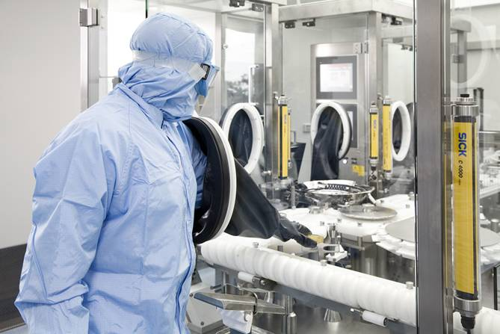
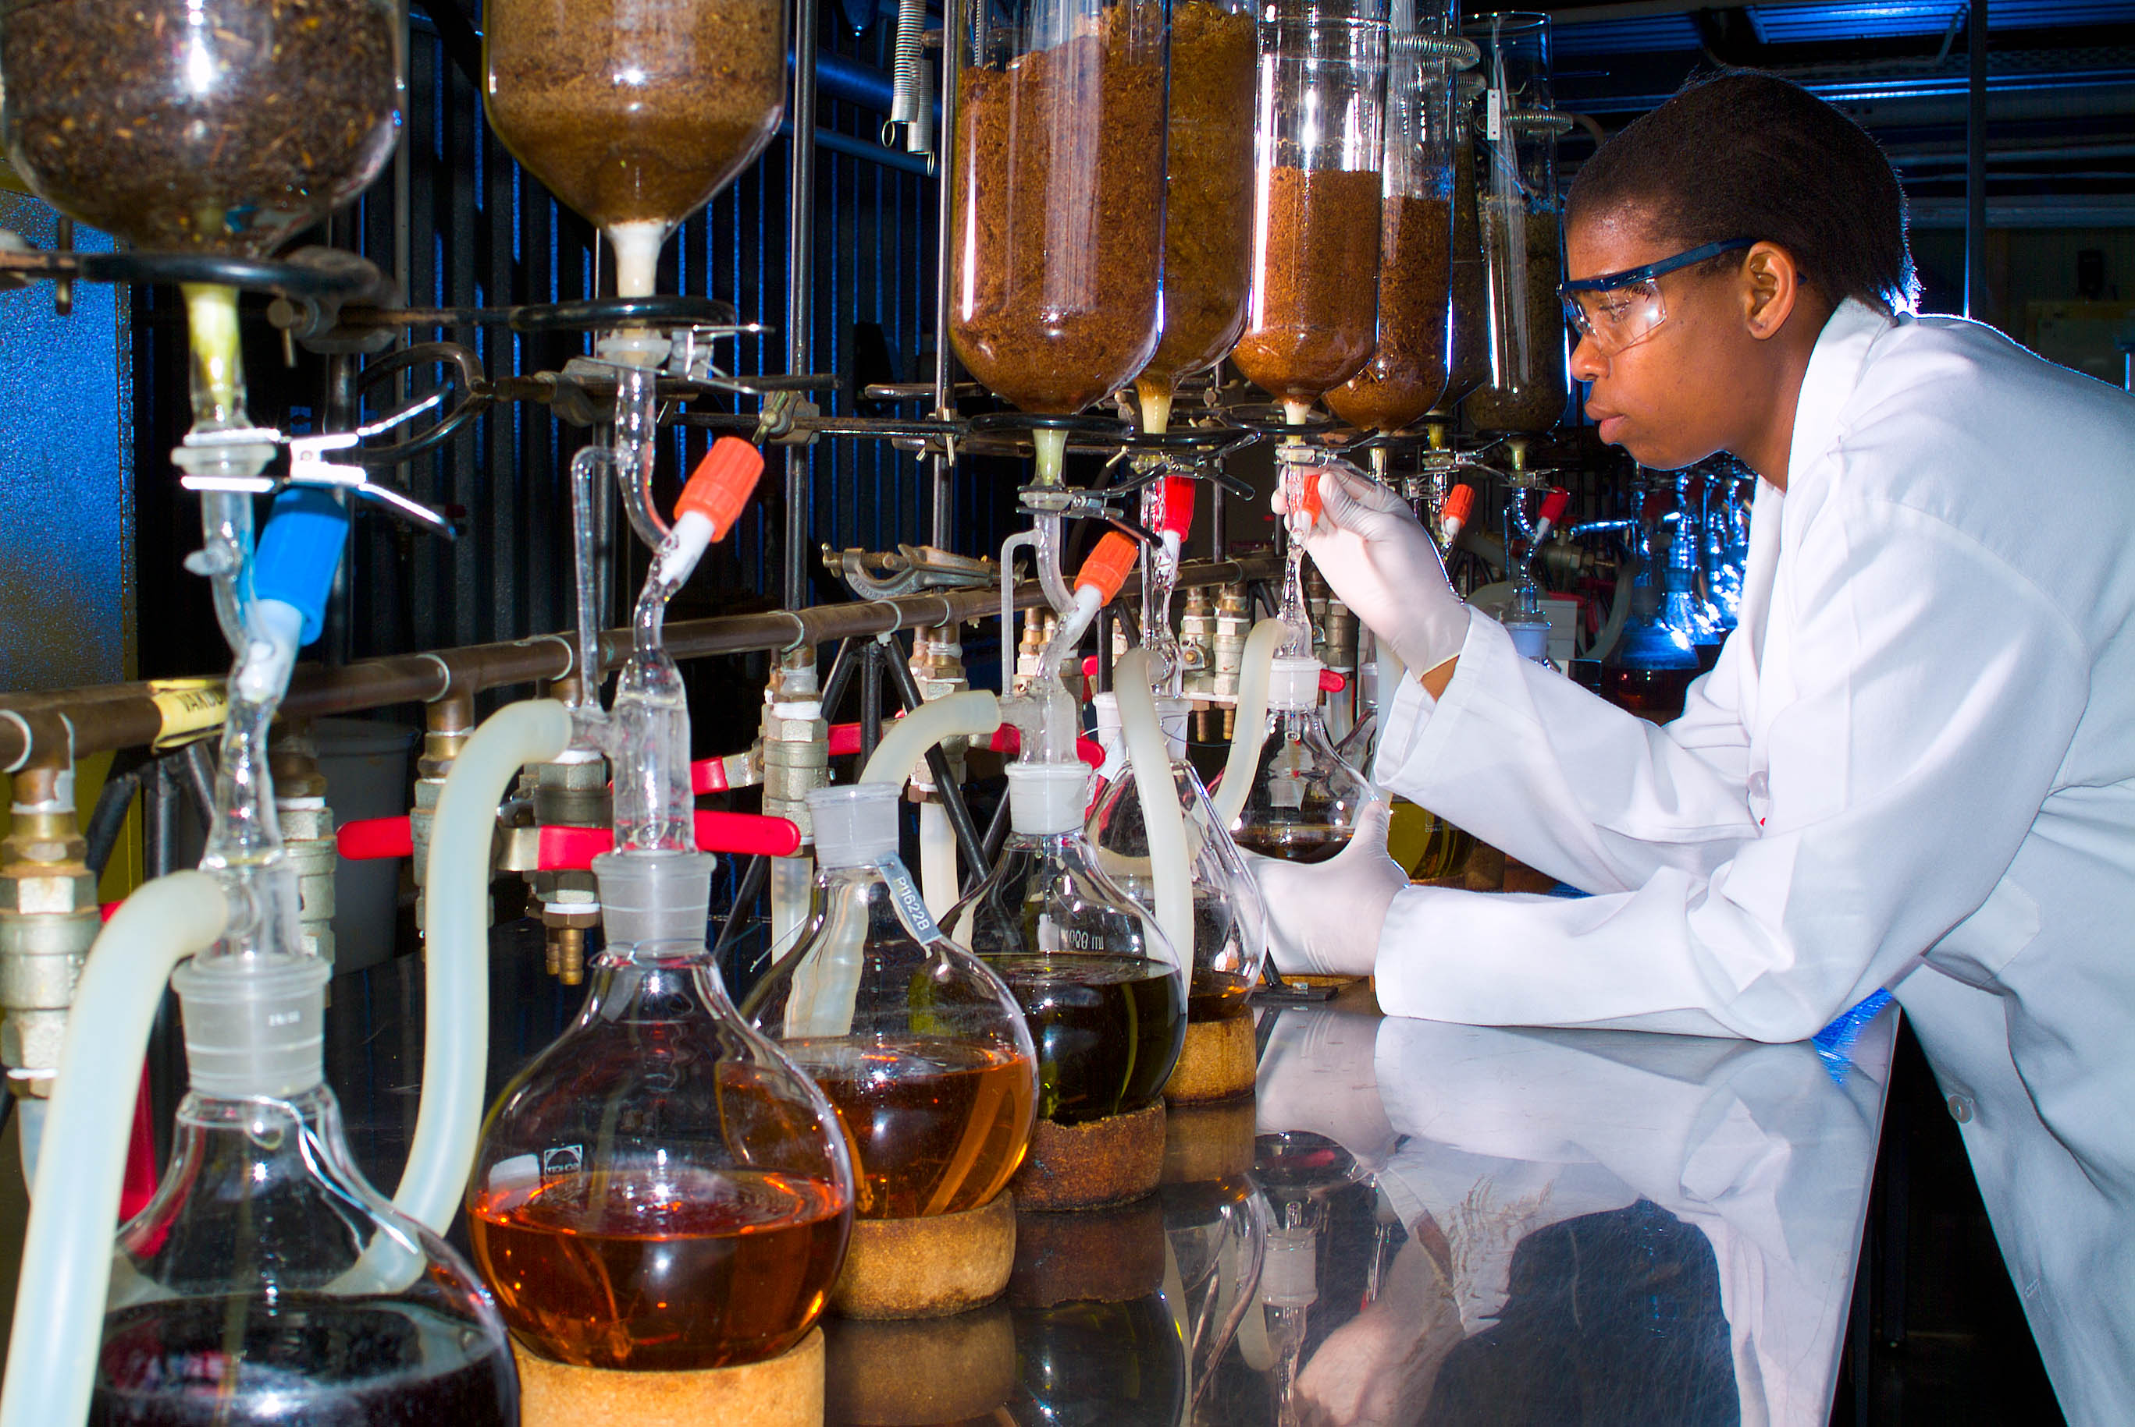
Programme 2
Technology Innovation
Purpose
To enable research and development in strategic and emerging focus areas to promote the realization of commercial products, processes and services from R&D outputs; through the implementation of enabling policy instruments.

Slide 36
Programme 2 Performance
Quarter 3 achievements – Technology Innovation
Annual Target | Quarter 3 Target | Quarter 3 Progress | Status
8 strategic and technical engagements with SANSA and TIA to alignment to national priorities by 31 March 2022 | 2 strategic and technical engagements with SANSA and TIA to alignment with national priorities by 31 December 2021 | 2 strategic and technical engagements with SANSA and TIA took place before 31 December 2021 | Achieved
250 trainees upskilled in intellectual property management and technology transfer skills by 31 March 2022 (Non-cumulative target) | 100 trainees upskilled | 162 trainees upskilled in intellectual property management and technology transfer | Achieved
235 disclosures received from publicly financed research and development institutions by NIPMO by 31 March 2022 (Non-cumulative target) | 105 disclosures received from publicly financed research and development institutions by NIPMO | 135 disclosures received from publicly financed research and development institutions by NIPMO | Achieved
15 disclosures licensed for the first time received from publicly financed research and development institutions and recipients as reported to NIPMO by 31 March 2022 (Non-cumulative target) | 7 disclosures licensed for the first time received from publicly financed research and development institutions | 9 disclosures licensed for the first time received from publicly financed research and development institutions | Achieved

Slide 37
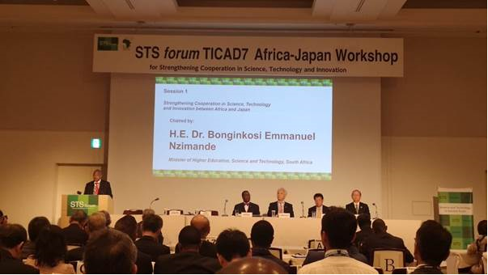
Programme 3
International Cooperation and Resources
Purpose
This Programme aims to strategically develop, promote and manage international relationships, opportunities and S&T agreements that strengthen the NSI and enable an exchange of knowledge, capacity and resources between South Africa and its regional and international partners.
Minister Dr Blade Nzimande at the STS Forum TICAD7 Africa-Japan Workshop

Slide 38
Programme 3 Performance
Quarter 3 achievements - Programme 3: International Cooperation and Resources
Annual Target | Quarter 3 Target | Quarter 3 Progress | Status
34 international policy dialogues and technical exchanges the policy intents of the White Paper on STI by 31 March 2022 | 11 international policy dialogues and technical exchanges to support the policy intents of the White Paper on STI | 27 international policy dialogues and technical exchanges to support the policy intents of the White Paper on STI | Achieved
15 new STI initiatives targeting objectives of Agenda 2063 supported by 31 March 2022 | 2 STI initiatives supporting Agenda 2063 | 2 STI initiatives supporting Agenda 2063 | Achieved
17 new STI initiatives targeting the objectives of the SADC RISDP supported by 31 March 2022 | 6 STI initiatives supporting the SADC RISDP | 9 STI initiatives supporting the SADC RISDP | Achieved
6 STI plans of action implemented with bilateral African partners by 31 March 2022 | 2 STI plan of action implemented with bilateral African partners | 4 STI plan of action implemented with bilateral African partners | Achieved
12 engagements with global science leaders to advance national priorities in multilateral forums by 31 March | 3 engagement with a global science leader | 7 engagement with a global science leader | Achieved
8 new international STI initiatives focused on SDGs supported by South Africa by 31 March 2022 | 1 international STI initiatives focused on SDGs supported by South Africa | 6 international STI initiatives focused on SDGs supported by South Africa | Achieved

Slide 39
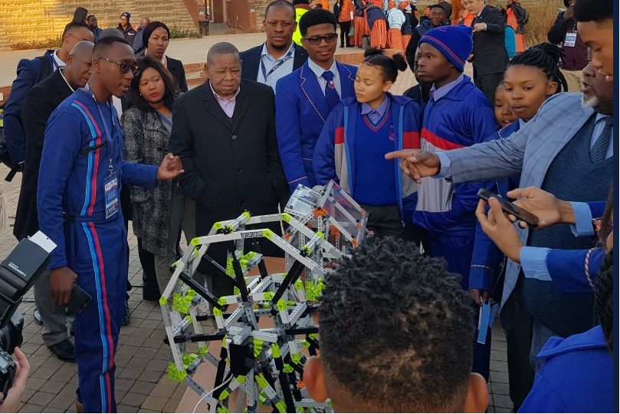

Programmes 4
Research Development and Support
Purpose
Provide an enabling environment for research and knowledge production that promotes strategic development of basic sciences and priority science areas, through science promotion, human capital development, the provision of research infrastructure and relevant research support in pursuit of South Africa’s transition to a knowledge economy.

Slide 40
Programme 4 Performance
Quarter 3 achievements - Programme 4: Research Development and Support
Annual Target | Quarter 3 Target | Quarter 3 Progress | Status
2 000 PhD students awarded bursaries annually as reflected in the reports from the NRF and other relevant entities by 31 March 2022 | 1 800 PhD students awarded an annual bursary as reflected in the reports from the NRF and other relevant entities by 31 December 2021 | 2 474 PhD students awarded an annual bursary as reflected in the reports from the NRF and other relevant entities by 30 December 2021. | Achieved
750 graduates and students placed in DSI-funded work preparation programmes in SETI institutions by 31 March 2022 | 650 graduates and students placed in DSI-funded work preparation programmes in SETI institutions | 1 115 graduates and students placed in DSI-funded work preparation programmes in SETI institutions | Achieved
3 000 researchers awarded research grants through NRF-managed programmes as reflected by the NRF project reports by 31 March 2022 | 2 000 researchers awarded research grants through NRF-managed programmes | 2 897 researchers awarded research grants through NRF-managed programmes | Achieved

Slide 41
Programme 4 Performance
Quarter 3 achievements - Programme 4: Research Development and Support
Annual Target | Quarter 3 Target | Quarter 3 Progress | Status
Production plan for the L-band receivers for the additional 20 MeerKAT antennas approved by SKA SA Project Director 31 March 2022 | SKA SA Project approved progress report with reference to production plan provided by 31 December 2021 | SKA SA Project progress report approved. The production readiness review for the L-band receivers has been concluded and approved by 31 December 2021 | Achieved
Annual target: Launch of the National Recordal System for registration and access to indigenous knowledge by 31 March 2022 | Testing the registration and access applications in a controlled environment by 30 December 2021 | The NRS applications (NIKSO Portal, Pharmacopoeia and NIKMAS) has been successfully tested internally by the CSIR-NGEI team for access and registration on 8, 17 and 19 November 2021 and a further testing for access and registration was conducted in a controlled environment (DSl officials) on 2 and 3 December 2021. The report has been approved by the CD: Science Missions | Achieved
12 strategic and technical engagements between NRF, SACNASP and ASSAf to alignment with national priorities by 31 March 2022 | 3 bilateral engagement reports | 3 bilateral meetings were held in Q3 (NRF, SACNASP and ASSAf) to ensure alignment with national priorities. | Achieved

Slide 42
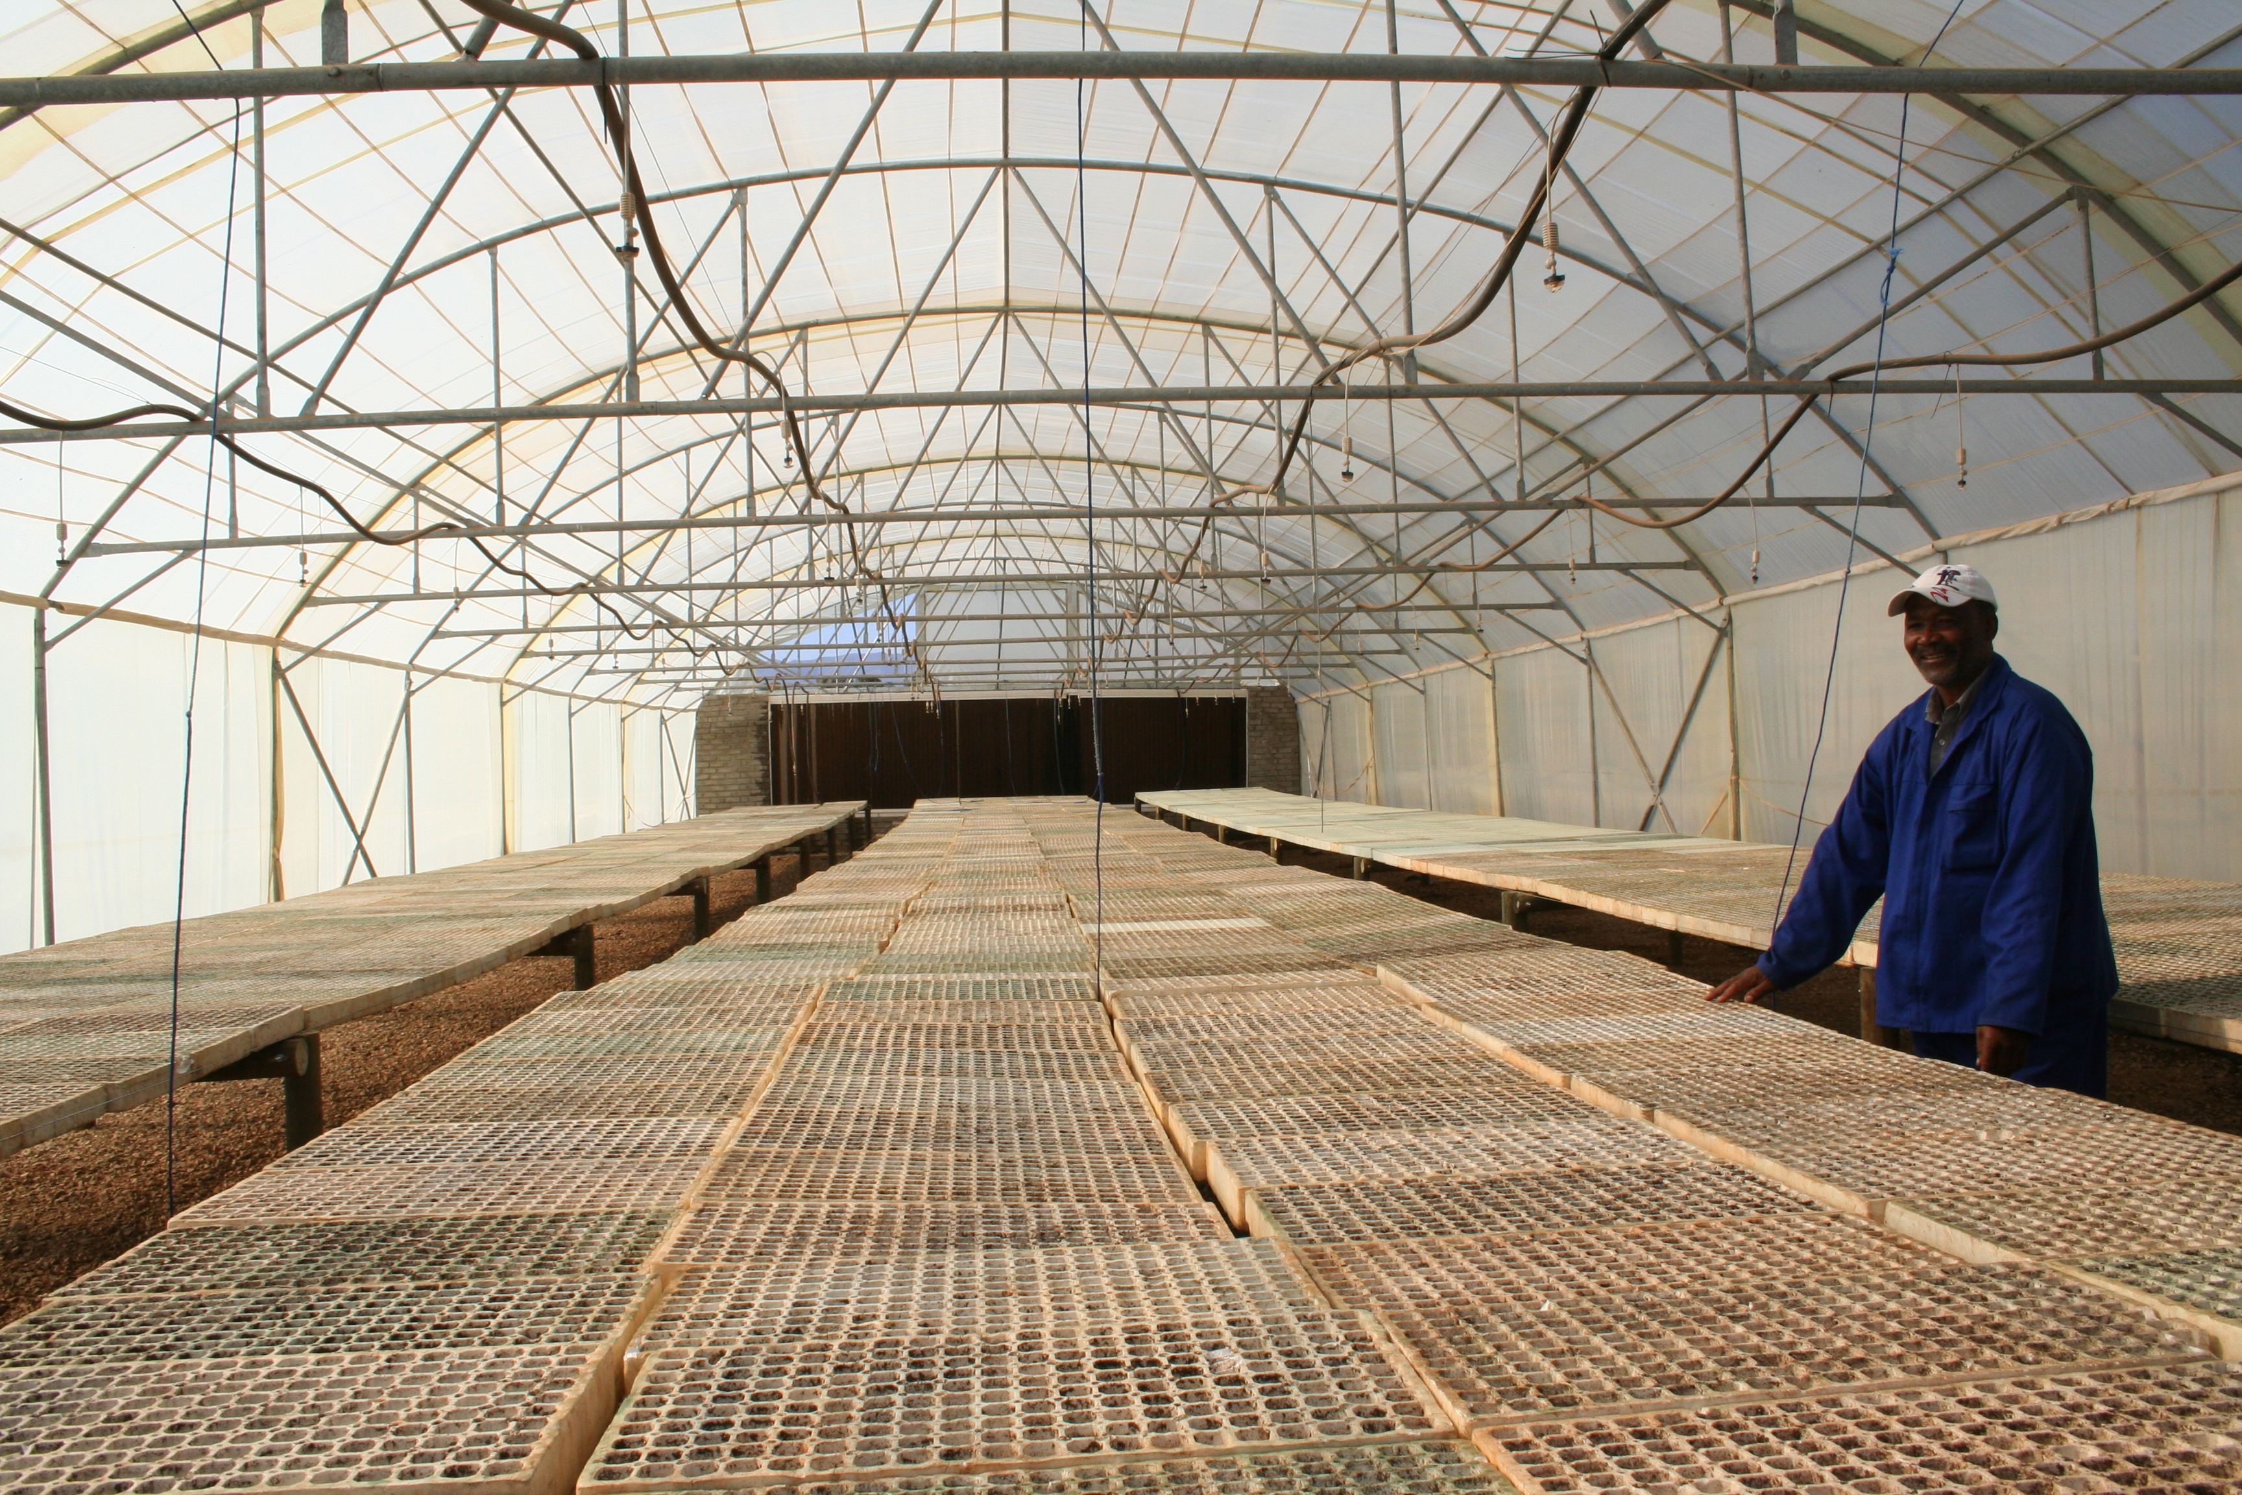

Programme 5
Socio-Economic Innovation Partnerships
Purpose
This Programme enhances the growth and development priorities of government through targeted S&T-based innovation interventions and the development of strategic partnerships with other government departments, industry, research institutions and communities.

Slide 43
Programme 5 Performance
Quarter 3 achievements - Programme 5: Socio-Economic Innovation Partnership
Annual Target | Quarter 3 Target | Quarter 3 Progress | Status
At least 4 knowledge products on innovation for inclusive development published by 31 March 2021 | 3 knowledge products on innovation for inclusive development published | 3 knowledge products on innovation for inclusive development published | Achieved
6 decision-support systems introduced, maintained and improved by 31 March 2022 | Annual work plan approved for 5 decision-support systems | Annual work plan approved for 6 decision-support systems | Achieved
3 learning interventions (seminars/policy round tables) hosted by 31 March 2022 | 3 learning interventions hosted between 01 April 2021 and 31 December 2022 | 4 learning interventions hosted between 01 April 2021 and 31 December 2022. | Achieved
6 statistical reports or policy briefs approved by Exco for publication and/or submitted to Cabinet and/ or disseminated to policy audience by 31 March 2022 | 3 statistical reports approved by Exco for publication and/or submitted to Cabinet and/or disseminated to policy audience | 3 statistical reports approved by Exco for publication and/ or submitted to Cabinet and/or disseminated to policy audience. | Achieved
Knowledge products refer to case studies, policy briefs, technology briefs and research reports.
Decision support interventions help people think about choices they face; they describe where and why choice exists; they provide information about options, including, where reasonable, the option of taking no action.

Slide 44
Underperformance
TARGETS NOT ACHIEVED

Slide 45
Analysis chart of the Unachieved Targets
The below graph shows the unachieved targets per the three previous quarters. One can deduce that the Department’s unachieved targets are increasing and not dropping, which is concerning as there is one quarter left towards the achievements of 2021/22 FY targets.

Slide 46
Classification of reasons for variances due to non / under achievement
Process delays: refers to factors which are outside the control of the DSI and therefore achievement of such targets is mainly dependent on outside circumstances.
Ineffectiveness of implementers: refers to non-achievement due to deficiencies during the implementation phase.
Target formulation deficiencies: refers to targets which were not achieved because of variables which were not foreseen during the target formulation phase.

Slide 47
DSI’s Underperformance Overview
Quarter 3 targets which were not achieved
Quarter 3 Target | Quarter 3 Progress | Reasons for non-achievement | Status | Variance Classification
Alignment of strategic plans and APPs of the DSI and its entities and the CSIR shareholder compact to the decadal plan priorities | In progress, to be finalised by end of financial year | The Inaugural IMC on Science & Innovation, only took place on 24 November 2021, to However, as the content of the Decadal Plan has been approved by Cabinet before that, , it was possible to begin to align the relevant planning instruments to the Decadal Plan and the White Paper. This process will be completed in Q4 when the planning instruments are reviewed and discussed with entities. (The editing and printing of the Final Decadal Plan will be finalised by the end of the financial year). | Not Achieved | Process delays
Launch of 3 CubeSats for MDASat constellation | The 3 CubeSats for the MDASat constellation was not launched | Launch of 3 CubeSats for MDASat constellation were postponed in September 2021 to January 2022 by the launch provider | Not Achieved | Process delays

Slide 48
DSI’s Underperformance Overview
Quarter 3 targets which were not achieved
Quarter 3 Target | Quarter 3 Progress | Reasons for non-achievement | Status | Variance Classification
21 international resource leveraging engagements | 13 international resource leveraging engagements | Limited opportunities were available during the quarter, but the over achievement in the previous two quarters places the programme well on track in achieving the annual target. | Not Achieved | Process delays
82 South African students participating in international training programmes | 48 South African students participating in international training programmes | The underachievement, is due to reporting from international partners mostly becoming available in the 4th quarter. | Not Achieved | Process delays
8 capacity-building initiatives for international cooperation | 4 capacity-building initiatives for international cooperation | Limited global movement are affecting efforts in supporting HDIs, due to insufficient IT infrastructure to support such institutions and individuals | Not Achieved | Process delays
5 600 pipeline postgraduate students awarded an annual bursary as reflected in the reports from the NRF and other relevant entities by 31 December 2021 | 5 356 pipeline students (2 474 Honours/BTech and 2 954 Master's) awarded an annual bursary as reflected in the reports from the NRF and other relevant entities by 31 December 2021. Of these 4 550 ( 85%) are blacks; 3 418 (63,8%) women; 19 (0,8%) people with disabilities ; and 5109 (95,4%) youth. | Q3 Target was under-achieved by 4,4%. Quarterly targets are estimates that cannot be predicted accurately at the start of the year. | Not Achieved | Process delays

Slide 49
DSI’s Underperformance Overview
Quarter 3 targets which were not achieved
Quarter 3 Target | Quarter 3 Progress | Reasons for non-achievement | Status | Variance Classification
(4) Three main STEMI Olympiads and competitions conducted targeting learners in all nine provinces by 31 December 2021 (5) South African Association of Science and Technology Centres conference held by December 2021 | (4) The following three STEMI Olympiads and competitions were conducted: SA Maths Olympiad – was completed by 16 October 2021, National Science Olympiad – was completed by 31 October 2021 Eskom Expo for Young Scientists – national finals conducted on 8 October 2021 (5) Conference postponed to January 2022 - Not Achieved (6) One holiday school and seven weekend support sessions were conducted online - Achieved | All targets were achieved except for the South African Association of Science and Technology Centres conference which was postponed to January 2022 | Not Achieved | Process delays

Slide 50
DSI’s Underperformance Overview
Quarter 3 targets which were not achieved
Quarter 3 Target | Quarter 3 Progress | Reasons for non-achievement | Status | Variance Classification
At 30 industrially relevant knowledge or innovation product added to the industrial development IP portfolio | A further three knowledge and innovation products added taking the total for the year-to-date to eleven (11). | Late submission of information by entities and lack of verification documentation. | Not Achieved | Process delays
Preapproval decisions provided within 90 days on 80% of applications received between 01 July 2021 and 30 September 2021 | Pre-approval decisions provided within 90 days on 53% of applications, (i.e., 18 of 34 applications) received between 1 July 2021 and 30 September 2021 | Although target has still not been reached, there is a steady improvement. The quality of information received from applicants is at times lacking. Lack of automation and staff shortages have an effect on monitoring and processing of applications. | Not Achieved | Process delays
Six strategic and technical engagements | An additional TEB engagement held with HSRC taking the total for the year-to-date to seven. | Register not loaded on alfresco as per the TID’s requirement | Not Achieved | Target formulation deficiencies

Slide 51

2021/22 Q3
FINANCIAL REPORTING

Slide 52
2021/22 Adjustment Budget
Economic classification | Adjusted Budget R’000
Compensation of employees | 363 326
Goods and services | 205 965
Transfers and subsidies | 8 430 994
Payments for capital assets | 5 353
Total | 9 005 638

Slide 53
OVERALL FINANCIAL PERFORMANCE
The department planned to spend R8,214 billion by end of quarter 3.
The actual spending for the period amounted to R6,727 billion (74,7% of the total adjusted budget of R9,005 billion).
This translates to a variance of R1,487 billion or 18.1% of planned expenditure.
The DSI has just concluded a reprioritisation process which includes virements amounting to R168.697 million across Programmes and major items. This will improve spending for the remainder of the financial year.

Slide 54
OVERALL FINANCIAL PERFORMANCE

Slide 55
FINANCIAL PERFORMANCE PER CLASSIFICATION

Slide 56
REASONS FOR VARIANCES AND PROPOSED REMEDIES
Expenditure Category | Reasons for variance | Remedies
Compensation of employees | Delays in filling critical positions The budget cuts effected on the compensation of employees budget affected the filling of positions for the current financial year. The DSI can only feel critical positions that are affordable for the 2022 MTEF period. | 21 vacancies have been advertised and are in the recruitment and selection stage.
Goods and services | The variance is due to slow spending under travel and subsistence, consultancy services, catering and venues and facilities as a result of COVID19 restrictions. | R30.8 million was moved from the item as part of the recently concluded reprioritization process.
Transfers and subsidies | The variance is due to the following: Delays in finalising contracts and slow spending by implementing agencies. | An amount of R137.885 million was moved within transfers from slow spending projects to those having shortfalls as part of the recent reprioritization process.

Slide 57
FINANCIAL PERFORMANCE PER PROGRAMME

Slide 58
Spending on Procurement
  The Total procurement expenditure on goods and services from 1 October 2021 to 31 December 2021 amounted to R22 618 824.
  The procurement expenditure on SMMEs, Black, Women and Youth Owned Companies is depicted below as follows:
TOTAL PROCUREMENT EXPENDITURE | TOTAL EXPENDITURE ON SMME COMPANIES | TOTAL EXPENDITURE ON BLACK COMPANIES | TOTAL EXPENDITURE ON WOMAN OWNED COMPANIES | TOTAL EXPENDITURE ON YOUTH OWNED COMPANIES
R22 618 824 | R10 050 352 | R17 762 688 | R6 504 713 | R1 719 687
% EXPENDITURE ON SMME COMPANIES | % EXPENDITURE ON BLACK OWNED COMPANIES | % EXPENDITURE ON WOMEN OWNED COMPANIES | % EXPENDITURE ON YOUTH OWNED COMPANIES
44,4% | 78,5% | 28,8% | 7,6%

Slide 59
Spending on COVID-19 Procurement
  The total COVID-19 procurement expenditure on goods and services from 1 October 2021 to 31 December 2021 amounted to R234 973.
  The procurement expenditure on SMMEs, Black, Women and Youth Owned Companies is depicted below as follows:
TOTAL PROCUREMENT EXPENDITURE | TOTAL EXPENDITURE ON SMME COMPANIES | TOTAL EXPENDITURE ON BLACK COMPANIES | TOTAL EXPENDITURE ON WOMAN OWNED COMPANIES | TOTAL EXPENDITURE ON YOUTH OWNED COMPANIES
R234 973 | R0 | R0 | R0 | R0
% EXPENDITURE ON SMME COMPANIES | % EXPENDITURE ON BLACK OWNED COMPANIES | % EXPENDITURE ON WOMEN OWNED COMPANIES | % EXPENDITURE ON YOUTH OWNED COMPANIES
0,0% | 0,0% | 0,0% | 0,0%

Slide 60
AVERAGE PAYMENT DAYS OF INVOICES PER MONTH FOR 2019/20 AND 2020/21 FINANCIAL YEARS
Month | Average payment days
 | 2020/21 | 2019/20
April | 12 | 11
May | 8 | 9
June | 12 | 9
July | 11 | 8
August | 10 | 8
September | 9 | 7
October | 8 | 8
November | 11 | 8
December | 7 | 9
Total average number of days | 10 | 9

Slide 61
PERCENTAGE OF INVOICES PAID WITHIN 30 DAYS PER MONTH FOR 2019/20 AND 2020/21 FINANCIAL YEARS
Month | Average payment days |  | Comments
 | 2020/21 | 2019/20
April | 100% | 100%
May | 100% | 100%
June | 100% | 100%
July | 100% | 100%
August | 92.57% | 100% | The department could not process all invoices due to the closure of the building and self-isolation of finance staff as a result of COVID 19 cases.
September | 94.97% | 100% | Few invoices could not be processes because the service provider’s tax matters were not in order and this was only pick-up during the processing of invoices.
October | 100% | 100%
November | 98.87% | 100% | The invoice date was incorrectly captured.
December | 100% | 100%
Average percentage | 97.92% | 100%

Slide 62
PROGRESS ON IMPLEMENTATION OF AUDIT ACTION PLAN

Slide 63
AUDIT PROJECT PLAN AND UPDATE ON PROGRESS TO ADDRESS FINDINGS
FINDING | COMMITMENT | DUE DATE | PROGRESS MADE
Overstatement of number of black emerging farmers benefiting from technology/innovation support programme There was no internal controls over the reconciling of the performance information reported to the supporting Annual Performance Report | The 2021-22 TID will be updated to clearly state that a list of the beneficiaries is needed. • The implementing agencies will be warned in advance that a list of beneficiaries should be included in the annual reports from this year (2021-22) forward. • The number of black emerging farmers will be revised down in the Annual Report as advised by the AG. The Programme had offered to ask the project to compile a full list, a process that would take up to three weeks, but this was deemed to be too late |  | The relevant Director was already informed about the required list that must be submitted as evidence in 2021, when Management had to respond to the AG finding. 2022-23 TID draft is already updated as requested.

Slide 64
AUDIT PROJECT PLAN AND UPDATE ON PROGRESS TO ADDRESS FINDINGS
FINDING | COMMITMENT | DUE DATE | PROGRESS MADE
2.Non-Compliance with the Broad-Based Black Economic Empowerment Ac | The service provider was appointed to do BBBEE assessment. The report will be submitted as soon as the BBBEE assessment is completed. The annual report will be sent also soon as it has been printed by the appointed service provider. The department will also ensure that the submission of the report becomes part of the process of the submission of the annual report | 30 June 2022 | The acting Director Strategy and Planning is in a process of concluding a 3-year service level agreement with appointed verification agency. The DSI assessment report on BBBEE compliance will be made available before the end of the 2022/23 1st Q and thereafter annually with the DSI Annual Report.
3. PIMS was running outdated and unsupported version and operating system version | Management has appointed a service provider to upgrade PIMS from Windows 2008 to 2019. The IS Directorate is also in the process of upgrading from Liferay Portal Community Edition to Liferay Digital Experience Platform (DXP). | 31 March 2022 | The Information Systems Directorate appointed the service provider to upgrade the PIMS system to a later version to resolve the issue of security patches and updates. The upgrade has been completed and the user acceptance testing is currently being conducted

Slide 65
AUDIT PROJECT PLAN AND UPDATE ON PROGRESS TO ADDRESS FINDINGS
FINDING | COMMITMENT | DUE DATE | PROGRESS MADE
4. The Information and Communication Technology continuity plan was still in draft The finalisation of the ICT service continuity plan was delayed by benchmarking review which was undertaken by a service provider on behalf of Department of Science and Innovation (DSI). This was done in accordance with good practice and global standards | The department is working with SITA on the implementation of the service provider recommendations | 31 March 2022 | The development of the ICT continuity plan and ICT disaster recovery strategy is completed and both documents are being taken through the departmental internal approval structures.

Slide 66
Dankie
Enkosi
Ha khensa
Re a leboga
Ro livhuwa
Siyabonga
Siyathokoza
Thank you

