Slide 1
PRESENTATION PCD&MV FINAL Q3 & PRELIMINARY Q4 PERFORMANCE INFORMATION REPORT (NON-FINANCIAL INFORMATION) (JANUARY – MARCH 2020)
Presented by: ADG Lt Gen (rtd)DM Mgwebi
Date: 03 June 2020

Slide 2
PRESENTATION OUTLINE
Mandate of the Department
DMV Approved Budget Programme Structure
Non-Financial Performance Information
Programme 1: Administration
Programme 2: Socio-Economic Support (SES)
Programme 3: Empowerment and Stakeholder Management (ESM)

Slide 3
MANDATE OF THE DEPARTMENT
Legislative mandate derived from the Military Veterans Act 18 of 2011:
To provide national policy and standards on socio-economic support to military veterans and their dependants, including benefits and entitlements to help realise a dignified, unified, empowered and self-sufficient community of military veterans.

Slide 4
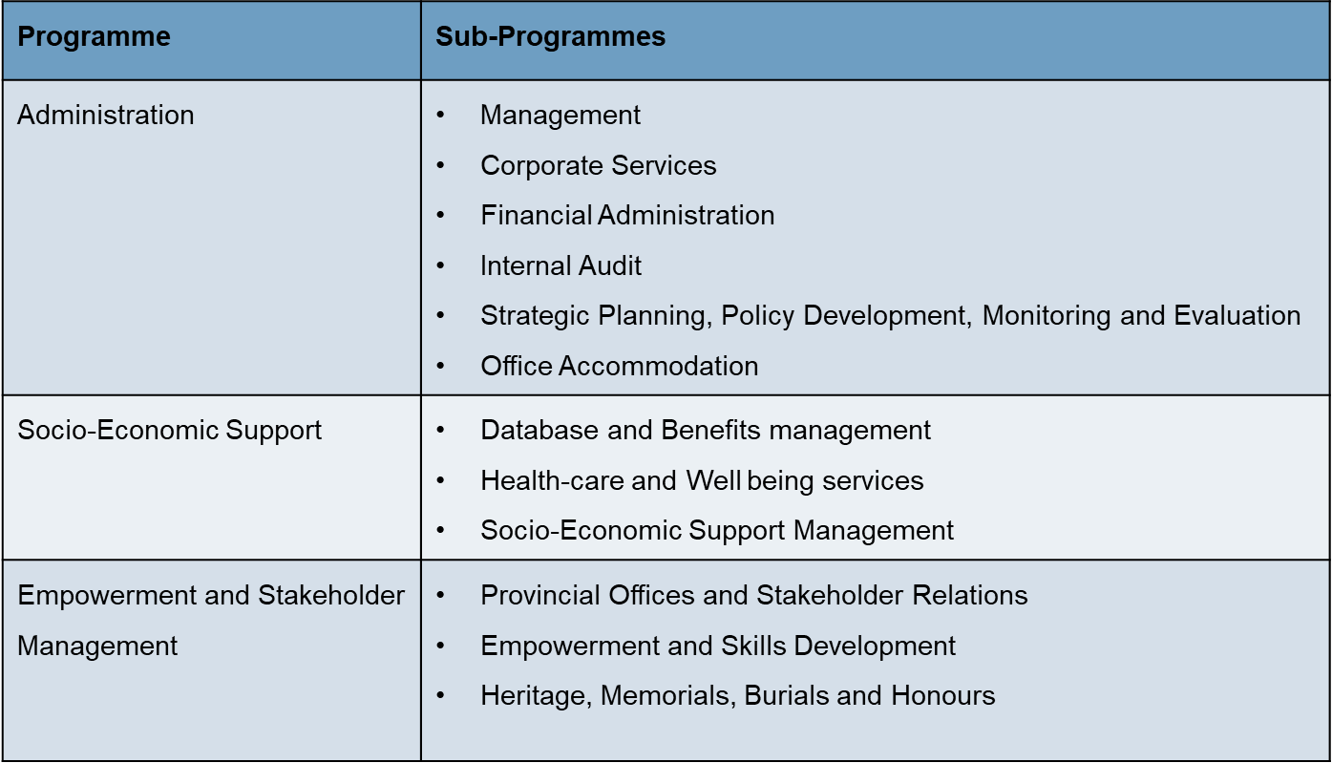
DMV APPROVED BUDGET PROGRAMME STRUCTURE

Slide 5
EXECUTIVE SUMMARY: OVERALL PERFORMANCE ANALYSIS
The department planned to achieve 20 performance areas over the quarter under review. Of the 20 targeted performance areas, 6 targets were achieved which constitute to 30% overall achievement for Q4. underneath is the comparative analysis of the non-financial performance per programme.
 | Admin |  |  |  | SES |  |  |  | ESM |  |  |  | DMV Overall
 | Q1 | Q2 | Q3 | Q4 | Q1 | Q2 | Q3 | Q4 | Q1 | Q2 | Q3 | Q4 | Q1 | Q2 | Q3 | Q4
Targets Planned | 5 | 5 | 5 | 7 | 5 | 5 | 5 | 8 | 3 | 3 | 4 | 5 | 13 | 13 | 14 | 20
Targets achieved | 1 | 1 | 1 | 3 | 1 | 1 | 3 | 1 | 1 | 2 | 3 | 2 | 3 | 4 | 7 | 6
Performance rating | 20% | 20% | 20% | 43% | 20% | 20% | 60% | 13% | 33% | 67% | 75% | 40% | 23% | 31% | 50% | 30%
Q4 Departmental Performance = No. of targets achieved x 100 Total no of targets = 6 x 100 20 = 30% DMV recorded 30% during quarter 4.

Slide 6
THE LEGEND COLOUR CODING
Target achieved | 95% - 100%
Target partially achieved | 50% - 94%
Target not achieved | 0% - 49% (less than 50%)

Slide 7
PERFORMANCE ANALYSIS: PROGRAMME 1 - ADMINISTRATION

Slide 8
PROGRAMME 1: ADMINISTRATION PERFORMANCE INDICATORS AND TARGETS (1)
PPI | Performance Indicator | Annual Target 2019/20 | Q1 Target as per APP | Q1 Output – Validated | Q2 Target as per APP | Q2 Output – Validated | Q3 Target as per APP | Q3 Output – Validated | Q4 Target as per APP | Q4 Output – Preliminary | Deviation | Comments |  | Overall progress of indicator (Green, Amber or Red)
 |  |  |  |  |  |  |  |  |  |  |  | Reason for Deviation | Corrective Action
PPI: 101 | Percentage representation of women at SMS level. | 50% | - | - | - | - | - | - | 50% | 50% | - | - | -
PPI: 102 | Percentage of approved Communication Strategy activities implemented. | 100% | 100% | 55% | 100% | 60% | 100% | 70% | 100% | 70% | -30% | The publication was only delivered in March 2020 | Have set up an annual publication plan with SCM and timelines of delivery.
PPI: 103 | Percentage of cases from the Presidential Hotline resolved. | 100% | 100% | 93.7% | 100% | 93.8% | 100% | 96% | 100% | 96.6% | -3.4% | 11 cases where not resolved during the period under review | Open ageing calls will be prioritized and treated as project with time frame
PPI: 104 | Develop a fully Integrated Database Management System (DBMS). | Integration of benefits & external entities. | Developed Registration Module, integrated with 4 benefits and 1 external stakeholder | The target was not achieved as planned. | Developed Registration Module, integrated with 7 benefits | The department met with DTPS & SITA, wherein it was agreed that a plan to complete the project must be developed | Developed Registration Module, integrated with all the benefits. | The target was not achieved as planned. | Developed DBMS, integrated with all the benefits | SITA has not been able to deliver the project. | Inability to Develop Registration Module, integrated with 7 benefits. | The Department has contracted SITA to develop and implement the IDBMS, however SITA has not been able to deliver the project. | The DTPS advised the Department to ensure adherence to the SITA Act in implementing the IDBMS. The ADG to meet with SITA CEO to finalize the sourcing strategy.

Slide 9
PROGRAMME 1: ADMINISTRATION PERFORMANCE INDICATORS AND TARGETS (2)
PPI | Performance Indicator | Annual Target 2019/20 | Q1 Target as per APP | Q1 Output – Validated | Q2 Target as per APP | Q2 Output – Validated | Q3 Target as per APP | Q3 Output – Validated | Q4 Target as per APP | Q4 Output – Preliminary | Deviation | Comments |  | Overall progress of indicator (Green, Amber or Red)
 |  |  |  |  |  |  |  |  |  |  |  | Reason for Deviation | Corrective Action
PPI: 105 | Percentage of legitimate invoices paid within 30 days of receipt. | 90% | 90% | 73.3% | 90% | 75.9% | 90% | 68.0% | 90% | 58.4% | -31.6% | The variance of 31.4% was mainly attributable to payments related to Travel with Flair where there was a catch up on long outstanding invoices. | An invoice tracking system was introduced however, capacity or volume of transactions causes delays.
PPI: 106 | Number of liberation struggle history research outputs. | 5 | 1 | 1 | 2 | 2 | 1 | 0 | 1 | 2 | 1 | The over achievement was as a result of the planned output targeted for Q3 but got delivered in Q4. | -
PPI: 107 | Percentage representation of Persons with Disability | 2% | - | - | - | - | - | - | 2% | 1.4% | -0.6% | There was no applications received from prospective persons living with disabilities and no targeted recruitment was done. | Target recruitment of PwD is being embarked upon. Consultation with relevant stakeholders was done and the Department will continuously engage.

Slide 10
PERFORMANCE ANALYSIS: PROGRAMME 2 - SES

Slide 11
PROGRAMME 2: SES PERFORMANCE INDICATORS AND TARGETS (1)
PPI | Performance Indicator | Annual Target 2019/20 | Q1 Target as per APP | Q1 Output – Validated | Q2 Target as per APP | Q2 Output – Validated | Q3 Target as per APP | Q3 Output – Validated | Q4 Target as per APP | Q4 Output – Preliminary | Deviation | Comments |  | Overall progress of indicator (Green, Amber or Red)
 |  |  |  |  |  |  |  |  |  |  |  | Reason for Deviation | Corrective Action
PPI: 201 | Total number of military veterans with access to Healthcare services | 18 000 (1000) | 17 250 (250) | 17 351 (285) | 17 500 (250) | 17 691 (340) | 17 750 (250) | 18 069 (378) | 18 000 (250) | 18 387 (318) | 387 (68) | Healthcare is in high demand | Continuous monitoring and budget alignment
PPI: 202 | Number of military veterans provided with newly built houses per year | 300 | 50 | 13 | 50 | 42 | 100 | 329 | 100 | 57 | -43 | The target was reached in quarter 3. Improved coordination between different role players. | Sustain the relationship with different stakeholders and pay attention to the non performing provinces such as Free State and KZN.
 |  | 100 bond rescue | 25 | 7 | 25 | 0 | 25 | 4 | 25 | 13 | -12 | Fewer application received for considerations. | The benefit is demand driven. To review target in the next financial year.
PPI: 203 | Number of military veterans who are verified and captured on the National Military Veterans’ Database | 30 000 | 7 500 | 1 268 | 7 500 | 1 437 | 7 500 | 37 421 | 7 500 | 766 | -6 734 | 766 were updated instead of 7,500 as the walk-ins in the department. The target was reached in quarter 3 together with DoD HR, hence the quarter 4 actual was less than the target. | -

Slide 12
PROGRAMME 2: SES PERFORMANCE INDICATORS AND TARGETS (2)
PPI | Performance Indicator | Annual Target 2019/20 | Q1 Target as per APP | Q1 Output – Validated | Q2 Target as per APP | Q2 Output – Validated | Q3 Target as per APP | Q3 Output – Validated | Q4 Target as per APP | Q4 Output – Preliminary | Deviation | Comments |  | Overall progress of indicator (Green, Amber or Red)
 |  |  |  |  |  |  |  |  |  |  |  | Reason for Deviation | Corrective Action
PPI: 204 | Number of bursaries provided for military veterans and their Dependants per year | 7 466 | - | - | - | - | - | - | 7 466 | 4 447 | -3 019 | Students previously funded by DMV were referred to NSFAS. There was no intake for new applicants during 2019/2020 for Tertiary education. There are still a large number of outstanding documents which have delayed the finalisation of the applications. Adjudication and capturing is still to continue until 31 March 2020. Fraud cases under investigation thus all these factors contributing to the variance. | Review future target in education support.
PPI: 205 | Number of military veterans provided with compensation payment | 300 | 75 | 34 | 75 | 52 | 75 | 59 | 75 | 6 | -69 | Assessments were conducted to 25 military veterans however, the Medical Panel could not sit due to non-availability of panel members and the Covid-19 responsibility. Final adjudication could not be held due to none availability of Doctors. | The final panel meeting has been postponed to be held in Q1 of 2020/21FY. Payment to be done in Q1

Slide 13
PROGRAMME 2: SES PERFORMANCE INDICATORS AND TARGETS (3)
PPI | Performance Indicator | Annual Target 2019/20 | Q1 Target as per APP | Q1 Output – Validated | Q2 Target as per APP | Q2 Output – Validated | Q3 Target as per APP | Q3 Output – Validated | Q4 Target as per APP | Q4 Output – Preliminary | Deviation | Comments |  | Overall progress of indicator (Green, Amber or Red)
 |  |  |  |  |  |  |  |  |  |  |  | Reason for Deviation | Corrective Action
PPI: 206 | Number of military veterans and their dependants provided with counselling and treatment | 1 000 | 250 | 144 | 250 | 132 | 250 | 207 | 250 | 160 | -90 | Challenge with receipt of reports from SAMHS, always retrospective therefore distorts quarterly reporting. | Continuous engagement with SAMHS.
PPI: 207 | Approved policy on military veteran’s pension benefit | Policy on military veteran’s Pension benefit approved | - | - | - | - | - | - | Policy on military veteran’s Pension benefit approved | Draft Policy on pension benefit was developed | No approved policy | Intense consultations required before sign off. | The Policy will be finalized in Q2 of 2020/21FY.
PPI: 208 | Approved policy on military veteran’s transport benefit | Policy on military veteran’s transport benefit approved | - | - | - | - | - | - | Policy on military veteran’s transport benefit approved | Policy Process initiated | No approved policy | Intense consultations required before finalizing the draft policy. | Policy will be finalized in Q2 of 2020/21FY.

Slide 14
PERFORMANCE ANALYSIS: PROGRAMME 3 - ESM

Slide 15
PROGRAMME 3: ESM PERFORMANCE INDICATORS AND TARGETS
PPI | Performance Indicator | Annual Target 2019/20 | Q1 Target as per APP | Q1 Output – Validated | Q2 Target as per APP | Q2 Output – Validated | Q3 Target as per APP | Q3 Output – Validated | Q4 Target as per APP | Q4 Output – Preliminary | Deviation | Comments |  | Overall progress of indicator (Green, Amber or Red)
 |  |  |  |  |  |  |  |  |  |  |  | Reason for Deviation | Corrective Action
PPI: 301 | Number of private sector companies and state of organs in agreements with the Department of Military veterans | 4 | - | - | - | - | 1 | 4 | 3 | 0 | -3 | The target was reached in Q3 | -
PPI: 302 | Number of military veterans and their dependants provided with approved funding for skills development programmes | 5 500 | 1 000 | 208 | 1 500 | 137 | 1 500 | 204 | 1 500 | 351 | -1 149 | Demand far below set target. Lack of capacity and resources; competing priorities. | Review of target in next cycle. More proactive work approach.
PPI: 303 | Number of military veterans’ businesses provided with access to empowerment opportunities | 110 | 40 | 36 | 50 | 81 | 70 | 152 | 110 | 163 | 53 | Proactive approach and initiatives by the Unit. | -
PPI: 304 | Percentage of approved burial claims paid within 30 days of receipt | 100% | 100% | 98.9% | 100% | 100% | 100% | 100% | 100% | 97% | -3% | No proper record management system. 3 files were lost and no back-up. | Implement proper record management system as recommended by record management policy.
PPI: 305 | Number of military veterans memorial sites erected per year | 3 | - | - | - | - | - | - | 3 | 0 | -3 | The task has dependencies that are beyond the Department | Successful buy-in of external role players, e.g. DSAC and DPWI.

Slide 16
THANK YOU

