Slide 1
NATIONAL SCHOOL NUTRITION PROGRAMME (NSNP)
DBE Presentation to the Portfolio Committee on Basic Education
16 May 2023

Slide 2
BACKGROUND OF THE NSNP
NSNP is a key poverty alleviation programme of government to address hunger, malnutrition and micronutrient deficiencies in learners
A key pillar of the Care and Support for Teaching and Learning Framework that seeks to address barriers to teaching and learning
NSNP key objective is to enhance learning capacity and give access to education.
In 2002 the programme transferred from Department of Health to Department of (Basic) Education (only primary schools)
Between 2009 – 2011 the Inclusion of Secondary Schools following recommendation by the Financial and Fiscal Commission
Since inception, NSNP Menu has evolved from serving a cold meal (bread and vitamin C enriched drink) to a warm cooked meal (variety in protein, starch, vegetable/fruit)
2

Slide 3
NSNP CONDITIONAL GRANT FRAMEWORK
Aim to provide meals to all learners in:
Q 1-3 schools
Special schools
Identified Q 4&5 (According to available resources)
Targeting
Budget Distribution:
Feeding Minimum (97%)
Meal cost per learner
5% increase for primary schools
3% increase for secondary
Min R1640 honorarium for VFHs
Far-flung farm and rural schools: higher cost (incl transport cost)
3

Slide 4
NSNP CONDITIONAL GRANT FRAMEWORK
Feeding requirements
Green, yellow & red fresh vegetables/fruits served daily.
Responsibilities of provinces
Implementation of NSNP
Payment schedule
Provinces that transfer funds to schools:
A variety of protein-rich foods served in line with approved menu options.
Soya mince meeting approved specifications served only once a week.
Canned pilchards/mackerel/sardines served at least once a week.
Seasoning should be provided for all meals.
UHT full cream milk or pasteurised maas served once a week.
Development and implementation of business plans
Provide human resource capacity at all relevant levels
Quarterly reports
Transfer schedules + Reconcile expenditure by schools (EC, FS, NC, NW)
06 April 2023, 14 June 2023, 07 September 2023, 08 November 2023, 07 December 2023
06 April 2023, 20 July 2023, 12 October 2023, 08 November 2023 and 23 January 2024
Provinces that procure via tender:
4

Slide 5
NSNP IMPLEMENTATION SUPPORT BY DBE
Research,
policy review, development of guidelines
Improvement Plan
Smallholder farmers
Breakfast concept
UIF
Food Safety
Facilities assessment
Improve practices towards compliance
Training
Capacity Building
Meal planning
Financial management
School gardens
Advocacy
Inter-sectoral forums
Education in various media platforms
National and Provincial Awards
Facilitate Partnerships
Private and public sector, NGOs.
5

Slide 6
OVERVIEW OF THE NSNP
The programme provides nutritious meals to 9.6 million learners on school days - A nutritious meal is made up of: quality of food items used, proper preparation and cooking methods and quantities served
Funded through a Conditional Grant – FY2023/24 budget = R9.8 billion.
Additional budget over the 2023-2025 Medium Term Expenditure Framework (MTEF) of R1.5 billion to mitigate increased food inflation, spikes in petrol prices, high learner numbers and improved menu options. Also to extend the provision of breakfast.
According to the NSNP Conditional Grant Framework:
DBE has a key responsibility for oversight of compliance with National Treasury Regulations including the NSNP Conditional Grant Framework as funds are disbursed to Provincial Education Departments to procure goods and services to implement the NSNP.
Monitoring and support as a key responsibility at provincial and district levels.
6

Slide 7
NSNP DASHBOARD
 | EC* | FS* | GP | KZN | LP | MP | NC* | NW* | WC | Total
Number of schools reached | 5728 | 790 | 1074 | 5446 | 3636 | 1620 | 483 | 1354 | 1025 | 21 156
Number of learners reached | 1,626 m | 585,100 | 1,150 m | 2,351 m | 1,660 m | 920,110 | 210,222 | 677,,078 | 509,713 | 9,689 m
Number of VFHs | 12583 | 3395 | 5592 | 14675 | 10640 | 5287 | 1660 | 4535 | 2947 | 61 314
2023/24 Budget- Rs | 1,647 b | 535 m | 1,094 b | 2,089 b | 1,665 b | 886 m | 244 m | 621m | 497m | 8,279 b
Awarding of contracts
Date of award | Schools procure | Schools procure | 01 Jul 2020 | Not yet submitted | Not yet submitted | 07 Oct 2017 | Schools procure via annual district contracts | Schools procure via short-term contracts | 01 Jan 2023
Contract duration | Schools procure | Schools procure | 3 yrs |  |  | 3 yrs – renew-ed |  |  | 3
* Notes: Provinces that transfer funds directly to schools for procurement of food. EC and NW schools have separate bank accounts.
7

Slide 8
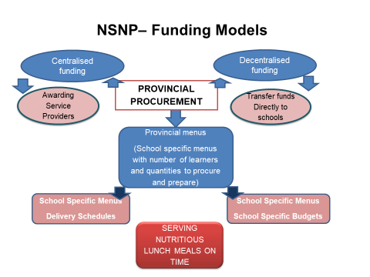
CURRENT NSNP PROCUREMENT MODELS
Source: FUEL

Slide 9
NSNP MENU
Menu specifications as per Grant Framework in line with the SA Based Dietary Guidelines of NDoH;
Benchmarked at 25 – 30% per meal of the children’s recommended daily allowance(RDA)
Specifies daily intake of protein, starch, fruit and veg
Menu Committee (incl PEDs) – annual reviews for costing and to improve the quality
9

Slide 10
THE NSNP EVALUATION
In 2016, an Implementation Evaluation of the NSNP was jointly undertaken with the Department of Planning, Monitoring and Evaluation (DPME)
Recommendations to improve menu:
To improve energy uptake: develop a model for providing breakfast at the start of the school day
- Improve the protein alternatives served and include a variety for a 5 day menu cycle
10

Slide 11
DIVERSIFYING PROTEIN PROVISION: BACKGROUND
NSNP old menu constitutes protein variety (soya, beans, canned pilchards, UHT milk / maas) – repeat of pilchards or sugar beans to complete 5 day cycle
Processed chicken livers – approached National Regulator for Compulsory Specifications (NRCS) for a database of canneries, approval of new product
It is nutrient dense (high in Iron, Zinc, Vitamin A as well as High Biological Value Protein); with food safety consideration

Slide 12
PROCESSED CHICKEN LIVER: HOW IT STARTED
2016/17 NSNP EVALUATION
RECOMMENDATIONS
Menu improvement
Protein alternative
Increase energy uptake
2017/18
PROTEIN IMPROVEMENT PROJECT
Researched on:
1. Nutrient
density
2. Cost
3. Shelf life
4. Effect of heat
2018/19 PILOT
DTIC Website used to source canneries
Soya manufacturers meeting
Product development
Budget tested
WC and GP piloted the canned chicken livers

Slide 13
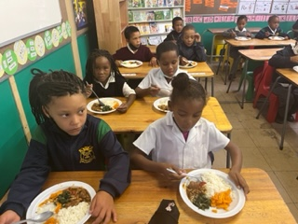
CHICKEN LIVER PROJECT IN PEDs
Developed with manufacturers processed chicken livers to provide good quality protein with Vitamin A and Iron
Currently three manufacturers engaged jointly with NRCS
GP and WC piloted and rolled out chicken liver (2018/19)
PEDs phasing-in approach in targeted districts/schools
13

Slide 14
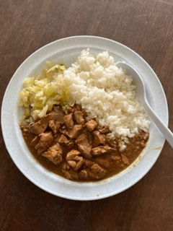
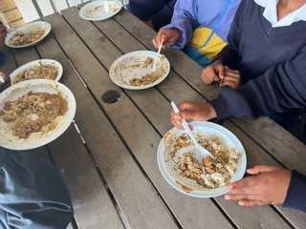
PROCESSED CHICKEN LIVERS PEDs PHASED-IN APPROACH DURING FY2023/24
All provinces phasing in processed chicken livers;
PEDs FY23/24 roll-out:
GP, FS and WC = in all schools
EC, KZN, LP, MP and NW = selected schools and districts
NC = all secondary schools

Slide 15
SCHOOL BREAKFAST
Research evidence is clear - breakfast has positive effects on immediate cognitive well-being.
It is effective in supporting learner well-being, promotes punctuality and attendance.
Tiger Brands Foundation (TBF) “Evaluation study of the NSNP and TBF in-school breakfast programme in Eastern Cape” (2015) suggests, lunch and breakfast combined provide nutrients to protect the most vulnerable children from undernutrition
Breakfast menu: fortified cooked porridge, sorghum maize
Collaborations with private sector on breakfast provision
FY2023/24 state of readiness of PEDs for breakfast roll-out

Slide 16
PEDs FY2023/24 ROLL-OUT & STATE OF READINESS/PHASED APPROACH
PED | SCHOOLS
EASTERN CAPE | 4 052 Primary School/Combined Schools
GAUTENG | ALL
FREE STATE | ALL
KWAZULU NATAL | All Primary Schools
LIMPOPO | 2 314 Primary Schools
MPUMALANGA | 93 Primary Schools + 47 Secondary Schools
NORTH WEST | 300 schools
NORTHERN CAPE | 90 103 learners in Primary Schools + 47 555 learners in Secondary Schools
WESTERN CAPE | ALL

Slide 17
PARTNERSHIPS
Long-standing partnerships serving breakfast and complements the NSNP meal;
To date the Department has entered into formal partnerships with the following for in-school breakfast programmes
Kellogg's SA
PepsiCo/Pioneer Foods
Tiger Brands Foundation
Nestle
Siqalo
17

Slide 18
FOOD SAFETY IN NSNP
A key priority as the sector adopts zero tolerance on food contamination and poisoning in schools;
To mitigate - collaboration with DoH in district based food safety teams
DBE continues to support PEDs through facilitation of annual Food Safety Workshops aimed at:
continuously raising awareness and promoting proper food handling practices e.g. storing food on pallets
accredited food safety and hygiene training
kitchen compliance with food safety regulations
18

Slide 19
WAREHOUSE MONITORING
Warehouses linked to NSNP in provinces are monitored to ensure compliance to health regulations on food safety
NSNP through provincial and district food safety teams collaborates with local municipalities and their Environmental Health Practitioners (EHPs) to monitor and certify warehouses for compliance
Ongoing training to service providers on safe and hygienic warehouse management
19

Slide 20
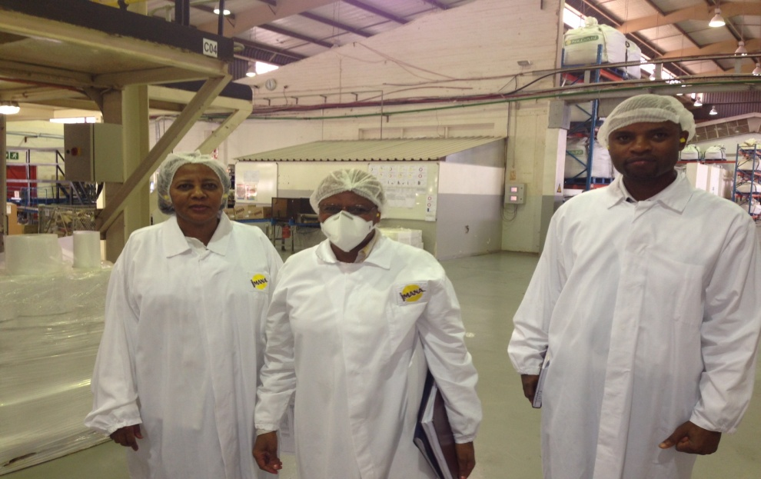
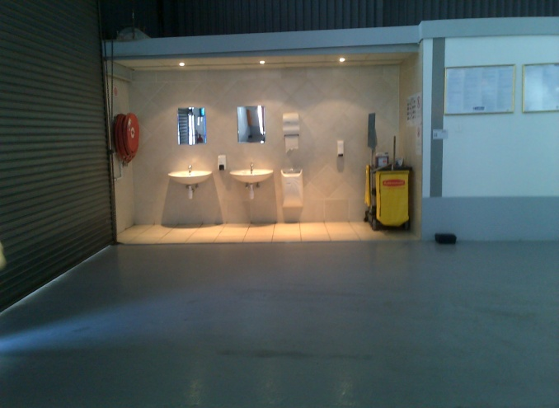
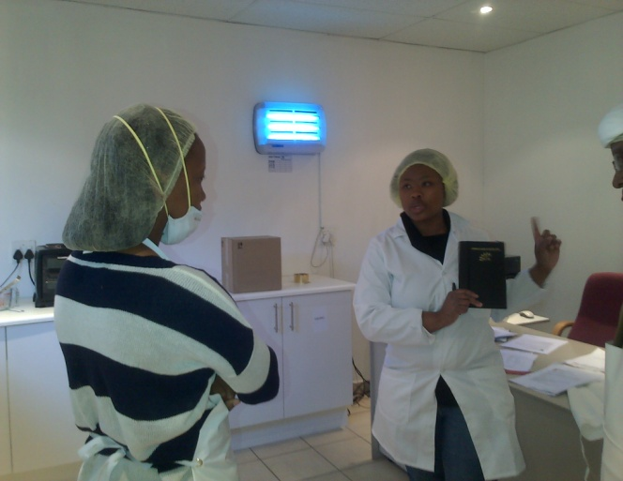
WAREHOUSE MONITORING
Protective clothing
Sterile clean factory
Hand washing area
Lab for quality assurance
Sensory evaluation
20

Slide 21
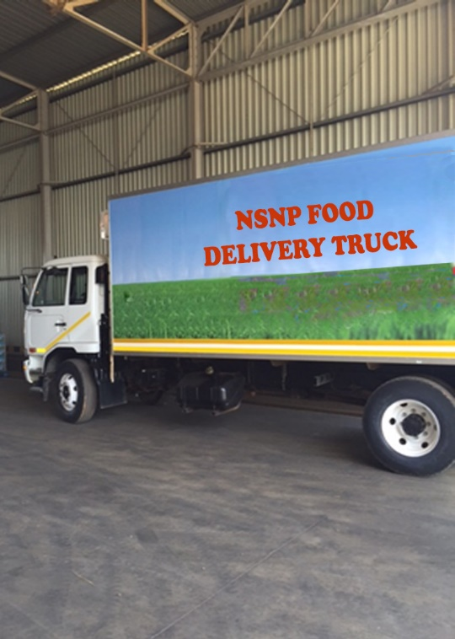
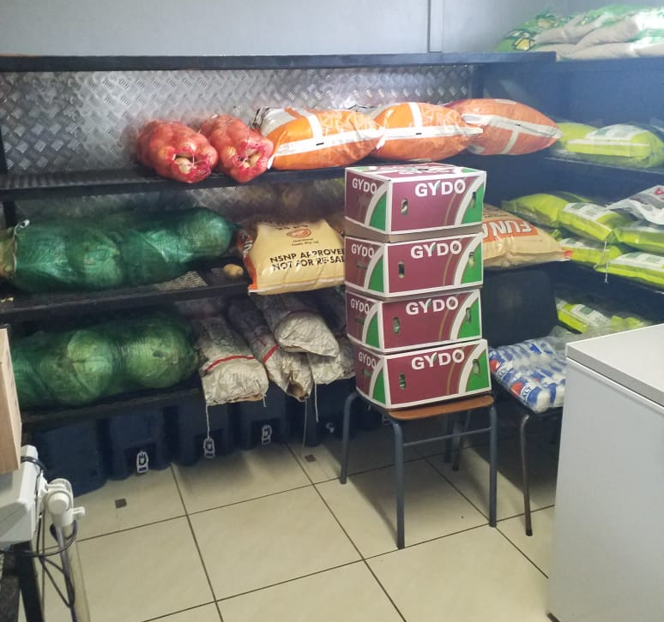
DELIVERY AND STORAGE AT SCHOOL
21

Slide 22
Monitoring, Response and Reporting (MRR)
Aims to:
Collect the right information (Monitor)
Analyse, understand and share this information in the right way (Report)
Use this information to improve performance (Respond)
Key Performance Indicator (KPI) > “nutritious meals served on time”
Nutritious meals (variety/3 food groups)
Serving portions
Health and safety
Record keeping
22

Slide 23
BUT WE CAN DO BETTER

Slide 24
NSNP IMPLEMENTATION INEFFICIENCIES- PRESSURES ON THE MEAL COST
The impact of COVID-19 pandemic has exacerbated hunger in communities. Covid unemployment and food insecurity increased the demand for food and school nutrition meals across all nine provinces
Pressure to include additional indigent learners in Q4-5
Additional pressure to include ECD
Steep food inflation that outstrips consumer price inflation (CPI)
Lack of an integrated logistics management system increasing the cost of food deliveries. Further aggravated by recent escalation in the cost of fuel
No benefits from economies of scale
Procurement from retailers, not manufacturers
Pilfering and corruption in the process due to poor stock control and management
24

Slide 25
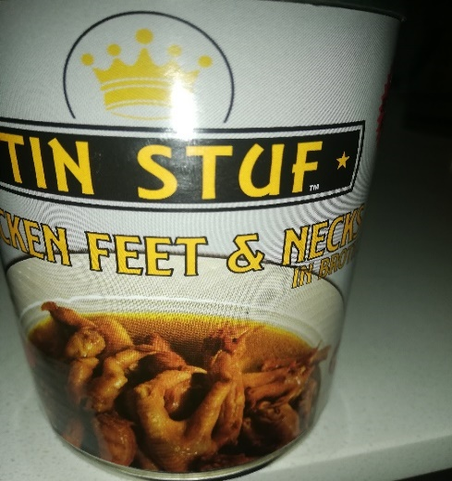
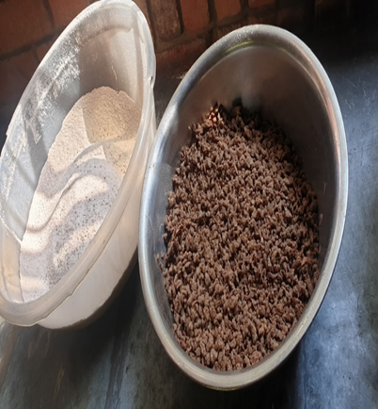
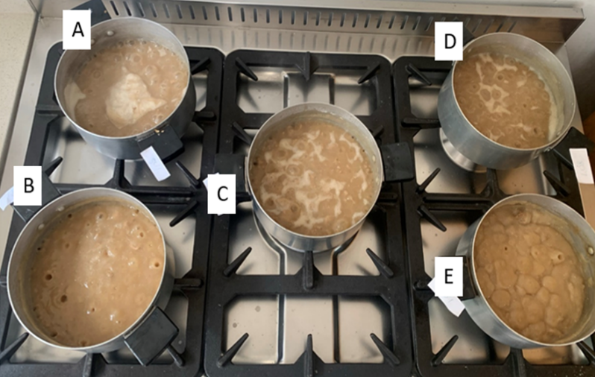
NSNP IMPLEMENTATION INEFFICIENCES: QUALITY CONTROL
Quality: Poor quality protein food items
Non-nutritious food items Additives to be thrown away Sub-standard soya mince cooked with additives
Quantities: Under delivery of protein food items
Short delivery of fresh fruit or vegetables
Poor quality food delivered
No batch management
25

Slide 26
MODERNISATION OF THE NSNP
Develop a new model to take advantage of economies of scale
Modern Stock Management System - right quantity, quality
Better Quality Assurance
Better compliance to food quality standards
Modern Integrated Logistics System - high quality inputs (fruit & veg) on regular basis; efficient warehouse and delivery system
Extensive Local Economic Empowerment - focus on women, youth and people with disability
Introduction of ‘home grown school feeding’ - direct link with smallholder farmers
26

Slide 27
CONCLUSION
A flagship poverty alleviation programme of government
School meals provide a critical safety net for vulnerable children and households
The DBE is committed to improve the quality of the meals we provide, as well as extending the reach of the programme.
27

Slide 28
Thank you

