Slide 1
COIDA amendment Bill
Richard Spoor Inc. Attorneys (“RSI”)
Parliament
28 April 2021
Richard@rsinc.co.za / Alex@rsinc.co.za / George@rsinc.co.za

Slide 2
Introductions
RSI is a public-interest law firm that focuses on industrial human rights law, e.g. occupational health and safety and related compensation aspects.
RSI is most well known for its work in obtaining compensation on behalf of sick gold miners with Silicosis (pneumoconiosis) in the largest class action in the history of South Africa. The firm specialises in COIDA, ODMWA, MHSA, OHSA and related common law aspects.
The firm was founded by Mr Richard Spoor BA LLB UCT and is today joined by Mr Alexander Spoor BA LLB LLM UCT as a director.
The firm also employs Mr George IB Kahn BSc UCT BSocSc LLB Rhodes as a senior associate and several other attorneys, candidates and paralegals.
The firm has offices in Parktown, Johannesburg, and White River, MP.
The firm frequently represents clients on a pro bono basis.

Slide 3
Agenda
Framing the COIDA within the constitutional context of occupational health and safety law and policy.
Written submissions:
Regulated Assessment of Permanent Disability - Spoor
Discouragement of Legal Representation - Kahn
Privatisation of Social Security – Spoor
Explanatory underlying jurisprudence and further challenges:
“The Meat Chart”
Privatisation
Kafkaesque violence
The Great Compromise of no fault compensation
Way forward:
Rationalising legislation dealing with the prevention and failures of occupational health and safety
Re-defining the concept of permanent disability
Empirical Problems encountered with COIDA

Slide 4
Correctly framing COIDA: A Constitutional Statute
COIDA is a constitutional statute that brings effect to section 27(1)(c) of the Bill of Rights – Molefe v Compensation Commissioner [2007] ZAGPHC 365 (25 September 2007) & Murugan v Minister of Labour and Others [2018] ZAKZDHC 25 (26 April 2018). Disability Social Security is a BASIC RIGHT that carries constitutional damages in certain cases of non-payment – MEC for the Department of Welfare v Kate [2006] ZASCA 49 (30 March 2006).
COIDA is the one side of the OCCUPATIONAL HEALTH AND SAFETY COIN, together with ODMWA – the other side being occupied by the MHSA, OHSA and the common law.
COIDA is also an instrument designed to ensure that no person is unfairly discriminated against because of their occupational disability when it does occur - Section 9(3) of the Bill of Rights, read with subsections 9(4)&(5). An injured worker who has lost an arm at the shoulder is 65% permanently disabled but 35% able still, and an employer can receive an experienced employee at 35% of the earnings – in theory.

Slide 5
Written submissions
summarised

Slide 6
Regulated Assessment of Permanent Disability
The current Bill seeks to grant the Minister the authority to codify the strict mechanism by which section 49(2) awards are made and their percentages, negating a broader discretion that presently exists.
This will made it harder to challenge inequitable awards.
Presently the courts have held that circulars are not law, and must be judicially considered against the case’s circumstances.
In some cases, a slavish application of a circular will result in an injustice – i.e. 24 month period before a section 49(2) assessment.
In other cases, a circular includes arbitrary provisions that nobody can explain or justify, and always tend to act to the detriment of the worker or their widow, i.e. 65% PD cap on mental illnesses.

Slide 7
Discouragement of Legal Representation
The current Bill seeks to restrict the awarding of legal costs to those of a Magistrate’s Court tariff. Currently they are whatever is deemed equitable by the presiding officer, similar to the Labour Court, and including High Court tariffs.
The subject matter of COIDA is frequently complicated legally and medically. The assistance of a good lawyer is frequently essential in these medico-legal cases.
The best way to develop the law surrounding COIDA is to ventilate its issues before the courts, but this requires good legal representation during the tribunal period as well. Our courts are bound by the factual findings of the tribunals.
Magistrate’s Court tariff will dissuade most lawyers from accepting instructions to challenge bad COIDA decisions.

Slide 8
Privatisation of Social Security
The Minister and Director General have delegated most of their powers under COIDA to private mutual assurance entities, including the power to call an impartial tribunal for hearing objections against the private mutual assurance entity.
The Minister has forced entire classes of employers and/or employees (metal workers) under the privatised mutual assurance entity, RMA, without their voluntary election.
The present Act does not allow for any of this, and it renders the system biased and unfair.
The current Bill seems to legitimatise some aspects of this, by creating the power without dealing with the arising problems created.

Slide 9
Underlying Jurisprudence
Understanding the Problem to find a better Solution

Slide 10
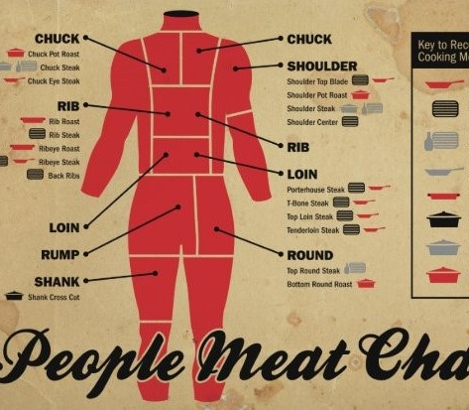
COIDA and its “Meat Chart”
The COIDA presently restricts all permanent disabilities from occupational sources into percentages of permanent disabilities (“PD%”) derived from Schedule 2 which is colloquially called the Meat Chart. See para [10] from JL v RMA [2019] ZAGPJHC 392 (15 October 2019):
Schedule 2 for instance prescribes that a worker who has lost their ring finger from the third phalange is 6% PD, someone who has lost one eye is 30% PD, or 35% PD for the functional use of their leg below the knee and can no longer walk on uneven ground.
Section 49(2)(b) prescribes that all injuries and diseases, read with section 65(6), not prescribed by Schedule 2 are nonetheless guided and restricted by Schedule 2, e.g. 5% PD for a person that has lost 50% of their ability to bend the IP joint of their thumb (table 1 of instruction 157).

Slide 11
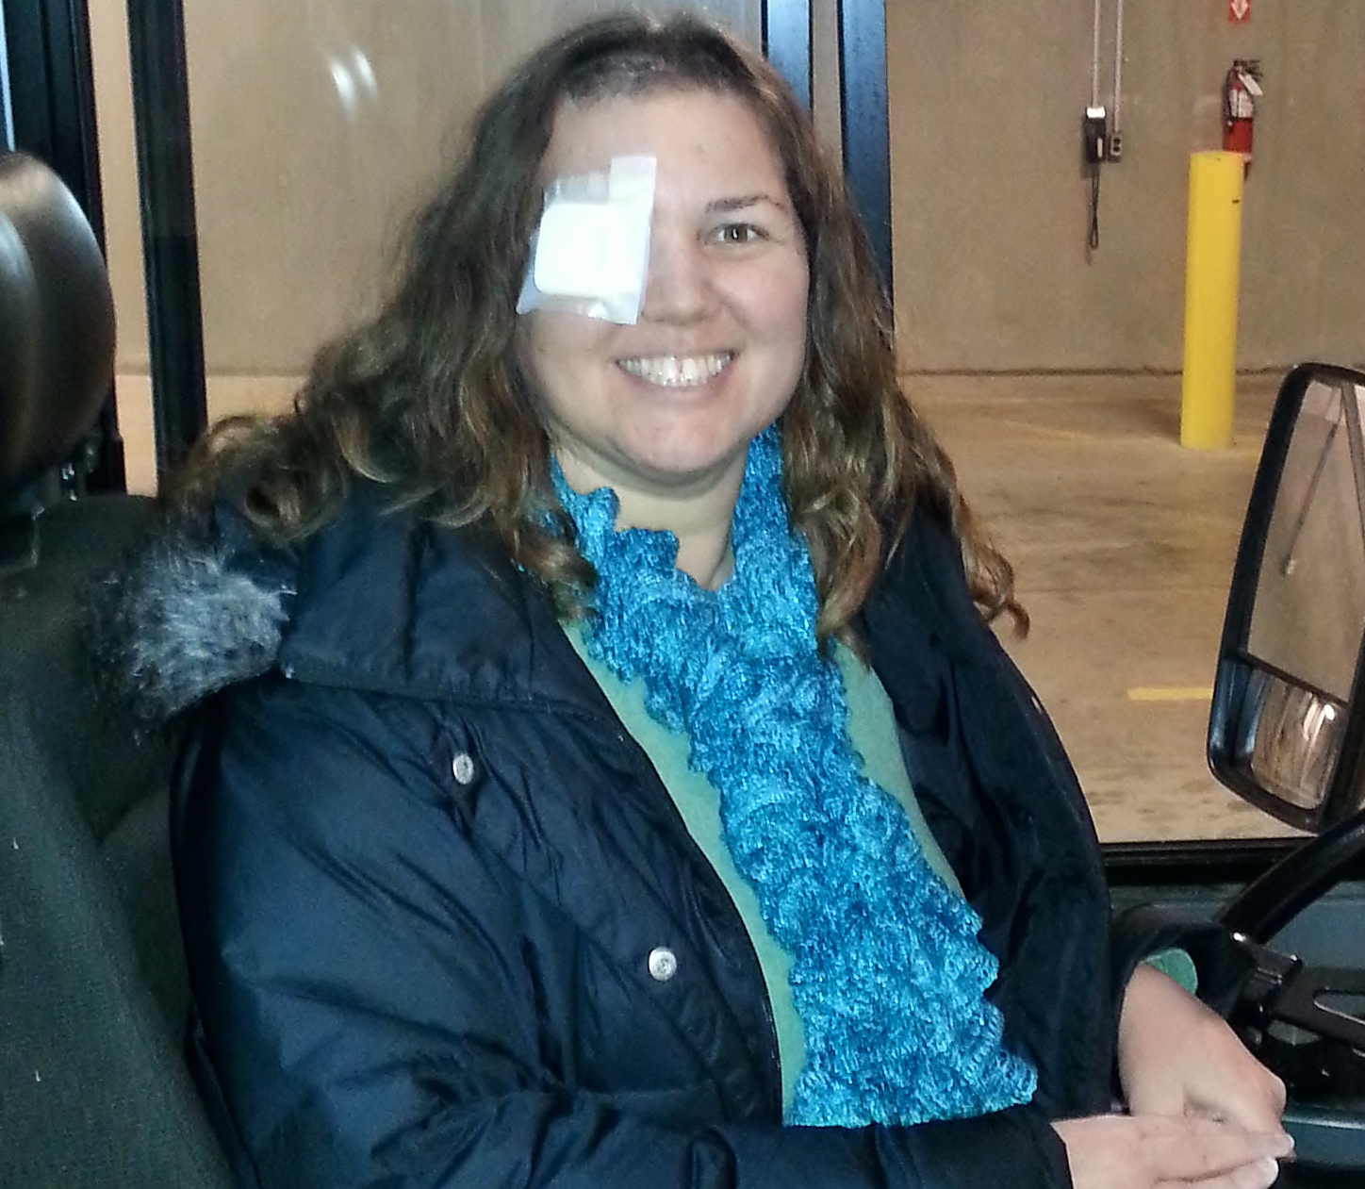
Schedule 2 disproportionally disadvantages blue-collar and/or manual labour workers
Consider previous examples:
Concert pianist loses ring finger (6% PD)
Bus driver loses dominant eye (30% PD)
Gold miner loses use of leg below knee (35% PD)
In each of the above cases the worker’s career is over because of the requirements of their employment:
Full use of their digits
Ability to tell distance accurately (statutory requirement for passenger drivers)
Ability to walk on uneven surfaces underground (statutory requirement for mine fitness)
They will be compensated by COIDA, in terms of Schedule 4, with 3 months salary, 15 months salary and a quarter of their previous earnings, respectively. And dismissed.
This may be fair for professions like lawyers, engineers, accountants or doctors who may be able to simply adapt and carry on. Though these professions are then hit by the Schedule 4 maximum caps in benefits.

Slide 12
Schedule 2 and Occupational Diseases
Persons with occupational diseases are unfairly discriminated against because Schedule 2 does not expressly mention any occupational diseases or mental health issues for that matter, i.e. PTSD.
Dr Anne-Marie van der Merwe, co-author to the present COIDA circular on PTSD, and medical officer for RMA, refuses to accept that Schedule 2 guides the section 49(2)(b) assessment for PTSD because Schedule 2 does not expressly mention occupational diseases or mental health illnesses in it.
Dr v/d Merwe insists, as per the circular for PTSD, that a person with the worst form of PTSD with a GAF/SOFAS score of zero (near death and confined to bed) can never get a higher disablement than a person who lost an arm at the shoulder (65% PD). Many workers may have already been assessed on this incorrect basis, and therefore not receiving their full social security benefits.
Schedule 2 also struggles to deal with recurring occupational diseases; diseases that only manifest when exposed to certain environments in the workplace, e.g. work-aggravated asthma, toxic hepatitis, etc.

Slide 13
Schedule 2 and Hearing
Schedule 2 includes within itself a unfairly discriminatory against persons who are completely blind and persons who are completely deaf – lose of all sight (100% PD) and lose of all hearing (50% PD).
Persons who are completely blind may qualify for constant help payments – section 28 - because they need additional assistance doing normal activities, i.e. crossing a busy road, cooking, etc. Persons who are completely deaf may not qualify for this additional benefit because it is typically only given to persons 100% PD.
Blindness disconnects a person with things, while being deaf disconnects the person with people. Both are significant disabilities that deserve the same level of acknowledgement and respect.

Slide 14
Conclusion: Schedule 2
Schedule 2 is deeply problematic and unconstitutional:
It disproportionally disadvantages blue collar workers, including domestic workers.
It fails to fully recognise and ensure the fair treatment of persons with occupational diseases and mental health illnesses, i.e. PTSD.
It unfairly discriminates against persons who cannot hear (maximum 50% PD) compared to those who cannot see (maximum 100% PD).
Schedule 2 is frequently arbitrary and irrational, and section 49(2)(c) does not rescue it because the subsection has never been used in the current Act – it comes from the previous legislation.
Better methodologies exist for assessing disablements, i.e. the American Medical Association guidelines through certified independent medical examiners (CIME).
Ultimately COIDA and Schedule 2 must enable those that can continue building our economy to do so, with support, and the others must be properly respected with a decent pension.
“Respect those who have worked to build and develop our country”
- Constitution’s Preamble

Slide 15
Privatisation of Constitutional Rights
Section 30 entities, mutual assurances / licensees (under the amendment), serve a viable function of ensuring the COIDA is effectively managed and implemented because the Compensation Commissioner is notoriously delinquent and ineffective. However they have their own problems.
There is an ongoing problem of reporting injuries and diseases to the correct entity, where the incorrect entity will merely repudiate the claim and the worker, or their widow, will not enjoy their social security rights. A clearing house is necessary and so far is not contemplated.
However more fundamentally, it creates problems when the entity deciding whether to grant a social security benefit has a profiting making (registered public company) component to that decision.
This problem can be offset when the appeal mechanism functions properly and independently from the private entity, but in most cases the Department has given those appeal right mechanisms to the private entities as well.
Indeed, RMA attempted to argue that its owned appeal mechanism was beyond the scope of the High Court on a further appeal – see J L v Rand Mutual Assurance Company Limited and Others [2016] ZAGPJHC 407 (13 July 2016) paras [18] – [33]. RMA retains its powers to call (or not call) the appeal tribunals, select its preferred members, identify dates for hearings, brief the panellists and train them. It is not uncommon for an objection or request for additional compensation matter to go without a hearing for several years or simply be refused.
It is debatable whether section 34 of the Bill of Rights persists, to the disadvantage of the workers – it is a frequent occurrence that the medical assessor will become a second legal representative on behalf of the mutual assurance by cross-examining witnesses for the worker, or the mutual assurance will simply refuse the worker their right to an objection hearing.
Mutual Assurances generally do not employ admitted legal representatives because they are not governed or subject to the same ethical requirements of the Legal Practice Council as admitted legal representatives, i.e. attorneys and/or advocates.
Objections against mutual assurance decisions tend to be won on appeal to the High Court, which is both costly and time-consuming. Medical experts frequently refuse to testify on behalf of workers because they do not believe in the integrity and independence of these tribunals, and frequently struggle to obtain their costs against them.

Slide 16
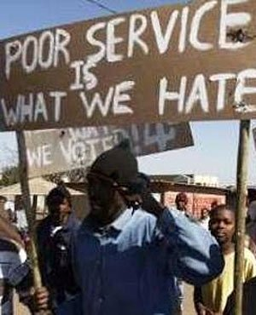
Balancing Private issues with Public non-delivery of services
There is a critical need for Parliament to ensure adequate safeguards are in place to ensure that:
The Compensation Commission provides performance within a reasonable period – finalising claims within 180 days of being reported.
The Mutual Assurance / Licensees provide performance that is not dedicated by profit considerations and the appeal mechanisms remain fully independent and impartial in that justice is not only done, but seen to be done.
The tribunal assessors’ appointments are subject to union and employer association consultation and verification.
The worker receives the most generous interpretation of the Act – Davis Rule.
Part of this may be a statutory recognition of Kate/Njongi constitutional damages (interest) on overdue social security payments; encouraging rapid delivery and erring on the side of the worker. (see for example section 94(4) of the Occupational Diseases in Mines and Works Act, for a pre-Constitutional interest clause)

Slide 17
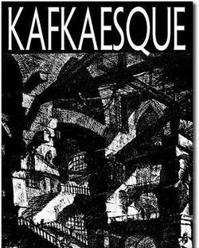
Kafkaesque and the COIDA
Franz Kafka (1883 – 1924) is a well-known German-speaking literary figure of the 20th century.
Kafkaesque is today an English word derived from Kafka’s writing on the absurdity of socio-bureaucratic powers, their ability to cause alienation, existential anxiety and guilt, through bureaucratic violence.
Kafkaesque means a type of bureaucratic violence, which section 12(1)(c) of the Bill of Rights renders unconstitutional.
His most famous work is likely the Der Process (the Trial), that considers a case of Josef K who is victim of an absurd justice system.
Kafka was a compensation commissioner in his country, explaining perhaps much of his thinking and work.
The current COIDA, together with its contemplated amendments, include numerous aspects of Kafkaesque – some are patent and some latent.

Slide 18
The Great Compromise: Jooste
The Constitutional Court explained that it is constitutional for an employer to enjoy immunity under COIDA because:
“COIDA supplants the essentially individualistic [liberal] common-law position, typically represented by civil claims of a plaintiff employee against a negligent defendant employer, by a system which is intended to and does enable employees to obtain limited compensation from a fund to which the employers are obliged to contribute.” - 1999 (2) SA 1 (CC) at 11E – F
This is premised fundamentally on the ease of use and no-fault basis of the COIDA system. The Constitutional Court assumed that the system was both effective and that there was no strict liablity under our occupational health and safety law.
Both these assumptions are however incorrect – the system is broken (workers/widows wait years for delivery) and strict liablity under the OHSA and MHSA does exist under our Law of Delict – see Joubert v Buscor Proprietary Limited [2016] ZAGPPHC 1024 (9 December 2016).
Strict liability from work accidents is also a major component of the English Law of Torts.
The common law / statutory provision that an employer must take all reasonably practicable steps to prevent injury or disease to its workers and non-workers in its workplace, results in a reverse onus against the employer or mine owner.

Slide 19
Foreign interpretation of reasonably practicable:
What is reasonably practicable is a question of fact. The English Court of Appeal held in 1949 that:
“in every case, it is the risk that has to be weighed against the measures necessary to eliminate the risk. The greater the risk, no doubt, the less will be the weight to be given to the factor of cost.”
— Lord Justice Tucker [1949] 1 KB 704; [1949] 1 All ER 743
and:
“Reasonably practicable is a narrower term than 'physically possible' and seems to me to imply that a computation must be made by the owner in which the quantum of risk is placed on one scale and the sacrifice involved in the measures necessary for averting the risk (whether in money, time or trouble) is placed in the other, and that, if it be shown that there is a gross disproportion between them – the risk being insignificant in relation to the sacrifice – the defendants discharge the onus on them.”
- Lord Justice Asquith [1949] 1 KB 704; [1949] 1 All ER 743

Slide 20
Loopholes and problems with the employers’ immunity
With the utmost respect to the Constitutional Court, it did not consider the question before it in the Jooste judgment with its eyes fully open. It should have recognised that there are certain problems with the immunity when:
Service delivery of the Commissioner fails… frequently.
General damages can be obtained against a defendant without proving negligence by an employer – it is strict or presumed.
Blue collar workers are disproportionally affected by Schedule 2.
White collar workers are capped to low maximum benefits unless negligence is proven – where under section 9 of OHSA and section 5 of MHSA negligence should be presumed through a duty to take reasonably practicable safeguards.
This does not however mean that COIDA is unconstitutional as a whole, but that Parliament must intervene to ensure workers receive the correct benefits under the Act.
Presently an employee under a labour broker has greater rights under COIDA and the common law than a full time employee with the principal employer. COIDA only recognises one ‘employer’ as holding immunity. The employee can hold both strictly liable, under COIDA for the broker employer and under the OHSA/MHSA for the principal employer.

Slide 21
Rationalisation of occupational health and safety legislation into a singular and coherent system
What needs to happen is that the different sides of the occupational health and safety legislation coin needs to be rationalised.
Re-consideration of the gaps and communications between MHSA, OHSA, COIDA and ODMWA (plus maybe the CPA, UIA, NEMA and Apportionment of Damages Act).
For example:
Injury on duty under OHSA should create a rebuttable presumption of negligence under section 56 of COIDA.
Declaration of unfitness due to an occupational injury under MHSA should automatically trigger section 49(2)(c) of COIDA.
The 1% negligence of a worker should not become a full defence against additional compensation claims against an employer’s negligence under section 56 of COIDA.
High risk covid19 workers under MHSA (underground workers) should automatically gain the benefit of the presumption of an occupational disease under section 66 of COIDA, read with Schedule 3 item 1.3.1. (Presently under the COIDA circular they are medium risk).
Inspectorates should be consolidated, so that the Commissioner under the Department of Labour does not ignore the findings of gross negligence by the Inspector of Mining or Labour.
COIDA should be recognised as a public asset that compensates all negatively affected individuals without creating discrimination based on type of employment, disability or indirect racial or gender aspects (i.e. domestic workers).
The National Institute of Occupational Health (NIOH)(Department of Health) should be given say over circulars, presumptions of occupational diseases and disability assessments.
Greater coordination between the Compensation Commissioner of Labour and the Compensation Commissioner of Occupational Diseases (Dept of Health).

Slide 22
Suggested New Criteria for PD%
Injured or sick workers should be assessed for their section 49(2) benefits based on the following multidimensional considerations:
Nature and Extent of Injury (current status quo)
Occupation and training of injured party
Age
Likelihood of finding alternative employment, including employment in the open job market
Reasonable likelihood of retraining / rehabilitation and its impact on reemployment prospects
The above must be taken into account before exercising an appealable discretion on the PD% award.
The High Court must enjoy jurisdiction to reconsider the findings of fact made in exercising the above discretion. (Presently the High Court has no jurisdiction to reconsider [potentially] incorrect findings of fact)

Slide 23
Real Problems encountered over the years:
Circulars incorrectly applied mechanically as though they were law, without judicial consideration of the facts.
COIDA unregistered medical assessors giving medical advice on cases – constitutes a criminal offence.
COIDA entity refusing to set down objections for hearing.
Refusal to take any decision or re-requesting documentations again and again.
COIDA claim being submitted to wrong entity, i.e. RMA, FEMA, Compensation Commissioner or even MBOD, and then being repudiated.
COIDA entity incorrectly labelling all mine diseases as ODMWA jurisdiction, i.e. non-mesothelima lung cancers.
Refusal to exercise sections 42 or 74(2) by COIDA entities to finalise outstanding cases beyond 24-month section 47 limits.
Refusal to presume diseases are occupational when contained in exposures described in Schedule 3, i.e. Noise-Induced Hearing Loss from underground gold mines.
Refusal to award legal costs for expert witnesses, when successful, and constant threat of adverse costs order if unsuccessful in exercising and/or protecting social security rights (Biowatch principle).
Absence of incentive to finalise claims quickly and correctly, other than discontinuing medical costs.
Inadequately trained and/or qualified personnel administrating and/or adjudicating COIDA claims, i.e. a chief medical assessor not registered with the HPCSA, section 56 opposed because Department legal representative didn’t understand employer was company and not former directors of company, or that all assessments must be consistent with Schedule 2.
Medical Inspector of Mines (statutory expert in all matters of occupational health in mining) making one finding and the COIDA entity making exactly the opposite finding, and refusing to acknowledge the Medical Inspector’s binding rulings.

Slide 24
Discussion
Thank you

