Slide 1
BLIND SA
Western Cape CAB provincial hearing Tuesday
07 March 2023

Slide 2
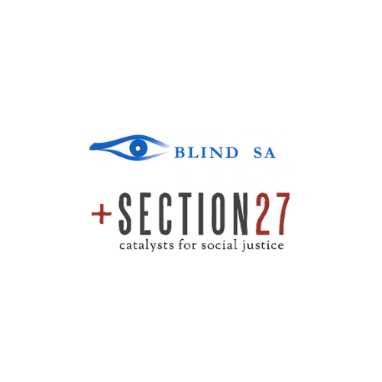

Slide 3
We are generally strongly in favour of the sections of the CAB that relate to our work and our participation in society, but in order to make these sections fully workable and to bring them in line with certain constitutional requirements, as recently clarified by the Constitutional Court, certain small but critical amendments have to be made. Our written submission set out what these critical amendments with recommended languages are.

Slide 4
Instruments
Blind SA and Section27 focuses the submission on:-
Copyright Amendment Bill [B13D-2017] {CAB}:
Constitutional Court Judgement 21 September 2022
Marrakesh Treaty to facilitate access to published works for blind, visually impaired and other print disable persons 2013] {Marrakesh Treaty}.

Slide 5
Constitutional Court Judgement 21 September 2022
The Constitutional Court )21 September 2022) confirmed the High Court’s (21 September 2021) finding that the Copyright Act 1978 was unconstitutional to the extent that it discriminated against people with visual and print disabilities and violated our rights to equality, dignity, and participation in cultural life. Importantly, the judgment centred upon the specific requirement of authorisation by the copyright owner. The Court was sensitive to the fact that the CAB continues to be debated in Parliament. Its declaration of constitutional invalidity was thus suspended for a period of two years to give Parliament time to legislate to fix this unconstitutionality. However, in order to provide us with immediate redress and to ensure that our rights do not continue to be violated, the Constitutional Court read in its own, court-crafted remedy, s 13A, for that interim period. Section 13A thus provides a baseline (an absolute minimum) which Parliament must meet in its formulation of provisions that impact people with disability, in order to rectify the unconstitutionality of the Copyright Act 1978 and fulfil its constitutional obligations.
We submit that s 13A does not function as a ceiling or a prescription: Parliament’s proposed legislative protection for our rights cannot go lower than s 13A, but it certainly can and, we submit, should go higher in view of South Africa’s concurrent constitutional and international human rights obligations to ensure that people with disabilities do not experience discrimination.

Slide 6
Recommendations
Accessible Formats
Accessible formats refers to braille, large print, Audio and Daisy materials.
We recommend that the Select Committee amends the CAB’s definition of accessible format copy to that of the Constitutional Court judgement for coherence with Blind SA CC and in conformity with the Marrakesh Treaty.

Slide 7
Recommendations
beneficiary person
The CAB defines ‘person with a disability’ broadly to include physical, intellectual, neurological, or sensory disabilities. The definition centres upon the constitutional guarantee of non-discrimination in describing how accessible format shifting should work ‘to enable that person to access and use the work in the same manner as a person without a disability’. The CAB’s definition provides for access for people with disabilities across the spectrum and is in line with s 9 of the Constitution as well as South Africa’s international obligations under the UN Convention on the Rights of Persons with Disabilities and the recently ratified AU Protocol on the rights of persons with disability
No change to the CAB is required.

Slide 8
Recommendations
Permitted Entity
The Constitutional court-crafted s 13A adopts the Marrakesh Treaty inclusive definition with government and NGOs as examples of organisations that could be considered permitted entities. The CAB’s restrictive definition, ’Authorised Entity’ could limit libraries, associations and private schools and universities.
The recommendation is for the CAB to be amended to adopt the Constitutional Court-crafted definition of Permitted Entities.

Slide 9
Artistic and Literary Works
• no change

Slide 10
Recommendations
Technical Protective Measures TPM
Accessible format shifting requires the conversion of works into formats other than the format in which it was published. For instance, running a software to read e-books aloud or printing an e-book in Braille. Often, the computer on which the e-book is accessed, say a library computer, does not have a Braille printer attached to it. What would then be required is for the e-book to be emailed / transferred on a flash drive to a computer that is connected to a Braille printer for us to access the e-book. However, technological protection measures (TPMs) that ‘lock’ e-books to a single device, for instance, prevent us from doing this entirely.
We recommend CAB S28P is amended and we suggest language in our written submission.

Slide 11
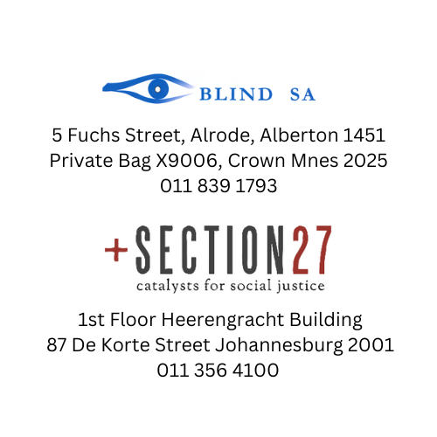
Thank you

Slide 12
THANKING YOU…
Christo De Klerk
Vice President
Blind SA
07 MARCH 2023
#Endthebookfamine
#Brailleisnocrime

