Slide 1

The Western Cape Provincial Parliament’s Standing Committee on Finance, Economic Opportunities and Tourism

Slide 2

Contents
CAPASSO
Statutory Damages
General Exception (Libraries, Archies, and Museums) and Private Copy Compensation
SECTION 6A (ROYALTY DEFINITION)
CMO (SECTION 22A: 22C: 22F )

Slide 3
CAPASSO REPRESENTS
CAPASSO represents over 10 000 (ten thousand) composers, authors, and publishers
Over 9 million musical works locally and over 100 thousand musical works within Africa
Licenses over 200 music users ranging from multibillion-dollar entities to much smaller platforms.

Slide 4
CAPASSO COLLECTION AND DISTRIBUTION
CAPASSO currently collects over R200 million for composers, authors and publishers.
Over 75% of collections are from digital services licensed for reproducing works.
For the past 4 years, we have seen an increase of 103% in distribution.

Slide 5
STATUTORY DAMAGES
Background
Digitisation saw the recorded music industry lose 43% of its revenues within a 18-year period, mostly as a result of digital piracy/ infringement (see figure below). Such developments continue to challenge authors and copyrights owners and their CMOs such as CAPASSO require revisiting the remedies available to them.
Digital exploitation of music has spotlighted the shortcomings of the current remedies thus necessitating additional remedies to have prospected.
Current
Section 24 of the Act grants the authors and copyrights owners one of two options as far as damages are concerned; to either prove actual damages or rely on a reasonable royalty. The actual damages contemplated in section 24 generally take the form of compensation for the loss of profit arising from the infringing action
Digitisation has made that computation a very difficult task for musicians as a whole. As exemplified in Figure A above, between 1999 and 2017, recorded music lost 43% of its value due to digitization. That macro assessment is easy to illustrate with hindsight, but an individual author or copyright owner would be hard-pressed to showcase that on a single-song basis due to audience preferences and consumption patterns.

Slide 6
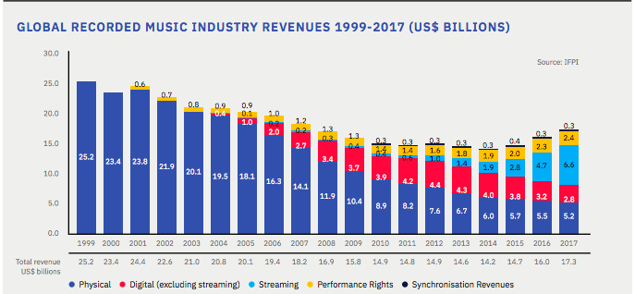

Slide 7
STATUTORY DAMAGES CONTINUED
  the reasonable royalty claim is a substitute for the erstwhile profit accounts claim, it is plagued by the same problems the account for profit would be in the digital era.
  In the case of CMOs such as CAPASSO, reasonable royalty also relates to an amount that a potential licensee would have paid, meaning that infringers can persist with their illegal actions bearing the risk of only ever having to pay the royalties they would have paid in the first place had they been bona fide, despite requiring authors and copyrights owners to go through the trouble of instituting proceedings. Mass users of musical works escape damage claims by circumventing the procedure of obtaining authority prior to usage, and thereafter demanding that CMOs “prove their copyright” as a method to delay making necessary payments, such proof relies on access to data that the infringers themselves have or control.
  Currently, the author and/ or copyright owner is burdened with funding the assessment despite it just not being financially viable to sue.

Slide 8
STATUTORY DAMAGES :
RECOMMENDATION
  The averment is thus that it is imperative that defined statutory damages be introduced via the Bill over and above the reasonable royalty contemplated in section 24 of the Act.
  This is particularly important if the view is to introduce general exceptions such as fair use. Statutory damages are a crucial function of how these general exceptions work due to the fact that they allow successful plaintiffs to recover substantial monetary damages without any proof that (1) the plaintiff suffered any actual harm from the infringement or (2) the defendant profited from the infringement. This is a crucial weapon for CMOs, authors, and copyrights owners in the digital era given the sheer amount of music consumed. Without statutory damages, they are left without much of an effective recourse.
STATUTORY DAMAGE IN FAIR USE EXCEPTION (12A)
  The incorporation of a Fair Use exception alongside that of Fair Dealing raises fundamental problems as the two are jurisprudentially incompatible. Fair Use is a wide and general exception whereas Fair Dealing is a closed and more specific list of exceptions.
  Regarding Fair Use, it is pertinent to note that a crucial part of the proper functioning of this doctrine is that it requires frequent and continuous litigation to develop jurisprudence and norms. By default, authors and rightsholders are the ones burdened with the task of instituting and developing the much-needed jurisprudence around Fair Use.
  Should the Committee be steadfast in the need to introduce the Fair Use doctrine into South African law, there would be even more of a need for the introduction of the Statutory Damages mentioned above. These are a fundamental part of the functioning of any general exceptions legal framework. Without statutory damages, author and copyright owners would be unduly prejudiced

Slide 9
General Exceptions and Private Copy Compensation
Background
  Exceptions for libraries and archives are born out of the Bangui Agreement under Annexure 8. The Agreement places a number of conditions in the implementation of this exception namely;
  1. The reproduction should not be for commercial purposes either direct or indirectly
  2. Should be to meet the request of a natural person
  3. For preservation, replacement or archiving
Current
  The current articulation seeks to extend this exception to include lending or granting access in digital means and to include other libraries or archives as beneficiaries. Due to the exceptions that are in Bangui Agreement, the agreement also expressly states that: “The authors of literary and artistic works, performers in respect of their performances fixed on phonograms and phonogram producers shall be entitled to remuneration for the reproduction of such works, performances and phonograms intended for strictly personal and private use and made in accordance with the provisions”
  Additionally, the extension into the digital space further requires that the libraries that benefit from the exception put in place protection measures to ensure that the work is not subsequently used for other purposes, especially infringement.

Slide 10
General Exceptions and Private Copy Compensation
Recommendation
  The Bill introduces many provisions relating to exceptions and limitations to the copyright owner’s exclusive rights. In order to balance this situation, there is a strong persuasion for South Africa to follow the example of other jurisdictions (including the likes of Botswana, Alegria, France etc.), by introducing a system of private copy compensation, to compensate rights-holders for the loss of income as a result of the wide exceptions and limitations that the Bill introduces, such a 12 system would be good for rights holders as it would provide them with an important alternative source of income This is only a fair way to ensure that rights-holders are not detrimentally affected by the changes proposed in the Bill.

Slide 11
ROYALTY DEFINITION : 6A
Current
  The definition of “royalty” to mean “gross profit made on the exploitation of a work” which is employed in section 6A of the Bill is highly prejudicial to the very people it seeks to protect.
  As far as musical works are concerned, this definition has the potential to affect the royalty flow of authors and composers. In the contemporary music publishing environment authors, and composers of musical works earn a share of royalties that are calculated as a percentage of the total turnover.
Recommendation
  It is noteworthy to state that royalties are shared from the first cent which any work generates. This practice guarantees that the composer’s royalties are payable even if the publisher or the musical work is not turning a profit. The new definition has the potential to be interpreted to authorize publishers to deduct their costs from the royalty provision, prior to distributing to composers and authors.
  Thus, royalty should be defined as a percentage of the total turnover/ revenue generated by the musical work.

Slide 12
SECTION 22A, 22C, 22F
SECTION 22A
  Proposing the licensing of orphan works
  CMOs already have mechanisms in place for orphan works by constantly improving databases accessed by users and research for the identification of songwriters.
  For the music industry, the process of seeking a license for unidentifiable rightsholders is one that is fairly within control. The process contemplated in the Bill would frustrate rather than assist.
  Recommend that the music industry should be exempted from the orphan works regime.
  Recommend further that CMOs be empowered to have an extended repertoire system as done in the Nordic countries and like to MLC in America.
SECTION 22C
  This clause generally contains provisions that seek to ensure that CMOs are accountable and work to serve the interests of their members. However, there is a need to guard against the pitfalls of the “one size fits all” approach which tends to plague parts of the Bill.
  It is not always feasible nor financially prudent for local CMOs to enter into “bilateral” agreements with foreign CMOs. In fact, it may, at times, prove strategic to enter to unilateral agreements with foreign CMOs in the interest of local authors and copyrights owners. By way of illustration, certain territories may have more than one CMO who all enter into varying types of agreements (some bilateral others unilateral) with a South African CMO.
  It is suggested that the clause simply read that the remittance of royalties is subject to a reasonable and valid agreement between the foreign CMO and the local one.

Slide 13
CONTINUED
SECTION 22F
  The provisions of the section tend to empower the Commission, even at the expense of the best interests of members of the CMO which is being regulated.
  Given the fact that the Commission will oversee the functioning of CMOs, it is ill-advisable for it to also have the ability to usurp the very same function it seeks to regulate. This will effectively usurp the control of the CMOs from members and in turn prejudice the members it seeks to protect.
  Prior to applying to the Tribunal, the Commission must be required to consult members and empower them to run the affairs of their organization.
  This can be done by reading the following wording into subsection 5:
SECTION 22 F CONTINUED
  (5) Following the suspension or the cancellation of the accreditation of any Collective Management Organisation, the Commission shall as soon as reasonably practicable, convene an emergency meeting of the members during which members shall elect a suitable person to be responsible for the administration and discharging of the functions of that Collective Management Organisation. The person so elected shall be skilled in one or more of the following
  (a) Collective management and general administration of rights under this Act;
  (b) business rescue, administration, or liquidation; or
  (c) other skills deemed appropriate by the Commission and Tribunal.”
  Should the AGM be unsuccessful in appointing a suitably qualified person to be responsible for the administration and discharging of the functions of the CMO, the Commission may then apply to the Tribunal to appoint such a person.

Slide 14
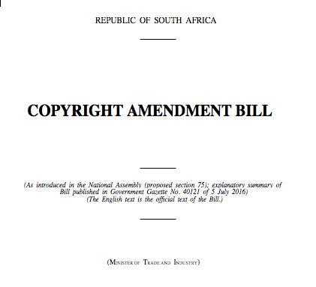

THE COPYRIGHT AMENDMENT BILL
Copyright © Academy of Sound Engineering

Slide 15
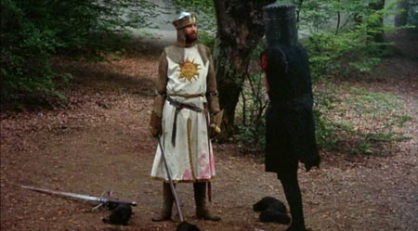
THE COPYRIGHT AMENDMENT BILL – IT’S NOT JUST A FLESH WOUND
Copyright © Academy of Sound Engineering

Slide 16
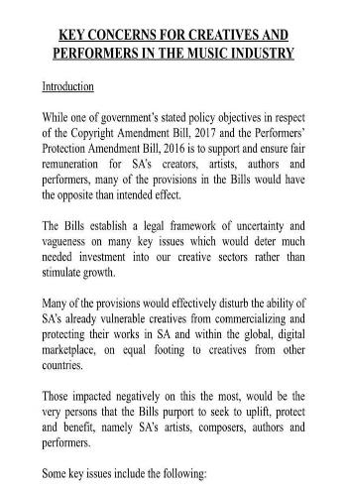

THE COPYRIGHT AMENDMENT BILL13 OF 2017 (as at 3 sept 2018)- REJECTED BY STATE PRESIDENT
Copyright © Academy of Sound Engineering

Slide 17
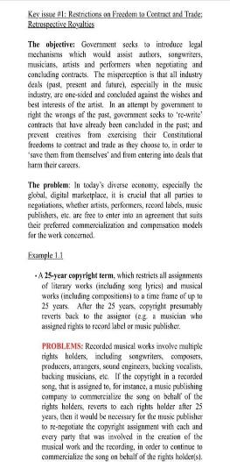
THE COPYRIGHT AMENDMENT BILL
Copyright © Academy of Sound Engineering

Slide 18
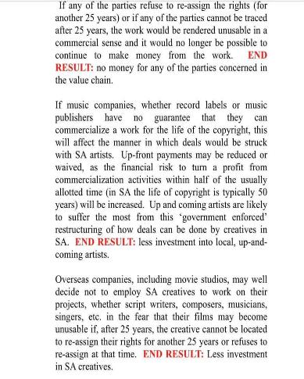

THE COPYRIGHT AMENDMENT BILL
Copyright © Academy of Sound Engineering

Slide 19
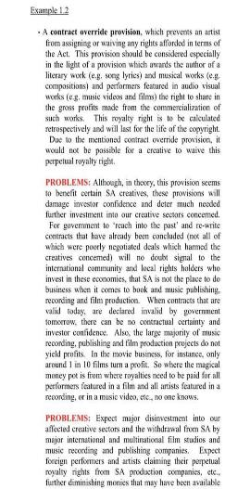

THE COPYRIGHT AMENDMENT BILL
Copyright © Academy of Sound Engineering

Slide 20


Fair Dealing – a Closed and Defined
List of Exceptions
Section 12(1) allows reproduction for the following purposes:-
Research or private study
Personal or private use (eg format-shifting)
Criticism or review
Reporting current events (e.g. in a newspaper or broadcast)
Judicial proceedings or a report of judicial proceedings
Section 12 (2-4) allow the following:
Quotation (a fair portion)
'By way of illustration' for teaching purposes (e.g. in a PowerPoint presentation). However, if you want to circulate the PPT slides or music to students, you will need to clear copyright for those copyright works used in the PPT, or exclude them before circulating the slides.
CERTAINTY!!!
Copyright © Academy of Sound Engineering

Slide 21


Fair use – an Open-ended and vague concept – even in its home, the USA
UNCERTAINTY
JUDGE-MADE LAW. PARLIAMENT SHOULD BE DECIDING WHAT IS FAIR – NOT THE COURTS THROUGH LITIGATION (NEITHER LITIGANT WILL KNOW UNTIL THE END OF THE CASE)
DIFFERENT COURTS WILL REACH DIFFERENT CONCLUSIONS
SOFA Entertainment v Dodger Productions—30sec clip of “Four Seasons” on Ed Sullivan Show in Jersey Boys = fair use: used for historical significance, imbued it with new meaning, and did so without usurping existing demand for the clip
Campbell v. Acuff-Rose Music 2 Live Crew parodied “Oh Pretty Woman” and got away with it despite the fact that big money was made. What a pity for Roy Orbison’s family.
Copyright © Academy of Sound Engineering

Slide 22
The Three Step Test
In terms of the three-step test an exception can only be granted if:
It amounts to a certain special case;
It does not conflict with a normal exploitation of the work; and
It does not unreasonably prejudice the legitimate interests of the rights holder.
These tests are applied consecutively.
Fair Use entails the court being given a discretion when passing judgment in a copyright infringement case to decide whether the prima facie infringement by the defendant should be excused or exempted because she was making “fair use” of the work in the particular circumstances of the case. In evaluating the “fairness” of the defendant’s infringing conduct, the court should take account, inter alia, of the following factors:
The purpose and character of the use;
The nature of the copyright work;
The amount and substantiality of the portion used; and
Copyright © Academy of Sound Engineering

Slide 23
The onus of proof is on the copyright-owner. That’s you
The effect on the plaintiff’s potential market.
In adopting this approach the court can decide for itself what actions ought to qualify as potential exceptions. In this respect, the system is in sharp contrast to the Fair Dealing system where the actions to which exceptions can be applied are determined and specified in the legislation. The court is free to regard any act of whatsoever nature as being capable of being exempted.

Slide 24

Who Wants this???
In the words of Owen Dean: “in general companies that operate vast databases of easily accessible digital information where copyright is a hindrance to their operations, argue that any action that is fair on the part of a user of a work constitutes a certain special case. It is submitted that this proposition defies logic and common sense and is untenable.”
DO WE NEED THIS INCREASED FLEXIBILITY OF COPYRIGHT TO “FUTURE PROOF” OURSELVES?
Not at all. Section 13 of the current Act empowers the minister of trade and industry to make new exemptions in regulations, provided they comply with the Three-step Test. New exceptions can thus be created in the short term.
Copyright © Academy of Sound Engineering

Slide 25


Who Wants this???
Draw your own conclusions…
Copyright © Academy of Sound Engineering

Slide 26
IT GETS EVEN WORSE…
IT IS A BREACH OF OUR INTERNATIONAL TREATIES (the Berne Convention and the Trips Agreement) THE CONSTITUTION REQUIRES US TO ADHERE TO THESE. Fair Dealing does adhere. FU does not (it was created before the US joined Berne & Trips.)
It is underpinned by the peculiarities and tenets of American copyright law and the American law and procedures in general, which are significantly different to our own.
FU HAS GAINED VIRTUALLY NO CURRENCY IN OTHER JURISDICTIONS
FU prevails in the US and in six other countries, out of nearly 200 countries in the world that are members of the conventions. It has been considered and found to be wanting and unacceptable, inter alia, in Europe, the UK, Australia and New Zealand, despite being urged by American business interests.
It has also not been taken up into the Copyright Model Law adopted by the African Regional Intellectual Property Office (Aripo) in 2019.
No other country has a hybrid
The Court has all the discretion. Do YOU want to be the test case that decides what Google can do with music?
No-one does, therefore they will have a field day with SA music
Copyright © Academy of Sound Engineering

Slide 27

Copyright Amendment Bill
FAIR USE
22 Open List – ‘such as’
No punitive damages
Permitted purposes in S.12A and not in Section 107 of the US Copyright Act are “personal use, including the use of a lawful copy of the work at a different time or with a different device; scholarship, teaching and education; illustration, parody, satire, caricature, cartoon, tribute, homage or pastiche; preservation of and access to the collections of libraries, archives and museums; ensuring proper performance of public administration.”
US Case Law
S.12B encapsulates all the specific provisions that were previously ‘fair dealing’ exceptions, but removing the qualification of “fair practice” from them, thereby leaving them non-compliant with the Three-Step Test for copyright exceptions laid down in the Berne Convention, TRIPS and WCT.
S.12D allows educational institutions to make coursepacks compiled of extracts from copyright works of others, without permission or remuneration, a form of product substitution that is not even allowed under ‘fair use’, as is clear from the history of the US case
Copyright © Academy of Sound Engineering

Slide 28
Copyright Amendment Bill
FAIR USE
In determining whether an act done in relation to a work constitutes fair use, all relevant factors shall be taken into account, including but not limited to—
(i) the nature of the work in question;
(ii) the amount and substantiality of the part of the work affected by the act in relation to the whole of the work;
(iii) the purpose and character of the use, including whether—
(aa) such use serves a purpose different from that of the work affected; and
(bb) it is of a commercial nature or for non-profit research, library or educational purposes; and
(iv) the substitution effect of the act upon the potential market for the work in question.
Copyright © Academy of Sound Engineering

Slide 29
Copyright Amendment Bill s23 – ASSIGNMENT ‘UP TO’ 25 yrS
not a reversionary right as one finds in relation to musical works in Section 203 of the United States Copyright Act, and not what the Copyright Review Commission intended. This provision, to be added to the current provisions relating to the formalities of assignments, simply states that every assignment of copyright in a literary or musical work shall only be valid for up to 25 years. This is irrespective of whether the publisher is marketing the work or not; even irrespective of whether the assignment is made by an author or a successor-in-title.
Copyright © Academy of Sound Engineering

Slide 30
Copyright Amendment Bill
ONGOING RIGHT TO EARN ROYALTIES AND SHARE IN ‘GROSS PROFITS’
CONTRACT OVERRIDE PROVISIONS
MINISTER TO DRAW UP CONTRACTUAL TERMS
Copyright © Academy of Sound Engineering

Slide 31
Copyright Amendment Bill —Old problems addressed ?
Dickens Clause is back— but not
Audio-visual fixation same as cinematograph film?
“Commission” = CIPC
Streaming – communicating to the public by wire or wireless means. Says ‘interactive/non interactive’ on my advice. Making available to the public also now covered.
Creator/author
Copyright © Academy of Sound Engineering

Slide 32
Copyright Amendment Bill —Old problems addressed ?
Users must approach ‘copyright owner, author, collecting society or indigenous community’ before playing, or then go to Tribunal – lengthy and will discourage music use.
creators will continue to earn even after sale or assignment
Copyright © Academy of Sound Engineering

Slide 33
Copyright Amendment Bill —Old problems addressed ? TREATY OBLIGATIONS
The following are in breach of South Africa’s treaty obligations under the Berne Convention and the Trade-Related Aspects of Intellectual Property Rights Agreement, to which South Africa is a party, and/or will obstruct South Africa’s accession to the WIPO Copyright Treaty, the WIPO Performances and Phonograms Treaty, the Beijing Treaty on Audiovisual Performances and/or the Marrakesh Treaty to Facilitate Access to Published Works for Persons Who Are Blind, Visually Impaired or Otherwise Print Disabled:
The entire framework for exceptions in Clauses 13 (inserting sections 12A, 12B, 12C(1)(b) and 12D), 19 and 20 (inserting Sections 19B and 19C), coupled with the contract override provision in Clause 34.
There is no definitive assessment whether the Act, the relevant provisions of which are Section 23(2), as it stands, and Sections 45 and 45A (neither of which are in operation, despite having been on the statute books since 1978 and 1983 respectively), meets the requirements of WCT in respect of the right of distribution.
The repeal of Section 23(2)(b) will not be compliant with the WIPO Copyright Treaty and means that South Africa will not be able to ratify the WIPO Copyright Treaty.
The WIPO Copyright Treaty requires the ‘digital rights’ to be extended at least to computer programmes.
Clause 11. Section 9A(1)(a)(iv) is contrary to the requirements of Article 14 of the WIPO Performances and Phonograms Treaty.
Clause 9. Section 8A, to the extent that the acts initiating its grounds for remuneration are more than the acts referred to in Articles 10 and 11 of the Beijing Treaty on Audiovisual Performances, would not be complaint with that Treaty.
The requirement in Section 22C(3)(c) of concluding bilateral agreements between South Africa and other countries to permit payment of royalties is not compliant with South Africa’s National Treatment obligations under the Berne Convention and the Trade- Related Aspects of Intellectual Property Rights Agreement inasmuch as “that country” is also a member of those treaties.
Copyright © Academy of Sound Engineering

Slide 34

Copyright Amendment Bill —New concepts introduced 1
Copyright vests in State in perpetuity where author can’t be located or is dead
Orphan works
One right one society came and went
Contracts Outside collecting societies to be prescribed by Minister. How?
Assignment to collecting societies should include non-exclusive – James Stewart
Quotas?
Fair Use added to Fair Dealing – US concept. Rely on US case law? Lawyers will get rich. Adds to it rather than replacing. Limited and restricted in SA. General in US. Napster etc. Onus of proof on owner. Jersey Boys will now apply to SA. Criticised in US, why bring to SA? Not for financial gain (so if failure, fair use). Endless copies of textbooks for classroom use (with 13(5)a. Authors will stop writing. Should be left alone and just add parody, teaching (not copyying) and format shifting (once)
Copyright © Academy of Sound Engineering

Slide 35
Copyright Amendment Bill —New concepts introduced 2
Caching. But too broad - “transiently and temporarily as an essential part of the technical process” SABC? DSP’s should not be exempt – only the public. Can CAPASSO now not collect for internet radio?
13(5)b and 12A allow textbooks to be copied
19D Accessibility for persons with disability
20(4) – right to ongoing income despite outright transfer in film, TV, radio, photo or artwork. Couched as a “moral right”. It’s not a moral right, it’s an economic right. A new performance right. Erodes free market principle.
Definition of “reproduction” watered down
Copyright © Academy of Sound Engineering

Slide 36
Copyright Amendment Bill —New concepts introduced 3
State ownership
Dickens Clause, but wrong.
Orphan Works – process too onerous. Users won’t use them. What if co-authored, or copyright disputed, or partly assigned to publisher. Where does undoc end and orphan start? Should be managed by CR Societies, not Commission – they report into the Commission anyway. 50 years rule?
23(4)(d) criminal offence to refuse another person permission?
Copyright © Academy of Sound Engineering

Slide 37
Copyright Amendment Bill —New concepts introduced 4
26 Onus of proof dealt with, but not in regard to performers’ neighbouring rights
Circumvention of DRM & CR information an offence. Where modification of meta-data, onus should be on user to take steps. VALUE GAP NOT CLOSED
Copyright Tribunal (was IP Tribunal) given broad powers
Void contracts: a) it is a contractual term; and either
b) it purports to prevent or restrict the doing of any thing that does not infringe copyright; or c) it renounces a right or protection afforded by the Act. outright sale, assignment, agreement wherein a performer alienates his neighbouring right to needle time, staff-writer agreements etc? Pacta sunt servanda? Should be rewritten to nullify exclusion of reversion, commissioned work excluding MR, PR or needletime, future works, future technologies, ambiguities
Copyright © Academy of Sound Engineering

Slide 38
Copyright Amendment Bill —New concepts introduced 5
20C Definition of Producer of a Phonogram—not precise enough
Compulsory mechanical licenses don’t sit well in the Reproduction Licensing section. “Systemic educational use” a compulsory licence?
Ongoing right of commissioned writers to earn mechanicals and performance royalties there but not clearly drafted
Translation compulsory
Actors now get a needletime-like royalty for audiovisual productions
Copyright © Academy of Sound Engineering

Slide 39
Copyright Amendment Bill —Required Changes Ignored
VPL should be treated like needletime. 50/50 split not mandated
20C Definition of Producer of a Phonogram
Streaming and downloads licenses
Private Copy Levy
Churches
No mechanicals for labels
Copyright © Academy of Sound Engineering

Slide 40
Copyright Amendment Bill —Required Changes Ignored 2
User information enforcement—task team
Needle Time for foreign companies s 4(1) of PPA should have been repealed
Unallocated revenues—75% accuracy, distribute
NRR and Pensions
Collecting Society Membership Voluntary
Ephemeral Exemption still there
Proof of Copyright
IPLAB still there, stronger than ever
Copyright © Academy of Sound Engineering

Slide 41
Performers Protection AMENDMENT BILL
Phonograms/sound recordings laws extended to audiovisual fixations (actors)—Beijing Convention. A needletime for actors
Performer’s consent required for every use. But by performing, he is deemed to have given his consent in the absence of an agreement to the contrary. Includes broadcasting and rebroadcasting (important for actors). Quantum finally addressed for musicians but not actors. Producer must pay and on payment being received, is absolved
Fair use/dealing exceptions extended to performers. Also contravention of protection measures (removing CA info and metadata)
Producer still gets right to receive
Moral rights now extended to performers
Copyright © Academy of Sound Engineering
Notes:
Phonograms/sound recordings laws extended to audiovisual fixations (actors) – Beijing Convention. A needletime for actors.
Performer’s consent required for every use. But by performing, he is deemed to have given his consent in the absence of an agreement to the contrary. Includes broadcasting and rebroadcasting (important for actors). Quantum finally addressed for musicians but not actors. Producer must pay and on payment being received, is absolved.
Fair use/dealing exceptions extended to performers. Also contravention of protection measures (removing CA info and metadata).
Producer still gets right to receive.
Moral rights now extended to performers

Slide 42
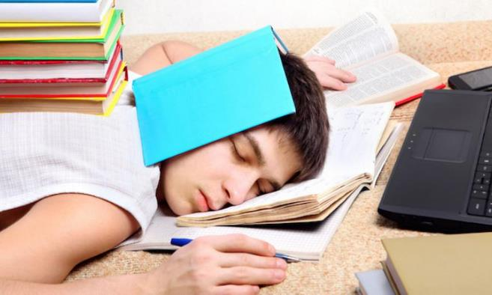
SUMMATIVE Assessment - Morgen

Slide 43
Assignment 01—5% Weighting
Find & research a copyright infringement case
NB: the case must not be in the textbook, the slides, or must not have been discussed in class!
For more info, go to LMS

Slide 44
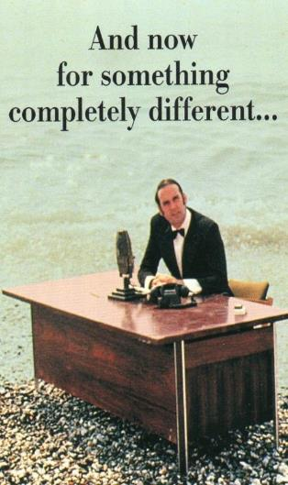
Next up… MusiC INDUSTRY Contracts!
Copyright © Academy of Sound Engineering

Slide 45
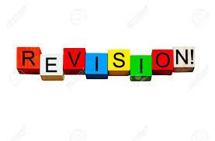

Slide 46
THANK YOU
Presented By: Thando Philison (General Counsel) and Nick Matzukis

