Slide 1
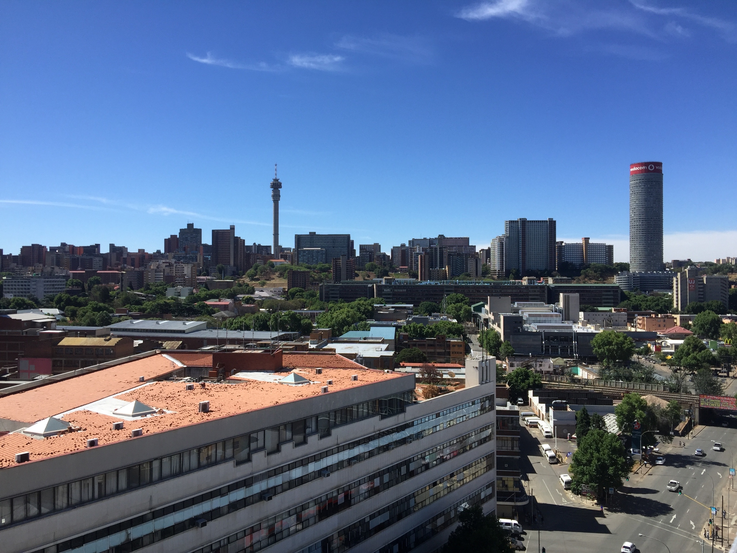

SHRA STRATEGIC PLAN 2020-2025 AND
APP 2020/21
PRESENTATION TO THE THE PORTFOLIO COMMITTEE ON HUMAN SETTLEMENTS, WATER AND SANITATION
7 May 2020

Slide 2
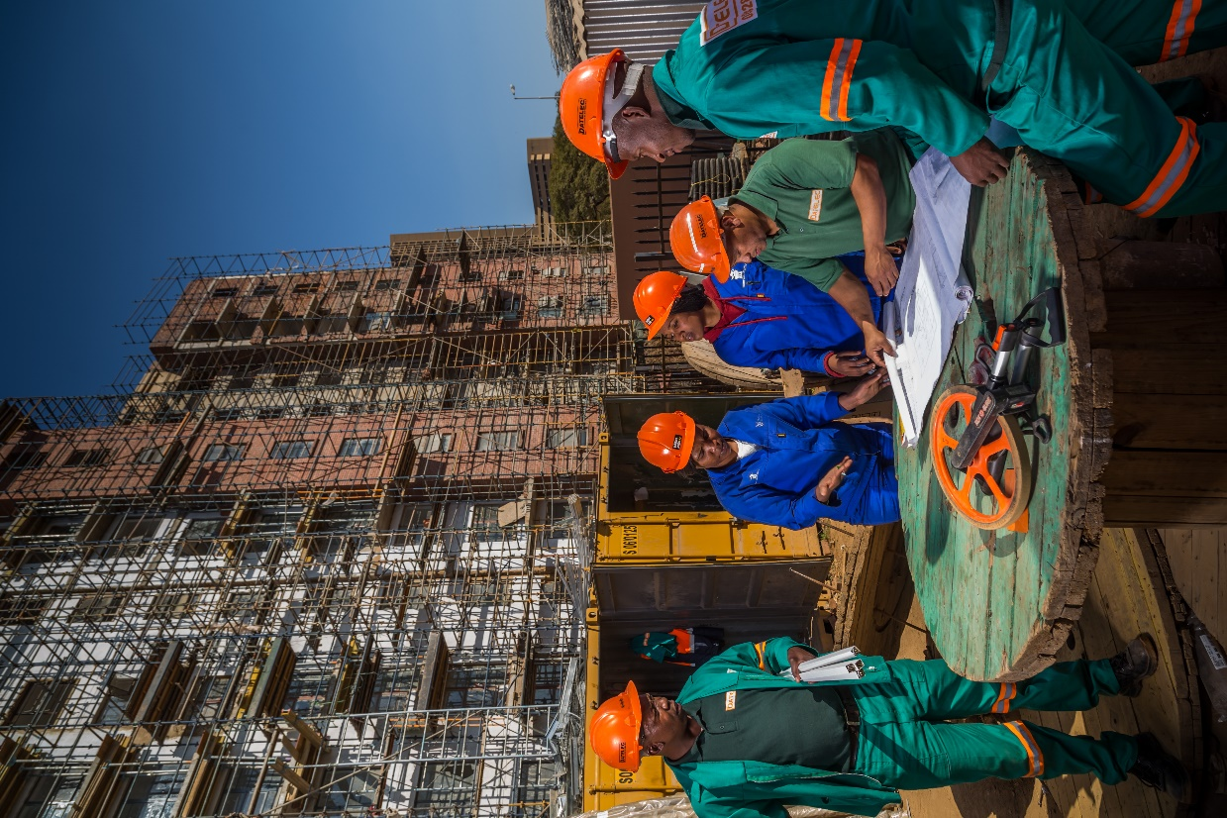
CONTENTS
        1
STRATEGIC PLAN
Purpose
Mandate
Impact
Outcomes
Discussion
        2
ANNUAL PERFORMANCE PLAN
        3
BUDGET

Slide 3
PURPOSE OF THE PRESENTATION
To present to the Portfolio Committee on Human Settlements, Water and Sanitation the Social Housing Regulatory Authority’s (SHRA’s):
  Strategic Plan for the Period 2020/21 – 2024/25;
  Annual Performance Plan 2020/21; and
  Budget

Slide 4
LEGISLATION AND POLICY MANDATES
Legislation
Policies
The Housing Act (No. 107 of 1997), as amended
The Rental Housing Act (No. 50 of 1999), as amended
Public Finance Management Act (No. 1 of 1998), as amended (PFMA)
Social Housing Policy
National Housing Code
Full suite of governance legislation, including, amongst others:
Comprehensive Plan for the Development of Sustainable Human Settlements: Breaking New Ground (BNG)
Intergovernmental Relations Framework Act (No. 13 of 2005)
Broad-Based Black Economic Empowerment Act (No. 53 of 2003, as amended by Act No.46 of 2013) and New B-BBEE Codes
Preferential Procurement Policy Framework Act, 2000, and Regulations (2017)
Social Housing Act (No. 16 of 2008).
Constitution of the Republic of South Africa, Act 108 of 1996,
IDMS and FIPDM (NT)
Where the Constitution provides the broad context to the mandate of the Social Housing Regulatory Authority (SHRA), the specific establishment mandate of the SHRA is informed by the Social Housing Act.

Slide 5
SOCIAL HOUSING ACT (2008)
  Establish and promote a sustainable social housing environment;
  Define the functions of national, provincial and local governments in respect of social housing;
  Provide for the establishment of the SHRA in order to regulate all SHIs obtaining or having obtained public funds;
  Allow for the undertaking of approved projects by SHIs and other delivery agents with the benefit of public money;
  Provides for statutory recognition to SHIs.
OBJECTIVES
OF THE ACT
Promote the development and awareness of social housing, and promote an enabling environment for the growth and development of the social housing sector;
Provide advice and support to the DHS in its development of policy for the social housing sector, and facilitate national social housing programmes;
Provide best practice information and research on the status of the social housing sector;
Support provincial governments with the approval of project applications by SHIs and assist, where requested, in the process of the designation of restructuring zones;
Enter into agreements with provincial governments and the National Housing Finance Corporation to ensure that implementation by these entities is coordinated;
Provide financial assistance to SHIs through grants to enable them to develop institutional capacity, gain accreditation as SHIs and submit viable project applications;
Accredit institutions meeting accreditation criteria as SHIs and maintain a register of SHIs. In addition, conduct compliance monitoring through regular inspections and enforce compliance where necessary. In addition, intervene in the affairs of SHIs in cases of maladministration;
Approve, administer and disburse institutional investment grants and capital grants and obtain applications for such grants through engagement with provincial governments and municipalities;
Make rules and regulations in respect of the accreditation of SHIs and the disbursement of government funds to them; and
The SHRA is empowered to intervene if it is satisfied on reasonable grounds that there has been maladministration by a SHI
FUNCTIONS OF THE SHRA
INVEST
ENABLE
REGULATE

Slide 6
SHRA IMPACT STATEMENT
Informed by legislative and policy mandates, and in support of the MTSF 2019-2024 impact of achieving spatial transformation through improved, integrated settlement development and linking job opportunities and housing opportunities,
SHRA defines its mandate and impact for the 2020-2025 planning period as follows:
A transformed, compliant and sustainable social housing sector
Integrated, quality and affordable social housing

Slide 7
STRATEGY ROADMAP
LEGISATIVE MANDATES
POLICY MANDATES
SHRA MANDATE AND IMPACT STATEMENT
A transformed, compliant and sustainable social housing sector Integrated, quality and affordable social housing
SHRA VISION
To create an integrated South Africa where citizens live a good quality life in well-located and affordable, quality rental homes
SHRA MISSION
In achieving it’s Vision, SHRA defines it’s Mission as: To ensure there is quality housing for lower to middle-income households in integrated settlements by investing in, enabling, regulating and transforming the affordable social housing for rental market
OUR VALUES
Service/ Stewardship Zealousness Connectedness/ Interconnectedness Accountability Our employees are holistic human beings
SHRA MANDATE-DIRECTED OUTCOMES
ADMINISTER | INVEST | ENABLE |  | REGULATE | TRANSFORM
1. Functional, efficient and integrated government | 2. Quality affordable social housing for rental delivered in strategically located areas | 3. Enhanced performance of delivery agents and projects | 4. Increased capacity of municipalities and provinces to deliver social housing | 5. An effectively regulated and sustainable social housing sector | 6. A transformed Social Housing Sector Value Chain

Slide 8
SHRA SP 2020-2025: OUTCOMES, OUTCOME INDICATORS AND 5-YEAR TARGETS
Outcome Statement | Outcome Indicator/s | Baseline 2019/20 | 5-Year Target 2020/21 to 2024/25
Outcome 1: Functional, efficient and integrated government | 1.1. External audit outcome | Unqualified audit opinion, with matters of emphasis | Unqualified audit opinion, with no matters of emphasis
 | 1.2. Increase in the biennial stakeholder perception survey rating | Baseline to be established by the end of the 2019/20 financial year. | Target will be published as an Annexure in the 2021/22 APP
Outcome 2: Quality affordable social housing for rental delivered in strategically located areas | 2.1. Number of social housing units delivered in strategically located areas | MTSF 2014–2019: 13 968 social housing units delivered SP 2015-2020: 15 915 social housing units delivered | MTSF 2019–2024: 30 000 social housing units delivered* SP 2020–2025: 30 000 social housing units delivered*
Outcome 3: Enhanced performance of delivery agents and projects | 3.1. Percentage of delivery agents that received institutional grant support, at minimum, maintained their level of accreditation | 75% of delivery agents that received institutional grant support, at minimum, maintained their level of accreditation | 75% of delivery agents that received institutional grant support, at minimum, maintained their level of accreditation
 | 3.2. Percentage of projects that received institutional grant support that are accredited for capital grant award | 77.5% of projects that received institutional grant support that are accredited for capital grant award | 75% of projects that received institutional grant support that are accredited for capital grant award

Slide 9
SHRA SP 2020-2025: OUTCOMES, OUTCOME INDICATORS AND 5-YEAR TARGETS
Outcome Statement | Outcome Indicator/s | Baseline 2019/20 | 5-Year Target 2020/21 to 2024/25
Outcome 4: Increased capacity of municipalities and provinces to deliver social housing** | 4.1. Number of municipalities capacitated to deliver social housing | New indicator | 12 municipalities capacitated to deliver social housing
Outcome 5: An effectively regulated and sustainable social housing sector | 5.1. Number of fully accredited Social Housing Institutions | 12 fully accredited Social Housing Institutions | 20 fully accredited Social Housing Institutions
 | 5.2. Number of social housing units accredited | 28 026 social housing units accredited | 63 026 social housing units accredited *** (Est. 7 000 p/a x 5)
 | 5.3. Number of social housing units under regulation | 39 407 units under regulation | 58 288 social housing units under regulation (Est. 4 000 p/a x 5)
Outcome 6: A transformed Social Housing Sector value chain | 6.1. Social Housing Sector Transformation Index | New indicator, baseline to be established in 2020/21. | An improvement in the state of transformation across the social housing sector.
NOTES:
* Assume full budget availability. Current budget indicative will result in 15 000 units delivered.
** It is implicit for municipalities to achieve ultimate outcome, provinces would need to support projects and have functional Provincial Steering Committees.
*** Best case scenario based on full funding availability to deliver 30 000 units. At current funding levels (for 15 000 units), an additional 19 000 social housing units will be accredited = 47 026 units.

Slide 10
DISCUSSION ON STRATEGIC OUTCOMES
“Enablers and Resourcing”

Slide 11
ENABLERS AND RESORUCES CONSIDERATIONS IN ACHIEVIENG OUTCOMES (1 OF 2)
OUTCOME | STRATEGIC ENABLERS | RESOURCE CONSIDERATIONS
OUTCOME 1: Functional, efficient and integrated organisation | Implement the external audit findings’ Implement Enterprise risk management plan; Implement automated ICT system. Improve contract formulation and management. Strengthen performance management system. Develop leadership development programme. Ongoing building of a values-based culture of high-performance in line with values. Implementation of a stakeholder strategy and management plan | Capacity needs to be strengthened in the areas of enterprise risk management, due diligence and ICT. Implement the automated performance management system. Fully automated supply chain management system.
Outcome 2: Quality, affordable social housing delivered in strategically located areas | Coordinate long term planning (alignment with PDAs & RZs): Increased share of the HS capital grant allocation for SH; Policy reforms that speed up the production rate and include more diverse unit types; Inclusion in the Infrastructure Investment Fund Grow the pipeline proactively via Request for Proposals” Strengthen the SHRA’s contract management capacity Improve the quality of accredited SHIs and projects. Adopt proactive approaches to source property developers on a turnkey basis, and hand over to accredited SHIs to manage | Additional capacity needed to handle implementation. Supportive policies CRM system implementation. Availability of Project Review Consultants (PRCs) Research-based sector intelligence informing social facilitation requirements.
Outcome 3: ENHANCED PERFORMANCE OF DELIVERY AGENTS AND PROJECTS | Pursue an incubation programme that provides business support to new SHIs until they have completed their first project, and achieved sustainability. Panel of accredited, capable and transformed, providers to support implementation of interventions. Develop partnerships to support the SHRA in the delivery of its mandate and capacity building programme. Ensure that the interventions ultimately lead to a growing project accreditation pipeline. | Integrated internal systems and processes that support responsive and timeous interventions. Partnerships that complement internal capacity.

Slide 12
ENABLERS AND RESORUCES CONSIDERATIONS IN ACHIEVIENG OUTCOMES (2 OF 2)
OUTCOME | STRATEGIC ENABLERS | RESOURCE CONSIDERATIONS
Outcome 4: Increased capacity of municipalities and provinces to deliver social housing | Incubation programme that provides business development support to new SHIs until they have completed their first social housing project, and achieved sustainability. Panel of accredited, capable and transformed, service providers to support the timeous implementation of institutional support interventions. Develop partnerships with sector participants to support the SHRA in the delivery of its mandate and strengthening the capacity building programme. Ensure that the interventions result in beneficiaries of the IIG either maintaining or improving their accreditation, and that the interventions lead to a growing project accreditation pipeline. | SLAs with sector participants to support the SHRA with the capacity building and institutional support programmes. Successful conclusion of MoUs with key metros and municipalities.
Outcome 5: An effectively regulated and sustainable social housing sector | Improved compliance monitoring and reporting Conduct tenancy and building condition audits as per regulation and/or good practice Establish the capacity to ensure compliance interventions are timeous and effective i.e. strengthen enforcement Strengthen accreditation processes Communicate the role of the SHRA as Regulator Implement an automated, integrated, case management system. Manage and maintain the District Development Model (DDM) and ensure all social housing projects are spatially referenced. | Strengthen the regulatory function and processes; Strengthen the existing compliance capacity and capabilities; Integrated, automated reporting of the accreditation, compliance, and regulatory cycle.
OUTCOME 6: A TRANSFORMED SOCIAL HOUSING SECTOR VALUE CHAIN | Include a social housing sector component in the property sector charter, including a consolidated transformation index for measuring overall performance. Engage the sector to increase the number of social housing grant recipients that have adopted the Property Sector Charter and are reporting on performance against the codes. | SHRA a signatory to the PSC Council. Monitoring and reporting system established – produce the annual social housing sector transformation dashboard and report for monitoring and feedback purposes.

Slide 13
CONTENTS
        1
STRATEGIC PLAN
        2
ANNUAL PERFORMANCE PLAN
Situational Analysis
Performance Information
Risks
        3
BUDGET

Slide 14
SITUATIONAL ANALYSIS

Slide 15
Theme | Message
Growth in demand | 24.3% of households living in rented accommodation in the country - need more than 2% of National Vote 38.
Positive reforms | Substantial reform has unlocked investment. Adjustment of subsidy quantum and revision of the income bands. Must ensure inflation-indexing of the subsidy quantum To continuously review the income bands Many provinces have 1 / 2 member households - scope to provide, more, smaller-sized social housing units in those provinces.
Improvement of SHRA performance | Clear upward trajectory in both financial and non-financial performance
Supply-side constraints | Land and inner city building availability, sustainable social housing financing, institutional capacity and viability, local government support, public sector coordination and SHI participation
Importance of State subsidies | Prevailing challenges in mobilising private sector investment in social housing Grant funding remains critical to the existence of the sector.
KEY MESSAGES FROM THE STATE OF THE SECTOR
15

Slide 16
Theme | Message
Social housing to be prioritised | SH is powerful instrument for SA to address spatial fragmentation, economic integration, social development, urban efficiency and inclusivity. But, under-capitalised.
Strengthening social housing institutions | Seed funding, interest-free capital, transfer of land and buildings to SHI’s, access to discounted land, technical expertise, partnerships
Empowerment in the sector | Empowerment within the sector is evident, especially participation of black men in the industry Focus on the participation of black women in the sector through identifying and unlocking obstacles. Must monitor transformation throughout the social housing value chain, especially the participation of black people within construction. Property Sector Charter
Opportunities to grow the sector | Catalytic human settlements projects, catalytic land development programmes and inclusionary housing. Need informed and capacitated provinces and municipalities that drive social housing through effective planning, policy and budgeting.
Importance of local government | Municipal support programme. Facilitate municipal and social housing planning, policy and financial alignment
KEY MESSAGES FROM THE STATE OF THE SECTOR
16

Slide 17
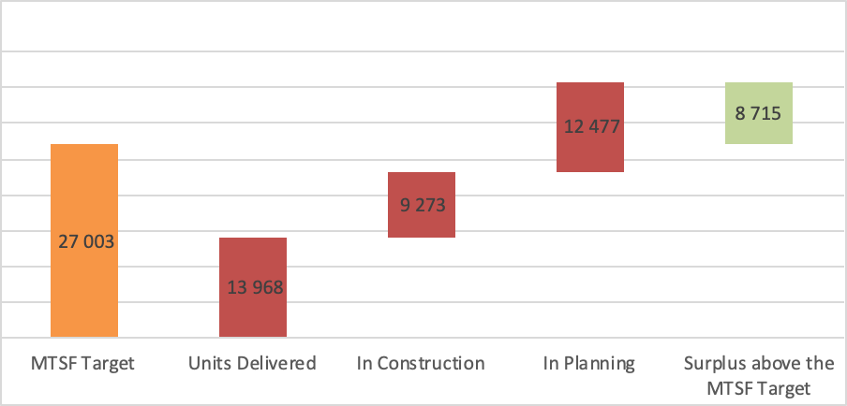
MTSF 2014-2019 ACHIEVEMENT = STARTING POINT FOR MTSF 2019-2024
A total of 13 968 units have been delivered, a further 23 241 are in various stages of delivery with 9 273 of these already under construction and 12 477 have been awarded capital grants but are yet to break ground.
As far as the accreditation of units is concerned, SHRA has exceeded the MTSF target of 27 003 by 8 611 units.

Slide 18
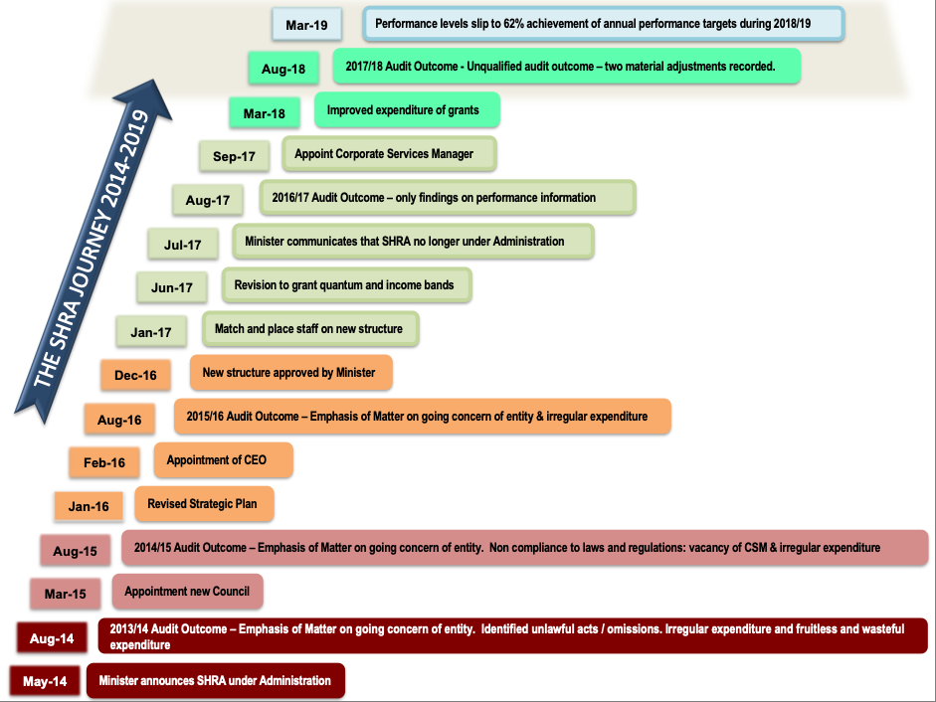
SHRA HISTORICAL VIEW

Slide 19
ORGANISATIONAL PERFORMANCE RATE

Slide 20
Problem Statement 1:
Indicative budget for the 2019-2024 MTSF is R4 billion, while approximately R8 billion is needed to deliver 30 000 units at current prices.
If additional funding is not sourced/received, the possibility exists that only 50% of the targeted 30 000 units will be delivered
PROBLEM STATEMENTS
PROBLEM STATEMENT 1: DELIVERY OF 30 000 NEW SOCIAL HOUSING UNITS
There is a substantial gap of ±R4 billion between the available grant and the funding that is needed to deliver the 30 000 social housing units by March 2024.
PROBLEM STATEMENT 2: EFFECTIVE REGULATION OF THE SOCIAL HOUSING SECTOR
The SHRA has not asserted itself with authority as the Regulator of the social housing sector. The result is a non-compliant and unsustainable social housing sector.
The SHRA is, however, duty-bound to correct the situation, as per the mandate provided by the SHA and applicable regulations and policy, and to ensure that the rental stock is managed by competent and efficient landlords, servicing empowered and responsible tenants
Problem Statement 2:

Slide 21
SHRA SWOT ANALYSIS

Slide 22
SHRA SWOT ANALYSIS
22

Slide 23
PERFORMANCE INFORMATION
“OUTPUT INDICATORS AND TARGETS IN THE APP 2020/21”

Slide 24
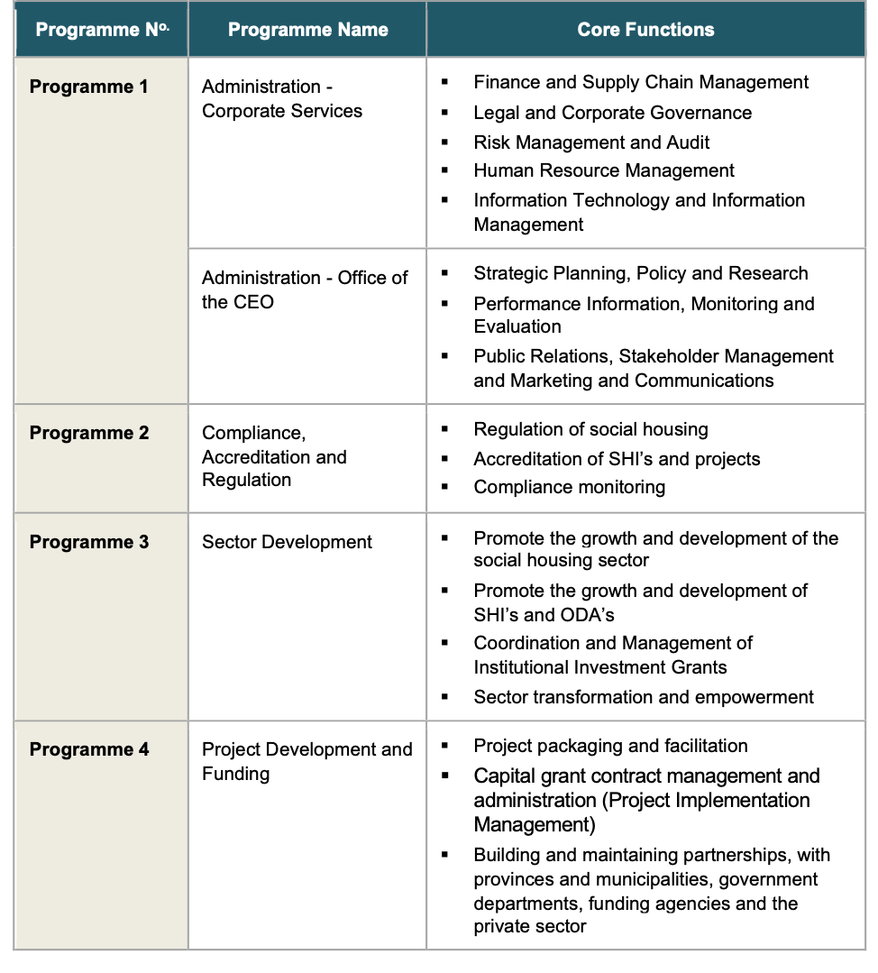
SHRA PROGRAMMES

Slide 25
SHRA OUTPUTS, OUTPUT INDICATORS AND TARGETS (APP)
PROGRAMME ONE: ADMINISTRATION
Outcome (SP) | APP Output | Output Indicator | Baseline 2019/20 (Estimated Performance) | Annual Target (2020/21) Refer to APP for Quarterly Targets
Outcome 1: Functional, efficient and integrated government | 1.1. Internal Audit Plan | 1.1.1. Percentage implementation of the approved internal audit plan | New indicator | 100% implementation of the approved internal audit plan
 | 1.2. Statutory tabling and prescripts | 1.2.1.. Percentage compliance with statutory tabling and prescripts | New indicator | 100% compliance with statutory tabling and prescripts
 | 1.3. Anti-Fraud and Corruption | 1.3.1. Percentage adherence to in terms of the Anti-Fraud and Corruption policy | New indicator | 100% adherence to the Anti-Fraud and Corruption policy
 | 1.4. Risk Management | 1.4.1. Percentage implementation of the approved risk management plan | New indicator | 100% implementation of the approved risk management plan
 | 1.5. Communications and Stakeholder Management | 1.5.1. Percentage implementation of the annual stakeholder management plan | Indicator reframed | 80% implementation of the annual stakeholder management plan
Outcome 6: A transformed Social Housing Sector Value chain | 6.1. B-BBEE codes and procurement set-asides implemented | 6.1.1. Percentage procurement spend to majority black-owned or controlled service providers | 65% procurement spend to majority black-owned or controlled service providers | 70% procurement spend to majority black-owned or controlled service providers
 |  | 6.1.2. Percentage procurement spend on designated groups | 30% procurement spend on designated groups | 30% procurement spend on designated groups

Slide 26
SHRA OUTPUTS, OUTPUT INDICATORS AND TARGETS (APP)
PROGRAMME TWO: COMPLIANCE, ACCREDITATION AND REGULATION
Outcome (SP) | APP Output | Output Indicator | Baseline 2019/20 (Estimated Performance) | Annual Target (2020/21) Refer to APP for Quarterly Targets
Outcome 5: An effectively regulated and sustainable social housing sector | 5.1. A compliant social housing sector | 5.1.1. Percentage of reporting SHIs and ODAs meeting 3 or more out of 5 of the primary performance benchmarks | 61% (16/28) of reporting SHIs and ODAs meeting 3 or more out of 5 of the primary performance benchmarks | 71% (20/28) of reporting SHIs and ODAs meeting 3 or more out of 5 of the primary performance benchmarks
 |  | 5.1.2. Number of subsidised housing units' tenancy audits conducted | 3 300 subsidised housing units' tenancy audits conducted | 3 300 subsidised housing units' tenancy audits conducted
 |  | 5.1.3. Number of subsidised housing units' building condition audits conducted | 3 300 subsidised housing units' building condition audits conducted | 2 000 subsidised housing units' building condition audits conducted
 | 5.2. Growing portfolio of social housing units under regulation | 5.2.1. Number of Institutional Housing Subsidy projects brought under regulation | 4 x Institutional Housing Subsidy projects brought under regulation | 4 x Institutional Housing Subsidy projects brought under regulation
Outcome 6: A transformed social housing sector value chain | 6.2. Increased proportion of project applicants that are black majority owned or controlled (>50% black) | 6.2.1. Percentage of projects in the pipeline that are from capital grant applicants that are black majority owned or controlled (>50% black) | 65% of projects in the pipeline are from capital grant applicants that are black majority owned or controlled | 70% of projects in the pipeline are from capital grant applicants that are black majority owned or controlled

Slide 27
SHRA OUTPUTS, OUTPUT INDICATORS AND TARGETS (APP)
PROGRAMME THREE: SECTOR DEVELOPMENT AND TRANSFORMATION
Outcome (SP) | APP Output | Output Indicator | Baseline 2019/20 (Estimated Performance) | Annual Target (2020/21) Refer to APP for Quarterly Targets
Outcome 3: Enhanced performance of delivery agents and projects | 3.1. Institutional investment Grant programme implemented | 3.1.1. Percentage of preselected qualifying institutions supported through a customised incubation programme to have projects in the pipeline by the end of the financial year | 50% (5/10) of preselected qualifying institutions supported through a customised incubation programme to have projects in the pipeline by the end of the financial year | 50% (3/6) of preselected qualifying institutions supported through a customised incubation programme to have projects in the pipeline by the end of the financial year
 |  | 3.1.2. Percentage of identified SHIs that received an IIG, of which the intervention is completed within the current financial year, at minimum, maintained their level of accreditation | 75% of identified SHIs that received an IIG, of which the intervention is completed within the current financial year, at minimum, maintained their level of accreditation | 75% of identified SHIs that received an IIG, of which the intervention is completed within the current financial year, at minimum, maintained their level of accreditation
 |  | 3.1.3. Percentage of identified projects that received an IIG, of which the work is completed within the current financial year, are recommended for capital grant award | 77.5% of identified projects that received an IIG, of which the work is completed within the current financial year, are recommended for capital grant award | 75% of identified projects that received an IIG, of which the work is completed within the current financial year, are recommended for capital grant award

Slide 28
SHRA OUTPUTS, OUTPUT INDICATORS AND TARGETS (APP)
PROGRAMME THREE: SECTOR DEVELOPMENT AND TRANSFORMATION
Outcome (SP) | APP Output | Output Indicator | Baseline 2019/20 (Estimated Performance) | Annual Target (2020/21) Refer to APP for Quarterly Targets
Outcome 4: Increased capacity of municipalities and provinces to deliver social housing | 4.1. Provinces capacitated in provincial social housing programmes | 4.1.1. Number of provinces that achieve at least 80% of the criteria for supporting a functional Social Housing Programme | New indicator | 7 provinces that achieve at least 80% of the criteria for supporting a functional Social Housing Programme
 | 4.2. Municipalities capacitated in local social housing programmes | 4.2.1. Number of social housing projects with land availability agreements approved | New indicator | 3 social housing projects with land availability agreements approved
Outcome 6: A transformed social housing sector value chain | 6.3. Increased proportion of supported SHIs and projects that are majority black-owned or controlled | 6.3.1. Percentage of Institutional Investment Grant (IIG) recipients that are majority black-owned or controlled | 65% of IIG recipients are majority black-owned or controlled | 70% of IIG recipients are majority black-owned or controlled

Slide 29
SHRA OUTPUTS, OUTPUT INDICATORS AND TARGETS (APP)
PROGRAMME FOUR: PROJECT DEVELOPMENT AND FUNDING
Outcome (SP) | APP Output | Output Indicator | Baseline 2019/20 (Estimated Performance) | Annual Target (2020/21) Refer to APP for Quarterly Targets
Outcome 2: Quality affordable social housing for rental delivered in strategically located areas | 2.1. Social housing units completed and delivered | 2.1.1. Number of social housing units completed | 4 000 social housing units completed | 5 800 social housing units completed
 |  | 2.1.2. Number of social housing units delivered | 3 513 Social housing units delivered | 6000 Social housing units delivered
 | 2.2. Expenditure of the Consolidated Capital Grant (CCG) | 2.2.1. Percentage expenditure of the approved annual Consolidated Capital Grant cash flow projection | Indicator reframed | 95% expenditure of the approved annual Consolidated Capital Grant cash flow projection
 | 2.3. Social Housing Development Plan | 2.3.1. Timeline for the submission of a 5-year development plan for delivery of 30 000 social housing units | New indicator | 5-year development plan for delivery of 30 000 social housing units submitted by end Q2 2020/21
Outcome 6: A transformed social housing sector value chain | 6.4. Increased proportion of funded enterprises that are majority black-owned or controlled and from the designated groups | 6.4.1. Percentage of Consolidated Capital Grant (CCG) awarded to black majority owned / controlled enterprises | 65% of CCG awarded to black majority owned / controlled enterprises | 70% of CCG awarded to black majority owned / controlled enterprises
 |  | 6.4.2. Percentage of Consolidated Capital Grant (CCG) allocation awarded to the designated groups | 30% of CCG allocation awarded to the designated groups | 30% of CCG allocation awarded to the designated groups

Slide 30
RISKS AND MITIGATION MEASURES

Slide 31
OUTCOMES - RISKS AND RISK MITIGATION (1 of 3)
Outcome | Key Risk | Risk Mitigation
Outcome 1: Functional, efficient and integrated organisation | Ineffective organisational performance arising from insufficient and inadequate resources. | Automation of processes; Implement a culture of performance management; Implement knowledge management process to improve organisation memory; Review and capacitate organisation structure and upskill as required; Enforce contract management, including but not limited to, evaluation of accreditation assessors, contractors, etc.
Outcome 2: Quality affordable social housing for rental delivered in strategically located areas | Insufficient resources to meet delivery targets. | Engage and motivate for additional sources of funding; Use of Project Review Consultants (PRCs) to monitor performance during construction; Benchmark, review and capacitate organisation structure; Strengthen the due diligence capability and procedures within the SHRA.
 | Inability to upscale the delivery of social housing. | Engage participation of private sector as the developers for social housing, with SHIs coming in at the tenant and property management stages.
 | Failure to implement social housing policy - public policy is not aligned with economic forces. | Policy reform process to be instituted.
 | Unavailability of strategically located land. | The SHRA to participate in the spatial targeting initiative of the National Department and HDA; Proactive approach to request proposals to mitigate spatial planning issues.

Slide 32
OUTCOMES - RISKS AND RISK MITIGATION (2 of 3)
Outcome | Key Risk | Risk Mitigation
Outcome 3: Enhanced performance of delivery agents/ entities and projects | Project owner is non -complaint with norms, standards and compliance benchmarks. | Engagement with SHIs and ODAs on non - compliance and strengthen enforcement and support; Monitor the continued implementation of projects by SHIs over time, and communicate the importance of long-term sustainability and financial viability of SHI and ODA is tied to continued project delivery.
 | Inability and ineffectiveness (poor performance) of SHIs and ODAs to continuously and sustainably implement and manage units.
Outcome 4: Increased capacity of municipalities and provinces to deliver social housing | Lack of associated support (from political leadership) for social housing initiatives in provinces and municipalities, arising from a lack of knowledge. | Implement the communications strategy; Implement the stakeholder and change management plan to ensure engagement with relevant officials at Provincial and Municipal levels.
 | Lack of capacity in provinces and municipalities to drive social housing programmes.

Slide 33
OUTCOMES - RISKS AND RISK MITIGATION (3 of 3)
Outcome | Key Risk | Risk Mitigation
Outcome 5: An effectively regulated and sustainable social housing sector | Delivery agents without requisite capability are accredited. | Redesign accreditation processes and evaluation tools to improve quality of accredited SHIs and ODAs.
 | Unplanned or uncoordinated involvement by various stakeholders (external to contract or court order) impacts the sustainability of the sector. | Develop and implement the stakeholder management plan and supporting communication strategy.
 | The SHRA role as the regulator poorly received or rejected by the sector due to legacy issues. | Implement the stakeholder management plan; Implement the brand management plan.
 | Insufficient expertise within the SHRA to perform and enforce its regulatory role as per the Act. | Fast-track the capacitation of the organisation structure.
Outcome 6: A transformed social housing sector value chain | Lack of implementation of the Property Sector Charter. | Implement, monitor and report on SHI and ODA spend on designated groups as per the sector code.

Slide 34
CONTENTS
        1
STRATEGIC PLAN
        2
ANNUAL PERFORMANCE PLAN
        3
BUDGET
MTEF BUDGET AND ESTIMATES
RECOMMENDATION

Slide 35
2020/21 MTEF BUDGET AND ESTIMATES

Slide 36
SUMMARY OF REVENUE
All Programmes (R’000) | Audited Outcome |  |  | Approved Budget Estimate | MTEF Budget Estimates
 | 2017/18 | 2018/19 | 2019/20 | 2020/21 | 2021/22 | 2022/23 | 2023/24
Revenue:
Operational Grant | 46 815 | 51 980 | 55 201 | 58 237 | 60 939 | 63 123 | 66 910
Consolidated Capital Grant | 851 658 | 743 640 | 723 706 | 725 747 | 764 646 | 791 144 | 838 613
Institutional Investment Grant | 20 490 | 20 132 | 21 259 | 22 428 | 23 662 | 24 764 | 26 250
Regulations | 8 000 | 10 000 | 10 560 | 11 141 | 12 255 | 13 481 | 14 289
Total revenue: | 926 963* | 825 752* | 810 726 | 817 553 | 861 502 | 892 512 | 946 062
*Excludes interest earned in FY2017/18 of R44 031 000 and in FY 2018/19 of R51 144 000
The operational grant has increased from R46.81m to R58.2 m representing an average annual growth form 2017/18 to 2020/21 of 7.5% with the outer years of the MTEF reflecting a constant amount or decrease in real terms.
The total revenue of R817.553m in 2020/21 to R946.06m in 2023/24 represents an average growth of 5% over the MTEF period

Slide 37
Rand thousand (R’000) | 2017/18 | 2018/19 | 2019/2020 | 2020/21 | 2021/22 | 2022/23 | 2023/24
 | Audited Outcome | Audited Outcome | Budget | Budget | Budget | Budget | Budget
Current payments | 52 395 | 77 430 | 65 761 | 69 378 | 73 194 | 76 604 | 81 200
Compensation of employees | 27 777 | 38 143 | 40 960 | 45 508 | 48 003 | 50 883 | 53 936
Goods and services | 24 042 | 38 102 | 23 256 | 22 093 | 23 291 | 23 820 | 25 364
Of which
Advertising | 2 503 | 2 254 | 2 402 | 2 642 | 2 642 | 2 801 | 2 969
Audit costs | 1 517 | 1 720 | 1 892 | 2 081 | 2 289 | 2 400 | 2 500
Bank charges | 42 | 47 | 52 | 57 | 63 | 66 | 71
Communication | - | - | 1 003 | 1 063 | 1 127 | 1 127 | 1 195
Computer services | 553 | 1 122 | 828 | 1 120 | 1 140 | 1 208 | 1 281
Consultants | 9 403 | 15 903 | 5 837 | 5 452 | 5 982 | 6 341 | 6 721
Lease Payments | 2 235 | 3 911 | 3 208 | 3 769 | 3 976 | 4 215 | 4 467
Legal fees | 1 977 | 3 437 | 3 286 | 2 107 | 2 229 | 2 014 | 1 240
Non-life insurance | 185 | 109 | 120 | 127 | 135 | 143 | 150
Repairs and maintenance | 64 | 68 | 88 | 97 | 102 | 157 | 166
Research & Dev. | - | - | - | - | - | 674 | 715
Training & staff Dev | 885 | 2 018 | 1 530 | 1 678 | 1 772 | 1 828 | 1 929
Travel and subsistence | 2 650 | 3 921 | 3 010 | 1 900 | 1 834 | 847 | 1 961
Other unclassified expenditure | 2 028 | 3 592 | - | - | - | - | -
Operational costs | 2 028 | 3 592 | - |  | - | - | -
Depreciation | 576 | 1 185 | 1 545 | 1 777 | 1 900 | 1 900 | 1 900
Transfers and subsidies | 623 244 | 789 057 | 744 965 | 748 175 | 788 308 | 815 908 | 864 862
Social Housing grant recipients | 623 244 | 789 057 | 744 965 | 748 175 | 788 308 | 815 908 | 864 862
Total Expenditure | 675 639 | 866 487 | 810 726 | 817 553 | 861 502 | 892 512 | 946 063
SUMMARY OF ACTUAL AND BUDGETED EXPENDITURE

Slide 38
EXPENDITURE COMMENTARY
During FY2018/19, R47.584m of over-expenditure was reported. R31.016m was attributable to capital expenditure and R16.568 on operational expenditure.
The significant operational cost drivers, include recurring items and directly linked to regulation in terms of professional fees to conduct tenancy audits and building conditions assessments. Also directly linked to delivery would be fees linked to assessment of institutions and projects submitted to the SHRA as project applications.
The implication of the 2020/21 budget allocation is that certain resources, identified as critical success factors in the strategy, have not been sufficiently resourced (e.g. HR, IT, Marketing and Comms, Regulatory aspects)

Slide 39
RECOMMENDATION
For the Portfolio Committee on Human Settlements, Water and Sanitation to NOTE the SHRA’s;
  Strategic Plan for the Period 2020/21 – 2024/25;
  Annual Performance Plan 2020/21; and
  Budget

