Slide 1
Provincial Treasury
FOURTH QUARTER PERFORMANCE & PRE-AUDITED FINANCIAL OUTCOMES for the 2022/23 FINANCIAL YEAR
Presentation to Budget Committee
21 July 2023

Slide 2
Annual Pre-audit Provincial Performance Report

Slide 3
Context of the integrated performance data
This presentation:
Is for the year ending 31 March 2023 and contains the provisional (unaudited) outcome for the financial year.
The financial analysis compares expenditure performance based on the Adjustments Budget.
The quarterly release in pre-audit data presents an integration of non-financial and financial performance data. As part of the transformed journey to increase the depth and breadth on the use of performance data to improve service delivery, this presentation continues to provide an integrated view of:
Socio-economic trends of the WC;
Performance delivery trends for the WCG; and
Trends as it relates to the contribution to Jobs, Safety and Wellbeing priority priorities.
Part A: Overview of socio-economic and performance trends for WC
Part B: Overview of financial performance trends for WCG
Part C: Delivery trends (attached to presentation)
The value of this integration is to take stock of where we are; what we need to do to fast track and strengthen our collaborative efforts to improve service delivery. A performance dialogue will trigger an evaluative reflection on our performance.

Slide 4
Part A: Overview of socio-economic and performance trends for WC

Slide 5
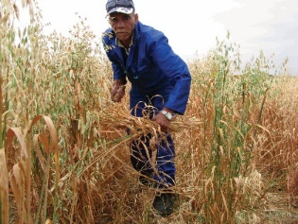
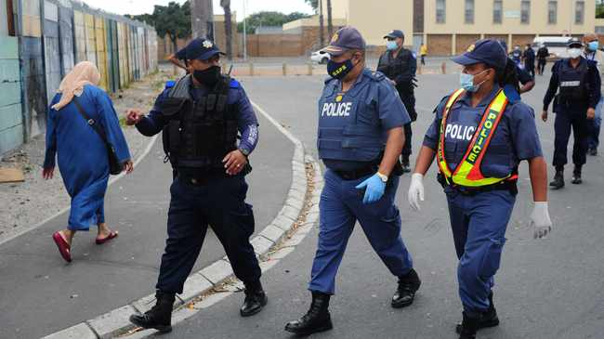
Socio-economic picture through PSIP outcome indicators
Jobs
Safety
Well-being
GDP for the WC contracted by 1.4% during Q4 of 2022
Number of people unemployed decreased by 2.0%
Official unemployment rate stood at 22.5%
Decrease in violent crime: homicides in the WC decreasing by 11.3% y-o-y from Q4 2021/22
13 priority areas in the Cape Metro recorded 10.7% decrease in homicides
This accounted for 44.7% of all homicides in the Province
13% decrease in the number of sexual assault presentations at public hospitals compared to last year
2022 systemic results have found that the percentage of learners in Grade 3 attaining acceptable outcomes in Reading for Meaning is 43.5% and in Mathematics, 47.32%.
Youth unemployment rate has decreased by 1,6% quarter-on-quarter to 32.9%
15.22% of children born in government facilities weighed under 2500g
Source: PSIP
40 outcome indicators (Jobs: 22; Safety: 6; Wellbeing: 12)

Slide 6
Overview of financial year delivery trends for performance indicators
Overview of provincial performance | Overview of departmental APP performance | Overview of public entity APP performance
Overall performance over financial year = 84% (793 of 947 targets achieved) | Achieved = 670 of 801 targets (84%) One of the 13 departments achieved 100% of all their targets. Partially achieved = 100 targets (12%) Not achieved = 31 targets (4%) | Achieved = 123 of 146 targets (84%) Four out of 10 public entities achieved 100% of all their targets. Partially achieved = 15 targets ( 10%) Not achieved = 8 targets (or 5%)
Performance Trends 2022/23: Overall performance for Q1 = 80% (388 of 485 targets achieved) Overall performance for Q2 = 83% (422 of 534 targets achieved) Overall performance for Q3 = 76% (408 of 536 targets achieved) Overall performance for Q4 = 77% (681of 879 targets achieved) | Departmental clusters performance: Governance Cluster = 97% Social Cluster = 73% Economic Cluster = 88% | Public entities clusters performance: Governance Cluster = 94% Social Cluster = 84% Economic Cluster = 83%
Source: eQPRS

Slide 7
Average annual performance – Provincial Departments
Eight (8) departments achieved more than or equal to (≥) the WCG average of 84%:
DotP (100%); PT (95%); DLG (97%); DOCS (98%); DCAS (94%); DOA (96%); DEDAT (96%) and DEA&DP (88%).
Five (5) departments achieved less than (<) the WCG average of 84%:
WCED (61%); DOH (58%); DSD (68%); DHS (63%) and DTPW (70%).

Slide 8
Average annual performance – Provincial Public Entities
Eight (8) public entities achieved more than or equal to (≥) the WCG average of 84%:
WCGRB (94%); HWC (100%); WCLC (100%); WCCC (100%); WESGRO (85%); SBIDZ (87%); CapeNature (100%); and ASEZ (94%).
Two (2) public entities achieved less than (<) the WCG average of 84%:
WCLA (77%) and Casidra (60%).

Slide 9
Part B Overview of Financial Performance (Pre-Audited)
Expenditure
Infrastructure
Revenue

Slide 10
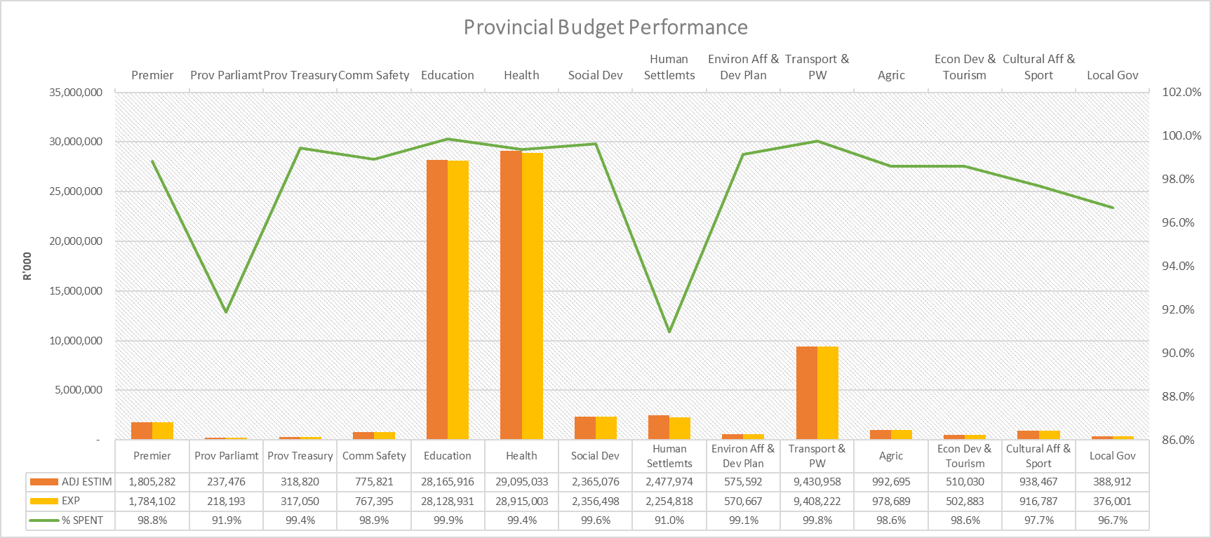
Provincial Budget Performance as at 31 March 2023
R77.495 billion or 99.3 % of WC budget spent. Lowest % spent - conditional grants (HS)

Slide 11
Provincial Expenditure as at 31 March 2023
Per economic classification:
Underspending:
Transfers and subsidies – mainly Human Settlements – grant funding delayed due to community unrest and blocking of projects
Payments for Capital Assets
Delayed implementation of infrastructure projects - mainly health and roads infrastructure
Overspending: Not unauthorised
COE – mainly Education
Goods and Services – mainly Health re service backlogs

Slide 12
Compensation of Employees – spending and headcount
COE headcount management:
Net growth of 1044:
Education 1 771 posts – additional educator posts due to growing leaner numbers
Health 670 - mainly termination of the contract COVID-19 posts as well as delays in recruiting of staff
Other depts. 57
* Excludes Direct Charges and the members of the provincial legislature

Slide 13
Provincial Infrastructure as at 31 March 2023
Main underspending:
Health: Global Logistical Network challenges delayed delivery of high-value Health Tech (equipment) imports.
Delays in municipal approvals - Land Use Management Scheme (LUMS) applications and Professional Service Providers (PSP) appointments.
Poor performance by Service Providers.
Delays in filling of professional posts to enable faster implementation of projects.
Human Settlements: Conditional grant funding (HSDG & ISUPG) delayed due to community unrest that prevented contractors from building and blocking projects. R212.134m has been approved for rollover to the 2023/24 financial year.
CapeNature: Supplier delays. Project timelines adjusted to accommodate longer lead times of critical materials.
Public Works: Overspending
Higher overall demand for cleaning services.
Unforeseen day-to-day maintenance and reactive responses = additional emergency requests. Load shedding resulted in a greater number of mechanical breakdowns and increased requirements for diesel.

Slide 14
Provincial own Revenue as at 31 March 2023
Main contributors to
additional own revenue collection:-
Gambling taxes
Human Settlements
Health
Transport and Public Works

Slide 15
Spending on Public Entities
Overspending:
WC Gambling and Racing Board:
An accrual for services-in-kind (non-cash) related to the rental and utilities accounted for within the Board’s Administrative Programme.
Atlantis Special Economic Zone (ASEZCo):
Mainly due to the purchase of a building to house investors and will be offset against the overcollection of budgeted revenue
Main underspending:
Western Cape Tourism, Trade & Investment Promotion Agency:
Goods and Services across various items related to accruals still to be finalised;
CoE due to the vacant CFO posts
Casidra:
Vacant positions put on hold due to lower income projections.
The Western Cape Liquor Authority (WCLA)
CoE - CFO post becoming vacant
Buildings and other Fixed structures - challenges in the construction of the client services centre relating to occupational health and safety and supply chain management.
Western Cape Nature Conservation Board:
CoE –filling of critical posts only and G&S - delays in procurement that led to Natural Resource Management/ Integrated Catchment Management projects being deferred to 2023 financial year.

Slide 16
Part C: Delivery Trends

Slide 17
Overview of delivery trends
DotP | 45 Western Cape Government services were made available to citizens on a mobile application platform. This was done in order to improve citizen access to government services
PT | 26 Bursaries awarded as a result of all bursary agreements signed.
DOCS | 3 Social Crime Prevention Programme implemented to promote community participation in crime prevention. 151 Community Police Forums assessed on functionality in the District Municipalities this year. 28 District Municipality Community Safety Forums assessed on functionality and effectiveness in line with CSF policy and implementation guidelines this year.
WCED | New technical and focus schools to be built are in planning. New Schools of Skills to be built are in planning. 8 new schools have reached completion. 7 new schools are under construction
 | 98.6% of SGBs have met the minimum criteria in terms of governance functionality. 3.8% of Grade 12 learners offer at least one subject in the technical, agricultural and vocational fields. 130 schools received Local Area Networks (LANs). 22 072 learners were subsidised at registered independent schools. 595 Learning Support teachers at public ordinary schools are employed. 12 Public Ordinary Schools are supported by special schools serving as resource centres. 2 147 learners are registered in Year 4 in a School of Skills curricula. 14 public schools were assessed for suitability to offer grade R. 17.7% of Grade 12 learners achieved at least one distinction in any subject in the NSC examination. A total of 26 428 subject distinctions was achieved in the Grade 12 NSC examination.
Governance
Measuring output indicators of the PSIP and
Selected service delivery indicators via eQPRS

Slide 18
Overview of delivery trends
DOH | Patient Safety Incident (PSI) cases closed and finalized at different hospitals across the Western Cape as follows: District Hospitals 98.2% Specialised Hospitals 97.9% Central Hospitals 97.2% Tertiary Hospitals 99.6% 63.1% average performance rate maintained towards the severity assessment code (SAC) of incidents reported within 24 hours in District Hospitals. 1349 Bursaries were awarded for scarce and critical skills categories within the Health Sector 62.4% of mothers received postnatal care within 6 days after delivery. 11.5% of deliveries were to women under the age of 20 years as proportion of total deliveries in health facilities. 50.2% of women were protected against pregnancy by using modern contraceptive methods, including sterilisations, as proportion of female population 15-49 year. 62.3% of maternal deaths occurred per 100,000 live births in District hospitals. 77.7% of children under 1 year (12 months) received measles 2nd dose, as a proportion of the 1-year population. 55.1% of children aged 12-59 months received vitamin A 200,000 units, every six months as a proportion of population aged 12 - 59 months. 60.2% and 53.3% average performance rate was maintained towards all ART child and adult who remain in care. 66% of ART child viral load under 400 supressed as a proportion of ART child viral load done at 12 months. 92.4 of ART adult viral load under 400 supressed as a proportion of ART adult viral load done at 12 months 75.4% of TB clients who started drug-susceptible tuberculosis (DS-TB) treatment have successfully completed the treatment. Complaints resolved in hospitals within 25 working days are as follows: District Hospitals 92.7% Regional Hospitals 99.5% Specialised Hospitals 98.4% Central Hospitals 92.1% Tertiary Hospitals 100%

Slide 19
Overview of delivery trends
DOH | 94.9% of all reported patient safety incident (PSI) cases in Regional Hospitals were closed. 24.6% EMS P1 in urban locations responded to under 15 minutes. 53.2% EMS P1 in urban locations responded to under 30 minutes. 76.5% EMS P1 responded to in rural locations under 60 minutes. 50.2% of all emergency responses responded to under 120 minutes. Severity assessment code (SAC) 1 Incidents reported within 24 hours as a proportion of Severity assessment code (SAC) 1 Incident reported are as follows: Regional Hospitals 65.9% Specialised Hospitals 30% Central Hospitals 53.3% Total number of satisfied responses as a proportion of all responses from Patient Experience of Care survey questionnaires in: District Health System 74.1% Regional Hospitals 78.5% Specialised Hospitals 79.9% Central Hospitals 82% Tertiary Hospitals 73.1%
 | 1349 Bursaries were awarded for scarce and critical skills categories within the Health Sector
DSD | 9 035 adults in conflict with the law referred to diversion programmes. 5 396 children in conflict with the law assessed. 11 human trafficking victims and their children accessed social services. 2 369 victims of crime and violence accessed services in funded Victim Empowerment Programme shelters. 1 525 victims of crime and violence accessing victim support services 5 770 adults in conflict with the law completed diversion programmes. 923 children in conflict with the law completed diversion programmes.
Measuring output indicators of the PSIP and
Selected service delivery indicators via eQPRS

Slide 20
Overview of delivery trends
DSD | 1 048 EPWP work opportunities created. 12 funded Youth Cafés.
 | 4 940 Older Persons benefitted from subsidised beds at NPO residential care facilities. 13 119 Older Persons benefitted from subsidies transferred to community-based care and support services. 1 647 Persons with Disabilities benefited from subsidised beds at funded NPO residential care facilities. 113 Persons with Disabilities (children and adults) accessed government-owned residential facilities. 2 655 Persons with Disabilities benefitted from protective workshops providing services. 1 033 Persons with Disabilities benefitted from community-based day care centres. 2 938 household undue hardship cases were assessed. 1 251 household disaster cases were assessed. 763 adult family members were reunited with their families. 19 428 families benefitted from participating in family preservation and support services. 260 children were reunified with their families or alternative caregivers.
DHS | 1230 serviced sites delivered. 3672 Breaking New Grounds (BNG) housing units delivered. 8 Capacitation workshops held with leader towns for the Social Housing Programme 1198 beneficiaries benefitted through the Enhanced Extended Discount Benefit Scheme (EEDBS) viz. the debt write-off policy. 331 title deeds transferred to qualifying beneficiaries of pre - 1994 housing units. 1880 title deeds registered for post-1994 housing developments. 973 title deeds registered for post - 2014 housing developments. 543 new title deeds registered for housing developments. Five (5) social compacts concluded with communities outlining their role in the upgrading process. Two (2) Social Housing projects supported for approval. One (1) Informal settlement upgraded to phase 3 of the Upgrading of Informal Settlements Programme (UISP)

Slide 21
Overview of delivery trends
DHS | 274 young people interested in construction trained. 272 beneficiaries earning between R0 – R3 500 per month provided with subsidies through the Individual Subsidy (Non-Credit Linked) Programme 1440 households received subsidies through FLISP (Finance Linked Individual Subsidy Programme) Two (2) banking forums were held with financial institutions.
DEADP | 421 compliance inspections conducted, due to the number of administrative enforcement notices issued. 6 completed criminal investigation handed to the NPA for prosecution.
 | 100% waste management licenses finalised within the legislated time frames. 53 environment capacity building activities conducted due to stakeholder requests and more opportunities presented, for sessions to be held. 3 non-infrastructure interventions completed by RSEP annually. 2 well-located land parcels assembled for development aimed at improved spatial transformation
 | 5 inspections conducted in respect of pollution control. 6 closure letters issued in respect of S30 cases. 13 decisions issued in respect of contaminated land cases received.
Measuring output indicators of the PSIP and
Selected service delivery indicators via eQPRS

Slide 22
Overview of delivery trends
DTPW | One (1) transport management initiatives supported. One (1) non-motorised transport initiatives supported. 45 861Km of gravel roads bladed to improve the safety of the road. 96Km of gravel roads re-gravelled to improve the capacity, safety, and riding quality of the road. 4 499 legal speed compliance operations conducted. 574 912 vehicles were stopped and weighed to ensure road safety. 4 320 drunken driving operations conducted to contribute towards crime prevention. 1 699 534 vehicles stopped and checked to ensure compliance with traffic regulations. 30 pedestrian operations conducted to ensure road safety. 418 road safety awareness interventions conducted. 244 schools involved to educate learners about road safety. 9 946 traffic law enforcement operations conducted to reduce road crash fatalities.
 | 97% of students successfully completing formal traffic training courses. 1 285 work opportunities created by Provincial Public Works for individuals through the EPWP projects. 27 new construction projects completed. 3 195 work opportunities created by Provincial Transport for individuals through the EPWP projects. 1 834 youth (aged between 18 and 35 years) have been employed by Provincial Transport on EPWP projects. 1 008 women have been employed by Provincial Transport on EPWP projects. 4 persons with disabilities have been employed by Provincial Transport on EPWP projects. 95 beneficiaries participating in the Contractor Development Programme
Measuring output indicators of the PSIP and
Selected service delivery indicators via eQPRS

Slide 23
Overview of delivery trends
DOA | 278 technical engineering activities supported, initiated to provided sustainable agricultural development to agricultural producers in the Western Cape. 1036 hectares of land under Conservation Agriculture practices cultivated, to minimize and reserve land degradation in order to improve agricultural production in the province. 1207 job for EPWP workers created in support of the Green economy, to rehabilitate and enhance the sustainable use and management of the natural agricultural resources. 45 farm management plans was provided with support. 12 producers in the red meat commodity markets supported, two (2) producers in the Grain commodity market and one (1) producer in the citrus commodity market, to develop and increase sustainable agricultural production. 25 black commercial farmers supported with the intent of increasing production. 80 agricultural business skills’ audits conducted to determine the training needs of subsistence and smallholder farmers. 32 “farmer’s days” facilitated. 31 smallholder producers supported to increase sustainable production through the effective use of production inputs, infrastructure, and equipment. 22 Research and Development (R&D) information packs developed. 18 technology transfer events organised and presented for information dissemination to all categories of farmers and other stakeholders. 112 graduates provided with accredited vocational agricultural qualifications, to increase their employability. 109 internal bursaries awarded to beneficiaries, through the Human Capital Development Strategy of the province. 65 learners assisted to complete their Learnership programmes and who are now declared competent in accredited formal skills programmes. 46 ASD learners assisted, who have gained access to higher education through an articulation process.

Slide 24
Overview of delivery trends
DOA | 455 Agri-workers, their families and rural community members assisted, through the referral system, with the intent of bringing service delivery closer to the farm workers and their family members in the Western Cape. 3992 households supported with agricultural food production initiatives to address food insecurity in the Western Cape and also, to combat the lingering impacts of the Covid-19 pandemic and the more current economic impact of the Ukraine war crisis.
 | 521 inspections conducted on meat producing outlets in the Western Cape to ensure compliance with the Meat Safety Act, Act 40 of 2000 and promote meat safety. 323 Veterinary Public Health samples tested for outlets producing food and cargo vessels docking at Cape Town harbour, in accordance with the ISO 17025 standard and / or DALRRD approval systems.
Measuring output indicators of the PSIP and
Selected service delivery indicators via eQPRS

Slide 25
Overview of delivery trends
DEDAT | 54 businesses assisted through municipal support interventions, to improve business support and easier access in performing business activities. Four (4) independently owned business entities in the townships assisted. R8 689 680 leveraged in support to SMME’s in the Western Cape. 16 capacity building interventions conducted on proposed best practice tools which create an enabling environment for the EODB. 215 consumer education interventions conducted to warrant an environment that is conducive for fair business practices and inform consumers in the Western Cape. 94% of all complaints received within 90 days resolved. 139 tourism establishments/individuals supported to improve and maintain a tourism enabling environment for organisations, businesses and tourists, through initiative such as Quality Assurance, Tourism Road Signage and Tourism Safety and Support. 4694 beneficiaries supported through skills interventions
DCAS | 28 Premier’s Advancement of Youth (PAY) interns employed. 431 EPWP job opportunities created. 470 staff members employed within the MOD programme. 709 existing after school practitioners trained.
 | Nine (9) Neighbourhood Clusters supported to promote and facilitate Culture, Arts, Recreation, Education and Sport activities across the province. Six (6) Culture, Arts, Recreation, Education and Sport (CARES) complexes supported that provide safe spaces for utilisation by school-going youth and school communities. 33 affiliated museums supported through transfer payments and administrative support. Three (3) libraries established with funding or partial funding from the Library Services. 228 libraries provided with public internet access.
Measuring output indicators of the PSIP and
Selected service delivery indicators via eQPRS

Slide 26
Overview of delivery trends
DCAS | 375 public libraries, mini libraries and depots are affiliated to the Library Services One (1) municipality assisted with funding to upgrade and maintain a library. Seven (7) indigenous games code structures supported. 25 recreation centres supported. Nine (9) districts supported by/through school sports. 134 neighbouring school centres supported to increase social inclusion and mass participation amongst participants at school. 181 MOD centres from disadvantages communities supported. Nine (9) districts supported through the MOD Programme. 315 practitioners benefitted from capacity building opportunities. Three (3) community conversation/ dialogue held to foster social interaction. 39 community arts and culture structures supported. 107 Arts and Culture organisations, individuals and companies financially supported. 20 arts and culture projects developed and promoted. One (1) Cultural Commission supported to promote, preserve and develop arts and culture in the province. 28 training programmes provided to public library staff. 134 affiliated districts sports federations supported. 135 major events supported to promote tourism. Four (4) fitness and wellness programme by the gymnasium facilitated. Six (6) sport and recreation days held. 176 sport persons trained. Four (4) facilities projects in the Municipalities supported. 50 athletes supported through higher performance programmes. Ten (10) events supported to develop sport and recreation for women and girls.
Measuring output indicators of the PSIP and
Selected service delivery indicators via eQPRS

Slide 27
Overview of delivery trends
DLG | Five Municipalities were supported in developing Disaster Risk Reduction measures in their IDPs. One Hazard Awareness Programme Facilitated to educate communities on hazards, disaster preparedness & provide emergency numbers.
 | Four Socio-economic projects were facilitated. Four Support actions were implemented to ensure effective functioning of the Thusong Programme. Five Government initiatives were implemented to enhance social well-being.
 | Four Initiatives were implemented to support the informal economy.
SBIDZ | R 0.604b contribution to the National GDP by investment in the zone R0,491b contribution to the Western Cape GGP by investment in the zone 944 direct and indirect jobs created throughout South Africa 35 tenant and operator lease agreements signed to facilitate revenue generation and economic activity in the Zone.
WCLA | 96% of licensees met the criterion in section 64(1) of the Act that are subjected to the non-automatic renewal process. (Target 90%) 98% of non-automatic renewal matters by the Liquor Licencing Tribunal finalised (target 95%) 100% of valid licenced outlets inspected.
Measuring output indicators of the PSIP and
Selected service delivery indicators via eQPRS

Slide 29
Compensation of Employees

Slide 30
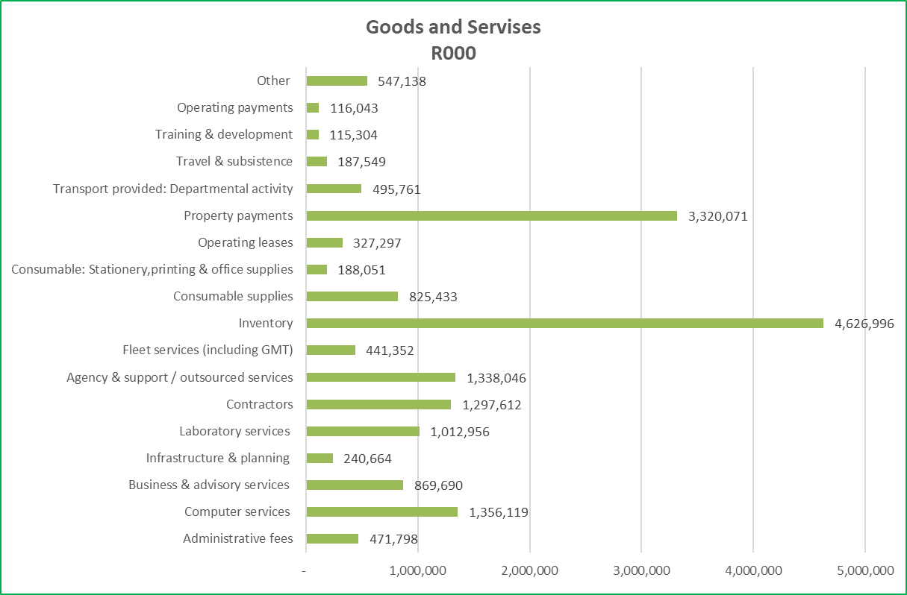
Good and Services

