Slide 1
Strategies to address Acute Malnutrition and High Mortality rates of children under 5 in the Province
Standing Committee on Health and Wellness
Cape Town
Dr S Kariem

Slide 2
Outline of presentation
Setting the Context
Current Strategies
Multisector
Engagement
What is Acute Malnutrition, What Causes it, and what does it look like in the Western Cape
What is currently being done by the Western Cape to reduce the impact of Acute Malnutrition
Analysis of the Multi-stakeholder engagements currently being implemented

Slide 3
Malnutrition in the Western Cape

Slide 4
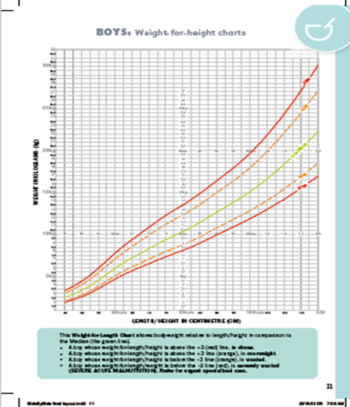
Introduction
Malnutrition, as defined by WHO, encompasses nutrient deficiencies or excesses, imbalances, and impaired utilization, including both overnutrition (related to overweight/obesity) and undernutrition (acute/chronic malnutrition, micronutrient deficiencies).
Acute Malnutrition is a result of a sudden reduction in food intake or the poor quality of food, often associated with pathological causes.
2 main categorizations:
1. Severe Acute Malnutrition is defined and measured by:
Mid-Upper Arm Circumference (MUAC) of less than 11.5cm in children aged 6–60 months (circumference of child’s left upper arm).
Weight-for-Height (WH) or Weight-for-Length (WL) below -3 standard deviations (SD) or z-score <-3
The presence of bilateral pitting pedal oedema (nutritional oedema).
2. Moderate Acute Malnutrition is defined as:
a WH/L between -3 and -2 SD below the median of the WHO child growth standards/ z-score between -3 and -2; or MUAC between 11.5cm and 12.5. The child doesn’t have any oedema and has a good appetite.
Chronic malnutrition results from insufficient intake or absorption of essential nutrients over a protracted period.
Lenters L, Wazny K, Bhutta ZA. Management of Severe and Moderate Acute Malnutrition in Children. In: Black RE, Laxminarayan R, Temmerman M, et al., editors. Reproductive, Maternal, Newborn, and Child Health: Disease Control Priorities, Third Edition (Volume 2). Washington (DC): The International Bank for Reconstruction and Development / The World Bank; 2016 Apr 5. Chapter 11. Available from: https://www.ncbi.nlm.nih.gov/books/NBK361900/ doi: 10.1596/978-1-4648-0348-2_ch11

Slide 5
Classification of Malnutrition
Malnutrition
Acute
Moderate
Severe
Chronic (stunting)
Overweight/Obesity
deficiencies or excesses in nutrient intake, imbalance of essential nutrients or impaired nutrient utilization
sudden reduction in food intake or the poor quality of food
Can Become
Severe starvation

Slide 6
Causes of Malnutrition
Malnutrition is multifaceted and can be caused by numerous factors throughout a child’s life. Some of which Include:
Food insecurity: Limited access to sufficient, nutritious food due to poverty, unemployment, and unequal distribution of resources
Inadequate breastfeeding practices: Suboptimal breastfeeding, such as early introduction of formula or inadequate exclusive breastfeeding
Poor dietary diversity: Limited availability and affordability of diverse and nutritious foods, coupled with unhealthy eating patterns
Inadequate maternal and child healthcare: Insufficient access to quality healthcare services, including prenatal and postnatal care
Water and sanitation challenges: Lack of clean water, sanitation facilities, and hygiene practices
Social and economic factors: Socioeconomic disparities, unemployment, limited education, and social
HIV/AIDS: The prevalence of HIV/AIDS in the Western Cape can affect nutritional status
Targeted directly by the First 1000 days initiative → Decrease in stunting rates seen in 2023 baseline survey

Slide 7
Stunting Baseline
Conducted to assess and establish the prevalence and severity of stunting among children in the province
Aimed to gather data on the current status of stunting, identify high-risk populations, and inform targeted interventions and policies to address the issue
2023 stunting survey showed overall improvement: 27.4% in 2016 to 17.55% in 2023
It also found that 19.7% of children under the age of two are stunted.
Additional interventions to further prevent and control malnutrition in children under-5-year-old children will be implemented following a whole of society approach
Goal now to engage different stakeholders who will best be able to achieve recommendations created from baseline survey
Importance of dietary diversity
Children are not consuming necessary nutrients but are eating high sugar/fat foods
Emphasizing Exclusive Breastfeeding: Only 18% of all children were exclusively breastfed
Key Considerations:
Preventing risky behaviours like smoking during pregnancy Successful predictor of stunting
Improving infrastructure: Those without proper access to clean water had an increased risk of stunting

Slide 8
Stunting predictors
6 months-<2 years
2 years-<5 years

Slide 9
Surge Season: U5 LRTI Episodes & Admissions
u5 LRTI admissions peaked in March this year with 2050 admissions but decreased in April to June relative to 2022.
Data: LRTI admissions here are all admissions where an ICD10 code matched the PHDC mapping for ICD10 codes for LRTI, on any diagnostic field, at any date from admission to discharge.
The rate of u5 LRTI admitted episodes peaked earlier compared to 2017-2021, and only crossed the median intensity threshold.
Data: LRTI episodes here are all encounters where an ICD10 code matched the PHDC mapping for LRTI, on any diagnostic field, from all electronic sources. All encounters within a 21 days window from first evidence date are counted as a single episode per pmi. Only episodes where an admission occurred within 21 days are used to calculate the provincial rate per 100 000.

Slide 10
Surge Season: Diarrhoea Admissions
Diarrhoea admissions in 2023 remain lower compared to 2022.
Data: Diarrhoea admissions here are all admissions where an ICD10 code matched the PHDC mapping for ICD10 codes for diarrhoea, on any diagnostic field, at any date from admission to discharge.

Slide 11
Surge Season: Admissions with Malnutrition
Admissions with SAM and MAM peaked in Quarter 1, 2022. Admissions in 2023 are still high relative to 2019-2021.
Data: Admissions with SAM and MAM are derived here from the Nutritional Status check box in eCCR. Where not available, the PHDC mapping for ICD10 codes for SAM only are used at any stage of admission on any diagnostic field.

Slide 12
Severe Acute Malnutrition
The SAM and MAM are monitored with the following indicators:
Severe Acute Malnutrition in child under 5 years, (incidence, of # of new cases of a condition during a certain time)
Separations in Severe Acute Malnutrition – measured by death rate, or # of deaths in a population during a certain time, discharges, or transfers
Moderate Acute Malnutrition in child under 5 years, new indicator (incidence)

Slide 13
SAM Incidence WC
SAM Incidence <5 |  |  |  |  |  | UW <5
Districts | Q1: Apr-Jun | Q2: Jul-Sep | Q3: Oct-Dec | Q4: Jan-Mar | Total 2022/2023 | Poverty Index | Quarter 1 April-June 2023
Cape Town | 1.01 | 0.97 | 0.78 | 1.10 | 1.93 | 16.02 | 0.35
Cape Winelands | 2.01 | 1.93 | 2.48 | 2.27 | 4.34 | 19.16 | 0.67
Central Karoo | 1.48 | 0.00 | 3.94 | 6.41 | 5.92 | 15.35 | 0.00
Eden | 2.28 | 1.58 | 2.03 | 1.84 | 3.86 | 19.31 | 0.51
Overberg | 1.77 | 0.25 | 1.64 | 1.64 | 2.66 | 15.33 | 0.51
West Coast | 0.57 | 1.54 | 0.81 | 1.14 | 2.03 | 16.88 | 0.73
Western Cape Province | 1.28 | 1.16 | 1.22 | 1.43 | 2.54 | 17.01 | 0.45

Slide 14
SAM Incidence MHS
SAM Incidence
Severe Acute Malnutrition | incidence
Districts | Sub districts | Quarter 1 2022/2023 | Quarter 2 2022/2023 | Quarter 3 2022/2023 | Quarter 4 2022/2023 | Total (2022/2023) | Quarter 1 April- June 2023
Cape Town | CT Eastern | 0.00 | 1.32 | 1.95 | 1.32 | 2.52 | 0.00
 | CT Khayelitsha | 2.25 | 2.25 | 0.22 | 2.02 | 3.37 | 1.80
 | CT Klipfontein | 0.91 | 0.73 | 0.73 | 1.82 | 2.10 | 0.00
 | CT Mitch Plain | 1.85 | 1.41 | 0.67 | 1.33 | 2.63 | 0.33
 | CT Northern | 0.39 | 0.78 | 0.24 | 0.78 | 1.10 | 0.27
 | CT Southern | 0.62 | 0.42 | 0.21 | 0.83 | 1.04 | 0.36
 | CT Tygerberg | 0.48 | 0.24 | 0.12 | 0.00 | 0.42 | 0.00
 | CT Western | 1.52 | 0.94 | 1.41 | 1.23 | 2.55 | 0.27
 | Cape Town Total | 1.01 | 0.97 | 0.78 | 1.10 | 1.93 | 0.35
Target: <2.2%

Slide 15
Strategies currently in place to combat Acute Malnutrition

Slide 16
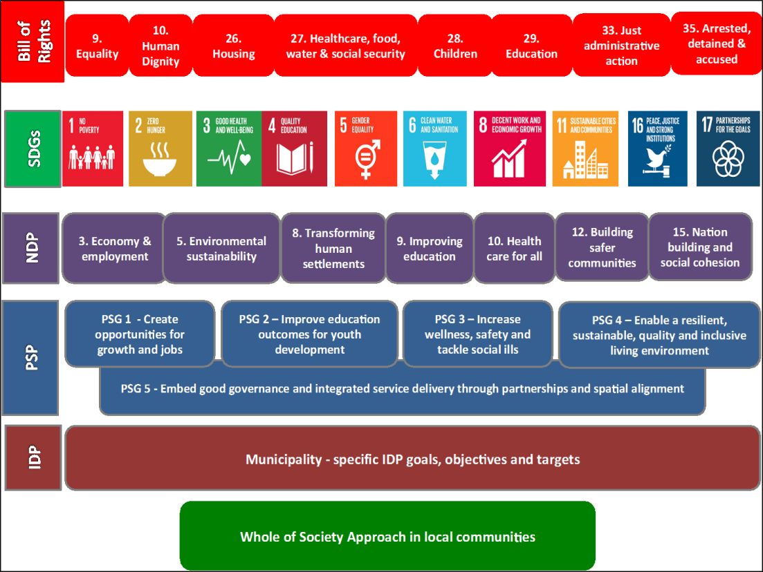
SURVIVE THRIVE AND TRANSFORM
Survive = end preventable deaths
Thrive = ensure health and well being
Transform = expand enabling environments

Slide 17
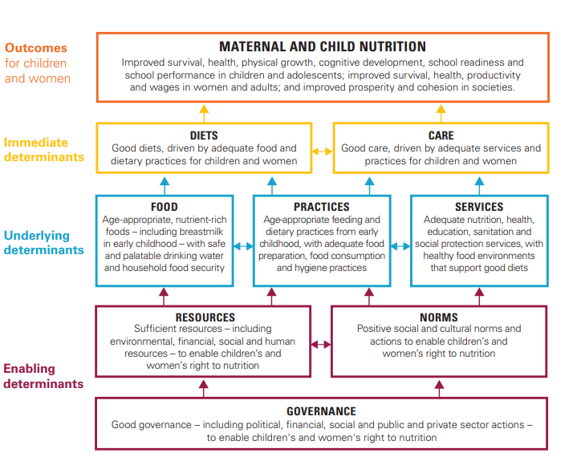
Preventing Malnutrition

Slide 18
Framework of action to achieve optimum fetal and child nutrition and development
Marie T. Ruel 1 and Harold Alderman 1 and the Maternal and Child Nutrition Study Group 1 International Food Policy Research Institute (IFPRI)

Slide 19
Nurturing care Framework
The Nurturing Care Framework (WHO) supports children's well-being, caregiver support, and health potential.
supported by the First 1000 Days Initiative and RtHB, promoting caregiver-healthcare collaboration for child development.
emphasizes childhood nutrition's importance for long-term outcomes, monitored by First 1000 Days Initiative and RtHB.

Slide 20
Facts about 1st 1000 days
Malnutrition during the first thousand days, including the prenatal period, significantly raises the likelihood of infant mortality and can lead to long-lasting cognitive, physical, and chronic health issues that persist throughout life
The right nutrition during the first 1,000 days has a profound impact on a child's cognitive development and learning abilities, setting the foundation for their future well-being. Ensuring access to proper nutrition and care during this critical window is vital.
Exclusive infant feeding, recommended for the first six months of life, plays a pivotal role in promoting healthy development.
In order to ensure that Parents are aware of the connection between factors like childhood nutrition and long-life outcomes, Parent/Caregiver/Family Support packages are encouraged
Parent/Caregiver/Family Support packages
4.
Road to Health Booklet and Side by Side Campaign
2.
Risk Assessment, Referral and Support
3.
Parent Resources aligned to Touch Points
5.
Home and community family relationship support
7.
Capturing Learnings
1. Communication
6. Training and Support of staff

Slide 21
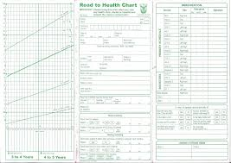
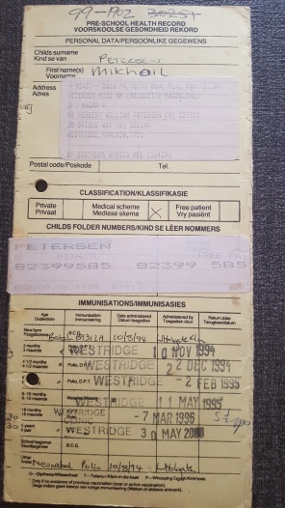
Evolution of the Road to Health Booklet
RtHB
1994
2002
2011
2018
PRESCHOOL CARDS
Growth standards | Z scores replacing centiles Weight for Length Weight for Age
Immunization schedule | Updated
Deworming | New
PMTCT information | Infant feeding information
TB status | Record contact and disease
1972

Slide 22
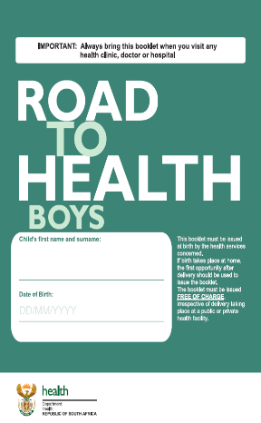
Every child needs to survive, thrive and transform
The revised Road to Health Booklet is a tool that should be used as basis to improve child health in South Africa.
The RtHB’s focuses on “what the child needs” rather than “what the departments must offer”.
It is user-friendly
It incorporate critical development aspects as well as linkage to care.
Patient Health tool

Slide 23
THE 5 THEMES OF THE ROAD TO HEALTH BOOK ARE WHAT CHILDREN NEED TO DEVELOP
NUTRITION Good nutrition is important for you and your child to grow and be healthy. It starts with breastfeeding.
Growth monitoring – 0 to 5 year
LOVE Your child learns from looking at you when you hold them close to you and love, play and talk to them.
PROTECTION Your child can be protected from disease and injury by getting immunised and by playing in safe places.
HEALTHCARE Your child needs help from you or a health worker when they are sick or injured.
EXTRA CARE Your child may need special care or support and knowing what to do and where to go will help both of you.

Slide 24
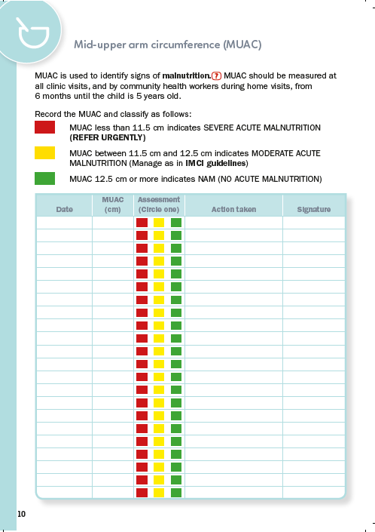
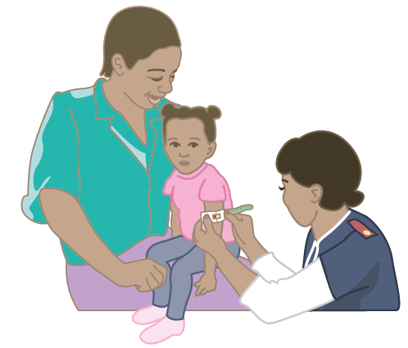
Information on growth monitoring (Page 8 -10)
This figure on page 8 shows a health worker doing MUAC screening. MUAC screening should be done at every visit from 6 months to 5 years.
MUAC is used to identify moderate or severe acute malnutrition (MAM or SAM). This chart is used to record the MUAC and classify

Slide 25
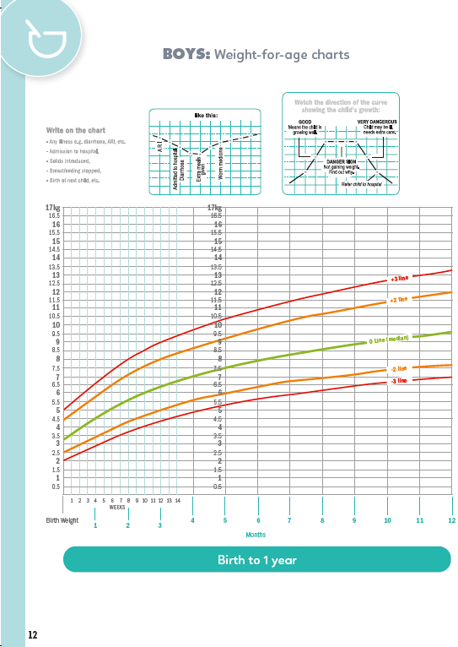
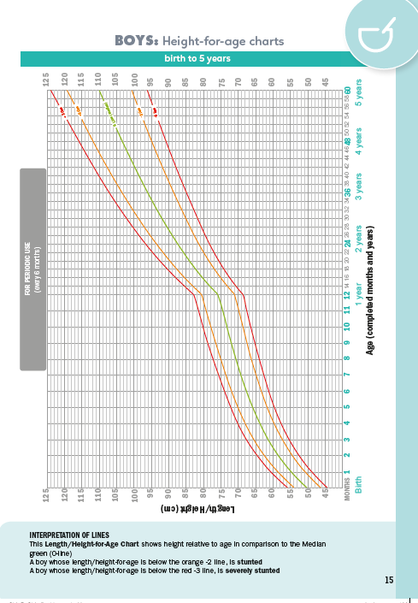
Growth Charts (Page 11 – 20)
On page 11in the RTHB are 3 sets of charts for each gender. It is important for health workers to plot on the correct charts. The booklet has both girls’ and boys’ charts.
At year 2 the child growth
can be monitored every
second month if child is
growing well.
The Weight for Age Chart is the most
important chart to be plotted at every visit
in the 1st years.
Height for Age can be plotted every six months
.
Weight for height shows body weight relative to length/ height

Slide 26
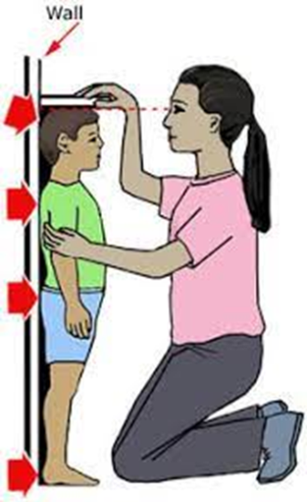
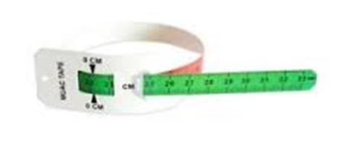
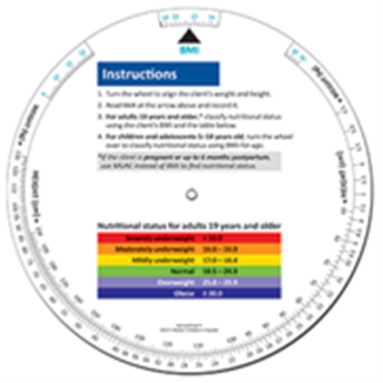
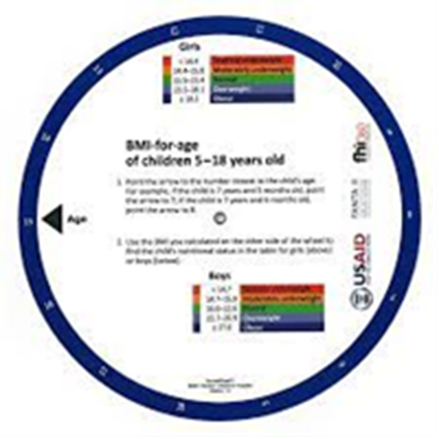
Growth Monitoring and Promotion (GMP)
GMP is widely regarded as a key essential element of child- survival and Primary Health Care (PHC) and can positively impact the growth and development of children.
Growth monitoring of young children is recognized as
A tool to prevent malnutrition
an effective means of detecting growth faltering early
providing a critical opportunity for preventive or curative actions
a powerful tool for increasing community awareness

Slide 27
Growth Monitoring and Promotion across the Life Course
Preconception &
Pregnancy
Infancy & early years
(0-5 years)
Childhood
&
Adolescents
Working age & Adults
(16-64 years)
Older people
Circular on route

Slide 28
MBFI strategy in the Western Cape
Circular H62/2023
The Western Cape Government Department of Health and Wellness (WCGH&W) has institutionalized the implementation of the Mother-Baby Friendly Initiative (MBFI) strategy since 2009.
Successful implementation of the Ten steps to successful breastfeeding has shown to improve the rates of exclusive breastfeeding and prolong breastfeeding duration beyond discharge from a birthing unit.
It implements:
standards of care to support optimal infant feeding
early initiation of breastfeeding within 1 hour of birth; skin-to-skin contact
exclusive breastfeeding for the first 6 months of life; and
introduction of nutritionally-adequate and safe complementary (solid) foods
at 6 months together with continued breastfeeding up to 2 years of age
or beyond.

Slide 29
Integrated management of Acute Malnutrition (IMAM) Policy
Circular H76/2021
The Integrated Management of Acute Malnutrition (IMAM) links routine health services with Community Based Services to optimize coverage, assessment, and treatment of acute malnutrition.
Key interventions to prevent the development of acute malnutrition include appropriate breastfeeding and complementary feeding practices.
It must be noted that disease prevention strategies are important in breaking the infection-malnutrition cycle, particularly related to diarrhoea and repeated respiratory infections.
The key determinants in the treatment of acute malnutrition however encompasses more than feeding practices and includes factors which facilitates identification, follow up and monitoring and evaluation of implementation.

Slide 30
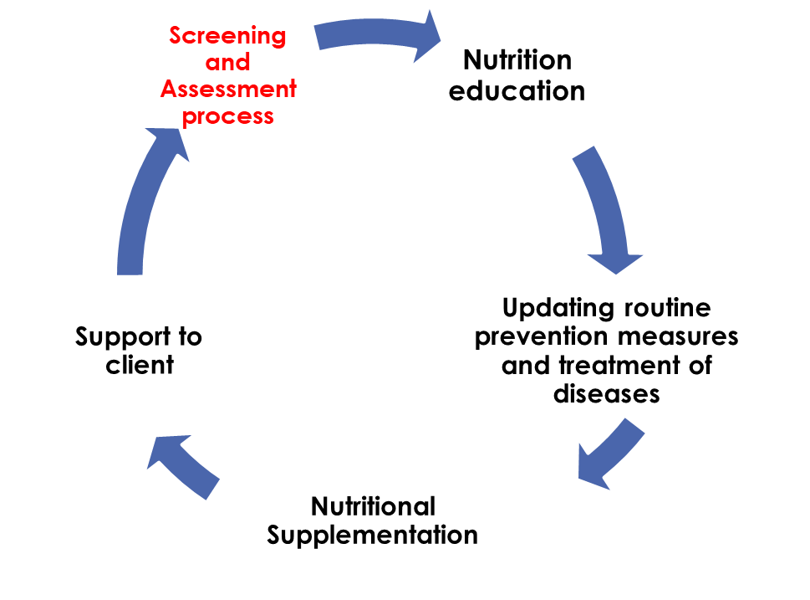
Nutritional Therapeutic Programme
Circular H27/2023
The Nutrition Therapeutic Programme (NTP) is a nutrition specific intervention implemented to address undernutrition in various categories of patients.
It forms part of the Health Facility Based Nutrition Programme (HFBNP), which is based on an integrated, comprehensive primary health care model focusing on nutritional health.
The NTP was designed to provide nutritional support using specialized products to at risk clients and those in the rehabilitation phase to improve their treatment outcomes and wellbeing.
Some of the objectives of the NTP is to provide nutritional support to nutritionally at-risk clients, which include Moderately Acute Malnutrition & Severely Acute Malnutrition child in the rehabilitation phase and growth faltering infants and young children.

Slide 31
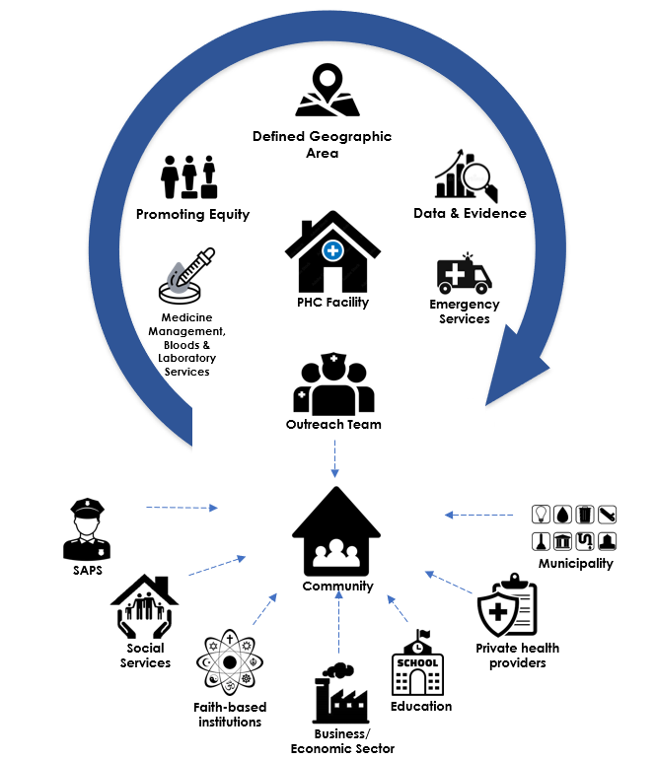
COPC
COPC is a community-based healthcare approach that focuses on addressing community needs, promoting community participation, and improving health outcomes.
Strategies outlined by COPC actively assist in preventing Acute Malnutrition by encouraging individual ownership of health
Better communication between healthcare providers and communities promotes educative opportunities for future mothers
COPC promotes frequent community-based screenings and assessments → helps identify individuals experiencing deficiencies and who are at a high risk of malnutrition

Slide 32
Intersectoral engagement, innovation and transversal projects

Slide 33
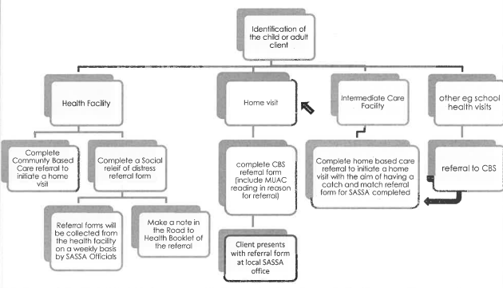
Social Relief of Distress & Community Kitchen
Circular H156/2017
Referral System Pathway
Social Relief of Distress (SRD) programs like the Zero Hunger Campaign and Normal Social Relief of distress are programs that aim to reduce food insecurity in children and adults.
Referral by health workers is required for eligible children and adults to access SRD programs that assist with providing food
The Zero Hunger Campaign directly aligns with reducing acute malnutrition as it targets high risk children aged 0-5

Slide 34
Western Cape Education Department
Early Childhood Development Centres
ECD centres serve as an effective platform to deliver child health services to underserved children.
Outreach services at ECD centres include malnutrition identification (GMP), provision of Vitamin A and deworming, and catch-up immunization
Food services in care facilities have undergone significant changes to meet national and international standards.
The WCGHW and partners have developed an operational manual which aims to:
Establish minimum standards and requirements for community-level food services
Ensure standardized nutrition for children in care facilities
Provide guidance to food handlers on safety, affordability, and appetizing meals.

Slide 35
DOTP – Family Strengthening programme
All programmes aims at strengthening the relationship between a primary caregiver and a child.
Purpose to reduce family and community violence.
Can be referred to as parenting programmes.
Family support through family strengthening programmes is a primary violence prevention tool that can potentially be accessed by any family.
Positive parenting is “warm, consistent parenting where parents have good relationships with their children, use non-violent forms of discipline and exercise supervision over their children as appropriate to their developmental stage”.
They aim to nurture and strengthen family relationships.

Slide 36
City of Cape Town – Reading Campaign – 1000 stories before school - 2021
Tips for challenges
Tips for parents
Lula byes
Tracking your reading journey

Slide 37
Acknowledgements
DG Murray Trust​
Hilary Goeiman​
Nicolette Henney​
Millicent February​
Isabella Moscoe​
Kelly Fortune

