Slide 1
South Africa Works because of Public Works
PROGRESS:
IMPLEMENTATION PLANS ON ASSISTING PRASA WITH THE RELOCATION OF ILLEGAL DWELLERS ON THE RAILWAY RESERVE BETWEEN PHILIPPI AND LANGA
5 June 2023
Acting Deputy Director General: REMS
M. Morris Mabinja

Slide 2
OUTLINE
Purpose of the presentation
Background
Progress to-date
Recommendation to SCOPA

Slide 3
1. PURPOSE OF THE PRESENTATION
To apprise the Standing Committee on Public Accounts (SCOPA) on the progress made regarding the implementation plans by the DPWI on assisting PRASA with the relocation of illegal dwellers on the railway reserve between Philippi and Langa.

Slide 4
2. BACKGROUND
DPWI as the custodian of national state-owned land, is often requested to release land to settle land claims for restitution, for human settlements development and land redistribution as part of government’s land reform programme..
In April 2020, DPWI received a letter from the Department of Human Settlements (DHS) requesting an immediate access to identified land parcels for the de-densification of informal settlements earmarked for relocation as part of the programme to contain the rapid spread of Covid-19.
The request was made pending formal release of the land parcels for human settlements purposes.
In the same month, another letter was received from PRASA requesting DPWI to urgently consider allocating an alternative land to resettle all the land occupants in the rail reserve in the Western Cape and then transfer the land ownership to Western Cape Provincial Government as a custodian.
It was later established that DHS was requesting the release of the identified properties in order to also assist PRASA with the relocation of land occupants in the rail reserve.

Slide 5
2. BACKGROUND (Cont…)
The Department of Human Settlements (DHS) targeted 17 land parcels, including 03 held under the custodianship of DPWI, for immediate erecting of temporary units to accommodate the occupants in the rail reserve.
DPWI conducted the ownership verification and progress status for the 02 land parcels that were said to be under its custodianship within Western Cape. The investigation and after having engaged the affected land users it was concluded that the two (02) land parcels could not be availed as they are allocated to SAPS for its functional use. (Refer to the table below for details).

Slide 6
2. BACKGROUND (Cont…)
Province | Custodian | Property Description | Extent / Size (Hectares) | Status
Gauteng | DPWI | Remainder of Portion 153 of the farm Elandsfontein No. 352 JR Registration Division | 112.2950 | Ministerial approval granted for the release, and Special Power of Attorney (SPOA) to commence with the development planning processes was issued to the HDA.
Western Cape | DPWI | A portion of farm Eersteriv No. 981 Stellenbosch Registration Division – (Faure Base) | 23,3548 | Not availed as the property is used by SAPS Units for Training purposes, shooting range, Anti Gang, Public Order Policing, Tactical response Units and used for SAPS residential accommodation.
 |  | A portion of Remainder of farm 1499 Cape Registration Division – (Phillippi Police Academy | 22,9114 | Not availed as the property is use by SAPS for Basic Police Development Learning (training purposes.

Slide 7
2. BACKGROUND (Cont…)
In an effort to further assist both PRASA and DHS, a desktop exercise to search other possible vacant sites was conducted. This process culminated into identification of seven vacant state owned land parcels.
For Khayelitsha and Nonkqubela communities:
No. | Property Description | Ownership | Extent (hectares) | Proposal
1 | Remainder of farm Ersf No. 644 Stellenbosch Registration Division | DPWI | 17.7074 | Consolidation of the two properties
2 | Portion 1 of farm Ersf No. 644 Stellenbosch Registration Division | WC Provincial | 6.3323
3 | Erf 2370 Eersterivier | DPWI | 1.3209 | As is
4 | Erf 647 Stellenbosch | DPWI | 2.2838 | As is
For Phillippi and Langa communities:
No. | Property Description | Ownership | Extent (Hectares) | Proposal
5 | Erf 1110, Weltevreden Valley | DPWI | 3.4033 | Consolidation of the two properties
6 | 126, Weltevreden Valley | Province | 3.3326
7 | Erf 5, Weltevreden Valley | DPWI | 2.4964 | As is

Slide 8
PROGRESS TO-DATE
No. | Property Description | Ownership | Extent (hectares) | Proposal
1 | Remainder of farm Ersf No. 644 Stellenbosch Registration Division | DPWI | 17.7074 | Consolidation of the two properties
2 | Portion 1 of farm Ersf No. 644 Stellenbosch Registration Division | WC Provincial | 6.3323
DHS chose the above two vacant state owned land for the relocation of the communities on the rail reserve, irrespective of the area. HDA were to engage the Western Cape Provincial Government on the release of the second land parcel.
The Minister approved the release of the first portion to HDA which is an agency of DHS and the granted a Special Power of Attorney (SPOA) to commence with the development planning processes.
DPWI is aware that the stakeholder engagement conducted by HDA. The local municipality & relevant communities were reportedly not in support of the relocation of the affected communities on to the identified land parcels.

Slide 9
2. RECOMMENDATION
It is recommended that SCOPA:
Notes the presentation and the progress made regarding the implementation plans by the DPWI on assisting PRASA with the relocation of illegal dwellers on the railway reserve between Philippi and Langa.

Slide 10
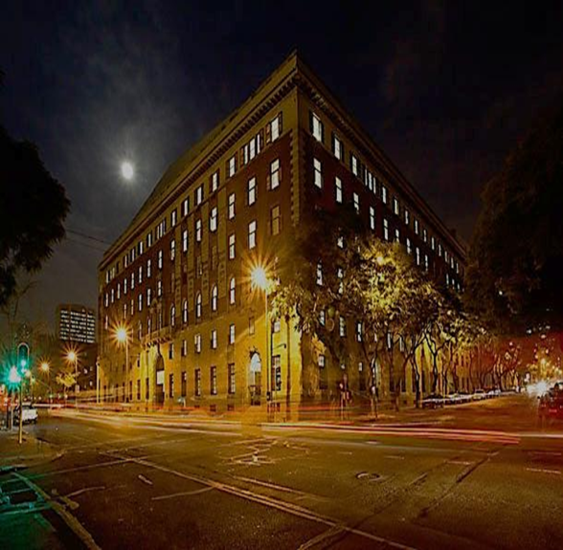
THANK YOU
Department of Public Works & Infrastructure
Head Office: Public Works CGO Building Cnr Bosman and Madiba Pretoria Central Private Bag X65 Pretoria 0001
Website: http://www.publicworks.gov.za

