Slide 1
PRASA Central line relocation
5 July 2023

Slide 2
Purpose
To provide an overview to the Standing Committee on Public Accounts (SCOPA) regarding the progress, challenges, and required interventions pertaining to the execution of the PRASA Central Line Relocation Programme.​

Slide 3
Background
Reliable and cost-effective public transport serves as catalyst for social and economic development
An estimated 5195 households have unlawfully settled on the PRASA Central Line and therefore currently not operational:
Approximately one thousand two hundred and fifty-four (1254) occupants who have erected their homes on the PRASA Central Line in Langa.
Approximately three thousand six hundred and eighty-eight (3688) occupants living in and around the Philippi Station and;
Approximately a further two hundred and fifty-three (253) occupants living at the Khayelitsha Station.
Commuter service were discontinued since October 2019 . This has affected household mobility and access from home to work and to other socio-economic facilities and services
It is of utmost importance to resettle households currently residing on PRASA rail networks as well as to ensure functional and cost-effective commuter rail services to the inhabitants
Therefore, the relocation of the occupants from the Central Line will allow for PRASA to rehabilitate the rail infrastructure and ensure resumption of rail service.

Slide 4
Background Continues….
An Implementation Protocol (IP) in or about 09 March 2022 was concluded to facilitate the resettlement of households currently residing on the PRASA Central by
National Department of Human Settlements (NDHS
National Department of Transport (DOT)
the National Department of Public Works & Infrastructure (DPWI),
the Western Cape Provincial Department of Infrastructure (WCID), the Western Cape Provincial Department of Mobility,
the City of Cape Town Municipality (CoCT),
The Housing Development Agency (HDA) and
Passenger Rail Agency of South Africa (PRASA)
The HDA, based on a service level agreement (SLA) concluded on 06 April 2022 with the Department of Transport, has been appointed as the Implementing Agent to facilitate the relocation of occupants on the PRASA Central Line. Based on various consultations both at an accounting and executive level

Slide 5
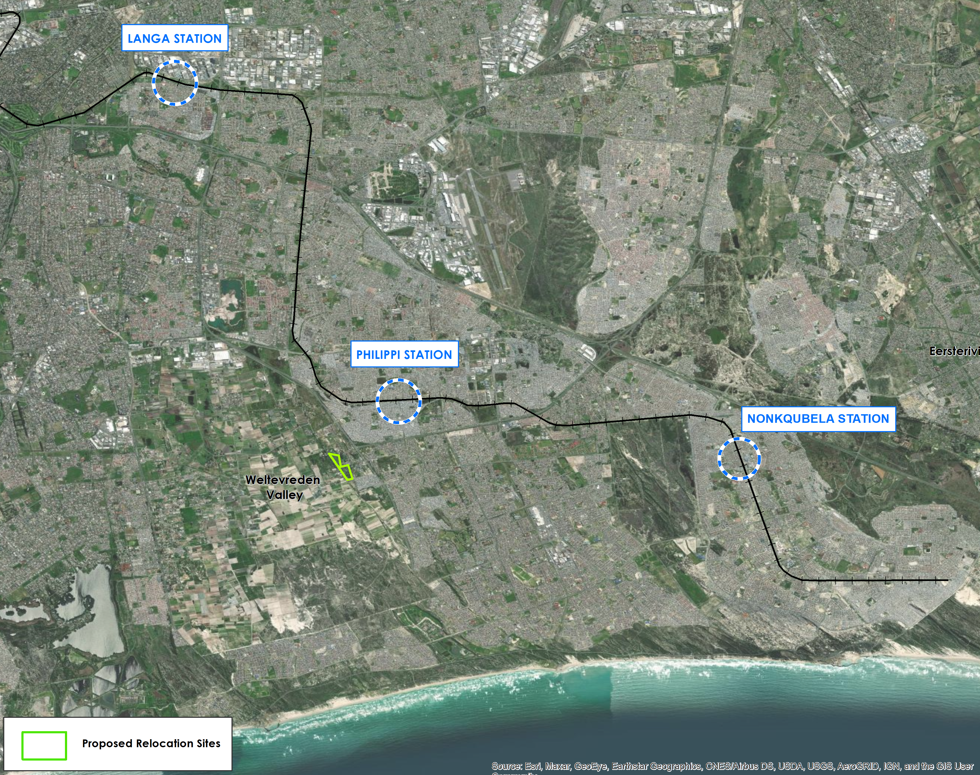
Phased Approach to Relocation
The aerial photograph and table below provide details to the area and extent of occupation on the Central Line in the Langa, Philippi and Khayelitsha.
`
Langa Station
Street Address | 12 Brinton St, Langa, Cape Town, 7506
Number of Occupants | Projected | Enumerated (Actual)
 | 650 | 1254
Relocation Phase | Phase 1
Relocation Site | Rem of Cape Farm 786 and 790
Philippi Station
Street Address | Browns Farms, Cape Town, 7750
Number of Occupants | Projected | Enumerated (Actual)
 | 1100 | 3688
Relocation Phase | Phase 2
Relocation Site | Private / State Land
Khayelitsha Station
Street Address | 25 Sulani Dr, Village 3 North, Cape Town, 7784
Number of Occupants | Projected | Enumeration (Actual)
 | 700 | 253
Relocation Phase | Phase 2
Relocation Site | Private / State Land

Slide 6
Role of the National Department of Human Settlements
In terms of the Implementation Protocol signed by the National Department, it committed to support the parities as follows:
Disburse funds as legislated and ensure that the Programme is provided with the necessary financial and other support required in order to successfully deliver on its targets.
Expeditiously process relevant applications for approvals that are required for the implementation of the Programme.
Where applicable, secure funding for the Programme and make budget provision thereof, aligned with affordability and in compliance with the PFMA, the DORA and any other relevant legislation and within such time-frames as shall be agreed with the stakeholders.
Assist in facilitating the unblocking of procedural bottlenecks that affect or may affect the Programme.
Keep the Parties informed of all changes in policies and processes within the National Department that could impact on the Programme.

Slide 7
Role of the Western Cape Department of Infrastructure
Disburse funds as legislated and ensure that the Programme is provided with the necessary financial and other support required in order to successfully deliver its targets.
Expeditiously process applications for approvals that are required for the implementation of the Programme and facilitate the approval of applications for the implementation of Programme.
Assist in facilitating the unblocking of procedural bottlenecks that affect or may affect the Programme.
Facilitate the release of provincially held land and establishment of temporary residential areas.
Facilitate the acquisition of land required for establishment of temporary residential areas required for the resettlement programme.

Slide 8
Role of the City of Cape Town Metropolitan Municipality
Facilitate the identification of land in consultation with the Provincial Department of Human Settlements and the HDA, required for the programme implementation.
Ensure the rendering and provision of basic services required for the programme.
Ensure the enforcement of by-laws to enable orderly programme implementation.
Expeditiously consider all land use and related applications relating to the programme implementation on the basis of urgency and exceptional emergency circumstances occasioned by this programme.
Prioritise in accordance with the Integrated Development Planning process bulk and link services required for the programme.
Facilitate release of city owned land required for the programme implementation.
Facilitate establishment of temporary residential areas and resettlement of households from identified rail networks.
Lead social engagement and community consultation in programme planning and implementation.
Assist in facilitating the unblocking of procedural bottlenecks that affect or may affect the Programme.
Keep the Parties informed of all changes in policies and processes within the City of Cape Town that could impact on the Programme.
.

Slide 9
Progress on funding of the Relocation Programme
On 19 July 2022; Letters were subsequently sent through the office of the Director General Human Settlements to CoCT and WCPDHS outlining the line items they are responsible to fund, as per the itemised billing and as per the resolution of the Special PSC held on 25 May 2022, requesting;
The City Make available funding for Land Acquisition, through the USDG allocation.
The City Make available funding for Bulk Earthworks, through the USDG allocation.
The City Make available funding for basic Interim Services, through the UISPG allocation
The Province and the City submit a Municipal Emergency Housing Grant application to the National Department of Human Settlements for consideration, for the provision of Emergency Housing Units
On 31 August 2022; the CoCT responded to the letter from DG: Human Settlements on Funding for the Programme, indicating that the City does not have the required funding, and that an additional allocation must be made by NDHS
A similar response was also received from the Provincial Department of Human Settlements, which indicated that there is no funding they could commit towards the Programme

Slide 10
Progress on funding of the Relocation Programme
No major progress was made towards resolving the funding challenges affecting the Programme,
The City of Cape Town indicate that it is PRASA problem and they are not going to prioritise
Disbursement of Funds:
National Treasury through a request submitted by the National Department of Human Settlements to reallocate additional R111 Million though the Informal Settlements Upgrading Partnership Grant
R50 million was ring fenced for the land acquisition and the balance of the funds were for 16 priority informal settlements that require basic services, including the PRASA Programme.
The City of Cape Town responded formally to the department, that they would not be in a position to legally spend the allocated funding within the remaining period of the financial year, and that they would require a roll-over of the funds
However, despite numerous interventions from the Department, the City on the 8th June 2023 indicated that they would be returning the sum of R50 Million to National Treasury, the amount which was allocated for land acquisition of the PRASA Programme

Slide 11
Land Acquisition (State-owned and Privately Owned Land)
The Department requested Dept of Public Works issued a Power of Attorney to the HDA to secure 2 potions of land that would have been utlised for relocation purposes. However, due to objections from surrounding landowners, these land parcels were no longer viable for relocation purposes, and an alternative had to be explored.
To expedite the land required and related development constraints to allow for the relocation of households, the HDA has acquired and funded the acquisition of two properties in the Philippi Wedge Area measuring approximately 8.7 hectares, to allow for the activation of the first phase of the relocation.

Slide 12
Conclusion
The PRASA central line relocation ensures that the State provides reliable and cost-effective public transport which is a catalyst for social and economic development.
The Implementation Protocol is an instrument to bring the various role-players together to resolve the challenges of the Prasa Central Line.
The National Department has provided the required support and interventions throughout the process.

Slide 13
Recommendations
It is recommended:
Strengthen the Intergovernmental cooperation and process by adopting the plan for relocation for all the role players.

