Slide 1
PRASA CENTRAL LINE RELOCATION PROGRAMME
PRESIDENTIAL PROJECT
Briefing Presentation:
Standing Committee On Public Accounts (SCOPA)
05 July 2023

Slide 2
Outline
Purpose of Presentation
Briefing Report: Sequence of Events
Problem Statement
Institutional Arrangements
Court Order
Land and Statutory Processes
Funding for the Relocation Programme
Conclusion
Recommendations

Slide 3
1. Purpose of Presentation
The objective of this presentation is to provide an overview to the Standing Committee on Public Accounts (SCOPA) regarding the current progress, obstacles, and necessary measures pertaining to the execution of the PRASA Central Line Relocation Programme.

Slide 4
2. Briefing Report: Sequence of Events
No. | Event | Date
01. | Provincial Transport & Public Works and National public Works make available 2 land parcels in Eerste Rivier for the PRASA Central Line Relocation Programme | 23 – Aug– 2021
02. | HDA submitted Section 68 Application to CoCT for the declaration of the Public Works released parcels (Portion 1 and Rem of Farm 644 as Emergency Relocation Sites | 23 – Sep – 2021
03. | CoCT wrote a formal letter to the HDA, communicating that the Section 68 was not to be approved by the City. | 18 – Oct – 2021
04. | The Implementation Protocol was signed by all stakeholder | 09 – Mar – 2022
05. | HDA successfully negotiated for, and signed a Deed of Sale with the landowners of Rem of 786 and 790 – Cape RD (Wedge Area / Philippi Properties). The landowners then issued HDA with Power of Attorney to commence with Planning Processes while the purchase and transfer of the land is finalized. | 18 – May – 2022
06. | IPSC No. 003 Took a resolution that the City of Cape Town should fund the provision of basic services, in line with the roles and responsibilities outlined in the signed Implementation Protocol | 25 – May – 2022
07. | HDA, through the SPE Directorate submits Section 68 Application to the CoCT for the Wedge Area Properties (in line with the issued Power of Attorney) | 31 – May – 2022

Slide 5
2. Briefing Report: Sequence of Events
No. | Event | Date
08. | DG Human Settlements Sends correspondence to Accounting Officers of CoCT and PDHS requesting them to make available funding for the Relocation Programme, in line with the IPSC No. 003 Resolution and Roles and Responsibilities outlined in the IP | 19 – Jul – 2022
09. | Resumption of Limited Rail Service (Langa) Minister of Transport Community Engagement with affected communities, including a site visit to acquired Phase 1: Langa relocation Site (Wedge Area / Philippi sites) | 26 – Jul – 2022
10. | PSC No.004 CoCT Requested to Submit Emergency Housing Application for processing by NDHS | 17 – Aug – 2022
11. | Community of Mitchells Plain Objects to the use of acquired Phase 1: Langa land parcels located in the Wedge Area for Relocation Purposes | 26 – Aug – 2022
12. | CoCT Responds to letter from DG – Human Settlements on Funding for the Programme: City does not have funding for the relocation Programme, and that an additional allocation must be made by NDHS | 31 – Aug – 2022

Slide 6
2. Briefing Report: Sequence of Events
No. | Event | Date
13. | Government hosts signing ceremony for Social Compact with communities of Langa, Philippi and Khayelitsha | 08 – Sep – 2022
14. | The inaugural CL-PSC, the oversight committee as established in terms of the Social Compact, was held. | 14 – Sep – 2022
15. | PDHS responds to the letter from DG – Human Settlements on Funding for the Programme: PDHS does not have funding for the relocation Programme | 03 – Oct – 2022
16. | City of Cape Town sent an official communication to the HDA regarding the outcome of the Section 68 Application : application cannot be approved at its current state due to the following- Circumstances leading to the relocation do not meet the criteria of Emergency Relocation will endure longer than 180 days Land has not been secured by PRASA/HDA No funding for provision of basic services. | 21 – Oct – 2022
17. | PMC deliberates on implication of Decision on Section 68 Application – (on statutory processes, land, funding and relocation programme) | 27 – Oct – 2022

Slide 7
2. Briefing Report: Sequence of Events
No. | Event | Date
18. | IPSC Deliberates on the Proposed relocation date (February 2025) – Not Supported | 03 – Nov – 2022
19. | Communities of Langa, Philippi and Khayelitsha march to the City of Cape Town and deliver a memorandum of demands for the expediting of the relocation programme. | 08 – Dec – 2022
20. | A Pre-submission meeting was held with the CoCT Land Use department for a full Rezoning Application process on the Wedge Area properties. The application is estimated to take up to 18 months, and may endure a longer timeframe in the event of objections and appeals. This does not align with the Relocation Programme. | 08 – Feb – 2023
21. | National Treasury (through NDHS) Gazetted and reallocated to the CoCT an additional R111 000 000 UISPG allocation for the 16 priority informal settlements that require basic services, including the PRASA Programme (R50M for land) | 29 – Mar – 2023
22. | Mayor of CoCT writes to the Minister outlining “material concerns” regarding the allocation | 19 – Apr – 2023
23. | the Executive Mayor of the City of Cape Town wrote to the Minister of Human Settlements, indicating that given the fact that the HDA has acquired land for Phase 1 of the relocation Programme, they would be returning the sum of R50 Million to National Treasury | 08 – June – 2023

Slide 8
3. Problem Statement
An estimated 5195 households have settled on the PRASA Central Line, including on the illegal structures being erected in Langa Station, at Philippi Station and at Khayelitsha Station. This has affected and rendered PRASA in its capability to halt indefinitely operation on the Central Line. Commuter service has been discontinued since October 2019 owing to vandalism, theft, and safety.
Phase 1 of the programme is the relocation of approximately 1254 occupants located on the Langa station and/or rail reserve.
Human Settlements is an enabler to a transport programme, as the relocation of the occupants from the Central Line will allow for PRASA to rehabilitate the rail infrastructure and ensure resumption of rail service.

Slide 9
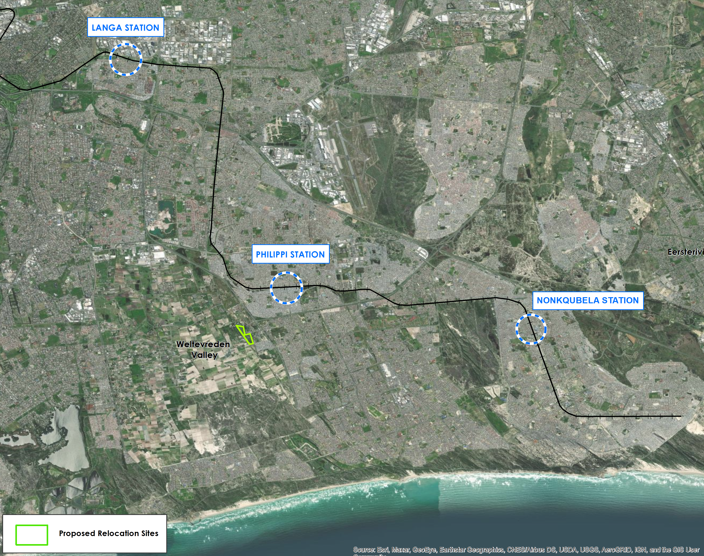
3. Problem Statement: Extent of Invasion
The aerial photograph and table below provide details to the area and extent of occupation on the Central Line in the Langa, Philippi and Khayelitsha.
`
Langa Station
Street Address | 12 Brinton St, Langa, Cape Town, 7506
Number of Occupants | Projected | Enumerated (Actual)
 | 650 | 1254
Relocation Phase | Phase 1
Relocation Site | Rem of Cape Farm 786 and 790
Philippi Station
Street Address | Browns Farms, Cape Town, 7750
Number of Occupants | Projected | Enumerated (Actual)
 | 1100 | 3688
Relocation Phase | Phase 2
Relocation Site | Private / State Land
Khayelitsha Station
Street Address | 25 Sulani Dr, Village 3 North, Cape Town, 7784
Number of Occupants | Projected | Enumeration (Actual)
 | 700 | 253
Relocation Phase | Phase 2
Relocation Site | Private / State Land

Slide 10
4. Institutional Arrangements
Implementation Protocol
As of 9 March 2022, all stakeholders have signed the Implementation Protocol.
The following stakeholders are party to the IP;
Department of Transport (DOT)
Department of Human Settlements (DHS)
Department of Public Works & Infrastructure (DPWI)
Western Cape Provincial Department of Human Settlements (PDHS)
Western Cape Provincial Department of Transport and Public Works (PDoT&PW)
City of Cape Town Municipality (CoCT)
Housing Development Agency (HDA)
Passenger Rail Agency of South Africa (PRASA)
Service Level Agreement
As of 06 April 2022. Both DoT and HDA signed the SLA, appointing HDA as an Implementing Agent.

Slide 11
4. Institutional Arrangements: Project Oversight
Implementation Protocol Steering Committee (IPSC): This is the decision-making structure with all the Accounting Officers as per the Implementation Protocol, co-chaired by the DG Human Settlements and DG Transport.
Project Management Committee (PMC): This is the deliberative body made up of technical representatives from all government entities/Stakeholders as per the Implementation Protocol, chaired by the Chief Director: Department of Transport. These representatives are elected by the Accounting Officers of each entity and have a responsibility to provide briefing and update reports to their organizations and Accounting Officers.
Central Line Project Steering Committee (CLPSC): This is the steering committee as established in term so the Social Compact between Government (signatories of the IP) and the affected Communities. Co-chaired by government and an elected representative of the communities.

Slide 12
5. Court Order
Phase 1: Langa Eviction Order
Over the past Two (2) years, the Western Cape High Court has granted Four (4) Court Orders and associated Variations to PRASA for the relocation of occupants settled on the Central Line.
26 November 2021 – Not achieved
Variation was granted on order for 31 July 2022 – Not Achieved
Variation was granted on order 30 November 2022 – Not Achieved.
Revised Court Order Date, 30 November 2023 – Target date for the conclusion of Phase 1 of the Relocation Programme.
In line with the PIE Act; the Court Order requires that suitable alternative land be secured and prepared with the necessary basic services prior to any relocation of the occupants.

Slide 13
6.1. Land & Statutory Processes: State-owned Land Parcels
Towards the end of 2019, PRASA sent a letter to the DPW&I requesting the department to make available approximately 60 ha of land to accommodate the informal settlements in the identified sections of the central line railway reserve.
As part of the land identification process, various land portions owned by the National Department of Public Works and Infrastructure, Ithemba Labs, were identified as viable options to addressing the relocation.
The Department of Public Works and Infrastructure has in February 2021 provided formal communication outlining its response and position on Ithemba Labs and it also provided alternative sites for further assessment and analysis to determine suitability for human settlements.
The subject properties, Portion 1 and Remainder of Farm E.R.S.F. No. 644 - Eerste Rivier were identified by NDPW&I as possible alternative sites.
The HDA submitted a formal request for the two land parcels, and were subsequently availed by NDPW&I and WCDoT&PW

Slide 14
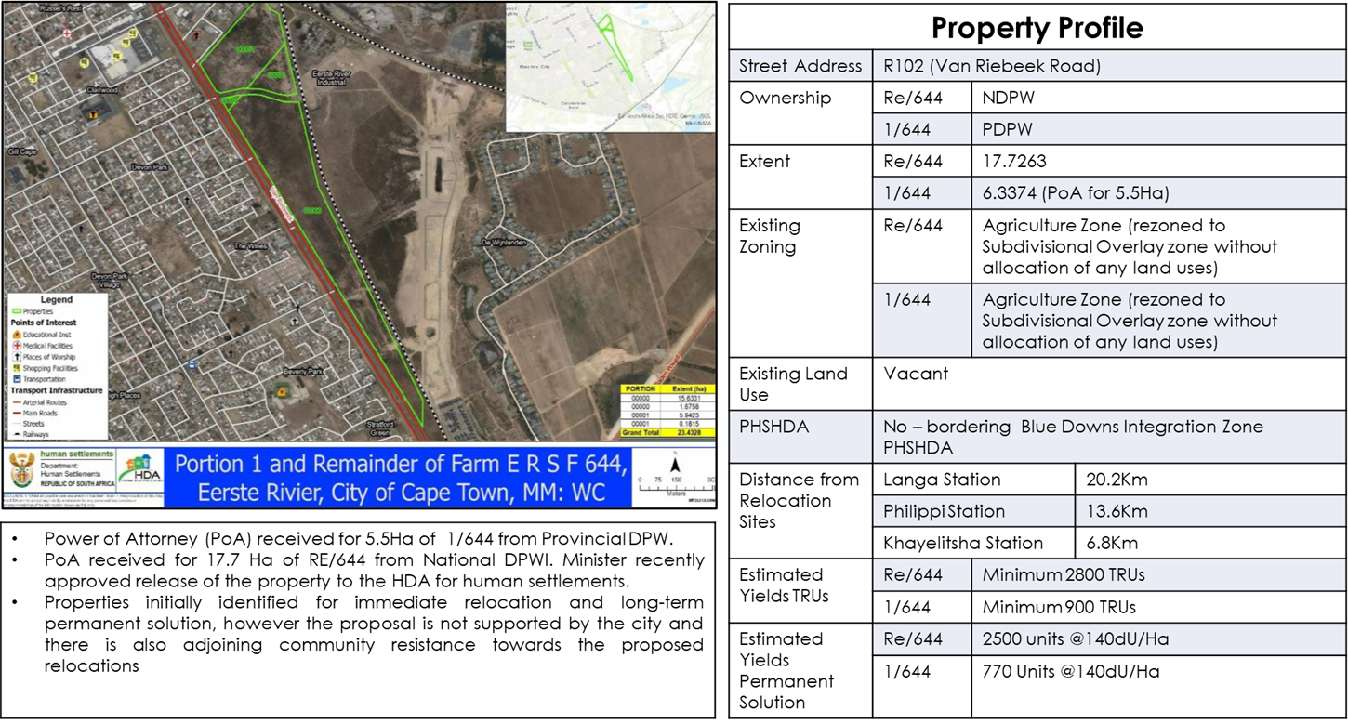
6.1. Land & Statutory Processes: State-owned Land Parcels

Slide 15
6.1. Land & Statutory Processes: State-owned Land Parcels
On receipt of the PoA for Portion 1 of Farm E.R.S.F, on 23 September 2021; The HDA made an official submission to the City of Cape Town (through the Human Settlements Directorate) for an urgent request to consider the Emergency Declaration for the use of Portion 1 of Farm E.R.S.F. No. 644 and Remainder of Farm E.R.S.F. No. 644 for relocation purposes
There were subsequently a number of objections received from various interest groups including surrounding landowners and political parties, with the most prominent being the objections received from Greenfields Development through their attorneys who expressed their intention to interdict the proposed relocation.
On 18 October 2021; the City of Cape Town Human Settlements Directorate wrote to the HDA to inform that the Section 68 request could not be supported.
The decision, coupled with the threat of litigation from the neighboring developers meant that the Public Works availed properties were no longer viable for relocation purposes, and an alternative had to be explored.

Slide 16
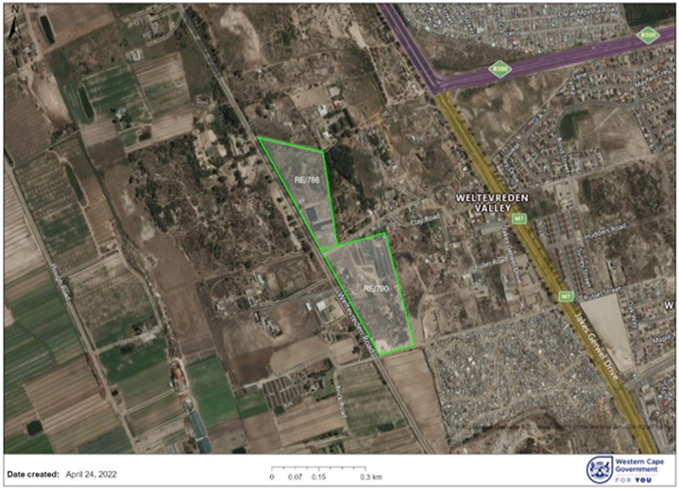
6.2. Land & Statutory Processes: Private Land Acquisition – Wedge Area Properties
Property Profile
Property Description | Rem of Farm 786 and 790 – Cape RD
Ownership | Private (under transfer to HDA)
Title Deed Number | T48068/2018 and T12833/2011
Extent | 8,7195 Ha
Existing Zoning | Agricultural
Existing Land Use | Rem 786: Portion proposed for acquisition currently vacant. Rem 790: Light chicken production industry.
Purchase Price | R12 770 070,00
Total Funding Requirements | R15 720 070,00 (including transfer and land holding costs)
Distance from Relocation Sites | Langa Station | 10Km
 | Philippi Station | 2Km
 | Khayelitsha Station | 8,6Km
Estimated Yields | Relocation Units | Approx. 1500 – 1700 TRUs
 | Permanent Solution | Approx. 1000 units (@120dU/Ha)
Purchase price for Rem 786 = R3 270 070.00 Purchase price for Rem 790 = R9 500 000.00 The HDA has paid for the land parcels and are currently undergoing final transfer stages. Power of Attorney received, allowing HDA to commence with statutory processes was received from the landowners as early as May 2022. The land parcels are Sufficient for relocation of Phase 1: Langa as it can accommodate between 1500 to 1700 Relocation Units

Slide 17
6.2. Land & Statutory Processes: Private Land Acquisition – Wedge Area Properties
To accelerate the relocation programme (as a resolution of the PMC), a Section 68 request, in terms of the City of Cape Town Municipal Planning By-Laws, was recommended to be pursued.
This is a shortened/accelerated process rather than a full Rezoning/Land Use Departure process that ensures approximately 18 months.
On 31 May 2022, the HDA lodged the Section 68 Request to the City of Cape Town, with the City’s Spatial Planning & Environment Directorate being the vehicle to facilitate the application internally, with confirmation of receipt received on 01 June 2022.
On 21 October 2022, the CoCT sent an official communication to the HDA regarding the outcome of the Section 68 Application. The communication was that the application could not be approved as is.
Given the outcome of Section 68, the PMC made a submission to the IPSC for undertaking a full rezoning process, which is estimated to take approximately 18 months. This would move the relocation date to February 2025. This submission was rejected by the IPSC as it does not align with the Relocation Programme and required timeframes.
Currently the PMC is running a parallel full rezoning process while engagements are being held to expedite the statutory processes.

Slide 18
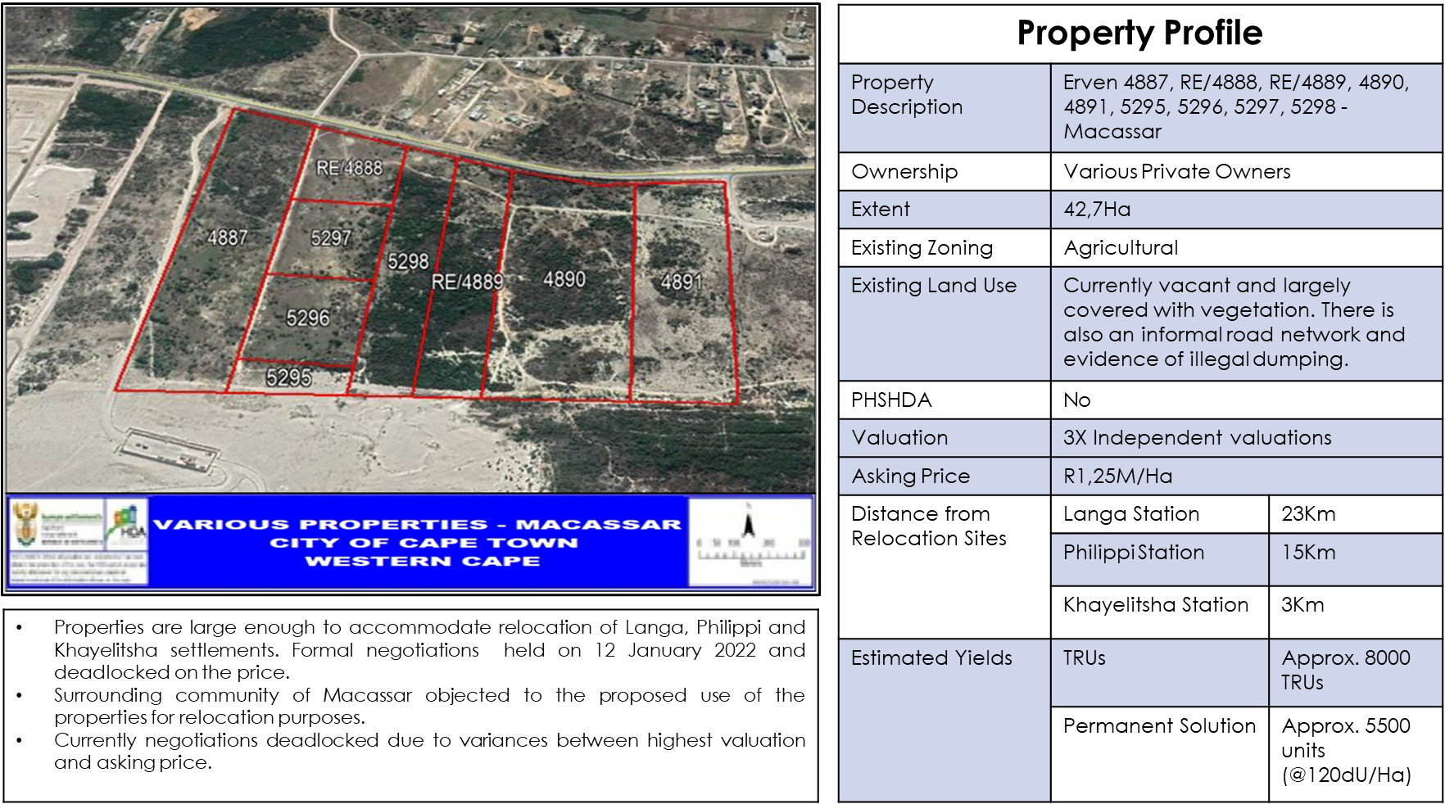
6.3. Land & Statutory Processes: Alternative Land Parcels – Macassar land

Slide 19
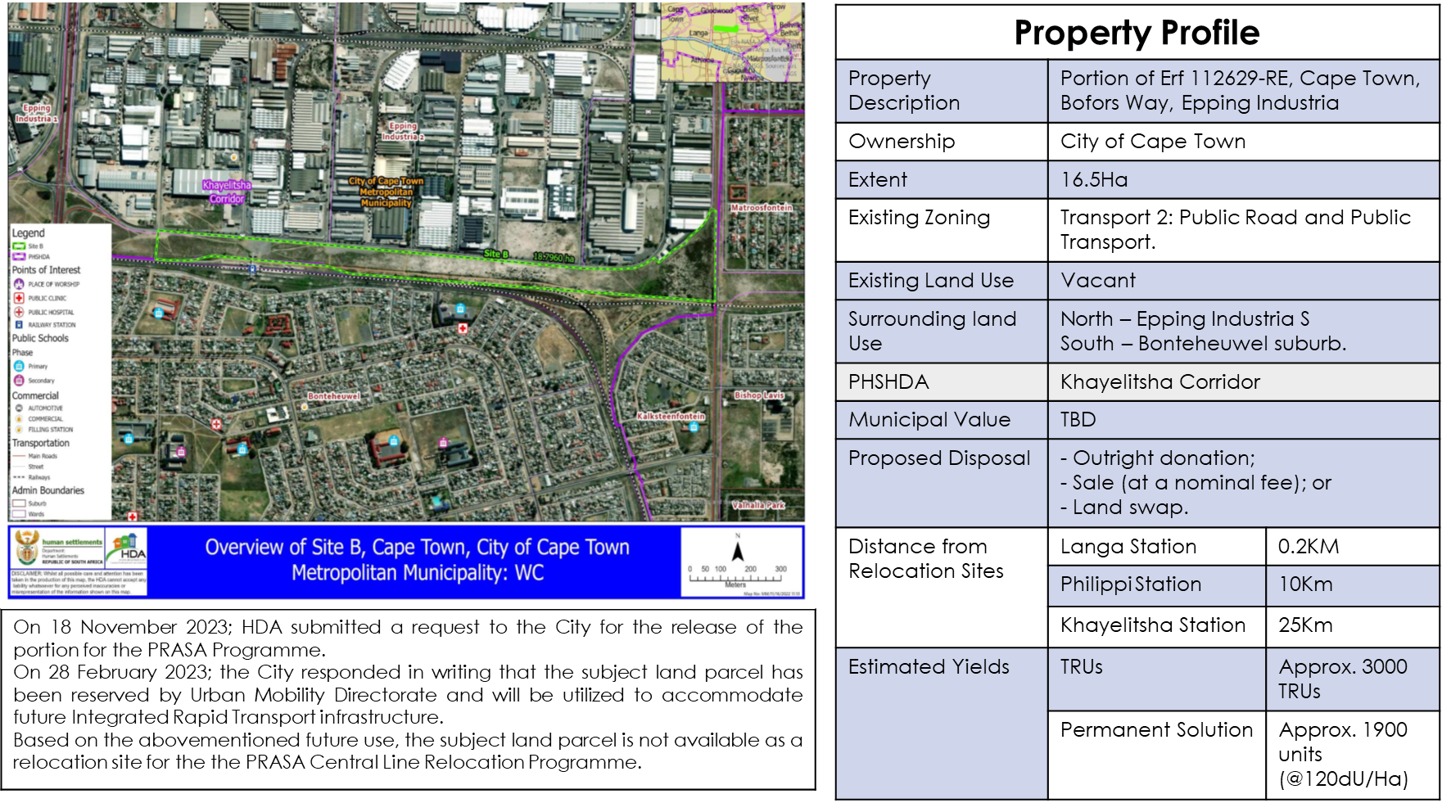
6.3. Land & Statutory Processes: Alternative Land Parcel – CoCT Land

Slide 20
6.3. Land & Statutory Processes: Alternative Land Parcels – CoCT Land
On 18 November 2022, the HDA submitted a request to the City for the release of the above-mentioned land parcel for the PRASA Programme, with a view of utilizing the land parcel for the relocation of the Langa occupants who are located less than 200 metres from the subject property.
On 28 February 2023; the City responded in writing that the subject land parcel has been reserved by the City’s Urban Mobility Directorate and will be utilized to accommodate future Integrated Rapid Transport infrastructure. Based on the planned future use, the subject land parcel is not available as a relocation site for the PRASA Central Line Relocation Programme.

Slide 21
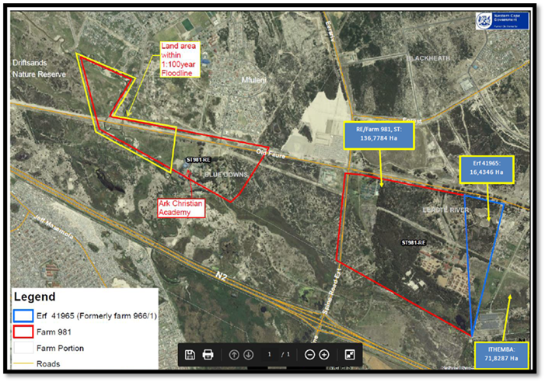
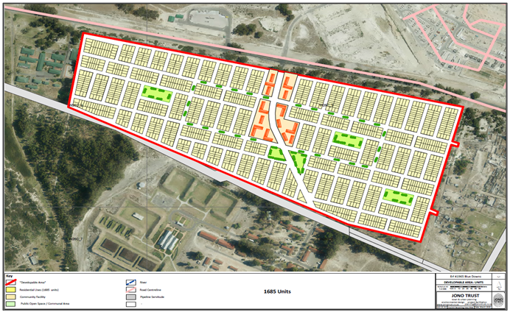
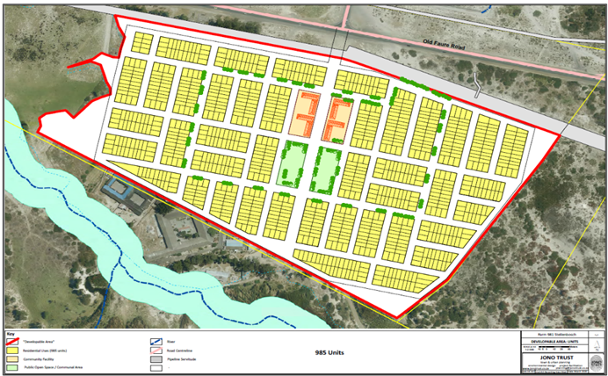
6.3. Land & Statutory Processes: Alternative Land Parcels – Ithemba Labs

Slide 22
7.1. Funding for Relocation Programme
On 25 May 2022, the IPSC approved an Itemized Billing outlining proposed funding for the Programme.
On 19 July 2022; Letters were sent by ADG: NDHS to CoCT and PDHS outlining the line items they are responsible to fund, as per the itemized billing and as per the resolution of the Special PSC held on 25 May 2022,
On 31 August 2022; the CoCT responded to the letter from DG: Human Settlements on Funding for the Programme, indicating that the City does not have the required funding and that an additional allocation must be made by NDHS.
A similar response was also received from the Provincial Department of Human Settlements,
31 March 2023 NT/NDHS reallocated to the City of Cape Town an additional R111 Million UISPG allocation for the 16 priority informal settlements that require basic services, including the PRASA Programme (R50M for land acquisition).
The City responded to National and indicated they would not be in a position to legally spend the allocated funding within the remaining period of the financial year, and that they would require a rollover of the funds.
On 08 June 2023, the Executive Mayor of the City of Cape Town wrote to the Minister of Human Settlements, indicating that given the fact that the HDA has acquired land for Phase 1 of the relocation Programme, they would be returning the sum of R50 Million to National Treasury, the amount which was allocated for land acquisition of the PRASA Programme. The City also recommended that further engagements be held at a later stage with regards to funding for the provision of basic service, as there would be no lawful means to ringfence the funding in the current allocation.

Slide 23
7.2. Funding for Relocation Programme: Phase 1 Funding Costs (Including Overall Land)
Component of the Programme | Funding (R)
Phase 1 Land Acquisition (HDA frontloaded) | R12 770 070.00
Additional Land Acquisition (for overall Programme) | ±R50 000 000.00
Bulk Earthworks and Provision of Basic Services (Phase 1 – Wedge Area) | ±R49 000 000.00
Relocation Structures - 18m² Emergency Housing Kit (Current Approved Relocation Model) | ±R28 215 000.00
Relocation Costs (Dismantling of informal structures and relocation) | R4 075 500.00
Total Estimated Funding Requirements | ±R144 060 570.00
Notes:
The estimated funding requirements are Capital funding requirements and exclude Operational Costs, including Land Holding costs and operating costs for the provision of basic services.
The estimated funding requirements would cover Phase 1 relocations, as well as acquiring land required for the overall programme to allow statutory processes to commence for Phase 2 (Philippi & Khayelitsha)

Slide 24
8. Conclusion
The challenges affecting the Implementation of the PRASA Central Line Relocation Programme, which require urgent intervention, can be summarized as follows:
The total estimated funding requirement for the Programme is R390 Million for Phase 1&2. The Department of Transport has committed R39 Million in Programme Management fees (over three years), in line with the signed SLA. NDHS has reallocated R111M to the City of Cape Town, with R50M ringfenced for land acquisition for the PRASA Programme. The funding for the shortfall in the funding requirements has not been confirmed.
Phase 1 and Phase 2 of the Programme require approximately 50Ha - 60Ha of land to successfully implement the relocation. Approximately 8,7Ha of that has been secured by the HDA for the relocation of Phase 1: Langa occupants, however, there is still approximately 40Ha – 50Ha required for the Phase 2 relocations.
A full rezoning application process is currently underway; however, this process is estimated to endure approximately 18 months. These timeframes do not align with the Emergency Relocation.
One of the key challenges that have resulted in the delay in the implementation of the Programme is objections from receiving communities. Should this not be adequately addressed and resolved, then the Programme risks further delays in statutory processes which may lead to lengthy appeal processes and possible legal challenges.

Slide 25
9. Recommendations
The following recommendations are proposed:
It is strongly recommended that the PRASA Central Line Relocation Programme secures immediate confirmation of funding to cover the comprehensive scope of the relocation efforts, including provisions for land acquisition, land preparation, relocation units, and the provision of basic services. To facilitate this, it is advisable that the programme be funded through a special dispensation that allows for the ringfencing of the necessary funds.
There should be active support for the restructuring of the request for the release of Ithemba Labs, with the aim of utilizing it specifically for the relocation of Phase 2, encompassing the areas of Philippi and Khayelitsha.
The City of Cape Town, in its capacity as the relevant authority, ought to intervene in expediting the statutory processes in alignment with an Emergency/Disaster Relocation or Intervention, as outlined by the roles and responsibilities delineated in the Implementation Protocol.
A coordinated and intergovernmental approach is strongly recommended for engaging with the community, particularly the receiving communities, ensuring that their concerns and perspectives are duly addressed and incorporated into the relocation process.

Slide 26
Enkosi,
Thank You,
Dankie.

