Slide 1
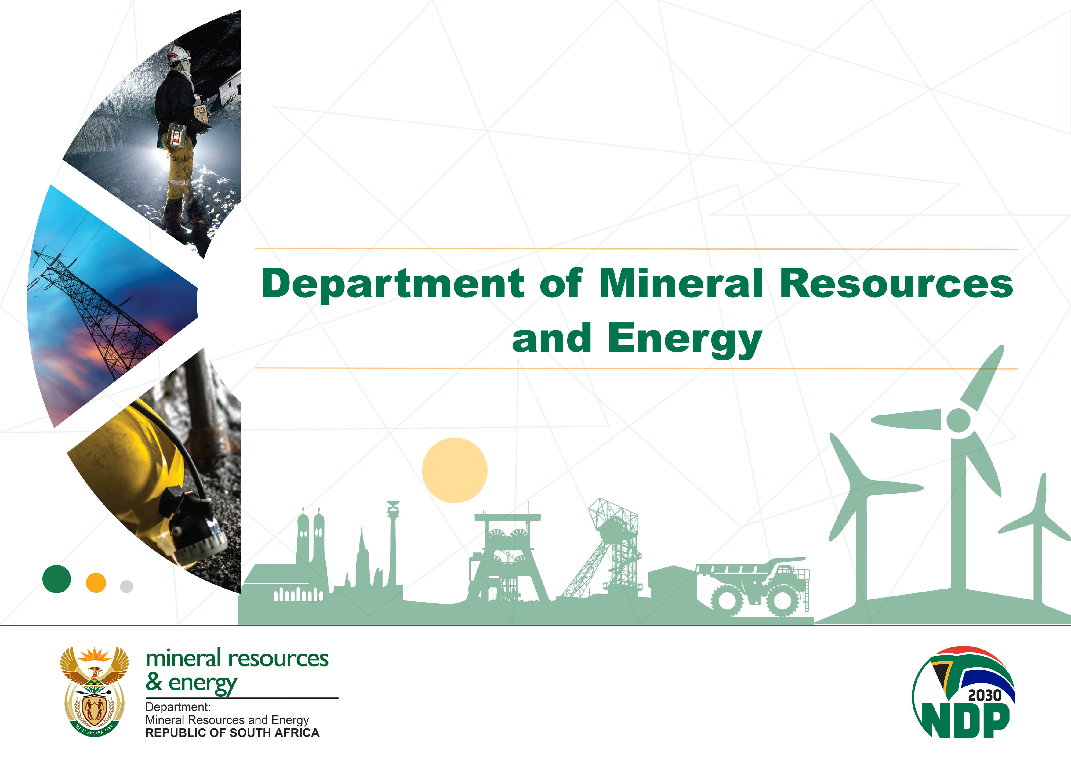
Presentation to Select Committee on Land Reform, Environment, Mineral Resources and Energy (National Council of Provinces) on National Radioactive Waste Management Plan
20 June 2023

Slide 2

Presentation Outline
Purpose
Legislative Background
Radioactive Waste Management Framework
Guiding Elements for Waste Management Plans
Waste Management Plans
Outlook of waste management programme
Conclude and Recommendation

Slide 3
Purpose
To brief the Select Committee about the South African Radioactive Waste Management Strategies and Programme; and
To request to the Select Committee note the South African Radioactive Waste Management Policy overview and requirements of Waste Management Plans for compliance by radioactive waste generators.

Slide 4
Legislative background
Nuclear Energy Act, 1999 –
  Section 45(1) – The authority over the management and discarding of radioactive waste and the storage of irradiated nuclear fuel vests in the Minister.
  Section 46(1) – Except where authorised by a ministerial authority issued under the Hazardous Substances Act, 1973 (Act No. 15 of 1973), no person may, without the written permission of the Minister, discard radioactive waste in any manner or cause it to be so discarded.
  Section 46(2) – Except with the written permission of the Minister, no person may store any irradiated nuclear fuel or cause it to be stored.

Slide 5
Legislative background, Continued
  National Radioactive Waste Management Policy and Strategy of 2005 – recommended for the establishment of the following:
  i) National Committee on Radioactive Waste Management (NCRWM);
  ii) National Radioactive Waste Disposal Institute (NRWDI);
  iii) Waste Management Fund, through the statutes.
  National Radioactive Waste Disposal Institute Act (Act 53 of 2008)
    Established the National Radioactive Waste Disposal Institute (NRWDI).
    NRWDI fulfils the Minister’s responsibilities as set out in section 45(1) of the Nuclear Energy Act 46 of 1999
    Manages radioactive waste disposal on a national basis.
    The Institute will amongst others source its funds from the “polluter pays principle” in order to effectively execute its mandate without hindrance.

Slide 6
Radioactive Waste Management Framework
Minister of Mineral Resources and Energy
Minister of Mineral Resources and Energy
Minister of Mineral Resources and Energy
evaluates & recommends
plans
evaluates & recommends
plans
evaluates & recommends
plans
approves plans
approves plans
approves plans
consults
consults
consults
Other Sources of Funds
(loans, donations, sales etc.)
Other Sources of Funds
(loans, donations, sales etc.)
Other Sources of Funds
(loans, donations, sales etc.)
National RWM Committee
(NNR, DMRE, DOH,
DEFF, DWS and NNR)
National RWM Fund
National RWM Committee
(NNR, DMRE, DOH,
DEFF, DWS and NNR)
National RWM Committee
(NNR, DMRE, DOH,
DEFF, DWS and NNR)
National RWM Fund
National RWM Fund
requests for funds
requests for funds
requests for funds
allocates funds
allocates funds
allocates funds
contributes funds (levies)
contributes funds (levies)
contributes funds (levies)
contributes funds (levies)
contributes funds (levies)
(c/kWh / Rm3)
(c/kWh / Rm3)
(c/kWh / Rm3)
pays user-charges
pays user-charges
submits plans
pays user-charges
submits plans
submits plans
Disposal Site
Consists of facilities for:
storage
encapsulation
disposal
Disposal Institute
WAC development
siting
R&D
storage
encapsulation
disposal
monitoring
execution of plans
Disposal Site
Consists of facilities for:
storage
encapsulation
disposal
Disposal Site
Consists of facilities for:
storage
encapsulation
disposal
Disposal Institute
WAC development
siting
R&D
storage
encapsulation
disposal
monitoring
execution of plans
Disposal Institute
WAC development
siting
R&D
storage
encapsulation
disposal
monitoring
execution of plans
Waste Generator
On-site waste
collection
treatment
packaging
storage
transportation
plans
Waste Generator
On-site waste
collection
treatment
packaging
storage
transportation
plans
Waste Generator
On-site waste
collection
treatment
packaging
storage
transportation
plans
sites, constructs,
operates, decomms
facilities
sites, constructs,
operates, decomms
facilities
sites, constructs,
operates, decomms
facilities
delivers waste
delivers waste
delivers waste

Slide 7
Radioactive Waste Management Framework
National Radioactive Waste Management Model
  The radioactive waste management process –
  Radioactive Waste Generation – potential radioactive waste generated through regulated activities.
  Pre-disposal Management of Radioactive Waste – to ensure waste minimization, selection of suitable waste management options (BATNEEC), waste package – to amongst others meet Waste Acceptance Criterion (WAC).
  Radioactive Waste management options – Including Regulated storage and disposal.
  Radioactive Waste management end-points – requires continued regulation of the disposal site for a predetermined duration where after the site shall be placed under institutional control.

Slide 8
Guiding Elements for Waste Management Plans
Radioactive Waste Management Programme:
  The establishment of NRWDI – to undertake waste disposal function – institutional obligation in terms of Section 55 (2) of the Nuclear Energy Act, 1999.
  Establishment of the National Committee on Radioactive Waste Management – to provide strategic guidance on waste management issues and advise Minister of Mineral Resources and Energy including on approvals of waste management plans. The Committee comprises of regulatory Departments that are independent from waste generators such as DEFF, NNR, DWS and DOH/SAPHRA.

Slide 9
Guiding Elements for Waste Management Plans
Understanding of Roles and Responsibilities of Stakeholders.
  DMRE/Minister – development of legislation, policy and the monitoring of the implementation thereof.
  Regulatory bodies – to work in a co-operative manner and be responsible to enforce compliance with legal requirements (Viz: NNR, DFFE, NNR and SAPHRA).
  Waste Generators & operators – to manage radioactive waste within the national regulatory framework; development and review of WMPs based on principles such as BATNEEC amongst others.

Slide 10
Guiding Elements for Waste Management Plans
Definition and Classification of radioactive waste
  The importance of IAEA guidelines in the definition and classification of radioactive waste. Any deviations can be justified.
  Definition (Nuclear Energy Act, 1999) – ‘‘radioactive waste’’ means any radioactive material destined to be disposed of as waste material.
  Potential radioactive waste – for example, Used Nuclear Fuel.

Slide 11
Guiding Elements for Waste Management Plans
Financial Provision for Radioactive Waste
  Application of “polluter pays” principle.
  Establishment of the Radioactive Waste Management Fund for the long-term management options of the various waste forms – e.g. disposal fees, R&D for waste management/disposal options.
  The existing interim arrangements – waste disposal contracts, conditioning of Disused radioactive sources (DSRS).

Slide 12
Waste Management Plans
Based on the national radioactive waste management framework, the radioactive waste generators within the nuclear industry develop Radioactive Waste Management Plans (RWMPs), in consultation with National Radioactive Waste Disposal Institute (NRWDI), as required.
The RWMPs are approved by Minister on recommendation of the National Committee on Radioactive Waste Management (NCRWM), in terms of the Radioactive Waste Management Policy & Strategy (2005).

Slide 13
Waste Management Plans
The DMRE monitors the implementation of the RWMPs by waste generators through the NCRWM.
The outcome thereof informs the policy factors to be considered to ensure that the Minister’s institutional obligations on radioactive waste management in terms of the Nuclear Energy Act, 1999, is fulfilled effectively.
Based on the evaluation of these policy elements, the measures are taken by the Department to improve the national radioactive waste management framework.

Slide 14
Waste Management Plans
South Africa commissioned international peer review Missions through the International Atomic Energy Agency (IAEA), such as the Integrated Regulatory Review Service Mission (IRRS) and Integrated Nuclear Infrastructure Mission (INIR) that informs policy development such as:
The Department is currently developing a Decommissioning Policy and a National Backend Strategy. These policy initiatives are currently at the development phase and are being consulted with relevant stakeholders.
The Department’s strategic plans on radioactive waste management is to exercise oversight on implementation such policy initiatives, in order to improve the effectiveness of the South African waste management programme.

Slide 15
Outlook of waste management programme
Current status
  Two long-term radioactive waste management options are (1) Above ground disposal in engineered facilities for the bulk of the mining waste, (2) Near surface disposal for Low and Intermediate Level Waste at Vaalputs.
  The High-Level Waste is currently stored onsite by waste generators. The inventories published in the Join Convention Reports of South Africa.

Slide 16
Outlook of waste management programme
Future Outlook
Key functions of NRWDI in terms of section 5 of the NRWDI Act 53 of 2008 are:
  Define and conduct research and development aimed at finding solutions for long-term radioactive waste management and disposal.
  Site, design and construct new disposal and related facilities as required.
NRWDI is currently focussing on providing solutions for the long-term management and disposal of Spent Nuclear fuel such as Central Interim Storage Facility (CISF) and Deep Geological Repository (DGR).

Slide 17
Outlook of waste management programme
Long-term waste management
  One site shall be developed for each of the waste classes (excluding NORM waste, which is disposed of on site in bulk). This is to maximize benefits from economies of scale for all activities associated with disposal waste management – In 2018, the Minister authorised NRWDI to establish the Centralised Interim Storage Facility by 2030.
  Vaalputs shall continue to be used as a National Disposal Site for Low and Intermediate Level Waste – DMRE continues to monitor progress and provide guidance on NRWDI license application process to operate Vaalputs.

Slide 18
Outlook of waste management programme
Long-term waste management
  The Government shall initiate investigations into the best long-term option for the management of Used Fuel – The DMRE is developing the National Backend Strategy, and to ensure coordination and phased approach in the implemented solutions such as the TISF, CISF, and DGR.
  The Government shall establish a radioactive waste management fund to ensure that there are sufficient provisions for the long-term management options of the various waste forms – The DMRE has developed the Radioactive Waste Management Fund Bill (RWMFB) to address the funding arrangements for the disposal of radioactive waste. Public comments are being addressed prior to submission of the Bill to Cabinet to seek approval be tabled in Parliament

Slide 19
Conclusion and Recommendation
It is recommended that the Select Committee:
  Notes that South Africa has well established Radioactive Waste Management Framework and waste is safely managed
  Notes that the Radioactive Waste Management Framework is being improved through policy and strategy enhancement based IAEA Missions conducted in the recent past.
  Notes that Government continues to exercise oversight on the implementation of the Radioactive Waste Management Plans, and the monitoring thereof through NCRWM led by DMRE.
  Notes that both waste generators such as Eskom and Necsa have submitted their overarching Radioactive Waste Management Plans to the Department for Ministerial approval

