Slide 1
SALGA on the plans in place to empower municipalities to mitigate loadshedding
WC Provincial Parliament
June 14, 2023

Slide 2
Content
Introduction
Implications of loadshedding on municipal infrastructure and finances
Cost for stolen, damaged and vandalised infrastructure (Electricity and WWTWs)
Revenue losses on unserved energy
Impact of loadshedding on the economy
Further potential revenue losses if prepayment meters are not reset
Plans to mitigate impact of loadshedding
SALGA proposals
Conclusion

Slide 3
Introduction
Energy is the crux of economic growth and development
Electricity is the life-blood of economic development and growth
Power cuts cost R1 billion a day
Energy crisis is the single biggest constraint on South Africa’s economic growth
SALGA is greatly concerned about the current electricity generation capacity challenges leading to excessive loadshedding, which has lasted almost two years continuously

Slide 4
Introduction cont…
SALGA acknowledges the challenges faced by the country due to loadshedding, as a result of failing generation infrastructure and lack of maintenance to Eskom’s generation fleet
Loadshedding is further incentivising paying customers to seek alternative options for their energy needs,
This is evidenced by the speed at which larger energy users are going off-grid. The result is declining revenue from electricity sales
Loadshedding overall has had a negative impact to the country and municipalities, not only in terms of revenue, but also in terms of additional expenditure, damage and vandalism to infrastructure, theft of electricity, over-time, and so on

Slide 5
Impact of loadshedding on municipal infrastructure and finances
Theft and vandalism of infrastructure:
Electrical infrastructure
Water infrastructure
Financial implications on replacement and repair of infrastructure
Budget: staff overtime and contractors during loadshedding
Revenue losses on unserved energy

Slide 6
Cost for stolen, damaged and vandalised infrastructure (Electricity)
The costs to replace or repairing damaged (due to excessive switching), vandalised or stolen electricity distribution network equipment across the 89 municipalities amounted to R1 602 300 000 million in this financial year
The estimated cost across all licensed municipal distributors for replacing and repairing the infrastructure is in excess of R3 billion.
Municipalities are incurring an annual average of R1 107 583 200 on staff overtime and contractors during loadshedding

Slide 7
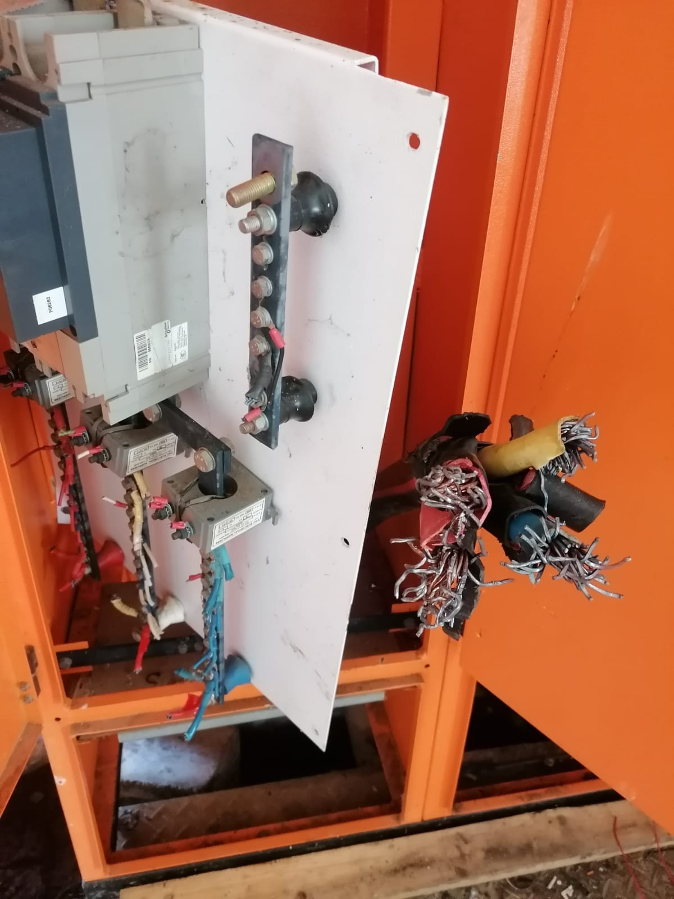
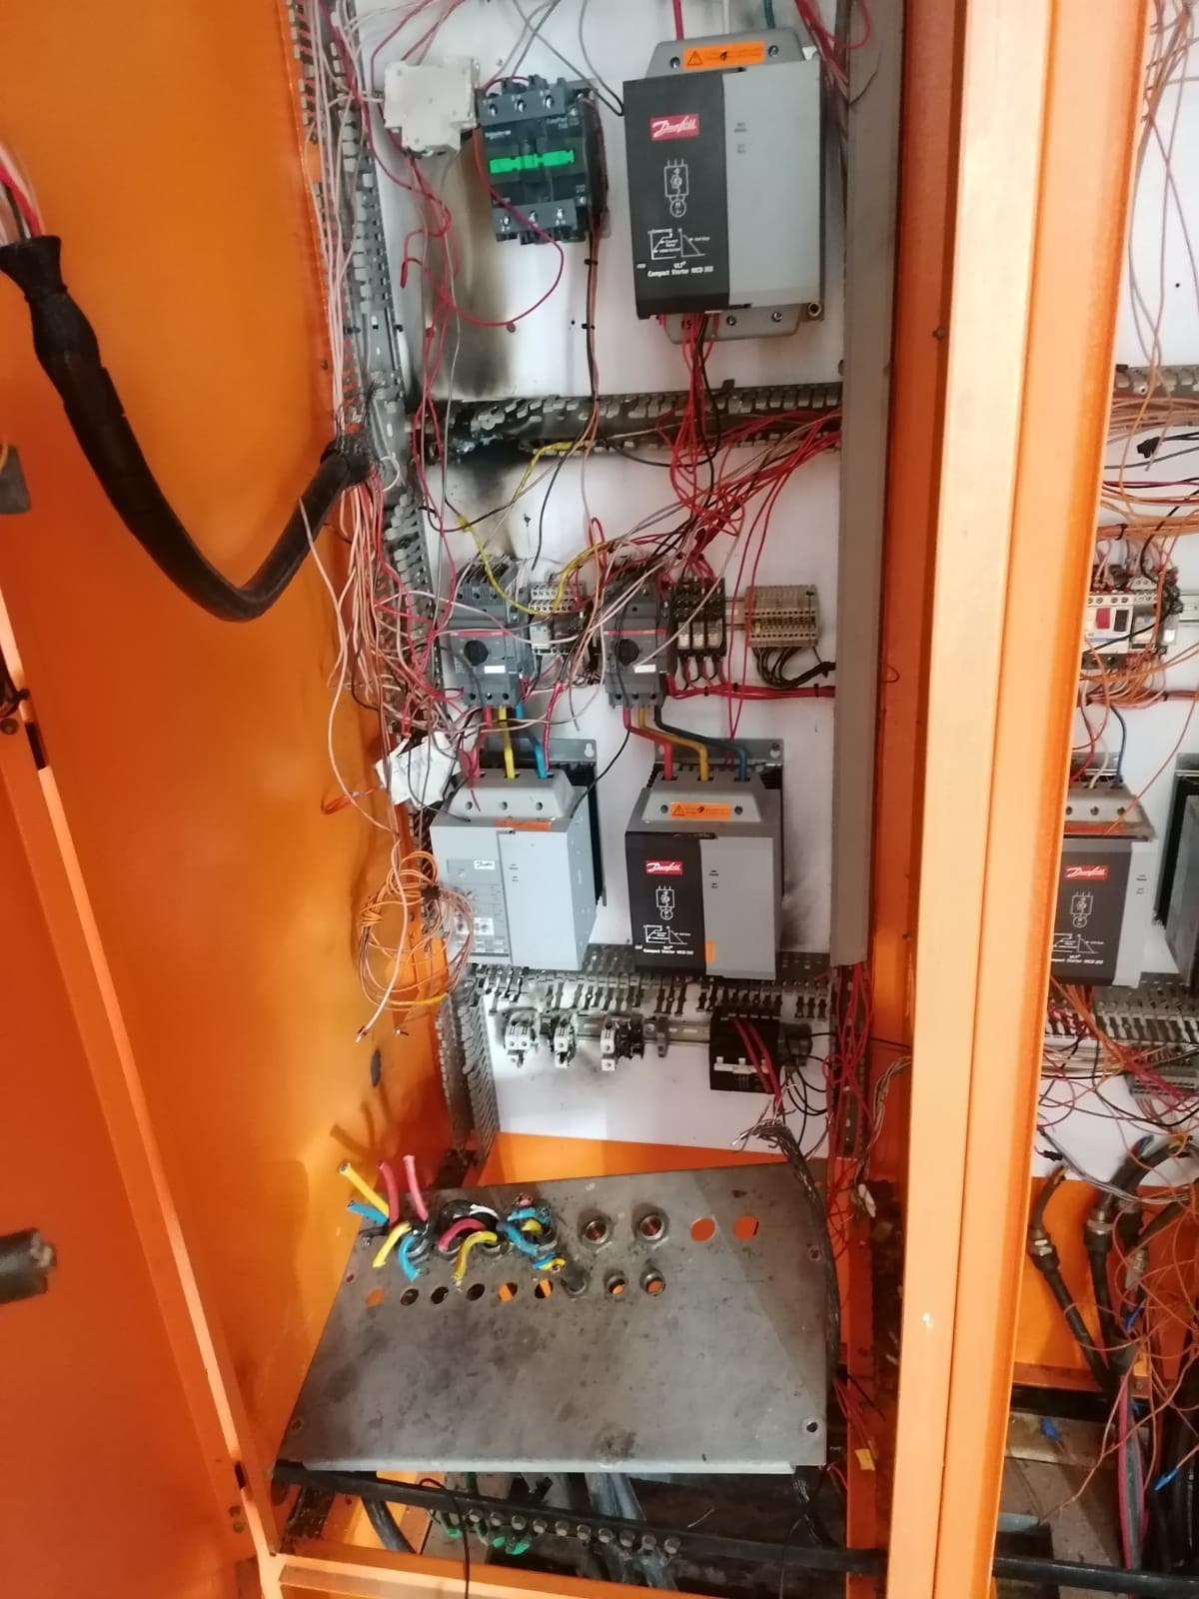
Cost for stolen, damaged and vandalised infrastructure (Electricity) cont…

Slide 8
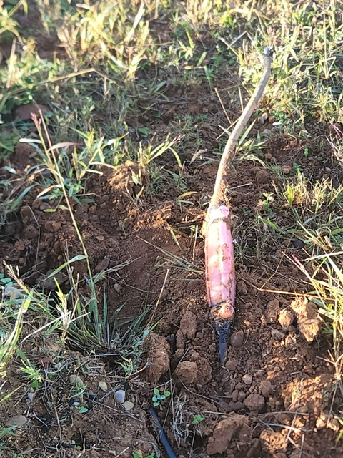
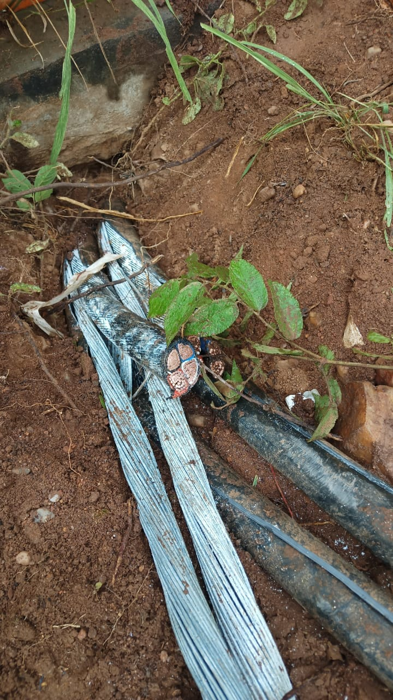
Cost for stolen, damaged and vandalised infrastructure (Electricity) cont…

Slide 9
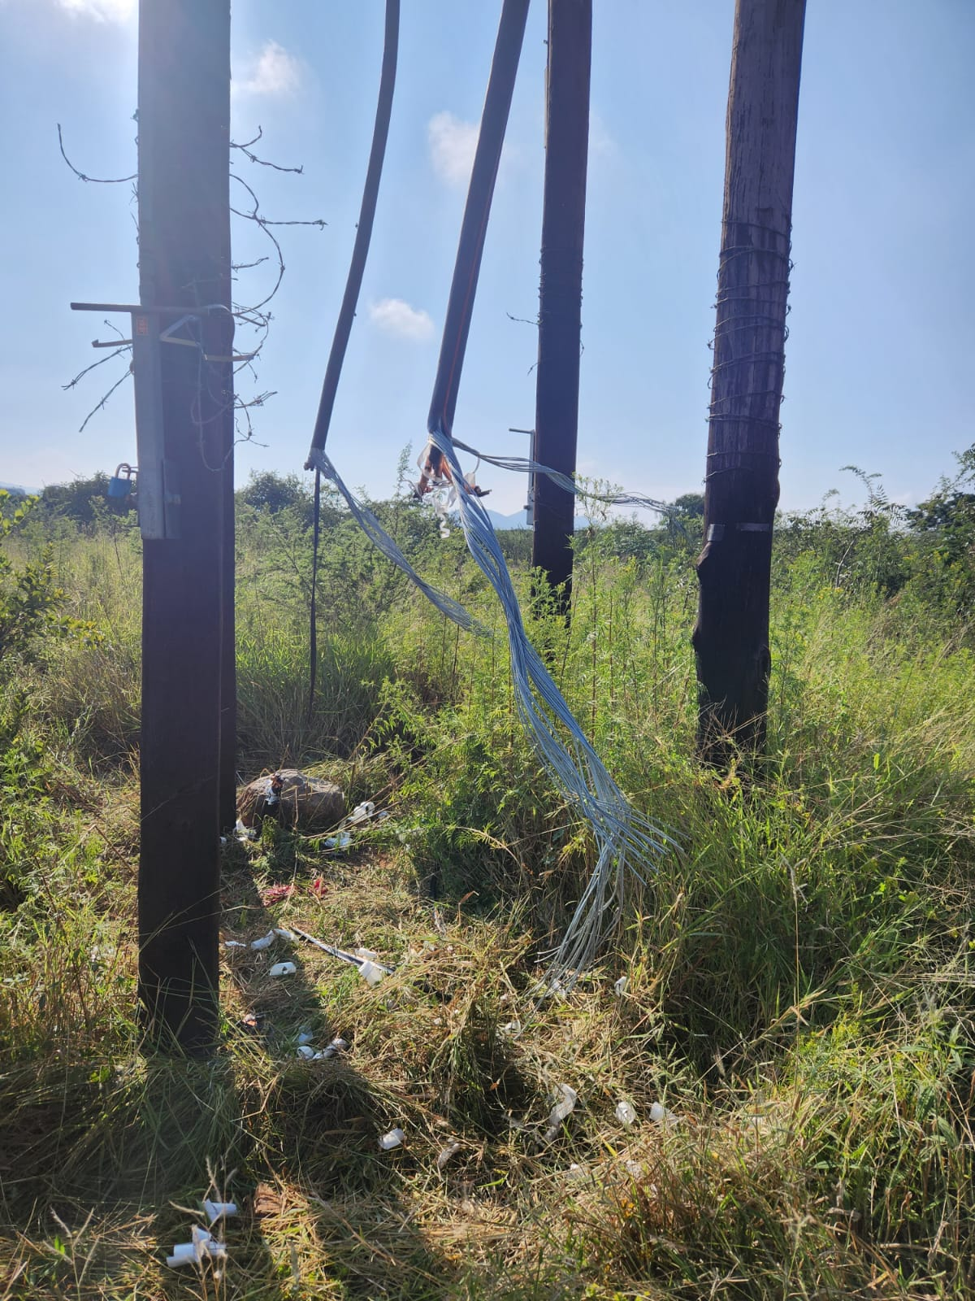
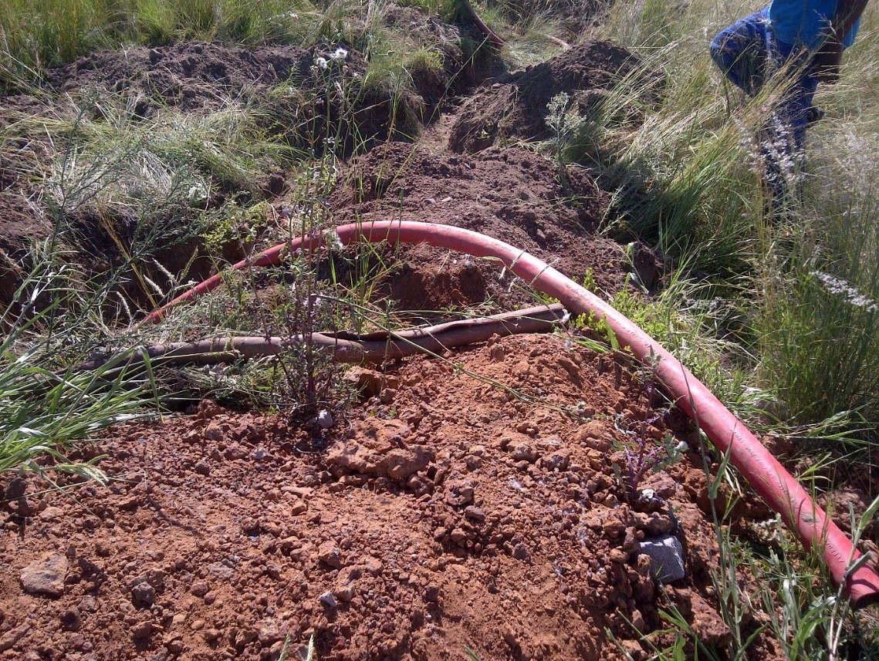
Cost for stolen, damaged and vandalised infrastructure (Electricity) cont…

Slide 10
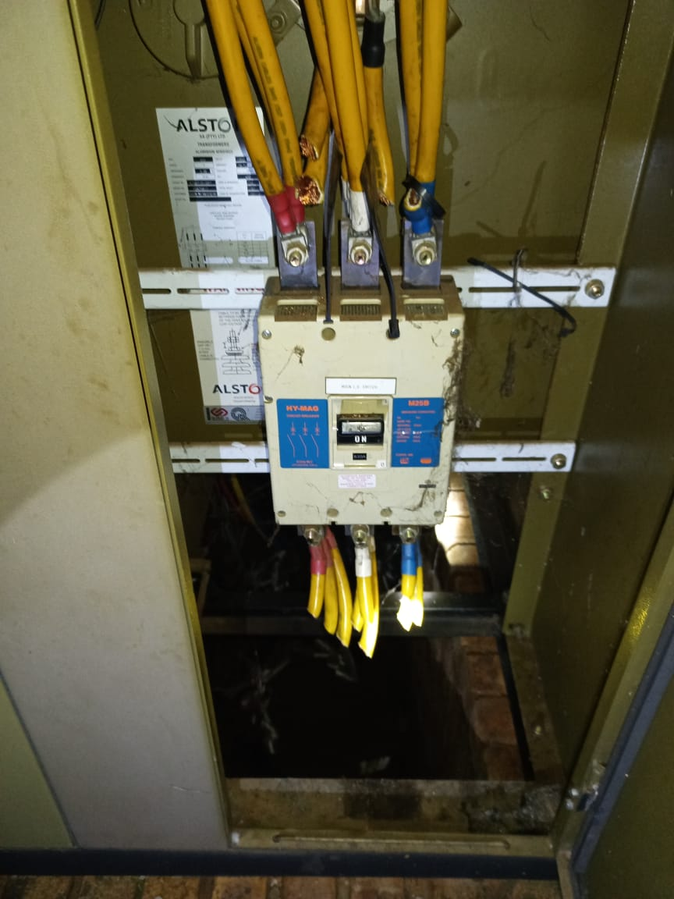
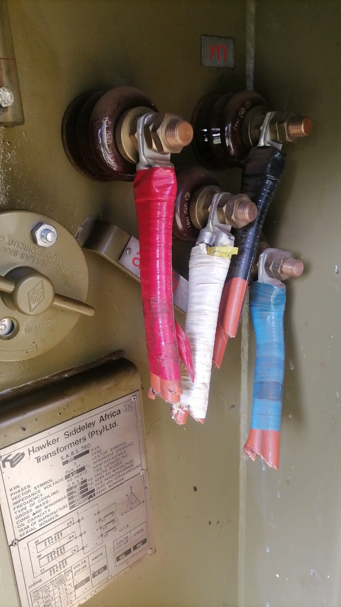
Cost for stolen, damaged and vandalised infrastructure (Electricity) cont…

Slide 11
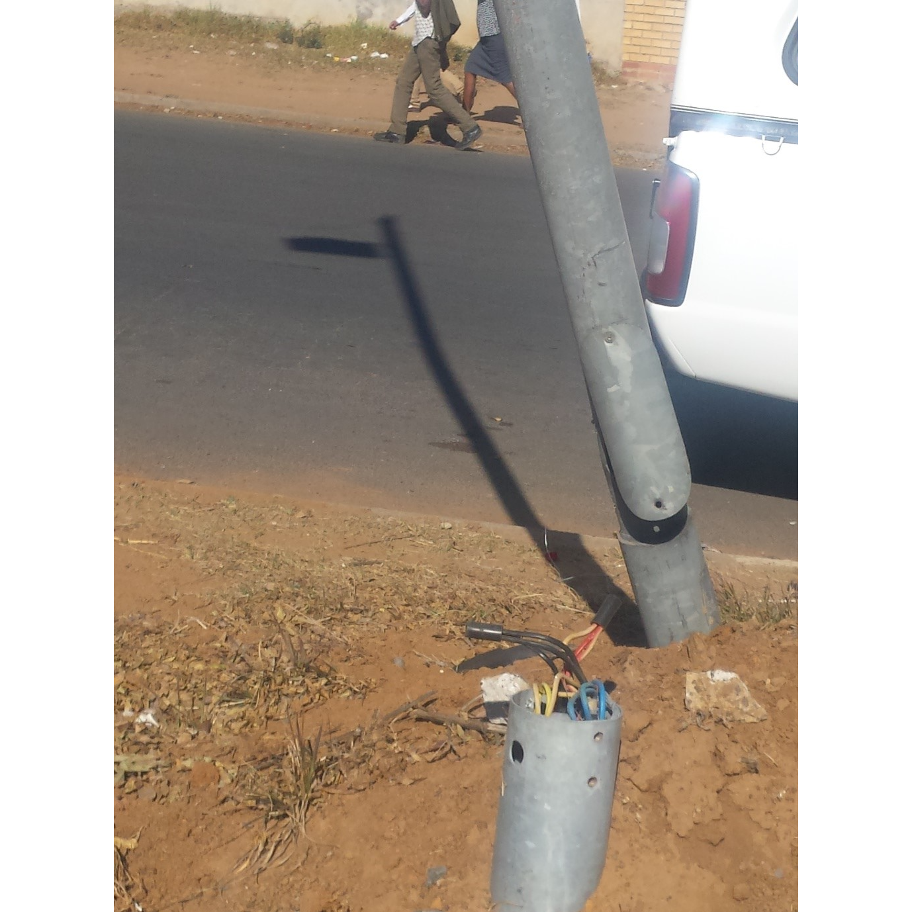
Cost for stolen, damaged and vandalised infrastructure (Electricity) cont…

Slide 12
Cost for stolen, damaged and vandalised infrastructure (WWTWs)
From the 75 WSA (out of 144), the local government is spending at least R443 640 000 to fix WWTWs facilities that have been damaged and vandalised during load shedding
Municipalities are spending at least R480 287 756 on procurement of back-up gensets and R482 517 300 per annum on fuel for generators during loadshedding
Thus, the cost for fixing the damaged WWTW and water purification facilities, procurement of back-up generators and diesel is R1 406 445 056 across the 75 WSA
The estimated cost across all WSAs for fixing damaged WWTW and water purification facilities, procurement of back-up generators and diesel is R3.5 billion.

Slide 13
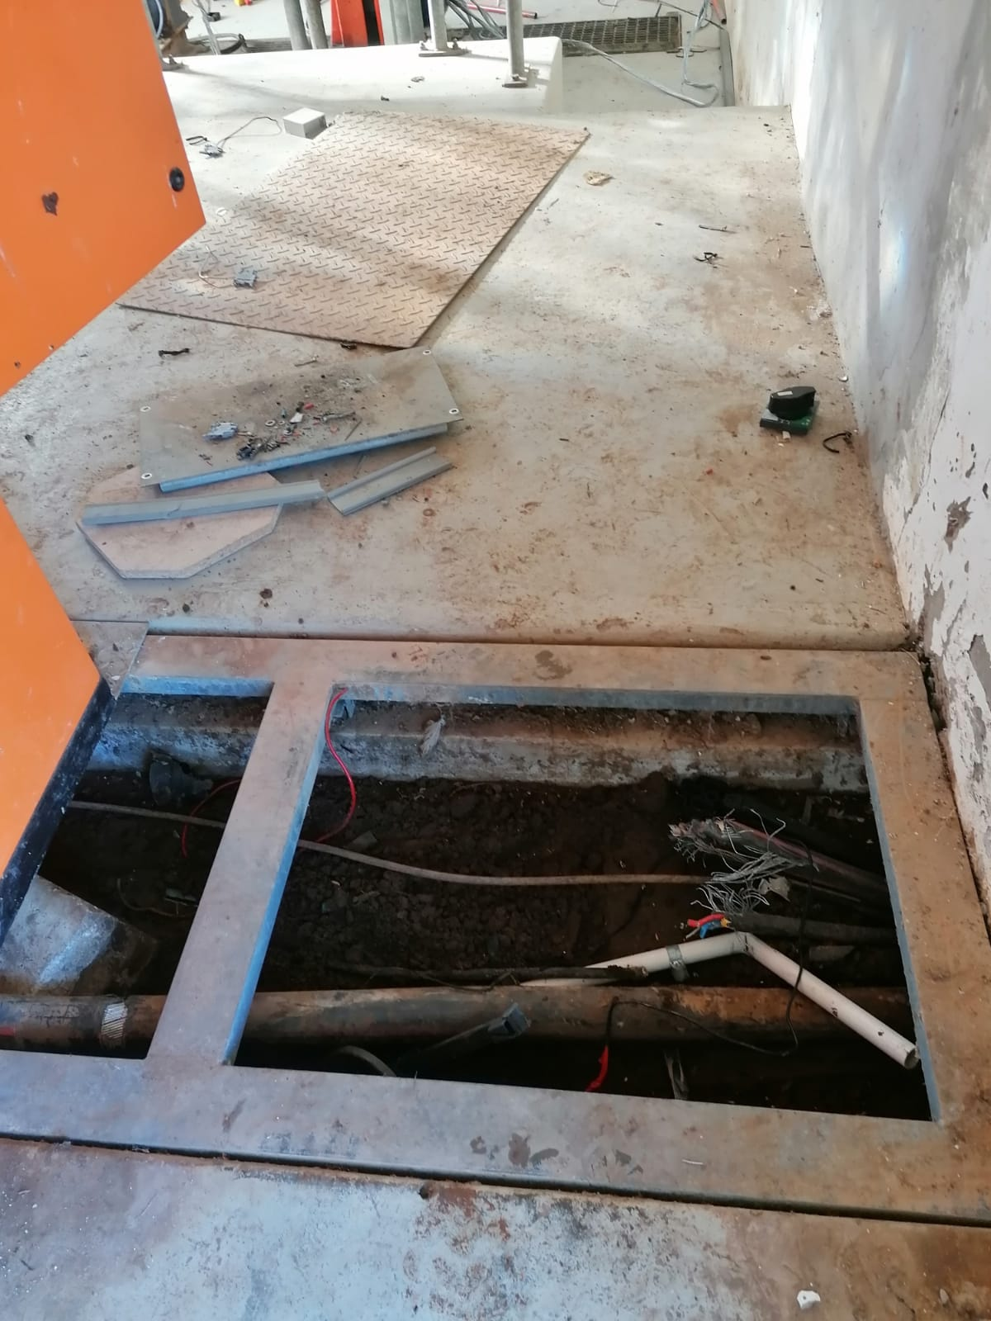
Cost for stolen, damaged and vandalised infrastructure (WWTWs) cont…

Slide 14
Revenue losses on unserved energy
This is typically a value (in R/kWh) that is placed on a unit of energy not supplied due to an unplanned outage or loadshedding
Eight metros are losing an average amounts to nearly R6.4 billion per annum
Similarly, the 156 licensed local municipal distributors are losing nearly R17 810 655 096 per annum
Therefore, the total local government loss due to unserved energy is R24 172 255 096
This excludes loss from customers that are going off-grid, partial loss from customers that are installing embedded generation

Slide 15
Impact of loadshedding on the economy
Businesses are losing revenue,
Jobs are being lost,
Lot of business closures and others relocate,
Businesses and households struggle to pay the municipal accounts,
High usage of diesel generators resulting in air and noise pollution
High operating costs that makes businesses unprofitable resulting in the reduced cashflows for the municipality.

Slide 16
Impact of loadshedding on the economy cont…
There has been an increase in criminal activity reports during the long hour of loadshedding,
There is a lot of damage to electrical equipment and stock and inventory
Traffic congestion due to traffic lights not working
City of Tshwane as an example, is losing R250 million per day from different sectors (agriculture, mining, manufacturing, retail, community service).
Joburg losses over R20 billion per annum

Slide 17
Implications on municipal viability and sustainability
Loss of revenue (unserved energy)
Loss of infrastructure
More expenditure on vandalised, damaged and stolen infrastructure
Increased unemployment and poverty
Inability for customers to pay the municipal taxes and rates
Increased number of indigent

Slide 18
Further potential revenue losses if prepayment meters are not reset
All electricity prepayment meters based on Standard Transfer Specifications (STS) technology will stop dispensing electricity on 24 November 2024
Municipalities must reset these meters to avoid service interruption and revenue losses
All the prepayment meters will require Key Change Tokens (KCT), which is done manually by entering the key change token (two reset tokens) in the meter
Only 16 months left (480 days) for the electricity prepayment meters to be reset, municipalities must start the process now, time is of essence

Slide 19
Potential revenue losses if prepayment meters are not reset cont…
Western Cape Dashboard
WC number of meters | 1 041 820
Meters reset thus far | 467 942
Percentages of meters reset | 45%
Outstanding | 573 431
Percentages of outstanding | 55%
Average to be reset per day | 1 042

Slide 20
Plans to mitigate impact of loadshedding
The plan was to identify areas of support including accessing National Disaster resources through Regulation 4(e), government has withdrawn the state of disaster.
Thus, NO FRAMEWORK against which applications for financial and other assistance can be made in terms of costs and damage incurred related to loadshedding.
SALGA to lobby provincial COGTA for support to municipalities (funding, technical assistance and skills development)
NECOM workstream 9: Distribution-safety and security sub-workstream to assist in preventing vandalism of infrastructure

Slide 21
SALGA proposals
Investments in utilising the available infrastructure in municipalities to address the energy crisis
Aggressive rollout of alternative energy solutions for municipal strategic infrastructure such as Water Treatment Works, Pumps, Sewer, traffic lights and public lighting for public safety.
Aggressive national investments in municipalities to assist municipalities review their current business models from electricity retailer to fully fletched energy services providers.
Repurpose unused conditional grants to be channelled to energy solutions in municipalities
Support municipalities in the procurement of energy from other suppliers (e.g. provide backing of government for strong balance sheet and guarantees

Slide 22
SALGA proposals cont…
National Investments in enabling municipalities to build, own and operate their own generation infrastructure
Invest in Demand Side Management, especially in municipal properties and facilities than asking industry to use less energy
Review INEP and EEDSM to align to prevailing developments in the sector
Provide support to municipalities in negotiating energy wheeling arrangements
Special grants to install energy packages to the settlements where non-payment and non-technical losses are high (or INEP can be repurposed for that)
Rollout of battery energy storage systems in municipal networks (can solve NMD issues)

Slide 23
SALGA proposals cont…
Assist municipalities with funded plans to reduce stages of loadshedding in their jurisdictions to procure utility scale generation (e.g. Cape Town and Ethekwini strategies)
Assist municipalities with JET infrastructure plans to access the climate financing package
National consolidated effort to improving security of critical energy infrastructure
Impress upon the regulator to develop a national framework for trading platform of small-scale embedded generation as well as Wheeling
Support provided in assisting municipalities to generate power using water reservoirs, waste to energy, and waste water treatment plants

Slide 24
Plans to ensure that all prepayment meters are reset
Workshops and information sharing sessions
Partnership with South African Council for Graduates (SACGRA)
Establishing STS TID rollover prepayment meter project dashboard

Slide 25
Conclusion
The cost and loss to municipalities due to loadshedding is substantially high, unsustainable and unaffordable
Collective effort (National, Provincial and Local) from all spheres of government is needed to address the energy crisis-Constitution, section 154 (municipalities in co-operative government)
SALGA has a clear strategic role to play in, representing the interests of local government to fulfil their developmental obligations
Continue with partnership to build capacity and resilience in the local government
Continue to support, represent and build capacity in energy transition in the local government
Continue to unlock the municipal generation capacity procurement

Slide 26
Conclusion cont…
SALGA implement a number of capacity building initiatives for municipalities through”:
Training/capacity building
Study and Guideline reports
Toolkits
Advisory services
Knowledge and information sharing sessions
Hands on support

Slide 27
Thank you
Dr Silas K. Mulaudzi
Specialist: Sustainable Energy
smulaudzi@salga.org.za

