Slide 1

Presentation on appointment of the National Council for Correctional Services
14 June 2023

Slide 2
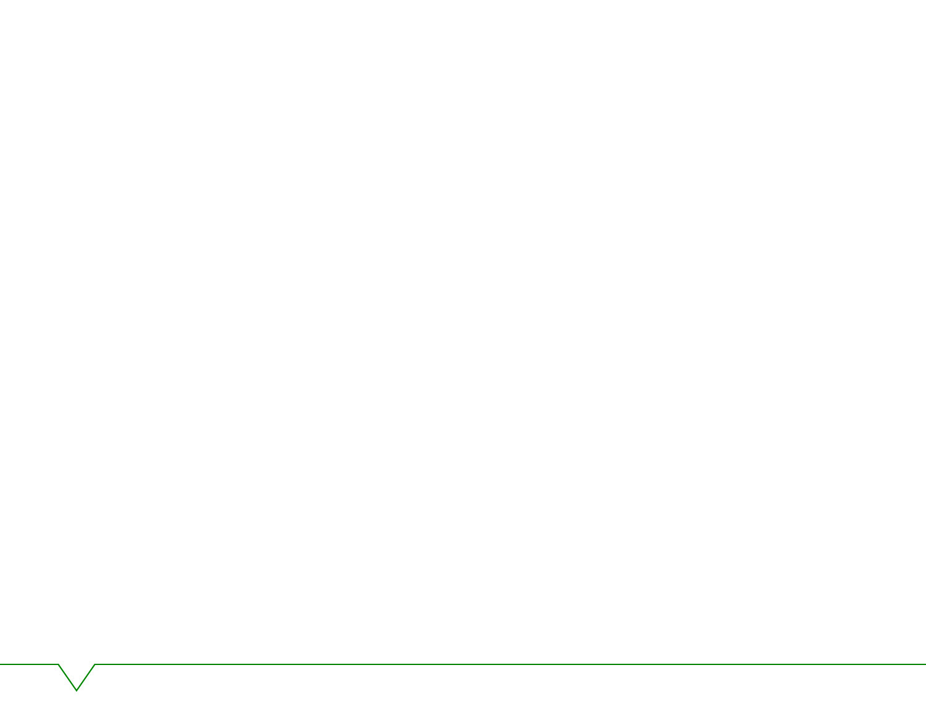
Purpose
The purpose of this presentation is to brief the Select Committee on Security and Justice on appointment of the National Council for Correctional Services (NCCS).

Slide 3
Contents
Introduction
Discussion
Conclusion

Slide 4
Introduction
As you may be aware, the Minister of Correctional Services is mandated to appoint a National Council for Correctional Services (NCCS) referred as the Council in terms of Section 83 of the Correctional Services Act, 1998 (Act 111of 1998).
The main function of the NCCS is to advise the Minister on developing policy with regard to the correctional system and the sentencing process. The Minister must refer draft legislation and major proposed policy developments regarding the correctional system to the National Council for its comments and advice.
The Council, has historically (dating as far back as the old Act of 1959) been very instrumental in the development of processes and procedure within the Correctional and Penology field nationally and outside our Borders.

Slide 5
Introduction
The Council also considers cases of offenders serving sentences of life imprisonment and must make recommendations to the Minister regarding the placement of such offenders on parole or day parole and cancellation of day parole or parole. Certain members of the Council also sit as the Correctional Supervision and Parole Review Board, to review the decisions of Parole Boards.
The term of the current Council was extended until 30 June 2023.
It is clear from Section 83 of Act 111 of 1998 as amended that the composition of this Council has to be reflective of the dynamics of our country, as far as the Administration of Justice and Public Safety is concerned.

Slide 6
Introduction
It is legislated that the Council needs to consist of the following persons:
Three Judges of the High Court or Supreme Court of Appeal;
A Magistrate;
A prosecutor from the National Prosecuting Authority;
Representatives from the Departments of Correctional Services, Social Development and Police;
Two persons who specialise in the field of corrections; and lastly
Members of the community.
For the purpose of this communication, we will limit discussions to the appointments as far as they relate to Section 83(h), appointments which must be made in consultation with relevant Parliamentary Committees.

Slide 7
Discussion
Furthermore, Section 78 of Act 111 of 1998, states that the Council will also be ceased with the responsibility of advising the Minister in respect of the powers in relation to offenders serving life sentences.
Appointments in terms of S83(2)(h)
An advert was published in the Sunday media inviting nominations/applications for appointment in the NCCS. A re-advert was done with the aim of increasing the pool of the candidates for appointment.
Following in-house consultation and needs based research; we have decided to limit appointments to the legal, religious, academic, community involvement and social fields.
We hereby propose that the relevant Parliamentary Committees to consider the following candidates for appointment:

Slide 8
Discussion
Legal Fraternity
Ms Amanda Lindokhuhle Vilakazi: age 34 years, Female, an admitted Attorney based in Johannesburg and currently serving as a member of the NCCS
  Adv Yvette Le Roux: age 46 years, Female, an Adv of the High Court of SA based in the Eastern Cape
  Adv Khavhareni Aarone Mahumane: age 65 years, Male, Adv of the High Court of SA based in Limpopo
  Mr Marothi Aaron Mashifane: age 45 years, Male, an admitted Attorney based in Pretoria (also represent people with disability)
  Ms Ngenzeni Victoria Mboweni (Nkuna): age 35 years, Female, an admitted Attorney based in Mpumalanga
  Mr Tshepo Nawane: age 41 years, Male, an admitted Attorney based in Johannesburg

Slide 9
Discussion
The religious fraternity
Rev Pogiso France Mookisi: age 58 years, Reverend in Apostolic Faith Mission based in Pretoria.
Academics with experience in criminal justice
Dr Lineo Rose Johnson: age 60 years, Doctor of Education based in Pretoria, involved in various projects and activities working closely with the Department of Correctional Services. Educational programme that benefit women offenders. She was also working with the Department in the establishment of Unisa Hub. She will be assisting the department with the training of professionals in the Department.
Mr Mziwoxolo Mfeketo: age 68 years, based in Western Cape, and completed Masters in Administration. He has served as a member of the NCCS from 2016 till to date. He is involved in various community developments.

Slide 10
Discussion
Knowledge of the community justice system
Dr Herma Hargovan: 61 years of age from KwaZulu-Natal. She obtained a Phd (Criminology) in 2008 from the University of KwaZulu-Natal. She served as a member of the Department of Justice and Constitutional Development Provincial Restorative Justice Sub-Committee. She is a former member of the KwaZulu-Natal quality assurance panel for diversion service providers. She is the current member of the NCCS.

Slide 11
Discussion
Criminologists
Dr Vanitha Chetty: age 71 years, Female who specialized in criminology which is a scare skill in the Correctional Services environment and is based in Durban. Her experience, skills and specialization are relevant to the work of the NCCS as she is currently serving on the NCCS.
Ms Vuyelwa K Maweni: 30 years of age from KwaZulu-Natal. With Masters in Social Science majoring in Criminology and Forensic Studies and Doctor of Philosophy candidate. She is lecturing forensic criminology and has worked with the Department of Correctional Services on risk profiling and community profiling.

Slide 12
Discussion
Social Workers
Ms Daleen Van Biljon: age 48 years from Eastern Cape, female with Masters in Forensic Social Work, with extensive experience in Social Work, Restorative Justice and Victim Empowerment.
Dr Yolinda Styen: aged 48 years from Free State, female with Doctorate in Social Work, with 23 years experience in Social Work.

Slide 13
Discussion
Psychologists:
Mr Willem A.A. Hanekom: 68 years of age from Western Cape. A Clinical Psychologist with Masters and experience in the Department of Correctional Services and private practice.
Ms Lusanda U.Z. Rataemane: 67 years of age based in Gauteng. A Clinical Psychologist with Masters Degrees obtained from University Surrey. She is the current member of the NCCS.

Slide 14
Discussion
The Security Screening was conducted by State Security Agency herewith attached letter from SSA marked Annexure A. The new Council will be appointed with effect from 01 July 2023 for a period of five years.
Annual Budget allocation:
It is important to indicate that the budget of the Council is controlled by the Council’s Secretariat which is employed by the Department. It for this reason that Act 111 of 1998 does not require appointment of an Accountant as a member of the Council.

Slide 15
Discussion
Council allowances:
The Council allowances (R2 698-00) per session (per day) are paid from the Compensation of Employees budget from the Department to members of the Council who are not in the service of the State. Attached hereto as Annexure B is a breakdown of allowances paid to members during 2021/2022 financial year.
Council: Goods and Services budget:
The budget allocated below is used for the running costs of the Council’s Secretariat. (Annexure C)
Budget allocated: 2020/2021: R1,869,000-00
Budget allocated: 2021/2022: R1,362,000-00
Budget allocated: 2022/2023: R1,142, 000-00

Slide 16
Discussion
NCCS meetings:
The Council meets once a month for three (3) days. The three days are divided as follows:
Day 1 -2: Lifer profiles (±150 profiles are discussed during the two days (±75 per day)
Day 3: Policies
Financial report / Batch list
Attached hereto the following documents:
Batch list (Annexure D)

Slide 17
Conclusion
As per the Correctional Services Act 111 of 1998 as amended section 83(2) (h), we therefore recommend and open to discuss the above-mentioned names to the the Select Committee on Security and Justice to consider for appointment as members of the Council.

Slide 18
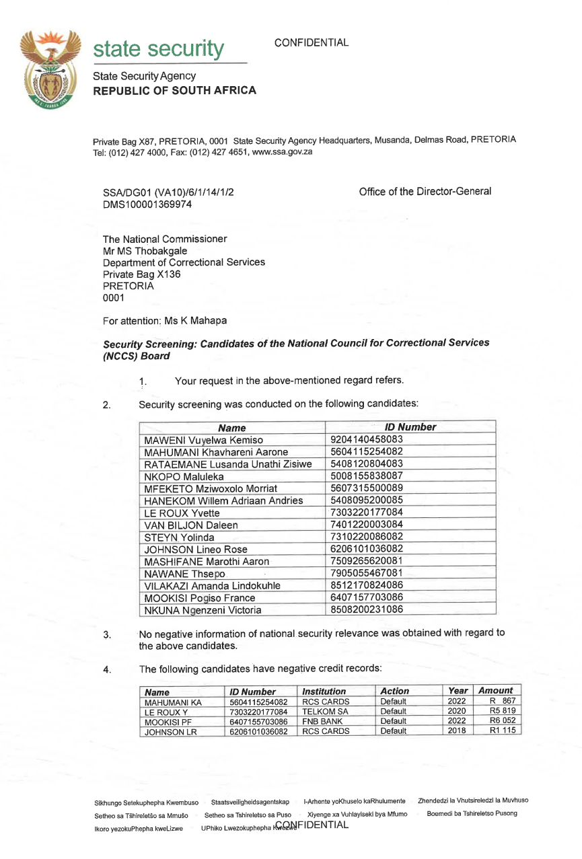
Annexure A

Slide 19
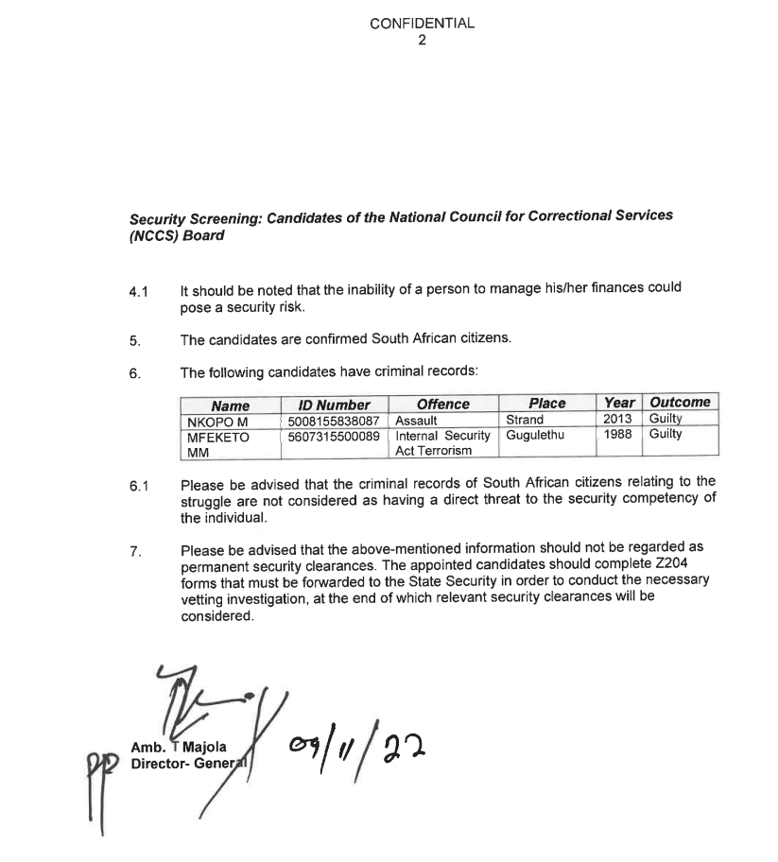
Annexure A

Slide 20
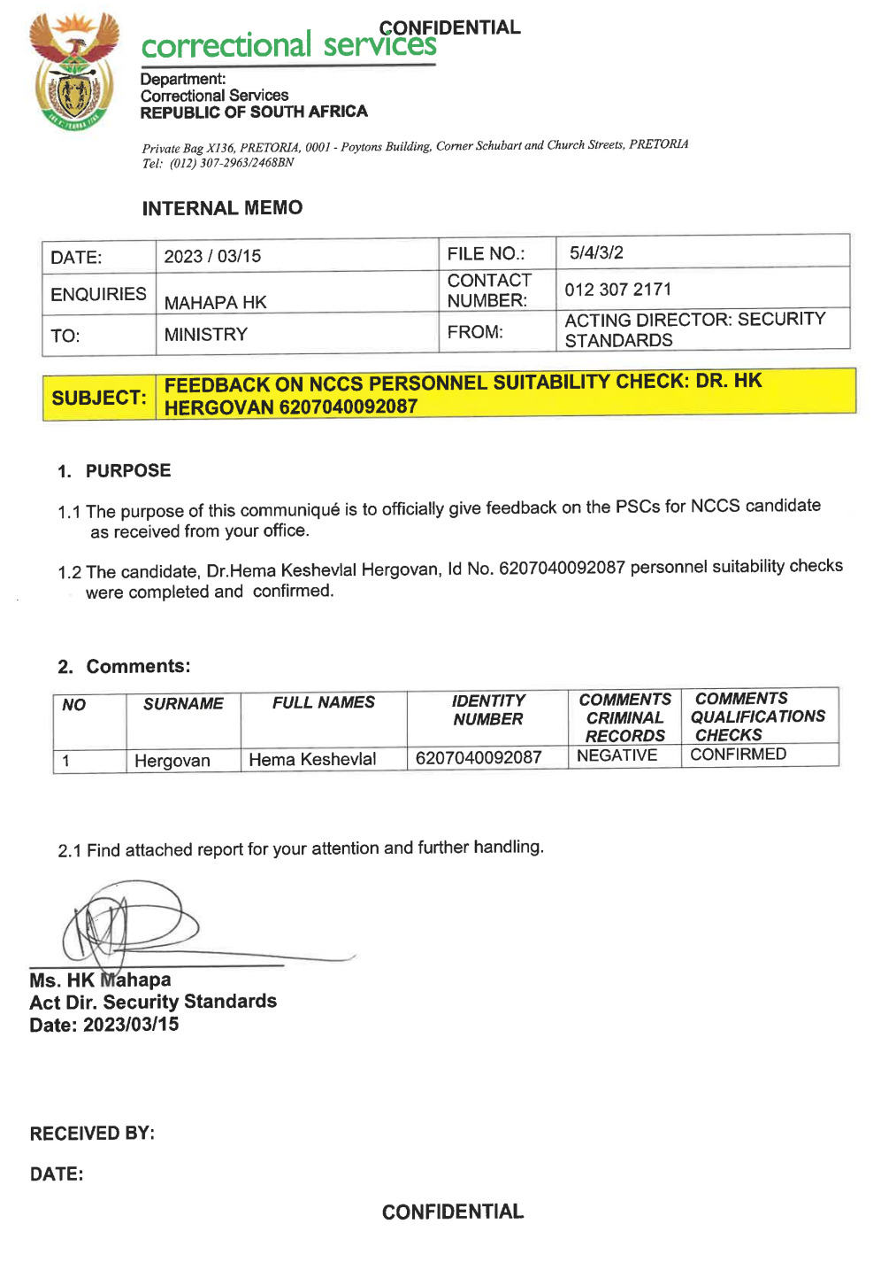
Annexure A

Slide 21
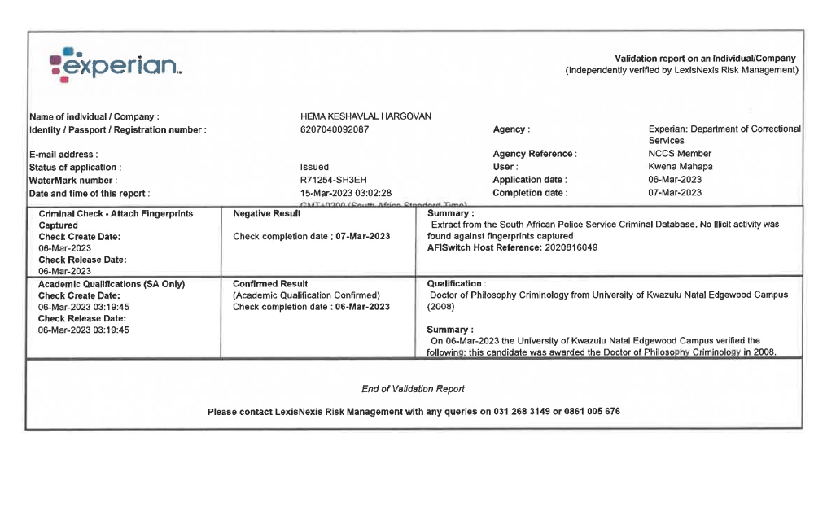
Annexure A

Slide 22
MINISTRY OF JUSTICE AND CORRECTIONAL SERVICES
REPUBLIC OF SOUTH AFRICA
Private Bag X853, Pretoria, 0001, Tel: (012) 307 2934, Fax: (012) 323 4111
Private Bag X9131, Cape Town, 8000, Tel: (021) 464 4600, Fax: (021) 465 4375
Annual Budget allocation:
NCCS Compensation :
The NCCS allowance (R2 698-00) per session (per day) are paid from the Compensation of Employees budget from the Department to members of the Council who are not in the service of the State. Here is a breakdown of allowances paid to members 2021/2022 financial year.
NCCS Board meetings:
The Board meets once per month for three (3) days. The 3 days are divided as follows:
Day 1-2 : Lifer profiles (±150 profiles are discussed during the two days (±75 per day)
Day 3: Policies
Other Sub meetings.
NCCS Overcrowding Sub-Committee
NCCS Restorative Justice Sub-Committee
NCCS Sub-Committees on Policies
Total number of currently paid members is eight (8) this includes all meeting:
Month 1 Payments R 172 854.00
Month 2 Payments R 170 235.00
Month 3 payments R 329 994.00
Subtotal for the three (03) months is R 673 083.00
Annexure B
Annual Budget allocation:
NCCS Compensation :
The NCCS allowance (R2 698-00) per session (per day) are paid from the Compensation of Employees budget from the Department to members of the Council who are not in the service of the State. Here is a breakdown of allowances paid to members 2021/2022 financial year.
NCCS Board meetings:
The Board meets once per month for three (3) days. The 3 days are divided as follows:
Day 1-2 : Lifer profiles (±150 profiles are discussed during the two days (±75 per day)
Day 3: Policies

Slide 23
MINISTRY OF JUSTICE AND CORRECTIONAL SERVICES
REPUBLIC OF SOUTH AFRICA
Private Bag X853, Pretoria, 0001, Tel: (012) 307 2934, Fax: (012) 323 4111
Private Bag X9131, Cape Town, 8000, Tel: (021) 464 4600, Fax: (021) 465 4375
Annual Budget allocation:
NCCS Compensation :
The NCCS allowance (R2 698-00) per session (per day) are paid from the Compensation of Employees budget from the Department to members of the Council who are not in the service of the State. Here is a breakdown of allowances paid to members 2021/2022 financial year.
NCCS Board meetings:
The Board meets once per month for three (3) days. The 3 days are divided as follows:
Day 1-2 : Lifer profiles (±150 profiles are discussed during the two days (±75 per day)
Day 3: Policies
Other Sub meetings.
NCCS Overcrowding Sub-Committee
NCCS Restorative Justice Sub-Committee
NCCS Sub-Committees on Policies
Total number of currently paid members is eight (8) this includes all meeting:
Month 1 Payments R 172 854.00
Month 2 Payments R 170 235.00
Month 3 payments R 329 994.00
Subtotal for the three (03) months is R 673 083.00
Annexure B
Other Sub meetings.
NCCS Overcrowding Sub-Committee
NCCS Restorative Justice Sub-Committee
NCCS Sub-Committees on Policies
Total number of currently paid members is eight (8) this includes all meeting:
Month 1 Payments R 172 854.00
Month 2 Payments R 170 235.00
Month 3 payments R 329 994.00
Subtotal for the three (03) months is R 673 083.00

Slide 24
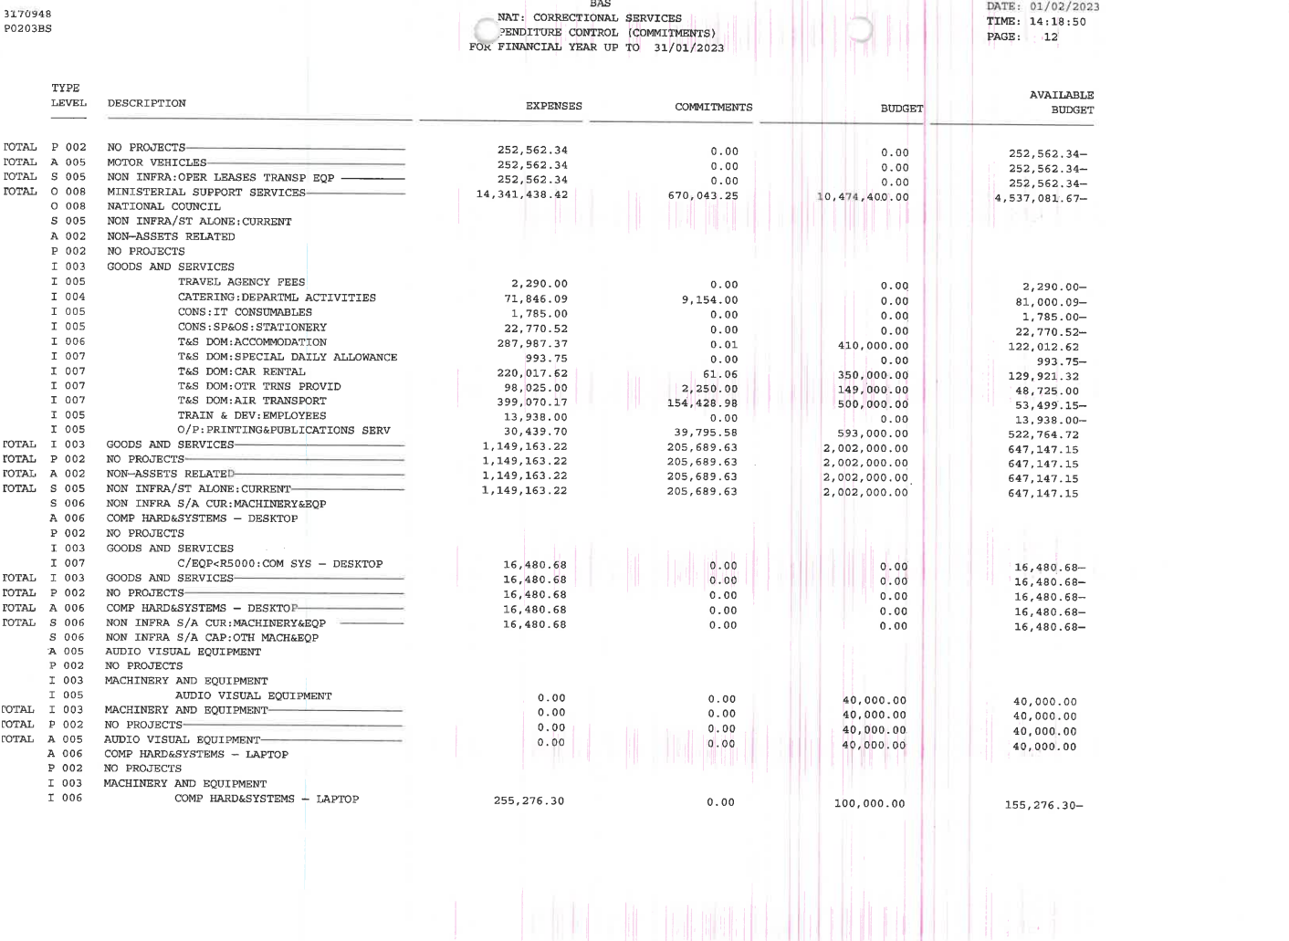
Annexure C

Slide 25
Annexure D
BATCHLIST
22 - 24 FEBRUARY 2023
MATTERS THAT STOOD DOWN
No. | OFFICE NR | NAME & SURNAME | REG NR & CC | ALLOCATION
1a. | F074 | Nkosi Zakhe | 2020408820 Krugersdorp | Mr Nqadala (Legal opinion on lifers also serving determinate sentences. Court Order)
MATTERS THAT ROLLED OVER
1b. | W670 | Luthando Bhovungane | 202020839 Durban Medium B | DPP Kanyane
2b. | PW669 | Shozi Mcatshangelwa Jerome | 205139314 Durban Medium B | DPP Kanyane
3b. | F619 | Mdunge Mbongeni | 203181698 Durban Medium B | DPP Kanyane

Slide 26
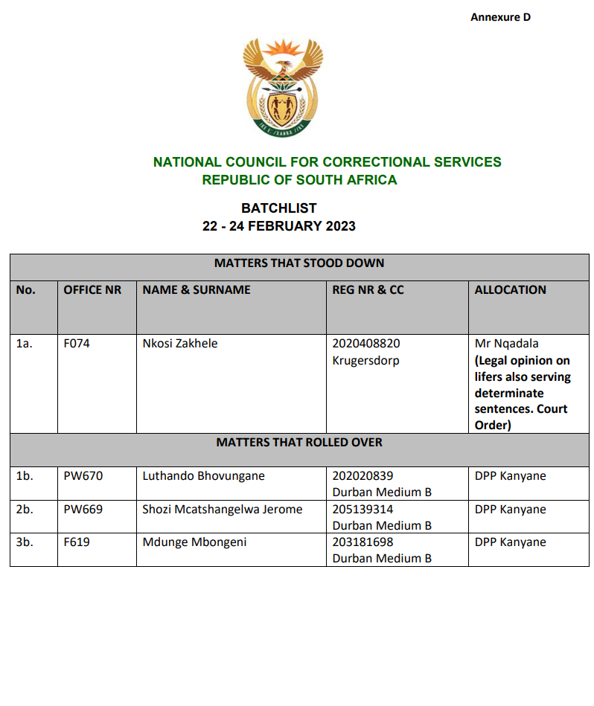
Annexure D
BATCHLIST
22 - 24 FEBRUARY 2023

Slide 27
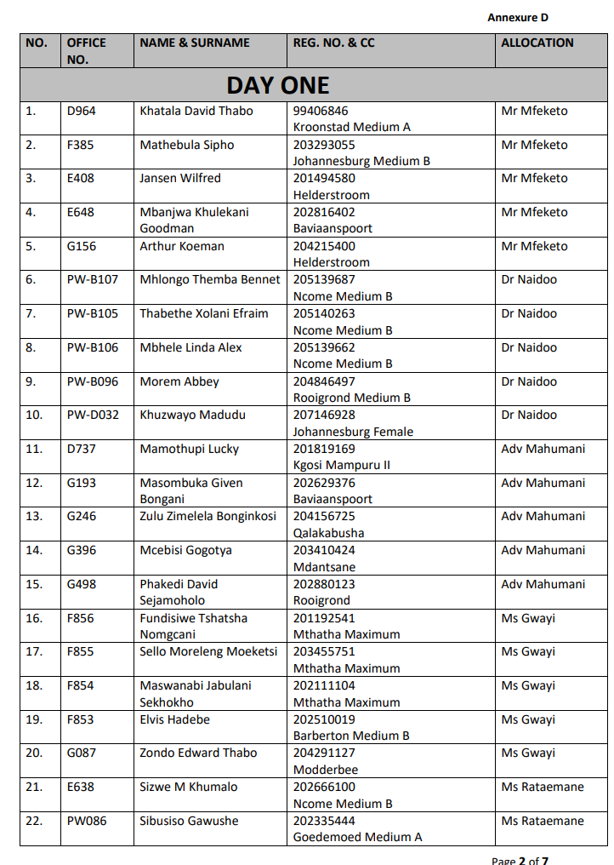
Annexure D
BATCHLIST
22 - 24 FEBRUARY 2023

Slide 28
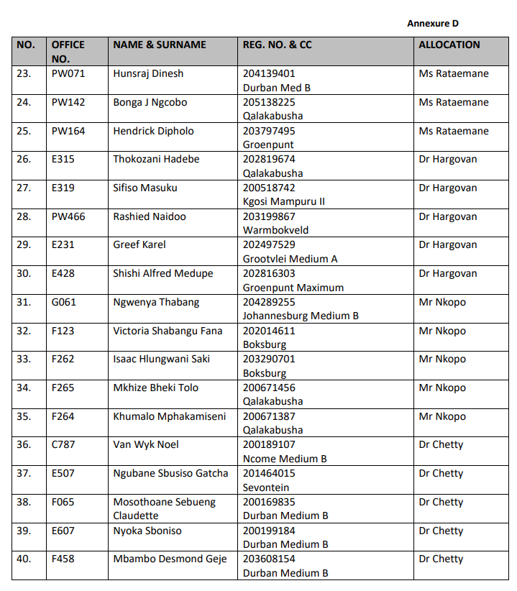
Annexure D
BATCHLIST
22 - 24 FEBRUARY 2023

Slide 29
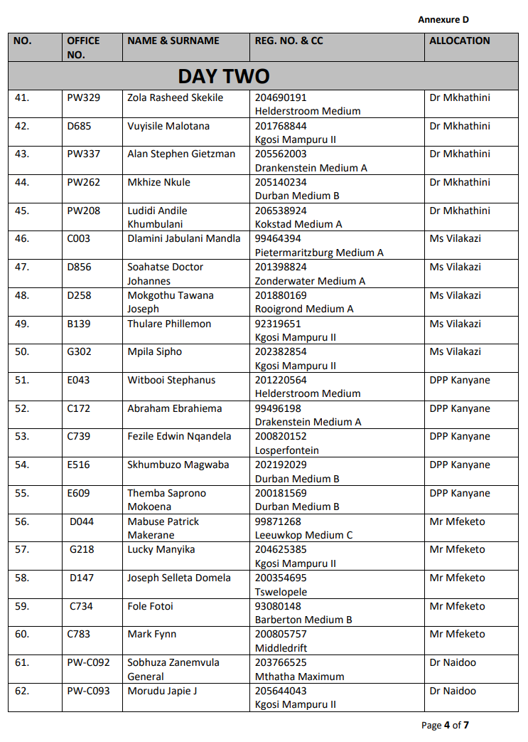
Annexure D
BATCHLIST
22 - 24 FEBRUARY 2023

Slide 30
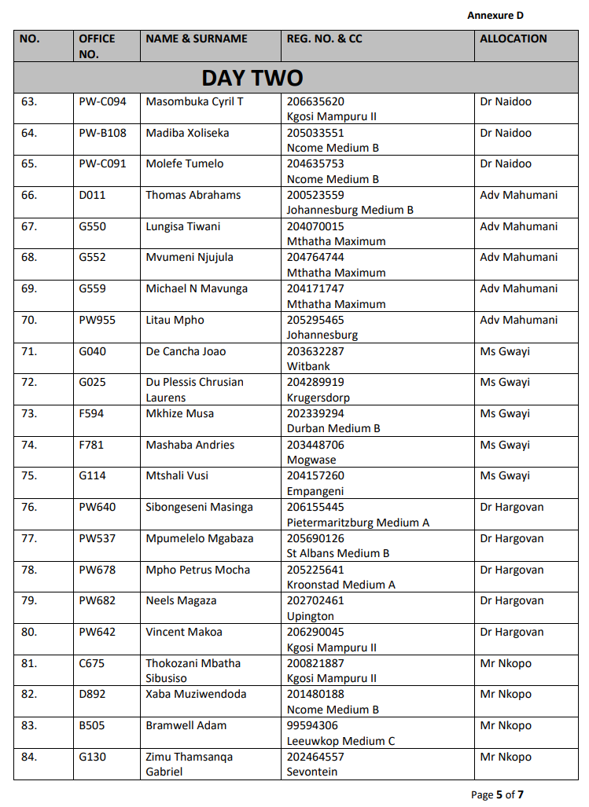
Annexure D
BATCHLIST
22 - 24 FEBRUARY 2023

Slide 31
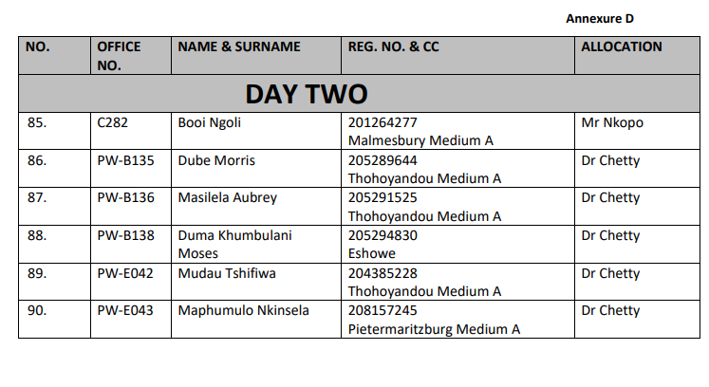
Annexure D
BATCHLIST
22 - 24 FEBRUARY 2023

Slide 32
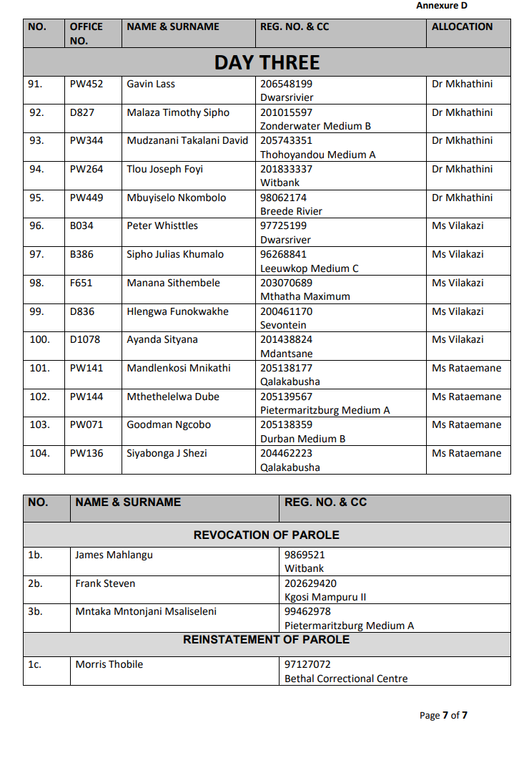
Annexure D
BATCHLIST
22 - 24 FEBRUARY 2023

Slide 33

Thank you
Thank You

