Slide 1

Portfolio Committee of Human Settlements
Service Delivery
14 June 2023
Cllr Gregory Nthatisi
Acting Executive Mayor

Slide 2
Presentation Outline:
Overview
Human Settlements core responsibilities
2022/23 Capital Breakdown and Allocation per service
Urban Settlements Development Grant (USDG) framework
USDG Financial and Non-Financial performance
Upgrading of Informal Settlement Programme
Serviced Sites
Land invasions

Slide 3
Overview:
Mangaung Metropolitan Municipality was placed under National Intervention in terms of section 139 (7) and 154 of the Constitution and section 150 of the Municipal Finance management Act, 2003.
All Senior Executive Management positions became vacant due to the lapse in their fixed term contracts.
Interim Management Team consisting of officials seconded from National Government were appointed from April 2022 initially for a period of 6 months, but the period has been extended to 30 June 2023.
The National Cabinet Representative (NCR) and a multidisciplinary team were appointed to assume the responsibility to implement the financial recovery
plan with effect from the 21st of April 2022 until further notice.

Slide 4
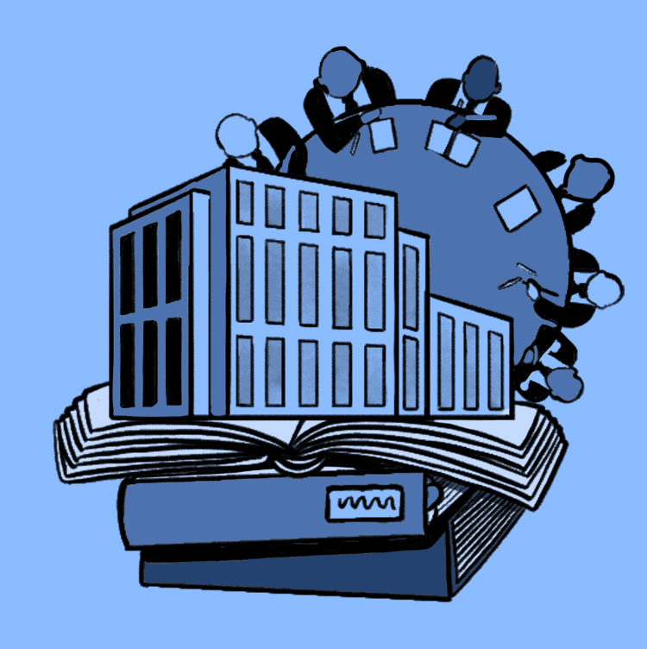

Overview:
The current changes to the Political Administration and Executive Management Team
  Acting Executive Mayor and Acting Mayoral Committee effective from 12th of April 2023 for three months
  New Acting City Manager
  Acting HOD’s

Slide 5
Human Settlements Core Responsibilities
Informal Settlements and Beneficiary Management | Project Management | Mixed Development and Rental | Land and Property Management | Stakeholder Management and Dispute Resolution
Implement the phased upgrading of informal settlements. Allocation of residential erven to communities. Collection and analyse data of informal settlements communities. | Plan projects for implementation. Provide basic services to support housing development. Develop and submit business plans for different relevant grants. Schedule projects and manage the implementation and close out.. | Facilitation of Mega/ Catalytic projects (Mixed Developments) Social housing - GAP housing Rental housing - provision of rental housing and management of housing stock | Release and disposal of land to facilitate privately initiated commercial and social development including urban acupuncture to densify and compact the City Release of land for municipal land development projects Acquisition of privately owned and state land for human settlements developments Acquisition of privately owned and state land for the upgrading and relocation of informal settlements Acquisition of land or other municipal land development projects driven by other departments to contribute to the development of sustainable human settlements | Management and facilitation of Human Settlements stakeholders Skill development within the HS directorate

Slide 6
Human Settlements Core Responsibilities
Informal Settlements and Beneficiary Management | Project Management | Mixed Development and Rental | Land and Property Management | Stakeholder Management and Dispute Resolution
Capture and register applications for low-income housing and other housing opportunities. | Quality assurance and inspection of construction works including the construction of houses by Province. | Implementation of housing policies like Intergraded Human Settlements plan, IDP | Creation of and management of investment leases on municipal land Management of short term commercial and sundry property leases Inspection and monitoring of land to curb land invasions and land grabs | Human Settlement Dispute Resolutions Finance and Administration within the HS directorate

Slide 7
2022/23 Capital Budget Breakdown
Sources of Finance | Amount | % of Capital budget
Own Funds | 203 447 961 | 16%
Public Transport Infrastructure & System Grant | 217 889 233 | 17%
Informal Settlement Upgrading Partnership | 265 636 150 | 20%
USDG Grant | 608 349 001 | 46%
Public Contributions | 14 300 000 | 1%
Total | 1 309 622 345 | 100%

Slide 8
Urban Settlement Development Grant Framework
The Urban Settlement Development Grant (USDG) is a Schedule 4B grant;
Its purpose is to supplement the capital revenues of metropolitan municipalities in order to implement infrastructure projects that promote equitable, integrated, productive, inclusive and sustainable urban development.
Its outcomes to be realised in order to promote integrated sustainable urban settlements and improved quality of living environments are:
  Supporting inclusive densification and transit-oriented urban development, integrating existing and new urban developments
  Provision of adequate bulk and link infrastructure for mixed-income and mixed-use urban developments
  Provide opportunities for leveraging of public funding within partnerships that promote integrated mixed-income and mixed-use development projects and funding for broader urban development
  Provision of resources for sustainable community development for social and economic infrastructure and meaningful participation

Slide 9
Urban Settlement Development Grant Framework
The outputs that should be funded by the grant to support the improvement of the overall built environment:
  Increase in municipal bulk and link infrastructure
  Construction/provision of internal engineering services, including backyarders and densification overlay zones
  Increase in the number of serviced sites
  Increase in the provision of individual connections
  Increase in land provision for informal settlement upgrading subsidised housing or mixed-use developments in support of approved human settlements and other urban developments
  Increase in access to public and socio-economic amenities
  Increase in the number of interim services and
  Increase in the number of community agreements.
On allocation per service, the Metro allocated its funding in line with the grant framework.

Slide 10
Utilisation of the USDG
The Metro is dependent on grants to fund its capital budget and investment on new infrastructure
It is a challenge that the Council and deployed capacity by national departments is reviewing in line with the mandatory financial recovery plan
The Urban Settlements Development Grant (USDG), 46% is the main source of funding for the Municipality’s Capital Budget followed by Informal Settlement Upgrading Partnership Grant (ISUPG), 20% and thirdly Public Transport Network Grant (PTNG), 17%.
Engineering Services Directorate (Roads and Stormwater, 25%, Water, 17% and Sanitation, 18%) has received the biggest portion of the USDG

Slide 11
Utilisation of the USDG
Expenditure on Repairs and Maintenance of Infrastructure has been prioritized
over investment in new infrastructure, Metro past budgets e.g. no new reservoirs, wastewater treatment works (WWTW) or extension on current
USDG previously not used for the intended purpose which is funding of new or renew capital assets, but it was used for operating expenses e.g., payment of salaries, bulk water purchases, etc.
Metro’s USDG Plan not aligned with the Medium-Term Strategic Framework (MTSF) in contributing to the national targets, e.g. number of serviced sites, provision of individual connections, construction/provision of internal engineering services, etc.
Grant Management to be formalized to address shortcomings alluded to above

Slide 12
2022/23 Allocation per service
USDG PER DIRECTORATE | Approved Budget | % on Approved Budget | Adjusted Budget | % on Adjusted Budget
CENTLEC | 20 000 000 | 4% | 26 000 000 | 5%
SOCIAL SERVICES | 6 755 839 | 1% | - | 0%
PLANNING | 48 699 851 | 10% | 39 010 976 | 8%
HUMAN SETTLEMENT | 62 500 000 | 13% | 58 001 944 | 12%
ROADS AND STORMWATER | 82 585 665 | 17% | 121 471 572 | 25%
SANITATION | 89 852 186 | 18% | 86 926 933 | 18%
WATER | 147 514 165 | 30% | 84 233 356 | 17%
WASTE AND FLEET | 19 099 494 | 4% | 67 400 000 | 14%
3% OPSCAPS | 14 752 800 | 3% | 8 715 220 | 2%
TOTAL | 491 760 000 | 100% | 491 760 000 | 100%

Slide 13
2022/23 USDG Budget and Expenditure
Description | Adjusted Budget R'000 | % of Total Allocated Budget | Spent by Municipality R'000 | % Spent | Unspent funds R'000 | % Unspent
Human Settlements | 58 002 | 12% | 42 195 | 73 % | 15 807 | 27%
Roads and Storm water | 121 472 | 25% | 82 736 | 68 % | 38 735 | 32%
Water | 84 233 | 17% | 56 756 | 67 % | 27 477 | 33%
Sanitation | 86 927 | 18% | 25 458 | 29 % | 61 469 | 71%
Electrification | 26 000 | 5% | 17 277 | 66 % | 8 723 | 34%
Socio Economic Amenities | 39 011 | 8% | 31 136 | 80% | 7 875 | 76%
Waste and Fleet | 67 400 | 14% | - | - | 67 400 | 100%
3% OPSCAP | 8 715 | 2% | 3 814 | 44% | 4 901 | 56%
Total | 491 760 | 100 | 259 372 | 53% | 232 388 | 47%
The actual expenditure for the period is R259 372 on the year-to-date budgeted target of R409 800.
On an annual basis we have thus spent only 53% of the year-to-date expenditure against the approved budget of R 491,760,000.

Slide 14
USDG Expenditure Trend
USDG | 2016/17 (R’000) | 2017/18 (R’000) | 2018/19 (R’000) | 2019/20 (R’000) | 2020/21 (R’000) | 2021/22 (R’000) | 2022/23 (End April 2023) (R’000) | 2022/23 (End April 2023) (R’000) plus rollover
Allocation | 783,647 | 943,536 | 706,402 | 511,856 | 532,317 | 799,361 | 491 760 | 617,660
Exp | 701,418 | 704,957 | 582,063 | 354,802 | 514,384 | 527,008 | 259 372 | 277,763
% | 90% | 75% | 82% | 69% | 97% | 66% | 53% | 45%

Slide 15

USDG Expenditure Trend Cont….
USDG | 2016/17 | 2017/18 | 2018/19 | 2019/20 | 2020/21 | 2021/22 | 2022/23
Approved Rollover | R 58,644,000 | R 82,229,000 | R0 | R0 | R 151,298,000 | R 4,092,075 | R125,900,000
Additional Funding | R0 | R 100,000,000 | R0 | R0 | R0 | R 300,000,000 | R0
Reallocated Funds | R0 | R0 | -R 49,814,000 | -R301,707,000 | -R300,000,000 | R0 | R0
National Treasury Stopping and reallocation of funds through Section 18 and 19 of DoRA
  2018/19 R 49 814 000
  2019/20 R 301,707,000
  2020/21 R 300,000,000
  2021/22 R 300,000,000 additional allocation
The Metro lost unspent USDG funds to National Revenue Fund during the 2018/19 and 2019/20 Financial Years

Slide 16
Background to reallocate funds
The Metro on the 20th of January 2023 received a letter from the Department of Human Settlements (DHS) dated 19th of January 2023, wherein the department was invoking section 17 (1) of Division of Revenue Act (DoRA) (No. 5 of 2022), the intention to withhold future tranches of USDG – R147,5 million and ISUPG – R38 million due to continuous poor financial performance;
On the 23rd of February 2023, received another letter dated 17th of February 2023 informing the Metro of the departmental decision to withhold future tranches of USDG and ISUPG;
The Metro received another letter from National Treasury dated 17th of February 2023 invoking section 18 (1) of DoRA, stopping of allocation to the Metro.
Thereafter National Treasury visited the Metro on the 22nd and 23rd of March 2023 for the 2023 Mid-Year Budget and Performance Assessment Engagement;
It was during this engagement that the Metro made a case for the funds not be stopped because of the challenges the Metro was experiencing
On 30th of March 2023 received a Published Gazette No 48327 from DHS informing the Metro of the stopping of R75 million of the ISUPG

Slide 17
The directive from National Treasury
The Metro received a letter from National Treasury redirecting R147,5 million to Freedom Square (R80 million)
  Installation, replacing and refurbishing of the bulk and connector infrastructure to connect households to waterborne sewer system;
  Rehabilitation and refurbishing of the roads and stormwater systems;
  Metro is required to provide maintenance plan for this rehabilitated infrastructure to ensure that the decay and derelict does not occur in the future
NT would like to further direct that the remaining balance (R67, 4 million) be utilised for the following projects:
  Purchase “essential fleet” that would assist the municipality in collecting waste;
  Permission is also granted for the fixing of weighbridges in the northern and southern landfill sites
  Special permission is also granted to the fencing of the southern landfill site

Slide 18
The implications of reallocated funds on business plan
DESCRIPTION | UNITS | UNIT PRICE | GRAND TOTAL
LANDFILL COMPACTOR | 2 | R14 201 788 | R28 403 576
LANDFILL DOZER | 2 | R5 435 102 | R10 870 204
REFUSE COMPACTION 10 TON | 4 | R3 302 630 | R13 210 519
TLB | 2 | R1 604 728 | R3 209 456
FRONT END LOADER | 2 | R2 318 159 | R4 636 319
10 CUBE TIPPER TRUCK | 2 | R2 507 373 | R5 014 746
LDV 4X4 S/CAB | 3 | R559 151 | R1 677 454
UPGRADE REFURB NORTHERN LANDFILL SITES | - | R3 400 000 | R0
NEW FENCE AT SOUTPAN LANDFIL SITE | - | R10 028 040 | R0
 |  |  | R 67 022 273
Reprioritization of projects as per letter issued by National Treasury on 28 March 2023
Additional submissions has been made to National Treasury with specific reference to:
  Fleet Management and maintenance
  Fencing of Southern Waste facility
  Fixing Weighbridge fixing North and Southern landfill
  Total Allocation: R 67 400 000.00 received
Priority vehicles has been identified:
  Emergency procurement for weigh bridges
  Landfill and fencing allocation requested to be redirected to Fleet as emergency procurement will not be possible before end of financial year.
  Balance to be utilized for skip bins – DFFE donated skip loader to the Metro
  to the value of R 1,9 mil

Slide 19
The implications of reallocated funds on USDG business plan
In the first place, these funds were linked to projects in the business plan
Secondly, this was not new funds, but reallocated funds linked to projects
The Metro had to take a difficult decision to delay certain projects in the current financial and push them into the new financial and outer years.
On the USDG business plan these are the projects mentioned below:
  Social amenities projects
  Land development or township establishment projects
  Provision of serviced sites
  Upgrading of roads infrastructure
  Provision of individual connections of sanitation and water
  Refurbishment or extension of wastewater treatment works plants and networks
  Refurbishment of water treatment works plants and network
  Rehabilitation of our landfill sites
Social Services and Waste Management projects ceased due to reallocation of funds

Slide 20
Town Planning - Financial and Non-Financial performance (2022/2023)
PROJECTS | STATUS/PROGRESS
T/SHIP EST MOROJANENG DEWETSDORP | Draft layout presented to the municipality, Environmental Impact Assessment (EIA) documents sent to Department of Small Business Development, Tourism and Environmental Affairs (DESTEA)
T/SHIP EST GRASSLAND | Draft layout presented to the municipality, EIA documents sent to Destea, Traffic Impact Assessment (TIA) complete.
FORMALISATION INFILL PLANNING | Caleb Motshabi surveying underway, to be completed by 20th of June 2023
TOWNSHIP ESTABLISHMENT FARM KLIPFONTIEN | Project in progress, Hydrological study is underway after natural flooding on the area, thus delaying the project. To be finalized and sit at Municipal Planning Tribunal (MPT) first quarter of 2023/24
TOWN ESTABLISHMENT BOTSH SEPANE FARMS | Township Establishment processes complete with approval from MPT. Land surveying to commence in 1st quarter 2023/24
T/SHIP ESTABL REMAIN FARM VEEKRAAL 605 | Project in progress, layout plan completed, specialists' studies compiled. Awaiting approval TIA and EIA
T/ESTABL RE FARM BOTS826 K1689 K1690 | Project in progress; layout plan completed, EIA approved, awaiting approval of TIA

Slide 21
Social Amenities - Financial and Non-Financial performance (2022/2023)
CONSTRUCTION OF A NEW COMMUNITY CENTRE IN THABA NCHU |  | CONSTRUCTION OF A NEW FIRE STATION IN BOTSHABELO
Site establishment, Excavation of spoil layer |  | Site establishment
Importing and compaction of gravel layer-works up to building platform and car park levels |  | Excavations & reducing levels
Building of retaining wall to contain the earthworks (as determined by the 100-year flood line) |  | Fencing of site
Laying of the new sewer and storm water lines, building of manholes and connection to the main sewer line. |  | The casting of foundation of the Office block
Caretaker house complete.
Ordering of steel for structural strength of the halls

Slide 22
Engineering Services - Financial and Non-Financial performance (2022/2023)
ROADS AND STORMWATER | PROJECTS PROGRESS
REFURBISHMENT MANAGEMENT SYSTEM: R & S | The project is at implementation stage, Stormwater infrastructure condition assessments are under way. 177 Km is targeted to be assessed and 133 Km thereof is assessed.
RESEALING OF STREETS | Resealing program is under construction. However, budget levels are very low to make a significant impact. Road Asset Management System of Mangaung states that 90% of the 1600 km sealed network is in poor conditions, requiring resealing and overlays, with 35% being very poor condition, requiring rehabilitation. 12,58 Km has been achieved from quarter 1 to quarter 3. This is against the 10 km that was targeted for 2022/2023.
T1428A MAN RD 198 199&200 BOCH | The project was on construction stage. However, the initial contractor was terminated when the progress was at 60% progress. A replacement contractor has to be appointed in order to complete the outstanding scope.
T1430C 7TH STR BOTSHB SECTION H | The project is under construction. The progress is at 96%. The contractor is attending to snag list that was identified during the final inspection.
T1523 BOT RD 304 305 308 SECTION G UPG | The project is at design stage. The design is targeted to be complete by the 30th June 2023
T1527A BOCHABELA STS | The project is complete.
T1530 BOT RD B16 & 903 SECTION T UPG | The project is complete.

Slide 23
Engineering Services - Financial and Non-Financial performance (2022/2023)
ROADS AND STORMWATER | PROJECTS PROGRESS
T1532 VISTA PARK BULK ROAD & S/WATER UPG | The project is at construction stage with progress of 65%.
T1534 VERENIGING AV EXT BRIDGE OVER RAIL | The project is complete.
T1534B VERENIGING AVENUE EXT ROADS | The project is at construction stage with a progress of 94%.
T1537 HEAVY REHAB NELSON M&ELA ST | The project is at planning stage. Construction stage could not be realised due to budget constraints.
T1432 MAN 10786 BERGMAN SQUARE | The project was at construction stage. However, the contractor terminated a contract due to late payments.
STORMWATER REFURBISHMENT | The program is under implementation, 0,149 km of the 3km targeted will be achieved in 2022/2023 FY. This is due to budget constraints.

Slide 24
Engineering Services - Financial and Non-Financial performance (2022/2023)
SANITATION | PROJECTS PROGRESS
SEWER MASTER AND DEVELOPMENT PLANS | 80% of the plan is complete
BOTSHABELO MAIN OUTFALL SEWER | Feasibility study and preliminary design complete
REFURBISHMENT OF SEWER SYSTEMS | Two contractors were appointed during February 2023 and the project is currently under construction with 18% of the budget being spent to date
REFURBISHMENT OF WWTW'S | Two contractors were appointed during February 2023 and the project is currently under construction with 10% of the budget being spent to date
EXTENSION THBA NCHU WWTW (SELOSESHA) | During December 2022, the contractor suspended works and terminated the contract during January 2023 leaving the civil works incomplete
EXTENSIONOF THABA NCHU WWTW SELOSESHA MECH ELECTR | No progress made due to civil works being incomplete

Slide 25
Engineering Services - Financial and Non-Financial performance (2022/2023)
WATER | PROJECTS PROGRESS
M/POORT WTW UPGRADING ( M/POORT FILTERS) | Re-advertisement of the tender for the appointment of the contractor in progress
NEW RESERVOIR IN THABA NCHU (20ML) | Detailed design report is being concluded
PELLISSIER RESERVOIR | Feasibility study is complete
REFUR OF WATER SUPPLY SYSTEMS | Re-advertisement of the tender for the appointment of the contractor in progress
MASELSP WAT RE-USE PUMP STAT RISING MAIN | The project is awaiting the purchase of land that is in progress for the registration of servitudes
MAKURUNG INTERNAL WATER RETIC | Tender document complete and ready for presentation to bid specification committee
HAMILTON PARK PUMP ST@ION REFURBISHMENT | The construction is in progress

Slide 26
Engineering Services - Financial and Non-Financial performance (2022/2023)
WATER | PROJECTS PROGRESS
WATER MASTER AND DEVELOPMENT PLAN | 80% of the plan is complete
MASELSPOORT WTW UPGRADE | No progress made as the project awaits the appointment of the professional service provider
REPLACE WATER METERS AND FIRE HYDRANTS | 277 water meters were replaced
PREPAID PROG (AUTOMATED METERS) | 900 prepaid water meters were installed
DEV & IMPLEMANTATION OF SAM MAST MODULE | Technical specification and project scope complete
BULK S MET LOCREP CALIBR/INST CON METERS | No progress made due to non-appointment of the service providers
PRES& N/WORK ZON MAN(AUD VAL) | No progress made due to poor performance of the contractors
WAT SYS MAN OPT TELE SCADA | Tender document ready to serve at bid specifications committee

Slide 27
Challenges
Procurement processes
PSP Panel appointments
Contract Management
Payment of contractors within 30 days
Rollover not likely approved
Stopping or re-allocation of funds

Slide 28
Upgrading of Informal Settlements Programme

Slide 29
Background on Upgrading of Informal Settlements Programme (UISP) Strategy
In 2014 the Metro developed a municipal wide informal settlements upgrading strategy.
At that time, there were 28 informal settlements which increased to 47 settlements in 2020.
The plan includes a phased approach in the upgrading of the informal settlements.
The upgrading strategy includes land acquisition, planning and surveying of land, provision of basic services, security of tenure.
The Metro has anti-land invasion plan to curb further mushrooming of informal settlements in the area of jurisdiction.
The Metro has been working with the HDA for the development of informal settlements upgrading plans.

Slide 30
Upgrading of Informal Settlements Programme (UISP)
The Metro has 47 informal settlements in terms of the Upgrading of Informal Settlements Programme (UISP) strategy. There are 4 new informal settlements taking the total to 51 informal settlements.
19 informal settlements upgrading plans were concluded in the previous (2021/2022) financial year.
From the strategy and the upgrading plans, the settlements are categorized as follows:
  Category A full upgrading – 32 settlements
  Category B1 interim services leading to full upgrade – 13 settlements
  Category B2 provision of basic level of service while awaiting relocation- 3 settlements
  Category C rapid relocation – 3 settlements

Slide 31
Level of Basic Services
A total of 12 informal settlements have been upgraded to phase 3 (access to water and sanitation) benefiting 2 203 households living in informal settlements.
95% of the households in informal settlements have access to electricity.
Additional 5 informal settlements projects are currently being electrified to benefit 335 households in the current financial year
In the new financial we planned 1 076 new connection, and this will come from six informal settlements around Mangaung

Slide 32
Level of Basic Services
23 informal settlements were targeted for upgrading through the provision of basic services.
  3 new informal settlements were planned for phase 2 (provision of interim services “communal water”) in the current financial year to benefit 558 households. Construction will be done internally.
  We have received the record of decision (approval of EIA) to complete the Klipfontein township establishment targeted for phase 2 to benefit approximately 4 000 households
  43 households have been connected with water and sanitation from one (1) informal settlement completed in the current financial year.

Slide 33
Level of Basic Services
  3 200 households are connected with water connections with the reservoir to be commissioned to provide running water.
  Construction of water and sanitation to 192 households in 2 informal settlements is under construction and was planned to be completed end of March 2023 but experienced delays to be completed end of June 2023.
  3 main roads and stormwater projects are under construction in 3 informal settlements (Botshabelo West, Grassland and Caleb Motshabi).
  5 informal settlements projects will be ready for implementation to provide water and sanitation to 2703 households as we anticipate to appoint three Contractors in June 2023.

Slide 34
Informal Settlements Upgrading Plan
The Metro is working with the HDA to develop seven (7) upgrading plans for 7 new settlements targeted for upgrading in the MTREF.
Focus is on the Phase 3 of the informal settlements programme to provide basic services to households in informal settlements.
Address accessibility and avoid flooding through provision of roads and stormwater network.
Provide security of tenure:
  Permission to occupy (PTO) as interim measure
  Title Deeds for permanent for permanent

Slide 35
Informal Settlements Upgrading Plan
ISUPG | 2022/23 Budget 000 | 2022/23 Expenditure 000 | No of households
Water | R 31 000 | R 21 773 | 3 500
Sanitation | R 10 600 | R 3 098 | 245
Water and Sanitation | R129 441 | R 31 892 | 1 238
Electrification | R 21 276 | R 2 934 | 335
Shared Services | R 5 300 | R 0 | 4 046
OPSCAP | R 7 000 | R 0
Total | R 204 617 | R 59 697 | 9 364
The allocation at beginning of financial year was R279 617 million
The Metro lost R75 million due to poor performance

Slide 36
The implications of reallocated funds on ISUPG business plan
These are the projects mentioned below:
  Land acquisition – procuring of land for informal settlements relocations
  Procurement of alternative sanitation professional service providers for informal settlements with bulk infrastructure challenges
  Upgrading of informal settlements which were targeted for upgrade
The Metro is still to inform the Ministry and Department of Human Settlements (DHS) on these changes as they affected the 2022/23 business plan as submitted to DHS

Slide 37
Challenges
Supply chain management issues, e.g. slow turnaround time by SCM Committees, late advertisement of bids.
Contract management issues, slow turnaround time around extension of time, extension of scope, variation orders.
Non-performance of Contractors and Service Providers.
Late payment of contractors slowing down the movement of projects.
Community unrests delaying projects.
Land owners changing the terms at advance stages of concluding offers.

Slide 38
Mitigation
SCM Committees to prioritise grant funded projects.
Delay all projects at designs and procurement to outer financial but processes should continue in preparation for next financial.
Enhance community engagements at the start of project to ensure smooth implementation.
The establishment of the Project Management Unit (PMU).
Introduce integrated approach across all directorates

Slide 39
Catalytic Projects

Slide 40
Catalytic Projects
The Metro is currently implementing two (2) catalytic projects that is Vista Park 2 and 3
The two (2) developers were appointed in 2014 wherein the Metro signed a land availability agreement with the developers
This is a turnkey projects – a project that is constructed so that it can be sold to any buyer as a completed product;
The funding mix is both government and private developers but predominately government.

Slide 41

Vista Park 2
The appointed developer is Emendo Project Managers and Planners:
  The developer is not on site due to disputed outstanding payments;
  The Metro Administrative leadership is prioritising the resolution of this matter and get the developer back on site;
  The developer completed 90% of the realignment of both bulk water and sewer pipes and still to complete the remaining 10%;
  The developer has to complete the township establishment processes to commence with the installation of internal services.

Slide 42
Vista Park 2 – Layout Plan

Slide 43
Vista Park 2 - Yields
NO | LAND USES | NUMBER | PERCENTAGE
1 | BNG/RDP HOUSING | 284 | 6.03%
2 | FLISP HOUSING | 293 | 6.22%
3 | BONDED HOUSING | 194 | 4.12%
4 | FLATS | 1518 | 32.24%
5 | SOCIAL HOUSING | 1820 | 38.65%
6 | STUDENT HOUSING | 559 | 11.87%
7 | OLD AGE | 40 | 0.85%
 | TOTAL HOUSING OPPORTUNITIES | 4709 | 100%
8 | SERVICE INDUSTRY | 3
9 | CONVENIENT CENTRE | 1
10 | BUSINESS | 8
11 | FILLING STATION | 1
12 | SCHOOLS | 3
13 | CRECHES | 5
14 | CHURCHES | 4
15 | PLACE OF ASSEMBLY | 1
16 | SPORTFIELD/PUBLIC OPEN SPACES | 15

Slide 44
Vista Park 2 – Progress to date
BULK SERVICES CONSTRUCTION | PROGESSS TO DATE
BULK WATER /SEWER - (PHASE 1) | 90%
BULK STORM WATER & ATTENUATION DAM | 0%
BULK ELECTRICITY | 0%
ROADS & STORM WATER | 0%
INTERNAL WATER AND SEWER | 0%
INTERNAL ROADS & STORM WATER | 0%
BULK STORM WATER | 0%
FIBRE/CONNECTIVITY –WI FI | 0%
SOLAR ENERGY | 0%
GAS ENERGY | 0%
SMART LIGHTING/CAMERAS | 0%
LANDSCAPING | 0%

Slide 45
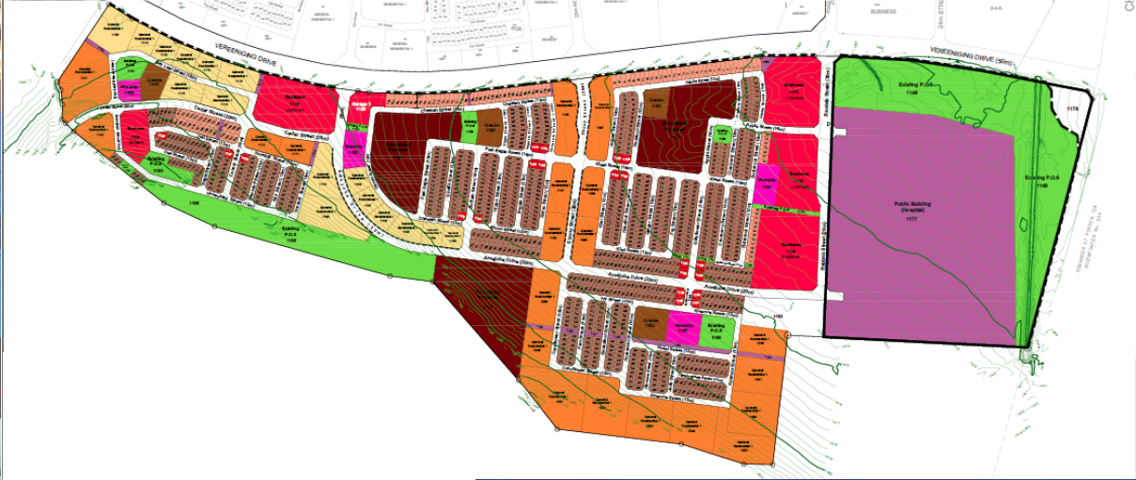
Vista Park 3 – Layout Plan
VISTA PARK 3 DEVELOPMENT COMPOSITION
DEVELOPMENT | COMPONENT | UNIT | HOUSING TYPOLOGIES
VISTA PARK 3 | RESIDENTIAL | 5131 | Affordable: 1086 RDP Multi Storey: 1336 Social/GAP: 2688 Mix Use: 21 Phase 1: 289 Phase 2;618 Phase 3;310 Phase 4;368 Phase 5:115 Phase 6: 912 Phase 7: 515 Phase 8: 202 Phase 9: 815 Phase 10: 1 023
 | BUSINESS | 5
 | GARAGE | 1
 | SCHOOLS | 3
 | CRECHE | 4
 | WORSHIP | 4
 | HOSPITAL | 1
 | OPEN SPACES | 13
VISTA PARK 3 DEVELOPMENT COMPOSITION
DEVELOPMENT | COMPONENT | UNIT
VISTA PARK 3 | AFFORDABLE
 | BNG MULTI STOREY
 | GAP HOUSING
 | SCHOOLS
 | BUSINESS
 | WORSHIP
 | HOSPITAL

Slide 46
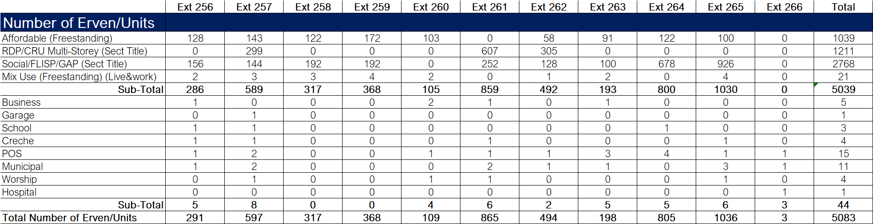
Vista Park 3 - Yields

Slide 47
Vista Park 3 – Progress to date
The appointed developer is Calgro M3 Developments which has contracted PZR (Pty) Ltd as their main contractor
The project is at installation of civil and electrical engineering services in Ext. 261, 262 and 263.
The following infrastructure has been installed to date:
  Water – 2.76km of pipes
  Sewer – 3.65km of pipes
  Roads – 2.4km of roads
  Storm water – 1.2km of pipes and culverts
  Electricity – 3km of cables and 5 mini-substations
  Ext. 261, 262 and 263 are ready for top structures for Mix-Use Development

Slide 48
Catalytic Projects - Challenges
Lack of funding to achieve targets – Adequate planning and budget will assist in better project performance
Delays in paying invoices for work done – Project Funds need to be ringfenced specifically for the project
Delays in decision making – There is a need for improved Intergovernmental Relations
There was a misuse of allocated funds

Slide 49
Catalytic Projects - Funding Instruments
Both projects are funded through HSDG and USDG, and below are responsibility of project’s different parties:
NDHS: The department disburse funds as legislated in terms of grant frameworks
FSHS: The department disburse HSDG funds for the HDA to successfully deliver on its obligations;
MMM: The Municipality secure infrastructure USDG funding for the Project and make budget provision thereof,
The Developer use own funds raised through investments for servicing and development of open market sites

Slide 50
Catalytic Projects - Intergovernmental Support
There are monthly Project Progress Meetings between the HDA, Mangaung Metro and the Developers
Monthly Technical Task Team Meetings chaired by Free State Human Settlements (FSHS), and attended by FSHS, Mangaung Metro and The HDA (who is the Implementing Agent)
Quarterly Provincial Steering Committee (PSC) Meetings, chaired by the National Department of Human Settlements (NDHS), and attended by NDHS, FSHS, Mangaung Metro and the HDA

Slide 51
Serviced Sites

Slide 52
2022/23 USDG Budget and Expenditure
The Metro had planned to deliver 331 serviced sites
In implementing the National Treasury directive to redirect the unspent grants all the projects were taken into the new financial year
The challenges which have been detailed above contributed a lot.
PROJECT | Budget | YTD Exp | Balance | %
FLEURDAL INFILL - SERVICES (21 U) | R 2,000,000 | R 170,550 | R 1,829,450 | 8.53%
LOURIERPARK - WAT& SEWER SERVICES (100U) | R 500,000 | R0 | R 500,000 | 0.00%
BOTSH SEC H2873 G1011 INST WATER SEW (110) | R 5,000,000 | R0 | R 5,000,000 | 0.00%
DEWETSDORP - INTERNAL RETIC (100 U) | R 4,000,000 | R0 | R 4,000,000 | 0.00%
BLOEMSIDE ERF 4510 - INTERNAL ROADS | R 6,000,000 | R0 | R 6,000,000 | 0.00%
TOTAL | R 17,500,000 | R 170,550 | R 17,329,450 | 0.97%

Slide 53
Land Invasions

Slide 54
Land Invasions
The Metro is currently experiencing high volumes of land invasions in Mangaung, Botshabelo and ThabaNchu and don’t have the necessary capacity to deal with challenge;
Mangaung
Two areas that have been invaded in Mangaung are Bobo Square and the remainder of farm Rodenbeck.
The shacks at Bobo Square are fewer than 10 shacks that are illegally erected.
Community members demolished 5 shacks but same were rebuilt.
Remainder of Rodenbeck farm also experienced invasion and a court application to have the unlawful occupiers evicted was issued.
The unlawful occupiers were served with eviction application and the attorneys representing MMM are waiting for further instructions from the municipality for further action.

Slide 55
Land Invasions
Botshabelo
There is currently land invasion at Botshabelo West.
The officials of the municipality managed to demolish several incomplete shacks.
To date there are approximately 200 shacks erected illegally on this land belonging to MMM.
Various engagements with the unlawful occupiers did not bear positive outcome in terms of ensuring that they refrain from invading the land.
A firm of attorneys have been appointed to apply for an eviction order. Consultations took place and the process of drafting a court application is in progress.

Slide 56
Land Invasions
ThabaNchu
Three pieces of land have been invaded in ThabaNchu.
A pieces of land are owned by the Department of Agriculture, Land Reform and Rural Development, another to Barolong Boo Seleka Traditional Authority while the third piece of land is donated to Mangaung Metropolitan Municipality (MMM) by the Department of Agriculture, Land Reform and Rural Development but not yet registered in the name of MMM.
There were engagements with the unlawful occupiers on the land donated to MMM, but the engagements did not deter them from invading the land.
A law firm was appointed to apply for an eviction order. The matter was heard by the High Court of South Africa, Free State Division, Bloemfontein.
The judgement is pending and is expected to be delivered by the 15th of June 2023.

Slide 57
Land Invasions - Challenges
Safety of MMM officials
MMM officials are frequently being threatened during engagements with the unlawful occupiers as well as during the demolishing of the illegally erected shacks.
As the threats becomes serve, the officials are led to request for intervention from South African Police Serves. This is because there is no assistance from Law Enforcement in the Metro because of lack of capacity in that unit.
Lack of Resources
The lack of resources affects monitoring and response time when there is land invasion within the Metro.

Slide 58
Land Invasions
The Plan is To Have Inspectors As Well As the Reaction Section to Deal With Land Invasion Incidents Decisively;
Proactive Acquisition of Land To Adequately Accommodate the Landless
Ensure Adequate Funding for Land Acquisition Projects
Capacitate Anti-Land Invasion Unit to Protect The Newly Acquired Land
We are developing standard operating procedures (SOP’s) to effectively deal with land invasion throughout the Metro

Slide 59
Proposal on reducing Land Invasions
The Metro working with all the role players in the sector have begun debates on the review of human settlements programmes and legislation:
That parliament should be lobbied to review the Prevention Of Illegal Eviction Act (No. 19 of 1998) as PIE sets out the procedure to be followed in the case of such evictions are creating opportunism – land invaders by-passing municipal procedures for land allocation;
That we must review our housing policy and government should provide serviced sites instead of RDP houses
That we must review the approach of informal settlements upgrading programmes as this messes the municipal plans for future developments trajectory

Slide 60
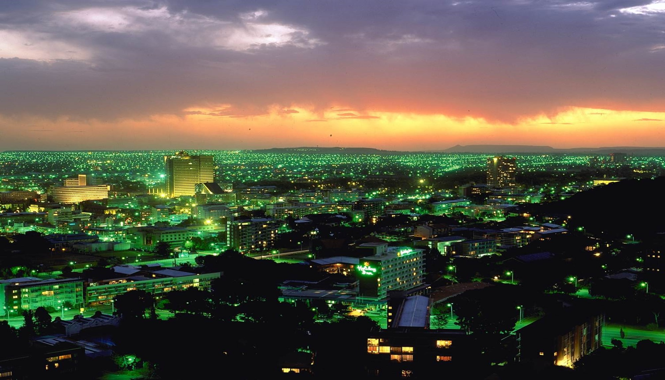
THANK YOU

