Slide 1
2022/2023 APP targets and performance REPORTING FOR QUARTER 3 AND QUARTER 4 presentation to the portfolio committee on agriculture, land reform and rural development 13 June 2023

Slide 2
2022/2023 APP targets and performance REPORTING FOR QUARTER 3 AND QUARTER 4

Slide 3
ACHIEVEMENT AGAINST 2022/2023 APP TARGETS: PER QUARTER 01 OCTOBER 2022 TO 31 MARCH 2023
Performance indicator | Annual Target | Performance Against Annual Target | % Achieved against Annual Target | Variance on Annual Target | Q3 |  |  | Q4
 |  |  |  |  | Actual Performance | % Achieved | Variance | Target | Actual Performance | % Achieved | Variance
Number of land claims settled | 336 | 355 | 106% | +19 | 53 | 49% | -55 | 101 | 200 (199 Actual plus 1 Adjustment) | 198% | +99
Number of land claims finalised | 372 | 429 | 115% | +57 | 91 | 70% | -39 | 101 | 197 (187 Actual plus 10 Adjustments) | 195% | +96

Slide 4
Reporting from 01 October 2022 to 31 march 2023

Slide 5
SUMMARY PROVINCIAL BREAKDOWN: NUMBER OF LAND CLAIMS SETTLED: 01 october 2022 – 31 MARCH 2023
Province | Target Total | Total Actual Performance | Performance Percentage % | Variance on Annual Target | 2022/23 ACTUAL PERFORMANCE
 |  |  |  |  | Q3 |  |  |  | Q4
 |  |  |  |  | Target | Achieved | Variance | % | Target | Achieved | Variance | %
Eastern Cape | 70 | 65 | 93% | -5 | 18 | 15 | -3 | 83% | 22 | 38 | +16 | 173%
Free State | - | 1 |  | +1 | - | - | - | - | - | 1 | +1
Gauteng | 14 | 20 | 143% | +6 | 5 | 2 | -3 | 40% | 2 | 4 | +2 | 200%
KwaZulu-Natal | 100 | 95 | 95% | -5 | 35 | 14 | -21 | 40% | 30 | 58 | +28 | 193%
Limpopo | 57 | 69 | 121% | +12 | 17 | 8 | -9 | 47% | 20 | 49 | +29 | 245%
Mpumalanga | 40 | 51 | 128% | +11 | 16 | 7 | -9 | 44% | 10 | 23 | +13 | 230%
North West | 2 | 1 | 50% | -1 | 1 | - | -1 | 0% | - | 1 | +1
Northern Cape | 5 | 5 | 100% | - | 1 | 2 | +1 | 200% | 1 | 2 | +1 | 200%
Western Cape | 48 | 48 | 100% | - | 15 | 5 | -10 | 33% | 16 | 24 | +8 | 150%
GRAND TOTAL | 336 | 355 | 106% | +19 | 108 | 53 | -55 | 49% | 101 | 200 | +99 | 198%

Slide 6
SUMMARY PROVINCIAL BREAKDOWN: NUMBER OF LAND CLAIMS finalised: 01 OCTOBER 2022 – 31 MARCH 2023
Province | Target Total | Total Actual Performance | Performance Percentage % | Variance on Annual Target | 2022/23 ACTUAL PERFORMANCE
 |  |  |  |  | Q3 |  |  |  | Q4
 |  |  |  |  | Target | Achieved | Variance | % | Target | Achieved | Variance | %
Eastern Cape | 75 | 58 | 77% | -17 | 23 | 10 | -13 | 43% | 28 | 34 | +6 | 121%
Free State | 8 | 5 | 63% | -3 | 2 | - | -2 | 0% | 4 | 4 | - | 100%
Gauteng | 30 | 85 | 283% | +55 | 12 | 10 | -2 | 83% | 5 | 61 | +56 | 1220%
KwaZulu-Natal | 120 | 93 | 78% | -27 | 50 | 28 | -22 | 56% | 20 | 40 | +20 | 200%
Limpopo | 16 | 58 | 363% | +42 | 6 | 8 | +2 | 133% | 3 | 8 | +5 | 267%
Mpumalanga | 45 | 44 | 98% | -1 | 14 | 12 | -2 | 86% | 13 | 20 | +7 | 154%
North West | 8 | 20 | 250% | +12 | 2 | 15 | +13 | 750% | 2 | 1 | -1 | 50%
Northern Cape | 10 | 5 | 50% | -5 | 4 | 1 | -3 | 25% | 6 | - | -6 | 0%
Western Cape | 60 | 61 | 102% | +1 | 17 | 7 | -10 | 41% | 20 | 29 | +9 | 145%
GRAND TOTAL | 372 | 429 | 115% | +57 | 130 | 91 | -39 | 70% | 101 | 197 | +96 | 195%

Slide 7
2022/2023 EXPENDITURE PERFORMANCE FOR QUARTER 3 AND QUARTER 4

Slide 8
restitution 2022- 2023 FINANCIAL PERFORMANCE AS AT 31 DECEMBER 2022
TOTAL | BUDGET | EXPENDITURE | AVAILABLE BUDGET | % EXP
Compensation of Employees | 410 337 000 | 295 121 493 | 115 215 507 | 72%
Goods and Services | 200 332 000 | 171 137 086 | -15 581 921 | 85%
Theft and losses | 0 | 0 | 0 | 0%
Municipality | 7 732 000 | 5 045 730 | 2 686 270 | 65%
Social Benefits | 960 000 | 632 946 | 327 055 | 66%
Capital Assets | 14 459 000 | 12 733 619 | -6 954 722 | 88%
Interest on land | 0 | 15 258 | -15 258 | 0%
Sub Total | 633 820 000 | 484 724 106 | 95 676 929 | 76%
Land and sub soil | 732 136 000 | 621 747 115 | 110 388 885 | 85%
Households | 2 419 107 000 | 1 124 392 982 | 1 296 625 931 | 46%
Subtotal | 3 151 243 000 | 1 746 140 097 | 1 407 034 816 | 55%
Total | 3 785 063 000 | 2 230 864 203 | 1 502 711 745 | 59%

Slide 9
restitution 2022- 2023 FINANCIAL PERFORMANCE AS AT 31 DECEMBER 2022 (household/projects)
TOTAL | BUDGET | EXPENDITURE | AVAILABLE BUDGET | % EXP
Eastern Cape | 761 465 000 | 446 863 733 | 316 513 180 | 59%
Free State | 4 725 000 | 1 645 457 | 3 079 543 | 35%
Gauteng | 42 769 000 | 29 228 640 | 13 540 360 | 68%
KwaZulu Natal | 775 519 000 | 267 806 811 | 507 712 189 | 35%
Limpopo | 618 845 000 | 383 050 954 | 235 794 046 | 62%
Mpumalanga | 334 457 000 | 146 531 956 | 187 925 044 | 44%
North West | 399 279 000 | 397 849 985 | 1 429 015 | 100%
Northern Cape | 85 916 000 | 41 311 770 | 44 604 230 | 48%
Western Cape | 128 268 000 | 31 850 791 | 96 417 209 | 25%
Total | 3 151 243 000 | 1 746 140 097 | 1 407 014 816 | 55%

Slide 10
restitution 2022- 2023 FINANCIAL PERFORMANCE AS AT 31 march 2023
TOTAL | BUDGET | EXPENDITURE | AVAILABLE BUDGET | % EXP
Compensation of Employees | 410 337 000 | 395 285 914 | 15 051 086 | 96%
Goods and Services | 193 972 000 | 233 574 209 | -58 974 618 | 120%
Theft and losses | 0 | 1 250 122 | -1 250 122 | 0%
Municipality | 7 732 000 | 5 122 861 | 2 609 139 | 66%
Social Benefits | 1 248 000 | 899 849 | 348 151 | 72%
Capital Assets | 20 708 000 | 14 374 526 | 4 752 000 | 69%
Interest on land | 16 000 | 9 587 | 6 413 | 60%
Sub Total | 634 013 000 | 650 562 861 | -37 457 952 | 103%
Land and sub soil | 732 136 000 | 1 243 750 001 | -511 614 001 | 170%
Households | 2 418 914 000 | 2 008 228 153 | 410 682 677 | 83%
Subtotal | 3 151 050 000 | 3 251 978 154 | -100 931 324 | 103%
Total | 3 785 063 000 | 3 902 541 015 | -138 389 276 | 103%

Slide 11
restitution 2022- 2023 FINANCIAL PERFORMANCE AS AT 31 MARCH 2023 (household/projects)
TOTAL | BUDGET | EXPENDITURE | AVAILABLE BUDGET | % EXP
Eastern Cape | 761 465 000 | 897 333 266 | -135 868 266 | 118%
Free State | 4 532 000 | 1 673 495 | 2 858 505 | 37%
Gauteng | 42 769 000 | 42 926 271 | -157 271 | 100%
KwaZulu Natal | 775 519 000 | 859 541 164 | -84 022 164 | 111%
Limpopo | 618 845 000 | 630 763 906 | -11 918 906 | 102%
Mpumalanga | 334 457 000 | 315 562 008 | 18 894 992 | 94%
North West | 399 279 000 | 412 542 225 | -13 266 395 | 103%
Northern Cape | 85 916 000 | 47 603 694 | 38 312 306 | 55%
Western Cape | 128 268 000 | 44 032 124 | 84 235 876 | 34%
Total | 3 151 050 000 | 3 251 978 154 | -100 931 324 | 103%

Slide 12
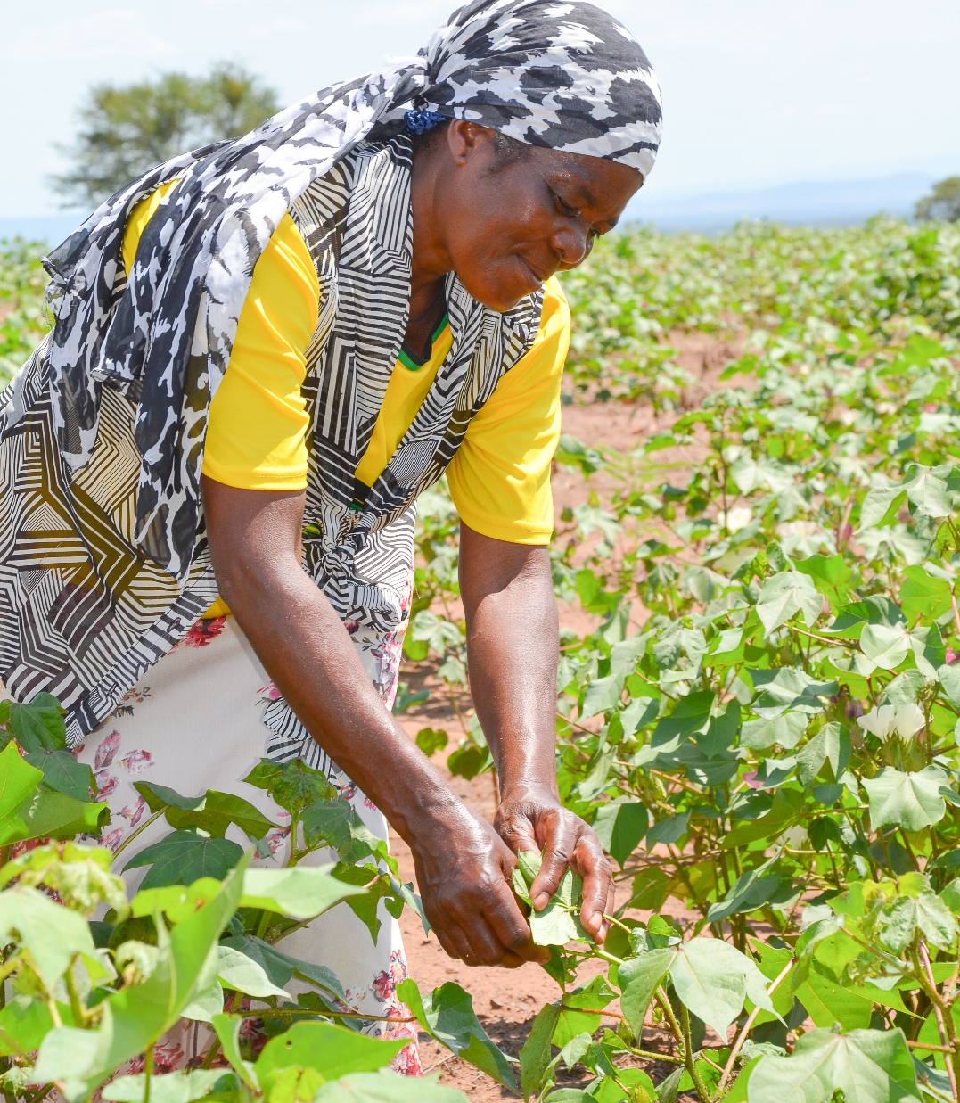
THANK YOU

