Slide 1

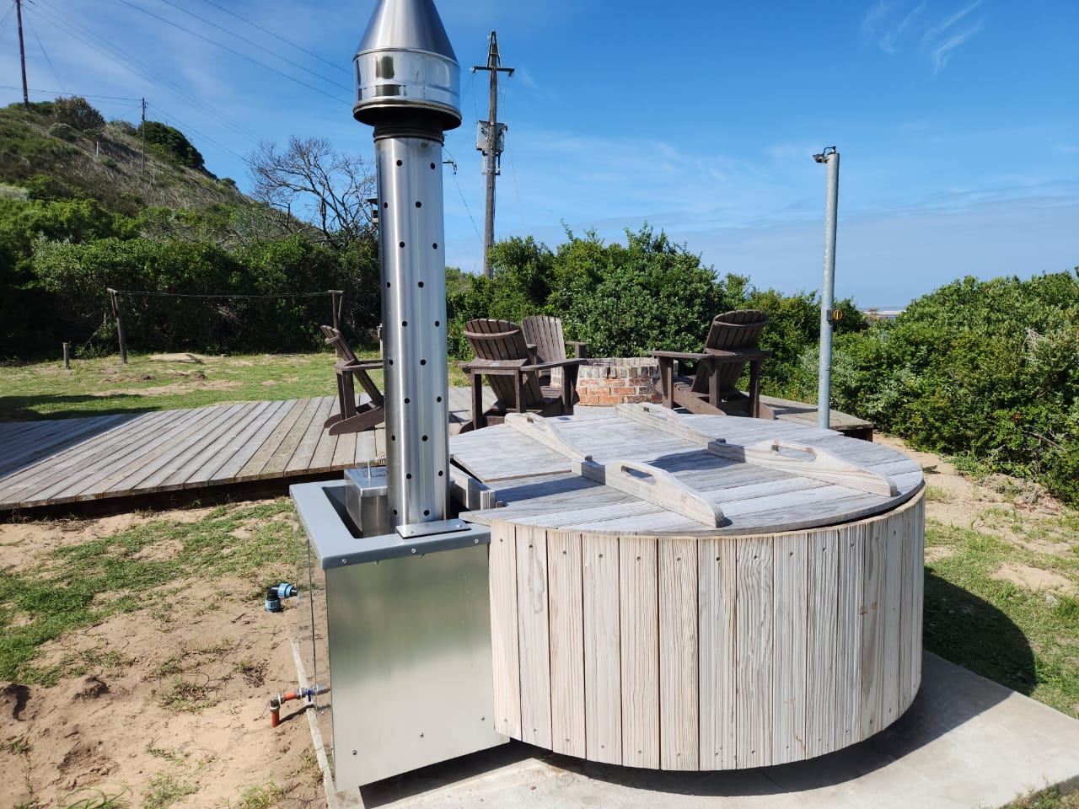
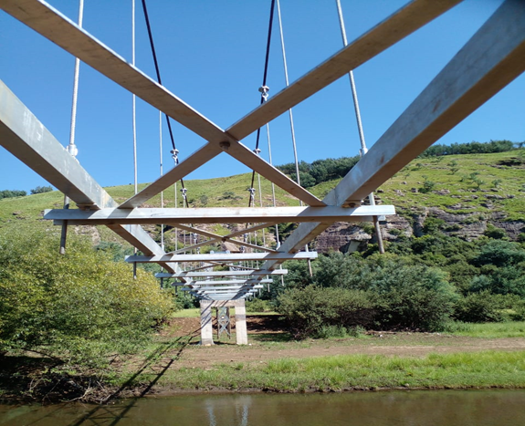
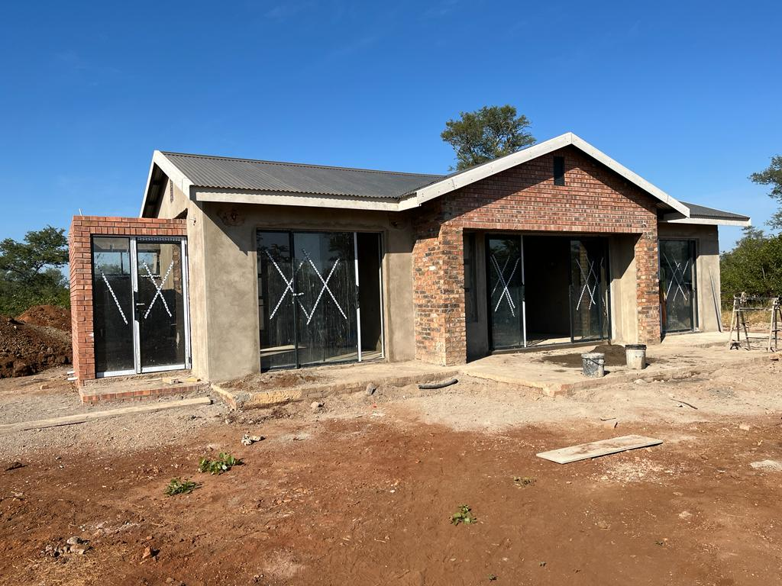
Development bank of southern Africa
Infrastructure delivery division
Goukamma nature reserve
Maloti hiking and horse trail
Mtititi game farm
Date : 13 June 2023
Time : 08h00 – 10h00
Venue : Room M515, Marks Building, Parliament

Slide 2



Purpose
To provide the Portfolio Committee on Tourism with a status update for projects allocated to the Development Bank of Southern Africa (DBSA) for implementation on behalf of the National Department of Tourism.

Slide 3
RESPONSE TO QUESTIONS POSED
Unpacking the MoU signed with the Department of Tourism, including the total amount to service the MoU, funds already transferred to the DBSA, outstanding amounts, etc.
All the projects ceded to DBSA for implementation as per MoU, their status, funding requirements and time-frames for implementation.
Progress made to date since signing the initial MoU with the Department of Tourism.
Challenges faced by DBSA in implementing the projects.
Community involvement in project implementation, including stakeholder consultations, the 30 percent local content and other related matters.
The database used by the DBSA in appointing service providers and the procurement process followed in sourcing service providers (contractors) for the implementation of the Department of Tourism infrastructure projects.
Any other matter you deem necessary for the attention of the Committee.
3

Slide 4
Memorandum of agreement discussion
4

Slide 5
1.1 Memorandum of agreement overview
DOCUMENTS | DATE SIGNED or SUBMITTED | Comments
Memorandum of Agreement (MOA) | 20 November 2020 | MoA signed by both parties
Infrastructure Programme Implementation Plan (IPIP) | 29 January 2021 | IPIP singed by both parties
Infrastructure Programme Implementation Plan (IPIP) Rev4 | 31 May 2022 | Submitted for review and approval
MOA duration | 3 years up to 30 Nov 2023 | May be extended by mutual agreement
The NDT appointed the DBSA as an Implementing Agent (IA) in the following Work Packages:
Community projects in the following categories
  Construction Planning, Procurement & Implementation
  Compliance Certificates
  Community Tourism Projects
  Further detailed planning & construction
Maintenance & Beautification of Provincial State-Owned Attractions
Local Community Museums
lndi-Atlantic Route (Coastal and Marine Tourism initiatives) – Only detailed planning
5

Slide 6
1.2 scope of the agreement
Scope of the agreement:
Assist the NDT to establish a PSU to implement the tourism infrastructure programme
Assist with the conditional assessments and planning for allocated tourism infrastructure
New built, upgrade/refurbishment of identified or prioritized tourism facilities
Support the NDT to implement comprehensive facilities maintenance programme
Propose alternative funding mechanisms for identified tourism infrastructure new build and upgrade/refurbishment when necessary
Provide project preparation facility (pre-feasibility and feasibility study facility) for national tourism investment projects with a strong business case as identified.
6

Slide 7
1.3 role of the implementing agent
The Implementing Agent’s (IA) role is:
To carry out full IA role for the infrastructure build and refurbishment projects as well as the maintenance projects throughout the construction lifecycle
To ensure that the Department receives adequate capacity on each of the projects, the initiative to appoint the necessary Professional Service Provider’s (PSP’s) to represent both the NDT and DBSA on all projects
To ensure project management throughout the lifecycle and appointment of the suitable qualified service provider (contractor) to implement the works.
To implement procurement of Service Providers on behalf of the Department. The DBSA will apply it’s own procurement policies and procedures in procuring Service Providers either by open tender (if the need require) or from panel of service providers. All of the Service providers to date, has been appointed from the DBSA panel of service providers
Consultation with the affected communities need to be conducted and coordinated by the DBSA social facilitators with support from NDT.
7

Slide 8
1.4 team structures
DBSA RESOURCE | ROLE(S) ON NDT Programmes
Chuene Ramphele | Group Executive - IDD
Crouse Schoeman | Head – Construction & Maintenance Delivery
Thulani Nxumalo | Programme Manager
Charles Ngundu | Senior Construction Project Manager
Isaac Motsoari | Construction Project Manager
Akhona Aphane | Construction Project Manager
Jeanette Ndou | Clerk of Works
Dorothy Mbuthia | Professional Quantity Surveyor
Lizelle Van Rooyen | Programme Planner
Sibongiseni Mdladla | Development Facilitator
Deepesh Govan | Programme Accountant
Mihloti Chabalala | Financial Administrator
Cindie Venter | OHS Specialist
Boipelo Tshugane | Programme Administrator
Mxolisi Maome | Legal expert
Institutional Arrangement (i.e. PSU)
DBSA Institutional Arrangement
8

Slide 9
Status of projects, funding and timeframes
9

Slide 10
2.1 Financial requirements - LIFE CYCLE
Total estimated budget required – R1,202,778,011
Total budget committed to date (incl 6% IA Fees) = R714,738,324
Total of 14 Professional Services Consortiums and a committed total value to date of R79,020m
Total of 29 Contractors appointed with a committed total value to date of R595,260m
IA Management fee of R40,460m committed.
10

Slide 11
2.2 FINANCIAL REQUIREMENTS FY 2023/24
Financial Year | Tranche Transferred | Actual / Planned Expenditure To Date
Previous FY | R563,755,274 | R219,355,111
FY 2023/24 | R123,543,271 | R330,000,000 (Actual to date FY – R19,982,317) | Planned Expenditure for FY 2023/24
Total | R687,298,545 | R549,355,111 | 80% of Planned Expenditure for FY 2023/24
Budget Committed | R714,738,324 |  | All appointments, committed budgets to date and 6% IA Management fees

Slide 12
2.3 PROPOSED TIMELINES OF THE PROGRAMME
Task Name | Duration (months) | Start | Finish
Department of Tourism (NDT) - Portfolio of Projects | 36 months | 14 Dec 2020 | 5 Feb 2025
Programme Definition and Mandate | 1 month | 14 Dec 2020 | 12 Jan 2021
Programme Delivery and Management | 34 months | 22 Feb 2021 | 5 Feb 2025
Compliance Certificate | 29 months | 5 May 2021 | 16 Sept 2024
Community Tourism Project | 30 months | 22 Feb 2021 | 9 Aug 2024
Local Community Museum (Implementation dependent on availability of budgets) | 31 months | 20 May 2021 | 2 Jan 2025
Indi-Atlantic Route (Planning stage only) | 18 months | 5 May 2021 | 31 Aug 2023
Maintenance & Beautification | 31 months | 17 June 2021 | 10 Jan 2025
Construction Planning, Procurement & Implementation | 32 months | 5 May 2021 | 10 Jan 2025
Note: In order to manage implementation within available budgets, projects may need to be implemented in a phased approach. In the worst case scenario final completion will be in the 2024/25 financial year. To align phased project implementation with the MOA, an extension of the MOA is required.
12

Slide 13
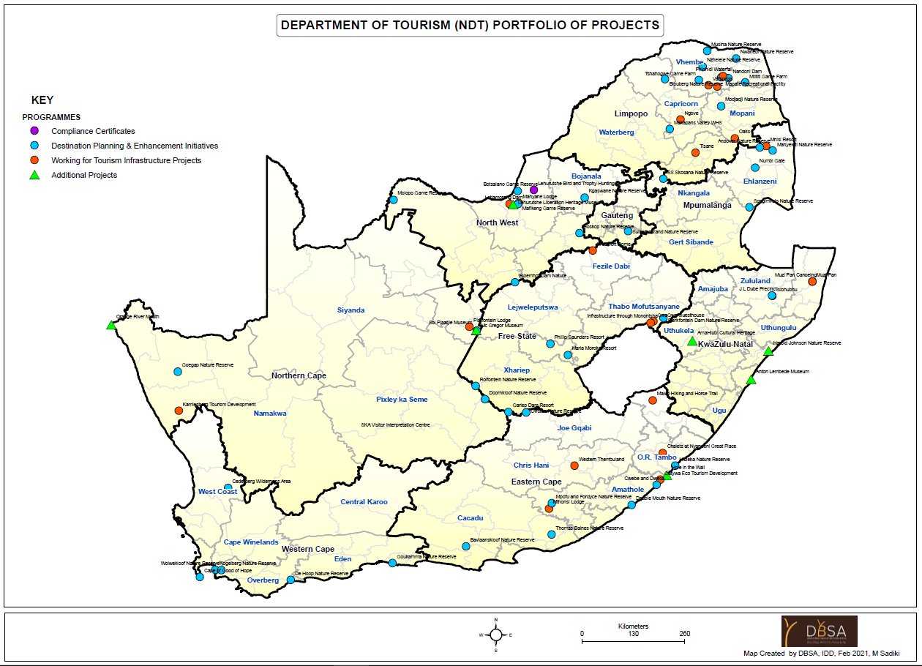
2.4 graphical representation of project clusters

Slide 14
2.5 distribution of projects per province
Programme | Work Package | EC | FS | GP | KZN | LP | MP | NC | NW | WC | Grand Total
Working for Tourism Infrastructure Projects | Construction Planning, Procurement & Implementation | 5 | 3 | 0 | 0 | 6 | 0 | 2 | 1 | 0 | 17
Compliance Certificates for Hand-Over of Community Projects | Compliance Certificates | 0 | 0 | 0 | 2 | 0 | 0 | 0 | 1 | 0 | 3
Planning: Destination Planning & Enhancement Initiatives | Community Tourism Projects | 0 | 0 | 0 | 0 | 4 | 2 | 0 | 0 | 0 | 6
Working for Tourism Infrastructure Projects | Further detailed planning & construction | 0 | 0 | 0 | 0 | 1 | 0 | 0 | 1 | 0 | 2
Planning: Destination Planning & Enhancement Initiatives | Local Community Museums | 0 | 0 | 0 | 2 | 0 | 0 | 2 | 2 | 0 | 6
Planning: Destination Planning & Enhancement Initiatives | lndi-Atlantic Route (Coastal and Marine Tourism initiatives) | 1 | 0 | 0 | 1 | 0 | 0 | 1 | 0 | 0 | 3
Planning: Destination Planning & Enhancement Initiatives | Maintenance & Beautification of Provincial State-Owned Attractions | 7 | 4 | 1 | 1 | 5 | 4 | 3 | 2 | 6 | 33
 | Grand Total | 13 | 7 | 1 | 6 | 16 | 6 | 8 | 7 | 6 | 70
 | % Projects allocated per Province | 19% | 10% | 1,2% | 8.6% | 23% | 8.6% | 11% | 10% | 8.6% | 100%
 | % Committed value of Projects | 25% | 12% | 0.1% | 8.9% | 32% | 14% | 3% | 2% | 3% | 100%
 | % Total Est Value of Projects | 20% | 6% | 1% | 12% | 29% | 8% | 16% | 6% | 2% | 100%

Slide 15
Progress made to date
15

Slide 16
3.1 progress overview
Programme | Work Package | No of Projects | Inception | Concept Design | Detail Design & Documents | Contractor Tender | Contractor Evaluation | Concurrence | Construction | < 25% | 26%-50% | 51%- 75% | 76%-99%
Compliance Certificates for Hand-Over of Community Projects | Compliance Certificates | 3 |  |  |  | 1 | 1 |  | 1 |  | 1
Planning: Destination Planning & Enhancement Initiatives | Community Tourism Projects | 6 |  |  |  |  |  | 1 | 5 | 2 | 2 | 1
Planning: Destination Planning & Enhancement Initiatives | Maintenance & Beautification of Provincial State-Owned Attractions | 33 |  | 2 | 2 |  |  |  | 28 | 6 | 4 | 6 | 12
Working for Tourism Infrastructure Projects | Further Detailed Planning & Construction | 2 |  |  | 2
Working for Tourism Infrastructure Projects | Construction Planning, Procurement & Implementation | 17 |  | 1 | 1 | 1 |  | 1 | 13 | 6 | 2 | 2 | 3
Planning: Destination Planning & Enhancement Initiatives | Local Community Museums | 6 |  | 2 |  | 2 |  | 2
Planning: Destination Planning & Enhancement Initiatives | lndi-Atlantic Route (Coastal and Marine Tourism initiatives) | 3 |  |  | 3 |  |  |  | N/A
 | TOTAL | 70 | 0 | 5 | 8 | 4 | 1 | 4 | 47 | 14 | 9 | 9 | 15
Note: The Indi-Atlantic Route projects are to be completed at Approval of Design Development Stage (only for planning phase)

Slide 17
3.2 Progress overview
Work Packages | No | Construction | Percentage
Community Projects | 28 | 21 | 75%
Maintenance | 33 | 28 | 85%
Local Community Museum | 6 | 0 | 0%
Indi-Atlantic | 3 | 0 | 0%
Total | 70 | 47 | 67%
Progress | No | %
0% - 25% | 14 | 30%
26%-50% | 9 | 19%
51%-75% | 9 | 19%
76%-100% | 15 | 32%
Total | 47
Practical Completion Month | Anticipated No
Jun-23 | 5
Jul-23 | 13
Aug-23 | 6
Sep-23 | 8
Oct-23 | 2
Nov-23 | 3
Dec-23 | 4
Jan-24 | 2
Feb-24 | 2
Mar-24 | 2

Slide 18
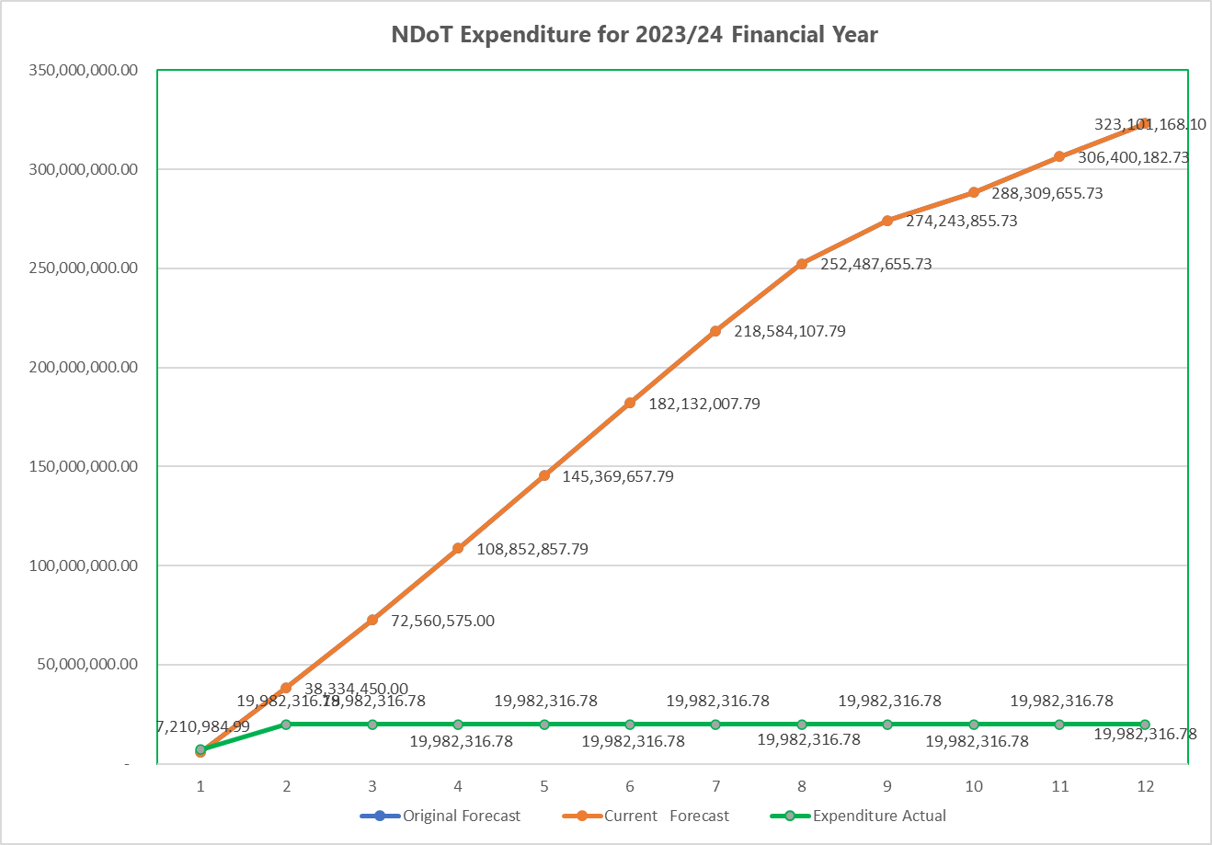
3.3 FINANCIAL REQUIREMENTS FY 2023/24
MONTHLY | FUM Budget 2023/24 | FUM Actual YTD | Forecast FUM March 2024 | Original Forecast | Current Forecast | Expenditure Actual | Management Fees Budget 2023/24 | Management Fees Actual YTD
Apr-23 |  | - | - | 5,760,950.00 | 5,760,950.00 | 7,210,984.99 | 403,266.50 | -
May-23 |  |  |  | 32,573,500.00 | 32,573,500.00 | 12,771,331.79 | 2,280,145.00 | -
Jun-23 |  |  |  | 34,226,125.00 | 34,226,125.00 | - | 2,395,828.75 | -
Jul-23 |  |  |  | 36,292,282.79 | 36,292,282.79 | - | 2,540,459.80
Aug-23 |  |  |  | 36,516,800.00 | 36,516,800.00 | - | 2,556,176.00
Sep-23 |  |  |  | 36,762,350.00 | 36,762,350.00 | - | 2,573,364.50
Oct-23 |  |  |  | 36,452,100.00 | 36,452,100.00 | - | 2,551,647.00
Nov-23 |  |  |  | 33,903,547.94 | 33,903,547.94 | - | 2,373,248.36
Dec-23 |  |  |  | 21,756,200.00 | 21,756,200.00 | - | 1,522,934.00
Jan-24 |  |  |  | 14,065,800.00 | 14,065,800.00 | - | 984,606.00
Feb-24 |  |  |  | 18,090,527.00 | 18,090,527.00 | - | 1,266,336.89
Mar-24 |  |  |  | 16,700,985.37 | 16,700,985.37 | - | 1,169,068.98
 |  |  | - |  |  |  | 3,630,023.65
CUMMULATIVE | FUM Budget 2023/24 | FUM Actual YTD | Forecast FUM March 2024 | Original Forecast | Current Forecast | Expenditure Actual | Management Fees Budget 2023/24 | Management Fees Actual YTD
Apr-23 | - | - | - | 5,760,950.00 | 5,760,950.00 | 7,210,984.99 | 403,266.50 | -
May-23 | - | - | - | 38,334,450.00 | 38,334,450.00 | 19,982,316.78 | 2,683,411.50 | -
Jun-23 | - | - | - | 72,560,575.00 | 72,560,575.00 |  | 5,079,240.25 | -
Jul-23 | - | - | - | 108,852,857.79 | 108,852,857.79 |  | 7,619,700.05 | -
Aug-23 | - | - | - | 145,369,657.79 | 145,369,657.79 |  | 10,175,876.05 | -
Sep-23 | - | - | - | 182,132,007.79 | 182,132,007.79 |  | 12,749,240.55 | -
Oct-23 | - | - | - | 218,584,107.79 | 218,584,107.79 |  | 15,300,887.55 | -
Nov-23 | - | - | - | 252,487,655.73 | 252,487,655.73 |  | 17,674,135.90 | -
Dec-23 | - | - | - | 274,243,855.73 | 274,243,855.73 |  | 19,197,069.90 | -
Jan-24 | - | - | - | 288,309,655.73 | 288,309,655.73 |  | 20,181,675.90 | -
Feb-24 | - | - | - | 306,400,182.73 | 306,400,182.73 |  | 21,448,012.79 | -
Mar-24 | - | - | - | 323,101,168.10 | 323,101,168.10 |  | 22,617,081.77 | -

Slide 19
Challenges and matters for discussion
19

Slide 20
4.1 Challenges or issues
Challenges or Issues encountered in the overall Programme:
National Treasury Moratorium affected timelines – there was an initial delay from Feb 2022 until June 2022 (4 months) delaying the procurement of service providers.
After assessment of facilities the condition found to be more severe or dilapidated and required more work than initially anticipated. This also include additional design not originally anticipated.
Access to site in some remote areas problematic and delivery of material problematic. With the severe flooding in the Eastern Cape, some of the roads were washed away and repair require coordination with other governmental departments.
Requests to change scope or add scope by the end users was also encountered but managed with the assistance of NDT as and when it was required.
Threats of project closure demands the appointment of contractors from specific area or province resulting in additional community facilitation and delay of implementation of projects.
It was found that many contractors are experience financial constraints after site establishment. This require additional monitoring and assistance to these contractors to implement the contracts. All these contractors work on recovery plans and monitored on weekly basis.

Slide 21
4.2 MATTERS
No. | RISK DESCRIPTION | RISK TREATMENT (MITIGATION) | COMMENTS / LESSON LEARNT
1 | Underperforming PSP’s | Weekly meetings will be held to ensure this is not an issue and the PSP's will be managed strictly by the Contract. | Proper Contract management, warning letter and subsequent termination to non-improving PSP’s
2 | Contractors not performing due to resources and cashflow constraints | Frequent site meetings and inspections to be executed. Funding support by the DBSA to the contractors through direct payment to suppliers when material is delivered to site. | To avoid any delays that could be due to cashflow, DBSA can intervene and fund the material delivered to site directly to the suppliers.
3 | Contractors not performing due to work stoppages, i.e. from community, labourers or subcontractors, Construction mafias | Early and proper social facilitation involvement will assist explain the issues that normally cause stoppages on sites | The PSP and DBSA facilitators should be pro-active
4 | Inclement weather, riots or pandemics | The contract shall be strictly followed, and all risks mitigated. | Safety will be a priority and no compromise.
5 | Force Majeure | The Clauses in the Contracts shall govern how to deal with it | All parties need to comply and allow the Contract to be followed
6 | Delay in payment of local Service Providers and/or of labourers | Service providers to ensure all submitted information is correct and submission of invoices to DBSA is done on time. DBSA to ensure payment is completed withing the contractual stipulated time and service providers to compensate the local service providers and labourers as per their agreement | A follow up with labourers or CLO will also ensure that there are no delayed payments that can stop implementation of services
7 | Risk of Theft on sites at completion – some sites are close to completion | The Owning Entities to identify an operator to take over immediately on handover as some equipment (fridge and stoves, beds etc has been added in some facilities) | Urgent action required as most projects will start being handover

Slide 22
OTHER matters
22

Slide 23
5 other matters
Of the 47 project in construction:
Total of 3 projects has appointed contract value larger that R30m i.e. LP Matsila Lodge (R36,366,481.12), EC Qatywa Eco Tourism Development (R32,802,163.00), EC Mthonsi Lodge (R31,072,567.60). Standard practice at DBSA and in line with the SCM policy and procedures any project above R30m need to include 30% of construction value to local SMME’s. These requirements are measured and reported on a monthly basis via our appointed PSP and reviewed by the DBSA team to ensure compliance.
The projects below R30m construction value are also encouraged to allocate the maximum amount to the local SMME’s and local community job creation. The appointed contractors are also encouraged to buy material for local suppliers.
In procuring of Service Providers in line with the implementation plan, the DBSA will make use of its own SCM policy and procedures, but will get concurrence from NDT before any appointment made. This will allow the DBSA to inform the NDT of any possible shortfall or material changes in the budget of the programme.
The DBSA will either make use of the already established contractor and PSP panels or in special circumstances go out on open tender. To date, all service providers were sourced from the DBSA SCM panels in competitive manner complying with all requirements.

Slide 24
Detailed discussion per project in construction (47)
27 Projects ahead or on track
11 projects have risks, but managed closely
9 projects managed with recovery plan, contractor experiencing problems
24

Slide 25
Construction STAGE
Construction Progress
Work Package | Project Description | Comments | Planned Progress | Actual Progress | Site Handover / Commencement | Project Duration | Practical Completion
Maintenance & Beautification of Provincial State-Owned Attractions. . | Goukamma Nature Reserve, Western Cape | Progress is at 98%, All works have been completed and attending to snags identified by PSP and team. AHEAD OF PLANNED PROGRESS | 95% | 98% | 2022/12/14 | 6 | 2023/06/14
 | Lookout Hill Khayelitsha, Western Cape | Progress is at 95%. Fencing complete, gates are complete and motorized, leaks on roof attended too. Working on sealing of the windows. Challenges with social facilitation at start and to get local labour. ON TRACK | 95% | 95% | 2022/12/14 | 6 | 2023/06/14
 | Cederberg Wilderness Area, Western Cape | Progress is at 97%. All works have been completed and snagging is ongoing. Rain interruptions delayed the works. EOT claims to be submitted to PSP for review. AHEAD OF PLANNED PROGRESS | 95% | 97% | 2022/12/14 | 6 | 2023/06/14
. | Nwanedi Nature Reserve, Limpopo | Progress is at 90%. Works on the reception area roof is completed, male and female ablutions are completed, ceilings completed and currently busy with painting and works on the septic tank. External work - installation of dustbins have been completed and currently installing benches. AHEAD OF PLANNED PROGRESS | 77% | 90% | 2023/01/16 | 6 | 2023/07/16
 | Blouberg Nature Reserve, Limpopo | Progress is at 94%. Works completed - foundations, superstructure, roof and plumbing for the kitchen; elevated steel frame with Jojo tank installed, masonry work and top slab for the septic tank from kitchen completed. Currently completing the steel structure for the canvas stands, borehole drilling and testing of the existing borehole and upgrade of the water pipe. AHEAD OF PLANNED PROGRESS | 77% | 94% | 2023/01/16 | 6 | 2023/07/16
 | Musina Nature Reserve, Limpopo | Progress is at 80%. The picnic site chalets have been completed and benches currently being installed. The kitchen construction and ablution block has been completed. Sanitary for ablutions blocks being installed. The water network to the kitchen being completed and the septic tank and soak away are currently being constructed. AHEAD OF PLANNED PROGRESS | 77% | 80% | 2023/01/16 | 6 | 2023/07/16
 | Modjadji Nature Reserve, Limpopo | Progress is at 80%. The roof and painting work on the reception area has been completed and currently working on the tiling and fixing of broken doors. Also replacing of toilet and handwash basins on the ablution by the reception and completing the tiling thereof. Completing installation of the elevated tank stand and jojo tank. AHEAD OF PLANNED PROGRESS | 77% | 80% | 2023/01/16 | 6 | 2023/07/16

Slide 26
Construction STAGE
Construction Progress
Wor Package | Project Description | Comments | Planned Progress | Actual Progress | Site Handover / Commencement | Project Duration | Practical Completion
Maintenance & Beautification of Provincial State-Owned Attractions. | SS Skosana Nature Reserve, Mpumalanga | Progress is 85%. Thatching of the main gate is ongoing. All tiling and painting completed. Landscaping by the main gate ongoing. AHEAD OF PLANNED PROGRESS | 77% | 85% | 2023/01/16 | 6 | 2023/07/16
 | Double Mouth Nature Reserve, Eastern Cape | Progress is about 87%. Renovation works, tiling to ablutions, waterproofing on the roof, plumbing, changing of wash basins is complete. Electrical fittings have also been installed. Contractor is busy with works on the V-drain for the stormwater reticulation. AHEAD OF PLANNED PROGRESS. | 72% | 87% | 2023/01/25 | 6 | 2023/07/25
 | Oviston Nature Reserve, Eastern Cape | Progress is 89%. Completing works on the kitchen built-in-cupboards, completing the plinth for the standby generator. The generator has already been procured and is on site. There is a potential EOT claim to be submitted by the contractor which will only be considered after assessment by the PSP. AHEAD OF PLANNED PROGRESS | 72% | 89% | 2023/01/25 | 6 | 2023/07/25
 | Thomas Baines Nature Reserve, Eastern Cape | Progress to date is 70%. Layer works of the roads is ongoing and roof thatching of the bird-hides is being implemented. Brickwork to the VIPs, wood-work to the bird-hide, painting and carpentry still outstanding. AHEAD OF PLANNED PROGRESS | 65% | 70% | 2023/02/08 | 6 | 2023/08/08
 | Sterkfontein Dam Nature Reserve, Free State | Progress to date is 92%. Tiling in the office building and toilets complete as well as plumbing work. The contractor is busy with snagging. AHEAD OF PLANNED PROGRESS | 61% | 92% | 2023/02/14 | 6 | 2023/08/14
 | Maria Moroka Resort in Thaba Nchu, Free State | Progress to date is 39%. Currently changing the plumbing works for the tank, casting concrete on walkways, carports. Painting completed on 5 chalets and working on the last chalets. Ceiling works is outstanding and renovations on the guardhouse to commence. ON TRACK | 45% | 39% | 2023/03/15 | 6 | 2023/09/15
Community Tourism Projects | Numbi Gate - Nkambeni Safari Lodge | Progress to date is 5%. Site Handover held on 25 April 2023. Completion of Site Establishment and all site appointments done. ON TRACK | 12% | 5% | 2023/04/25 | 11 | 2024/03/26
 | Numbi Gate - Mdlhuli Safari Lodge | Progress to date is 5%. Site Handover held on 26 April 2023. Completion of Site Establishment and all site appointments. ON TRACK | 12% | 5% | 2023/04/26 | 11 | 2024/03/26

Slide 27
Construction STAGE
Construction Progress
Work Package | Project Description | Comments | Planned Progress | Actual Progress | Site Handover / Commencement | Project Duration | Practical Completion
Construction Planning, Procurement & Implementation | EC Maluti Hiking and Horse Trail | Progress is at 98%. Two Bridges are completed, one bridge is 90% complete. Fencing is 100% complete. Outstanding works are mostly on the lapas. Roofing on the lapas completed. Practical Completion Certificate expected in June 2023. AHEAD OF PLANNED PROGRESS | 91% | 98% | 2022/07/07 | 12 | 2023/07/07
 | EC Western Thembuland | Chalets have been completed, elevated tank installation, parking also completed. Furniture has also been fitted. Challenge: ESKOM outstanding debt of R191,199.27 to date by the end-user will affect completion of the project as the power upgrade can only be executed on payment of the outstanding debt. The risk is the project will not be tested and taken over at completion. This will affect achieving PC on time. AHEAD OF PLANNED PROGRESS | 91% | 95% | 2022/07/07 | 12 | 2023/07/07
 | EC Chalets at Nyandeni Great Place | Progress is at 75%. Tiling of the chalets has commenced, paving of walkways, replacement of doors completed. Rehabilitation of the site and external works is ongoing. ON TRACK | 81% | 75% | 2022/08/15 | 12 | 2023/08/15
 | FS QwaQwa Guesthouse | Progress is at 90%. External works and finishes in progress. Installing main gate at entrance and fire hydrants in the building, completing painting to the external walls. Completion of cupboards. Outstanding work to be completed is the sanitary ware and external lights. AHEAD OF PLANNED PROGRESS | 72% | 90% | 2022/09/17 | 12 | 2023/09/17
 | FS Infrastructure through Monontsha | Progress is at 73%.Completing concrete work on Stormwater v-drains, and laying the paving. Kerbing work is also ongoing. Layer works have been completed. AHEAD OF PLANNED PROGRESS | 72% | 73% | 2022/09/17 | 12 | 2023/09/17
 | Royal Khalanga Lodge | Submission of Guarantees and signing of Contracts completed. Site Handover held on 25.04.2023. Site establishment has commenced. ON TRACK | 12% | 5% | 2023/04/25 | 6 | 2023/10/25
 | EC Mthonsi Lodge | Progress is at 40%. Bases and compaction for paving works for the road has commenced and kerbing, works on the guardhouse, lapas, and restaurants has commenced. AHEAD OF PLANNED PROGRESS | 36% | 40% | 25/1/2023 | 12 | 2024/01/25

Slide 28
Construction STAGE
Construction Progress
Work Package | Project Description | Comments | Planned Progress | Actual Progress | Site Handover / Commencement | Project Duration | Practical Completion
Maintenance & Beautification of Provincial State-Owned Attractions. | Doornkloof Nature Reserve, Northern Cape | Progress is at 3%. Appointment letter issued 18 April 2023. Kick-off meeting held on 16.05.2023. Site was handed-over on 29.05.2023.The contractor is busy with site establishment and mobilization | 5% | 3% | 2023/05/23 | 6 | 2023/11/23
 | Rolfontein Nature Reserve, Northern Cape | Progress is at 3%. Appointment letter issued 18 April 2023. Kick-off meeting held on 16.05.2023. Site was handed-over on 30.05.2023. The contractor is busy with site establishment and mobilization | 5% | 3% | 2023/05/23 | 6 | 2023/11/23
 | Goegap and Witsand Nature Reserve, Northern Cape | Progress is at 3%. Appointment letter issued 18 April 2023. Kick-off meeting held on 16.05.2023. Site handed-over on 26.05.2023 for Witsand and 25.05.2023 for Goegap. The contractor is busy with site establishment and mobilization | 5% | 3% | 2023/05/23 | 6 | 2023/11/23
 | Cwebe and Dwesa, Eastern Cape | Progress is at 3%. Appointment letter issued 18 April 2023. Contractual obligations have been met and a kick off meeting was held on 16.05.2023. Site was handed-over on 01.06.2023. | 3% | 3% | 2023/06/01 | 6 | 2023/12/01
 | Mpofu and Fordyce Nature Reserve, Eastern Cape | Progress is at 3%. Appointment letter issued 18 April 2023. Contractual obligations have been met and a kick off meeting was held on 16.05.2023. Site was handed-over on 02.06.2023. | 3% | 3% | 2023/06/02 | 6 | 2023/12/02
Local Community Museums | Product Enhancement at Anton Lembede Museum eThekwini Municipality (KZN) | BEC Report has been approved at SCMC on the 06.04.2023. Concurrence request letter sent to NDT on 11.04.2023. Concurrence approval received on 24.05.2023. Appointment has been made and awaiting site handover which is has been put on-hold. Awaiting approval from NDT | 0% | 0% | On-Hold | Await approval from NDT
 | Product Enhancement at Sol Plaatjie Museum (NW) | Evaluation completed. Concurrence request letter sent to NDT on 11.04.2023. Concurrence approval received on 24.05.2023. Appointment has been made and awaiting site handover which is has been put on-hold. Awaiting approval from NDT | 0% | 0% | On-Hold | Await approval from NDT

Slide 29
Construction STAGE
Construction Progress
Work Package | Project Description | Comments | Planned Progress | Actual Progress | Site Handover / Commencement | Project Duration | Practical Completion
Maintenance & Beautification of Provincial State-Owned Attractions. | Manyeleti Nature Reserve, Mpumalanga | Progress is at 55%. Finishes on chalets, tiling and carpentry is being completed. External works completed. Electrical and plumbing work outstanding. Painting of Reception area to be completed. Fencing to also be executed. | 77% | 55% | 2023/01/16 | 6 | 2023/07/16
 | Andover Nature Reserve, Mpumalanga | Progress is 55%. Pouring of foundation for the septic tank completed, braai stands foundation, main gate guardhouse painting and tiling to be commenced. Local Community had issues with MP Tourism about the perimeter fence and the access closed. Animals killed by wild animals Delay in access to the site to complete the work. | 77% | 55% | 2023/01/16 | 6 | 2023/07/16
 | Makapans Valley WHS, Limpopo | Progress is at 40%. Current activities are plumbing, tiling at the reception area, borehole drilling and water infrastructure network,. The ablution block foundation is completed and busy with the superstructure. SMME's wanted 30% of the value of the project, but with social facilitation resolved | 77% | 40% | 2023/01/16 | 6 | 2023/07/16
 | Phillip Saunders Resort in Bloemfontein, Free State | Progress to date is 40%. Maintenance work has commenced after delay on scope of work, Tiling in the conference hall has been completed and waterproofing on the roof has also been completed. | 61% | 40% | 2023/02/15 | 6 | 2023/08/15
 | Gariep Dam Resort, Free State | Progress to date is 25%. Ceiling repairs and Painting of main office has been completed. Currently working on the abattoir and external lighting, change of motors for the gates. | 45% | 25% | 2023/03/14 | 6 | 2023/09/14
Compliance Certificates | KZN Isibhubhu Project | Progress is at 42%. Working on the new ablutions, layer works for walkways, tiling, plumbing and painting are in progress. Electrical and plumbing works in the new toilets has commenced. Tiling and fittings work for the restrooms under the grand-stand is complete. Ceiling work to commence and plastering. Contractor is also working on the foundation of the demolished change room building. Material suppliers and delivery of material to site has been the challenge. | 58% | 42% | 2023/01/16 | 8 | 2023/09/16

Slide 30
Construction STAGE
Construction Progress
Work Package | Project Description | Comments | Planned Progress | Actual Progress | Site Handover / Commencement | Project Duration | Practical Completion
Maintenance & Beautification of Provincial State-Owned Attractions. | De Hoop Nature Reserve, Western Cape | Progress is at 70%. Roof completed, commenced with ceiling. All surface beds completed, screeded and tiled. Completion of tiling ongoing. Specialised windows installation is outstanding. Caution had to be exercised working around these building as it is a heritage site. | 95% | 70% | 2022/12/14 | 6 | 2023/06/30
 | Wolwekloof Nature Reserve, Western Cape | Progress is at 75%. Filtration plant to be commenced, fencing to the swimming pool to be completed. Walkway network to all braai stands are completed, pool repairs done, braai stands completed. | 95% | 75% | 2022/12/14 | 6 | 2023/06/30
Construction Planning, Procurement & Implementation | LP Matsila Lodge | Earthworks in progress at restaurant, guard house and internal roads. Heavy rainfall has delayed the works. The Contractor submitted a recovery plan and measured accordingly. EOT claim due to rain delay. | 39% | 25% | 2023/01/25 | 11 | 2023/12/24
 | LP Tisane | Renovations on chalets, verandah, construction of guard house, storerooms and restaurant is in progress. Construction of swimming pool has also commenced, parking area and general landscape has also commenced. Community unrest due to labour and SMMEs selection. PSC member interfering with the progress on project. Issues managed by the social facilitation team. | 37% | 22% | 2023/01/25 | 11 | 2023/12/24
 | EC Qatywa Eco Tourism Development | Internal alterations on chalets, restaurant and fencing is ongoing. Subsoil drainage work around the units is also ongoing. The main challenge has been accessing site. The bad road to site (with a seriously washed away section) resulting in more time and money being spent to bring material to site. The contractor has resorted to double handling of material. Assistance to engage the local municipality to fix the road is being received from NDT. | 38% | 22% | 2023/01/16 | 12 | 2024/01/16

Slide 31
Construction STAGE
Construction Progress
Work Package | Project Description | Comments | Planned Progress | Actual Progress | Site Handover / Commencement | Project Duration | Practical Completion
Maintenance & Beautification of Provincial State-Owned Attractions. | Kogelberg Nature Reserve, Western Cape | Progress is at 57%. Work on car port is ongoing. Work on the roofing and battery room is still outstanding. Batteries, inverter and solar panels purchased and will be installed. Challenge: The longer methodology in execution of works had to be used due to the strict environmental compliances. Example, mixing of concrete could not be done on site. Recovery plan in place and managed. | 95% | 76% | 2022/12/14 | 7 | 2023/07/14
 | Songimvelo Nature Reserve, Mpumalanga | Progress is at 55%. Building of changerooms is on roofing, septic tank construction ongoing, roofing of toilets at the main gate, decking of the external patio on the chalets has commenced. Heavy rains delayed access to site as the rivers had flooded and this delayed the start of the project as works commenced physically in April. EOT has been submitted to the PSP. | 77% | 55% | 2023/01/16 | 7 | 2023/08/16
 | Baviaanskloof Nature Reserve, Eastern Cape | Progress is at 41%. Renovations to the office building, tiling, plumbing and electrical works have been completed. Thatching to the chalets is complete. Braai stands are complete. Outstanding work is the kitchen building construction. | 60% | 41% | 2023/01/25 | 7 | 2023/08/25
Community Tourism Projects | Tshathogwe Game Farm | Progress is at 32%. Contractor is currently working on superstructure. DBSA had an intervention meeting with contractor re slow progress. Recovery plan submitted. Building works on laundry and staff quarters in progress. Late start on project due to previous owners and current Trust members taking each other to Court. | 75% | 32% | 2022/09/09 | 12 | 2023/09/09
 | Mapate Recreational Social Tourism Facility | Progress is at 47%. Construction works on Restaurant buildings have started. Final letter of default has been issued to contractor due to non-performance. An Intervention meeting was held at DBSA and review of their recovery plan to be held on 19.05.2023 on site. An EOT claim has been submitted for rain and is under review. | 99% | 47% | 2022/06/09 | 15 | 2023/09/09
 | Mtititi Game Farm | Progress is at 75%. Building works on gate house and lapa in progress. Staff quarters and laundry room plastered. Working on finishes for the Accommodation facilities. Community unrest at Shongoni gate project affected the works on site and rain delays. Expecting an EOT claim which is under review by the PSP. | 99% | 75% | 2022/06/10 | 15 | 2023/09/10

Slide 32
Construction STAGE
Construction Progress
Work Package | Project Description | Comments | Planned Progress | Actual Progress | Site Handover / Commencement | Project Duration | Practical Completion
Construction Planning, Procurement & Implementation | FS Vredefort Dome | Progress is at 35%. The project is behind schedule. Contractor was put on terms. Recovery plan was submitted. Performance of the contractor is being monitored on a weekly basis. Plastering, preparation for waterproofing and external works in progress. | 63% | 35% | 2022/10/17 | 12 | 2023/10/17
 | LP Ngove | Contractor has been appointed however works have not commenced. The End user client has requested the PSP to make changes on the scope whereby day visit activities are being recommended to replace overnight chalets. NDT to have a meeting with end-user and advice a way forward after clarity has been sort. The works on the restaurant, multipurpose hall and all other amenities can continue as per original scope. Experienced a delay of 3 months due to above. | 27% | 5% | 2023/03/06 | 11 | 2024/02/06
 | LP Oaks | Project was interrupted frequently from site handover due to social issues. Meeting was held with the Mayor and the Project Stakeholders to resolve issues which included local business forums demanding SMME package, appointment of CLO and appointment of security company. Issues have currently been resolved and works allowed to commence on site. Site establishment completed and refurbishment of existing buildings has commenced, electrical and plumbing works has commenced. Delay of 3 months as result of above issues | 27% | 5% | 2023/03/07 | 11 | 2024/02/07

Slide 33
Programme current Progress
Progress to date – Planning Phase
Work Package | Project Description | Progress to Date | BRC / Bid Spec | Tender Advert | Close of Tender | Evaluation | SCMC Approval | NDT Concurrence | Appoint Contractor | Site Hand Over | Commencement Date | Contractual Finish Date
Community Tourism Projects | LP- Nandoni Dam | Project was tabled at SCMC on 20.04.2023 and was approved for appointment. Concurrence request prepared and sent to NDT on 21.04.2023 for approval. NDT reviewing the information based on available budget. | 2022-07-14 | 2022-08-12 | 2022-09-14 | 2023-01-30 | 2023-04-20 | 2023-05-12 | 2023-05-19 | 2023-05-31 | 2023-05-31 | 2024-03-31
Further detailed planning & construction | NW Lotlamoreng Dam | PSP amending the procurement documents to include the CIDB changes and challenges identified at the meeting that was held with Portfolio committee has resulted in a change of procurement method. Tender advert anticipated to be on June 2023 | 2022-12-05 | 2023-06-24 | 2023-07-14 | 2023-07-28 | 2023-08-05 | 2023-08-07 | 2023-08-10 | 2023-09-20 | 2023-09-20 | 2024-03-20
 | LP Vhatsonga | Project has been approved to go out on tender. Anticipated tender advert in June 2023 | 2022-12-05 | 2023-06-24 | 2023-07-14 | 2023-07-28 | 2023-08-05 | 2023-08-07 | 2023-08-10 | 2023-09-20 | 2023-09-20 | 2024-05-15

Slide 34
Programme current Progress
Progress to date – Planning Phase
Work Package | Project Description | Progress to Date | BRC / Bid Spec | Tender Advert | Close of Tender | Evaluation | SCMC Approval | NDT Concurrence | Appoint Contractor | Site Hand Over | Commencement Date | Contractual Finish Date
Compliance Certificates | NW-Lehurutshe Bird and Trophy Hunting | Tender was advertised on 11.04.2023. The Tender Briefing closed on 28.04.2023. Tender currently under evaluation and to be submitted to SCMC for approval. Tender Office Has submitted to governance for review for the next SCMC on 15 June 2023 | 2023-03-06 | 2023-04-11 | 2023-04-28 | 2023-05-19 | 2023-06-15 | 2023-06-30 | 2023-07-01 | 2023-07-03 | 2023-07-03 | 2023-12-27
 | KZN- Muzi Pan | Project is under procurement stage. Tender was advertised 09.06.2023, tender briefing on 07.06.2023 and tender closing on 15.06.2023. | 2022-07-07 | 2023-05-22 | 2023-06-15 | 2023-06-23 | 2023-06-29 | 2023-07-06 | 2023-07-13 | 2023-07-25 | 2023-07-25 | 2024-02-25
lndi-Atlantic Route (Coastal and Marine Tourism initiatives) | NC-Tourism development at Orange River Mouth as part of the Indi-Atlantic Route | PSP is still working on stage 3 (Detailed Design). Designs are expected to be completed by end of August 2023. | N/A
 | EC-Tourism Development at Hole in the Wall (EC) as part of the Indi-Atlantic Route | PSP submitted the Design development report on 28.02.2023. Designs have been accepted by the DBSA Technical Team and are now on DocuSign for sign off . | N/A
 | KZN- Tourism development at Harold Johnson Nature Reserve as part of the Indi-Atlantic Route | PSP submitted the Design development report on 28.02.2023.Designs have been accepted by the DBSA Technical Team and are now on DocuSign for sign off . | N/A

Slide 35
Programme current Progress
Progress to date – Planning Phase
Work Package | Project Description | Progress to Date | BRC / Bid Spec | Tender Advert | Close of Tender | Evaluation | SCMC Approval | NDT Concurrence | Appoint Contractor | Site Hand Over | Commencement Date | Contractual Finish Date
Construction Planning, Procurement & Implementation | NC Platfontein Lodge | DBSA has shared the report with NDT. A meeting to discuss the project was held on 08.03.2023. PSP to submit quotes for the additional studies that need to be done for the area planned for relocation of new accommodation. DBSA has submitted the quotations to NDT in May 2023 and awaits way forward after review of budget / funding. | 2023-06-30 | 2023-07-07 | 2023-07-28 | 2023-08-11 | 2023-08-18 | 2023-08-20 | 2023-08-23 | 2023-09-02 | 2023-09-02 | 2024-05-02
 | NW Manyane Lodge | Tender advertised on 19.04.2023. the tender briefing session was held on 26.04.2023. A site visit with bidders held on the 03.05.2023. Tender closing will be on the 19.05.2023. Subsequently, evaluation will commence. | 2022-10-24 | 2023-04-19 | 2023-05-19 | 2023-06-02 | 2023-06-09 | 2023-06-11 | 2023-06-14 | 2023-06-24 | 2023-06-24 | 2023-12-24
 | LP Phiphidi Waterfall | SCMC approved the project on 12.05.2023. Concurrence request letter sent to NDT on 12.05.2023 | 2022-07-14 | 2022-08-12 | 2022-09-14 | 2023-01-30 | 2023-05-25 | 2023-06-01 | 2023-06-08 | 2023-06-20 | 2023-06-20 | 2024-04-20
 | NC Kamiesberg Tourism Development | PSP to submit the Design Development report by 30 June 2023. | 2023-06-30 | 2023-07-07 | 2023-07-28 | 2023-08-11 | 2023-08-18 | 2023-08-20 | 2023-08-23 | 2023-09-02 | 2023-09-02 | 2024-05-02

Slide 36
Programme current Progress
Progress to date – Planning Phase
Work Package | Project Description | Progress to Date | BRC / Bid Spec | Tender Advert | Close of Tender | Evaluation | SCMC Approval | NDT Concurrence | Appoint Contractor | Site Hand Over | Commencement Date | Contractual Finish Date
Maintenance & Beautification of Provincial State-Owned Attractions. | GP- Suikerbosrand Nature Reserve | PSP to submit the Design Development report by 31 August 2023. | 2023-05-16 | 2023-05-23 | 2023-06-13 | 2023-06-27 | 2023-07-07 | 2023-07-14 | 2023-07-21 | 2023-08-02 | 2023-08-02 | 2024-04-02
 | KZN_ J L Dube Precinct | PSP has submitted Detailed Designs to DBSA which are now under review. | 2023-05-31 | 2023-06-07 | 2023-06-28 | 2023-07-12 | 2023-07-22 | 2023-07-29 | 2023-08-05 | 2023-08-17 | 2023-08-17 | 2024-01-17
 | EC- Hluleka Nature Reserve | Project is still at Concept. There were comments from the NDT project team which have been addressed and sent on 12.05.2023 to NDT for review. | 2023-06-30 | 2023-07-07 | 2023-07-28 | 2023-08-11 | 2023-08-18 | 2023-08-20 | 2023-08-23 | 2023-09-02 | 2023-09-02 | 2024-05-02
 | NW-Mafikeng Hotel School (PSP) | PSP submitted the revised report on 02.05.2023. DBSA has reviewed and sent it to NDT for review on 08.05.2023 | 2023-06-30 | 2023-07-07 | 2023-07-28 | 2023-08-11 | 2023-08-18 | 2023-08-20 | 2023-08-23 | 2023-09-02 | TBC | TBC
 | NW-Pilanesberg Nature Reserve (PSP Appointment) | Tender advertised on 05.04.2023. The Tender Briefing was on 18.04.2023. Tender closed on 28.04.2023. Tender under evaluation and appointment of PSP is expected by end of June 2023. | 2022-11-30 | 2023-04-05 | 2023-04-28 | 2023-05-19 | 2023-06-01 | 2023-06-08 | 2023-06-15 | NA | NA | NA

Slide 37
Programme current Progress
Progress to date – Planning Phase
Work Package | Project Description | Progress to Date | BRC / Bid Spec | Tender Advert | Close of Tender | Evaluation | SCMC Approval | NDT Concurrence | Appoint Contractor | Site Hand Over | Commencement Date | Contractual Finish Date
Local Community Museum | NC- Product Enhancement at McGregor Museum (WP1) | Tender advert went out on the 2nd May 2023. Briefing held on 10 May 2023. Tender closing on 19 May 2023. Tender evaluation is in progress. | 2023-02-13 | 2023-05-02 | 2023-05-19 | 2023-06-15 | 2023-06-30 | 2023-07-14 | 2023-07-15 | 2023-07-16 | 2023-07-16 | 2024-03-11
 | NC- Product Enhancement at McGregor Museum (WP2) | Tender advert went out on the 2nd May 2023. Briefing held on 10 May 2023. Tender closing on 19 May 2023. Tender evaluation is in progress. | 2023-02-13 | 2023-05-02 | 2023-05-19 | 2023-06-15 | 2023-06-30 | 2023-07-14 | 2023-07-15 | 2023-07-16 | 2023-07-16 | 2024-03-11
 | KZN -Product Enhancement at AmaHlubi Cultural Heritage | Concept reports sent to NDT on 13.10.2022. NDT reviewing the report in line with budget and funding available | 2023-06-30 | 2023-07-07 | 2023-07-28 | 2023-08-11 | 2023-08-18 | 2023-08-20 | 2023-08-23 | 2023-09-02 | 2023-09-02 | 2024-05-02
 | NW-Product Enhancement at Lehurutshe Liberation Heritage Museum | Concept reports sent to NDT on 12.10.2022. Report under review in line with budget and funding available | 2023-06-30 | 2023-07-07 | 2023-07-28 | 2023-08-11 | 2023-08-18 | 2023-08-20 | 2023-08-23 | 2023-09-02 | 2023-09-02 | 2024-05-02

Slide 38
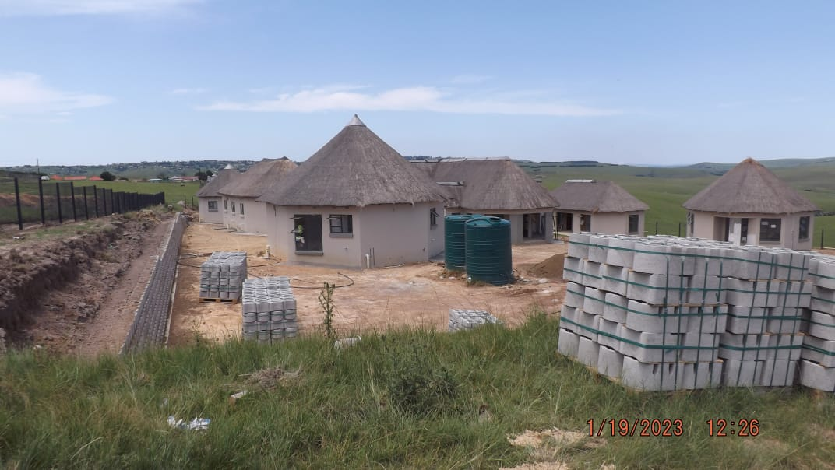
Development Outputs and outcomes
 | FY 2022-23 | FY 2023-24
Number of Employment Opportunities created | 638 | TBA
Adult Male | 259
Woman Opportunities | 82
Youth | 288
Youth Male | 217
Youth Female | 76
People with Disability | 4
Number of SMMEs and Subcontractors Benefitting | 107 | 0
Employment opportunities estimated at 4 jobs per R1mil spend.
For FY 2023-24 – New appointments to be advised after verification.
30% to SMME’s only applicable to projects with value larger than R30m. Contracts however allow for allocation of work to local SMME’s and labour with review done by DBSA team.
Other Developmental objectives required by the Department
DBSA request from the PSP’s to appoint graduates on projects for duration of project

Slide 39


THANK YOU

