Slide 1
Presentation to the Portfolio committee on Home affairs
Western Cape: Stellenbosch
DATE: 13 June 2023

Slide 2
PURPOSE OF THE PRESENTATION
To provide the Portfolio Committee on Home Affairs :
A short overview of the Cape Winelands District,
A summary of services provided by Stellenbosch Medium Office,
Increased footprint in the Stellenbosch area – ABSA bank.

Slide 3
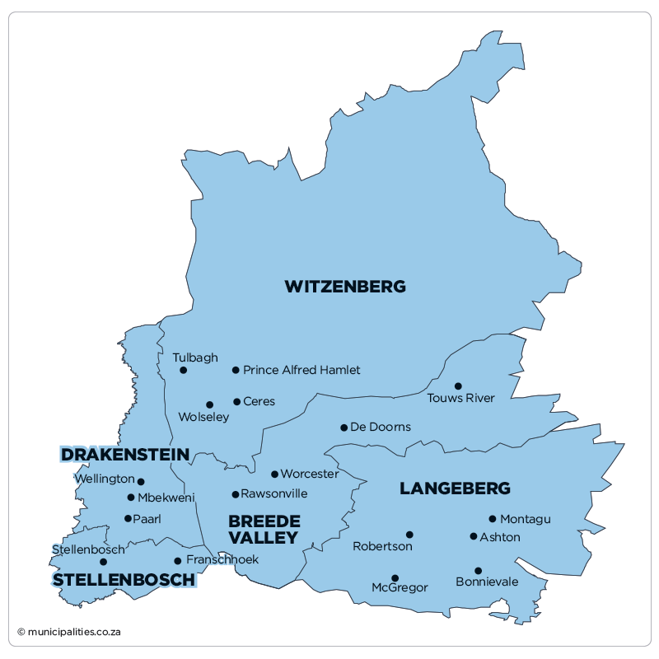
CAPE WINELANDS: GEOGRAPHICAL LAYOUT
Robertson
CERES
WORCESTER
PAARL
Paarl
STELLENBOSCH
ROBERTSON

Slide 4
OVERVIEW CAPE WINELANDS
Cape Winelands has the second highest population with 14%, Cape Metro has the highest population of 62%, Garden Route at 9,8% , West Coast 6.7%, Overberg 3.8% and Central Karoo 1.5%.
18% of the Provincial staff compliment is deployed in the Cape Winelands.
Offices with high client volumes in Cape Winelands – Paarl, Stellenbosch, Worcester Offices due to their close proximity to the Metro ( Mitchell’s Plain and Cape Town high Volume) and of late Robertson and Ceres are also experiencing high volumes.
Predominantly Afrikaans speaking at 74.8%, Xhosa speaking at 16.6%, English speaking at 4.3%, Sotho Speaking at 1.9%, other 2.4%.
5.5% of population is disabled ( Provincial 5.4%).
Average household size at 4.0.
Female headed households are at 33.2%.

Slide 5
STELLENBOSCH OFFICE SERVICE AREA AND POPULATION
Population numbers (Stats SA) | Elderly (60 plus years) | Population for age group (1 - 14 years) | Population for age group (15 - 60 years) | Unemployed
176523 | 10123 | 125042 | 41354 | 42756
Area of service:
Klapmuts, Pniel, Kylemore, Lyndoch, Vlottenburg, Cloetesville, Jamestown, Idasvalley, Franschoek.
Due to proximity to Metro (18.5km) the office also has a high number of clients from the Cape Metro.

Slide 6
STELLENBOSCH OFFICE ORGANOGRAM
Office Manager
Ms N Smith (P)
seconded to Permitting
1x Civic Service Supervisor
6 x Civic services clerks
1 CSC in process of recruitment due to Natural attrition
1x Control Immigration Officer
1 x Immigration Officer
1x Hospital clerk:
Total staff compliment: 8 (excluding OM seconded to HO)
Permanent on staff establishment (P) - 7
Temporary Deployed (TD) - 1

Slide 7
OVERVIEW STELLENBOSCH OFFICE
Stellenbosch Office relocated to the newly renovated space on 17 December 2018 and is providing modernised services.
Improvements to the office although not comprehensive increased the capacity for waiting seats to clients from 8 to above 30 seats and counters from 3 to 9 counter including 2 photo booths.
The office also migrated from a Legacy office (Birth, Marriage, Death) to a Modernized office with passport and Smart ID Card services.
The building is State owned and is managed by the Department of Public Works and infrastructure.
The department provides contracted Security services which are available during day and night.
The office also provide roaming services for birth registration at the local public hospital and private health facility in Stellenbosch.

Slide 8
PERFORMANCE IN RELATION TO TARGETS
Birth Registrations
Financial year | 2022/2023
Target | 1258
Performance | 1628
Percentage | 129%
Smart ID Cards
Financial year | 2022/2023
Target | 5162
Performance | 12988
Percentage | 252%

Slide 9
BIRTH REGISTRATION AT HEALTH FACILITIES
Hospitals demographics pre-covid
Total number of Hospitals visited | Public Hospitals | Private Hospital | No of officials permanently employed at facilities (L5) | No of staff members (L6) dedicated to health facilities
2 | 1 | 1 | 1 | 0
High volume hospitals
Health facility | Connectivity Status | Capacitated
Stellenbosch Public | Not connected | Yes – L5 roaming
Mediclinic | Not Connected | L5 - Roaming
Plans are underway for the availing of space at the local public health facility and reconnect systems by 17 July 2023 to allow for increased birth registration services in the area.

Slide 10
HIGH VOLUME OFFICES & QUEUE MANAGEMENT STRATEGIES
Efforts to reduce waiting times:
Signage displayed on queue poles placed outside of the office to categories queues into:
Smart card and passport applications,
Smart card and passport collections,
Legacy system applications (Birth-, Death- registration, Temporary ID Certificates).
Prioritize client categories: Elderly, persons with disabilities, pregnant mothers, mothers with infants.
Learners in uniform accompanied by parents are prioritized.
Compulsory for office managers to visit front office areas every 2 hours and interact with clients.
Floorwalkers direct clients and communicate approximate waiting times to clients inside of the office.
Continuous communication to clients when high volumes are experienced.
Awareness raising of booking pilot.

Slide 11
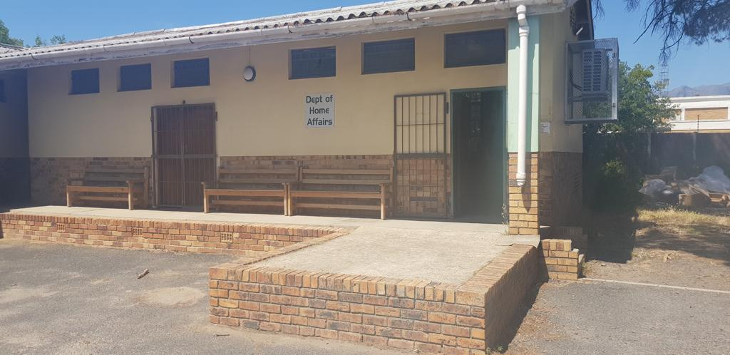
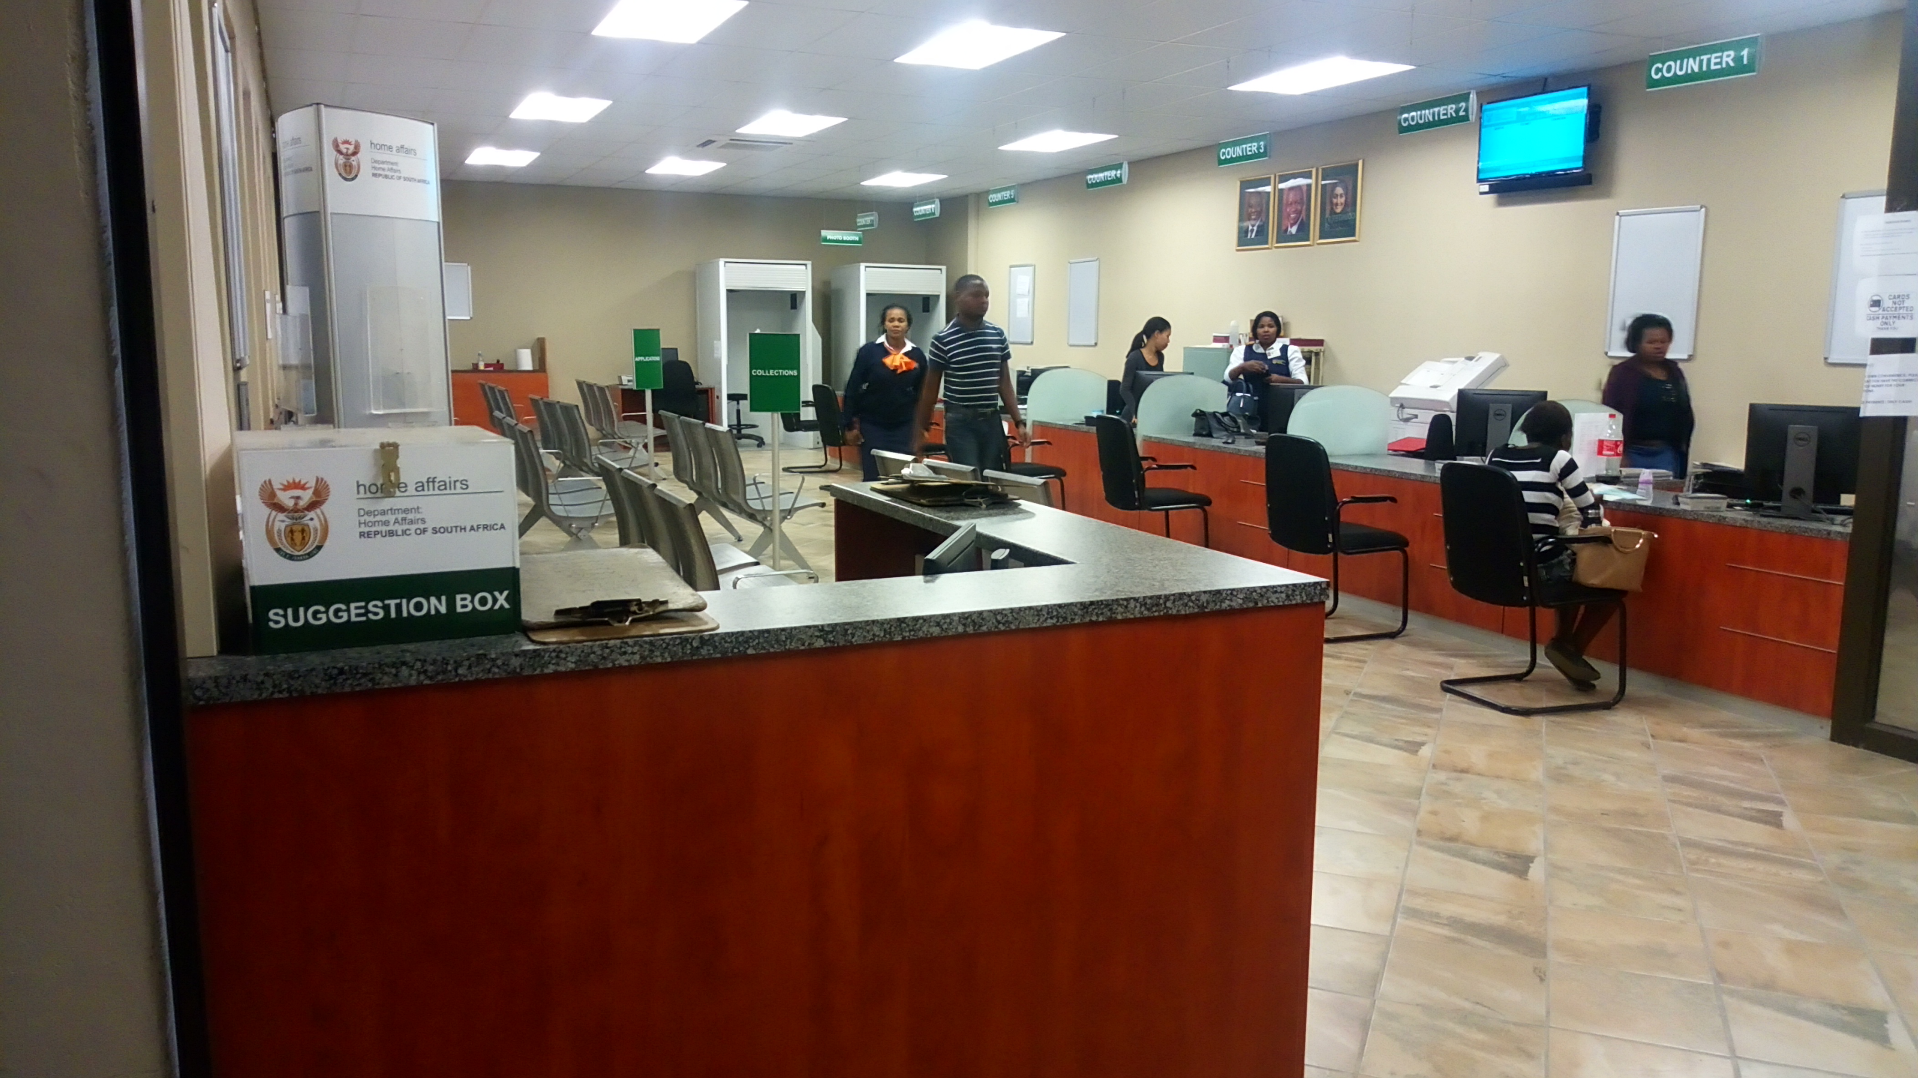
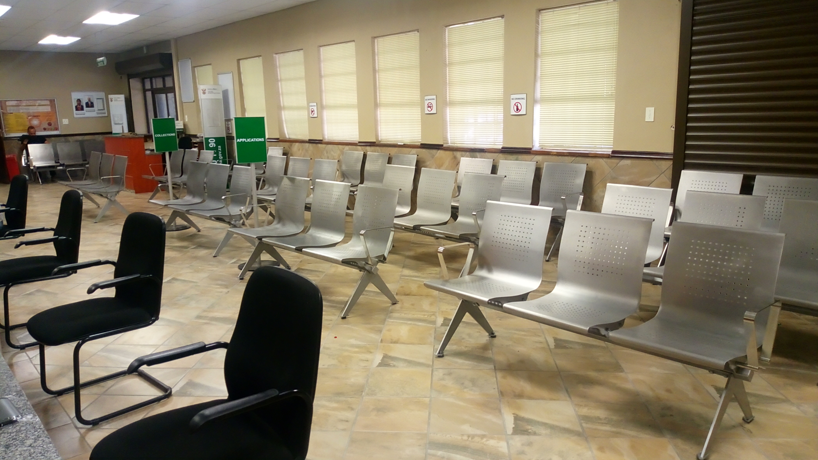
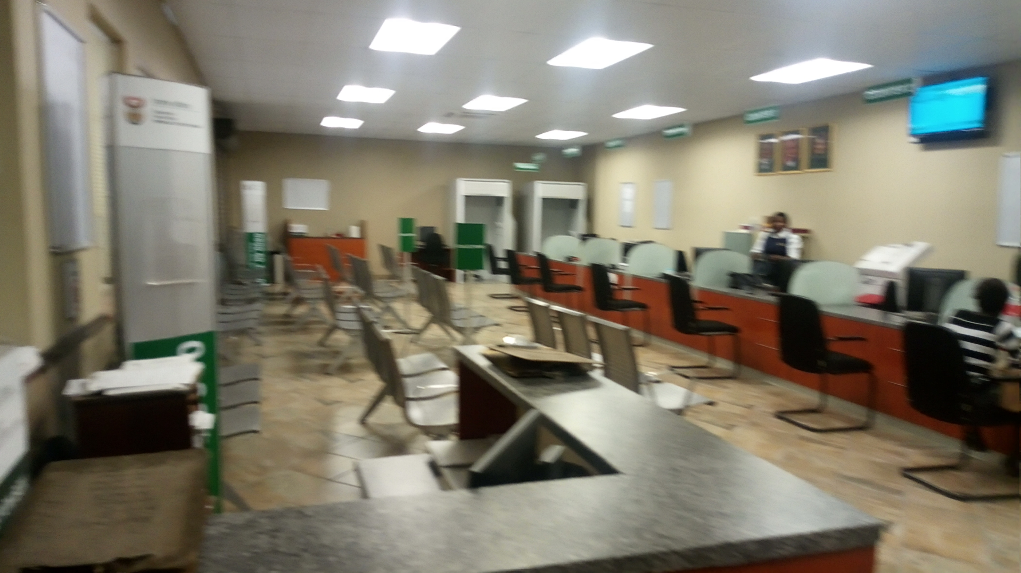
STELLENBOSCH PICTURES
OLD OFFICE SPACE
NEW OFFICE COUNTERS
NEW OFFICE WAITING AREA
NEW OFFICE INTERIOR

Slide 12
OVERVIEW STELLENBOSCH ABSA BANK
Stellenbosch ABSA bank c/o Ryneveld and Plein street is earmarked to open for Home Affairs services on 26 June 2023.
The branch will provide online booking on eHomeAffairs services for clients in the Stellenbosch and surrounding areas.
Service infrastructure in the branch will include waiting areas, 2 counters and 1 photo booth.
The ABSA branch will be able to provide much needed services such as Smart ID cards and passport applications.

Slide 13
CHALLENGES
Adequate offices space in the Stellenbosch area remains a matter of concern to be addressed.
Loadshedding disruptions continues to impact on the overall service programs of the office despite the office having a generator. (on and off switch – rebooting)
Systems stability during service hours negatively impacts on the management of service and contributes to longer public queues outside the small office.
Human Resource capacity is receiving attention but natural attrition impacted the office negatively.

Slide 14
Thank you
Ngiyabonga
Dankie

