Slide 1
LETABA TVET COLLEGE Presentation on state of the College to Portfolio Committee on Higher Education, Science and Innovation by Makoala TW President of Letaba TVET College SRC on 07 June 2023

Slide 2
Table of Contents
1. SRC of Letaba TVET College
2. SRC Constitution
3. SRC participation in Governance
4. Challenges experienced by students at Colleges
5. Recommendations to take the College forward

Slide 3
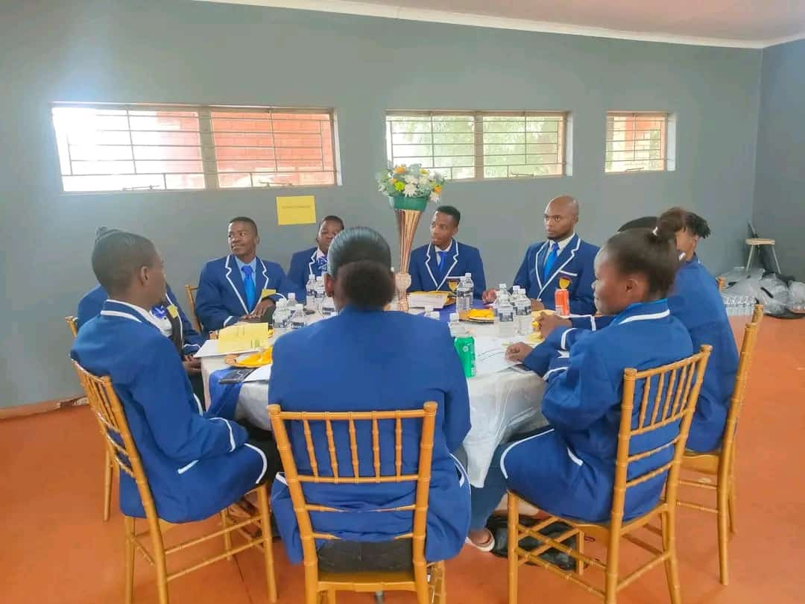
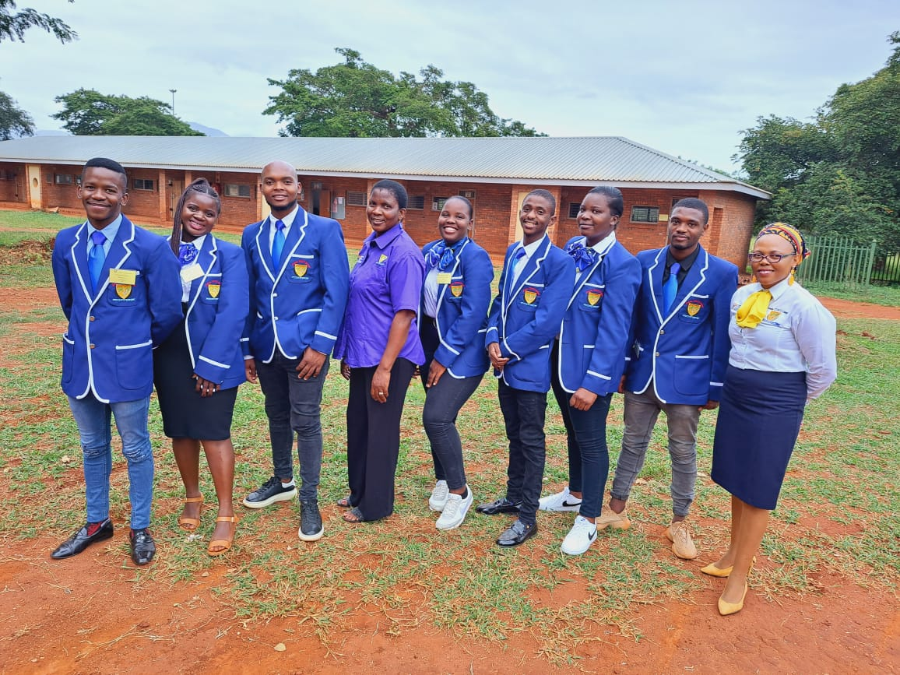

Slide 4
1. STUDENT REPRESENTATIVE COUNCIL OF LETABA TVET COLLEGE -The Students Representative Council of Letaba TVET College is fully constituted in terms of section 9(1)and 14 of the CET Act 16 of 2006 -The Student Representative of the College consist of the 12 members elected by Students of the college in line with the constitution of the SRC, consisting of 6 female and 6 males
Names | Surnames | portfolio | Gender | Campus
TSHEKGOFATSO WAYN | MAKOALA | PRESIDENT | MALE | MAAKE
LUCAS | LEBELO | DEPUTY PRESIDENT | MALE | MODJADJI
VALENCIA | MATHONSI | SECRETARY GENERAL | FEMALE | GIYANI
NOMONDE | MATHEBULA | DEPUTY SECRETARY | FEMALE | GIYANI
DZUNISANI | TLAKULA | EDUCATIONAL OFFICER | MALE | GIYANI
DEVINE NHLALALA | CAUKE | POLICY DEVEOPMENT OFFICER | FEMALE | TZANEEN
MAHLATSE | PHEKGOLE | MEDIA OFFICER | MALE | TZANEEN
CELIA | BOPAPE | HEALTH AND WELLNESS OFFICER | FEMALE | MAAKE
NOLOFATSO | LEKGANYANE | SPORTS OFFICER | MALE | MAAKE
DESMOND | MACHAKA | TREASURER | MALE | MAAKE
KELEBOGILE | PHIRI | SAFETY OFFICER | FEMALE | TZANEEN
GLACIA | MAENETJA | GENDER AND DISABILITY OFFICER | FEMALE | MODJADJI

Slide 5
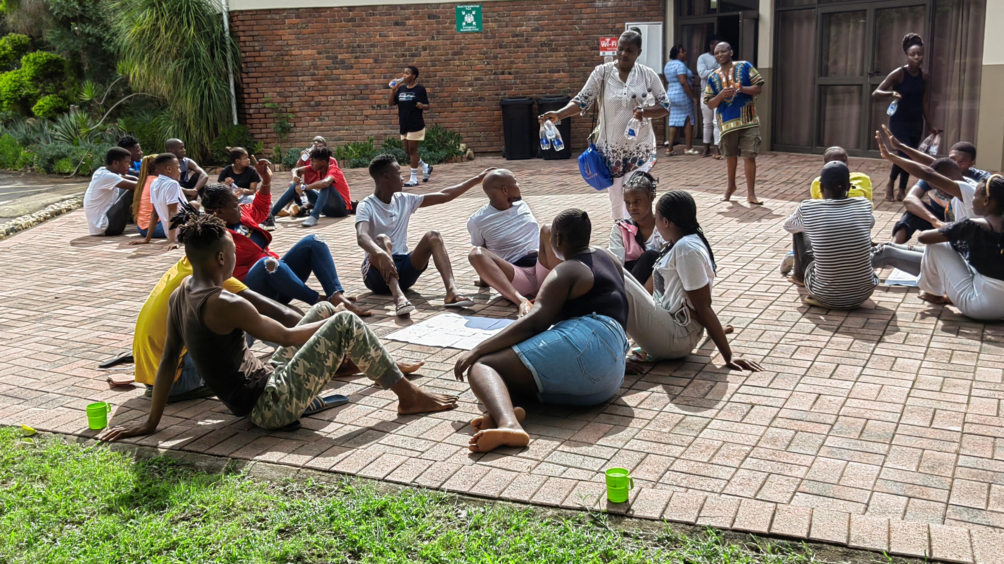

Slide 6
2. The SRC Constitution
The SRC Constitution was approved in 2016 and it was now reviewed in 2022.
SRC Election
The Campus SRC are being elected by the SRC at the campus level democratically by using a close ballot paper with the help of IEC.
The College SRC are elected on the last day of the SRC induction by the four Campus SRCs.
SRC FUNCTIONS
Participating in institutional decision-making structures.
Advising and supporting the delivery of effective and efficient student support services.
Managing and administering student representation at different levels.
Advising on the development of academic programmes and student-learning experiences

Slide 7
3. SRC PARTICIPATION IN COLLEGE GOVERNANCE
President and secretary Participate in the college council.
The 4 Campus SRC, the Educational desk together with the president attend the college academic board.
The 4 Campus Treasurers attend the financial committee meetings(NSFAS)
OTHER SRC ENGAGEMENT PLATFORMS
CAMPUS FORUM MEETINGS
All Campus SRCs form part of Campus forums Meeting, to discuss issues concerning the students.
Sports committee meetings
Wellness committee meetings
SRC MEETINGS
Quarterly meeting between College Senior Management team and EXCO SRC. In this meeting they discuss issues concerning the students.

Slide 8
5. Challenges experienced by students at the colleges.
Ineffective control
Students are always absent from school without valid reasons since there is no control measures in place to deal with such problem, the college rely only in punctuality and attendance policy as measure, but it is not solving the problem.
Inadequate learning facilities.
Due to lack of infrastructure students are forced to come on rotational basis and this poses a risk to the students that are using transport when we have late classes.
Some of our classes are not in good conditions
The college infrastructures are not attractive as it was old infrastructure used long time ago , no rapid changes E.g Maake Campus infrastructures.
The infrastructure and facilities and ground, ablution facilities are not in an excellent condition
No libraries or study centres in our campuses

Slide 9
Challenges continue : Delays for certificate
We have lot of students complaining about certificate, they wrote exams received statements, but certificates are not coming.
Students want to use certificates for various reasons, but certificate are not there.
Delay of certificate lessen motivation to tell students to come to TVET Colleges.
Inadequate funding for students from NSFAS
Delay in the payment of accommodation and transport allowances it causes high absenteeism, high drop rate and poses high risk of failure rate.
The college does not have sufficient staff qualified enough in student support services to assist students .
We still have number of students that are dropping at the college and there is no support to those students
There are students that are using substance abuse at the campuses but because we have one person looking after the students it is difficult to attend all of them.
High pregnancy rate is also a challenge.

Slide 10
Challenges continue: Providing courses that are over saturated
The college is continuously providing the same courses that are no longer needed by employers
Students have done the same courses and it if difficult to find employment since competition is very high.
Shortage of lecturers
There are not enough lecturers to some of our campuses
1 teacher teaching different subjects which is compromising the student's education and contribute to high failure rate.
.

Slide 11
6. Recommendations to take the college forward.
The college must ensure that the college environment are safe by putting securities that can be able to do their work properly
Build advance infrastructure that goes with the advance courses that are done to the campuses.
Intensive training programs of the student support services staff to ensure effective implementation of student support functions.
Employ SSS staff with relevant qualifications that can ensure that campuses’ students are taken care of, and to get full support they require.
Involve different stake holders partnered with the college to ensure that there are adequate learning facilities.
Employ staff member dealing with certificate only, the person who can make follow-ups every day.
The college to ensure that all resources promoting teaching and learning are available.
The management to address the issues of NSFAS with the department.
To introduce courses that can address the needs of the students and the need of the community

Slide 12
THANK YOU!!

