Slide 1
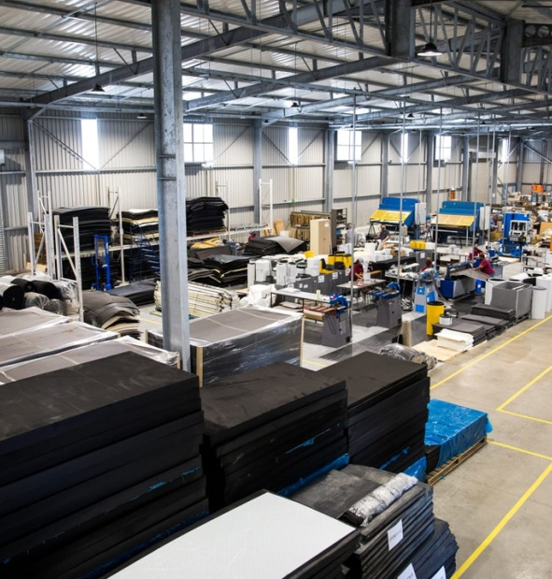
July Motsoeneng
Portfolio Committee on Small Business Development
Relationship between DSBD and DGRV, Legislation on Co-operatives development
Date: 07 June 2023
Presenter: Jeffery Ndumo/Vukile
Nkabinde
Co-operatives Business Support

Slide 2
1. Purpose
Relationship between DSBD and DGRV, Legislation on Co-operatives development
Is to brief the Portfolio Committee on the Relationship (MOU) between DSBD and DGRV, Legislation on Co-operatives development
2

Slide 3
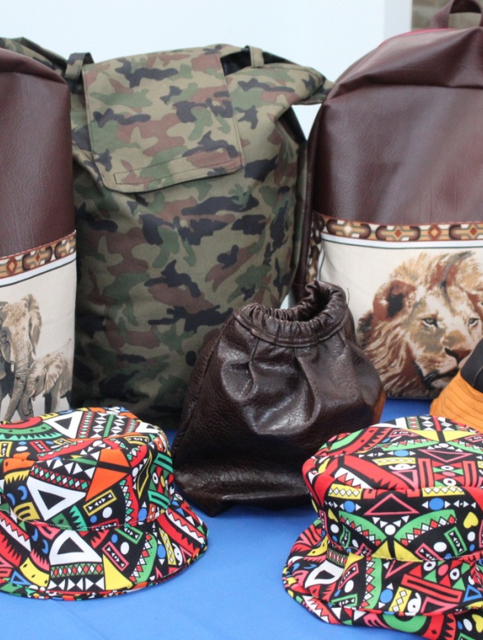
2. DSBD Mandate, Leadership, Agencies, Structure and Programmes, Background
3

Slide 4
Mandate, Vision and Mission
Mandate
Mission
Vision
To lead and coordinate an integrated approach to the promotion and development of entrepreneurship, Small, Micro and Medium Enterprises (SMMEs) and Co-operatives, and to ensure an enabling legislative and policy environment to support their growth and sustainability.
The coordination, integration and mobilisation of efforts and resources towards the creation of an enabling environment for the growth and sustainability of small businesses and co-operatives.
A transformed and inclusive economy driven by sustainable, innovative SMMEs and Co-operatives.
4

Slide 5
Leadership
Stella Tembisa Ndabeni-Abrahams | Elizabeth Dipuo Peters | Lindokuhle Mkhumane
Minister | Deputy Minister | Director-General
5

Slide 6
DSBD Agencies
The two entities reporting to the Ministry for Small Business Development are the Small Enterprise Finance Agency (sefa) and Small Enterprise Development Agency (Seda). The agencies report through governance arrangements that give them autonomy but also enable them to align their strategies with Government policy and priorities.
CBDA is now integrated into the SBD Portfolio
Non-Financial Support
Financial Support
6

Slide 7
DEPARTMENTAL STRUCTURE AND PROGRAMMES
Programme 1
Ministry (M&DM)
Director General -:
Strategy and Governance
Financial Management
Corporate Services
Risk and Integrity
Internal Audit
Programme 2 - Sector Policy & Research
Programme 3 – Enterprise Development, Innovation and Entrepreneurship
Programme 4 - Integrated Cooperatives and Micro Enterprise Development
Economic Transformation Initiative – Chief Directorate
Informal and Micro Business Development Support Directorate &
Cooperative Business Support Directorate – responsible for Cooperative Development Support Programme (CDSP)

Slide 8
1. Background
Establishment of the Department of Small Business Development Department (DSBD)
The Presidential Proclamation 41 of 2014, proclaiming the independent Ministry of Small Business Development (DSBD) and a new mandate, functions and regulatory environment for Small, Medium, Micro Enterprises (SMME’s) through the transfer of the SMME sector to the DSBD also necessitated the transfer of relevant and applicable legislation that gives effect to the DSBD’s mandate to provide regulatory guidance to the SMME sector.
The Co-operative Policy, Co-operative Act, and the Co-operative Strategy were transferred from the DTIC ( then the dti) to DSBD following the establishment of DSBD.
8

Slide 9
3. About the MOU between DGRV and DSBD
9

Slide 10
About the MOU between the DSBD and DGRV - Preamble
In August 2022 DSBD through a Memorandum of Understanding partnered with The German Co-operative Raiffeisen Confederation (DGRV), the following are the subheadings contained in the MOU:
SECTION 1 - PREAMBLE
The National Development Plan recognizes that the creation of jobs and economic growth requires a combination of initiatives that require direct state involvement, private sector partnerships, as well as the mobilization of civil society to take a pro-active interest in addressing the problems presented by poverty, unemployment, financial and socio-economic exclusion and marginalization of blacks, women, youth, and people with disabilities in South Africa.
DSBD - through its Integrated Co-operatives Development Branch has a responsibility to facilitate the creation of an enabling environment for the development and growth of co-operatives in South Africa.
DSBD aims to forge partnerships with other spheres of Government and Private Institutions for the development of sustainable co-operatives through the upskilling and development of their human resource capacities, understanding of co-operatives principles and values through the provision of technical entrepreneurship, management skills and co-operatives education and training.
DSBD requires the co-operation of various local institutions like DGRV involved in the promotion of co-operatives to achieve its mandate.

Slide 11
About the MOU between the DSBD and DGRV – Preamble (Cont)
E. DGRV’s mission in SADC in general and in South Africa in particular, is to use its over 200 years of co-operatives tradition and experience to contribute towards supporting and increasing the number of co-operatively organized groups that are actively participating in economic activity, income generation, job creation and poverty alleviation through working with recognized representative organizations, the government, and other stakeholders.

Slide 12
About the MOU between the DSBD and DGRV – Preamble (Cont)
F. The Parties acknowledge their distinct and complementary roles and hereby confirm a common commitment to jointly embark on supporting and facilitating the development from preformation to fully sustainable co-operatives at local government level.
G. The Parties further commit themselves to provide such support and facilitation within the current legal framework for the development of viable, autonomous, self-reliant, and self-sustaining co-operatives, able to grasp opportunities presented by various government programmes not limited to procurement set-asides, community works program and indigent support.
H. AND now therefore the parties wish to regulate their relationship by concluding this MoU, with the intention of providing in writing the terms and conditions of their collaboration. The Parties understand that this MoU does not create any obligations on either party and that the overall intent is to collaborate and work together on areas identified in the MoU. It is further understood that specific programmes and projects to be implemented under this MoU will be determined and agreed to jointly by the parties on a case by case basis and in the event the parties embark on a project, it will be on the basis of a specific work, programme implementation plan and/ or Service Level Agreement.

Slide 13
About the MOU between the DSBD and DGRV
SECTION 2 – ABBREVIATIONS (DEFINITIONS) AND INTERPRETATIONS
SECTION 3 - THE AIM OF THIS MEMORANDUM
3.1 To ensure responsive local government that is effective, efficient and economically able to promote local economic development – through coordinated facilitation and delivery of capacity building, technical and institutional support to municipalities working with Co-operatives, government development agencies and sector departments, to achieve an outcome driven local economic development that empowers all role players to actively contribute inclusive local economic development and sustainable communities that–
are socially cohesive and united;
are capable of taking an active role in the improvement of their socio-economic status;
are less dependent on social grant support;
have access to affordable financial services from their own cooperative banks;

Slide 14
About the MOU between the DSBD and DGRV
have ownership of the means of production for their consumption and markets;
embrace self-employment and job creation opportunities;
are able to eradicate poverty and hunger;
are able to make contribution to payment for municipal services; and
protect community infrastructure from vandalism and theft.
3.2 To guide the collaboration between the two Parties on the implementation of this MoU within the framework of the Constitution, the National Development Plan, Co-operatives Act, 2005 (Act No. of 2013 as amended) Co-operatives Bank Act, 2007 (Act No.40 of 2007)

Slide 15
About the MOU between the DSBD and DGRV
SECTION 4 - OBJECTIVES AND SCOPE OF THE MEMORANDUM
4.1 The Parties agree that the primary aim of this Memorandum is to facilitate job creation through supporting and capacitating communities, officials and groups for development of viable and sustainable co-operatives within their space.
4.2 The principles which underpin the Parties’ activities and operations, as contemplated in this Memorandum are to:
4.2.1 Formalise the relationship and desired strategic partnership amongst DSBD and DGRV, and their respective responsibilities regarding the support and capacitation of municipalities to develop co-operatives through capacity building, promotion and other support measures practically feasible to ensure growth and sustainability of co-operatives and communities.
4.2.2 Work with DSBD to further the development of co-operatives through capacity building, technical and institutional support measures.
4.2.3 Collaborate with other partners to support the existing co-operatives that have scope for growth and growing local economies through capacity building, technical and institutional support.
4.2.4 Monitor jobs created through co-operatives whilst contributing to the growth of the local economy.
4.2.5 Support municipalities in the development of co-operatives through capacity building; technical and institutional support.
4.2.6 Facilitate co-operatives’ access to training, technical support, financial support and so forth from any private; public; or not for profit organizations working with the parties in a joint or separate agreement.

Slide 16
About the MOU between the DSBD and DGRV - 4.3 The implementation of the Memorandum shall be measured, and success evaluated periodically and reviewed annually in terms of the following KRA and KPIs: Table A: Scope of Memorandum
KRA | Activity of Cooperation
Implementation of the Co-operatives Development Support Programme | Workshop LED officials and departments working with cooperatives on implementing the Co-operatives Development Support Programme (CDSP).
 | Jointly identify qualifying pipeline of cooperatives-based projects to be supported to benefit and repay the credit portion of the CDSP facility.
 | Provide business and technical training to co-operatives in the various sectors of the economy, especially those that have been identified as potential pipeline for CDSP.
 | Monitor and compile an impact assessment report on percentage of cooperatives that are growing programme participants in the CDSP.
 | Developing network of trainers, mentors, and coaches for co-operatives with skills in cooperative bookkeeping, financial management, auditing, governance, marketing, customer service and human resource management.
Building of cooperatives knowledge based and adoption by role-players | Setting up of reference groups within identified district to guide, implement and monitor cooperative community economic development model.
 | Implement community cooperative economic participation pilot projects undertaken in each municipality under the district development model
 | Number of operational co-operatives members trained as facilitators, assessors and moderators of co-operatives training nationally.
Financial and economic inclusivity for township and village economic vibrancy | Facilitate and support establishment of cooperative financial institutions within identified districts.
 | Facilitate and support establishment of cooperatives for Community Works Programme participants in identified municipalities.
 | Increase percentage of viable and sustainable co-operatives that have benefitted from DGRV/DSBD intervention.

Slide 17
About the MOU between the DSBD and DGRV - 5. ROLES AND RESPONSIBILITIES
5.1 GERMAN CO-OPERATIVE RAIFFEISEN CONFEDERATION (DGRV)
Subject to mutually agreed project concept, DGRV intends to support implementation thereof, through measures not limited to the following:
5.1.1 Joint development of programme implementation work plan with DSBD;
5.1.2 Participation in the steering committee implementation meetings;
5.1.3 Assist in the preparation of the necessary workshop documentation, material and post training reports;
5.1.4 Facilitation and provision of training for officials, leaders and cooperatives in line with approved cooperative economic development plans;
5.1.5 Consolidation of provincial monitoring and impact evaluation reports and impact reports;
5.1.6 Coordination with DSBD or relevant government agents for logistics – such as venues, travel and accommodation for experts where applicable;
5.1.7 Funds permitting, cover the costs material printing and travel for at least 2 facilitators to and from the training venue.
5.1.8 Provision of services of technical and non-technical nature at the costs of DGRV or shared costs basis where applicable subject to availability of funds.
5.1.9 Provision of the train-the-trainer and mentoring of co-operative representative and support organization as well as departmental staff or people seconded for this purpose by DSBD;
5.1.10 Assisting with inputs to newsletters, articles and co-operatives performance and status quo annual reports; and
5.1.11 Together with DSBD, facilitate pre-formation workshops with municipalities and identified groups;

Slide 18
About the MOU between the DSBD and DGRV - 5. ROLES AND RESPONSIBILITIES
5.2 THE DEPARTMENT OF SMALL BUSINESS DEVELOPMENT
DSBD shall be responsible for the functions listed below in terms of development and support to municipalities:
5.2.1 To assist identified districts and/or municipalities with the development of the operational/implementation work plan.
5.2.2 To coordinate, organize, participate and chair the MoU steering committee and implementation monitoring meetings.
5.2.3 To mobilize and facilitate convergence of relevant stakeholders to a central convenient venue.
5.2.4 To co-ordinate training workshops in consultation with DGRV in line with approved operational/implementation work plans.
5.2.5 To ensure the provision for logistics for training venues and accommodation expenses for a maximum of two (2) facilitators/ trainers, involved in each intervention done through this MoU where applicable.
5.2.6 On shared cost basis where applicable, to ensure preparation, printing, packaging and shipping of the necessary workshop material to the venue of intervention.
5.2.7 To facilitate data collection through municipalities and coordinate the preparation of annual co-operatives performance and status reports.
5.2.8 To facilitate development and distribution of co-operatives newsletter once a quarter.
5.2.9 Together with the provincial governments, DSBD will facilitate acquisition of information at local government level, with the co-operation of municipalities, to identify eligible beneficiaries of the programme; and
5.2.10 DSBD will facilitate other forms of support for co-operatives through partnerships with other government Departments and other stakeholders.

Slide 19
About the MOU between the DSBD and DGRV
SECTION 6 - DURATION OF THE MEMORANDUM
6.1 The duration of this Memorandum shall be a period of up to December 2024, commencing on the Effective Date.
6.2 The designated representatives of the Parties or their nominees shall meet at the commencement of each quarter of every year or by notice from each party to another to discuss and determine progress in the implementation of this MoU.
6.3 The parties agree that there shall be no expectation of the future renewal of this agreement. Any decision to renew shall be subject to agreement by the Parties and reduced to writing by means of an Addendum.

Slide 20
About the MOU between the DSBD and DGRV
SECTION 7 - COOPERATION AND GOOD FAITH
7.1 The Parties enter into this MoU in good faith, in the spirit of mutual co-operation and assistance and undertake to work together in order to achieve the purpose of this MoU.
SECTION 8 - DISPUTE RESOLUTION
8.1 In this clause, a "dispute" means any dispute, disagreement or claim arising between the Parties in connection with:
the formation or existence of this MOU;
the implementation of this MOU;
the interpretation or application of the provisions of this MOU;
the Parties’ respective rights and obligations in terms of or arising out of this MOU; and or
the validity, enforceability, rectification, termination or cancellation, whether in whole or in part of this MOU.
A Party may declare a dispute on written notice to the other Parties.
In the event of a dispute, the Parties will meet within seven (7) days of the dispute having been declared to attempt to resolve it.
In the event of the inability of the Parties to resolve the dispute and the dispute affects the continuance of the MOU, the MOU may be terminated.
8.5 For any programme that the parties agree to because of this MoU, an arbitration process shall be an acceptable dispute resolution mechanism to be held in terms of the AFSA rules and applicable South African legislation.

Slide 21
About the MOU between the DSBD and DGRV
SECTION 9 - WHOLE AGREEMENT
9.1 This MoU constitutes the entire agreement between the Parties regarding the subject matter thereof and supersedes all previous agreements, written or oral, between the Parties relating to the subject matter of this MoU.
9.2 This MoU shall be governed and interpreted in accordance with the laws of the Republic of South Africa.
SECTION 10 - FINANCIAL IMPLICATIONS
This MoU does not constitute financial obligations on either Party, it provides for an overall intent to collaborate and work together on those areas identified in clauses 4 of this MoU.
SECTION 11 - STEERING COMMITTEE
The Parties shall jointly set up a steering committee to manage and implement this MoU effectively and efficiently.
SECTION 12 - ADDRESS FOR COMMUNICATIONS, SERVICE OF NOTICES AND CORRESPONDENCE
SECTION 13 - ADDRESS FOR COMMUNICATIONS, SERVICE OF NOTICES AND CORRESPONDENCE
SECTION 14 - BREACH AND TERMINATION
SECTION 15 - ATTESTATION

Slide 22
4. State of the MOU since signature, Future action and Conclusion/Way Forward
22

Slide 23
STATE OF THE MOU SINCE SIGNATURE
In 2022/23 F/Y:

Slide 24
STATE OF THE MOU SINCE SIGNATURE AND FUTURE ACTIONS
In 2023/24:
From the planning for training done in 2022 between DGRV and DSBD – 30 Cooperatives have been trained in Nkungumathe, Inkandla KZN.
Session between DSBD and DGRV was held on 25 April – this yielded the following actions:
There shall be a Meeting to further discuss the MOU – DSBD to provide dates.
Development of training schedule to be created by DSBD- include number of participants, topics, and venue/location. Catering for the training will also need to be confirmed before sending the final schedule (DGRV will need 2 weeks for planning and logistic purposes)
Request from DSBD to have a session with DGRV and the facilitators to update the manual either over teams or in person- DSBD to provide meeting dates.
DGRV to provide feedback on needs analysis collected for Limpopo
DGRV to provide feedback on the pilot bakery project in Western cape( to understand what happened with this project, any steps or actions taken, or lessons learnt after the project collapsed)
Combined effort between DGRV and DSBD to come up with possible interventions post training.

Slide 25
CONCLUSION/WAY FORWARD
It is highly recommended that DSBD officials working with Cooperatives be exposed to the German Cooperative Model through visiting German. This will seek to strengthen the relationship
It is further recommended that DSBD and DGRV cooperate towards the support of the development of an Apex body
Meeting urgently on the MOU implementation plan, including the Steer com

Slide 26
Thank You!

