Slide 1
G4J team
Growth for Jobs Strategy
Overview presentation

Slide 2
Growth for Jobs Strategy
Notes:
Introduction
Like the rest of South Africa, the Western Cape faces a range of deep, interconnected, socio-economic challenges that include unemployment, poverty and crime. While there is no panacea for these challenges, which have deep roots in the country’s history and social structure, there is also no prospect of addressing any of them without faster economic growth. Economic growth is essential to generating rapid and sustained job creation, faster growth in living standards and increased resources available to society. The Western Cape Government identified the need for a strategy to lift dramatically the provincial growth rate and, to the extent that growth continues to falter in South Africa, to decouple the province’s growth trajectory from that of the rest of the country.
Therefore, this Growth for Jobs Strategy sets out a comprehensive, challenging and ambitious goal for the Western Cape to grow its economy by between 4 and 6% by 2035.
It is also a strategy that clarifies that how we grow our economy is as important as the growth itself. In this way, the Growth for Jobs Strategy distinguishes itself from previous strategies, by providing a long-term perspective with clear targets, framed within defined principles. It is centred on systemic solutions that address key binding constraints and an enabling environment for the private sector that accelerates our economic growth.
The formulation of the Growth for Jobs Strategy has been data-driven, evidence-led and has involved extensive consultation. It draws on a provincial Growth Diagnostic completed in 2022 and involved a team of officials and independent experts who engaged with stakeholders from the private and public sectors, and representatives from across civil society and academia.
The Growth for Jobs Strategy process drew from three surveys that were conducted and disseminated through private-sector channels, drawing in the views of over 540 stakeholders. Furthermore, during the strategy formulation process, the Western Cape Government consulted over 2000 people and industry representatives (and their constituents representing more than 30 000 individuals) over the course of 188 engagements.
At its heart, the Growth for Jobs Strategy is premised on a recognition that the private sector creates jobs, while the State needs to create an environment in which people and businesses are enabled to create and exploit opportunities as they arise. This kind of ‘horizontal’ enablement empowers citizens and fosters independence, freedom, and self-reliance.
To give effect to this approach, the Growth for Jobs Strategy has several important anchors:
Clear principles set out in a strategic framework that have guided thinking and decisions.
Crucial priority focus areas (PFAs) that shape decisions around the nature of the interventions needed to maximise impact.
Key levers, enablers and accelerators that facilitate the achievement of these goals.
Finally, the Growth for Jobs Strategy is a whole-of- government, all-of-society strategy whose success requires the energy, commitment and allocation of resources from across government, the private sector and civil society.

Slide 3
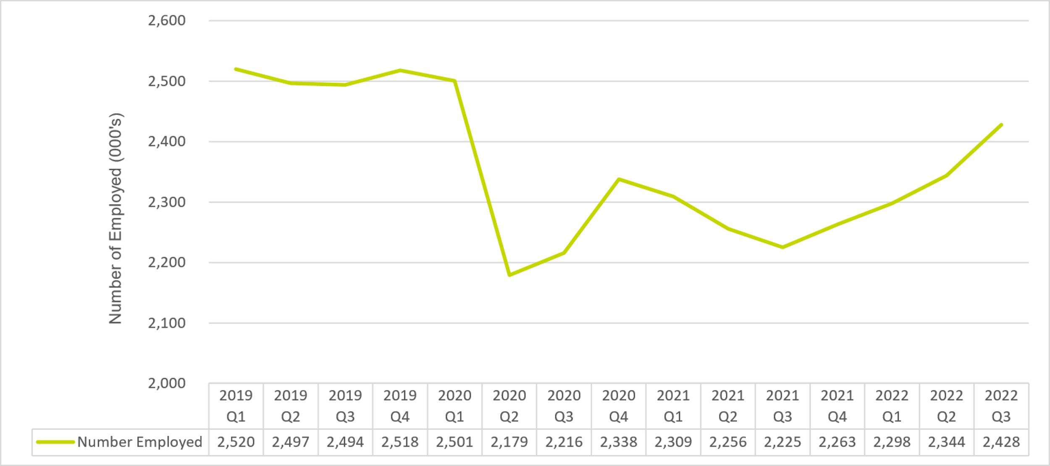
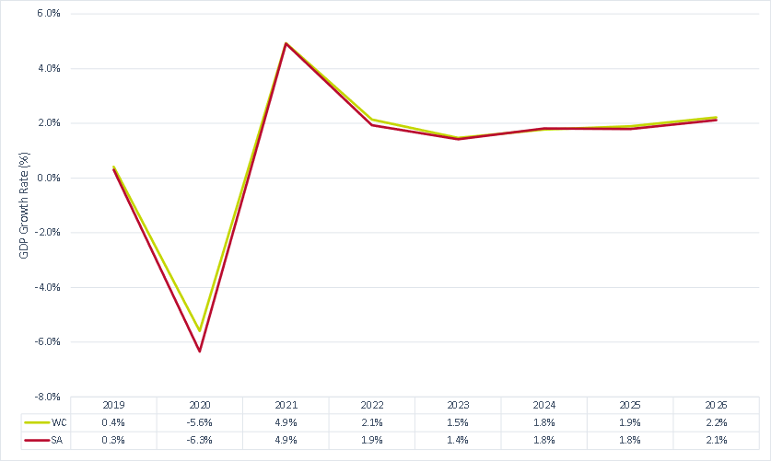
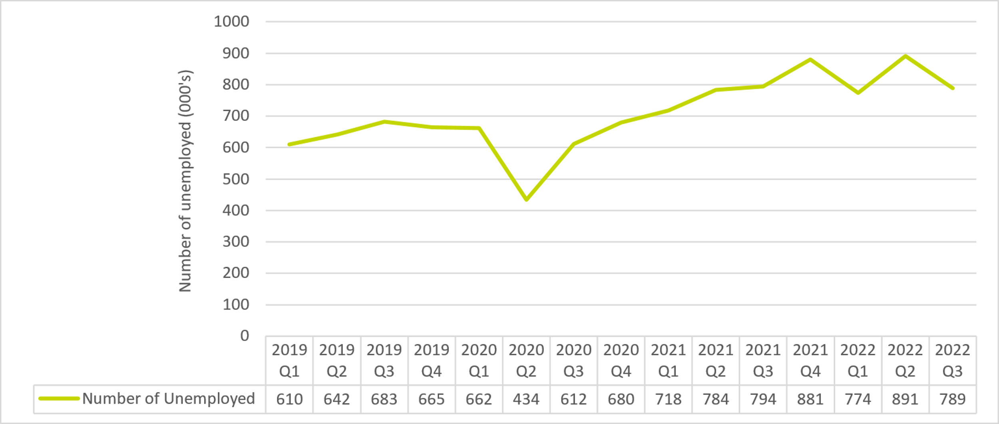
Problem Statement
Tracking South Africa with its low growth rate, the Western Cape Province needs to grow much faster to reduce high unemployment
Western Cape employment (2020Q2–2022Q3
South Africa and Western Cape GDP growth rate (2019−2026)
Western Cape unemployment (2020Q2–2022Q3)
Notes:
Understanding our problem statement
The Growth for Jobs Strategy seeks to address the high unemployment rate by achieving significant economic growth. South Africa is not immune to global realities
As an open economy, global trends and events affect South Africa both directly and indirectly. The Covid-19 pandemic-induced recession in 2020 highlighted the global interdependence of economic and social structures. The same is true of the conflict in Ukraine, which impacted domestic food, energy, and feedstock prices leading serious inflationary consequences. Central banks were slow to respond with interest rate hikes, eventually taking action aggressively. While the Russia-Ukraine war remains a downside risk, inflation is expected to return to target levels over the medium-term.
South Africa’s economic performance
South Africa’s economic growth is likely to slow to 0.8% in 2023 (Figure 1). As a result, gross domestic product (GDP) per capita may only recover to its pre-pandemic levels by the end of 2024.
Figure 1: South Africa and Western Cape GDP growth rate (2019−2026)
Source: IHS
Economic, financial, and fiscal conditions remain stressed. The growth recovery is tepid and below the pathway required to make meaningful inroads into the chronic challenges of poverty, inequality and unemployment facing South Africa. For the best part of two decades, unemployment has been stubbornly high, recently reaching a record-high rate of 35%, excluding discouraged job seekers. Periodic and intrusive power shortages weigh heavily on the production capacity of all sectors in both the formal and informal economy.
The many reasons for South Africa’s disappointing growth performance include poor policy choices, declining governance, especially increased corruption, and increasingly unsound macroeconomic fundamentals, especially the rate at which public debt has been rising.
To meaningfully reduce unemployment and poverty, it is generally recognised that South Africa needs an annual growth rate approaching 6%. This will require significant fixed capital investments (i.e., in long-term assets, such as factories, buildings, land and equipment) that generate employment. These investments would, in turn, add to aggregate demand in the economy and stimulate further fixed investments. However, this cannot be achieved as long as local and foreign savings are used to finance consumption spending.
Western Cape economy’s shoots of opportunity
The performance of the Western Cape economy is shaped and constrained by the broader national context – e.g., national fiscal and monetary policy, international trade protocols and agreements, policing, sovereign risk levels, policy uncertainty, etc.
A ‘snapshot’ view of the provincial economy is given below:
It is the third-largest provincial economy, accounting for approximately 14% of the national GDP, after KwaZulu-Natal (approximately 15%) and Gauteng (approximately 30%).
The primary sector constitutes less than 5%, the secondary sector just over 20%, and the tertiary sector almost 75% of gross value added (GVA).
Agriculture constitutes only 4% of the Western Cape’s economy but is a large contributor to employment. The province’s contribution to the country’s GVA in agriculture is above 20%, and over 50% of the province’s exports originate in the agricultural sector.
More than 40% of exports are destined for the European Union and North America.
The province is relatively urbanised.
Both the level of human capital and the quality of life (as measured by employment, life expectancy, literacy, etc.) are somewhat higher than national averages.
Although above 20%, the province’s unemployment rate is significantly lower than the national average.
Income and wealth inequality in the Western Cape remains a challenge, as in the rest of the country.
Over the past decade growth rates in the Western Cape have been in line with the national economy, which entered a protracted economic downturn at the end of 2013. Between 2014 and 2021, South Africa’s real GDP dipped to below its trend level, averaging 1% per year. The Western Cape’s real economic growth averaged slightly higher, at 1.2% per year.
Figure 2: Western Cape unemployment (2020Q2–2022Q3)
Source: Stats SA
In the fourth quarter of 2022, the Western Cape had a working-age population of 4.93 million people and an overall unemployment rate of 22.5%. Of the 1.5 million citizens who were not economically active, 106 000 people were discouraged job seekers, while of the 3.35 million people in the narrow labour force, 2.60 million were employed and 752 000 unemployed.
What is holding back inclusive economic growth?
Long-term growth is the result of an economy accumulating new sources of productive capacity, e.g., human and physical capital, new technologies, entrepreneurial capabilities and increasing capabilities to deploy those productive capabilities in more efficient ways (e.g., through improved technologies and the building of social institutions that promote growth, such as efficient contract enforcement and sound property rights).
The lack of growth in the South African economy is the consequence of the failure to accumulate productive capabilities and the erosion of some of the institutional underpinnings of efficient production. Thus, investment in fixed capital has been slow and in some areas – most notably energy – has failed to keep up with the rate of depreciation of existing assets, leading to a real decline in productive capacity with negative implications for the rest of the economy.
Productivity is a prerequisite
Productivity is a prerequisite for international competitiveness and economic growth and development. Multi-factor productivity (MFP) or total factor productivity (TFP) reflects the overall efficiency with which labour and capital inputs are used together in production. For an average country, the TFP accounts for 60% of the growth in output per worker.A key factor behind slow GDP growth is the 1.2% decline in the Western Cape’s TFP between 2016 and 2020.
The Growth for Jobs Strategy is, therefore, committed to raising the overall productivity of the Western Cape economy, through horizontal enablement and supporting private-sector-led market stimulation and growth opportunities. The focus on sustainability offers opportunities to enhance productivity, as the circular economy will enable the region to derive greater use from each resource unit and require fewer resource inputs.

Slide 4
Vision and Goal Statements to address the problem statement
Vision
A provincial economy that achieves break-out economic growth,
resulting sufficient employment and opportunity and an economy that is sustainable, resilient, diverse and thriving – generating confidence, hope and prosperity for all.
Goal
By 2035, the Western Cape will be a R1-trillion inclusive economy in real terms and growing at between 4% and 6% per annum. This will be achieved through enabling a competitive business environment in which growth is driven through businesses exploiting opportunities
Notes:
Vision
A provincial economy that achieves break-out economic growth, resulting sufficient employment and opportunity and an economy that is sustainable, resilient, diverse and thriving – generating confidence, hope and prosperity for all.
Goal
By 2035, the Western Cape will be a R1-trillion inclusive economy in real terms and growing at between 4% and 6% per annum. This will be achieved through enabling a competitive business environment in which growth is driven through businesses exploiting opportunities.
Increasing inclusion
driven by jobs-rich growth in the formal, informal and township sectors, benefitting all citizens, communities and enterprises – both urban and rural – and especially women and young people.
Competitive business environment
that ensures total factor productivity growth through competition, productivity enhancing spatial policies, and investment in infrastructure, connectivity and skills, with government officials who all apply an ease-of-doing-business approach.
Increased sustainability
as the Western Cape Government accelerates progress to a net zero carbon and resilient province, conserves the natural environment and mitigates the impact of climate change.
Resilience
through diversifying economic activity and strengthening the Western Cape Government’s ability to anticipate, prepare for and respond to exogenous shocks, including climate change, migration, adverse political/geopolitical events and the Fourth Industrial Revolution.
Thriving people and places
whose social and economic potential is being realised through improved access to opportunities, and where solutions to challenges build on a diversity of cultures and talents.
Confidence and hope
with businesses and citizens that are positive about their economy and the Western Cape’s future, and a high level of trust among the private sector, communities, residents and government, who work together to address challenges and realise opportunities.
Prosperity
with everyone in the region having an improved quality of life, increased wealth and more opportunities

Slide 5
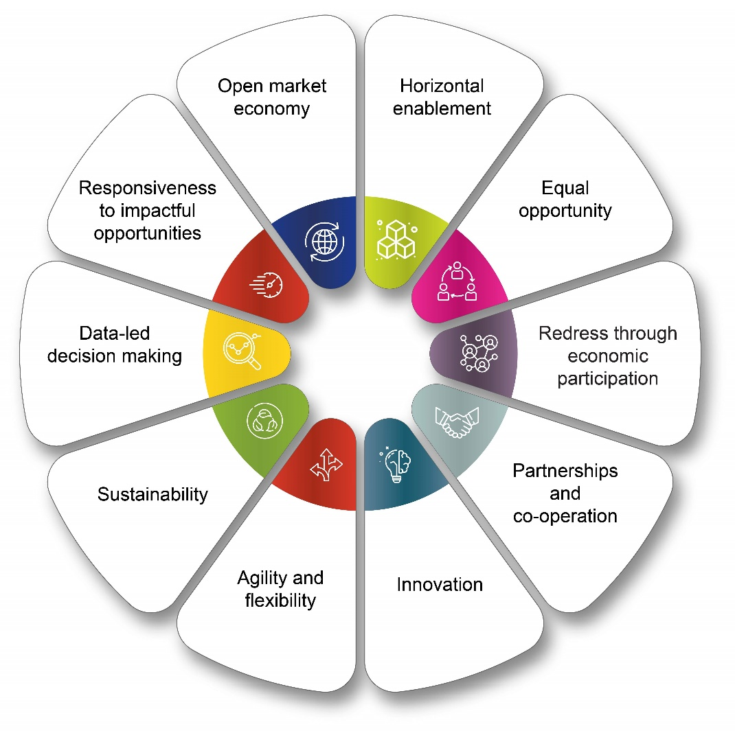
Principles underpinning the Growth for Jobs Strategic Framework
The Growth for Jobs Strategic Framework supports economic growth for job creation that favours…
Notes:
Strategic Intent and principles
Guiding principles function as beacons that inform strategic and operational decisions because no strategy or strategic framework can provide a precise guide to every decision. The guiding principles underpin what should be included and excluded from the strategy and enable decision-makers to make choices informed by an understanding of broader goals and values.
The Growth for Jobs Strategy’s primary set of principles govern the substantive content of the strategy and are reflected in ten statements (see Figure).
An open market economy. An open market economy, rather than a developmental state, makes possible an open opportunity society for all. In embracing and supporting an open-market economy, positive interventions aimed at improving competitiveness and productivity will be deployed to enable businesses to grow and create jobs.
Horizontal enablement. Government is an enabler of the economy, creating a conducive, enabling environment supportive of private-sector growth and providing support in the realisation of private-sector-led opportunities that ultimately generate jobs.
Equality of opportunity. A state that facilitates economic opportunity for citizens and expands choice and the independence of its residents without limiting individual freedom.
Redress through active economic participation. Redress is achieved by pulling more people into the economy, stimulating competition, improving skills and productivity, raising investment, reducing poverty, increasing employment and broadening the tax base. Private-sector involvement includes entrepreneurs; small, medium and micro enterprises (SMMEs); and the informal and township economies,
Partnerships and cooperation. Strategic partnerships and cooperation with other spheres of government and the private sector to increase the speed and scale of change.
Innovation. Embracing new ideas and pushing the boundaries of the Western Cape’s constitutional mandate to enable private-sector-led economic growth and job creation in tourism, trade and industrial policy.
Agility and flexibility. Government needs to be agile and responsive in pursuit of break-out growth. Support to identified opportunities and nascent industries needs to be time-bound with clear criteria for continued funding.
Sustainability. Growth must be uncoupled from wasteful resource usage and fossil fuel dependency so that it can be sustainable over the long term and can meet present needs without further compromising the future. With our natural assets safeguarded, our economy and society will be shielded from the impacts of resource deterioration, climate change and other shocks, while our competitiveness and resilience will be enhanced.
Data-led decision-making. Sound decision-making requires a data management and reporting capability that pulls together and utilises the excellent − if underutilised − data that the province already has. Establishing strong and agile economic and spatial data, analytical capabilities and intelligence is imperative.
Responsiveness to impactful opportunities. Government should be responsive to all private-sector-led opportunities, while being selective about which support levers are deployed based on the extent of private-sector involvement and participation, and evidence of the potential of the opportunity.

Slide 6
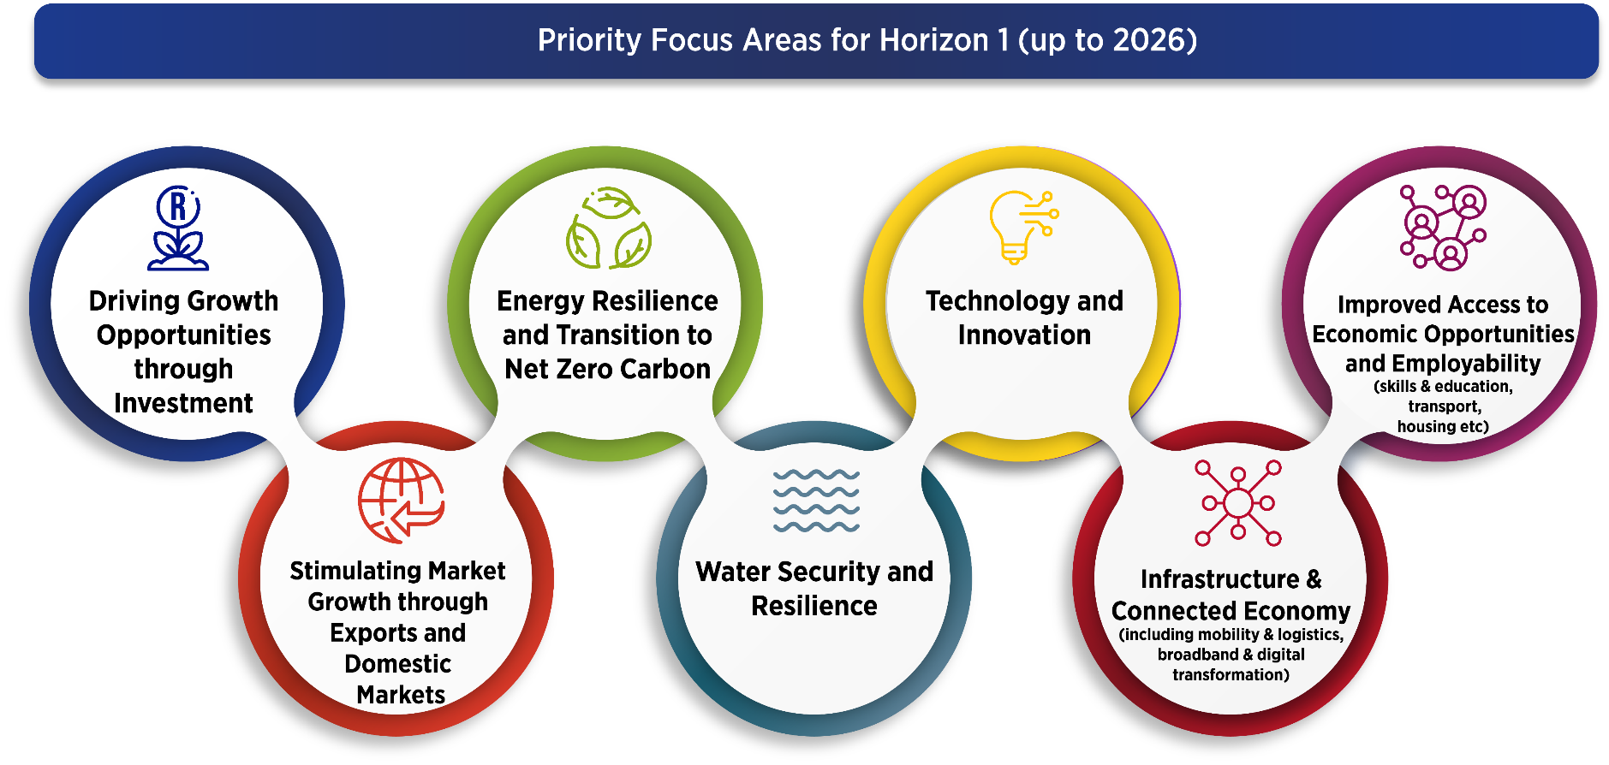
Priority Focus Areas, Levers and Enablers
7 priority focus areas identified for short and medium term based on the need to:
Horizontally enable the economy
Addressing key binding constraints and most pressing issues
Reaching the G4J goals and vision
Notes:
Priority Focus Areas
A process of analysis and engagement led to seven Priority Focus Areas for the Strategy being identified for implementation over the short and medium term. The seven PFAs concentrate on the key constraints in network industries and on the essential elements needed to raise total factor productivity and competitiveness. Over time, these priority areas may change, as the Growth for Jobs Strategy will need to be agile in the face of changing circumstances and opportunities

Slide 7
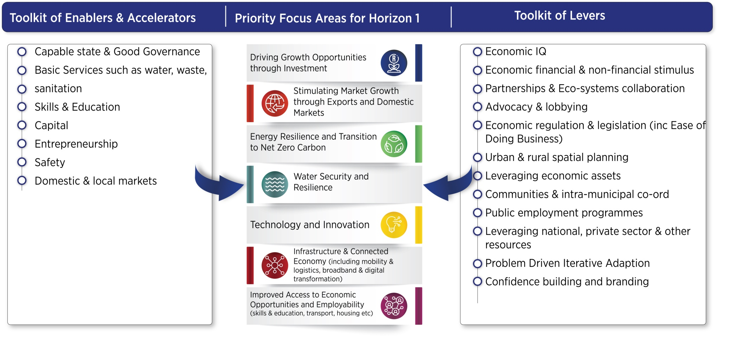
Toolkits of policy levers, enablers and accelerators
The Priority Focus Areas will deploy a range of policy levers, enablers and tools to facilitate the implementation of the Priority Focus Areas

Slide 8
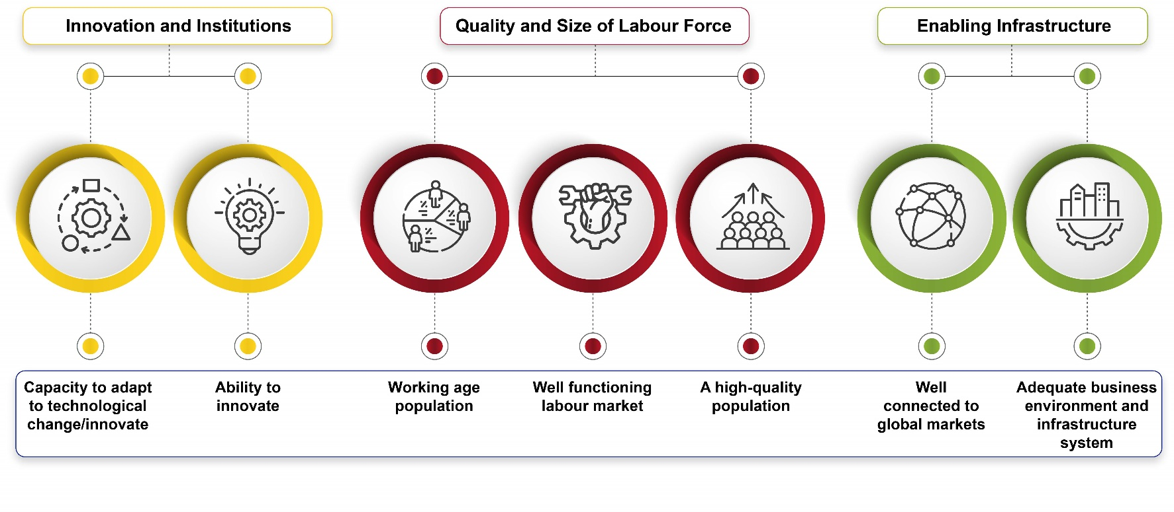
Strengthening geographic synergies
The G4J Strategy embraces the consolidate, capitalise, cluster and connect spatial logic that identifies four focus areas for spatial transformation:
Improving the places where people live.
Creating more opportunities for people to live in better locations.
Creating better linkages between places.
Creating spatially and economically vibrant growth points.
Growth Potential Study Indices (2018)
Source: Western Cape Government
Notes:
The Growth for Jobs Strategy and its implementation plan lands spatially, and therefore the Strategy will play a key role in driving the implementation of the Provincial Spatial Development Framework. This will require spatial intelligence and an effective and efficient system of governance implementing a deliberate spatial approach that seeks to exploit the province’s endowments and competitive advantages.
The Growth for Jobs Strategy’s spatial goals are aligned with, and informed by, the goals of the Provincial Spatial Development Framework (PSDF) and are guided by two questions:
Where should government efforts related to enabling the business environment, supporting growth opportunities, and stimulating (domestic) market growth be prioritised, to ensure maximum regional economic and socio-economic impact?
What kind of spatial arrangement is most conducive to the objective of a jobs-rich provincial economy, rolling back poverty and improving citizens’ wellbeing?
At a strategic level, the goals of the Western Cape Government’s spatial plans are to consolidate investment, both to improve the places where people are living and to capitalise on spatially and economically vibrant growth points; to cluster investment and government activities, including more affordable opportunities for people to live in these areas; and to connect places through better linkages between areas with an emphasis on public transport. The consolidate, capitalise, cluster and connect spatial logic identifies four focus areas for spatial transformation:
Improving the places where people live.
Creating more opportunities for people to live in better locations.
Creating better linkages between places.
Creating spatially and economically vibrant growth points.
Innovation and other economic growth determinants have strong geographic/spatial dimensions, and investment decisions must be made with spatial differentiations in mind. The Western Cape Government’s Growth Potential Study models growth potential across space by assessing key drivers
Each place – be it a community, municipality or district – has different attributes, growth opportunities and dynamics. This means that because the Growth for Jobs approach is agile and responsive, its implementation will land differently in municipalities and townships, depending on the unique needs and prospects of the geographic area. The implication is that stakeholders will need to engage collectively with the Growth for Jobs strategy and translate its implications for the economic implementation plans of their geographic area. To this end, support and assistance will be provided by the Western Cape Government

Slide 9
Theory of Change- as part of strategy development
Series of theory of change workshops were conducted at the meso-level for each of the seven PFAs
Provided insight into the overarching logic and intended causality of the G4J Strategy in relation to its overarching vision.
Overarching theory of change for the G4J Strategy was finally developed and included in Strategy
Notes:
As part of the strategy development, a series of theory of change workshops were conducted at the meso-level for each of the seven PFAs. These workshops provided insight into the overarching logic and intended causality of the Growth for Jobs Strategy in relation to its overarching vision. An overarching theory of change for the Growth for Jobs Strategy was developed

Slide 10
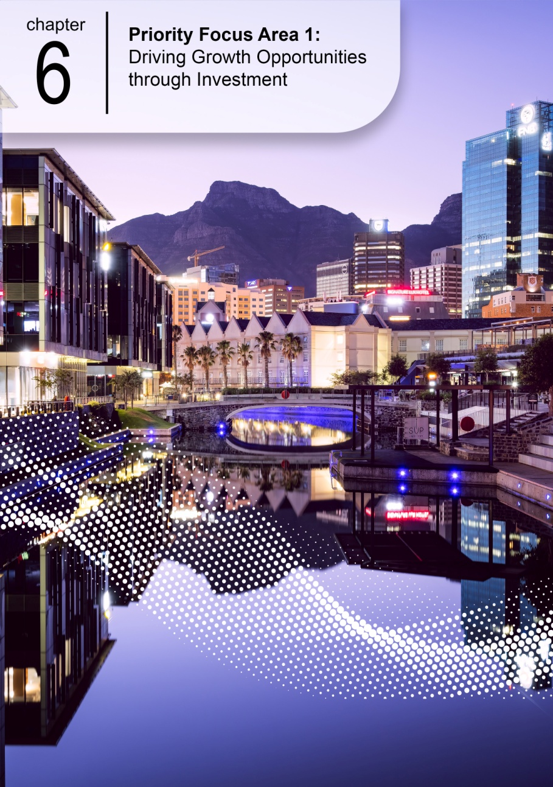
Driving Growth Opportunities through Investment

Slide 11
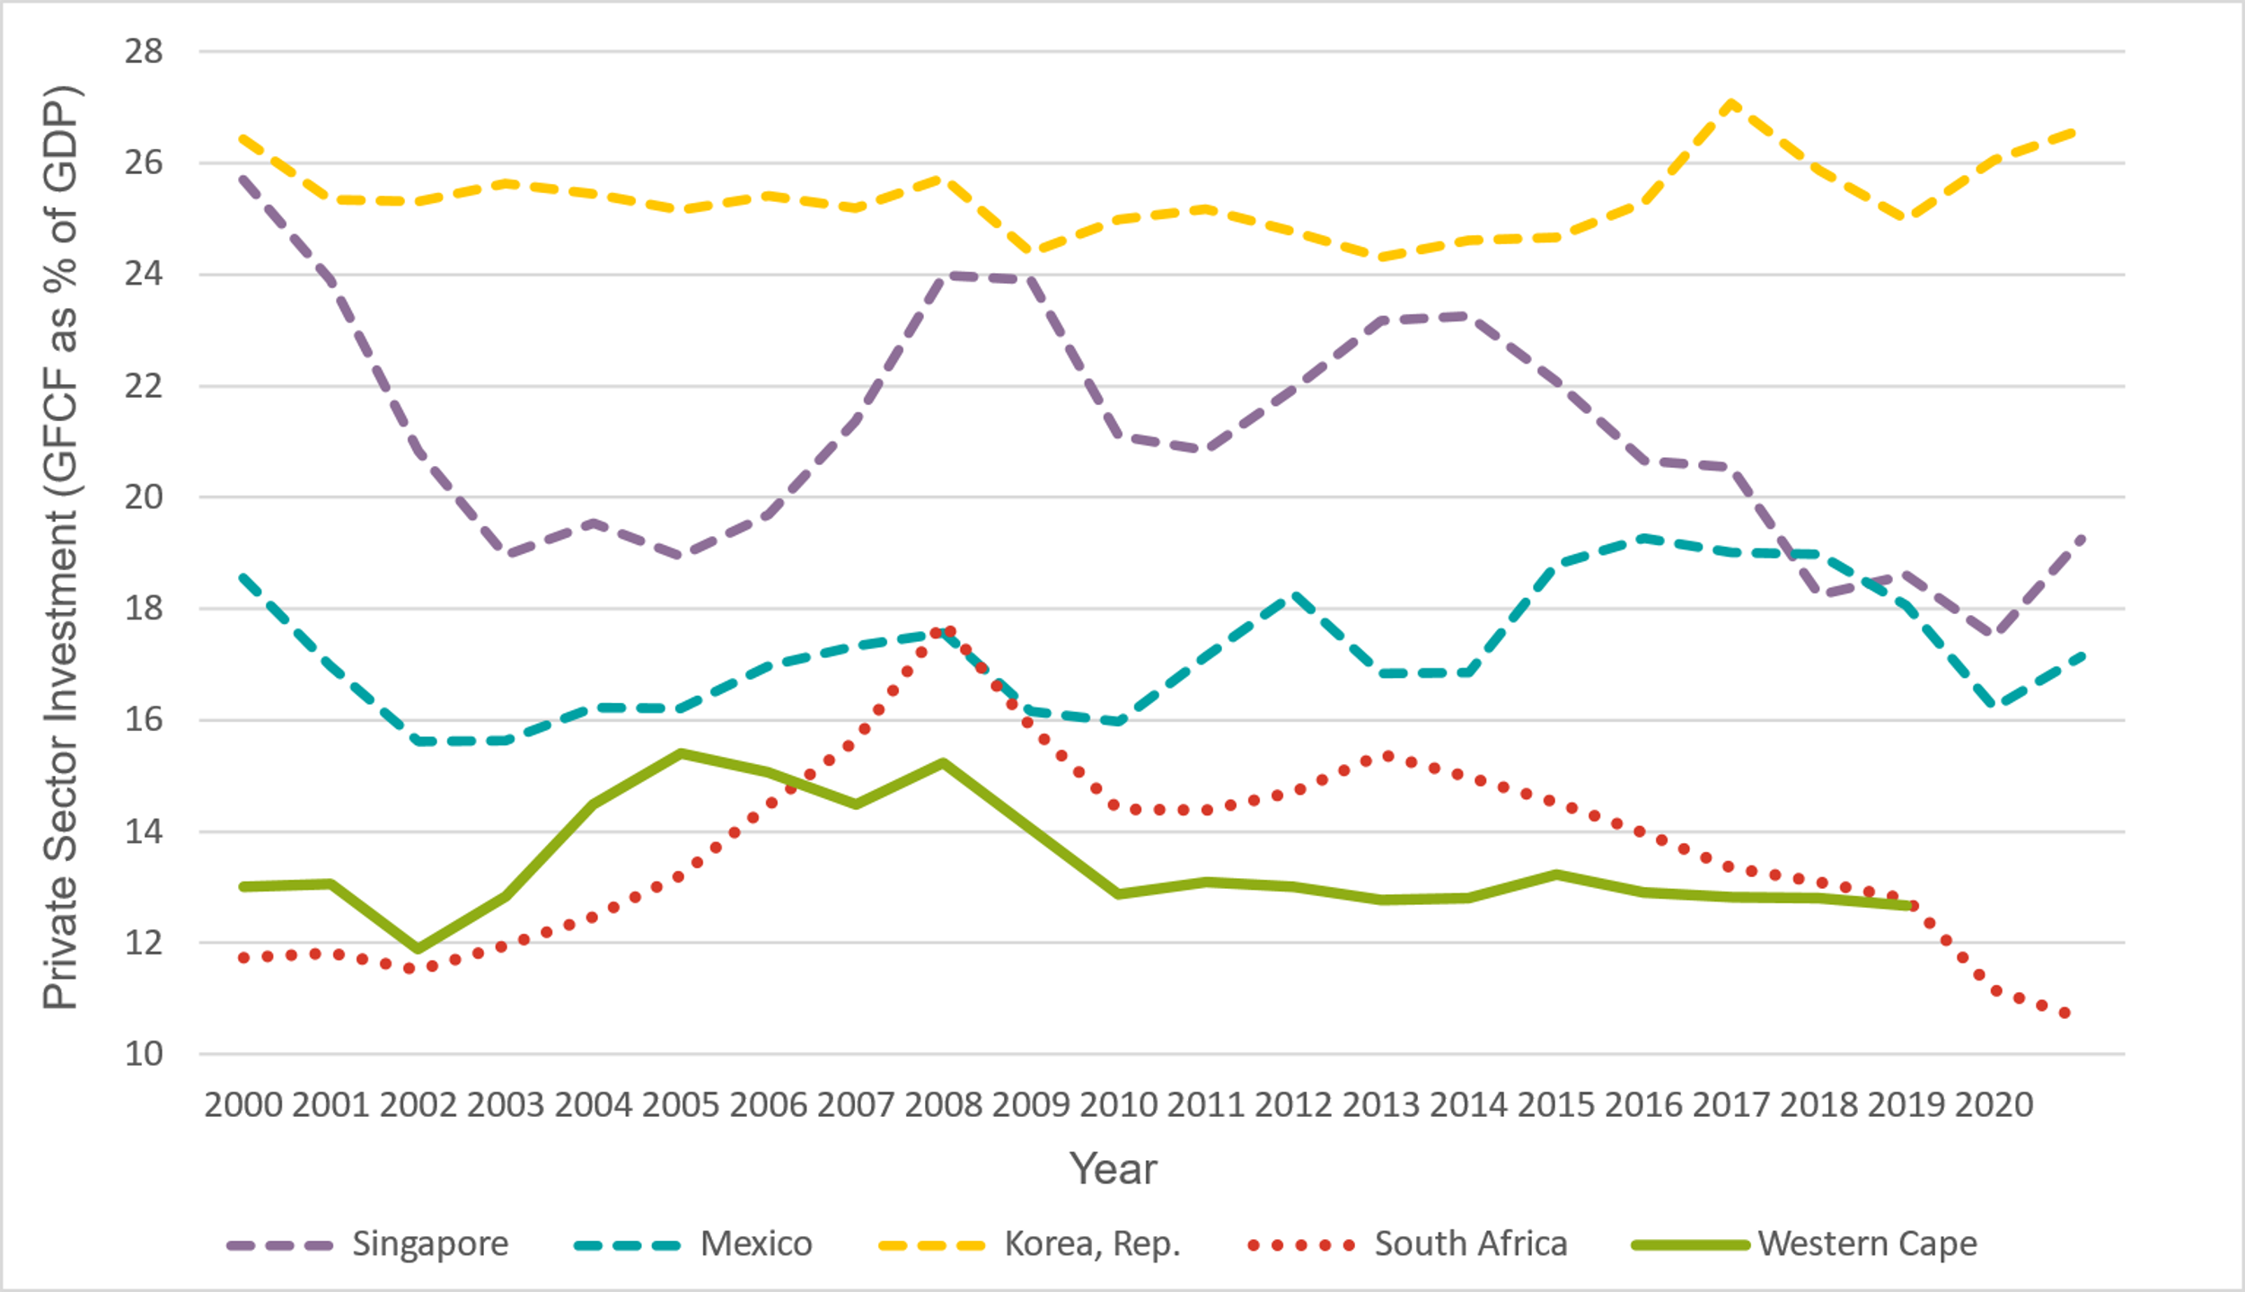
Driving Growth Opportunities through Investment
Goal
Why it matters
Private-sector investment will be 20% of regional GDP (translating to R200-billion) by 2035.
The accumulation of fixed capital raises productivity capacity, increases productivity, and improves business confidence. It is a critical contributor towards GDP growth.
Private-sector investment (GFCF as a percentage of GDP)
Objective
The Western Cape is the investment destination of choice for local and international investors in a range of growth opportunities, providing an enabled environment and strong networks of ecosystems.
Source: World Bank; SARB / Quantec (Western Cape
Notes:
Goal Statement
Private-sector investment will be 20% of regional GDP (translating to R200-billion) by 2035.
Objective Statement
The Western Cape is the investment destination of choice for local and international investors in a range of growth opportunities, providing an enabled environment and strong networks of ecosystems.
The target refers to overall private sector investment into the Western Cape as the 20% private sector component of GFCF. The specific target for investments directly supported by the Western Cape Government is R100-billion by 2035.
Driving growth through INVESTMENT
Investment expands production capacity and improves competitiveness and productivity, introducing innovations and new technology. The Growth for Jobs Strategy therefore regards investments by foreign, trans-provincial and local businesses to be a fundamental driver of success.
Top foreign direct investment performance
The Western Cape has consistently been rated as one of Africa’s top investment destinations. Over the past two decades, the Western Cape has attracted 434 foreign direct investment (FDI) projects, of which over 90% were greenfield investments. They have injected an estimated R157-billion in capital and resulted in the creation of 31 371 jobs.
Reviving private-sector investment rates in Western Cape
The National Development Plan (NDP) targets 20% private sector investment, as measured by gross fixed capital formation (GFCF) to GDP ratio. The level of private sector investment in the Western Cape, was 13% in 2019. While the Western Cape’s trend appears more stable than the overall South African average, it is markedly lower than benchmark economies.
Private-sector investment (GFCF as a percentage of GDP)
Gross fixed capital formation calculates between 2012 and 2021, total gross fixed capital formation was around R1.3-trillion (adjusted to 2021 prices) while total FDI was R122.3-billion. As Figure 4 shows, the private sector financed 12−15% of fixed investment in the Western Cape. These statistics underscore the important role played by local and domestic investors in achieving provincial growth objectives, although there is significant potential for FDI-oriented interventions to increase overall investment demand in the Western Cape.
Responsive provincial policy
The Western Cape Government must be responsive to evolving growth opportunities available to local, national and offshore investors. In this, the Western Cape Government needs to reinforce its investment attractiveness by addressing barriers and amplifying its strengths and value propositions. This will include leveraging a comprehensive approach that addresses the competitiveness of relevant factors of production, legal, regulatory, procedural, and institutional barriers affecting all phases of the investment lifecycl

Slide 12
Driving Growth Opportunities
Picture of Success
A cohesive investment support ecosystem Cape that attracts a pipeline of investment opportunities
An enabling ease-of-doing-business environment exists for South African and foreign investors
A strong and positive domestic and international brand
Strong partnerships between government and businesses, with high degrees of trust among stakeholders
All necessary information is available and accessible to support sound investment decision-making
A high degree of confidence among investors and businesses in the Western Cape and the Western Cape Government
Investment diversifies the economy, increases inclusion, and facilitates spatial transformation and social cohesion
A robust and wide network of overseas and local advocates and ambassadors
Constraints to investment and specific opportunities are addressed and government assets and levers are used
Energy plans to build energy security unlock investment opportunities and provide assurances to investors.
Environmental, social and governance investors attracted to WC and investors are assisted to improve their ESG portfolio
Notes:
2035 Picture of Success
Domestic and foreign investment that helps diversify the economy, increases inclusion, and facilitates spatial transformation and social cohesion, including investment in labour-intensive industries and townships.
A high degree of confidence among investors and businesses in the Western Cape and the Western Cape Government.
Strong partnerships between government and businesses, with high degrees of trust among stakeholders.
A strong and positive domestic and international brand that builds on existing and unique strengths and capitalises on new growth opportunities.
An enabling ease-of-doing-business environment exists for South African and foreign investors where they can invest with certainty and assurance
Government assets and levers are used to provide competitive investment incentives and support.
A robust and wide network of overseas and local advocates and ambassadors who know the Western Cape value proposition and help to attract investment.
All necessary information is available and accessible to support sound investment decision-making,
Environmental, social and governance (ESG) investors are attracted to the Western Cape and investors are assisted to improve their ESG portfolio.
A cohesive investment support ecosystem in the Western Cape that attracts a pipeline of investment opportunities.

Slide 13
Driving Growth Opportunities through Investment
1
2
3
Smart investment promotion, facilitation and support
Developing an overall Cape brand, as well as sets of brands, for specific ‘foundation’ and emerging industry and place-based opportunities.
Undertaking aggressive programmes to market and promote the growth opportunities
Strengthening the overall investment facilitation ecosystem
Developing a platform to seamlessly link investors with opportunities
Enabling competitive environment
Addressing visa challenges.
Identifying and addressing the top three investor constraints
Developing nuanced packages of support and incentives (especially non-financial) for individual growth opportunities, and simultaneously address the systemic competitiveness issues.
Ensuring that the necessary infrastructure for investment is provided
Radically increasing supply of affordable housing
Increasing policy and regulatory certainty through engaging with all spheres of government
Strong supportive eco-systems of collaboration, intelligence sharing and trust
Supporting growth opportunity ecosystems
Strengthening the investment and opportunity economic IQ
Notes:
Actions towards 2035 success
Smart investment promotion, facilitation and support
Developing an overall Cape Brand inclusive of industry and place-based opportunities
Undertaking aggressive programmes to market and promote growth opportunities
Strengthening the overall investment facilitation ecosystem
Developing platforms to link investors to opportunities
Enabling and competitive environment
Addressing visa challenges and identifying the top three investor constraints
Developing nuanced packages of support and incentives (especially non-financial)
Ensuring that the necessary infrastructure for investment is provided
Radically increasing supply of affordable housing
Increasing policy and regulatory certainty
Strong and supportive ecosystems of collaboration, intelligence sharing and trust
Supporting growth opportunity ecosystems
Strengthening the investment and opportunity economic intelligence

Slide 14
Priority Focus Area 2: Stimulating Market Growth through Exports and Domestic Markets

Slide 15
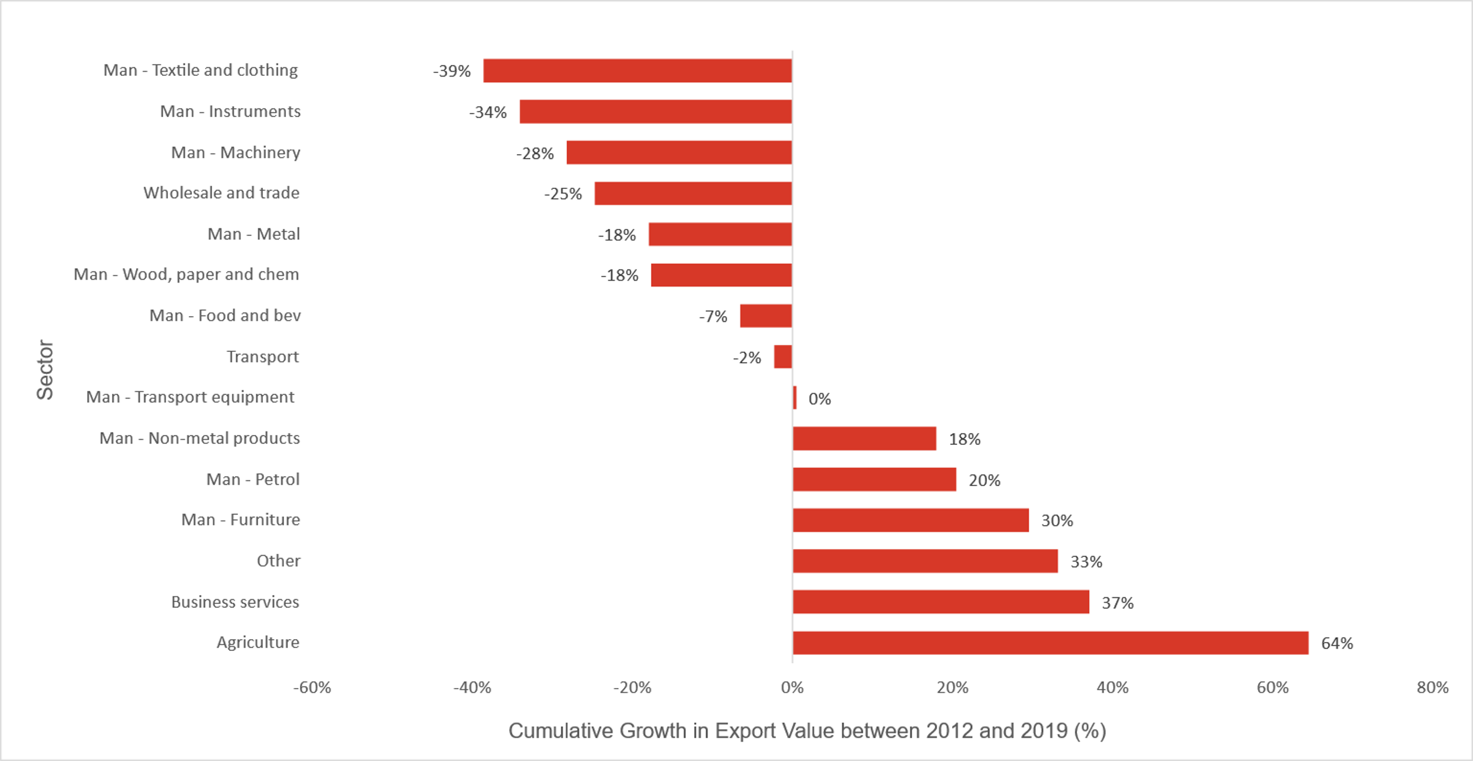
Stimulating Market Growth through Exports and Domestic Markets
Goal
Why it matters
The value of Western Cape exports of goods and services (inclusive of tourism) will triple by 2035.
Exporting allows a country to diversify its production across new products and additional markets, achieve economies of scale and therefore improve productivity and competitiveness, raising overall trade and protecting the country from potential shocks.
Export performance by sector, cumulative growth in export value (2012–2019)
Objective
The Western Cape, with a strong domestic market capability, is a leading global export region in a diversified basket of goods and services and a sought-after tourism destination known for its quality, reliability and cost-effective goods and service offerings.
Source: World Bank,^{[1]} Quantec^{[2]}
Notes:
Building EXPORTS and DOMESTIC MARKETS
Goal Statement
The value of Western Cape exports of goods and services (inclusive of tourism) will triple by 2035.
Objective Statement
The Western Cape, with a strong domestic market capability, is a leading global export region in a diversified basket of goods and services and a sought-after tourism destination known for its quality, reliability and cost-effective goods and service offerings
Exports of products, services and international tourism, which are enabled to access global markets, are key for break-out economic growth. Exports allow producers to diversify their customer base and increase sales, making economies of scale possible, which collectively help raise productivity. The domestic market nonetheless remains crucial. High domestic consumption offers prospects for additional growth, resilience and job creation, particularly if local suppliers are able to out-compete importers.
Break-out exports from the Western Cape
Between 2000 and 2021, provincial exports grew by 146% in real terms, compared to 35% for South Africa’s exports.
The Western Cape can capitalise on its brand as the leading location for domestic tourism, tech start-ups, asset management, retail headquarters, cultural and creative industries and, to a lesser extent, for banking and insurance. Enhancing the competitiveness of service-based exports may require different enablers, including strengthened skills capabilities and access to cost-effective high-speed broadband.
Outstanding tourism performance
The Western Cape has exhibited sustained tourism growth with overall international visitor arrivals to the Western Cape have tracked and exceeded comparable countries.
In 2019, two million international visitors came to the province, spending R18.6-billion. In addition, the thriving domestic tourism market adds to the region’s resilience, smoothing seasonally induced fluctuations.
Given the relatively small size of the domestic market, the Western Cape’s future economic growth and development rests largely on the province’s ability to expand its existing exports and diversify its export base.

Slide 16
Stimulating Market Growth through Exports and Domestic Markets
The Western Cape has an engaging brand, positive sentiment, a good reputation and strong sector brands and capabilities through which the province is seen as a desirable source of quality, reliable and cost-effective goods and services
Improved market access, lower trade barriers, and Western Cape interests are accommodated in national trade policies, agreements and incentives
Strong networks and support in targeted countries, including Africa, drive new exports and opportunities
Picture of Success
Vibrant and broad exporter ecosystems share intelligence and contacts and collectively address problems and opportunities
Exporters have the necessary knowledge, capabilities, skills and support tools to export successfully
Infrastructure and the enabling environment in the Western Cape are competitive, efficient, cost-effective and sustainable
Diversification of Western Cape exports and services allows for a wider range of specialisation and scaling of goods and services that input into a range of vertical sectors
Notes:
2035 Picture of Success
Infrastructure and the enabling environment in the Western Cape are competitive, efficient, cost-effective and sustainable.
Improved market access, lower trade barriers, and Western Cape interests are accommodated in national trade policies, agreements and incentives.
Exporters have the necessary knowledge, capabilities, skills and support tools to export successfully.
Vibrant and broad exporter ecosystems share intelligence and contacts and collectively address problems and opportunities.
The Western Cape has an engaging brand, positive sentiment, a good reputation and strong sector brands and capabilities through which the province is seen as a desirable source of quality, reliable and cost-effective goods and services.
Strong networks and support in targeted countries, including Africa, drive new exports and opportunities.
Diversification of Western Cape exports and services allows for a wider range of specialisation and scaling of goods and services that input into a range of vertical sectors.

Slide 17
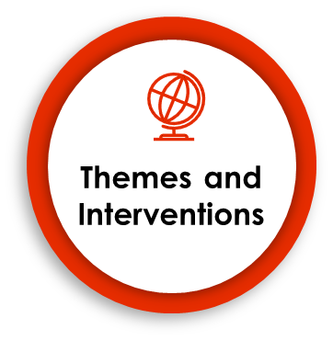
Stimulating Market Growth through Exports and Domestic Markets
1
2
3
Unlocking an enabling and competitive export environment
Improving freight logistics.
Expanding the Air Access Initiative.
Enhancing supportive compliance infrastructure and regulations.
Strengthen and diversify the Western Cape export base
Producing and using economic IQ.
Coordinating and leveraging the activities of other provincial departments.
Enhancing and developing exporter ecosystems.
Developing and implementing export strategies and plans.
Strengthening the export capabilities in identified industries.
Drive market access
Developing and implementing country plans.
Creating an enabling and facilitating environment in target countries.
Identifying and pursuing export opportunities in Africa.
Strengthening intergovernmental coordination and advocacy.
Establishing and promoting a Western Cape brand.
Using technology for enhanced matchmaking.
Leveraging cross-selling opportunities.
Notes:
Actions towards 2035 success
1. Unlocking an enabling and competitive export environment
Improving freight logistics
Expanding Air Access
Enhancing supportive compliance infrastructure and regulations
2. Strengthen and diversify the Western Cape export base
Producing and using economic intelligence
Enhancing and developing exporter ecosystems
Developing and implementing export strategies and plans
Strengthening export capabilities in identified industries
Coordinating and leveraging the activities of other provincial departments
3. Drive market access
Establishing and promoting a Western Cape brand
Developing and implementing country marketing plans
Creating an enabling and facilitating environment in target countries
Identifying and pursuing export opportunities in Africa
Strengthening intergovernmental coordination and advocacy
Using technology for enhanced matchmaking
Leveraging cross-selling opportunities

Slide 18
Priority Focus Area 3: Energy Resilience and Transition to Net Zero Carbon

Slide 19
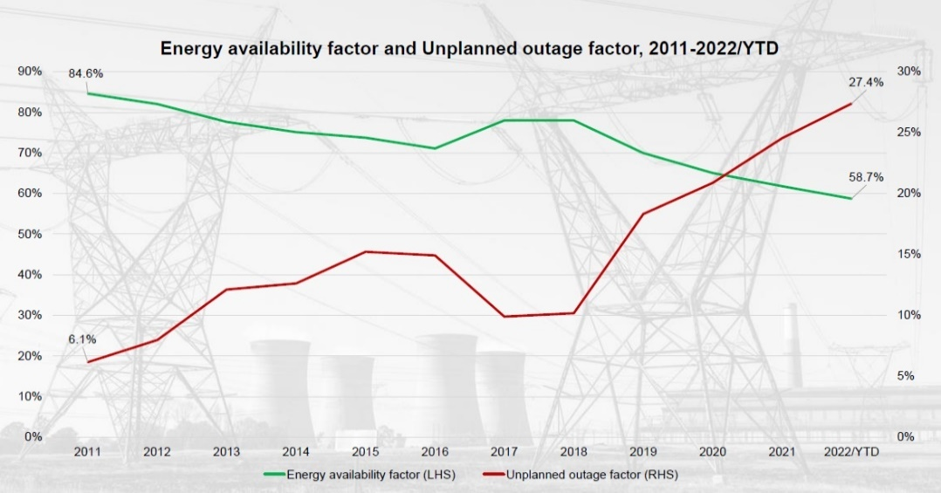
Energy Resilience and Transition to Net Zero Carbon
Goal
Why it matters
Reduce reliance of energy from Eskom of between 1 800 – 5 700 MW by 2035, estimated to attract between R21.6-billion and R68.4-billion in related investment.
Energy security continues to remain the major constraint on growth – Load-shedding established to have reduced real GDP growth by 3% in 2021, resulting in 350000 job losses (CSIR and PWC) .
Energy availability factor and Renewable energy procurement Unplanned outages, 2011 – 2022 Year-To-Date
Objective
Energy is low carbon, reliable, competitive, accessible, enabled supplied at scale, and meets the energy-efficient demands of the economy, using data, analytical tools and new models of delivery and contributing towards net zero carbon targets.
CO2/cap 3rd
CO2/GDP 7th
CO2 total 13th
South Africa’s Global Rankings
Notes:
ENERGY RESILIENCE
… and transitioning towards net zero carbon
Goal Statement
Reduce reliance of energy from Eskom of between 1 800 – 5700 MW by 2035, estimated to attract between R21.6-billion and R68.4-billion in related investment
Objective Statement
Energy is low carbon, reliable, competitive, accessible, enabled and supplied at scale, and meets the energy-efficient demands of the economy, using data, analytical tools and new models of delivery and contributing towards net zero carbon targets
Electricity is currently the number one binding constraint to economic growth and job creation, caused by the 6 GW shortfall in electricity production. Over and above this, South Africa is one of the world’s most carbon-intensive economies, with dire implications for the climate, the environment and the economy. The key energy thrusts that the Growth for Jobs Strategy seeks to address are:
ensuring the availability of affordable, reliable electricity supply
creating an enabling environment for the transition from fossil fuels to renewable sources of energy
leveraging the energy transition as a source of competitive advantage for the Western Cape’s economy
National electricity crisis
The South African economy is 8−10% smaller as a direct consequence of load-shedding. Accessing alternative sources of reliable energy is an economic imperative, as Eskom’s performance is unlikely to improve for the remainder of the decade. The Energy Availability Factor (EAF) will continue to decline primarily due to plant breakdowns and the decommissioning of Eskom coal plants by 2035.
Western Cape has tremendous renewable-energy generation potential
South Africa has extremely good conditions for both wind and solar energy, with South Africa’s Renewable Energy Independent Power Producer (REIPP) already attracting over R200-billion in private-sector investment.
The Western Cape, with its sound infrastructural base and conducive climate, has been the largest provincial beneficiary of FDI in renewable energy projects. Despite rapid growth and the potential to create 1.2 million jobs., renewable energy still represents a small share of the total amount of energy produced in South Africa.
Share of electricity production from renewable sources
The growing dominance of carbon border adjustment (CBA) mechanisms will increase the price of imports from carbon-intensive nations such as South Africa. The impacts of climate change demand a response and the Western Cape Government has committed to net zero greenhouse gas (GHG) emissions by the year 2050.
There is no simple solution to the energy crisis in South Africa. A total overhaul of the power sector, including increasing diversification and decentralisation of the energy supply is required

Slide 20
Energy Resilience and Transition to Net Zero Carbon
The Western Cape has a clear energy plan that provides certainty and assurance to the private sector
The province has a strong and well-informed energy ecosystem with international linkages to low carbon export products and services
The Western Cape has enabled the generation, procurement and trading of low-carbon energy by municipalities, the private sector and households
Picture
of Success
The Western Cape has a localised energy network, with supporting grid infrastructure
The province has a strong and well-informed energy ecosystem with international linkages to low carbon export products and services
Abundant, reliable, low-carbon energy is available to meet the needs of the growing Western Cape economy
Businesses, citizens and government have adopted world-class energy-efficient production processes and operations and reduced the carbon intensity of their energy consumption
Notes:
2035 Picture of Success
The Western Cape has a clear energy plan that provides certainty and assurance to the private sector.
The Western Cape has enabled the generation, procurement and trading of low-carbon energy by municipalities, the private sector and households.
The Western Cape has a localised energy network, with supporting grid infrastructure.
Abundant, reliable, low-carbon energy is available to meet the needs of the growing Western Cape economy.
Businesses, citizens and government have adopted world-class energy-efficient production processes and operations and reduced the carbon intensity of their energy consumption.
The province has a strong and well-informed energy ecosystem with international linkages to low carbon export products and services.
The Western Cape has an export-ready green hydrogen hub in Saldanha Bay complimented by renewable energy value-chain manufacturing in Atlantis.

Slide 21
Energy Resilience themes and interventions
1
4
5
Disaster mitigation and management
Strengthening and coordinating the disaster mitigation and management system
Generation, procurement and trading
of low-carbon energy
Streamlining processes for SSEG registration and creating an enabling & cost-effective wheeling framework
Testing of individual municipal IPP procurement projects while working on establishing and operationalising an energy trading system/pooled buying mechanism
Making government land available for utility-scale energy generation and energy storage
Developing a digital platform for sharing energy data and enabling transactions
Considering the adoption of natural gas alternatives
Providing alternative energy support for SMMEs
Implementing renewable energy solutions in municipalities
Implementing a programme for Solar PV in schools and WCG buildings / facilities
Maintenance and expansion of
required energy infrastructure
Mapping out infrastructure requirements, including scaled penetration of renewable energies
Protecting energy infrastructure from vandalism and theft.
Planning and implementing the required upgraded transmission and distribution infrastructure.
2
Energy efficiency at scale
(demand management)
Conducting provincial energy efficiency surveys.
Developing a provincial energy efficiency programme
6
Increased investment in the energy sector
Developing a Western Cape Just Energy Transition (JET) Investment Plan
Establish a project preparation facility to take identified projects to bankability.
Planning and forming partnerships to enable green hydrogen production at scale
Planning for electric vehicles
Working with liquid fuels companies to encourage biofuel blending
Encouraging local production of key renewable energy components and/or systems
3
Strategic development and management
Developing a Western Cape Integrated Resource Plan
Developing strong partnerships and a strengthened ecosystem with energy stakeholders, including economic IQ capabilities
Notes:
Actions towards 2035 success
1. Disaster mitigation and management (load-shedding impact reduction)
Strengthening and co-ordinating the disaster mitigation and management system
2. Energy efficiency at scale (demand management)
Conducting provincial energy efficiency surveys and developing energy efficiency programmes
3. Generation, procurement, and trading of low carbon energy
Streamlining processes for SSEG and wheeling, potentially creating a virtual power station
Testing of individual municipal IPP procurement projects and implementing renewable energy solutions in municipalities
Making government land available for energy generation
Considering the adoption of natural gas alternatives
Providing alternative energy support for SMMEs
Implementing a programme for Solar PV in schools and Western Cape Government buildings/facilities
Stimulating the green energy market by developing a digital platform
4. Increased investment in the energy sector
Developing a Western Cape Just Energy Transition (JET) Investment Plan
Establishing a project preparation facility to take identified projects to bankability
Planning and forming partnerships to enable green hydrogen production
Planning for an enabling environment for electric vehicles
Working with liquid fuels companies to encourage biofuel blending
Encouraging local production of key renewable energy components
5. Increased investment in the energy sector
Developing a Western Cape Integrated Resource Plan
Developing strong partnerships and a strengthened ecosystem and resourcing economic intelligence capabilities

Slide 22
Priority Focus Area 4: Water Security and Resilience

Slide 23
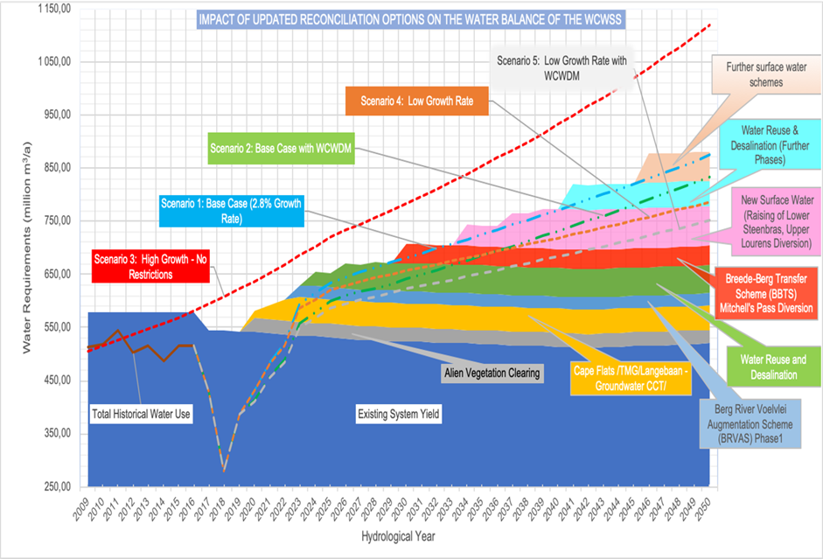
Water Security and Resilience
Goal
Why it matters
Addressing water security will give investors confidence – in water availability and in government
Double the amount of water available for secondary and tertiary economic sectors (primarily from non-productive use) by 2035 and honour existing allocations to agriculture.
Objective
The province will have optimised and increased its water supply, integrated the management of water resources, and enhanced the adaptive capacity of business and citizens with respect to water usage to improve resilience, competitiveness, and quality of life for all its people, so that it has a sufficient water supply to achieve its economic growth aspirations.
Notes:
Goal Statement
Double the amount of water available for secondary and tertiary economic sectors (primarily from non-productive use) by 2035 and honour existing allocations to agriculture.
Objective Statement
The province will have optimised and increased water supply, integrated the management of water resources, and enhanced the adaptive capacity of business and citizens with respect to water usage to improve resilience, competitiveness, and quality of life for all its people, so that it has sufficient water supply to achieve its economic growth aspirations.
As populations and economies grow, the need for water increases. Indeed, given the importance of water to all production processes. Constraints in water provision translate directly into slower economic growth and reduced economic opportunities. The Western Cape’s experience with severe drought illustrated the impact that poor water security has on citizens and the economy. The key challenges facing the province are the distribution, management, and availability of water, with climate change deepening these challenges.
Changing our relationship with water
Despite being among the top 30 most water-stressed countries in the world (ranked 29), South Africa consumes about 233 litres per person/day compared to the international benchmark of 180 litres per person/day.
Although the Western Cape has limited control over its global impacts, climate change can serve as a driver for proactive investment in climate adaptation. If the Western Cape were to become a national leader in water and climate resilience, by 2040, the province’s economy would grow by up to 15%, with a commensurate 12.4% increase in jobs and the overall cost of living would decrease..
The Western Cape Water Supply System (WCWSS) consists of six dams, pump stations, pipelines, and tunnels. The WCWSS water demand modelling undertaken by the DWS indicates five demand growth scenarios and the committed supply interventions. (See scenarios below).
The provincial Economic Water Resilience Strategic Framework maps out the various steps to support business in reducing overall water consumption and use, through audits, targets and risks, water efficiency interventions, onsite re-use of water and alternative water supply. Guided by the strategic framework, the 2021
Western Cape Water Resilience Plan, which comprises a set of inter-disciplinary and comprehensive reports, provides the most recent situation analysis and guides all economic water resilience interventions.

Slide 24
Water Security and Resilience
Economic water security and resilience are secured and give businesses confidence
Western Cape industries are efficient and waterwise with reliable, de-risked local supply chains
Western Cape companies and sectors uphold best practice water efficiency benchmarks
Water assurances mean that the Western Cape can expand and diversify sectors, such as agriculture, agri-processing and light manufacturing industries
Picture
of Success
People have ready access to clean, potable water resulting in improved productivity and quality of life
Investment in ecological infrastructure enables water release for productive use
The Western Cape has a thriving water technology sector with demonstrable proof of success and the potential to export innovative water solutions to other countries
The Western Cape develops and implements best practice, sustainable, innovative municipal business models with respect to water and water management
Investment is provided to meet future water demand, as well as for water efficiency, conservation, and environmental infrastructure
Notes:
2035 Picture of Success
Economic water security and resilience are secured and give businesses confidence.
Western Cape industries are efficient and waterwise with reliable, de-risked local supply chains.
Western Cape companies and sectors uphold best practice water efficiency benchmarks.
Water assurances mean that the Western Cape can expand and diversify sectors, such as agriculture, agri-processing and light manufacturing industries.
People have ready access to clean, potable water resulting in improved productivity and quality of life.
Investment in ecological infrastructure enables water release for productive use.
The Western Cape has a thriving water technology sector with demonstrable proof of success and the potential to export innovative water solutions to other countries.
The Western Cape develops and implements best practice, sustainable, innovative municipal business models with respect to water and water management.
Investment is provided to meet future water demand, as well as for water efficiency, conservation, and environmental infrastructure.

Slide 25
Water Security and Resilience themes and interventions
1
2
Supply side management
Conducting a study of the water supply value chain
Optimising water supply at source
Reviewing and revising municipal water bylaws
Monitoring groundwater quality and abstraction levels, to ensure adequate aquifer recharge.
Infrastructure Maintenance
Expanding ‘smart’ water systems for monitoring of water usage and data collection
Improving supply-chain management processes
Prioritising the maintenance of the waterways and canals
3
Demand side management
Collecting accurate, real-time data and intelligence on water usage
Developing, resourcing, and implementing a sustained provincial economic water resilience programme
Targeting industrial areas to implement water re-use strategies.
Developing a behavioural change programme to foster a culture of valuing and conserving water
Identifying and addressing regulatory challenges that impede water system efficiencies
Incorporating water sensitive design into urban development
5
4
Alternative water costing models for municipalities
De-coupling water service charges from sanitation charges to encourage grey water reticulation.
Innovating around a shift in the municipal revenue model
Exploring risk-sharing and co-financing arrangements with innovative funding models and revenue systems.
Coordinated water infrastructure oversight and investment
Undertaking appropriate and coordinated water governance planning (including forecasting)
Collaborating on water infrastructure investment
Providing clear policies to businesses with respect to decentralised systems
Funding regional water innovation hubs
Notes:
Actions towards 2035 success
1. Supply-side management
Conducting a study of the water supply value chain
Optimising water supply at source
Reviewing and revising municipal water bylaws
Monitoring groundwater quality
2. Infrastructure maintenance
Expanding ‘smart’ water systems
Developing a provincial energy efficiency programme
Improving supply-chain management processes
Prioritising the maintenance of the waterways and canals
3. Demand-side management
Collecting accurate, real-time data and intelligence
Developing, resourcing, and implementing a sustained provincial economic water resilience programme
Targeting industrial areas
Developing a behavioural change programme
Identifying and addressing regulatory challenges
Incorporating water sensitive design
4. Coordinated water infrastructure oversight and investment
Undertaking appropriate and coordinated water governance planning
Collaborating and coordinating with respect to water infrastructure investment
Providing clear policies to businesses
Funding regional water innovation hubs
5. Alternative water costing models for municipalities
De-coupling water service charges from sanitation charges
Innovating around a shift in the municipal revenue model
Exploring risk-sharing and co-financing arrangements

Slide 26
Priority Focus Area 5: Technology and Innovation

Slide 27
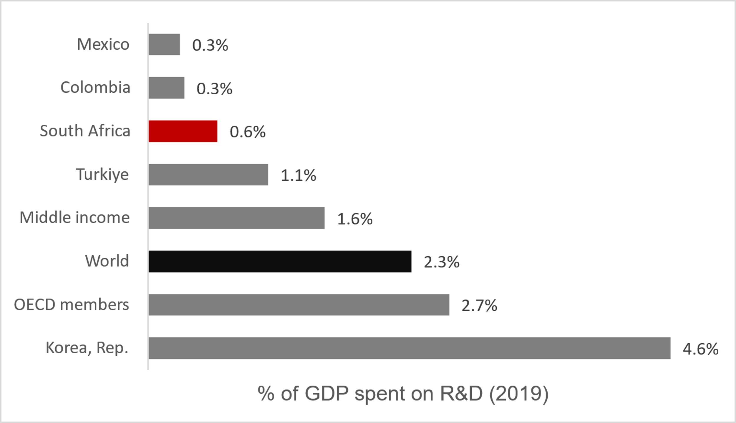
Technology and Innovation
Goal
Why it matters
Technological innovation is responsible for 85% of growth (OECD, 2004) and it is a key driver of increased Total Factor Productivity growth and thereby long-term economic growth.
By 2035, research and development expenditure will increase by 300% in real terms, reaching R35-billion and venture capital deals will total R20-billion.
Share of GDP spent on R&D (2019)
Objective
The Western Cape is the tech, start-up and venture capital and innovation and design capital of Africa, through robust business, government and community innovation (supported by academia), with strong technology ecosystems and centres of excellence in a range of industries and opportunities, with a supportive enabling environment and where the adoption of appropriate technology and accessible innovation leads to an improvement in the Global Innovation Index and the productivity and competitiveness of the regional economy.
Notes:
Partnering for TECHNOLOGY AND INNOVATION
Goal Statement
By 2035, research and development expenditure will increase by 300% in real terms, reaching R35-billion and venture capital deals will total R20-billion
Objective Statement
The Western Cape is the tech, start-up and venture capital and innovation and design capital of Africa, through robust business, government and community innovation (supported by academia), with strong technology ecosystems and centres of excellence in a range of industries and opportunities, with a supportive enabling environment, and where the adoption of appropriate technology and accessible innovation leads to an improvement in the Global Innovation Index and the productivity and competitiveness of the regional economy.
Changes in technology are the only source of permanent increases in productivity, while R&D investment causes 50% of output growth and 75% of productivity growth.
Technologically and innovatively driven firms drive economy-wide productivity gains through resource efficiency. Innovative firms use cooperation with higher education institutions to commercialise R&D and spur new economic activity. The strength and depth of these processes are crucial for a region’s competitiveness.
South Africa needs expand innovation and Research and Development
The gulf between the country’s R&D targets and its performance is stark and widening, with expenditure just 62% of the targeted 1.1% of GDP. If the target of 1.1% of GDP is met, this could translate into R54-billion growth by 2024. Furthermore, the private sector should ideally contribute over 50% of gross expenditure on R&D but only contributed 31% in 2019. At the same time, the Western Cape has growing tech and start-up enterprises that can be further expanded with a greater focus on enabling R&D.
“…in 2019, the gross tertiary enrolment rate was 53.8% in China, 55.1% in Brazil, 42.8% in Mexico but just 23.9% in South Africa”.
Higher education institutions are key actors in the regional innovation system. Knowledge can be transferred to local businesses, or start-ups can be created. Despite being home to world-class innovations, in 2020, the country had 25 patent applications per million population, compared to the average of 641 for upper middle-income countries. South Africa has the potential and talent for further ground-breaking R&D that can be commercialised, but this needs to be unlocked by additional and more synchronised investment.
Firms need to adopt technology and innovation
In 2020, 70% of South African firms in manufacturing and services used email for conducting business, while only 36% of firms had websites. The implication is that South African businesses are not fully utilising the productivity and competitiveness improvements offered by technology.
The Western Cape must embrace the opportunities as Africa’s innovation and tech hub
The overall value of the digital economy ranges between 4.5% and 22.5% of global GDP, depending on which definitions and measures are used. According to the definition used by the World Bank, the size of the global digital economy is expected to be the fastest-growing component of most economies.. In 2020, South Africa’s ‘internet economy’ was valued at $21.55-billion, or about 6.51% of GDP, and is expected to grow to more than $125-billion, or 12.92% of GDP by 2050.
The Western Cape is South Africa’s key node of this growth, being the home to 39 tech ecosystem accelerators. These high performing hubs has attracted the highest number of venture capital firms in Africa and, in 2020, a total of $88-million was invested into tech start-ups in Cape Town.
Innovation can be understood as “the multi-stage process whereby organisations transform ideas into new/improved products, service or processes, in order to compete and differentiate themselves successfully in their marketplace”. Technology, inclusive of digital technology, is the creation, usage and knowledge of tools, techniques, crafts, systems or methods to solve a problem or serve a purpose or end. Innovation and technology are therefore not synonymous but are inter-related in that technology is often a driver and enabler of the proliferation and evolution of innovation.

Slide 28
Technology and Innovation
A digitally transformed and enabled Western Cape that creates jobs and economic value through establishing and developing digital businesses (from start-ups to corporates) and improved public sector efficiency
A strengthened technology and innovation ecosystem that significantly contributes to a strong virtuous cycle of growth
The right technology skills available in the right place at the right time, coupled with the appropriate digital and hybrid infrastructure, enable enterprises
The emergence of a wide range of research-based innovation results in an extensive, diverse pipeline of commercialised opportunities attracting a strong venture-capital base.
Picture of Success
Government becomes a catalyst for innovations in the province, helping to drive uptake through its embrace of innovative private-sector solutions to service delivery.
Networks of local innovation hubs, ecosystems and centres of excellence have international standing and reputations, and attract foreign talent and financing
The private sector has an energised culture of R&D, innovation and technology adaptation, supported by an enabling environment.
Citizens have positive feedback options to government through innovation/digital mechanisms, creating a positive experience for the citizen and providing immediate feedback to government on the effectiveness of its service delivery.
Notes:
2035 Picture of Success
A digitally transformed and enabled Western Cape that establishes and develops digital businesses (from start-ups to corporates).
A strengthened technology and innovation ecosystem that significantly contributes to a strong virtuous cycle of growth.
The right technology skills which are available in the right place at the right time, coupled with the appropriate digital and hybrid infrastructure, enable enterprises to invest and locate their technology and commercial businesses.
The sustained emergence of a wide range of research-based innovation results in an extensive, diverse pipeline of commercialised opportunities that attracts a strong venture capital base.
Government becomes a catalyst for innovations in the province, helping to drive uptake through its embrace of innovative private-sector solutions to service delivery.
Networks of local innovation hubs, ecosystems and centres of excellence have international standing and reputations and attract foreign talent and financing.
The private sector has an energised culture of R&D, innovation and technology adaptation, supported by an enabling environment.
Citizens have positive feedback options to government through innovation/digital mechanisms, creating

Slide 29
Technology and Innovation themes and interventions
1
4
Strengthen ease of doing business and promote eco-systems of technology and innovation
Addressing regulatory and legal reform
Building and supporting networks in the technology and innovation ecosystems
Establishing a sandbox for emerging technologies and innovation
Investigating the establishment of a challenge fund to stimulate collaboration in R&D and innovation
Strengthening the catalytic role of universities in the economy
Developing a single, comprehensive entrepreneurial/innovation portal that addresses the market need
Supporting human capital development
Introducing practical postgraduate ICT and tech conversion programmes
Strengthening the digital skills foundation at school level
Using the Western Cape assets for digital education, skills development and for accessing the digital economy
Assisting the WCED to adapt the education system, to increase the focus on innovation and creativity
Targeting specialist skills programmes for sector-specific skills-sets and developing capabilities in key growth sectors.
Building and strengthening public service innovation capabilities
Themes & interventions
2
3
Stimulating growth of and demand of innovation and technology start-ups and scale ups
Positioning and marketing the Western Cape as Africa’s hub of venture capital, digital, tech, innovation and start-ups.
Promoting the uptake of technology and innovation within the private sector.
Driving the Western Cape Government to be more outward-facing with respect to innovation
Establishing a regulatory sandbox for government
Establish the Western Cape as a venture capital hub for start-ups and scale ups
Improving ease of doing business with respect to funding and venture capital accessibility
Investigating how incentives or creating a physical hub can attract investment in digital, technology and innovation start-ups.
Facilitating the growth of venture capital funds
Providing support particularly for growth-orientated business to access and maximise national incentive programmes with respect to R&D and innovation.
Notes:
Actions towards 2035 success
1. Strengthen ease of doing business and promote ecosystems of technology and innovation
Addressing regulatory and legal reform
Building and supporting networks in the technology and innovation ecosystems
Establishing a sandbox for emerging technologies and innovation
Investigating the establishment of a challenge fund
Strengthening the catalytic role of universities and support for research chairs at universities
Developing a single, comprehensive entrepreneurial/innovation portal
2. Establish the Western Cape as a venture capital hub for start-ups and scale-ups
Improving ease of doing business, including exchange control and intellectual property
Investigating incentives to attract and support start-ups and growth-orientated business
Facilitating the growth of venture capital funds
Strengthening the finance and funding ecosystem
3. Stimulate growth of and demand for innovation and technology start-ups and scale-ups
Positioning and marketing the Western Cape as Africa’s hub of venture capital, digital, tech, innovation and start-ups
Promoting the uptake of technology and innovation within industries and verticals
Enabling SMMEs to take up technology
Driving the Western Cape Government to be more outward-facing in terms of innovation
4. Supporting human capital development
Introducing practical postgraduate ICT and tech conversion programmes
Strengthening the digital skills foundation at school level and adapting the education system
Economic growth requires economic infrastructure, which supports productive activities and social infrastructure, which enables the functionality of communities. While all infrastructure is prioritised, particular attention is needed on infrastructure for connectivity, which includes both the movement of goods and people and digital connectivity.

Slide 30
Priority Focus Area 6: Infrastructure and Connected Economy (mobility, logistics, broadband and digital transformation)

Slide 31
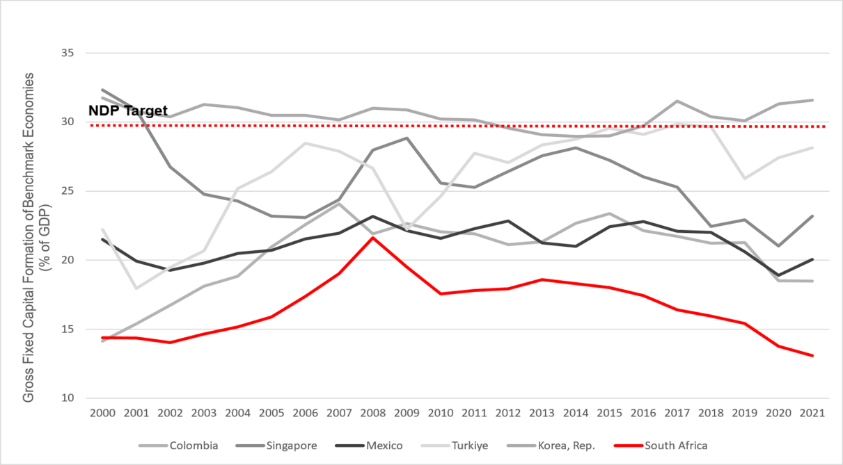
Infrastructure and Connected Economy
Goal
Why it matters
The Western Cape economy will have the infrastructure required to support and enable a R1 trillion economy by 2035 and public sector capital investment in the Western Cape will be 10% of regional GDP.
Well-developed infrastructure is key requirement for a competitive economy bringing multiple benefits and avoids costs and 1% increase in infrastructure quality increases competitiveness by 0,64%
Objective
GFCF comparison with NDP target and other countries
To coordinate, prioritise, plan and implement the timeous delivery of relevant and smart infrastructural solutions (physical, digital and hybrid) to support break-out economic growth and a connected economy, providing flexible, resilient infrastructure that intelligently connects spaces, places, and people, transforms lives and delivers sustainable value to the economy and ecology of the Western Cape.
Notes:
Connecting through INFRASTRUCTURE and DIGITALISATION
Goal Statement
By 2035, the Western Cape economy will have the infrastructure required to support and enable a R1-trillion economy and public sector capital investment in the Western Cape will be 10% of regional GDP.
Objective Statement
To coordinate, prioritise, plan, and implement the timeous delivery of relevant and smart infrastructural solutions (physical, digital and hybrid) to support break-out economic growth and a connected economy, providing flexible, resilient infrastructure that intelligently connects spaces, places, and people, transforms lives and delivers sustainable value to the economy of the Western Cape.
Economic infrastructure has deteriorated nationally due to underinvestment
Economic infrastructure – under direct control of national departments and SOEs – represents the most immediate and binding constraint on provincial economic growth prospects.
Public-sector investment needs to enable growth
Public sector infrastructure investment sits at 4.1% of GDP (2022), - against a target of 10%. It is estimated that one-third of infrastructure expenditure is lost as a result of inefficiency due to governance-related challenges. State Owneed Entities have struggled to allocate and deliver infrastructure efficiently and effectively, undermining the country’s macroeconomic stability. Municipalities have also continuously underspent on conditional grants and increasingly, have not collected sufficient revenue to finance capital infrastructure. The impact of the expenditure decline and inefficiencies is reflected in the 2022 SAICE Report, where South Africa’s public infrastructure received a ‘D’, signifying that overall it is at risk of failure, although the grades vary across sectors.
Provincial infrastructure landscape
Western Cape Government is directly responsible for about one-third of the overall capital budget, with the City of Cape Town’s capital budget contributing 40% towards the total spend. The remaining budget is split between the tertiary education sector and other municipalities.
Infrastructure needs to enable economic growth
The Growth for Jobs Strategy will shape the Western Cape Infrastructure Plan 2050 (WCIP 2050), which will complement the City of Cape Town’s Infrastructure Delivery Plan as well as plans of other municipalities. The Plan will include an emphasis, amongst others, on connectivity and the network industries:
Ports: The importance of the port sector to the Western Cape economy cannot be overestimated. Over half (52%) of Western Cape exports (valued at R86-billion) were exported via the port of Cape Town. A high-growth scenario would result in another R6-billion in exports and about 20 000 more direct and indirect jobs at the port by 2026. Port expansion is required in Cape Town and Saldanha in response to local and international markets and as economic catalysts – but equally there are low-hanging fruit such as solving land-side transport bottlenecks to allow the better flow of goods, and better planning and tracking.
Rail network: The Western Cape rail network consists of 4994 km of Transnet and 610 km of Passenger Rail Agency of South Africa (PRASA) railway lines. Vandalism of the rail system has resulted in half the trainsets being lost and approximately 400 000 passengers moving away from using rail services to passenger vehicles, resulting in high traffic volumes and increased fuel use and vehicle emissions. Rail infrastructure has suffered heavily from historical underinvestment, and the rehabilitation and upgrading of existing passenger and freight rail systems is a priority. An end-to-end view of logistics is the opportunity that needs to be grasped.
Airports: Demand-led expansion plans for Cape Town International Airport, which had been deferred in part because of Covid-19, need to be revived in line with the revived increase in cargo and passenger flows.
Digital connectivity. Provincially, access to mobile communication has increased dramatically whereas internet access has been stagnant. .The foundational role of digital transformation means that the benefits of becoming a fully digitally enabled society and economy outweigh the costs.
Three factors that influence the delivery and condition of infrastructure are people and relationships, institutional robustness, and data and information. The Western Cape’s economy depends on effective and efficient transport networks and services for the movement of people and goods, and, these three factors have to be addressed along with the necessary planning and financing.

Slide 32
Infrastructure and Connected Economy
Intelligent, resilient infrastructure solutions contribute to accelerated, break-out economic growth, connecting people, communities, and businesses to opportunities
‘Futureproofed’ infrastructure and total cost of ownership considerations are part of the solution/design approach and ecological, social and governance (ESG) opportunities are utilised to maximise project benefits.
Relevant infrastructure solutions (physical, digital and hybrid) are coordinated, prioritised, innovated and planned for timeous delivery to support the achievement of break-out economic growth and a connected economy
Picture of Success
Officials are enabled to be innovative, supportive and responsive to economic opportunities.
Ease of doing business is embodied in the approach of officials with respect to infrastructure investment for the private sector.
A collaborative ecosystem of infrastructure stakeholders is established and strengthened that identifies infrastructure challenges and opportunities, and works together to ensure that they are addressed timeously, efficiently and cost-effectively. This will be inclusive of collaboratively identifying and championing catalytic infrastructure solutions that will contribute to sustained economic growth and job creation
The transformative power of digital and hybrid infrastructure is harnessed to deliver greater value to inhabitants and the economy whilst simultaneously decreasing cost
Notes:
2035 Picture of Success
Intelligent, resilient infrastructure solutions contribute to accelerated, break-out economic growth, connecting people, communities, and businesses to opportunities.
‘Futureproofed’ infrastructure and total cost of ownership considerations are part of the solution/design approach and ecological, social and governance (ESG) opportunities are utilised to maximise project benefits.
Relevant infrastructure solutions (physical, digital and hybrid) are coordinated, prioritised, innovated and planned for timeous delivery to support the achievement of break-out economic growth and a connected economy.
Officials are enabled to be innovative, supportive and responsive to economic opportunities.
Ease of doing business is embodied in the approach of officials with respect to infrastructure investment for the private sector.
A collaborative ecosystem of infrastructure stakeholders is established and strengthened that identifies infrastructure challenges and opportunities and works together to ensure that they are addressed timeously, efficiently and cost-effectively. This will be inclusive of collaboratively identifying and championing catalytic infrastructure solutions that will contribute to sustained economic growth and job creation.
The transformative power of digital and hybrid infrastructure is harnessed to deliver greater value to inhabitants and the economy whilst simultaneously decreasing cost.

Slide 33
Infrastructure and Connected Economy
Government spending on infrastructure is used as a stimulus to encourage spatial transformation and broader ecosystem investment, benefitting the economy and communities accordingly
The competitiveness of the economy and its associated sectors is improved through targeted infrastructure investment and ease-of-doing-business response for development, identifying and delivering catalytic infrastructure that will contribute to the development of the economy
Current government assets (land, etc.) are identified and used as infrastructure catalysts for economic and/or social change
Picture of Success
New freight corridors (intermodal logistics hubs) are developed that enable goods to move seamlessly and quickly to their destinations with minimal delays, in the process contributing to spatial transformation in the province. A portfolio of ports (sea, air and inland) is developed, serving the economy that have the necessary efficiency, focus and capacity to deliver goods to their destinations quickly and efficiently
Circular infrastructure is advanced, enabling circular economy activity (e.g., re-use, recycle or recover waste), and minimising the amount of material used across the infrastructure lifecycle or value chain
Infrastructure asset management is viewed as an important opportunity to improve the capacity of local and provincial government to systematically manage assets over entire lifecycles and within a broader asset portfolio
Notes:
Government spending on infrastructure is used as a stimulus to encourage spatial transformation and broader ecosystem investment, benefitting the economy and communities accordingly.
The competitiveness of the economy and its associated sectors is improved through targeted infrastructure investment and ease-of-doing-business response for development, identifying and delivering catalytic infrastructure that will contribute to the development of the economy.
Current government assets (land, etc.) are identified and used as infrastructure catalysts for economic and/or social change.
New freight corridors (intermodal logistics hubs) are developed that enable goods to move seamlessly and quickly to their destinations with minimal delays, in the process contributing to spatial transformation in the province. A portfolio of ports (sea, air and inland) is developed, serving the economy that have the necessary efficiency, focus and capacity to deliver goods to their destinations quickly and efficiently.
Circular infrastructure is advanced, enabling circular economy activity (e.g., re-use, recycle or recover waste), and minimising the amount of material used across the infrastructure lifecycle or value chain.
Infrastructure asset management is viewed as an important opportunity to improve the capacity of local and provincial government to systematically manage assets over entire lifecycles and within a broader asset portfolio.

Slide 34
Infrastructure and Connected Economy Themes and Interventions
1
2
3
Coordinated planning
and strengthened ecosystem
Developing a Western Cape infrastructure framework incorporating 50% economic growth of the economy by 2035
Better aligning planning units of economic cluster departments, municipalities and infrastructure implementors, and establishing a provincial multi-sectoral infrastructure planning and coordination committee or commission
Establishing a well-capacitated data management and infrastructure monitoring system and economic intelligence capability (economic IQ)
Strengthening the ecosystems between government and the private sector along and across various infrastructure verticals or themes
Ease-of-doing government
for accelerated delivery and
management of infrastructure
Overcoming PFMA and MFMA constraints and developing bespoke governance and supply-chain management (SCM) models
Developing an AI and predictive analytics enabled technology platform to model the optimal supply and demand for infrastructure
Reviewing infrastructure-related legislation and regulations (including international benchmarking) with the aim of providing evidence-based advocacy for legislative and regulatory change, including a regulatory sandbox
Building the capacity and capability of municipal officials, including systemic solutions
Infrastructure as a catalyst for targeted economic growth opportunities
Identifying private-sector and community-led models for business infrastructure which includes initiating pilot t township initiatives, exploring high street models, & address the lack of tenure and title deeds
Identifying under-utilised WCG buildings and land that can be for targeted growth opportunities.
Strengthening apprenticeships and semi-skills through expanding contracted in-house capacity
Supporting and strengthening approaches to urban planning, design and development
Driving spatial transformation through enabling and fast-tracking housing development for mixed use and mixed income
4
5
Harness the opportunities in digital and hybrid infrastructure
Rolling out the next phase of the Western Cape Government’s broadband programme
Addressing ease-of-doing business with respect to access to way leaves
Accelerating the rollout of Digital Access Centres.
Providing laptops to all Grade 8s in two rural towns as a pilot project
Driving business and citizen uptake through the digitisation of government services and procurement processes
Making government data open and accessible to businesses and academia.
Logistics & mobility
Championing catalytic logistics initiatives that stimulate economic growth, deliver infrastructure solutions and positively impact spatial patterns
Working collaboratively with Transnet and partners to address the current challenges at the Cape Town port/container terminal.
Explore, among others, the introduction of a cashless payment system to be used in taxis and buses to promote productivity
Seeking devolution of the PRASA Metrorail function and the development of PPP concession approaches to public transport development
Introducing new mobility solutions and/or positively impacting spatial patterns
Notes:
Actions towards 2035 success
1. Coordinated planning and strengthened ecosystem
Developing a Western Cape infrastructure framework incorporating 50% economic growth of the economy by 2035
Better aligning provincial multi-sectoral infrastructure planning
Establishing a well-capacitated data management and infrastructure monitoring system and economic intelligence capability
Strengthening the ecosystems between government and the private sector
2. Ease-of-doing government for accelerated delivery and management of infrastructure
Overcoming PFMA and MFMA constraints
Developing an AI and predictive analytics enabled technology platform for demand modelling
Reviewing infrastructure-related legislation and regulations to provide evidence-based advocacy for legislative and regulatory change,
Building the capacity and capability of municipal officials
3. Infrastructure as a catalyst for targeted economic growth opportunities
Driving spatial transformation and economic accessibility and initiating one or two pilot project township initiatives and exploring the development of high street or hybrid models
Addressing the lack of tenure and title deeds
Identifying under-utilised Western Cape Government buildings and land that can be deployed as an accelerator
Strengthening the regional pipeline of apprenticeships and semi-skilled labour
Supporting and strengthening approaches to urban planning, design and development
Driving spatial transformation through enabling and fast-tracking housing development for mixed use and mixed income
4. Harness the opportunities in digital and hybrid infrastructure
Rolling out the next phase of the Western Cape Government’s broadband programme
Addressing ease-of-doing business with respect to access to way leaves
Accelerating the rollout of Digital Access Centres
Providing laptops to all Grade 8s in two rural towns as a pilot
Driving business and citizen uptake through the digitisation of government services and procurement processes
Making government data open and accessible to businesses and academia.
5. Harness the opportunities in digital and hybrid infrastructure
Championing catalytic logistics initiatives
Working collaboratively with Transnet and partners to address the current challenges at the Cape Town port/container terminal
Establishing a task team to explore, among others, the introduction of a cashless payment system to be used in taxis and buses
Seeking devolution of the PRASA Metrorail function
Introducing new mobility solutions and/or positively impacting spatial patterns to reduce time spent commuting

Slide 35
Priority Focus Area 7: Improved Access to Economic Opportunities and Employability (skills and education, transport, housing, etc.)

Slide 36
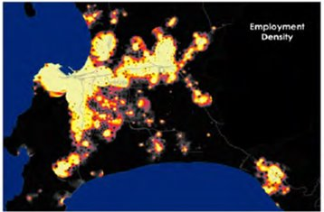
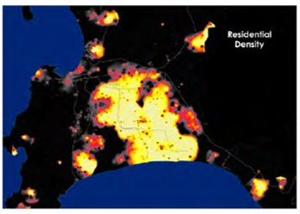
Improved Access to Economic Opportunities and Employability
Goal
Why it matters
All citizens who want to be economically active have improved access to economic opportunities and employability through at least one pathway, with pathways comprising improved employability assets (knowledge, skills, experience, and/or competencies), career management skills, workplace-ready capabilities and skills, economic opportunities more accessible to communities, and entrepreneurship.
891 000 people are unemployed in the WC, equating to an unemployment rate of 27.2% and 32.6% for youth
For every aspirant job seeker in the Western Cape, there are 2.3 residents of working age who have permanently disengaged from the world of work
Actual and budgeted national GFCF as % of GDP
Objective
A thriving society where capable, economically active citizens are able to access economic opportunities and employment, including the skills of the future, and where barriers to accessing information, to developing competencies and skills, and to finding work, have been reduced or removed.
Notes:
Improving pathways for learners, entrepreneurs and aspirant job seekers
Goal Statement
All citizens who want to be economically active have improved access to economic opportunities and employability through at least one pathway, with pathways comprising improved employability assets (knowledge, skills, experience, and/or competencies), career management skills, workplace-ready capabilities and skills, economic opportunities more accessible to communities, and entrepreneurship.
Objective Statement
A thriving society where capable, economically active citizens are able to access economic opportunities and employment, including the skills of the future, and where barriers to accessing information, to developing competencies and skills, and to finding work have been reduced or removed.
Human capital development is at the core of growth strategies. Low-income households face time, distance and cost burdens that reduce access to economic opportunities. The Western Cape Government seeks to enable people to access opportunities through developing skills and productivity, nurturing local expertise and entrepreneurship, enabling micro- and small-sized enterprises to participate in industry value chains, and supporting self-employment.
In a country that has one of the highest levels of unemployment in the world, improving access to economic opportunities and employability is crucial. For the individual, employability depends on four elements:
human capital assets (knowledge, skills, experience, attitudes)
deployment (career management skills)
presentation (job acquisition skills, CV, interview techniques, etc.)
personal circumstances (who you are, who you know, where you live, responsibility, labour market, etc.).
To these, might be added the skills, know-how and resources needed to exploit opportunities for entrepreneurship, be it within a formal or informal business.
South Africa’s labour market: a familiar and wicked problem
The structure of the Western Cape’s labour market closely resembles that of South Africa. With a formal economy that is being held back by a critical shortage of skilled workers, and yet 2.6 million working-age residents are not in gainful employment.
Critical shortage of skilled workers stifling growth
The structure of the Western Cape’s labour market resembles that of South Africa. With a formal economy that is being held back by a critical shortage of skilled workers, and yet 2.6 million working-age residents are not in gainful employment.
South Africa’s economic growth is constrained in part by shortages of skilled labour. Whereas unemployment levels among citizens with advanced qualifications are broadly in line with benchmark economies, unemployment amongst unskilled and semi-skilled job seekers is exceptionally high.
Enabling growth-oriented entrepreneurs
Compared to benchmark economies, South Africans appear to be exceptionally dependent on salaried positions and not particularly successful at self-employment, whether formal or informal.
In South Africa, the informal sector’s contribution to economic activity or employment is small compared to benchmark and even developed country economies, pointing to the need to address. the binding constraints inhibiting the success of growth-oriented entrepreneurs and the improved sustainability of survivalist micro-businesses. Growth-oriented entrepreneurs are key to creating economic opportunities and employment. The binary distinction between formal and informal business inhibits the identification of high potential sectors and nodes.
Preparing learners for the workplace
The Western Cape spends 36% of its budget on education, but weak labour market outcomes suggest a need to align education/skills provided with the needs of employers, especially around jobs for the future.
The WCED curriculum and learning needs to link education to employment more effectively. The knowledge, skills, and abilities that enable people to find or keep a job or advance in the workforce are known as workforce preparation skills. , while more accessible support is required to guide learners and job-seekers towards the skills that the economy requires.
Addressing binding spatial constraints impeding entrepreneurship
To thrive, township economic development depends firstly on the capabilities and resilience of township business and an enabling regulatory environment, and secondly on a spatial environment conducive for businesses to flourish and connect. In townships, the material welfare of local households is constrained by declining levels of inward private investment and insufficient levels of bottom-up business establishment and growth.
The spatial factors driving poor labour market outcomes
Figure : Cape Metro employment density compared to residential density
Source: City of Cape Town
As reflected in the City of Cape Town’s residential area and employment density heat maps for Cape Town (Figure 17), the distances between where Low-income households live and work are significant, imposing time and out-of-pocket costs that can amount to a large portion of poor households’ income, while increasing exposure to crime. face time, distance and cost burdens that reduce access to economic opportunities. These burdens also lower growth because households are unable to accumulate land and human capital.

Slide 37
Improved Access to Economic Opportunities and Employability
Youth and the unemployed can make informed choices about their careers and future and are enabled to pursue their career pathways
Citizens have easier access to economic opportunities and pathways nearer to the places that they live.
A strong pipeline of suitably qualified people who are employment-ready, able to access available jobs and be absorbed rapidly and sustainably into employment.
A strong pipeline of suitably qualified people who are employment-ready, able to access available jobs and be absorbed rapidly and sustainably into employment.
Picture of Success
Western Cape school leavers/graduates have a reputation for technical expertise coupled with innovation/creativity/problem-solving and collaboration skills and are highly sought after by employers
Entrepreneurship is considered a viable choice as an economic opportunity and citizens starting up a business – whether formal or informal – have access to the necessary support and enabling environment
Changing the view of township economies from latent informal business to potential value chain business or suppliers in specific sectors would open opportunities for township-based entrepreneurs to participate more favourably in industry value chains
Townships are vibrant and dynamic economic places contributing to and benefitting from break-out economic growth
Notes:
2035 Picture of Success
Youth and the unemployed can make informed choices about their careers and future and are enabled to pursue their career pathways.
Citizens have easier access to economic opportunities and pathways nearer to the places that they live.
A strong pipeline of suitably qualified people who are employment-ready, able to access available jobs and be absorbed rapidly and sustainably into employment.
Western Cape school leavers/graduates have a reputation for technical expertise coupled with innovation/creativity/problem-solving and collaboration skills and are highly sought after by employers.
Entrepreneurship is considered a viable choice as an economic opportunity and citizens starting up a business – whether formal or informal – have access to the necessary support and enabling environment.
Changing the view of township economies from latent informal business to potential value chain business or suppliers in specific sectors would open opportunities for township-based entrepreneurs to participate more favourably in industry value chains.
Townships are vibrant and dynamic economic places contributing to and benefitting from break-out economic growth.

Slide 38
Improved Access to Economic Opportunities and Employability Themes & Interventions
1
2
Improved education-based and
competency-based pathways
Improving life orientation content on careers, work-readiness and competencies
Expanding after-school programme to develop competencies
Revising curriculum and modes of learning to maximise relevance to the workplace
Accelerating the roll-out of focus schools and increase scale and geographic coverage of these schools
In partnership with the private sector, rolling out an online blended school
Improved post-school
and tertiary education partners
Investigating the feasibility and develop a strategy to expand the number of universities (private sector and public sector) and Technical Vocational Education and Training (TVET) colleges in the Western Cape
Together with the tertiary institutions, enhancing the through-put rates of enrolled tertiary students
4
Bringing economic pathways and opportunities closer to citizens and communities and visa versa
Overcoming the digital divide by making devices, connectivity, and relevant learning content available and accessible to all learners
Creating mixed-use, high density and compact settlements
Developing a vibrant, functional housing market as well as a land assembly pipeline to promote affordable, better located, more integrated housing opportunities and access to housing ladder
Work with municipalities to support homeowner-driven small scale development
Improving public transport to reduce commuting times
Developing an overall Western Cape township strategy as well as township action plans within targeted communities
Considering whether programmes such as the WCG’s Year Beyond Programme and EPWP can be used to assist skills transfer into township-based growth opportunities
Improving urban management in townships to support investment, enabling the development of economic nodes and commercial activities
3
Improved work-place skills and productivity
pathways
Developing initiatives to enhance experiential learning, as well as knowledge exchange
Exploring how the DEDAT’s BPO work placement model can be replicated for growth opportunities
Developing innovative models for micro-certification of modules from credible tertiary institutions rather than long-term accredited skills programmes.
Working with the private sector re their hiring practices
Strengthening dialogue between SMMEs and SETAs to increase funding to non-corporate businesses
Forging closer relationships with the Presidential Employment Stimulus team and YES initiative to better leverage and reorientate these support packages
Championing and investing in programmes to deliver digital skills relevant to the workplace at scale (see Tech and Innovation PFA).
Notes:
Actions towards 2035 success
1. Improved education-based and competency-based pathways
Improving life orientation content on careers, work-readiness, and competencies
Expanding after-school programme to develop competencies
Revising curriculum and modes of learning to maximise relevance to the workplace
Accelerating the roll-out of focus schools
In partnership with the private sector, roll out an online blended school for those who have not completed their schooling
2. Improved post-school and tertiary education pathways
Investigating the feasibility and developing a strategy to expand the number of universities (private sector and public sector) and TVET colleges
Together with the tertiary institutions, enhancing the through-put rates of enrolled tertiary students.
3. Improved work-place skills and productivity pathways
Through the improved understanding of businesses’ skills needs, developing initiatives to enhance experiential learning
Exploring how the DEDAT’s BPO work placement model can be replicated for growth opportunities
Developing innovative models for recognising emerging trends of training
Working with the private sector with respect to their hiring practices
Strengthening dialogue between SMMEs and SETAs
Forging closer relationships with the Presidential Employment Stimulus team and the private sector
Championing and investing in programmes to deliver digital skills
4. Bringing economic pathways and opportunities closer to citizens and communities and vice versa
Overcoming the digital divide by making devices, connectivity, and relevant learning content available and accessible to all learners
Creating the enabling environment
Developing a vibrant, functional housing market as well as a land assembly pipeline
Work with municipalities to support homeowner-driven small scale development
Collaborating with the PFA 6 with respect to improving public transport to reduce commuting times
Developing an overall Western Cape township strategy as well as township action plans within targeted communities
Considering whether programmes such as the Western Cape Government’s Year Beyond Programme and the Expanded Public Works Programme can be used to assist skills transfer into township-based growth opportunities
Improving urban management in townships to support investment

Slide 39
Improved Access to Economic Opportunities and Employability Themes & Interventions
5
6
Enhancing entrepreneurship pathways
Understanding the impact of compliance enforcement on local businesses, and develop more incremental, affordable, and empowering systems where necessary.
Leveraging existing digital entrepreneurial platforms to provide support to entrepreneurs, providing information and a community of guidance to start-ups and those who want to expand.
Supporting opportunities for microbusiness support for women
Identifying and address challenges and ease of doing business, including the concerns about crime and safety, within the environment for entrepreneurs/microbusiness
Developing campaigns to promote entrepreneurship and microbusiness.
Conducting an international benchmarking of South Africa’s labour legislation and regulations, as well as assist business compliance with respect to labour relations regulations.
Supporting the entrepreneurship pathway from skills (business skills) to SMME support, to SMME development through supplier development in the public and private sector
Developing school-based collaborative programmes with private sector that supports youth start-up businesses
Strategic Co-ordination and strengthened eco-systems
Increasing economic IQ about learning, schools, entrepreneurship, and microbusiness, providing open data
Strengthening the learning ecosystem and forums of learning institutions to support relevant learning
Notes:
5. Enhancing entrepreneurship pathways
Understanding the impact of compliance enforcement on local businesses
Leveraging existing digital entrepreneurial platforms to provide support to entrepreneurs
Supporting opportunities for microbusiness support for women, including ECD
Identifying and address challenges and ease of doing business, including the concerns about crime and safety
Developing campaigns to promote entrepreneurship and microbusiness.
Conducting an international benchmarking of South Africa’s labour legislation and regulations
Supporting the entrepreneurship pathway from skills (business skills) to SMME support
Developing school-based collaborative programmes with private sector
6. Strategic coordination and strengthened ecosystems
Increasing economic IQ about learning, schools, entrepreneurship, and microbusiness, providing open data
Working with the private sector, including training institutions, to enhance the relevance of skills and education training and to reduce the skills mismatch

Slide 40
Transversality and the Way Forward

Slide 41
Transversal themes arising from the Priority Focus Areas
Driving investment
Stimulating domestic markets & exports
Transversal themes
Private-public sector coalition coordination
Economic intelligence (IQ)
Ease of doing government
Regulatory and legislative ease of doing business
Enabling procurement systems
Spatial coordination of the G4J Strategy
Energy resilience and transition to net carbon 0
Water security and resilience
Technology and innovation
Infrastructure and connected economy
Improved access to economic opportunities
Notes:
Way forward
Drawing from research and expert input, purposeful, choiceful, realistic and impactful choices were made in determining what and how the Western Cape Government will accomplish the overall targets set out by the Growth for Jobs Strategic Framework. Seven Priority Focus Areas have been identified, each with clear and ambitious objective and goal statements, and with sets of themes and interventions that will be sequenced along 3 time horizons over the next 12 years:
Doing what it takes to deliver
The Growth for Jobs Strategy has identified a suite of policy levers – or toolkits – to be deployed in pursuit of the interventions and goals within the Priority Focus Areas and the overall Strategy.
Transversal management and governance of the Growth for Jobs approach
A risk for success is the extent to which all PFAs are fundamentally dependent on other enablers and levers. The Western Cape Government will utilise various models of transversal management, delivery and coordination, as appropriate, to make sure that the PFAs get the necessary support across provincial government in order to deliver.

Slide 42
Chapter 13: Transversality and the Way Forward
Driving investment
Private sector investment will be 20% of regional GDP (translating to R200 billion) by 2035.
Stimulating domestic markets & exports
The value of Western Cape exports of goods and services (inclusive of tourism) will triple by 2035.
R1 trillion economy growing at
4 – 6%
GDP
Energy resilience and transition to net carbon 0
Reduce reliance of energy from Eskom of between 1 800 – 5700 MW by 2035, estimated to attract between R21.6-billion and R68.4-billion in related investment
Water security and resilience
Double water available for secondary and tertiary economic sectors (primarily from non-productive use) by 2035 and honour existing allocations to agriculture.
Technology and innovation
Research and Development expenditure will quadruple to R35 billion and the value of venture capital deals will reach R20 billion by 2035.
Infrastructure and connected economy
The Western Cape economy will have the infrastructure required to support and enable a R1 trillion economy by 2035 and public sector capital investment in the Western Cape will be 10% of regional GDP.
Improved access to economic opportunities
All citizens who want to be economically active have improved access to economic opportunities through at least one pathway.
Notes:
Striving for the ultimate G4J goal
Collectively these seven Priority Focus Areas will have a direct GDP impact of R395-billion, and the economic modelling shows that this can generate 600 000 and over one million jobs.
Accomplishing the objectives and targets set out by these PFAs is an imperative and will synergistically and meaningfully contribute towards the Western Cape having an enabled, competitive and inclusive economy.

Slide 43
Chapter 13: Transversality and the Way Forward
Driving investment
Stimulating domestic markets & exports
GOAL
R1 trillion economy growing at
4 – 6%
GDP
Energy resilience and transition to net carbon 0
Direct
R395 billion GDP &
600 000 –
1 million jobs
Water security and resilience
Technology and innovation
Infrastructure and connected economy
Improved access to economic opportunities

Slide 44
Launch of the G4J Strategy
Launch of the Growth for Jobs Strategy is planned for 2nd quarter of 2023/24 financial year

Slide 45
G4J relevance for SMMEs (formal & informal)
G4J Guiding principle- Redress through active economic participation
Explicit touchpoints for SMMEs and township businesses in specific PFAs
Some Opportunities across the PFAs for small businesses & township businesses:
Enablement of growth-oriented entrepreneurs through strengthening ecosystems and access to markets
Addressing binding spatial constraints impeding entrepreneurship
Support the informal economy by providing infrastructure and removing barriers to entry
Tackling red tape and addressing ease of doing businesses
Enabling the potential of township economies to become value chain business or suppliers
Supporting the entrepreneurship pathway from skills (business skills) to SMME support
Overcoming the digital divide enablement through uptake of tech and innovation
Supporting small businesses in dealing with the energy crisis
Stimulating domestic markets & exports
Energy resilience and transition to net carbon 0
Technology and innovation
Infrastructure and connected economy
Improved access to economic opportunities
Notes:
G4JGuiding principle- Redress through active economic participation….by pulling more people into the economy, stimulating competition, improving skills and productivity, raising investment, reducing poverty, increasing employment and broadening the tax base. Private-sector involvement includes entrepreneurs; small, medium and micro enterprises (SMMEs); and the informal and township economies

Slide 46
TMS Chase

