Slide 1
Economic Development and Tourism
STANDING COMMITTEE ON FINANCE AND ECONOMIC OPPORTUNITIES
Port of Cape Town Container Logistics
Glen Steyn
6 June 2023

Slide 2

Content of Presentation
The Journey of Collaboration since Dec 2019
Applied Research Results
Logistics Chain
Logistics Dashboard
Current Situation Summary
Proposed Way Forward

Slide 3
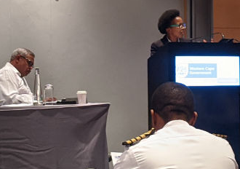
1. The Journey of Collaboration since December 2019
Context in 2019 was good rain after devasting drought
Fruit and wine represent almost 50% of WC exports
Yields also increased from improved rootstock
Port congestion drove stakeholders together
Root causes of congestion were identified as:
Institutional, including poor logistics integration, communications, industrial relations, data and weak voice of cargo owners,
No strategy for cargo growth, seasonal peaks, high wind speeds and ranging,
Bunching of truck arrivals in the morning, with queuing on Marine Drive and Duncan Road
PoCT Stakeholder Workshop: Dec 2019
Consensus was reached on need for collaboration and collective focus on top priorities

Slide 4
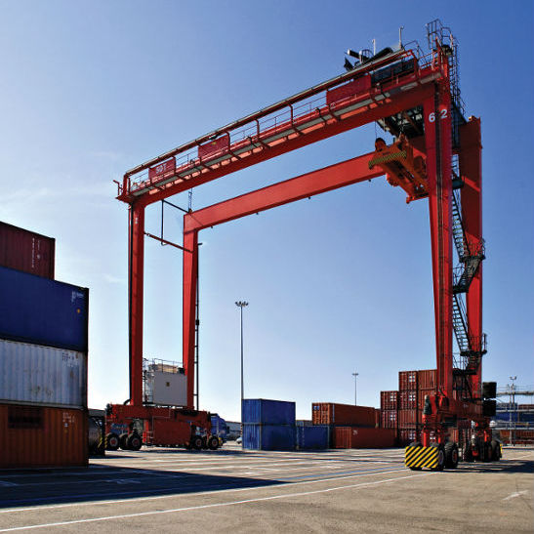
1.1 The Journey Continued: Top 3 Priorities
1. Inadequate operational port and terminal equipment for growing cargo volumes
TNPA improved the marine fleet and are approaching zero marine delays
Hydraulic tensioners installed in Nov 2022 to mitigate ranging
TPT improved STS fleet to 9 and RTG’s to 24. Industry is appealing for more RTG’s
2. Improved communication in the Port Logistics Chain
WhatsApp groups and access to shift manager contact details are valuable
Weekly operations co-ordination meetings with port and terminal managers promote collaboration
Room to further improve real time multi-stakeholder communications. Refer to logistics dashboard
3. Transporter Congestion
Remains problematic – interfaces with all priorities
Truck booking system is helpful, but requires fine tuning
Night shift utilization improved to 17% in week of 5 Dec. Further improvement requires agency co-ordination

Slide 5
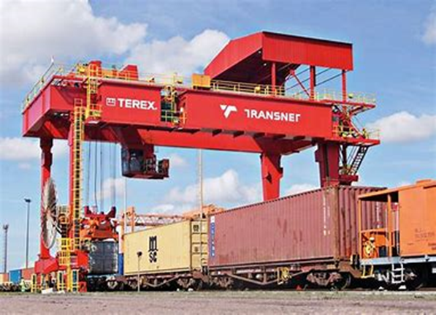
1.2 The Journey Continued: Priorities 4-6
4. Data and Logistics Chain Integration
Excellent data parcels exist, but isolated at points of collection
Data integration has started to improve management of seasonal cargo flow – refer to applied research
Next step is improved interface between container terminal, cold stores, shipping lines and transporters
5. Comparative Best Practice Performance Indicators – Logistics Dashboard
Consensus is emerging on marine and terminal performance indicators (WTTB, VTAT, TEU’s moved, SWH)
Information is increasingly being provided, processed and discussed to improve performance/reduce delays
Focus needs to expand to nodes in logistic chain beyond the container terminals
6. Inland Terminal Development
Belcon is an exciting psp opportunity. Ready for 2023 deciduous exports
Kraaifontein provides an additional option for the longer term
Both options could trigger valuable shifts from road to rail

Slide 6
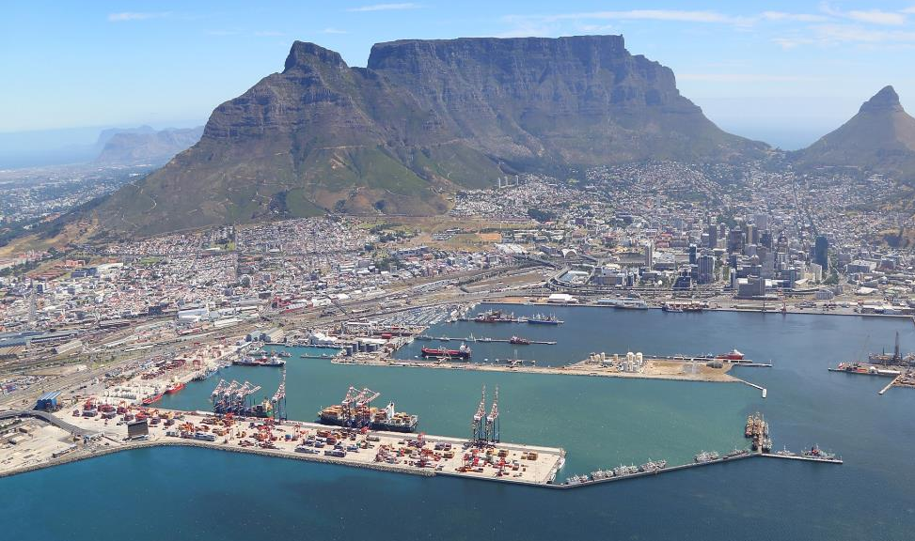
2. Action Research Completed
Root cause analysis on transporter congestion
Enhanced the Western Cape FDM to understand growth in containerized cargo volumes per commodity until 2026
Deep dive to understand wine export trends and dynamics
Estimated the economic contribution of container terminals

Slide 7
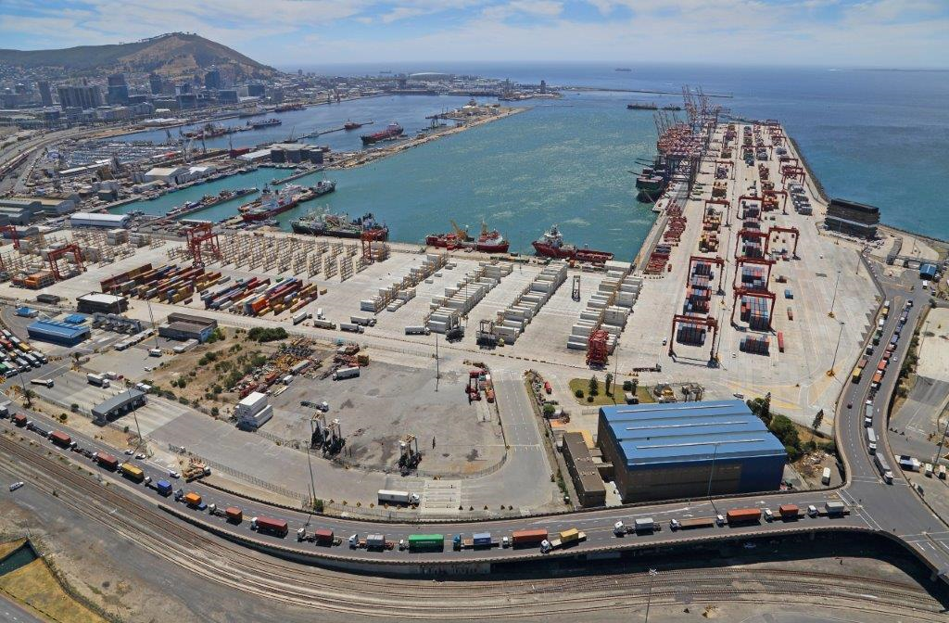
2.1 Action Research Completed –Root Causes of Transporter Congestion
Wind/weather: 30%
      Gate closure, including shift change: 9%
      Stack congestion and IT system failure: 4%
      Unspecified, including terminal capacity limitations/operational availability of equipment – 57%
      Recommendations:
      Truck booking system – Done Oct ‘21- consider optimization
      Improve traffic control and driver behaviour
      Improve terminal capacity/performance (time lost on shift change)
      Improve planning & communication among different members in log chain

Slide 8
2.2 Projected containerized cargo 2026 – Anticipated Growth is 26%

Slide 9
2.3. Current and Expected Growth in Wine Exports
Wine exports are expected to grow until 2026, after the slump from 2019 to 2020. Volume growth in 2023 is expected to be 12%
Exporters are concerned about terminal efficiency and vessels bypassing Cape Town
Wine is less perishable than fruit and provides some opportunity for logistics management during off-peak periods for Port of Cape Town
Wine export industry is well organized and should be engaged to develop win-win export solutions. Data intelligence can be improved via DALLRD WoL
Stakeholders could collaborate to promote wine exports

Slide 10
2.4. Contribution of CT Container Terminals to Western Cape Economy
It is estimated that container terminals contributed towards R72.5 bn of the GVA in Western Cape in 2021 (8.6%) and to the creation/sustaining of 225,000 jobs. Taxes paid from these activities was almost R20 billion.
Difference between high and low growth scenarios for 2026 (at current prices) is as follows:
DEDAT interventions are aimed at facilitating the high-growth outcome in collaboration with all agencies in the port logistics chain.
Indicator | High Growth | Low Growth | Difference
GVA R’bn | 74.7 | 69.1 | 5.6
Jobs | 240,000 | 220,500 | 19,500
Remuneration R’bn | 32 | 29.9 | 2.1
Taxes Paid R’bn | 21.8 | 20.2 | 1.6

Slide 11
3. Macro Logistics Chain for Port of Cape Town Containers
National Government
Exporters
Packhouses
Cold Stores
DC’s
Container
Depots
Transnet
OD’s
Shipping Lines
Importers
Provincial Government
Industry Associations
Transporters
Metro, District & Local Government

Slide 12
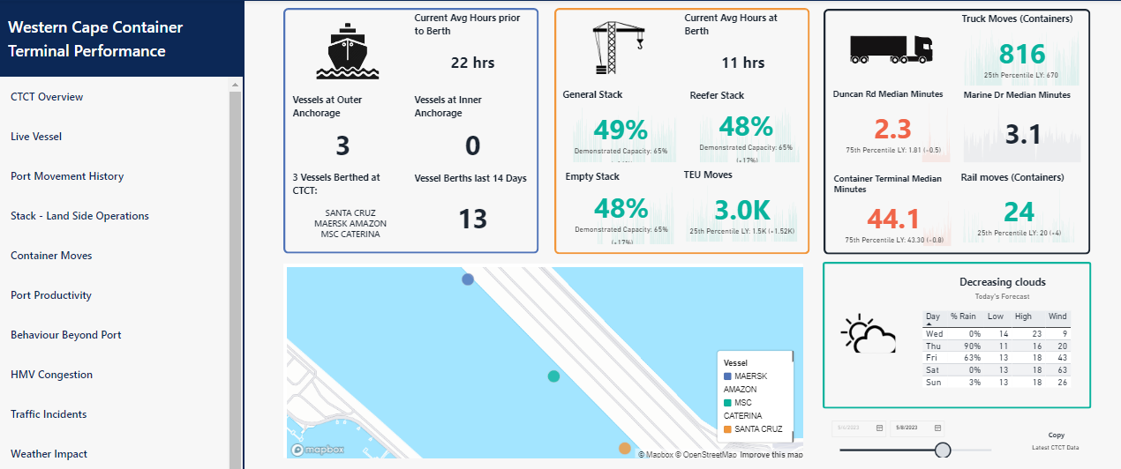
4. Cape Town Container Logistics Dashboard

Slide 13
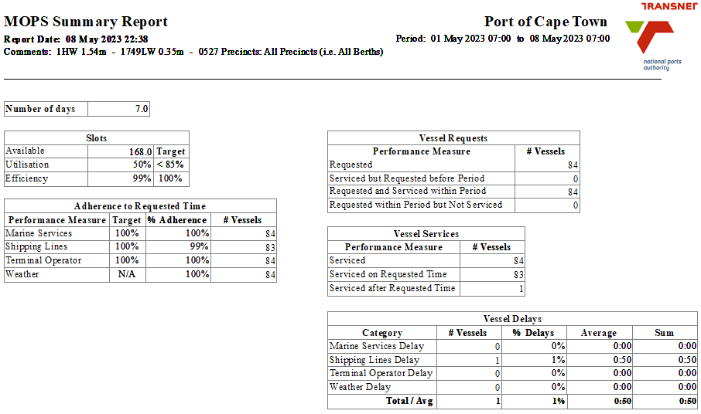
4.2. Cape Town Container Logistics Dashboard: Why a dashboard?
Port container logistics dashboard provides transparent view to facilitate integrated cargo planning and identify bottlenecks.
Real time view using multiple data sources, providing an end-to-end view of the port logistics value chain.
One of 12 joint priorities from annual port stakeholder dialogue.
Port of Cape Town prototype customized and enhanced from Durban test case
Free subscription to primary user agencies for 2023 to extend logistics focus and refine indicators.
Objective is line of sight on cargo from origin to destination

Slide 14
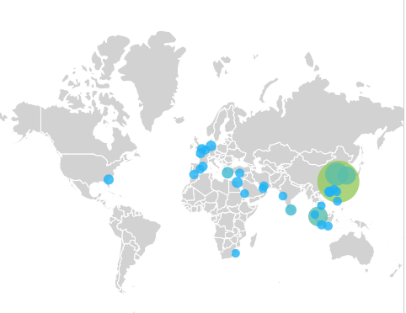
5. Current Situation Summary
Citrus export season started on 15 May.
WTTB improved from >6 days March - 2 days May
VTAT improved from >15 days March - 4 days May
Big improvement on Linerlytica global port congestion watch: Position 7 on 28 March to position 61 on 2 May (position 1 is most congested, with 143 ports on the list)
Operational availability of rubber tyred gantries remains a critical constraint.
Shore tensioners on 2 berths brought relief – 1 berth remains vulnerable to ranging
Belcon will provide additional plug points
Loadshedding is a significant constraint

Slide 15
5.2 Synopsis of Successes to Date
Effective platform for collaboration established in Port of Cape Town Logistics Chain – Fourth Annual Port Stakeholder engagement held on 20th January 2023
Hydraulic tensioners on 2 berths are mitigating the impact of ranging
Port Manager has implemented a policy of zero tolerance for marine delays
Transnet Port Terminals deployed a 9th ship to shore crane and a 3rd mobile harbour crane
Critical indicators have improved, such as WTTB from >6 days March to 2 days May; and VTAT >15 days March to 4 days May
Record performance of 21,000 TEU’s moved in the two TPT terminals during 1st week of April 2023
PoCT position on Linerlytica global port congestion watch improved significantly
First version of Port of Cape Town Container Logistics Dashboard Released
Belcon will provide additional plug points for refrigerated containers at inland terminal

Slide 16
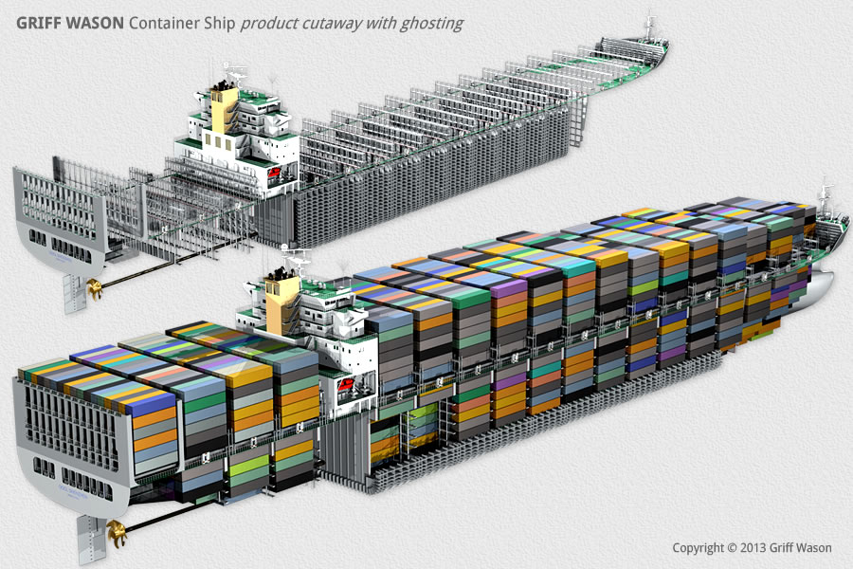
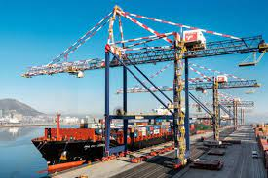
6. Proposed Way Forward
Build on what has worked.
Intensify collaboration with TRANSNET/other stakeholders to synchronize and extend the logistics chain as a platform for further development
Improve planning co-ordination between cold stores, container terminals, shipping lines and transporters - Dashboard.
Mitigate wind disruption and optimize utilization of operational time
1
2
3
Agree upon and jointly pursue appropriate performance targets, including operational availability of HLE, with the required resources
Investigate suitable opportunities for private sector participation in the port logistics chain
5
4
Collaboratively make the best - case scenario happen, with 26% export and cargo growth by 2026; and 20,000 new jobs

Slide 17
Thank you!

