Slide 1
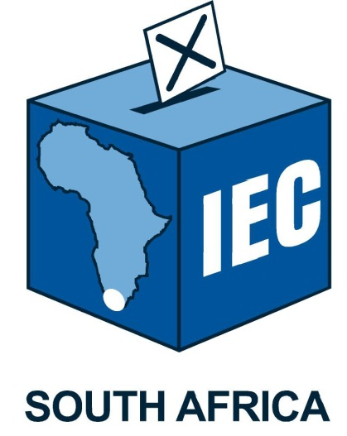
ELECTORAL COMMISSION OF SOUTH AFRICA

Slide 2
Electoral Commission’s Proposed Administrative Amendments to the Party Funding Act No. 6 of 2018

Slide 3
Section 1: Definitions
The definition of the Chief Executive Officer (CEO) must be amended to read the Chief Electoral Officer appointed in terms of section 12(1) of the Electoral Commission Act";
All reference to the chief executive officer must be amended to chief electoral officer

Slide 4
Section 3: Establishment of the MPDF
Insert a provision that provides the Commission with express permission to fund-raise for the MPDF.
Insert a provision on where the forfeited funds (e.g., proceeds of crime) must be directed to. Whether to the National Revenue Fund, Criminal Assets Recovery Account, MPDF, etc.

Slide 5
Section 4: Investment of money in Funds
Limitation to investment with the Public Investment Corporation (PIC) must be reviewed and be broadened to include short-term investments with any of the registered banks which may earn interest and in line with PFMA

Slide 6
Section 5: Management and administration of Funds
Add a provision for forfeiture of funds after a prescribed period of non-compliance, for example, where over a period of two financial years that the party or Independent Representative has failed to submit audited financial statements. However, a forfeiture period need not apply in instances where there is a intra-party court process underway.

Slide 7
Section 6: Allocation and payment of money to represented parties
Include a provision that s179 of the Tax Administration Act should not apply to monies from the RPPF and that there should be no Third Party collections to be served against the RPPF/the Commission in the context of this legislation.

Slide 8
Section 7: Purposes for which money from Funds may be used
Insert a provision to prevent money from the funds being attached in the settlement of third party debts such as garnishee orders in favour of debtors.

Slide 9
Section 12: Purposes for which money from Funds may be used
s12(2)(d)(i) - Change "statement" to "financial statements“.
s12(2)(d)(ii) – Add that the Commission is empowered to prescribe the format of the statement

Slide 10
Section 14: Commission’s monitoring and inspection powers
s14(4) – Amend to add a provision that says that the Commission and Electoral Court have powers to deal with appeals against decisions of the Chief Electoral Officer.

Slide 11
Section 16: Power to suspend payment of money
Provide for the forfeiture of allocations of the Funds, where a party fails to submit financials for a prescribed period.

Slide 12
Section 21: Administration
Delete section 21(2) as the chief electoral officer is now the accounting of the funds and the officer responsible for the implementation of the Act

Slide 13
Section 22: Report to Parliament
Delete the words "together with the Commission’s annual report in terms of section 14 of the Electoral Commission Act“ in s22(3)

Slide 14
Submission by the Electoral Commission on Consequential Amendments to the Electoral Amendment Act No. 1 of 2023 and the Electoral Commission Act No. 51 of 1996

Slide 15
Proposed Amendments to the Electoral Act
1.1 Impact of the two ballots for the National Assembly
With the introduction of independent candidates, the Electoral Amendment Act provides for 2 ballot papers to be issued for the regional seats in the National Assembly and the compensatory seats in the National Assembly.
In terms of the current provisions of the Electoral Act, as amended, the following categories of voters are qualified to be issued with the compensatory ballots for the National Assembly:
voters who cast their ballot abroad;
A voter who by way of section 24A of the Electoral Act who votes in a voting district outside of the province of registration; and
Voters who have applied for special votes outside of the province of their registration.

Slide 16
1.1 Impact of the two ballots for the National Assembly (Continued)
The issue to be resolved: Are voters who are resident outside of the Republic, those that are voting abroad and those who are outside of their province of registration on voting day be entitled the ballot for the regional seats in the National Assembly?
In order to conclusively respond to this issue, it is proposed that Sections 24A, 33(3) as well as section 33A of the Electoral Act be amended.
The impact of such proposed amendments are as follows:
A voter who casts a ballot at a voting district outside of the province of registration is not entitled to be issued with the ballot for the regional seats in the National Assembly.
A voter who has applied for a special vote and is outside of the province of registration is not entitled to be issued with the ballot for the regional seats in the National Assembly.
Similarly, a voter who is resident outside of the Republic and those voting abroad are not entitled to be issued with the ballot for the regional seats of the National Assembly.

Slide 17
1.2 Objections against candidates of political parties
Currently section 30 of the Electoral Act makes no provision for objections to unrepresented political parties and independent candidates who fail to meet the signature quota requirements to contest elections.
It is proposed that section 30 of the Electoral Act be amended to include section 30(1)(d) to enable objections to unrepresented parties and independent candidates that fail to satisfy the requirements in relation to signature quota requirements.

Slide 18
1.3 Amend clause 1 of the Electoral Act
Amend section 1 to substitute the definition of “serve” to exclude obsolete means of communication (telegram, telex and telefax) and include e-mail as a mode for service.

Slide 19
Proposed Amendments to the Electoral Commission Act No. 73 of 1998
Amend section 1 of the Electoral Commission Act, to insert a definition of “independent candidate” by cross-referring to the definition in the Electoral Act.
Amend section 1 by the substitution for the definition of “political office” of the following definition: “ ‘political office’ means any executive appointment or elected office, including any elected or nominated public representative of a party, whether involving remuneration or not, or any other paid office, in the service of a party; and an independent candidate, whether involving remuneration or not;”.
Amend section 5(1)(g) by broadening the Commission’s liaison and co-operation function to include independent candidates and independent representatives

Slide 20
Proposed Amendments to the Electoral Commission Act No. 73 of 1998
Section 6 (2)(b) of the Electoral Commission Act must be amended by the substitution in subsection (2) for paragraph (b) of the following paragraph:
“(b) does not at that stage have a high [party-political] political profile;”
Section 6(2)(d) must be amended by the substitution in subsection (2) for paragraph (d) of the following paragraph:
“(d) has been nominated by a committee of the National Assembly, proportionally composed of members of all parties represented in the National Assembly, from a list of recommended candidates submitted to the committee by the panel referred to in subsection (3): Provided that the National Assembly must establish Rules for the for the participation of independent representatives for this purpose.

Slide 21
Thank you

