Slide 1
Overview and progress update

Slide 2
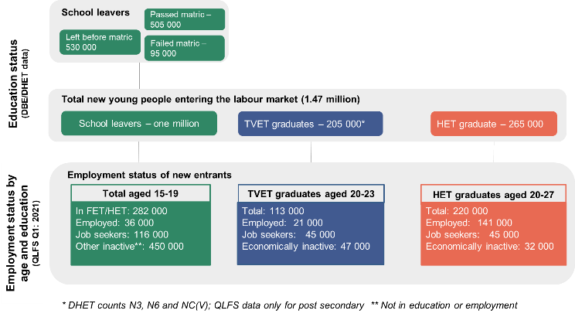
Too many young people are not transitioning from learning to earning!
Every year about 1 million young people leave school in South Africa – of these approximately 28% enter post-schooling education, another 15% find work or remain active in the labour market, whilst the remaining 57% sit outside the labour market.
There remains a strong relationship between the levels of education that young people have and the opportunities that they can access.
Many young people are no longer actively searching for opportunities and this number is highest among those with the lowest levels of educational attainment.

Slide 3
“..we have to run just to remain in the same place” – President Ramaphosa
Young people face both supply and demand-side barriers to employment. On the demand side, job opportunities are limited by slow economic growth and the concentrated, skill-intensive structure of the economy.
In addition, the systems and ecosystems for identifying, training, placing and supporting talent in the jobs that do exist are weak and not sufficiently demand-led.
Many young people are unable to find employment as they do not have strong social networks, are not close to opportunities, and cannot afford the costs of work seeking.
Many of the young people who do find opportunities land up in dead ends and do not gain a foothold in the economy.

Slide 4
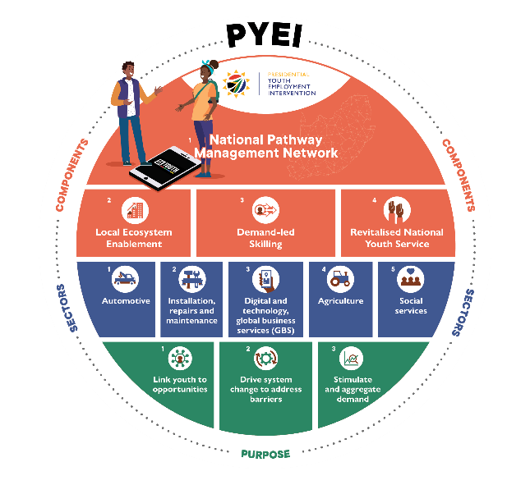
Transitioning young people from learning to earning
One network, four components, five sectors
Central to the PYEI's efforts is the establishment of a National Pathway Management Network (NPMN) that guides young people towards opportunities for learning and earning.
In addition to the NPMN, other PYEI components include:
demand-led skilling;
the enabling of local ecosystems to facilitate self-employment and enterprise opportunities; and
the revitalisation of the National Youth Service (NYS).
Interventions focus on priority growth areas with employment potential for young people.

Slide 5
A strong partnership approach to delivery
Coordinating efforts within and beyond government
The PYEI has made coordination and partnership central to its approach.
A Project Management Office (PMO) in the Presidency provides overall coordination and political leadership, while key government departments and agencies lead the implementation.
The PYEI has established coordination mechanisms to improve alignment and deliver greater impact with existing resources.

Slide 6
Main components of the PYEI

Slide 7
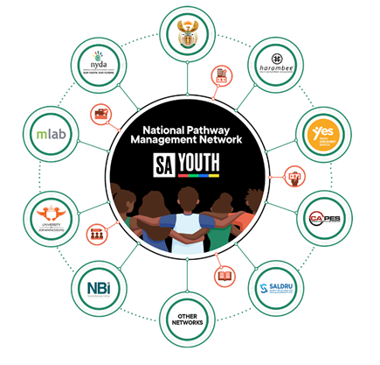
1. National Pathway Management Network
The National Pathway Management Network (NPMN) is “network of networks” led by the Department of Employment and Labour: a single network that links up and integrates all existing networks in the country that serve young unemployed people.
The NPMN partners work together to stimulate and aggregate demand and supply opportunities in one place while addressing barriers young people face.
Increase the visibility of young people seeking opportunities while maximizing the reach of actors offering/enabling such opportunities.
The NPMN can be accessed via various channels including, amongst others, the SA Youth platform, the National Youth Development Agency telephonic helpline and centres and at Department of Employment and Labour (DEL) centres.

Slide 8
“SAYouth.mobi” is a platform where young South African work-seekers can - FOR FREE - access a network to find job opportunities, to earn income, and to stay engaged and connected.
The platform provides young people with ongoing recommendations to learning, content, and support so that they know what they must do to grow their profile and access more opportunities.
This inclusive platform have a free mobisite as its entry point for all youth. This entry point will be enhanced by so many other channels – online and offline – that reach young people where they are. These include a toll free 0800 support line, an outbound call centre, and free SMS services.
SAYouth.mobi is already supporting over 4 million young people who have registered on the platform, many of whom have already accessed opportunities.

Slide 9
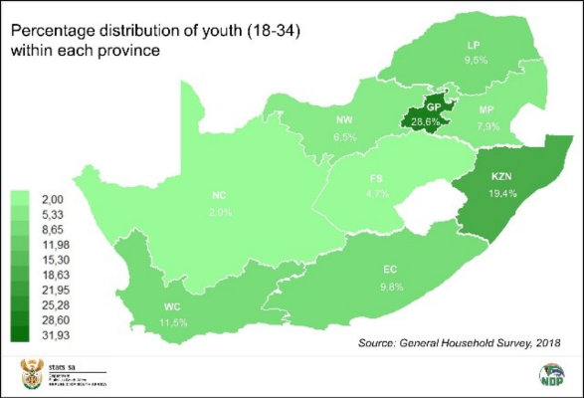
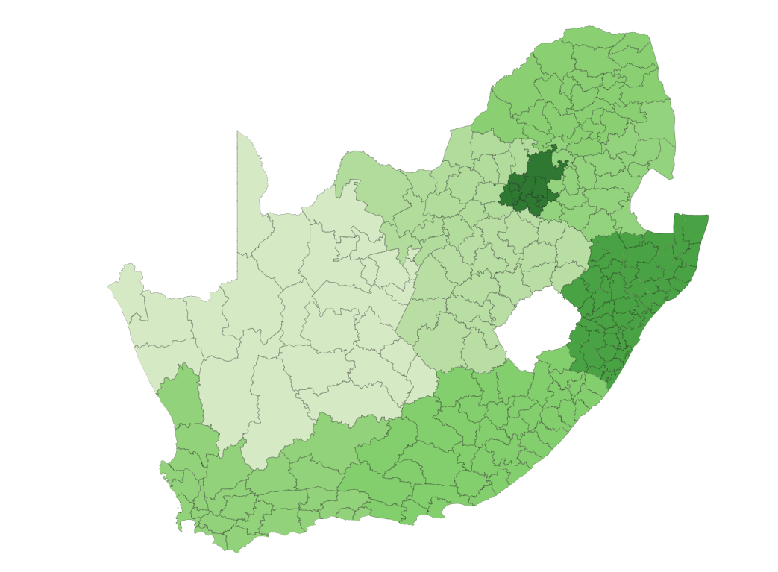
Nationally representative spread of the 4.2 million young people on SA Youth
Distribution of youth in the country, Stats SA
Distribution of young people on SA Youth
LP, 9%
GP, 28.5%
NW, 9%
FS, 4.3%
KZN, 20%
NC, 1.7%
EC, 9.7%
WC, 8,2%
The DBE school assistant programme’s spatial distribution has contributed to national representation of young people on SA Youth which has enabled better targeting of opportunities and support.

Slide 10
For the 2.5 million young people there is educational data, the majority report completing at least a matric/ additional certification/ qualification

Slide 11
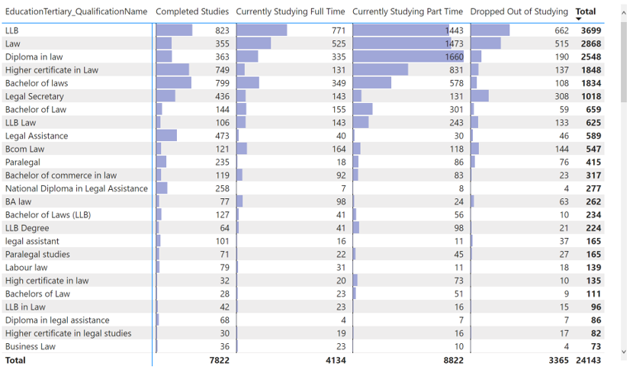
Able to access further detail on education and qualifications to support matching to opportunities
Example with legal and paralegal qualifications:
Overall, 24 143 young people report completing, currently studying or dropping out of various legal and paralegal qualifications.

Slide 12
2. Demand-led skills development
Three key interventions are led by the Department of Higher Education and Training (DHET) and delivered through its Skills Strategy for the Economic Recovery and Reconstruction Plan (ERRP).
1. The PYEI is piloting a Pay-for-Performance model to unlock employment opportunities for young people with the National Skills Fund as the Outcomes Funder.
2. The PYEI has established demand-led skilling workstreams to test a new approach to short term skills planning.
3. Placement of 20 000 TVET learners into workplace experience in partnership with DEL and DSBD.

Slide 13
A pay-for-performance model pilot
The pay-for-performance mechanism places a strong emphasis on the realisation of desired outcomes. The outcome of interest in the PYEI is placement of young people into earning opportunities. We are targeting 4500 young people for the pilot phase.
Example:

Slide 14
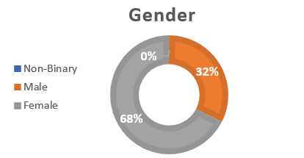
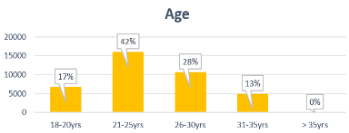
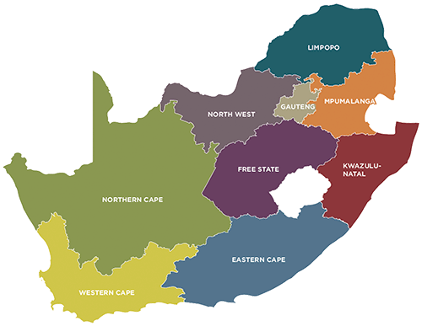
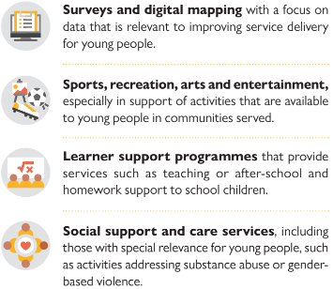
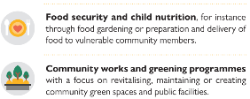
3. National Youth Service
Over 45 000 young people have secured paid service opportunities to date. Using just 16 hours of the participant’s time per week, the NYS with room to explore further opportunities for training, employment or entrepreneurship during their term of service. This eases the transition into follow-on earning activities.
14%
16%
6%
4%
37%
4%
25%
3%
15%
12%
To date 7,634 (17%) transitions have been reported and evidenced.

Slide 15
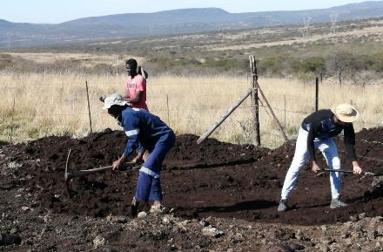
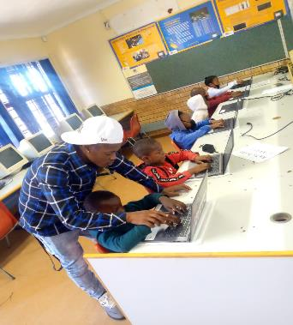
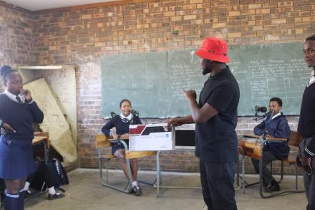
Benefits to the young person and the community
INDIVIDUAL LEVEL
Forming an identity as a working person: Importance of having obtained ‘work’ (being paid) and providing an ‘introduction to the world of work.’
Financial benefits
Greater self-reliance and self-confidence/ increased assertiveness.
Service satisfaction from doing meaningful work.
COMMUNITY LEVEL
Increased awareness in the community about the importance of ECD (over 30,000 children were benefiting from ECD services daily)
Over 27,000 farmers were being assisted by NYS farm assistants.
Over 96,000 young people accessing the sports, recreation, and life skills activities/coaching sessions

Slide 16
Forthcoming work and the future of the NYS
We have sufficient budget to implement NYS for 20 000 participants in 2023 / 2024.
There is potential for a partnership with the SANDF particularly on the medical side of the Defence Force. In our engagements their costs were outside our model for NYS but we will explore further engagements
Key lesson is that it typically takes longer to transition participants into meaningful opportunities. Ideally the program should be a 12-month program.
Some partners have developed successful models, and these have potential to be replicated by other implementers.
There is capacity to scale the program beyond 50 000 participants and sufficient demand side opportunities, however, budgets remain constrained.

Slide 17
Since inception over 4.2 million young people in the NPMN and just over 630 000 earning opportunities secured.

Slide 18
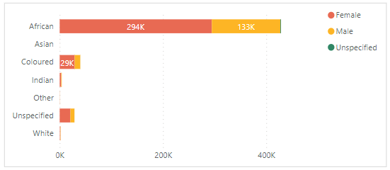
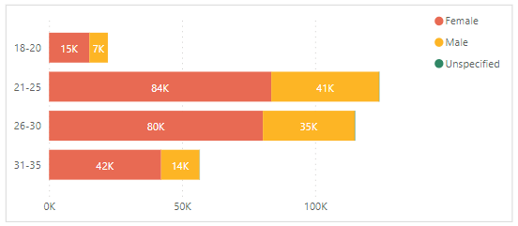
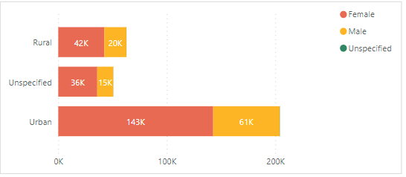
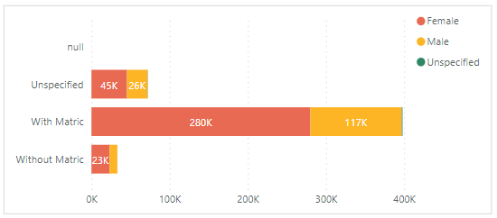
Earning opportunities secured by young African women with matric, mostly in urban areas
Demographic profile of young people securing earning opportunities in the NPMN (Jan – Dec 2022)
Race
Age
Geography
Education

Slide 19
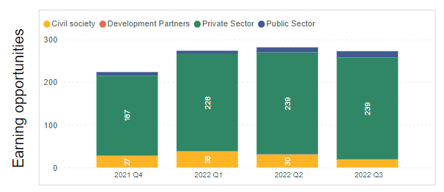
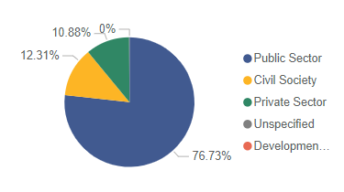
Public employment remains a critical source of earning opportunities for young people
Opportunity holders in the NPMN
Earning opportunities by opportunity holder
(Jan – Dec 2022
Over 80% of the opportunity holders in the NPMN are from the private sector, however, 77% of the earning opportunities secured by young people were provided by the public sector mainly through the Presidential Employment Stimulus, notably the DBE school assistants programme.
While the data on SA Youth is representative of young people, it is not yet representative of all opportunities in the labour market. It does, however, demonstrate the low labour demand noted in existing research.

Slide 20
Overarching reflections and priorities
Institutionalising
Operationalising
Funding
Maintaining additionality
Change is challenging – a concerted effort was and continues to be required to institutionalise the PYEI within government and create effecting mechanisms for partnering with non-government stakeholders
Operationalising the PYEI, especially the innovative and catalytic interventions has required negotiating different rules, cultures and systems between partners while navigating rigidity in the system across the different components
Securing funding from the fiscus that recognises the PYEI as a long term intervention remains a key priority –
making the case for the case for the PYEI and demonstrating the value for different cohorts of young people
A key priority is to maintain the additionality of the PYEI more broadly –
it is not simply about bringing together everything into one place but effectively coordinating the system and introducing catalytic innovation that enhances the overall impact

