Slide 1
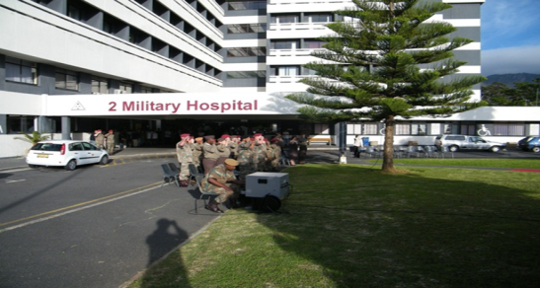
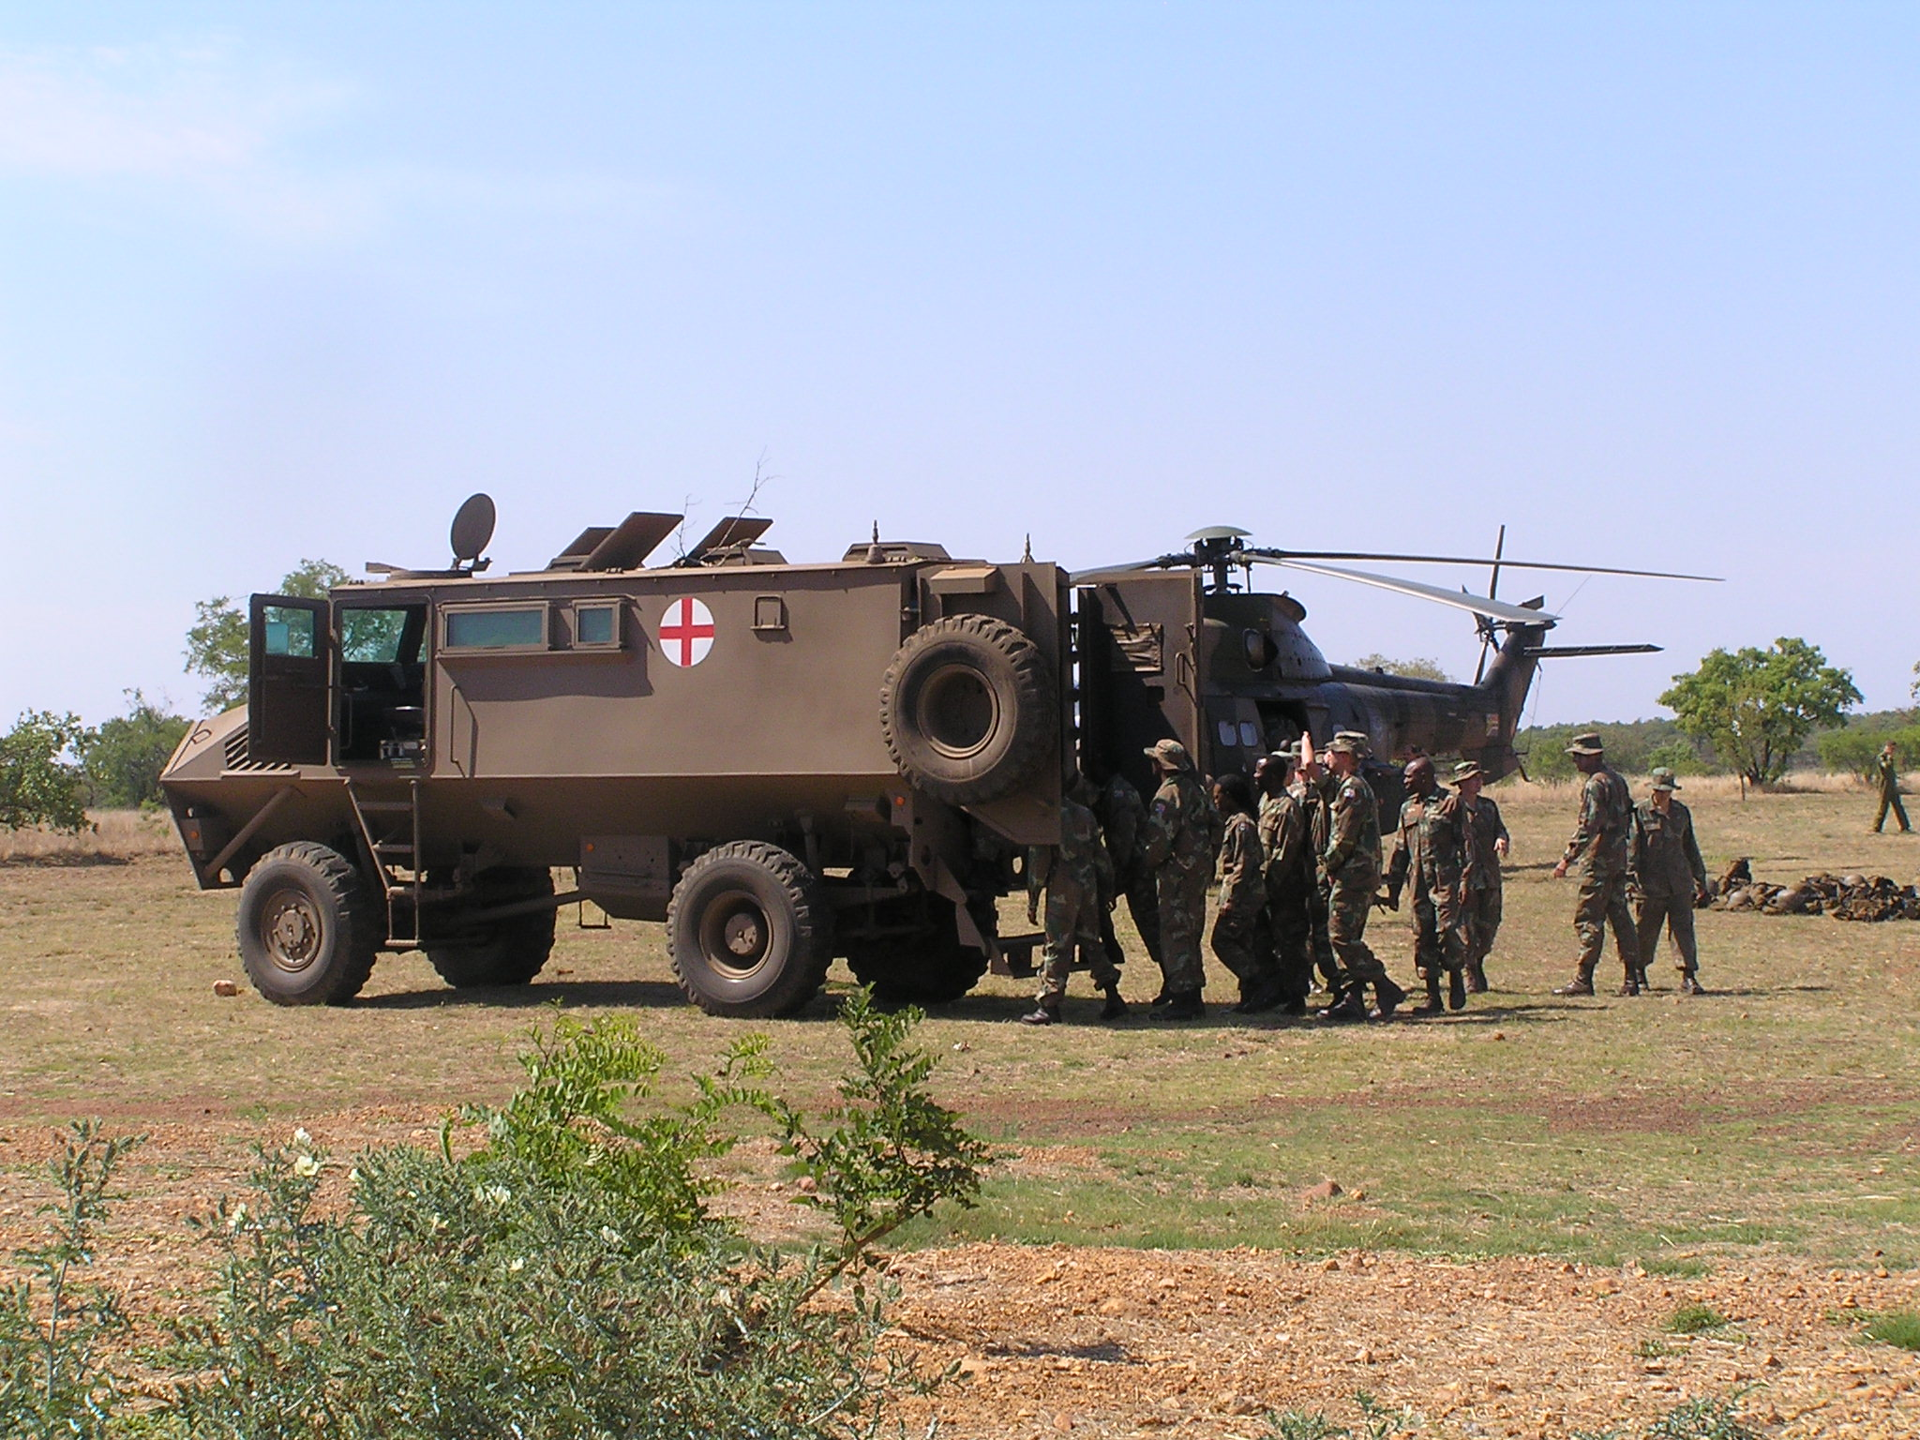
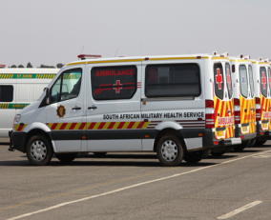
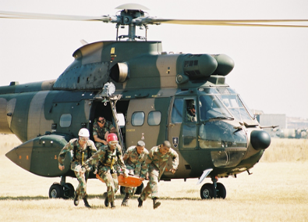
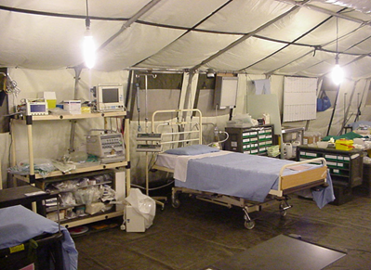
Briefing by the SA Military Health Services on requirements for improving the capacity
and capabilities at Military Hospitals, including needs and expected costs
Joint Standing Committee on Defence
01 June 2023: 18:00 - 21:00 (Virtual)
Brig Gen M.P. Langa
Dir Mil Health Planning
RESTRICTED
RESTRICTED

Slide 2
Aim
Brief the Joint Standing Committee on Defence (JSCD) on the SAMHS Requirements for Improving the Capacity and Capabilities at Military Hospitals, Including Needs and Expected Costs
2

Slide 3
Scope and Layout
SAMHS Mandate
Status and Requirements of Hospitals
Estimate of Expenditure for Requirements
Discussions/Questions / Comments
3

Slide 4
Defence Act and General Regulations determine:
“The SA Military Health Service (SAMHS) must at all times be structured and funded at State cost to provide an all-inclusive multi-disciplinary health capability to the SANDF and its members: Provided that the cost of services to serving members shall be the liability of the State”
Healthcare services to the military community should therefore be regarded as a contractual obligation and an operational standard
SAMHS argues that it is executing the mandate, the biggest challenge is to provide affordable and quality healthcare services within the limitations of resources
SAMHS Mandate
4

Slide 5
SAMHS Mandate
SAMHS Purpose:
Provides prepared and supported health capabilities and services for the defence and protection of South Africa
SAMHS Outputs:
Output 1: A health support capability of five medical battalion groups, including accompanying field hospitals and one specialist medical battalion group for deployed and contingency forces (Joint Force Employment Capabilities [JFE])
Output 2: A comprehensive multidisciplinary military health service for a projected patient population of 302 000 members per year (including Mil Vets) and VVIPs (Presidential Medical Unit) - Base Orientated Support (BOS)
5

Slide 6
Joint Force Employment
Support 10 x SANDF Priority Missions (MS1 to MS10)
Msn 1
Msn 2
Msn 3
Msn 4
Msn 5
Msn 6
Msn 7
Msn 8
Msn 9
Msn 10
Defend RSA
Reach and Intervene
Border Safeguarding
National Infrastructure
Irregular Threats
ICT
PSO
Cooperate with SAPS
Support Other Gov Depts
Support to Presidency
Joint Force Employment
3 x Med Bns (ResF)
2 x Regular Force Bn Gp
Lack of dedicated JFE Capabilities/Structures (1 x Regular Force Bn Gp in support of conventional/peace support operations operates on a virtual structure )
Mfezi
RESTRICTED
6

Slide 7
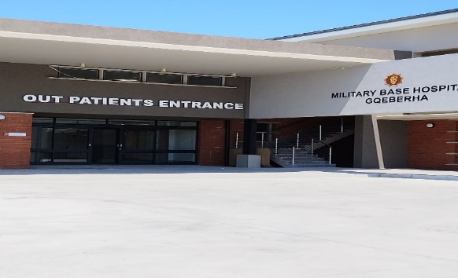
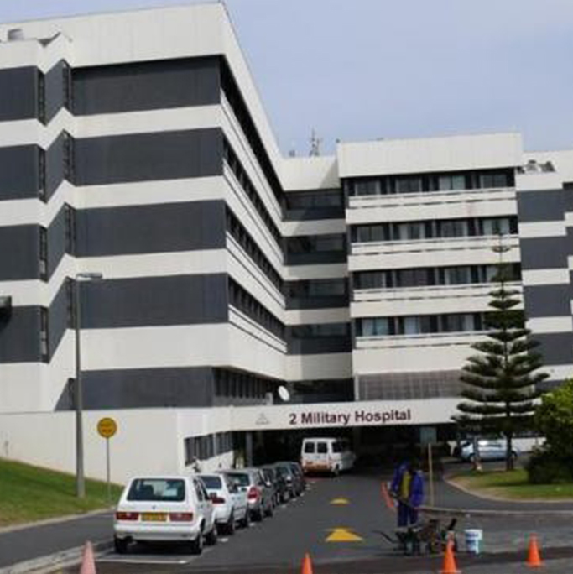
Base Orientated Support
Support to Military Veterans (Challenges are still being experienced with rreimbursements from Dept. of Military Veterans
Force preparation: SA Army Force Prep activities
Ageing military population/ Longevity increases cross-subsidization of Regular Force Medical Continuation Fund (RFMCF)
Ever increasing Joint Force Employment Requirements and Patient Load
Specialist Health Care – Tertiary Hospitals
3 x Hosps
Primary Health Care – Base Hosps and Clinics
86 x Clinics
Very Very Important Persons (VVIP)
Presidential Teams
7

Slide 8
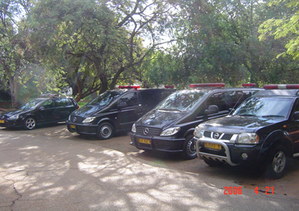
VVIP Support
Incumbent and Retired RSA Heads of State
Incumbent Deputy President
Visiting Heads of State
Services provided via Presidential Medical Unit (PMU)
PMU operate on virtual structure (personnel borrowed from other critical services)
Commitment increases with each new administration
Very Very Important Persons (VVIP)
8

Slide 9
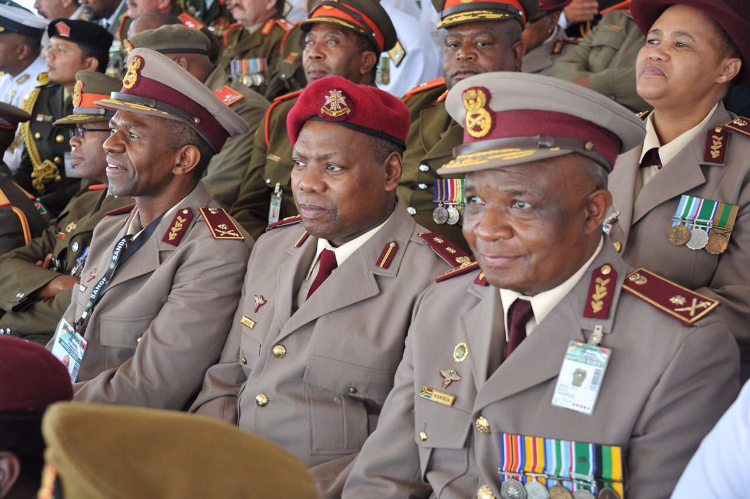
Personnel
SANDF Approved Structure: 73,153
Funded : 64 567
SAMHS Approved Structure: 10 748
National Treasury (NT) Ceiling: 6 612 (SAMHS operating at 62% capacity of its approved structure)
Unilateral Budget Cuts
Human Resource (HR) Capacity Challenges - Costly outsourcing
Provision of 24-hours of care by Hospitals
Current Capacity levels do not allow for the provision of a 24hrs service without the use overtime dispensation

Slide 10
Organisation
Structure
Inadequate funded posts (in relation to patent size [Health Care Practitioner [HCP]-Patient ratio]) and JFE requirements
Presidential Medical Team (PMU) and JFE Capabilities operate on Virtual structures
Lack of dedicated JFE capabilities (HCPs are juggled and shuffled between BOS and JFE commitments)
Increasingly challenging to meet the increased demand for JFE and to simultaneously render base healthcare services
SAMHS has no Regular Force Protection Posts in structure and relies on the call-up Reserve Force (ResF) personnel
Continued budget cuts on ResF Cost of Employee (COE)/reduction in man-days will leave military hospitals, patients and personnel at risk due to lack of protection personnel

Slide 11
Sustainment
SAMHS has over the past five years seen an exponential increase in the number and cost of healthcare outsourcing, including medicine buy-outs to the private sector
Poor standard of health care facilities
Obsolete equipment/ Lack of technologically advanced equipment
Continuous inadequate supply of medicines
Shortage of HCPs as well as medical specialists
Hospitals are unable to sustain stock levels of pharmaceuticals, medical consumables and strategic reserves
Insufficient budget allocation
Lack of cold chain capacity at the Medical Base Depot is also major contributor to the challenges experienced by the hospitals on stock levels
RESTRICTED
11

Slide 12
Training
Backlog of Soldiering Training (Mil Courses)
COVID-19 pandemic has restricted the traditional face-to-face classrooms attendance which compounded training backlog
Backlog has contributed to challenges with overall CR levels
Challenges with SAMHS plan on number of courses to address backlog - Training Formation in dolomitic area of Thaba Tshwane (experiencing sink holes) which poses an occupational risk
Courses relocated to Lephalale Training Centre in Limpopo. Lephalale Trg Centre has limited capacity
12

Slide 13
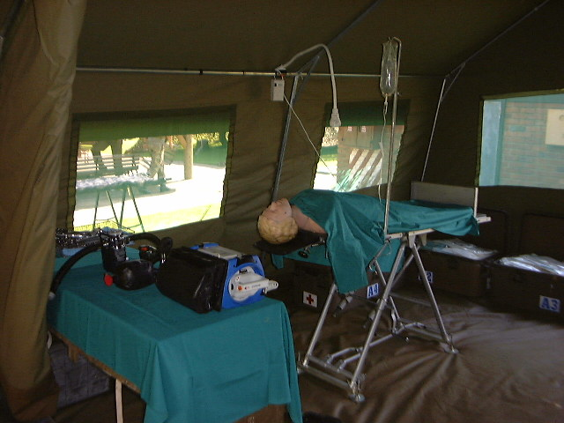
Equipment
Ageing Main Medical Equipment (MME)
Requires constant repairs and servicing. Process of repair and calibration takes too long due to the unavailability of spares
Long waiting times and delays for patients requiring specialist medical intervention
Delays and waiting times potentially exposes patients to development of complications or even loss of life
13

Slide 14
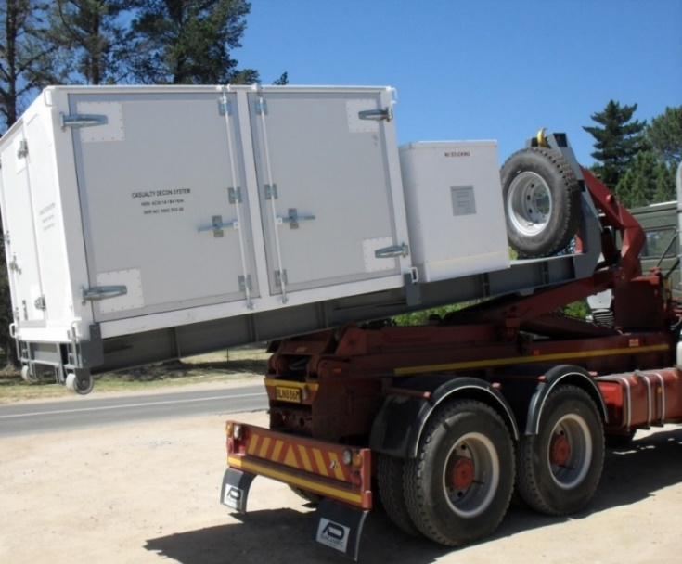
Equipment
Ageing MME
Military Hospitals are designated junior HCPs training routes with regards tutors and community service
Ageing equipment can cause the loss of accreditation with statutory bodies such as Dept. of Health and Health Professions Council of South Africa (HPCSA)
Direct impact on HCPs job satisfaction, standard of care, skills retention and the on-the-job training
Shortage of Ambulances
Ambulances service contracted to private service providers
24 hour hospital service require an increased EMS fleet in order to meet the service requirements of hospitals for emergency and non-emergency patient transfers (inter-facility transfers)
14

Slide 15
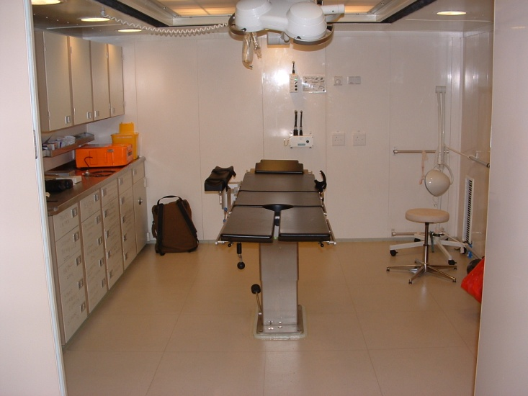
FACILITIES
Facilities
Protracted infrastructure programme has worsened the financial woes of SAMHS, esp. 1 Mil Hospital
1 Mil Hosp, Hoedspruit and Lohathla Base Hosps require significant repairs and maintenance. Facilities not in compliance with the National Norms and Standards.
Can cause the loss of accreditation with statutory bodies such as Dept of Health and Health Professions Council of South Africa (HPCSA) as well as the loss of junior HCPs
Direct impact on HCPs job satisfaction, standard of care, skills retention and the on-the-job training
SAMHS has already lost a number of Specialists (lack of compliance of the medical facilities and equipment)
Contribute to an increase in healthcare outsourcing
Health Facilities require in house maintenance and repair capability (1st and 2nd line). Will contribute to minimising costs associated with unplanned downtime and offset sub-optimal procurement process
15

Slide 16
TECHNOLOGY
Information
Health Informatics System is archaic and paper based
Serious drawback ito the delivery of patient care
Contributes to poor patient care and litigation (records)
Personnel spend more time navigating administrative tasks than they actually engage in value-added tasks
16

Slide 17
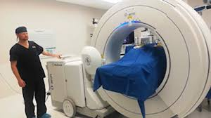
Technology
Military Hospitals lag behind in technology compared to the other public hospitals
Current healthcare infrastructure still functions in silos, with various legacy devices limiting functionality and interoperability with new technology and applications
17

Slide 18
Legal
Department looses millions annually due to medical malpractice/negligence
Claims are driven by the quality of healthcare services and clinical errors
Patients are having higher expectations
Patients being more aware of their rights or as a consequence of older equipment and understaffing
Money spent on these claims is money that could be spent on essential healthcare priorities
18

Slide 19
Budget
Full Cost
R9 619 274 000
R5 525 626 536
10
R9 619 274 538
R5 525 626 000
57%
-Rbn 4.1
9
Medical Inflation?
Quality Health Care?
Technology?
Sustainment?
Facilities?
Incentives for HCPs
8
7
Full Cost
6
HR
R6 365 776 706
R3 998 500 921
5
4
COE Budget
3
Operating
R2 713 597 261
R1 527 125 097
2
Op Budget
1
Cap Budget
Capital
0
FY10
FY14
FY16
FY18
FY20
FY22
FY24
19

Slide 20
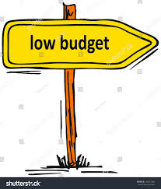
Budget
Funding Gap (Underfunding at Rb4,5 )
Fail to account for inflation
Population growth (patient load)
Changes in the DOD footprint (more operations)
Impact on:
Squeeze on day-to-day unit combat readiness, quality of patient care and support to Services force-preparation
Acquisition and retention of scarce skills
Shortages of Pharmaceuticals and medical Consumables
Acquisition of health technology
Refurbishment of facilities
20

Slide 21
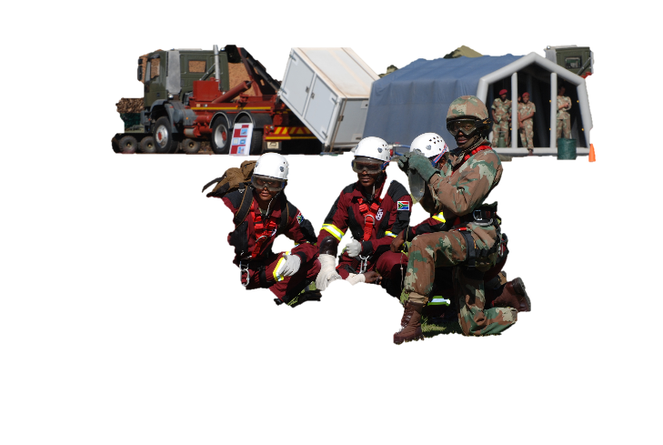
SAMHS’ Collateral Utility
SAMHS contributed to National Development Plan (NDP) 2030 - Vision for the South African health system to achieve “A long and healthy life for all South Africans”
Op CHARIOT - In support to the Department of Health (DOH) during industrial action over the period 08 to 30 March 2023
North West: Tshepong hospital
Gauteng
Thelle Mogoerane, Vosloorus
Sebokeng
Kwa-Zulu Natal
KwaDabeka Clinic, KwaMashu Community Hospital and Northdale Hospital
21

Slide 22
SAMHS’ Collateral Utility
Project OWETHU - SAMHS’ Armed Forces Event Community Outreach Project ( 02 - 22 Feb 2023)
Eshowe District Hospital, KwaMsane Clinic and 18 villages in and around Eshowe
17 662 Health Care Activities
Oral Health: 1 084 (Oral health screenings, partial plastic/acrylic dentures, prosthodontic, oral health treatment, septic socket treatment, fillings, root canal Treatment, dental extraction, scaling and polishing)
Animal Health: 4 011 (Rabies canine inoculations, rabies cats inoculations , female dog mastectomy, female dog sterilization, puppy consultation, cat consultation, etc)
22

Slide 23
SAMHS’ Collateral Utility
Ex SHARED ACCORD 22
Richards Bay, 30 Jun to 30 Jul 22 in
Exercise included an Outreach Programme - Local Communities
Mhlathuzi Municipality
Ntambana, Madwaleni, Dondota, Shikishela, Bhekamandla & Nqamlana, Mfekanyi West, Nhlohlweni, Qakweni, Obizo and Kwa Hlaza
Health Activities Statistics
Oral Health activities: 3 309
Animal Health activities: 1 045
Others: 1737
Grand Total: 6 091
23

Slide 24
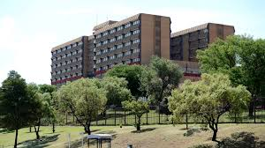
Key Requirements
Key Requirements to optimize health care:
Acquisition and retention of HCPs
Upgrading of military health facilities
Required Pharmaceutical Stock levels
Establishment of in-house capabilities for 1st and 2nd line (Workshops/Factotums)
Medical Equipment
Contemporary and Digital Technology
Electronic Security Surveillance System
eLearning and Virtual Learning
24

Slide 25
Estimate of Expenditure (EoE) for Investment in Initiatives of Improving the Capacity and Capabilities of Military Hospitals
25

Slide 26
Estimate of Expenditure
SAMHS requires capital injection to invest in initiatives to improve the capacity and capabilities of military hospitals is estimated as follows
Ser | Facility | Medical Specialists | Nursing Officers | Medical Officers/ Dental Officers | Other HCPs | Support Personnel | Total
1 | 1 Mil Hosp | 15 | 388 | - | 163 | 233 | 799
2 | 2 Mil Hosp | 13 | 72 | 12 | 31 | 177 | 305
3 | 3 Mil Hosp | 15 | 62 | 26 | 32 | 67 | 202
4 | SAA CTC | - | 12 | - | 5 | 23 | 40
5 | Saldanha | - | 4 | 1 | 16 | 4 | 25
6 | Middleburg | - | 7 | - | 9 | 21 | 37
7 | Qheberha | - | 55 | 15 | 53 | 58 | 181
8 | Hoedspruit | - | 5 | 2 | 27 | 8 | 42
9 | Totals | 43 | 605 | 56 | 336 | 591 | 1 631
Totals Personnel Required: 1 688 COE Estimate: R721 861 000,00 (COE Calculation was done on current notch as on 30 April 2023)
12
RESTRICTED
26

Slide 27
Estimate of Expenditure
Ser | Operation | Rand
1 | In-house capability, Factotum (Pretoria, Bloemfontein and Cape Town) | Rm 60
2 | Ambulances | Rm100
3 | Digital Infrastructure and Medical Equipment
 | Internet connectivity and reliable bandwidth | Rm 32
 | Accessibility to eLearning networks (eLibrary) | R 17,5m
 | Investment in technology platforms that put the patient at the centre of care (eHealth, mHealth) to improve health outcomes) | Rm 120
 | Medical Equipment | Rm 370
 | Digitalisation of Records (electronic medical records and overtime management) Cost Factors: Initial system costs (hardware and software), Integration with other systems, Data storage and migration costs, including costs for records that need to be maintained in medium to long-term (over 10 years) | Rm 405
4 | Security
 | Installation of video detection and surveillance systems) can be a force multiplier | Rm 44
 | Installation of biometric system for staff and patients (Member and dependants) | Rm 34
TOTAL |  | Rb 1 182
15
RESTRICTED
27

Slide 28
Estimate of Expenditure
The cost of resources required to improve the capacity and capabilities of military hospitals is Rb 2 707
Human Resources: Rb 1 521, 5 (Annually)
Other Resources: Rb 1 182,5 (Once-Off Capital Injection over single or multiple financial years)
28
RESTRICTED
28

Slide 29
Concluding Remarks
The key to the functionality of the military health system depends on:
Medical infrastructure that is compliant with National Health Norms and Standards, Occupational Health and Safety (OHS) and statutory regulations. Infrastructure that is fully maintained and managed accordingly
Contemporary technology ito health informatics system and medical equipment
Investment in digital technology to improve efficiency and effectiveness of management systems
Adequate, approximately skilled and well-resourced HR
Investment in health infrastructure
29
RESTRICTED
29

Slide 30
Discussions/Questions / Comments
30
RESTRICTED
30

