Slide 1

Seda 2022/23 Quarter 4 Performance
Meeting: Portfolio Committee
Date:
Presenter:
Date: 31 May 2023
Presenter: Mr. N Mbatha

Slide 2
PRESENTATION OUTLINE
1 | Introduction
2 | Performance Overview
3 | Performance Information
4 | Human Resource Report
5 | Financial Report
6 | Governance and Compliance
7 | Marketing and Communication
8 | Key Projects

Slide 3



1. INTRODUCTION
Notes:
As At 30 September 2022, the portfolio had a total balance of R3.9bn (Including funds).
The total portfolio is made up of R1.4bn WL representing 36% and R2.5bn in DL representing 64%.
The WL book increased by 5% (R71.2m) quarter on quarter as a result of the net effect of repayments and disbursements.
DL book grew by 10% (R233m) quarter on quarter as a result of new disbursements and repayments.

Slide 4
Introduction
The report highlights the organisation's performance for the fourth quarter of the 2022/23 Financial Year.
A total number of 20 indicators were measured in quarter 4, The organisation achieved 100% or more on 19 indicators and underperformed on 1 indicator. This amounts to 95% performance achievement.
One indicator that was under achieved below 50%: Number of SMMEs & Cooperatives assisted through the Technology Transfer Assistance Programme
Notes:
As At 30 September 2022, the portfolio had a total balance of R3.9bn (Including funds).
The total portfolio is made up of R1.4bn WL representing 36% and R2.5bn in DL representing 64%.
The WL book increased by 5% (R71.2m) quarter on quarter as a result of the net effect of repayments and disbursements.
DL book grew by 10% (R233m) quarter on quarter as a result of new disbursements and repayments.

Slide 5
2. PERFORMANCE OVERVIEW
Notes:
As At 30 September 2022, the portfolio had a total balance of R3.9bn (Including funds).
The total portfolio is made up of R1.4bn WL representing 36% and R2.5bn in DL representing 64%.
The WL book increased by 5% (R71.2m) quarter on quarter as a result of the net effect of repayments and disbursements.
DL book grew by 10% (R233m) quarter on quarter as a result of new disbursements and repayments.

Slide 6
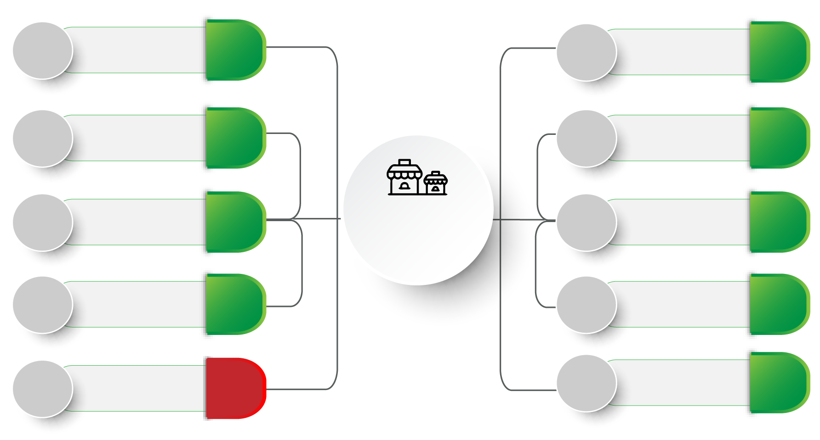
Performance Overview
7 000
Entrepreneurship
Awareness
10 065
2 500
Incubation
Programme
2507
5 000
Township & Rural
based clients
6 814
500
Productivity
Improvement
569
20
Seda Access
Points
34
Total SMMEs &
Cooperatives
Supported
30 789
750
Quality
Improvement
1 377
Access to
Local
Markets
2 054
Priority Sectors
62
600
30
300
Access to
International
Markets
457
6 000
Training, Mentorship
& Coaching
6 884
Notes:
As At 30 September 2022, the portfolio had a total balance of R3.9bn (Including funds).
The total portfolio is made up of R1.4bn WL representing 36% and R2.5bn in DL representing 64%.
The WL book increased by 5% (R71.2m) quarter on quarter as a result of the net effect of repayments and disbursements.
DL book grew by 10% (R233m) quarter on quarter as a result of new disbursements and repayments.

Slide 7
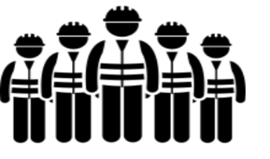
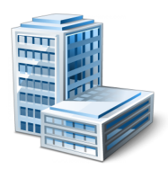
Performance Overview
Jobs Created & Sustained
Seda Branches - 53
Incubation Centres - 110
Seda Access Points - 58
6 910
Seda Colocation Points - 57
Notes:
As At 30 September 2022, the portfolio had a total balance of R3.9bn (Including funds).
The total portfolio is made up of R1.4bn WL representing 36% and R2.5bn in DL representing 64%.
The WL book increased by 5% (R71.2m) quarter on quarter as a result of the net effect of repayments and disbursements.
DL book grew by 10% (R233m) quarter on quarter as a result of new disbursements and repayments.

Slide 8
Seda Quarter 4 Performance Comparison
Notes:
As At 30 September 2022, the portfolio had a total balance of R3.9bn (Including funds).
The total portfolio is made up of R1.4bn WL representing 36% and R2.5bn in DL representing 64%.
The WL book increased by 5% (R71.2m) quarter on quarter as a result of the net effect of repayments and disbursements.
DL book grew by 10% (R233m) quarter on quarter as a result of new disbursements and repayments.

Slide 9
3. PERFORMANCE INFORMATION
Notes:
As At 30 September 2022, the portfolio had a total balance of R3.9bn (Including funds).
The total portfolio is made up of R1.4bn WL representing 36% and R2.5bn in DL representing 64%.
The WL book increased by 5% (R71.2m) quarter on quarter as a result of the net effect of repayments and disbursements.
DL book grew by 10% (R233m) quarter on quarter as a result of new disbursements and repayments.

Slide 10
PROGRAMME 1: Township, Rural and Informal Business
NO. | Output Indicator | Annual Targets | Q4 Target | Q4 Achievement | Q4 Variance | Reason for Variance | Corrective Measures | YTD Target | YTD Achieve ment
1.1 | Number of SMMEs & Cooperatives reached through entrepreneurship awareness sessions | 20 000 | 7 000 | 10 065 | 3 065 | Target exceeded due to more briefing and outreach sessions that took place during the quarter. | None | 20 000 | 68 117
1.2 | Number of township & rural business supported | 16 000 | 5 000 | 6 814 | 1 814 | The leads that were generated in the previous quarter were assisted with various interventions, such as Business Plans, Promotional material, signage and facilitation of access to finance. | None | 16 000 | 22 181
1.3 | Number of new Incubation Centres established | 11 | 4 | 11 | 7 | The targeted number of incubation centres were established at the end of the fourth quarter. | None | 11 | 11
1.4 | Number of new Seda access point | 80 | 20 | 34 | 14 | The organisation adjudicated 75 partners where 58 partners signed the contracts/service level agreement. While 17 partners only signed the acceptance letters. | Seda will finalise contracting with approved partners in the new financial year. | 80 | 58
1.5 | Ecosystem Development Plan implementation | 40% | - | - | 0 | None | None | 40% | 40%
Notes:
As At 30 September 2022, the portfolio had a total balance of R3.9bn (Including funds).
The total portfolio is made up of R1.4bn WL representing 36% and R2.5bn in DL representing 64%.
The WL book increased by 5% (R71.2m) quarter on quarter as a result of the net effect of repayments and disbursements.
DL book grew by 10% (R233m) quarter on quarter as a result of new disbursements and repayments.

Slide 11
PROGRAMME 2: Business Competitiveness and Viability
No. | Output indicator | Annual Targets | Q4 Target | Q4 Achievement | Q4 Variance | Reason for Variance | Corrective Measures | YTD Target | YTD Achieve- ment
2.1 | Number of SMMEs & Cooperatives exposed to Local markets | 2 000 | 600 | 2 054 | 1 454 | Access to Local market interventions like mall activation, pop-up markets & enterprise and supplier development contributed to this performance. | None | 2 000 | 5 207
2.2 | Number of SMMEs & Cooperatives supported to participate in the international markets | 1 000 | 300 | 457 | 157 | Seda was able to support a significant number of clients to participate in many tradeshows, export awareness and international trade webinars. | None | 1 000 | 2 559
2.3 | Number of SMMEs & Cooperatives assisted through Incubation programme | 2 500 | 2 500 | 2507 | 07 | A targeted number of clients were enrolled into the incubation programme. | None | 2 500 | 2 507
2.4 | Number of SMMEs & Cooperatives assisted with Productivity improvement | 2 000 | 500 | 569 | 69 | The increase in performance was due to the increased demand of productivity improvement trainings. | None | 2 000 | 3 010
2.5 | Number of SMMEs & Cooperatives assisted through the Technology Transfer Assistance Programme | 70 | 25 | 0 | 25 | Under achievement due to budgetary constraints | In the new financial year, the target has been reduced to match available funding. | 70 | 32
Notes:
As At 30 September 2022, the portfolio had a total balance of R3.9bn (Including funds).
The total portfolio is made up of R1.4bn WL representing 36% and R2.5bn in DL representing 64%.
The WL book increased by 5% (R71.2m) quarter on quarter as a result of the net effect of repayments and disbursements.
DL book grew by 10% (R233m) quarter on quarter as a result of new disbursements and repayments.

Slide 12
PROGRAMME 2: Business Competitiveness and Viability
No. | Output indicator | Annual Targets | Q4 Target | Q4 Achievement | Q4 Variance | Reason for Variance | Corrective Measures | YTD Target | YTD Achieve- ment
2.6 | Number of SMMEs & Cooperatives assisted with Quality improvements | 2 500 | 750 | 1 377 | 627 | Training focusing on Quality Management Systems & HACCP took place and QMS training were facilitated during the quarter. | None | 2 500 | 5 231
2.7 | Number of SMMEs & Cooperatives whose turnover has increased by 5% per annum | 450 | 100 | 1 194 | 1 094 | More improvement assessments were conducted in this quarter, whilst more businesses reported an increase in turnover still recovering after the lockdowns. | None | 450 | 2 754
2.8 | Number of jobs created | 4 000 | 1 200 | 2 255 | 1 189 | Most of the assessed businesses created jobs. More focus was on large-scale and job creating sectors. | None | 4 000 | 5 415
2.9 | Number of jobs sustained | 6 000 | 2 000 | 4 655 | 2 655 | The high number of jobs sustained is a result of the number of interventions implemented with most of the assessed businesses focusing on retaining jobs due to the economic climate. | None | 6 000 | 13 991
Notes:
As At 30 September 2022, the portfolio had a total balance of R3.9bn (Including funds).
The total portfolio is made up of R1.4bn WL representing 36% and R2.5bn in DL representing 64%.
The WL book increased by 5% (R71.2m) quarter on quarter as a result of the net effect of repayments and disbursements.
DL book grew by 10% (R233m) quarter on quarter as a result of new disbursements and repayments.

Slide 13
PROGRAMME 2: Business Competitiveness and Viability
No. | Output indicator | Annual Targets | Q4 Target | Q4 Achievement | Q4 Variance | Reason for Variance | Corrective Measures | YTD Target | YTD Achieve- ment
2.10 | Number of SMMEs & Co-operatives supported in the priority sectors (Scale-Up / High Growth Potential) | 100 | 30 | 62 | 32 | Focus was given to high end clients in the priority sectors with business development support. | None | 100 | 196
2.11 | Number of SMMEs & Co-operatives supported with training, mentorship & coaching | 20 000 | 6 000 | 6 884 | 884 | Clients were assisted with Business management skills, customer care, and sector specific training during the quarter. | None | 20 000 | 30 068
Notes:
As At 30 September 2022, the portfolio had a total balance of R3.9bn (Including funds).
The total portfolio is made up of R1.4bn WL representing 36% and R2.5bn in DL representing 64%.
The WL book increased by 5% (R71.2m) quarter on quarter as a result of the net effect of repayments and disbursements.
DL book grew by 10% (R233m) quarter on quarter as a result of new disbursements and repayments.

Slide 14
PROGRAMME 3: Administration
No. | Output indicator | Annual Targets | Q4 Target | Q4 Achievement | Q4 Variance | Reason for Variance | Corrective Measures | YTD Target | YTD Achieve- ment
3.1 | Percentage of innovative ideas implemented | 35% | 35% | 40% | 5% | The organisation implemented 40% of the project plan. | None | 35% | 40%
3.2 | Percentage of staff who performed at 311 & above in the performance evaluation recognized for excellence | 60% | 60% | 61% | 1% | Based on the performance evaluations scores, the organisation achieved the target set. | None | 60% | 61%
3.3 | Percentage of staff satisfaction | 50% | - | - | - | None | None | 50% | 51%
3.4 | Percentage of customer satisfaction | 80% | 80% | 99% | 19% | The target was exceeded due to positive feedback from clients | None | 80% | 99%
3.5 | Percentage of vacancy rate | 10% | 10% | 7,3% | 2,7% | Continuous engagements and follow-ups made to accelerate the filling of approved critical vacant positions | None | 10% | 7,3%
3.6 | Number of priority systems digitized | 2 | 2 | 4 | 2 | The following system were implemented: Board View Client Assessment & Diagnostics (Tools portal) Declaration of outside interest (Case management) Performance Reporting System | None | 2 | 4
Notes:
As At 30 September 2022, the portfolio had a total balance of R3.9bn (Including funds).
The total portfolio is made up of R1.4bn WL representing 36% and R2.5bn in DL representing 64%.
The WL book increased by 5% (R71.2m) quarter on quarter as a result of the net effect of repayments and disbursements.
DL book grew by 10% (R233m) quarter on quarter as a result of new disbursements and repayments.

Slide 15
Cooperatives Supported
Quarter 4 Performance | Achievement
Total Number of Cooperatives supported | 600
Indicators where Cooperatives were supported | Township and Rural Businesses Access to Local Markets Quality Improvement Priority Sector Training, Mentorship and Coaching
Notes:
As At 30 September 2022, the portfolio had a total balance of R3.9bn (Including funds).
The total portfolio is made up of R1.4bn WL representing 36% and R2.5bn in DL representing 64%.
The WL book increased by 5% (R71.2m) quarter on quarter as a result of the net effect of repayments and disbursements.
DL book grew by 10% (R233m) quarter on quarter as a result of new disbursements and repayments.

Slide 16
4. HUMAN RESOURCE REPORT
Notes:
As At 30 September 2022, the portfolio had a total balance of R3.9bn (Including funds).
The total portfolio is made up of R1.4bn WL representing 36% and R2.5bn in DL representing 64%.
The WL book increased by 5% (R71.2m) quarter on quarter as a result of the net effect of repayments and disbursements.
DL book grew by 10% (R233m) quarter on quarter as a result of new disbursements and repayments.

Slide 17
Human Resource Vacancies
The total approved structure -713
The total number of staff as of the end of March 2023 was 661
The vacancy rate as of the end of March 2023: 7.3%
Total number employees as per approved structure -713
Number of staff as at end September 2022 was 679
The vacancy rate as end June 2022 : 4,8%
Notes:
As At 30 September 2022, the portfolio had a total balance of R3.9bn (Including funds).
The total portfolio is made up of R1.4bn WL representing 36% and R2.5bn in DL representing 64%.
The WL book increased by 5% (R71.2m) quarter on quarter as a result of the net effect of repayments and disbursements.
DL book grew by 10% (R233m) quarter on quarter as a result of new disbursements and repayments.

Slide 18
5. FINANCIAL REPORT
Notes:
As At 30 September 2022, the portfolio had a total balance of R3.9bn (Including funds).
The total portfolio is made up of R1.4bn WL representing 36% and R2.5bn in DL representing 64%.
The WL book increased by 5% (R71.2m) quarter on quarter as a result of the net effect of repayments and disbursements.
DL book grew by 10% (R233m) quarter on quarter as a result of new disbursements and repayments.

Slide 19
BUDGET 2022/2023
Budget for 2022/23
The total revenue budget for Seda for the 2022/23 financial year amounts to R955,20 million and, the total expenditure budget amounts to R955,20 million (including capital). The total include R60 million for special Flood Relief project.
Notes:
As At 30 September 2022, the portfolio had a total balance of R3.9bn (Including funds).
The total portfolio is made up of R1.4bn WL representing 36% and R2.5bn in DL representing 64%.
The WL book increased by 5% (R71.2m) quarter on quarter as a result of the net effect of repayments and disbursements.
DL book grew by 10% (R233m) quarter on quarter as a result of new disbursements and repayments.

Slide 20
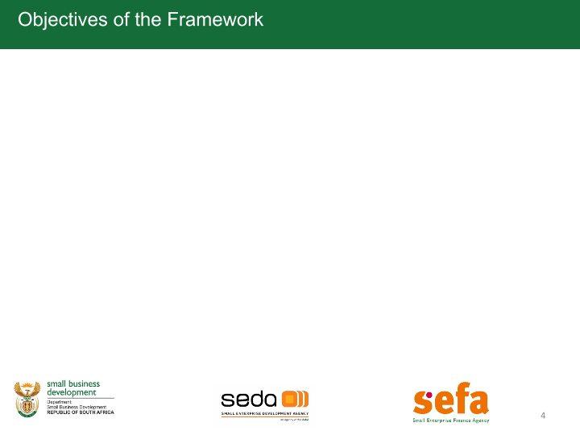

EXPENDITURE SPLIT OF CORE VS SUPPORT FUNCTIONS
Actual expenditure
Core:
R865,06 million
Support:
R89,49 million
Target
Core:
75%
Support:
25%
Achieved
Core:
91%
Support:
9%
Seda’s target is to allocate 75% and above on the core and 25% to support.

Slide 21
FINANCIAL REPORT end of Quarter 3
The expenditure as at the fourth quarter (January – March 2023), amounted to R221,85 million against the budget of R210,81 million, resulting in overspending of R11,04 million (5.24%).
The overspending in quarter 4 was due to catching up from the past quarters that were underspending.
The annual underspending is R647 684 (0.07%) at year end.
99,9% of the invoices (3817) were paid within 30 days. One invoice from NW Province was delayed by the branch. The remedial action was taken against the responsible official.
Notes:
As At 30 September 2022, the portfolio had a total balance of R3.9bn (Including funds).
The total portfolio is made up of R1.4bn WL representing 36% and R2.5bn in DL representing 64%.
The WL book increased by 5% (R71.2m) quarter on quarter as a result of the net effect of repayments and disbursements.
DL book grew by 10% (R233m) quarter on quarter as a result of new disbursements and repayments.

Slide 22
FINANCIAL REPORT FOR QUARTER 4
Explanation of variances:
Personnel costs – The variance of 1.61% in the fourth quarter is mainly due the provisions and accruals for year-end related.
Administration, Project and Programme – overspending of 9.00% catching up from past quarters, on overall year end there is no overspending.
Capital expenditure – Overspending due to ordered items arrived in Quarter 4.
The expenditure for the quarter is an overspending is 5.24%.
Overall for the year end the actual expenditure is R954 555 841 (99,93%), thereby underspending by 0.07%

Slide 23
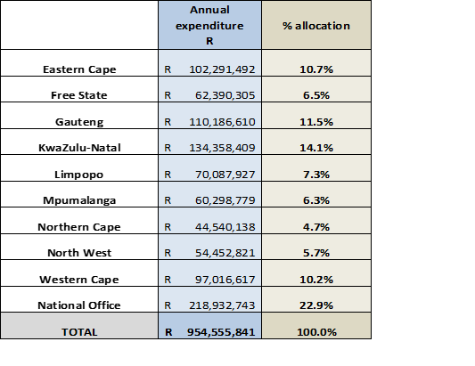
SPLIT PER PROVINCE & NATIONAL OFFICE (Apr – Mrch 2023)
KZN and EC received R60 million for the Flood Relief project.
Notes:
As At 30 September 2022, the portfolio had a total balance of R3.9bn (Including funds).
The total portfolio is made up of R1.4bn WL representing 36% and R2.5bn in DL representing 64%.
The WL book increased by 5% (R71.2m) quarter on quarter as a result of the net effect of repayments and disbursements.
DL book grew by 10% (R233m) quarter on quarter as a result of new disbursements and repayments.

Slide 24
AG - AUDIT FINDINGS
Performance Information issues raised:
In the fourth quarter the organisation continued with providing training and guidance on capturing data on the Performance Reporting system.
Performance information audit was conducted to confirm that various divisions are reporting achievement that is backed by data.

Slide 25
6. GOVERNANCE & COMPLIANCE
Notes:
As At 30 September 2022, the portfolio had a total balance of R3.9bn (Including funds).
The total portfolio is made up of R1.4bn WL representing 36% and R2.5bn in DL representing 64%.
The WL book increased by 5% (R71.2m) quarter on quarter as a result of the net effect of repayments and disbursements.
DL book grew by 10% (R233m) quarter on quarter as a result of new disbursements and repayments.

Slide 26
Board Priorities (January – March 2023)
Committee | Number of Scheduled meetings | Dates
Board meetings | 3 | 31 January 2023 15 March 2023 (Special) 30 March 2023
Strategy and Organisational Performance Committee | 3 | 24 January 2023 24 February 2023 (Special) 24 March 2023 (Special)
Audit and Risk Committee | 1 | 25 January 2023
Human Resources and Remuneration Committee | 1 | 22 March 2023
Social and Ethics Committee | 1 | 23 March 2023
Amalgamation Committee | 1 | 23 March 2023
Incubation Committee | 3 | 23 January 2023 01 February 2023 (Special) 30 March 2023 (Special)
Nomination Committee | 2 | 13 March 2023 27 March 2023
Notes:
As At 30 September 2022, the portfolio had a total balance of R3.9bn (Including funds).
The total portfolio is made up of R1.4bn WL representing 36% and R2.5bn in DL representing 64%.
The WL book increased by 5% (R71.2m) quarter on quarter as a result of the net effect of repayments and disbursements.
DL book grew by 10% (R233m) quarter on quarter as a result of new disbursements and repayments.

Slide 27
Board Priorities (January – March 2023)
During the period under review the Board held 3 meetings (Scheduled and Special). The Board approved the following Policies to enhance operational efficiency:
Reviewed Data Classification Policy
Reviewed Information Security Policy
Reviewed Local Access Policy
Reviewed Telecommunications Policy
Reviewed Mobile Policy
Reviewed Application Security Policy
Reviewed Recruitment and Selection Policy
Reviewed Employment Equity Policy
Reviewed Performance Management and Development Policy
Reviewed Remuneration Policy
Reviewed ICT Governance Policy
Notes:
As At 30 September 2022, the portfolio had a total balance of R3.9bn (Including funds).
The total portfolio is made up of R1.4bn WL representing 36% and R2.5bn in DL representing 64%.
The WL book increased by 5% (R71.2m) quarter on quarter as a result of the net effect of repayments and disbursements.
DL book grew by 10% (R233m) quarter on quarter as a result of new disbursements and repayments.

Slide 28
Board Priorities (January – March 2023)
The Board deliberated on, and approved the following:
Finance and Supply Chain Management Quarter 3 Report
Business Continuity Management Framework
Business Continuity Management Strategy
Risk and Investigations 3rd Quarter Report
Compliance and Ethics Management 3rd Quarter Report
Risk Appetite and Tolerance Matrix
Strategic Risk Register
Seda Quarter 3 Report
ICT Governance Framework
Draft Annual Board Calendar 2023/2024
Final Provincial Oversight Report
Annual Performance Plan
Presentation of ICT Strategy
Human Resources Strategic Report Quarter 3
Employee Satisfaction Survey
Motivation for amendment of PAD & Learning organogram and creation of new position: Senior Manager ESD and Export and Development
ASF2022 Close-Out Report
Motivation for Extension of the fixed term contract: EM:EDD
Notes:
As At 30 September 2022, the portfolio had a total balance of R3.9bn (Including funds).
The total portfolio is made up of R1.4bn WL representing 36% and R2.5bn in DL representing 64%.
The WL book increased by 5% (R71.2m) quarter on quarter as a result of the net effect of repayments and disbursements.
DL book grew by 10% (R233m) quarter on quarter as a result of new disbursements and repayments.

Slide 29
7. MARKETING & COMMUNICATION
Notes:
As At 30 September 2022, the portfolio had a total balance of R3.9bn (Including funds).
The total portfolio is made up of R1.4bn WL representing 36% and R2.5bn in DL representing 64%.
The WL book increased by 5% (R71.2m) quarter on quarter as a result of the net effect of repayments and disbursements.
DL book grew by 10% (R233m) quarter on quarter as a result of new disbursements and repayments.

Slide 30

Marketing and Communication
Events support provided to Seda divisions and the DSBD
Audiovisual Communication
Brand Management & Website and Intranet
Township Rural Outreach Programme
Eastern Cape Township Rural Event in Matatiele 14 March 2023
Northern Cape Township Rural Event in Griekwastad 15 March 2023
Western Cape underserviced areas 8-9 Mar 2023
Enterprise Coaching and Mentorship Programme
Graduation Ceremony in Tzaneen (Mopani) 15/02/2023
Graduation Ceremony in Vryburg 17/03/2023
Graduation Ceremony in Pietermaritzburg 22/ 03/2023
SMME’s Bootcamps conducted in all Provinces
Pop-Up Markets
4 x Pop-Up Markets held as supported
External and Audio Visuals
Voiceovers for Pop-Up Markets done inhouse
aired on local radio stations.
Voiceovers
8 audio-visuals of Seda’s success stories placed on Youtube
Success Stories (As per annual report Seda Programmes (e.g sheTradesZa) Webinars conducted.
Manufacturing sector audio-visuals (featured Limpopo Provincial Manager and WC Provincial Manager done
Hackathons Women Coaching audio-visual communication is done.
Board Chair Messaging on Technology Transfer Assistance and Youth done
Brand Management
The Internal Brand Awareness Campaign commenced in Q3 (My Seda, My Brand, My Pride)
Brand Advocates trained and started performing their role.
A Brand repositioning video was developed to train Provincial Marketing Specialists and Brand Advocates
Brand Spirit Booklet developed and shared with all employees
Brand Style guide/CI manual updated and shared with all employees
Brand Style guide/CI manual training sessions conducted
To ensure standardized branding- Pull-up banners, Wall Banners & Telescopic banners were procured and delivered to Provinces in February 2023 detailing Vision and Mission, Portfolio, and Key Messages.

Slide 31
8. KEY PROJECTS
Notes:
As At 30 September 2022, the portfolio had a total balance of R3.9bn (Including funds).
The total portfolio is made up of R1.4bn WL representing 36% and R2.5bn in DL representing 64%.
The WL book increased by 5% (R71.2m) quarter on quarter as a result of the net effect of repayments and disbursements.
DL book grew by 10% (R233m) quarter on quarter as a result of new disbursements and repayments.

Slide 32
High Impact Projects
Project/targeted support | Project Focus/ Outcomes
Aukotowa Fisheries | Aukotowa fisheries in Northern Cape is a primary cooperative that was registered in 2018. It is an initiative that focuses on benefiting small scall fishers through working together. The Cooperative consists of 50 members. It has about 28 boats it uses through its members for fishing. The Cooperative has obtained a license for nearshore -Lobster, offshore- Lobster, traditional Line fish. It is currently waiting for its Hake hand line fishing and meetings scheduled with Department fisheries for this. Project of Financial Management completed during the month under review.
Petra Mines – Xhariep | Letsemeng Local Municipality and Letsemeng community are implementing a Social Labour Plan (SLP 3) as well as a brick making plant and stone crusher plant. The Mine has allocated over R10 million for implementation for 2 of these projects.
Buntu Foods – Manufacturing Project | Buntu Foods is a Large-Scale Project in the Midrand / City of Joburg area. Buntu Foods manufacture white label products for different companies such as Cremora, Ricoffy and other products for Nestle. They have capacity to increase their manufacturing capacity at the Midrand plant. Buntu Foods is 100% black owned and managed. Buntu Foods have off-takes agreements in some of the countries on the continent and manufacture African delicacies such as tripe and chicken feet.

Slide 33

Thank You!
Thank You!

Slide 34
