Slide 1
2022/23 Fourth Quarter Performance Report (Financial and Non-Financial)
Briefing to the Portfolio Committee on
Higher Education, Science and Innovation
Date: 31 May 2023

Slide 2
OUTLINE OF THE PRESENTATION
Vision and Mission
Five-year Strategic Plan Outcomes
Performance Trends (Q1-Q4)
Performance against 4th Quarter Targets
Overview of Targets Achieved
Targets Not Achieved
Financial Performance

Slide 3
VISION AND MISSION
Vision
An integrated, coordinated and articulated PSET system for improved economic participation, and social development of youth and adults.
Mission
To provide strategic leadership to the PSET system through:
Development of appropriate steering mechanisms
Effective oversight, monitoring and evaluation
Funding of PSET institutions and entities
Provision of support services in relation to teaching and learning

Slide 4
MEDIUM-TERM STRATEGIC FRAMEWORK OUTCOMES
(WHAT WE AIM TO ACHIEVE)
Increasing participation as a result of expanded opportunities
Ensuring excellent teaching and learning
Improved social and economic development through the PSET system
Access to PSET opportunities
Quality provisioning
IMPACT
Addressing education and training needs of individuals, employers and society
Optimal use of resources in the PSET system
Success and efficiency
Responsiveness

Slide 5
Performance Highlights against the 5-Year Outcomes
Expansion of access
Students' enrolments at universities reached 1 094 808, while at TVET colleges 452 277 and CET colleges 143 031 during 2021 academic year. For 2022 academic year, preliminary performance at universities is 1 070 894 and at TVET Colleges 511 573.
A total of 826 084 eligible students both at universities (555 950) and TVET colleges (270 134) were funded through NSFAS (preliminary data). 517 869 (prelim data) students were supported at universities during the 2022 academic year.
Feasibility studies of the two new universities (University of Science in Ekurhuleni and University of Crime Detection in Hammanskraal) have been completed and the Department is at the design stage of the two projects.
2. Improving Success
There were 233 257 graduates produced at public universities during the 2021 academic year
The number of students who completed GETC: ABET Level 4 in 2021 academic year.
There were 19 536 learners who completed artisanal learning programmes in the 2021/22 financial year.

Slide 6
Performance Highlights against the 5-Year Outcomes
3. Improving quality
For the 2021 academic year, a total of 87 nGAP posts were filled, exceeding the set MTSF target .
As part of teacher development at TVET colleges, 10 universities received accreditation to offer TVET related programmes. Eight of these are already offering TVET programmes.
The proportion of lecturers who hold PhD is at 55%.
4. Improving responsiveness
A total of 38 TVET college curricula have thus been reviewed, with a commitment to review 10 added curricula per annum in future, to keep vocational skills current and relevant.
CET colleges have expanded their programme provision by adding occupational skills programmes in collaboration with SETAs.
6% (1 419) of the targeted 21 454 NEET Group taking part in CETC occupational skills programmes.

Slide 7
Performance Trends: Q1, Q2, Q3 and Q4
About 42 (57%) of the 74 planned targets were achieved during the 4th quarter.
Quarter 4 showed a slight improvement of performance in comparison with the past two quarters i.e. Q2 and Q3
This is 12% performance improvement from quarter 3.

Slide 8
Fourth Quarter performance by Programme

Slide 9
PROGRAMME 1: ADMINISTRATION
The Programme had six (6) targets planned for the quarter under review,
Three (3) of the targets were achieved as planned.
Major achievements are as follows:
Quarter 4 Targets | Achievement
80% of disciplinary cases resolved within 90 days per annum | 80%
Below 10% Vacancy rate | 9.40%
100% determination tests on irregular, fruitless and wasteful expenditure concluded within 12 months | 100%

Slide 10
PROGRAMME 1: ADMINISTRATION (Non-achievements)
Quarter 4 Targets | Achievement | Reasons for Deviation
1. 100% of valid invoices received from creditors paid within 30 days | 99.54% | Administrative delays relating to purchase order matters were apparent during the period under review. This affected about 19 invoices.
2. 40% of public procurement spent on women owned business | 22.9% | Lack of enabling Preferential Procurement legislation. The current reporting standard is cumbersome and labour intensive to calculate the percentage procurement as it is based on expenditure.
3. 98% of network connectivity uptime per annum | 95% | The challenges are usual load-shedding and SITA outages. Generators must be installed at all sites because Uninterrupted Power Supplies only last for an hour.

Slide 11
PROGRAMME 2: PLANNING, POLICY AND STRATEGY
23 targets were due for completion. 12 (52%) targets were achieved and 11 were not achieved.
Quarter 4 Targets | Achievements
Revised RPL Coordination Policy Gazetted for public comments by 31 March 2023 | Target Achieved Revised RPL Coordination Policy was Gazetted for public comments on 30 March 2023
Policy brief on articulation between TVET and universities submitted to the Minister for approval by 31 March 2023 | Policy brief on articulation between TVET and universities was submitted and approved by the Minister on 23 March 2023
NQF Amendment Bill approved by Parliament by 31 March 2023 | The Minister approved the submission and NQF Amendment Bill on 28 March 2023
Monitoring report of a feasibility study for the establishment of a satellite campus in Ulundi approved by the Director-General by 31 March 2023 | Monitoring report of a feasibility study for the establishment of a satellite campus in Ulundi was approved by the Director-General on 28 March 2023.
A report on the implementation of Social Inclusion in the PSET system approved by the Director-General by 31 March 2023 | A report on the implementation of Social Inclusion in the PSET system was approved by the Director-General on 16 February 2023
A report on the implementation of Gender Equality and GBV policy framework for PSET system approved by the Director-General by 31 March 2023 | A report on the implementation of Gender Equality and GBV policy framework for PSET system was approved by the Director-General on 16 February 2023

Slide 12
PROGRAMME 2: PLANNING, POLICY AND STRATEGY
23 targets were due for completion. 12 (52%) targets were achieved and 11 were not achieved.
Quarter 4 Targets | Achievements
Monitoring report on the number of people reached through collaborative efforts between DHET and Higher Health approved by the Director-General by 31 March 2023 | Monitoring report on the number of people reached through collaborative efforts between DHET and Higher Health was approved by the Director-General 03 February 2023
PSET reports published: Report on Statistics on PSET published by 31 March 2023 Draft PSET monitor report produced by 31 March 2023 | Report on Statistics on PSET was published on 31 March 2023 The Draft PSET monitor report was produced and approved by the Director- General on 30 March 2023
A report on the implementation of National integrated CDS system approved by the Director-General on 31 March 2023 | A report on the implementation of National integrated CDS system was approved by the Director-General on 16 February 2023
Guidelines on provision of open access LTSM for students in TVET colleges approved by the Director-General by 31 March 2023 | Guidelines on provision of open access LTSM for students in TVET colleges approved by the Director-General on 16 February 2023
Policy brief on E-learning/Open Learning Strategy in PSET approved by the Director-General by 31 March 2023 | Policy brief on E-learning/Open Learning Strategy in PSET was approved by the Director-General on 16 February 2023
Monitoring report on the implementation of ERRP Skills Strategy approved by the Minister by 31 March 202 | Monitoring report on the implementation of ERRP Skills Strategy was approved by the Director-General on 28 February 2023

Slide 13
PROGRAMME 2: PLANNING, POLICY AND STRATEGY (Non-achievements)
Quarter 4 Target | Deviation
2 new agreements on cooperation in Higher Education and Training entered with foreign countries | Agreements on cooperation on DHET with the Republic of Mozambique and the United Arab Emirates (UAE) were finalized. However, these Agreements were in the process of signing by the Minister together with the counterparts at time of reporting.
A report on the implementation of IIDSP for PSET approved by the Director-General by 31 March 2023 | The targets on Infrastructure development were not achieved as planned due to lack of capacity. A request has been made to capacitate the Chief Directorate: Infrastructure.
Monitoring report on the number of Imbali Precinct projects completed in collaboration with DUT approved by the Director-General by 31 March 2023
Monitoring report of a feasibility study to establish Multi-Purpose Centre in Giyani, Limpopo approved by the Director-General by 31 March 2023
A monitoring report on progress towards the achievement of MIF milestones approved by the Director-General by 31 March 2023
Multifaceted student accommodation strategy approved by the Minister by 31 March 2023
A plan for establishment of the new institutions, based on the feasibility study submitted to the Minister for approval by 31 March 2023

Slide 14
PROGRAMME 2: PLANNING, POLICY AND STRATEGY (Non-achievements)
Quarter 4 Targets | Reasons for Deviation
Revised Policy on Minimum Norms and Standards for student housing approved by the Director-General for submission to the Minister by 31 March 2023 | Due to lack of capacity the Infrastructure targets were not achieved as planned. A request has been made to capacitate the Chief Directorate: Infrastructure.
TVET colleges Infrastructure maintenance plans for 2023/24 relating to all (100%) sites of delivery approved by the Director-General by 31 March 2023
Infrastructure delivery plans for universities approved by the Director-General by 31 March 2023
A report on the implementation of norms for differentiated infrastructure approved by the Director-General by 31 March 2023

Slide 15
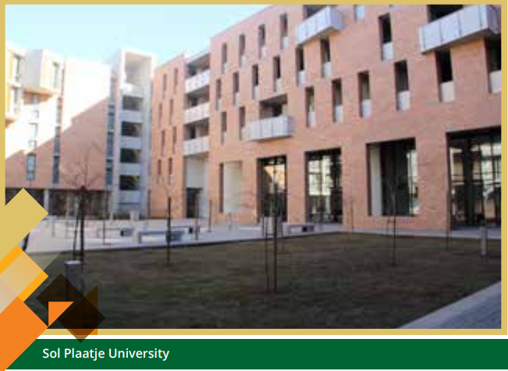
PROGRAMME 3: UNIVERSITY EDUCATION
The Programme had 15 targets planned for the quarter under review.
11 (73%) of the targets were achieved as planned.
Quarter 4 Targets | Achievement
A report on the achievement of Ministerial enrolment planning targets approved by the Director-General by 31 March 2023 | A report on the achievement of Ministerial enrolment planning targets was approved by the Director-General on 11 November 2022
61% Throughput rate of 2014 first–time cohort at universities | 63%
85 nGAP posts filled at universities every year | 87
40 scholarship or internship positions allocated to universities through the Nurturing Emerging Scholars Programme | 40
40 doctoral scholarships allocated to universities through the University Staff Doctoral Programme (USDP) for award to permanent instructional or research staff members | 48
25 awards made to permanent instructional or research staff at universities to participate in the Future Professors Programme | 27
48% of university lecturers (permanent instruction or research staff) who hold doctoral degrees | 485%

Slide 16
PROGRAMME 3: UNIVERSITY EDUCATION
Quarter 4 Targets | Achievement
85% universities that meet standard of good governance | 86%
6 universities that are supported to develop TVET college articulation implementation plans | 6
A report on effective governance of all 26 public HEIs approved by the Director-General by 31 March 2023 | A report on effective governance of all 26 public HEIs was approved by the Director-General on 20 February 2023
8 (Cumulative) Universities that are implementing student-focused entrepreneurship development activities | 20

Slide 17
PROGRAMME 3: UNIVERSITY EDUCATION (Non-achievements)
Quarter 4 Targets | Achievement | Reason for Deviation
A report on the implementation of UCDP approved by the Director-General by 31 March 2023 | A report on the implementation of UCDP was not approved as planned. | There were delays in approving the release of funds that must form part of the financial component of the UCDP
A report on the compliance of PHEIs to the regulations approved by the Director-General by 31 March 2023. | The draft of the compliance report has been finalised. | The draft of the compliance report was not approved due to capacity constraints in the Chief Directorate
A needs analysis report and framework for the university governance programme approved by the Director-General by 31 March 2023 | Draft needs analysis report was developed | The draft needs analysis report needed major revisions and possibly additional research.
A report on the evaluation of the 2021 research outputs of public universities approved by the Director-General by 31 March 2023 | Draft report on the evaluation of the 2021 research outputs of public universities was developed | The report could not be concluded on time due to capacity constraints in the Chief Directorate.

Slide 18
PROGRAMME 4: TVET
The Programme had 13 targets planned for the quarter under review, nine (9) of the targets were achieved as planned.
Quarter 4 Targets | Achievement
Additional one DSU to support students with disabilities in TVET colleges established by 31 March 2023 | Additional one DSU to support students with disabilities in TVET colleges established on 16 February 2023
10 000 unemployed TVET students placed in workplaces annually | 10 616
A report on cooperation agreement with Germany on SAIVCET work approved by the Director-General by 31 March 2023 | A report on cooperation agreement with Germany on SAIVCET work approved by the Director-General on 04 May 2023 (Achieved outside planned timeframe)
Examination results released to qualifying students within 40 days from last day of the exams timetable (per cycle) | 35 days
4000 students enrolled in PLP to improve success | 4 581

Slide 19
PROGRAMME 4: TVET
Quarter 4 Targets | Achievement
Instrument to monitor the implementation of TVET college council code of conduct approved by the Director-General by 31 March 2023 | Instrument to monitor the implementation of TVET college council code of conduct was approved by the Director-General on 20 March 2023
8% increase in student placement in the workplace for experiential learning per annum | 282%
10 new or revised subject curricula for TVET colleges approved by the Director-General for implementation by 31 March 2023 | 11 new or revised subject curricula for TVET colleges approved by the Director-General for implementation by 31 March 2023
3 additional new/reviewed TVET programmes with integrated digital skills training approved by the Director-General for implementation by 31 March 2023 | 3 additional new/reviewed TVET programmes with integrated digital skills training approved by the Director-General for implementation on 16 February 2023

Slide 20
PROGRAMME 4: TVET (Non-achievements)
Quarter 4 Targets | Achievement | Reason for Deviation
Period it takes to issue certificates to qualifying candidates following publication of results (months) | 0 | No certificates were released during the quarter under review
Throughput rate of TVET (NC(V)) | 24.3% | 2 years impact of Covid-19. Long stays away from teaching and learning, and adaptation to multi-modal learning strategies.
All 50 public TVET colleges implementing student-focused entrepreneurship development programmes | 48 | 8 TVET Colleges, namely: Flavius Mareka, Sedibeng, Tshwane South, Western, Nthashana, Thekwini, Letaba and South Cape TVET colleges, did not implement student-focused entrepreneurship development programmes.
Number of protocols signed with industry to place TVET college students and lecturers for workplace experience annually | 22 | 28 public TVET colleges did not submit reports.

Slide 21
PROGRAMME 5: SKILLS DEVELOPMENT
The Programme had 11 targets planned for the quarter under review.
Only 3 (27%) of targets were achieved as planned.
Quarter 4 Targets | Achievement
31 3 00 Learners who completed learnerships annually | 41 161
40 Days average lead time from qualifying trade test applications received until trade test is conducted | 33 days
A monitoring report on the implementation of Skills Strategy approved by the Director-General by 31 March 2023 | A monitoring report on the implementation of ERRP Skills Strategy was approved by the Director-General on 28 February 2023

Slide 22
PROGRAMME 5: SKILLS DEVELOPMENT (Non-achievements)
Quarter 4 Targets | Target Achievement* | Preliminary for 2022 | Reason for Deviation
107 000 number of learners or students placed in WBL programmes | 94 483 (88%) | 157 316 | Impact of COVID-19 pandemic (restrictions on learner movement, announcement of skills levy holidays, employers could not take in learners, employers closed.)
148 000 learners registered in skills development programmes annually | 87 223 (59%) | 57 086 | Impact of COVID-19 pandemic
22 000 number of learners entering artisanal programmes annually | 14 379 (65%) | 10 560
20 500 number of artisans found competent annually | 19 536 (95%) | Data not yet available
5 200 number of learners who completed internships annually | 3 606 (69%) | 1 160
100 000 learners who completed skills programmes | 83 922 (84%) | 54 142
*2021/22 Financial year

Slide 23
PROGRAMME 5: SKILLS DEVELOPMENT (Non-achievements)
Quarter 4 Target | Target Achievement | Reason for Deviation
Percentage of allocated SETA mandatory grants paid to employers | 62% | The SETMIS is not ready yet to allow SETAs to report on this indicator.
Percentage of SETAs that meet standard of good governance | 93% | Two SETAs failed to fully comply with the submission of documentary evidence required for good governance.

Slide 24
PROGRAMME 6: CET
The Programme had six (6) targets planned for the quarter under review, five ( 5) of the targets were achieved as planned.
Quarter 4 Targets | Achievement
2 Programmes and qualifications offered in CET colleges | 7
Report on the implementation of open access LTSM for students in CET colleges approved by the Director-General by 31 March 2023 | Report on the implementation of open access LTSM for students in CET colleges approved by the Director-General on 16 February 2023
95% of CETCs that meet standards of good governance | 100%
900 CET college lecturers trained | 938
100% CET colleges compliant with the policy on the conduct and management of examination and assessment | 100%

Slide 25
PROGRAMME 6: CET (Non-achievement)
Quarter 4 Targets | Achievement | Reason for Deviation
Number of pilot community learning centres accredited | 0% | CLC’s were not compliant to the accreditation requirements by QCTO and SETAs.

Slide 26
Cluster of reasons for under-achievements during Quarter four

Slide 28
2022/23: Overview of Allocations: 4th Quarter

Slide 29
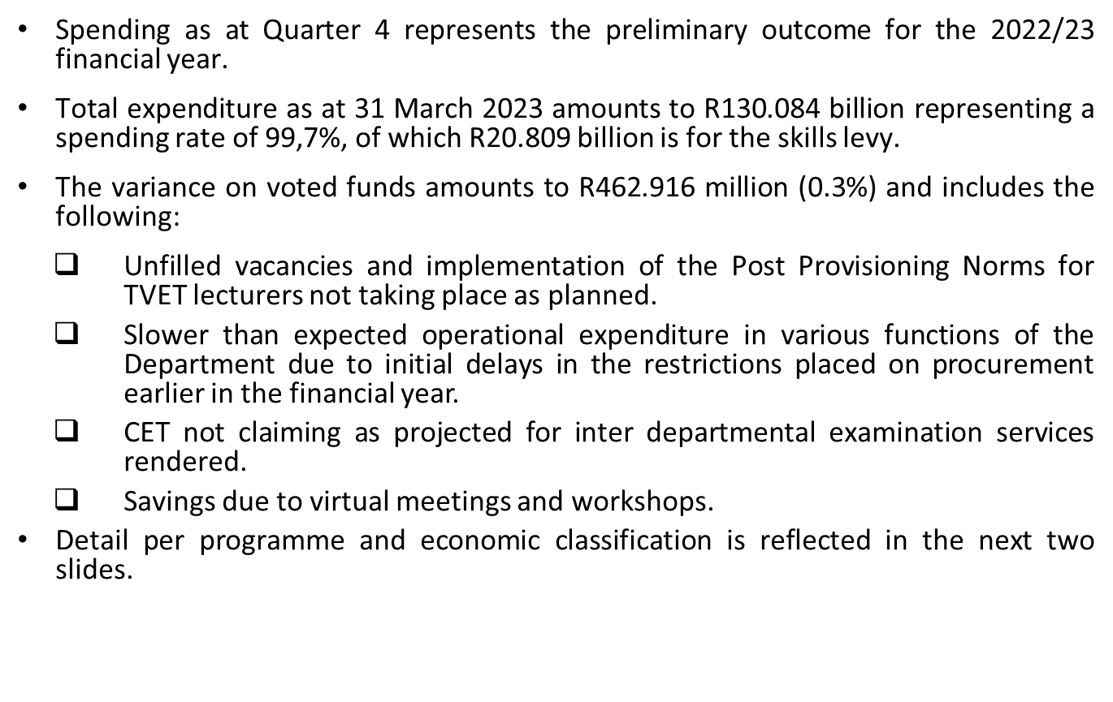
2022/23: Overview of Expenditure: 4th

Slide 30
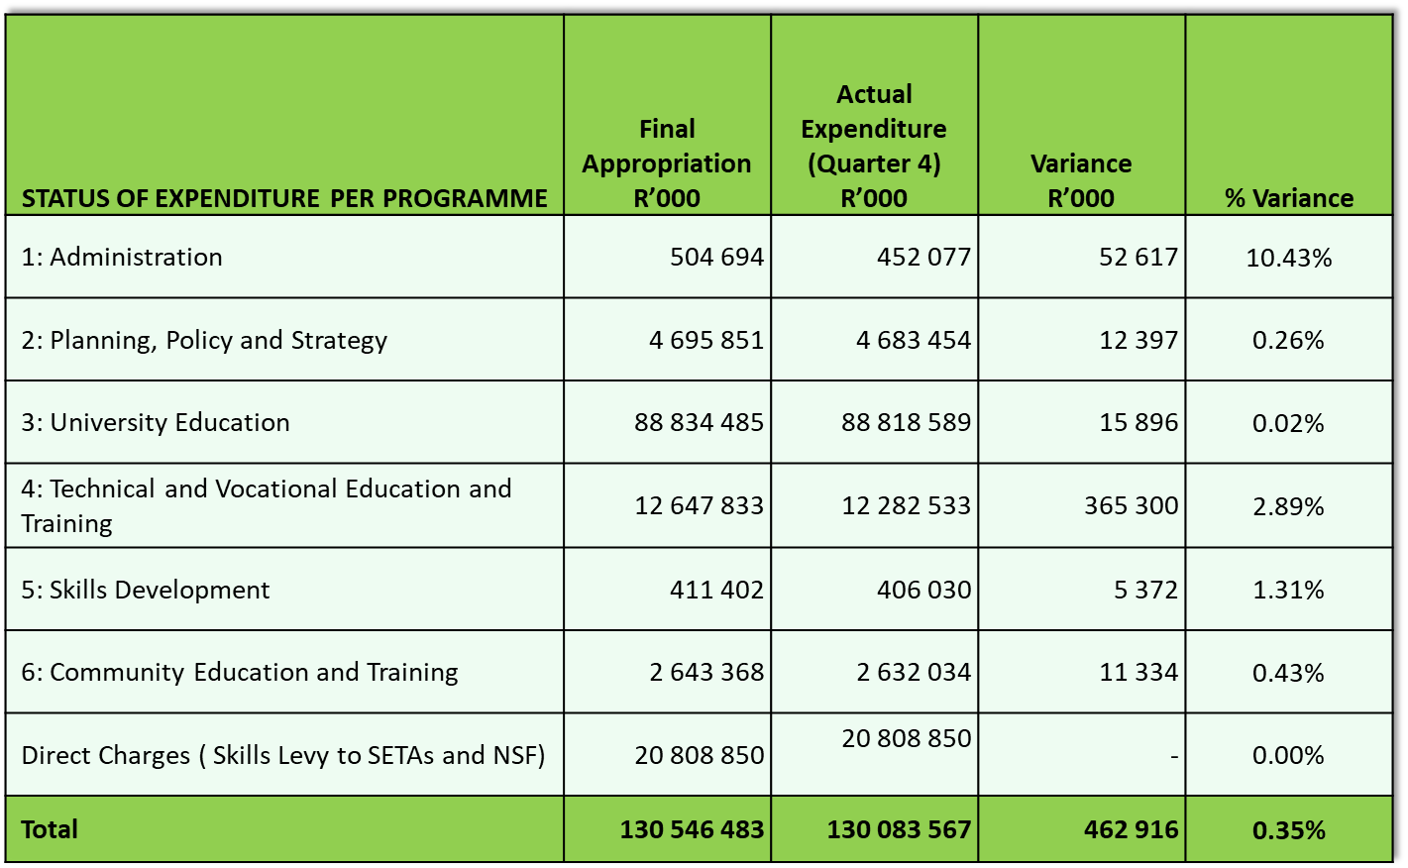
Status of expenditure per programme: 4th Quarter

Slide 31
Status of expenditure per economic classification: 4th Quarter
Status of Expenditure per Economic Classification | Final Appropriation R’000 | Actual Expenditure (Quarter 4) R’000 | Variance R’000 | % Variance
Compensation of Employees | 10 651 217 | 10 251 820 | 399 397 | 3.75%
Personnel Expenditure | 10 353 467 | 9 954 838 | 398 629
Examiners and Moderators | 297 750 | 296 982 | 768
Goods and Services | 684 714 | 634 440 | 50 274 | 7.36%
Transfer Payments | 119 194 110 | 119 185 791 | 8 319 | 0.01%
Capital Expenditure | 16 442 | 11 516 | 4 926 | 29.96%
Total | 130 546 483 | 130 083 567 | 462 916 | 0.35%

Slide 32
2022/23: Overview of Expenditure: 4th Quarter
Institution/Entity | Main Appropriation R’000 | Actual Expenditure (Quarter 4) R’000 | Balance Available R’000
Universities | 46 356 856 | 46 352 812 | 4 044
Public Entities
National Student Financial Aid Scheme (NSFAS) | 45 794 967 | 45 794 967 | -
Council on Higher Education (CHE) | 74 486 | 74 486 | -
South African Qualifications Authority (SAQA) | 81 164 | 81 164 | -
Quality Council for Trades and Occupations (QCTO) | 28 506 | 28 506 | -
Public Services SETA | 123 972 | 123 972 | -
Education and Training Practices SETA | 21 338 | 21 338 | -
National Skills Fund: Demand Led Skills Training | 100 000 | 100 000 | -
Higher Health | 20 604 | 20 604 | -
National Institute for Humanities and Social Sciences | 39 709 | 39 709 | -
TVET Colleges Subsidies | 5 490 927 | 5 490 918 | 9
CET College Subsidies | 215 151 | 215 151 | -
Foreign Governments and International Organisations | 4 276 | 3 250 | 1 026
Leave Gratuity | 33 100 | 29 860 | 3 240
Total | 98 385 056 | 98 376 737 | 8 319

Slide 33
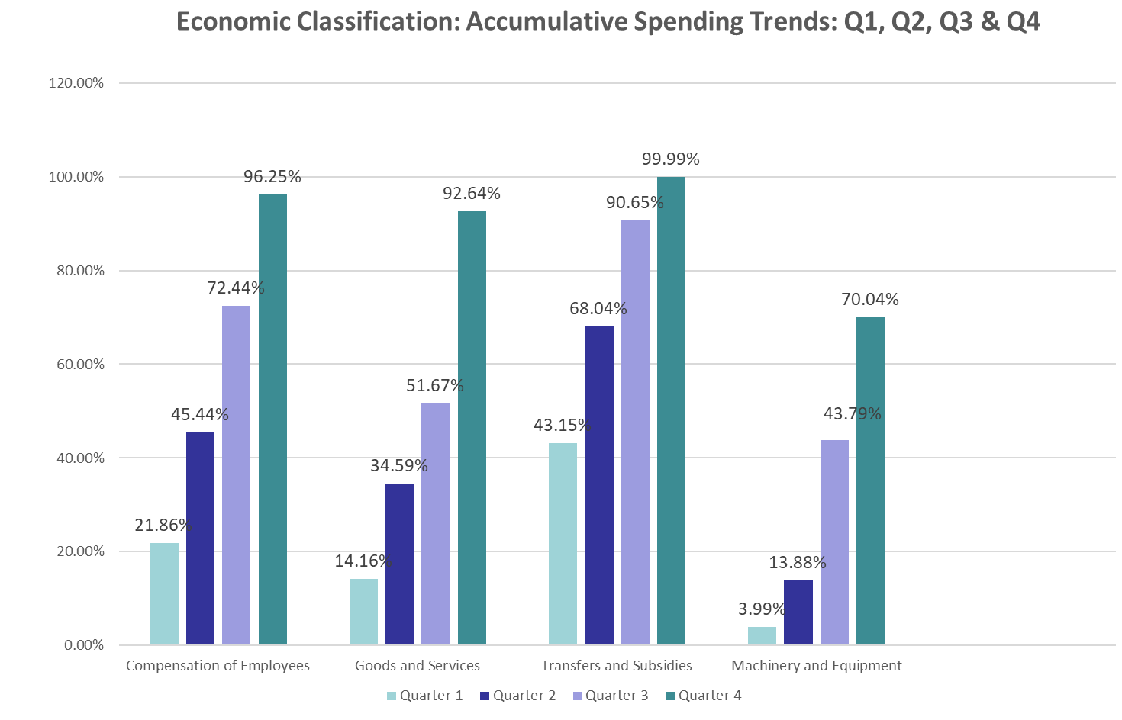
Economic Classifications: Spending Trends: Quarter 1, 2, 3 and 4

Slide 34
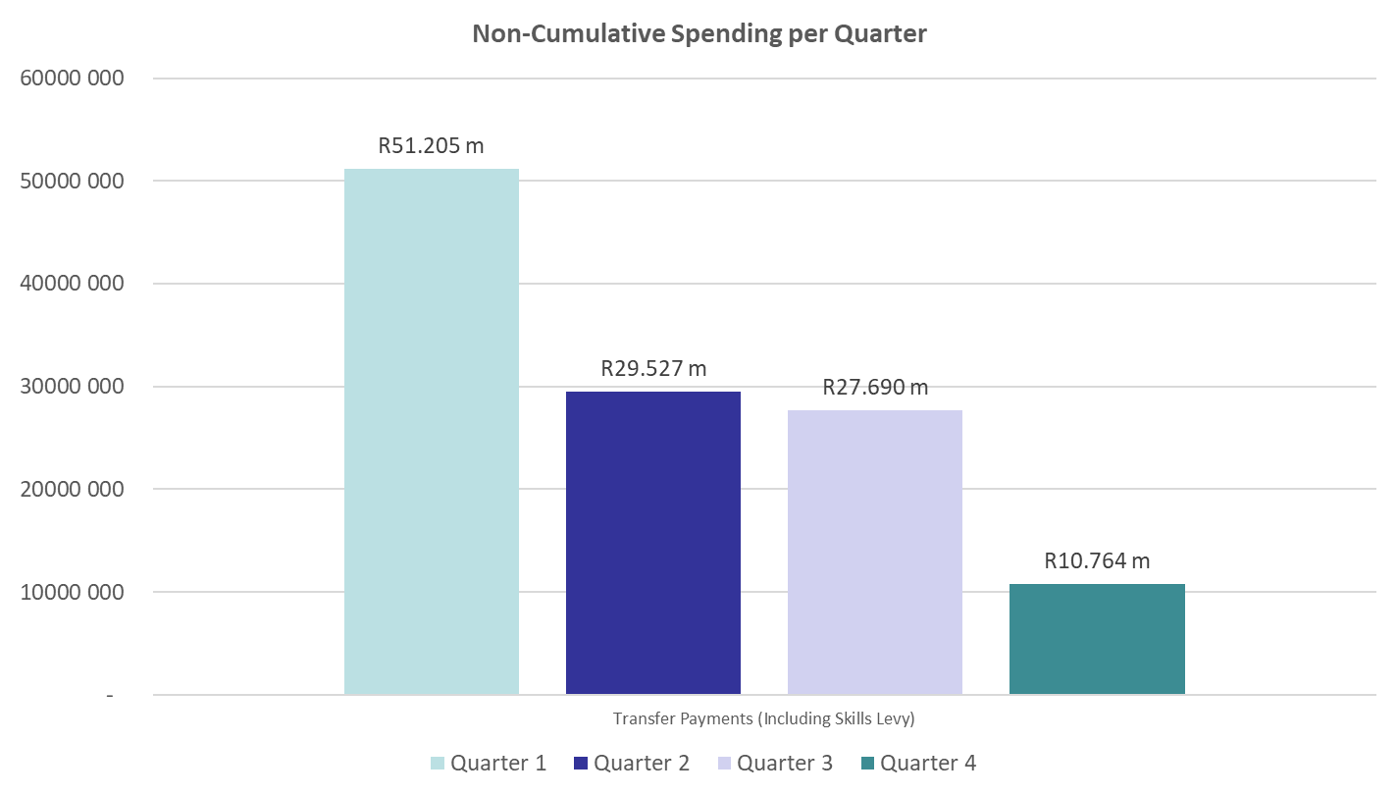
Spending trends of Transfers and Subsidies: Quarter 1 to Quarter 4

Slide 35
2022/23: Reasons for extensive increases in the Economic Classification between the third and fourth quarter
The significant increase from the third quarter to the fourth quarter:
Goods and services: The conduct of the November/December national examinations and increased travel activities mainly as a result of the start of the academic year.
Machinery and equipment: Increase in the procurement of machinery and equipment. Spending on this item is seasonal.
The significant decrease from the third quarter to the fourth quarter:
Transfers and subsidies: The total amount allocated for block grants to Universities are paid in the first to the third quarter.

