Slide 1
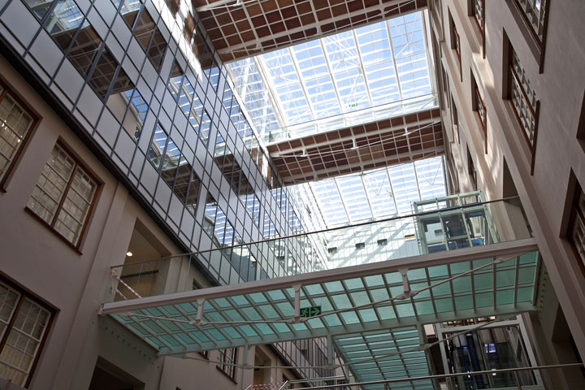
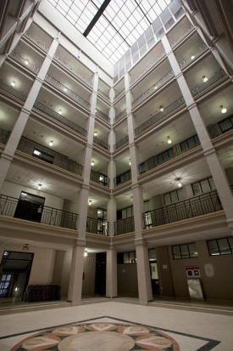
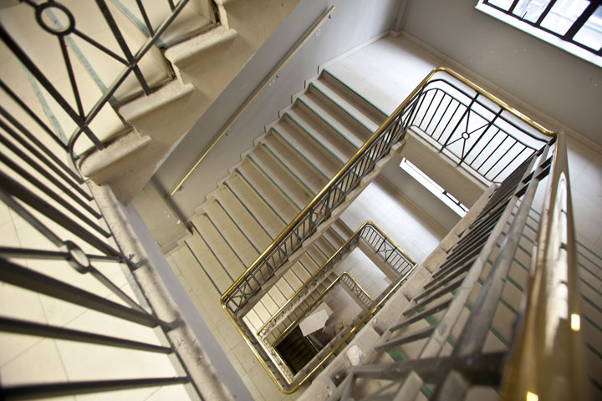
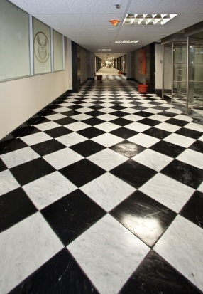
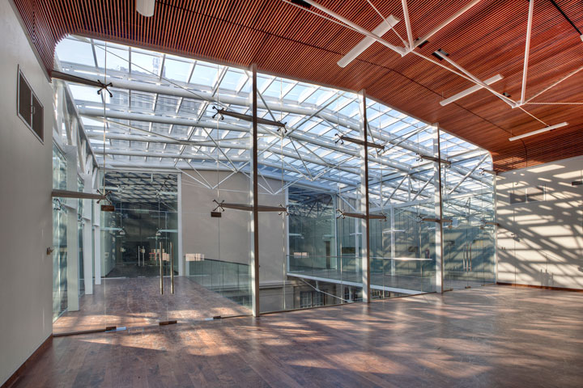
Presentation to the Department of Public Works Portfolio Committee
Briefing by the Department of Public Works (DPW):
Update report on progress with the implementation of the Enterprise Resource System (SAGE and ARCHIBUS) to strengthen supply chain management and financial control systems to comply with PFMA and Treasury Guidelines

Slide 2
Contents
NO | ITEM | SLIDE
1. | Table of Contents | 2
2. | Glossary of terms | 3
3. | Historical Context | 4-5
4. | PMTE Strategy | 6
5. | From Transversal systems to GRAP compliant systems | 7
6. | Operationalising billing and accounting system | 9
7. | Operationalising Archibus ERP System | 11-15
8 . | PMTE Applications Landscape | 16-20
9. | Alignment to GIAMA | 21
10. | ARCHIBUS full suite; Functionality; Integration; Business Process alignment; Value Chain integration | 22-34
NO | ITEM | SLIDE
11. | ARCHIBUS deployment Enhancements and System Views | 35-41
12. | Reporting standards (GRAP, Lease Out & Itemised Billing) | 42
12. | SAGE in production since 2014 | 43-44
13. | SAGE 2018/19 Roll out | 41
14 | ARCHIBUS & Sage Project Expenditure | 45-47
14. | RISK AND MITIGATION | 48
15 | SAGE-ARCHIBUS delivery plan | 49-50

Slide 3
Glossary of terms
Abbreviation | Definition | Abbreviation | Definition
BAS | Basic Accounting System | KZN | Kwa-Zulu Natal
CSD | Central Supplier Database | LDM | Service provider (Consortium)
DPW | Department of Public Works | MIOS | Minimum Interoperability Standards
FM | Facility Management | PMTE | Property Management Trading Entity
GRAP | Generally Recognized Accounting Principles | UAT | User Acceptance Testing
GIS | Geographical Information System | U-AMP | User - Asset Management Plan
GRV | Goods Received Voucher | C-AMP | Custodian – Asset Management Plan
GWEA | Government Wide Enterprise Architecture | PMIS | Property Management Information System
GIAMA | Government Immovable Asset Management Act | WCS | Works Control Systems
GRV | Goods Received Voucher

Slide 4
HISTORICAL CONTEXT
2011
National Treasury grants PMTE permission to buy Billing and Accounting solution
2014
SAGE went live with Billing and Accounting modules
2013
PMTE went out on open tender to procure a Billing and Accounting solution with capabilities to integrate.
Deloitte appointed as SAGE service provider and recommended Archibus for IAR. Contract ( Nov 2013 – May 2016).
2012
Accenture Score Card supported the decision to opt for Archibus against Oracle, IFS, SAP and iEWorks.
4

Slide 5
HISTORICAL CONTEXT (CONTINUED)
2015
The Department opted to increase the SAGE scope of work to include Lease IN, Lease OUT and Variable payment modules.
2017
2017: Deloitte poor performance due to inability to do leaseIN module, ICT Steering Committee decides to release them from delivery of the Lease Out module on condition that they finish the outstanding issues on SAGE by 28 Feb 2018.
ALCM appointed through an open tender (01 August 2017 – 31 July 2019
2018- 21
Due to termination of Deloite AccTech appointed for SAGE support
& implementation
2015
A decision was taken as part of the turnaround programme to implement other “expanded "modules of ARCHIBUS. Services of LDM were sourced through the KZN contract. Services were acquired through the National Treasury. LDM contract expired in March 2017.
A feasibility study also confirmed ARCHIBUS as a match to PMTE requirements
This decision was on the basis that ARCHIBUS was already bought though an open bid.
5

Slide 6
PMTE STRATEGY
In 2011 informed by the PMTE ERP strategy DPWI approach NT, for permission to implement ERP Strategy.
The objective was to move from Government Transversal systems to GRAP Compliant Systems. (Slide 7)
The plan was to procure an off-the-shelf ERP solution (Slide 8) in order to digitize the PMTE core Business Functions – REIRS, REMS, FM, CPM, REIS & Finance
NT granted DPWI permission to procure a Billing and Accounting Solution

Slide 7
FROM TRANSVERSAL SYSTEMS TO GRAP COMPLIANT SYSTEMS
Department of Public Works Systems | PMTE Systems
DPW is cash accounting based and using transversal systems BAS, LOGIS and PERSAL. LOGIS – Produces Purchase Orders and limited in terms of functionality to track invoices, goods and orders. BAS – Basic Accounting System for payables/receivables. PERSAL – Personnel Administration Systems for payment of salaries and leave administration. | PMTE uses GRAP as a standard and systems used need to conform to these GRAP standard. Through authorization from National Treasury SAGE and ARCHIBUS were procured. SAGE – Finance systems currently used for payment of suppliers and process interfaces from operational systems (WCS & PMIS). ARCHIBUS – Property management system for the Asset lifecycle management. PERSAL – Personnel Administration Systems for payment of salaries and leave administration.
7

Slide 8
Based on the PMTE Strategy, NT was approach
The strategy ID key strategic areas: RIERS, REMS, FINANCE
8

Slide 9
Operationalising of Billing and Accounting System
2011: PMTE went out on open tender to procure a Billing and Accounting solution with capabilities to integrate to other systems.
2013 – 2016 :Deloitte appointed as SAGE service provider to implement the Billing and Accounting System. The decision to opt for SAGE was supported by amongst others the Gartner Magic Quadrant (Slide 10)
Deloitte Architecture included Archibus Immovable Asset Management as the container for Immovable assets which SAGE will be paying against.
2014 : SAGE went live with Billing and Accounting modules
2015 : The Department opted to increase the SAGE scope of work to include Lease IN, Lease OUT and Variable payment modules.
2017: ICT Steering Committee decides to release Deloitte due failure to deliver the Lease Out module and LeaseIN module.
2017 -2021 : Due to termination of Deloite, AccTech appointed for SAGE support
& implementation

Slide 10
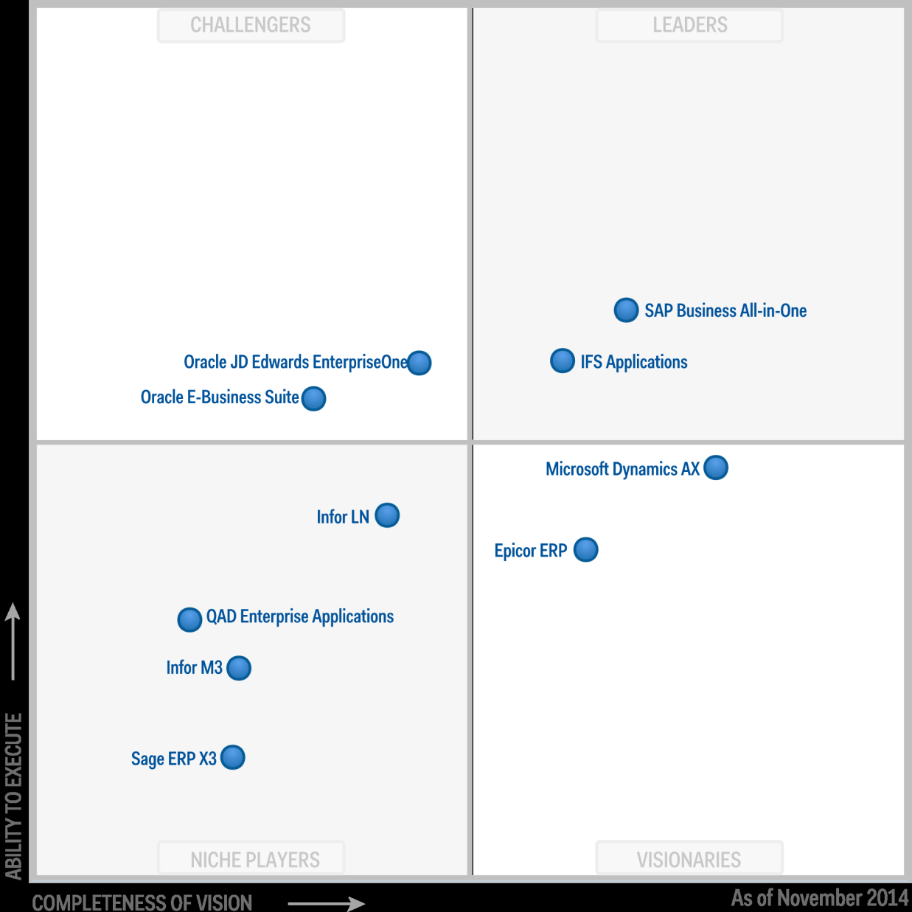
GARTNER MAGIC QUADRANT (SAGE )
10

Slide 11
Operationalising of Archibus ERP system
2015 : EXCO took a decision as part of the turnaround programme to implement other “expanded "modules of ARCHIBUS. This decision was on the basis that ARCHIBUS was already bought though an open bid in when SAGE was procured in 2015.
Core business stakeholders participate in the Modules Functional Analysis (Slide 12). All the modules score above the 70% pass mark except for SCM module.
Further, the decision to opt for Archibus is supported by Accenture Report and Gardner Quadrant slides
Services of LDM were sourced through the KZN DPW contract. The acquisition of the services of LDM was approved by NT . LDM contract expired in March 2017.

Slide 12
FUNCTIONAL ANALYSIS: SCORING ARCHIBUS FUNCTIONALITY AGAINST BUSINESS REQUIREMENTS
Immovable Asset Register (79.4%)
Lease Management (96.4%)
Facilities Management(80%)
Movable Asset Management(80%)
Construction Projects and budgeting (74%)
UDM Client Relations Management (70%)
SCM (41,5%)
Success criteria = 70% business requirements 30% Customization
12

Slide 13
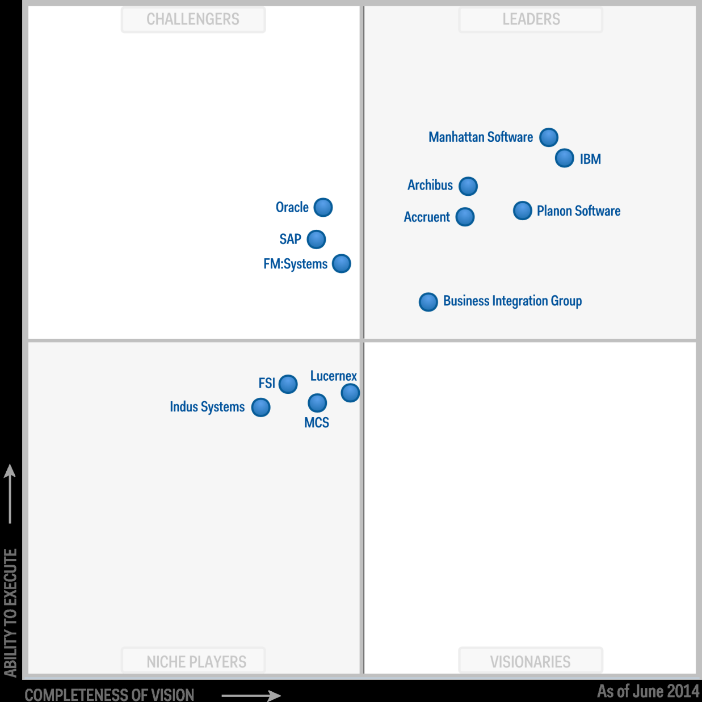
GARTNER MAGIC QUADRANT (ARCHIBUS)

Slide 14
ARCHIBUS ENTERPRISE OVERVIEW ACCENTURE CONCLUSIONS
The world’s most comprehensive facilities management solution for managing space totalling thousands to millions of square feet or meters.
Modular structure lets you choose only those applications you need;
Supports an unlimited number of concurrent users and sites;
Sized for an unlimited number of unique records;
Supports native Microsoft SQL Server, Oracle, and Sybase; and
Web-enabled by adding ARCHIBUS Web Central.

Slide 15
The DPWI ERP System
The AS-IS DPWI IT Application Landscape is characterized by siloed and a combination of old modern systems across business functions. (Slide 16 -19).These system as they are currently, do not support business to perform at its optimal. There are other legacy system like BAS, PMIS, WCS, etc. The aim is to replace these old systems with Archibus and SAGE.
Therefore , the core application which make the ERP System are Archibus and SAGE. (Slide 20)
Archibus does the business transactions (Capturing and verification of leases) and SAGE makes the payments. There is a secured and automated communication layer between the two systems. The ERP Strategy implementation is aimed at supporting the legislative alignment with GIAMA (slide 21)
Further, the Archibus ERP solution is aimed at support the core business of DPWI (Slide 22).
Further, the Archibus System Full suite capabilities is covered in slide 24 to 29.
Further, the SAGE System Full suite capabilities is covered in slide 31 to 34.
Slide 30 is the Architecture Model which brings together all the systems, policies, business processes and legislation

Slide 16
PMTE APPLICATIONS conceptual landscape (planning)
Manage Immovable Asset Portfolio (Strategic Portfolio Supply)
PMIS
Plan Accommodation (Analysis and Pre-Planning)
WCS
Project Tracking System
WCS
Analytical Tool
Manage Immovable Asset Register
WCS
Archibus
SAS
WCS
PMIS
EXCEL
GIS Syst
Manage Immovable Asset Portfolio(Strategic Portfolio Demand)
Plan Accommodation (Implementation Planning)
Safety Net
CSD

Slide 17
PMTE APPLICATIONS conceptual landscape (execution)
Acquire Permanent Immovable Asset
PMIS
WCS
Construct Immovable Asset
WCS
Reapatala
Acquire Temporary Immovable Asset (Leasing In)
Manage Immovable Asset
Maintain Facility
Dispose (Temporary) Immovable Asset
PMIS
PMIS
PMIS
Dispose (Permanent) Immovable Asset
PMIS
WCS
Security Management
Information Security Storage System
OHS Management System
PMIS
Worx4U
Archibus
MDB
Paper Trail System

Slide 18
PMTE APPLICATIONS conceptual landscape (SCM)
Procurement Planning
PMIS
Movable Asset Management
Provisioning and Logistics
Quote Management (Demand and Acquisition)
Tender Management (Bid Administration)
Quotation Tracking System (TQS)
PMIS
SAGE
Paper Trail System
Reapatala
TSM System
PERSAL
Archibus
SAGE
Devolution System
Supplier Verification System - CSD
WCS
WCS

Slide 19
PMTE APPLICATIONS conceptual landscape (finance)
Financial Planning and Budgeting
WCS
Revenue and Debt Management
Archibus
Accounts Payable and Cash Management
SAGE
Financial Accounting
Financial Reporting
WCS
Payroll Management
SAGE
SAGE
SAGE
PMIS
WCS
PMIS
Archibus
Worx4U
SAGE
Reapatala
PERSAL
Reapatala
PMIS
SAGE
Archibus
Worx4U
PMIS
Supplier Verification System - CSD
Safety Net
WCS

Slide 20
APPLICATIONS OF CHOICE : ARCHIBUS & SAGE
Is a system that manages the operational aspects of Asset Management lifecycle
Immovable Asset Management
Provides the platform on which financial transactions take place
Consists of
Procurement
Variable (property) payments
Budgeting
Bank recon
Procurement module
Accounts Receivable
Lease IN
FM: Scheduled Maintenance
Condition Assessment
Project Management
Movable Asset Management
Lease OUT
FM: Unscheduled Maintenance
Accounts Payable
20

Slide 21
ALIGNMENT TO GIAMA
C-AMP
21

Slide 22
ARCHIBUS FUNCTIONALITY OVERVIEW
U-AMP
C-AMP
Vesting
GRAP
Reports
Lease Out
Revenue
Portfolio Analysis
Workplace & Facilities
Space Planning & Management
Real Estate Portfolio Management
Real Estate & Property
SAGE
IAR
Move Management
Capital Project Management
Condition Assessment
Optimise
Allocate
Rates & Taxes
Enterprise Information Modeling
Expenditure
Workplace
Infrastructure
Risk Management
Engineering & Operations
Workplace Services
Enable
Preserve
Maintenance
Capital Projects
Facilities
Management
Maintenance Costs
Building Operations
Asset Management
22

Slide 23
ARCHIBUS MODULE FULL SUITE

Slide 24
ARCHIBUS MODULE INTEGRATION
24

Slide 25
Unscheduled Maintenance
Schedule, dispatch, manage, and report maintenance tasks efficiently using self-service capabilities to reduce operational costs and increase customer satisfaction
Benefits
Improve the Planning Process
Simplifies the request, dispatch, and feedback processes of maintenance tasks to improve service provision
Reduces operating costs through automated workflows, mobile access and streamlined communication
Provides a seamless link to Service Level Agreements (SLAs) to enforce standards and increase efficiency
Enables improved forecasting of maintenance and capital budgets
Helps achieve business results with ARCHIBUS Quick-Start, a productivity aid which includes tutorial videos and “How To” instructions
Increases productivity with ARCHIBUS All-in-One Home Page with quick access to 80% of most common tasks
Assist with capital planning by reporting on equipment usage, parts, and service information
Use summary reports to gain the proper oversight of various spending categories
Track and report on parts inventories, equipment maintenance data, and work requests of all types
Create reports to help allocate resources, justify additional personnel or purchase of capital equipment, and forecast future maintenance budgets
Collect and report on metrics required by third party regulatory mandates more efficiently than paper based processes
Simplify the Maintenance Process
Enforce Standards with SLAs
Enable standardized maintenance provision to reduce costs, discourage ad-hoc processes, and increase overall transparency of service delivery
Identify when a resource is available, the projected response time, and the time to complete the task
Approve or reject actions to maintain control over work requests using rules-based workflow
Group work requests to work orders by priority, location, or trade enabling the most efficient dispatch and execution of work tasks
Provide work requestors with automated email feedback at each status change
Keep maintenance staff utilized in the field with the most current work, while getting their results in real time
Allow work requests to take advantage of SLAs that define work team obligations, service windows, and performance measurements
Measure response and completion times to detect performance issues and provide timely information for continuous process improvement
Provide intelligent SLA selection that assigns requests based on need type, level of authorization, expertise, and resources required to satisfy the request
Create automated routing that forwards requests for required approvals and, based on the SLA, accelerates urgent requests to either internal or external work teams within seconds of submission
Reduce Operating Costs
Simplify the maintenance process by organizing crafts persons into work teams, provide specific steps for estimating costs, and assign work efficiently using the Planning Board function
Ensure the appropriate trade or service provider receives the correct maintenance requests on time, so they can take action immediately
Automate escalations to eliminate costly delays caused by non-response of requests
Establish workflow parameters to re-prioritize requests and move them to the top of the list as other requests are completed
Reduce costs of responding to inquiries by using mobile and dynamic updates to a centralized status page or via automated email notification at predefined status

Slide 26
Lease Administration
Centralize and automate lease administration processes to increase efficiency, reduce errors, and avoid penalties
Accurate Charges and More Accountability
Benefits
Eliminates time wasted locating and reviewing leases and specific responsibility clauses
Confirms landlord versus tenant responsibilities thereby avoiding service delivery and payment confusion
Provides immediate online access to lease details to easily validate invoices
Automated Lease Tracking and Management
Improved Data Access for Better Decisions
Automate processes for lease tracking and management
Improve access of lease information to facilitate easy analysis and reporting
Streamline tracking of landlord and tenant responsibilities to avoid unnecessary charges
Minimize errors and speeds data entry through intuitive prompts, reducing administrative costs
Monitor leases, options coming due, alerts and more from a single screen with the Lease Portfolio Console
Improve overall real estate service levels with a comprehensive repository of lease information
Automate tracking of leases, options due dates, and other events with lease alerts
Assign three levels of urgency to alerts, personalized for Building, Structure, and Land portfolio types
Issue alerts as emails or as flagged entries in the Lease Administration dashboard
Provide the framework for improved lease analytics to avoid costly errors or missed opportunities
Simplify the selection and presentation of desired leases with associated costs, options, amendments
Locate or edit leases directly from an easy to navigate dashboard
Research costs by month, lease, or specific cost component using drill-down capabilities
Summarize monthly recurring costs across the lease portfolio for an entire year according to user preferences, such as geography, cost category, or year
Reduce Data Entry Burden
Reduce manual effort needed to perform data entry and maintenance tasks with Add/Edit Wizard
Define a new lease portfolio item or edit an existing one with ease using the intuitive Wizard features
Use the Wizard’s dynamic tabs to efficiently guide users through the steps necessary to add, modify, and/or delete lease information
Reduce processing time and administrative overhead with faster data entry and greater accuracy

Slide 27
Condition Assessment
Track and effectively manage deferred maintenance liabilities to mitigate risk and enable a closed loop process in taking corrective actions
Justify Budgets and Spending
Benefits
Identify Deficiencies and Extend Service Life
Mitigate Risk and Prioritize Actions
Prepare budgets for capital renewal, preventive maintenance, and repairs with ease
Triage spending by focusing inspection on the most susceptible assets or systems
Compare results from different time periods to determine a facility’s or organization’s improvement
Weigh the importance of your physical assets and allocate funds to the most critical areas
Improve information accuracy and consistency by applying assessment standards across the organization
Enable segmented and consolidated views of all projects, groups of projects, or functional area projects
Visualize, at a glance, which aspects of your facilities or infrastructure require immediate attention
Analyze the impact the condition of physical assets has on achieving strategic and operational missions
Mitigate risk by prioritizing problems for correction, based on objective measures and organizational needs
Enables proactive identification of deficiencies to extend asset service life
Demonstrate how costs are associated with corrective measures to justify budgets
Reduce administrative cost by establishing a closed loop assessment and resolution process costs
Extend asset service life by identifying minor repair issues before they escalate to more serious problems, such as damage to adjacent assets or total component failure
Reduce downtime and its associated costs through the proactive identification of asset deficiencies
Demonstrate that suitable mitigation measures are in place to manage identified risks
Integrate assessment and work order management for closed-loop problem resolution
Reduce Administrative Cost
Integrate seamlessly with supported mobile devices to enable cost-effective inspections and reporting
Present easily compiled, complete, and defensible condition assessment findings to justify funding
Reduce data collection and analysis efforts by applying assessment criteria to existing ARCHIBUS asset data
Import and export asset data and assessment values effortlessly to facilitate assessments and informed decision-making

Slide 28
Infrastructure Budgeting
Master the capital budget cycle to achieve improved, centralized strategic planning across the organization
Manage Projects across Multiple Sites
Capture the costs associated with improvement projects from every site, in one source, for enhanced decision making at the executive level
Provide self-service features via the Web, allowing stakeholders to check the status of projects, anytime and anywhere
Offer standard program/project templates and time frames to ensure that all programs and projects follow the same approval procedures and are evaluated on comparable terms
Define standard document templates accessible over the Web for items such as project justification, program summaries, and associated back-up documentation
Integrate non-standard documents such as CAD drawings, multimedia files, and more in an easily accessible, Web-based repository
Share information with ERP solutions such as SAGE, Oracle Financials® and SAP® as well as other Project Management solutions such as Primavera® and Prolog®
Benefits
Integrate End-to-End Planning
Consolidate Planning Activities
Leverage existing ARCHIBUS data by accessing cost estimates and depreciation information, to justify capital projects
Capture data in the field using mobile and/or tablet devices to populate the capital budgeting baseline
Compare actual condition assessments with budget to keep abreast of progress
Track the condition assessment items that have been addressed by capital projects to update the Facility Condition Index
Summarize all capital planning activity in a consistent format to prioritize programs and projects, coordinate activities, and budget resources
Develop a centralized methodology to efficiently manage capital projects across multiple departments and sites
Enable “what-if” planning to reduce business interruption and cost overruns
Integrate condition assessment, capital budgeting, and project management functions to better allocate budget and resources for complete end-to-end planning
Match project activities to the appropriate funding source(s) to ensure that program needs are met on-time and within budget
Enables personalized workflow processes to help users manage the scope of a project, from task-level detail to multi-year budgets
Develop a centralized knowledge base of capital budgets that provides a history of past budgets and a benchmark for future projects
Coordinate projects and their timeframes using Web based calendars and executive overview Gantt charts
Enable “What-if” Planning
Compare multiple “what-if” scenarios to determine the optimal use of funds and help manage cash flow
Present top-level funding requirements and sources
Manage multi-year budgets based on estimated costs to show the impact of program and project additions/ deletions on strategic objectives

Slide 29
Project Management
Manage projects, from an owner’s perspective, so they remain on-schedule and within budget
Benefits
Reduce the Administrative Burden
Reduce duplicate data entry by integrating existing ARCHIBUS data such as property details, condition assessments, maintenance data, and more
Encourage a self-service posture and reduce overhead with real-time, Web-accessible data
Promote consistent documentation by posting templates, examples, and policies
Create a central repository for a “Top-Down” perspective of program and project priorities, actions, and costs
Facilitate a collaborative process to allow project members to synchronize information at different locations or organizational units
Provide clear, weighted performance scorecard views of multiple programs and/or projects to identify late or over-budget components at a glance
Streamline project oversight via consolidated views displaying milestones, tasks, and status changes to all project members
Reduce administrative burden by leveraging existing data
Provide Centralized, “Top-down” Perspective
Benchmark Performance
Define, estimate, and prioritize projects in a centralized location using a consistent format
Present project opportunities and risks based on the organization’s capital plan and overall mission
Determine cost estimates and track trends
Connect projects directly to the capital budget cycle to compare actual versus estimated costs
Weighted performance scorecards identify late or over-budget programs and/or projects at a glance. The application makes it easy to review payments, costs by activity type, work packages, and any schedule variances throughout the duration of a project. With all this information at hand, users can easily establish benchmarks and identify projects that are not measuring up to these standards. Tracking historical project data also makes it easier to identify improvement opportunities for future projects.
Streamline Project Oversight
Create work packages for Web-based contract bids
Route projects for approval and estimate, manage, and approve change orders
Enforce organization-wide standards to ensure project objectives are met
Maintain accountability through electronic audit trails to track all project changes
Synchronize Project Team Members
Manage time-based tasks using project calendars and Gantt charts
Coordinate location-based tasks using the Projects Map
Notify task assignees automatically using intelligent workflow processes
Exchange data seamlessly with Microsoft Project®, delivering information in familiar formats to project managers, financial managers, and executives
Notes:
Ushering a successful project to its completion—whether
it is a renovation, acquisition, construction, or move project
—requires a well-organized repository of project data and
workflow practices. ARCHIBUS Project Management gives
project team members workflow access to a central storehouse
of information that keeps all participants aligned with
master planning goals. This helps ensure that projects remain
on-schedule and within budget, while providing valuable
benchmarking data for future projects
The application includes many features for streamlining
project management and reporting, from the planning
to the execution phases. Project templates enforce a
standardized project methodology among all project
members, including service providers or contractors.
Integrated workflow capabilities issue relevant,
proactive notifications to project team members.
ARCHIBUS Project Management can greatly reduce
administrative burdens by leveraging pre-existing data.
The application’s ability to integrate multiple functions
and systems reduces duplicate entry and promotes
communication among different departments and sites.
Granting all team members enterprise-wide access to
project data simplifies communication by reducing
phone calls, paper invoices, and manual processes.

Slide 30
SAGE FULL SUITE

Slide 31
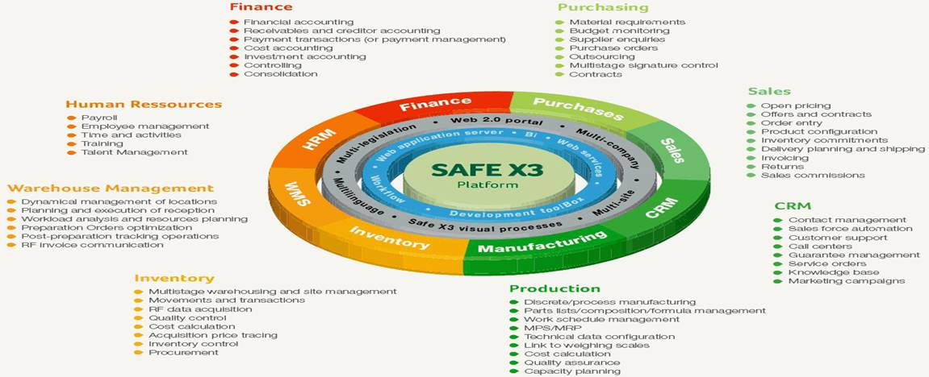
SAGE FULL SUITE

Slide 32
ERP & SAGE VALUE CHAIN PROCESS INTEGRATION FRAMEWORK
Workplace & Facilities
Space Planning & Management
Real Estate Portfolio Management
Real Estate & Property
Manage Immovable Asset Register
Move Management
Capital Project Management
Manage Immovable Asset Portfolio
Optimise
Allocate
Enterprise Infrastructure Management
Plan Accommodation
Acquire and/or Construct Accommodation
Manage Real Estate Land and Improvements
Maintain Facilities
Manage Disposal
PMTE Value Chain Activities
Workplace
Infrastructure
Engineering & Operations
Workplace Services
Preserve
Risk Management
Enable
Manage Supply Chain
Asset Management
Manage Finance
Building Operations

Slide 33
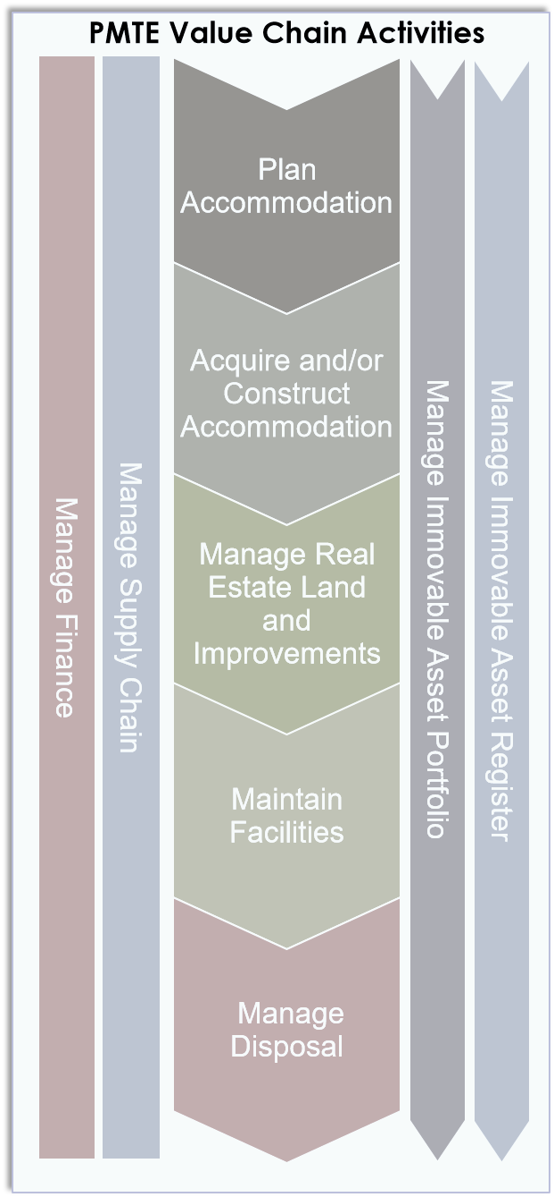
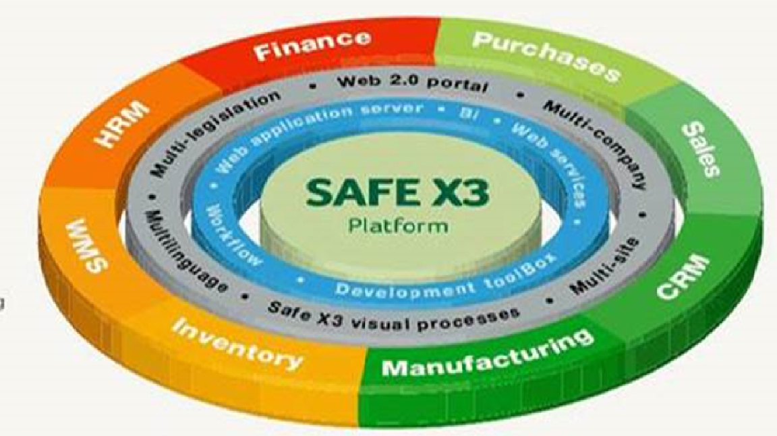
SAGE VALUE CHAIN process integration

Slide 34
BUSINESS PROCESS AND ALIGNMENT TO ARCHIBUS
Planning (DPW Family)
Acquisition & Disposal
Capital Projects & Budgeting
Portfolio/ Investment Management
Real Estate Portfolio Management
REMS (Leases)
Real Estate Portfolio Management
Real Estate Portfolio Management
Real Estate Portfolio Management
Capital Budgeting Projects
Building Operations
Space Management
Environmental & Risk
Facility Management
Demand Management
REIRS (Asset Register)
Asset Management
Work Place Management
Asset Management
Asset Management
Capital Budgeting
Asset Management
Capital Budgeting
Real Estate Portfolio Management
Asset Management
Asset Management
Asset Management
SAGE
INFORMATION COMMUNICATION TECHNOLOGY (ICT)
Legal and Regulatory Framework (GRAP, IDMS, GIAMA, PFMA etc.)
Risk Management and Quality Assurance
34

Slide 35
ARCHIBUS MODULE CURRENTLY DEPLOYED AND FUNCTIONALITY AVAILABLE FOR BUSINESS USE.
Currently there are 3 modules that are live, namely: IAR, FM (Unscheduled Maintenance) and LeaseIN
High Level Dashboard and functionality (Slide 36 – Slide 42)

Slide 36
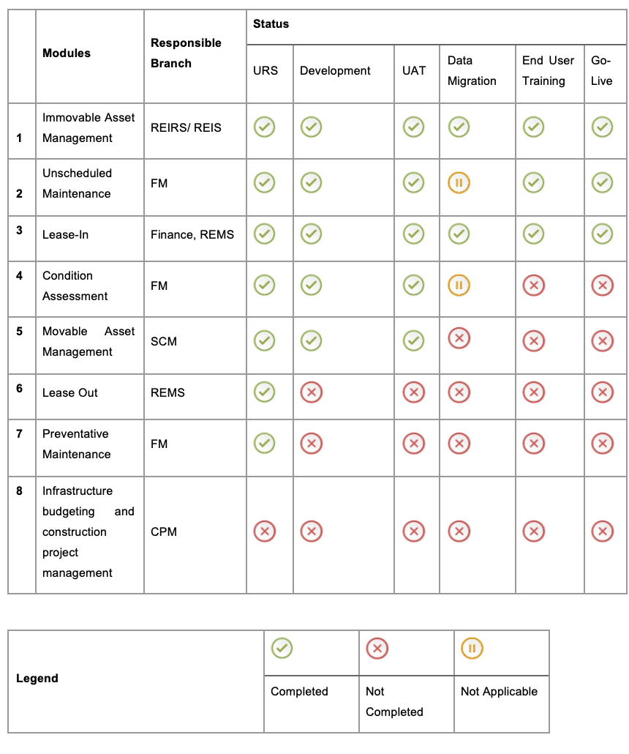
ARCHIBUS MODULE STATUS – Dash board

Slide 37
CURRENT MODULES – LIVE AS OF APRIL 2018
Immovable Asset Register (IAR)
Unscheduled Maintenance
LeaseIN
Available Functionality | Immovable Asset loading. Linking land and improvement. Immovable Asset updating Assigning user departments
Activities completed | User Requirements Specifications Functional Requirements Specifications Development User acceptance testing Change Management User training Data migration
Available functionality | Call Logging and assigning reference numbers to calls being logged Assigning a call to an Asset Assigning a call to a service provider Closing of calls Add employee’s client Add service providers to Archibus View feedback report
Activities completed | User Requirements Specifications Functional Requirements Specifications Development User acceptance testing Change Management User acceptance testing User training
Available Functionality | Create a Leased Asset, Verification and Approval Lease Asset Management, Verification and Approval Lease Capturing, Verification and Approval Lease Renewal, Verification and Approval Lease Suspension, Verification and ApprovalLease Termination, Verification and Approval Cost Adjustment. Automatic seamless interface and payment of all valid lease from ARCHIBUS to SAGE for the full term of the lease. No requirement for PP38 approvals. Centralised single source supplier information. Seamless interface of supplier details from SAGE to ARCHIBUS used when capturing a lease.
Activities Completed | User Requirements Specifications Functional Requirements Specifications Development User acceptance testing Change Management User acceptance testing User training
31

Slide 38
IMMOVABLE ASSET REGISTER VIEW
38

Slide 39
FM CALL LOG AND STATUS VIEW
39

Slide 40
LEASE-IN VIEW
405

Slide 41
IMMOVABLE ASSET REGISTER GIS VIEW
41

Slide 42
GRAP REPORTING STANDARDS
GRAP requirement Standards GRAP 17, 16, 103 reports | Module Dependency | Date of resolution
Disclosure | IAR | Oct 2018
Additions | IAR | Oct 2018
Residual value | IAR | Oct 2018
Disposal | IAR and SAGE receivables (integration) | Oct 2018
Depreciation Report | IAR and SAGE receivables (integration) | Oct 2018
Revaluation | Condition Assessment | Dec 2018
Verification and Condition assessment | Condition Assessment | Dec 2018
Useful life assessment | Condition Assessment (in progress) | Dec 2018
Impairment | IAR | Oct 2018
Reversal of Impairment | IAR | Oct 2018
Exception Report (Depreciable amount) | Condition Assessment and Projects (not started) | Dec 2018
Market value | Condition Assessment | Dec 2018
Master Standard Report | IAR | Oct 2018
Financial Asset Register (AG) | IAR | Oct 2018
Lease out and in report | IAR and SAGE receivables (integration) | Oct 2018

Slide 43
SAGE System

Slide 44
CURRENT SAGE MODULES IN PRODUCTION SINCE 2014
Available Functionality | Accounts Payable Accounts Receivables Financial reporting (Trial balance, Bank recon etc.) Process Interfaces from WCS and PMIS (Payments/Journals) Interface with Archibus LeaseIN, Persal, CSD Variable payment (Training Pending appointment of a new service provider
44

Slide 45
Project Expenditure
ERP Projects are by their nature time sensitive projects, delays like unavailability of
Stakeholders, Lack of Executive support, poor project governance, unavailability of approved
business processes, inadequate change management and poor project finance management
All have a huge impact on the delivarables and the project scope.
However, the lessons learn increases the opportunity and the probability of a successful implementation this time around.
Slide 46 -47 is project expenditure to-date
Slide 48 are the project risks identified from the previous implementation
Slide 49 is the SAGE- Archibus high level implementation Plan
Slide 50 is the Archibus high level implementation Plan. The Detail breakdown will be avail after engagement with the systems module owners.

Slide 46
ARCHIBUS Project Expenditure
LDM
ALCM
Award Amount | R 22 017 515.86
Total Expenditure at End of Contract | R 16 500 027.78
Award Amount | R 22 895 092.00
Total Expenditure at End of Contract | R 19 848933.46

Slide 47
SAGE Project Expenditure
DELOITTE
ACCTECH
Award Amount | R18 223 481,72
Total Expenditure at End of Contract | R15 423 883,08
Award Amount | R 49 803 170,00
Total Expenditure at End of Contract | R 49 335 201,76

Slide 48
Risk and Mitigation
Risk | Mitigation
Lack of Executive buy in | EXCO signed MEMO supporting the ERP rollout. Signed Business Case. Appoint Programme Sponsor Devolving accountability of implementing modules to branch heads. Made ERP a standing item at EXCO, Audit Committee, MANCO and Portfolio Committee.
Poor project governance | Established the ICT EXCO and ICT Ops to facilitate oversight , ownership and decision making by the Stakeholders
Unavailability of approved business cases | - As-is and to-be business cases available.
Poor data quality | - Established a data task team.
insufficient change management | - Established a change management committee with HR and RMs and Regional Office’s change agents
Cost overruns | identifying potential threats or uncertainties that may impact the financial aspects of a project and implementing strategies to minimize their negative effects. E.g. Thoroughly estimate and budget project costs, egular cost monitoring and control , Id deviations, and and take corrective actions, tracking expenses, managing scope changes, and conducting risk assessments.

Slide 49
SAGE-ARCHIBUS delivery plan: Next Steps
Activity | Due date
Appointment of Archibus Service Provider | Done
Appointment of SAGE Service Provider | Q 3 2023/24
Finalize CPM & LeaseOut modules | Q2 2023/24
Finalize MAM & Payments Modules | Q3 2023/24
Finalize Preventative Maintenance | Q3 2023/24
Sage variable payments training | Q4 2023/24
Finalize Sage Procurement Module | Q4 2023/24
Start enhancements | Q1 2024/23

Slide 50
SAGE-ARCHIBUS delivery plan: Next Steps

Slide 51
THE END
Thank you.
51

