Slide 2
^{WHO IS THE GEPF?}
Africa’s largest pension fund established by the Government Employees Pension Law of 1996.
1 261 363 members
499 726 pensioners and beneficiaries
Assets Under Management

Slide 3
^{WHO AND WHAT DOES THE GEPF DO?}
Objective: To provide pensions and other related benefits as determined in
the GEP Law to members, pensioners and their beneficiaries.
The GEPF manages and administers pensions and related benefits on
behalf of government employees in South Africa:
we invest funds
we pay monthly pensions
we pay monthly child pensions
we pay spouse pensions
we pay funeral and resignation benefits

Slide 4
^{GOVERNANCE}

Slide 5
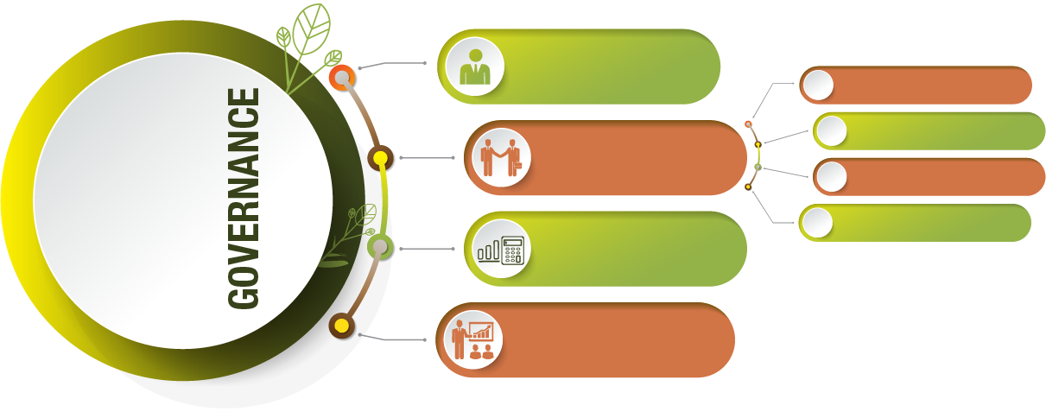
^{GOVERNANCE}
Executive Authority:
Board of Trustees
8 Employer representatives.
Members and employers have equal representation on the Board.
6 Employee representatives.
1 Pensioner representative.
Board shall manage the Fund in terms of the powers, and duties conferred upon it as per the GEP Law.
1 Forces representative.
Board ensures the effective and efficient administration of the Fund and is accountable for the investment performance.

Slide 6
OPERATING MODEL
Other Service Providers:
External Auditors
Actuarial Valuator
Legal
Unlisted Investment Valuators

Slide 7
FINANCIAL YEAR 2021/22 RESULTS CONTEXT
GLOBAL ECONOMIC RECOVERY WITH DISRUPTIONS
HIGHEST ANNUAL GROWTH RATE IN MORE THAN A DECADE FOR SOUTH AFRICA
HIGHLY CORRELATED DOMESTIC EQUITY MARKET
RESILIENT LOCAL BOND MARKET
RUSSIA-UKRAINE CONFLICT
GLOBAL ENERGY SUPPLY CONCERNS

Slide 8
FINANCIAL YEAR 2021/22 ADMINISTRATIVE HIGHLIGHTS
R2.3
R136
billion
trilion
Benefits PaId
Investment Portfolio
9.6%
Increase in Investment Portfolio
8.6%
R255.7
billion
Growth in Reserves over 10 years
Net Investment Income
11.1%
Return on Investment

Slide 9
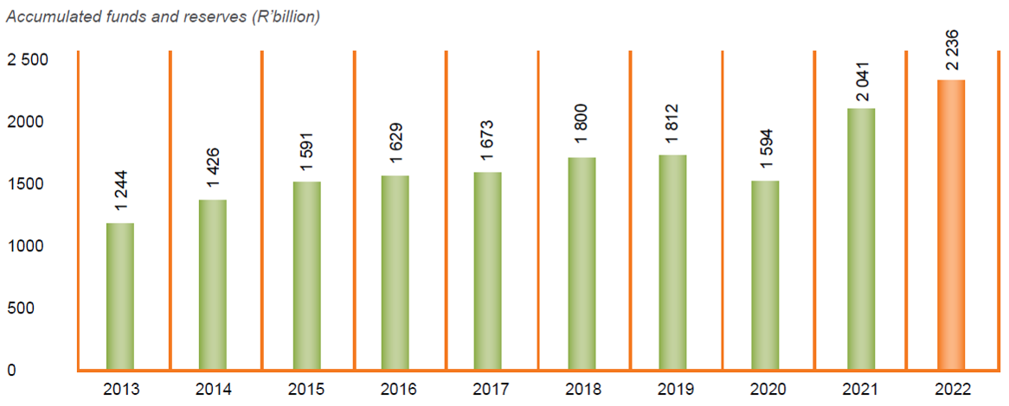
ASSETS
Assets of the fund grew at an average rate of 8.60% during the 2013-2022 period.
^{(R’BILLION)}

Slide 10
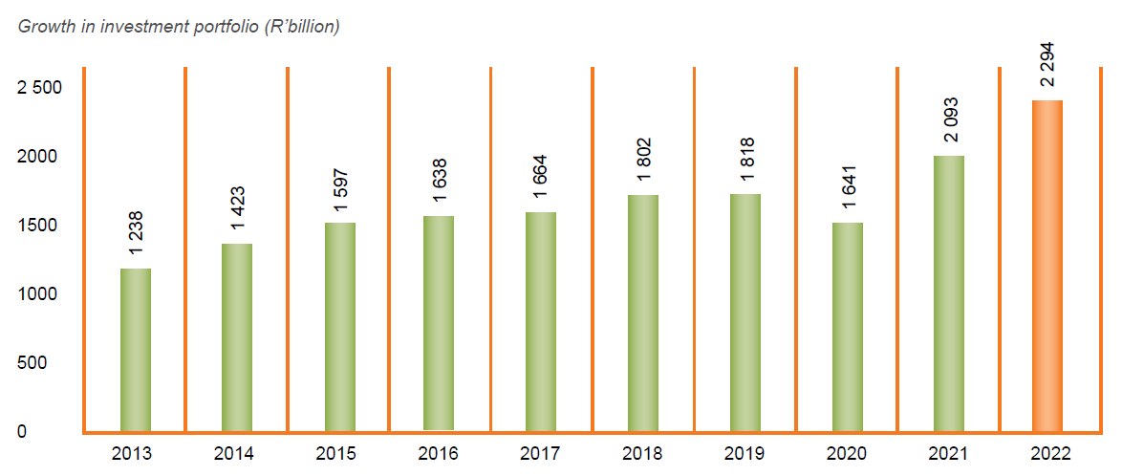
GROWTH INVESTMENT PORTFOLIO
The GEPF investment portfolio increased by R201 billion, an increase of 9.6%
^{(R’BILLION)}

Slide 11
GROWTH INVESTMENT PORTFOLIO
Domestic bonds increased as a result of additions and positive fair value adjustments
Foreign collective investments schemes increased as a result of positive fair value adjustments and investments to new asset managers
Notes:
Listed equity decreased by 20.8% as a result of economic inactivity experienced in March 2020 due to COVID-19, a downgrade in credit ratings and interest rate cuts that were imposed by the Reserve Bank.
Domestic bonds decreased by 2.1% as a result of negative fair value adjustments.
Domestic unlisted equities decreased by 2.6% .
Foreign collective investments schemes increased by 9.4% as a result of positive fair value adjustments and investments to new asset managers.

Slide 12
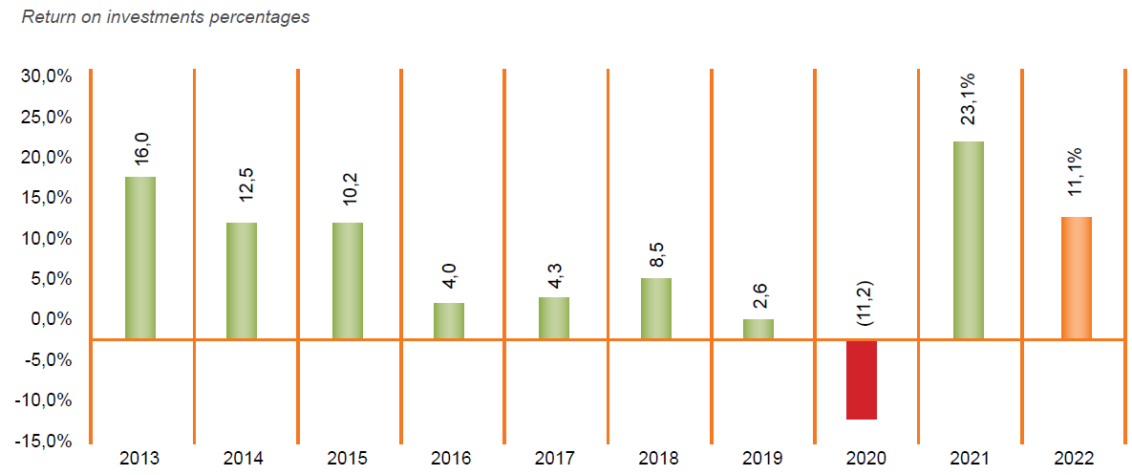
RETURNS ON INVESTMENT
AVERAGE RETURN PERCENTAGES
During the reporting period, the GEPF investments yielded an average positive return of 11.1%

Slide 13
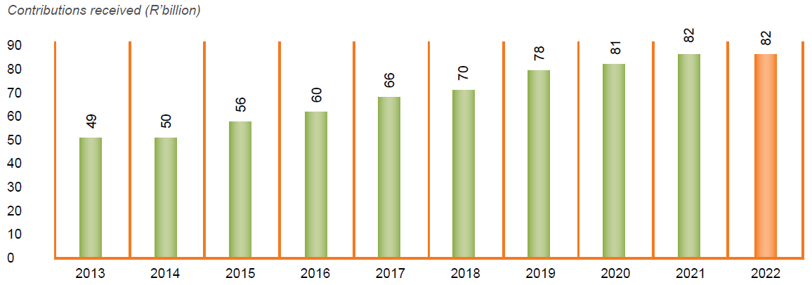
CONTRIBUTIONS RECEIVED AND ACCRUED INCREASE IN CONTRIBUTIONS RECEIVED
The GEPF receives a percentage of members’ pensionable salaries as contributions. Contributions income increased by 0.53% during the reporting period, from R81.57 billion in 2021 to R81.99 billion in 2022.
^{(R’BILLION)}

Slide 14
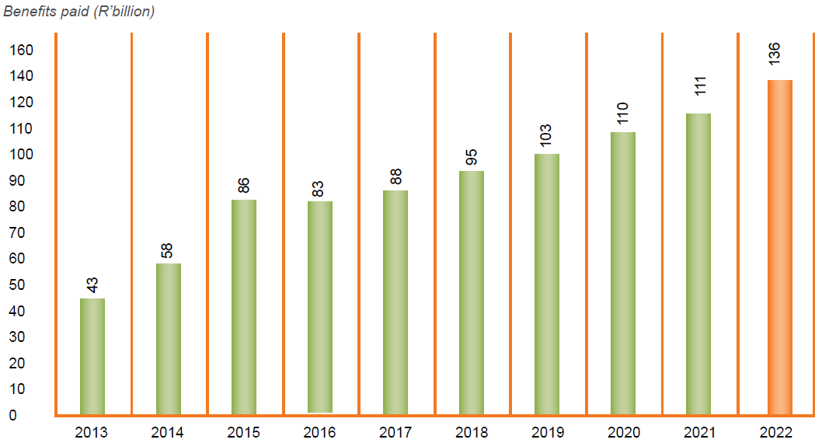
BENEFITS AWARDED
INCREASE IN BENEFITS AWARDED
Pension payments increased by R25 billion to R136 billion
^{(R’BILLION)}

Slide 15
GEPF BENEFITS
Retirement.
33 627 cases processed and finalised of members retiring. The total value of gratuities paid was R21.4 billion and annuities amounted to R62.3 billion.
Resignation.
R33.8 billion was paid in resignation benefits to 20 659 beneficiaries during the reporting period.

Slide 16
GEPF BENEFITS
Death.
R14.8 billion paid in death benefits during the reporting period to 11 776 beneficiaries
Funeral.
37 798 funeral benefit claims processed and paid and an amount of R550.1 million was paid to beneficiaries during the reporting period.
Child’s Pension.
R551m paid in orphan’s annuities during the reporting period. 9 824 children are currently receiving this benefit from the GEPF.

Slide 17
THANK YOU

