Slide 1
2022/23 Q4 SPENDING OUTCOMES
PRESENTED BY:
Public Finance
Date: May 2023

Slide 2
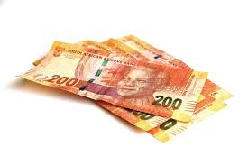
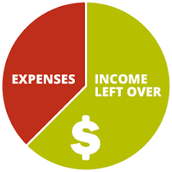

SUMMARY OF SPENDING
Spending summary
Higher than projected expenditure
Personnel expenditure
Lower than projected expenditure

Slide 3
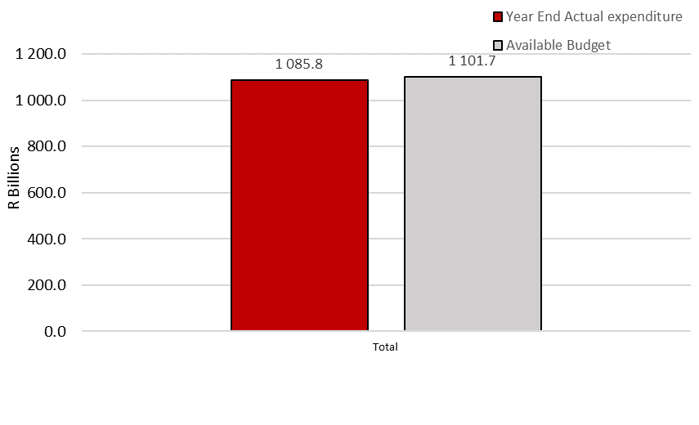
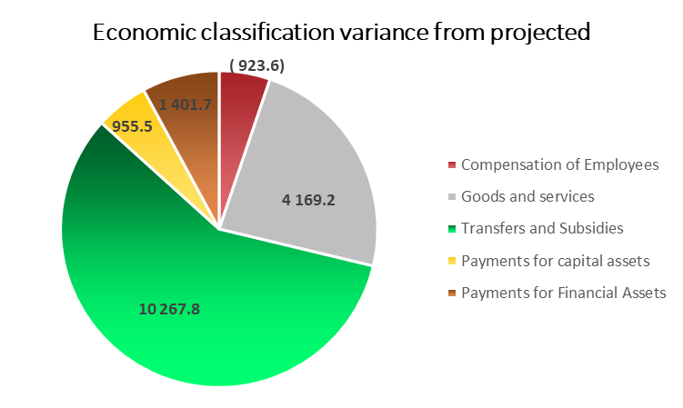

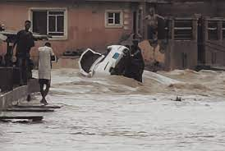
Summary of spending
R15.8 billion or 1.4 per cent underspending against the available budget of R1.1 trillion
R31.7 billion at the end of 2022/23
R7.9 billion at the end of 2022/23
Notes:
The preliminary expenditure estimate for the 2022/23 financial year is R1.09 trillion, which represents an underspending of R15.9 billion or 1.4 per cent against the available budget of R1.10 trillion. The largest underspending was on transfers and subsidies (R10.3 billion), followed by goods and services (R4.2 billion), payment for financial assets (R1.4 billion) and payment for capital assets (R955.4 million). Compensation of employees and interest and rent on land overspent by R923.6 million and R6.5 million respectively. Expenditure for COVID-19 activities amounted to R31.7 billion at the end 2022/23 financial year mainly under the department of Social Development relating to the R350 social relief of distress grant. The disaster spending amounted to R7.9 billion, it includes R3.9 billion on the Municipal Disaster Recovery Grant under the department of Cooperative Governance, and R2.0 billion under the department of Agriculture, Land Reform and Rural Development for combatting animal and plants diseases outbreaks, cold spells and veld fires.

Slide 4
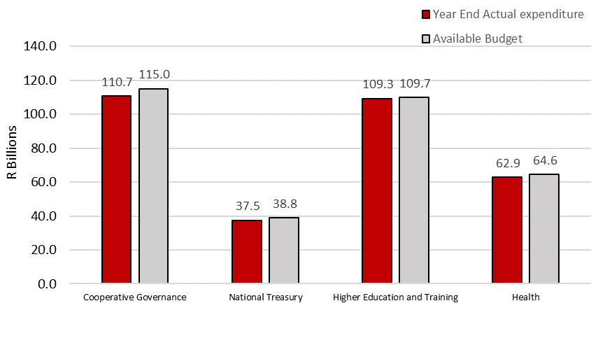
Summary of spending
R4.3 billion or 3.8 per cent underspending
R1.3 billion or 3.5 per cent underspending
R462.9 million or 0.4 per cent underspending
R1.7 billion or 2.6 per cent underspending
Notes:
Cooperative Governance: majority of the underspending was incurred under transfers and subsidies largely as a result of the offsetting of the local government equitable share against rollovers funds that were not approved and not transferred back into the national revenue fund.
National Treasury: The underspending is mainly due to; (1) the Land and Agricultural Development Bank of South Africa for which a payment for guaranteed debt was made as a direct charge against the National Revenue Fund in terms of the Public Finance Management Act under payment for financial assets, (2) goods and services for the renewal of annual license support and maintenance for the Integrated Financial Management System and delays in implementing various projects within the Office of the Chief Procurement Officer that are currently at various stages of the procurement process and (3) transfers and subsidies for the Post-Retirement Medical Scheme due to the increased mortality rate of the pre-1992 members, resulting in a decline in membership and on the SA Citizen Force relating to the death of the members/ beneficiaries, suspension of life certificates and review cases.
Higher Education and Training: majority of the underspending was incurred under compensation of employees underspending is mainly due to delays in the implementation of the Post-Provisioning Norms, which will place TVET employees on the department’s payroll system.
Health: The underspending was mainly incurred under goods and services mostly because of COVID-19 vaccines not being procured and low spending against NHI-related allocations; and capital assets due to delays in the Limpopo Academic Hospital project.

Slide 5
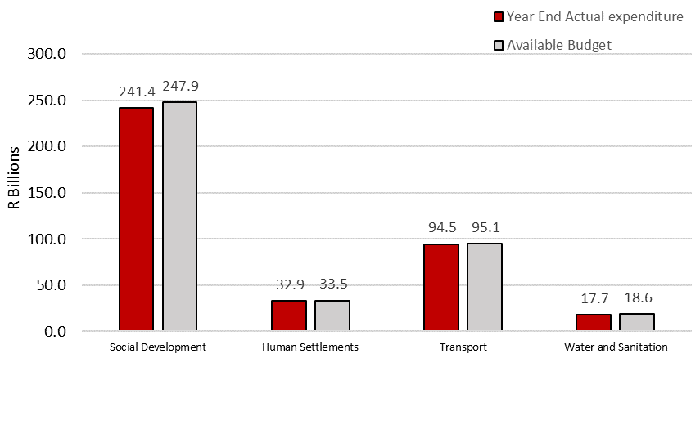
Summary of spending
R6.4 billion or 2.6 per cent underspending
R621.3 million or 1.9 per cent underspending
R591 million or 0.6 per cent underspending
R861.6 million or 4.6 per cent underspending
Notes:
Social Development: underspending mainly under transfers and subsidies is mainly due to the COVID-19 SRD grant as a result of the lower than anticipated uptake of the grant following implementation of stringent income verification measures intended at improving targeting of the poorest.
Human Settlements: underspending mainly under transfers and subsidies and goods and services due to; (1) the partial transfer of the Provincial Emergency Housing Grant which is only disbursed when there are qualifying and approved applications and (2) goods and services such as consultants and computer services from delays in the recruitment process for appointing professional services and delays in procuring computer equipment.
Transport: The underspending mainly attributed to transfer and subsidies and good and services. This is mainly due to the tender cancellation for the S’hamba Sonke development programme, and the road transport legislative review project. Transfers to Road Traffic Infringement Agency for the Administrative Adjudication of Road Traffic Offences national rollout have been halted pending the outcome of the constitutional court ruling.
Water and Sanitation: underspending was incurred under the payments for capital assets mainly on the Schedule 6B Indirect Portions of both the Regional Bulk Infrastructure Grant and Water Services Infrastructure Grant Bucket Eradication Programme and Drought Intervention projects. The reasons being delays by implementing agents to appoint contractors, cancellation of contracts due to under performance by contractors, as well as the ongoing theft and vandalism to infrastructure and generators.

Slide 6
SUMMARY OF SPENDING: Underspending
Total allocation
Compensation of employees
Goods and services
Transfers
Payments for capital assets

Slide 7
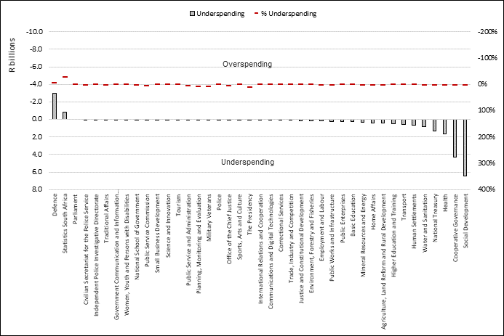
SUMMARY OF SPENDING: Underspending

Slide 8
SUMMARY OF SPENDING: Underspending

Slide 9
SUMMARY OF SPENDING: SOCIAL DEVELOPMENT
underspending mainly under transfers and subsidies is mainly due to the COVID-19 SRD grant as a result of the lower than anticipated uptake of the grant following implementation of stringent income verification measures intended at improving targeting of the qualifying population

Slide 10
SUMMARY OF SPENDING: COGTA
majority of the underspending was incurred under transfers and subsidies largely as a result of the offsetting of the local government equitable share against rollovers funds that were not approved and not transferred back into the national revenue fund
LIST THE MUNICIPALITIES

Slide 11
SUMMARY OF SPENDING: HEALTH
The underspending was mainly incurred under goods and services mostly because of
COVID-19 vaccines not being procured
Low spending against NHI-related allocations
Capital assets due to delays in the Limpopo Academic Hospital project.

Slide 12
SUMMARY OF SPENDING: NATIONAL TREASURY
The underspending is mainly due to
the Land Bank for which a payment for guaranteed debt was made as a direct charge against the NRF in terms of the PFMA under payment for financial assets
Goods and services for the renewal of annual license support and maintenance for the Integrated Financial Management System
Delays in implementing various projects within the Office of the Chief Procurement Officer that are currently at various stages of the procurement process
Transfers and subsidies for the Post-Retirement Medical Scheme due to the increased mortality rate of the pre-1992 members, resulting in a decline in membership and on the SA Citizen Force relating to the death of the members/ beneficiaries, suspension of life certificates and review cases.

Slide 13
SUMMARY OF SPENDING: WATER AND SANITATION
underspending was incurred under the payments for capital assets mainly on the Schedule 6B Indirect Portions of both the Regional Bulk Infrastructure Grant and Water Services Infrastructure Grant Bucket Eradication Programme and Drought Intervention projects. The reasons being delays by implementing agents to appoint contractors, cancellation of contracts due to under performance by contractors, as well as the ongoing theft and vandalism to infrastructure and generators.

Slide 14
SUMMARY OF SPENDING: HUMAN SETTLEMENT
underspending mainly under transfers and subsidies and goods and services due to;
the partial transfer of the Provincial Emergency Housing Grant which is only disbursed when there are qualifying and approved applications
goods and services such as consultants and computer services from delays in the recruitment process for appointing professional services and delays in procuring computer equipment

Slide 15
SUMMARY OF SPENDING: TRANSPORT
The underspending mainly attributed to transfer and subsidies and good and services. This is mainly due to the tender cancellation for the S’hamba Sonke development programme, and the road transport legislative review project
Transfers to Road Traffic Infringement Agency for the Administrative Adjudication of Road Traffic Offences national rollout have been halted pending the outcome of the constitutional court ruling

Slide 16
SUMMARY OF SPENDING: DHET
majority of the underspending was incurred under compensation of employees underspending is mainly due to delays in the implementation of the Post-Provisioning Norms, which will place TVET employees on the department’s payroll system.
PLEASE PROVIDE A SIMPLER EXPLANATION

Slide 17
SUMMARY OF SPENDING: DALRRD
PLEASE PROVIDE REASONS

Slide 18
SUMMARY OF SPENDING: HOME AFFAIRS
PLEASE PROVIDE REASON

Slide 19
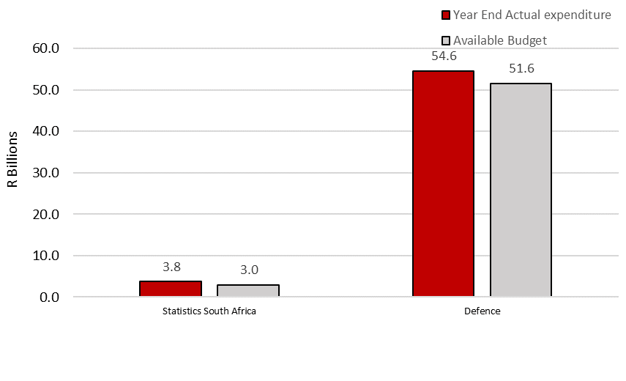
Summary of spending
R798.2 million or 26.6 per cent overspending
R2.98 billion or 5.8 per cent overspending
Notes:
Defence: the overspending was incurred under compensation of employees due to the compensation of employees’ ceiling which does not support the current personnel numbers of the department. Under transfers and subsidies, the overspending is mainly due to the higher than anticipated payment to the Government Employees Pension Fund’s liability for the mobility exit mechanism of South African National Defence Force personnel.
Statistics South Africa: majority of the overspending was incurred under good and services due to the payment of contract workers, as well as travel and subsistence for the 2022 population census project. This was as a result of the extension of the population census project from March 2022 to May 2022. The department submitted a request to the National Treasury to rollover funds from the 2021/22 underspending to mitigate against the overspending in 2022/23. In addition, the department has also prioritised funds from other activities and/or programmes in order to partially defray the overspending on the census project.

Slide 20
SUMMARY OF SPENDING: STATISTICS SOUTH AFRICA
majority of the overspending was incurred under good and services due to the payment of contract workers, as well as travel and subsistence for the 2022 population census project. This was as a result of the extension of the population census project from March 2022 to May 2022. The department submitted a request to the National Treasury to rollover funds from the 2021/22 underspending to mitigate against the overspending in 2022/23. In addition, the department has also prioritised funds from other activities and/or programmes in order to partially defray the overspending on the census project
BUT THEY STILL OVERSPENT

Slide 21
SUMMARY OF SPENDING: DEFENCE
the overspending was incurred under compensation of employees due to the compensation of employees’ ceiling which does not support the current personnel numbers of the department. Under transfers and subsidies, the overspending is mainly due to the higher than anticipated payment to the Government Employees Pension Fund’s liability for the mobility exit mechanism of South African National Defence Force personnel.

Slide 22
DISASTER FUNDING FRAMEWORK POST THE 2022 MTBPS
Immediate response grants for the 2022/23 financial year
Disaster relief grants were allocated a total of R1 billion in the 2022 DoRA
Due to the response that was required for the April 2022 floods, by the time of the tabling of the 2022 MTBPS, three of the four disaster relief grants had been depleted, with only R38 million remaining in the MEHG
Due to patterns from previous years showing that disasters typically occur in the summer season, in the 2022 DoRA Act, a total of R694.5 million was added to the disaster relief grants that had been depleted, to enable for response in the event that a disaster occurs in the remaining months of the current financial year
Only R38.6 million has been allocated to municipalities post the MTBPS, from the MEHG
This leaves R447 million available for immediate response for provinces in the remaining months of the 2022/23 financial year; and R248 for municipalities
Notes:
The higher than projected spending was recorded due to the implementation of cost-of-living adjustments for the department’s employees in November 2022, which included backdated payments from April 2022

Slide 23
DISASTER FUNDING FRAMEWORK POST THE 2022 MTBPS
Other sources of funding for immediate response
Reprioritisation within existing budgets - National, provincial and local organs of state may financially contribute to response efforts and post-disaster recovery and rehabilitation
Reprioritising grant funds - Funds from other conditional grants to provinces and municipalities may also be reallocated to pay for the alleviation of the impact of a declared disaster. Municipalities have some scope to reprioritise as they are currently in the 2nd month of the 3rd quarter, their financial year ending in June
Post-disaster repair and recovery
Following a disaster, the repair and rebuilding of damaged infrastructure is typically funded through ring-fenced allocations in the next Budget or Adjustment Budget.
Notes:
The higher than projected spending was recorded due to the implementation of cost-of-living adjustments for the department’s employees in November 2022, which included backdated payments from April 2022

Slide 24

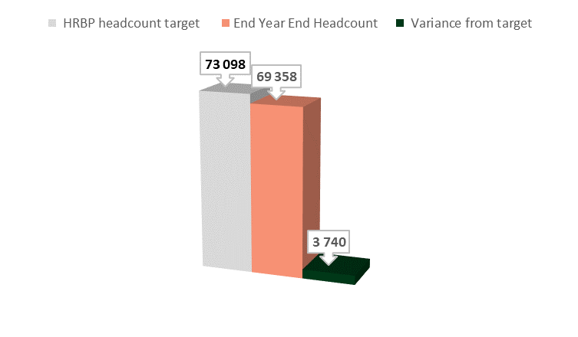
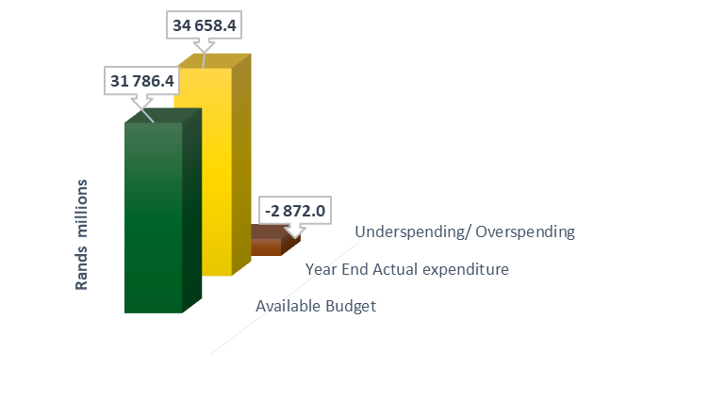
Summary of spending
Personnel spending and vacancy rates
Overspending is due to the compensation of employees ceiling which does not support the current personnel numbers of the department. The department has managed to significantly decrease personnel headcount in 2022/23.
Notes:
Defence: overspending is due to the compensation of employees ceiling which does not support the current personnel numbers of the department. The department has managed to significantly decrease personnel headcount in 2022/23. However, this was still insufficient to bridge the gap between the budget and compensation of employees ceiling.

Slide 25

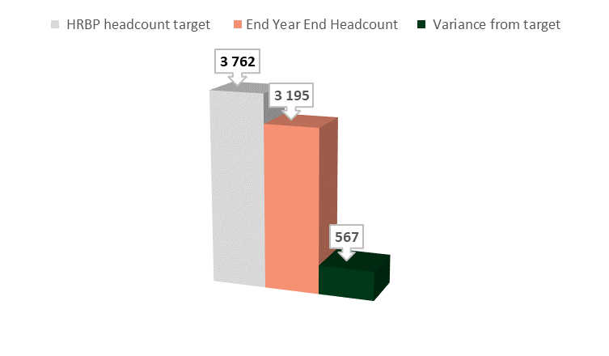
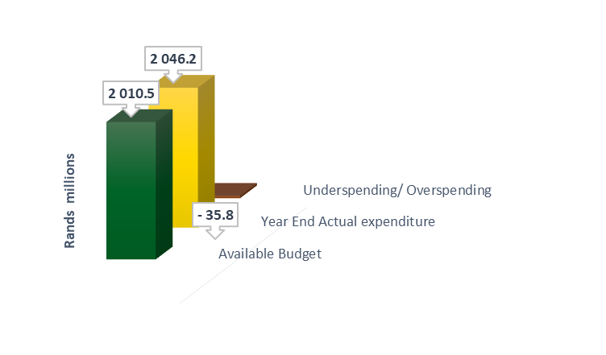
Summary of spending
Personnel spending and vacancy rates
Overspending is mainly due to the Waste Bureau and Waste Phakisa projects being paid on PERSAL. However, the officials do not form part of the departmental compensation of employees’ allocation.
Notes:
Environment, Forestry and Fisheries: the overspending is mainly due to the Waste Bureau and Waste Phakisa projects being paid on PERSAL. The officials for these projects are on contract and included in the total allocation towards the Waste Bureau and Waste Phakisa, however, the officials do not form part of the departmental compensation of employees’ allocation.

Slide 26

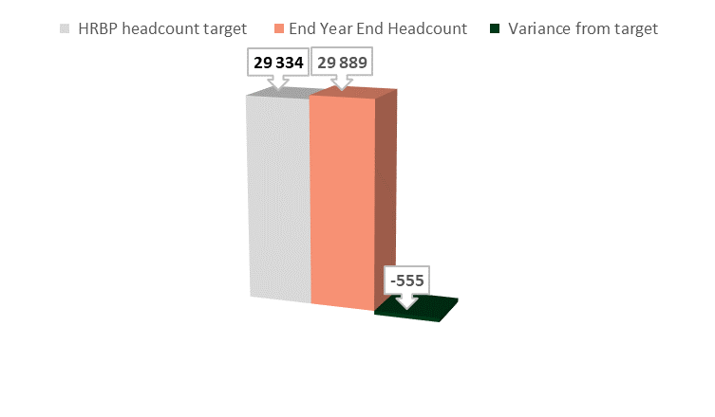
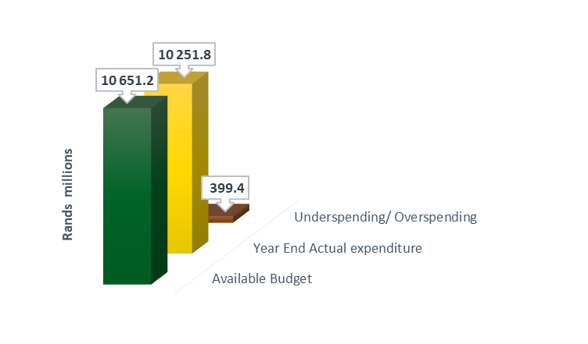
Summary of spending
Personnel spending and vacancy rates
Underspending was incurred under compensation of employees underspending is mainly due to delays in the implementation of the Post-Provisioning Norms, which will place TVET employees on the department’s payroll system.
Notes:
Higher Education and Training: majority of the underspending was incurred under compensation of employees underspending is mainly due to delays in the implementation of the Post-Provisioning Norms, which will place TVET employees on the department’s payroll system.

Slide 27

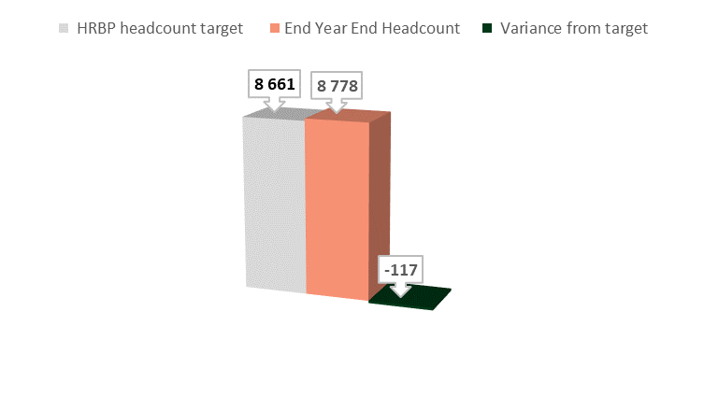
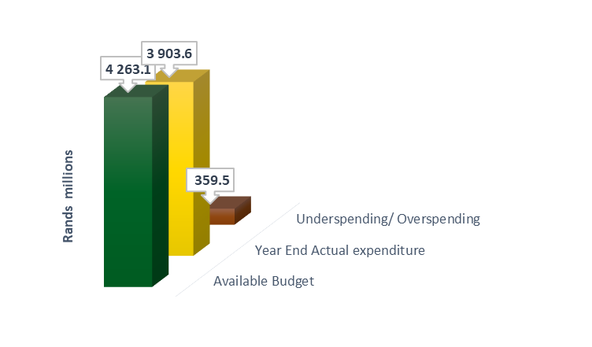
Summary of spending
Personnel spending and vacancy rates
Underspending is mainly due to delays in the appointment of graduate recruits responsible for the digitisation of records and delays in filling of vacant funded posts.
Notes:
Home Affairs: underspending is mainly due to delays in the appointment of graduate recruits responsible for the digitisation of records and delays in filling of vacant funded posts.

Slide 28


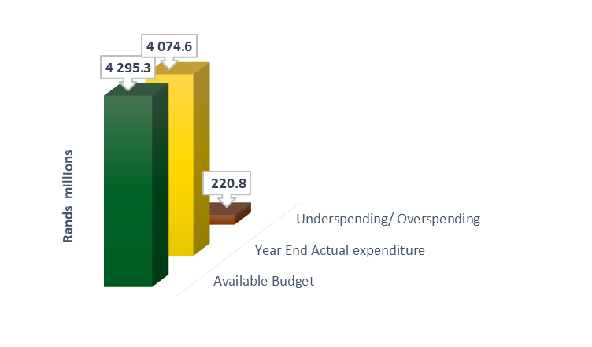
Summary of spending
Personnel spending and vacancy rates
Underspending is mainly due to vacancies owing to the delay experienced in the finalisation of job descriptions for the OSD posts and the delays with the completion of the Personnel Suitability Check.
Notes:
Agriculture, Land Reform and Rural Development: underspending is mainly due to vacancies owing to the delay experienced in the finalisation of job descriptions for the OSD posts and the delays with the completion of the Personnel Suitability Check. The department is in consultation with the DPSA to resolve the issue of job descriptions regarding the OSD posts.

Slide 29

Thank you

