Slide 1
PROTOCOL ON LAND-BASED SOURCES AND ACTIVITIES
Select Committee
30 May 2023

Slide 2
PURPOSE
To obtain Parliament approval for South Africa to accede to the of the Nairobi Convention. Protocol for the Protection of the Marine and Coastal Environment of the Western Indian Ocean from Land-based Sources and Activities

Slide 3
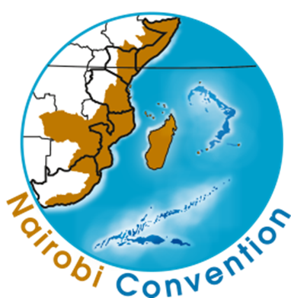
BACKGROUND TO THE CONVENTION
Developed in 1985 under UNEP’s Regional Seas Programme, which was established directly to address oceans and coastal issues as part of the 1972 Stockholm Agenda.
Overall objective: To achieve sustainable management and use of the marine and coastal environment.
Covers over 15,000km of coastline from Somalia to South Africa including islands states in WIO region.
It came into force in 1996; RSA acceded in 2003; Currently 10 Contracting Parties.

Slide 4
KEY OBLIGATIONS OF THE CONVENTION:
Take measures to prevent, reduce, combat and control pollution of the Convention area (land-based and offshore sources);
To ensure sound environmental management of natural resources;
To prevent, reduce, combat and control coastal erosion;
To protect and preserve rare or fragile ecosystems and endangered species, through the establishment of Marine Protected Areas;
To co-operate in taking all necessary measures to deal with pollution emergencies.

Slide 5
PROCESS OF DEVELOPING THE PROTOCOL:
The 1st draft LBSA Protocol was presented in March 2006 in the 2nd Regional Task Force Meeting in Diani, Mombasa;
Draft Protocol then presented to MINTEC Working Group II (Session 2: Pollution and Waste) in September 2007;
The National Advisory Forum established under the Department’s National Programme of Action (NPOA) on land-based activities, in July 2008;
South Africa participated in two regional negotiation meetings which were held in Cape Town (2008) and Mombasa (2009) to finalise the Protocol;
Convened a national stakeholder consultation workshop on 22 January 2010;
In April 2010, All parties of the Nairobi Convention finalized the Protocol and was open for signature;
Reconvened a national stakeholder consultation workshop in October 2018 to discuss the importance of the protocol.

Slide 6
FEATURES OF THE LBSA PROTOCOL :
Detailed preamble
26 Articles, thematically organized under five headings:
General provisions, including definitions, geographical scope, protocol application, and general obligations
Provisions on pollution and other degrading activities and sources: includes pollution from point and diffuse sources, degradation from other harmful activities and transboundary pollution
Legal opinions were obtained and view the Protocol on Land Based Sources and Activities of the Nairobi Convention as consistent with international law and with South Africa’s international obligations.

Slide 7
RECOMMENDATIONS
It is recommended that Parliament approves for South Africa to accede to the Protocol for the Protection of the Marine and Coastal Environment of the Western Indian Ocean from Land-based Sources and Activities of the Nairobi Convention.

Slide 8
THANK YOU!
Dr Lisolomzi Fikizolo
Oceans and Coast Branch
Department of Environment, Forestry and Fisheries
021493 37039/ 084 625 1333
Website: http://www.environment.gov.za
East Pier 2, East Pier Road,
V&A Waterfront, Cape Town
8002

