Slide 1

Detailed progress report on school infrastructure
Presentation by the Department of Basic Education
30 May 2023

Slide 2
PART A : Sources of information

Slide 3
Data sources
The Department of Education compiled the School Register of Needs (SRN-1996). This was the first database that included every school in the country, including their geographical location, the condition of buildings and the facilities available.
The Department of Education updated the survey and released the School Register of Needs (SRN-2000).
The Department of Education developed the National Education Infrastructure Management System (NEIMS-2007).
In 2011, the Department of Basic Education launched the Accelerated School Infrastructure Delivery Initiative (ASIDI-2011). This programme focused on the following:
  Appropriate building for schools made entirely of inappropriate materials.
  Appropriate water supply to schools with no water.
  Appropriate sanitation at schools with no toilets.
  Appropriate electricity supply to schools with no electricity supply.
In 2018, the Department of Basic Education launched the Sanitation Appropriate For Education (SAFE-2018) initiative. This programme focused on the following:
  Appropriate sanitation at schools dependent on basic pit toilets.
Both the ASIDI & SAFE programmes are funded from the School Infrastructure Backlog Grant. The Department submit weekly progress reports on the ASIDI & SAFE programmes to the Minister (DBE-2023).

Slide 4
PART B : Number of ordinary public schools

Slide 5
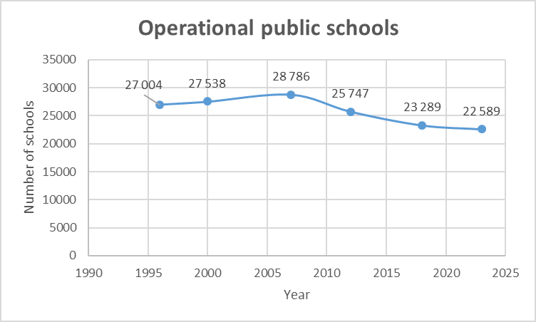
Operational schools
The number of operational public schools has initially increased from 27 004 in 1996 to 28 876 in 2007.
The number of operational schools then decreased to 22 589 in 2022.
Drop of 6 287

Slide 6
PART C : Schools made entirely of inappropriate materials

Slide 7
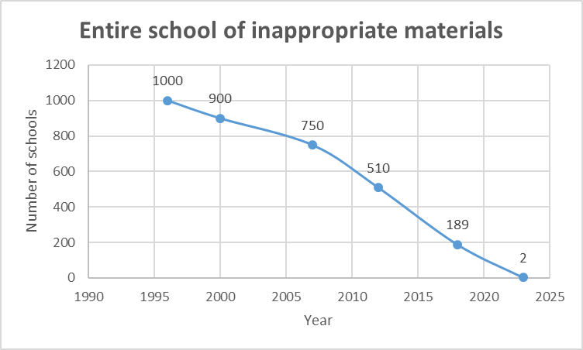
“Mud” schools & other inappropriate structures
It is estimated that in 1996 there were about 1 000 schools made entirely of inappropriate materials.
In 2011, there were initially 510 schools on the ASIDI programme (This number decreased to 332).
Of the 332 schools made entirely of inappropriate materials, 330 have been replaced.
The remaining 2 replacement schools are scheduled for completion in 2023/24.
ASIDI

Slide 8
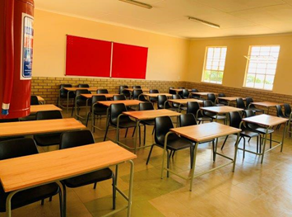
Example

Slide 9
PART D : Schools with no water supply

Slide 10
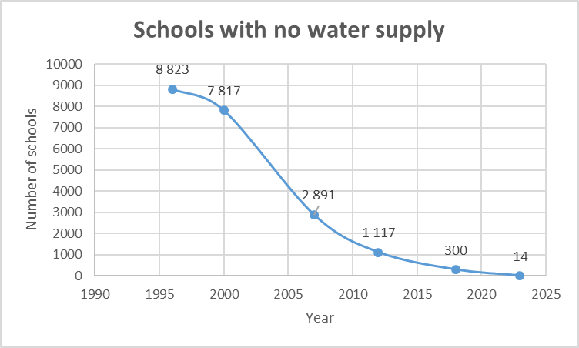
Schools with no water supply
The SRN 2006 recorded 8 823 schools with no water supply.
In 2011, there were initially 1 117 schools on the ASIDI programme (This number increased to 1 306).
Of the 1 306 water supply projects, 1 292 have been completed.
The remaining 14 water supply projects are scheduled for completion in 2023/24.
ASIDI

Slide 11
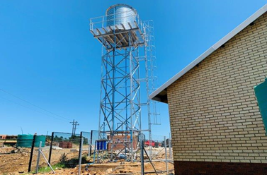
Example

Slide 12
PART E : Schools with no electricity supply

Slide 13
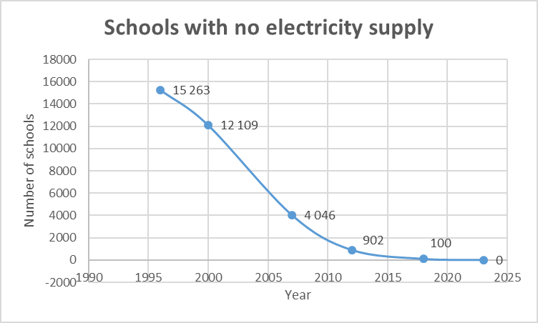
Schools with no electricity supply
The SRN 2006 recorded 15 263 schools with no electricity supply.
In 2011, there were initially 902 schools on the ASIDI programme (This number decreased to 373).
All of the 373 electricity supply projects have been completed.
ASIDI

Slide 14
PART F : Schools with no toilets

Slide 15
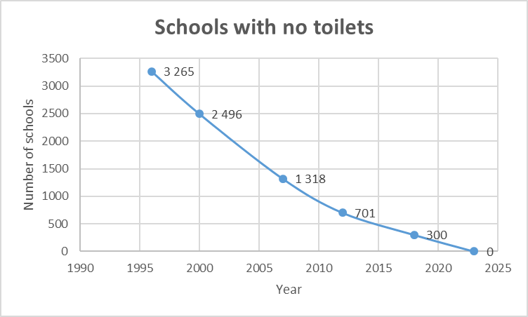
Schools with no toilets
The SRN 2006 recorded 3 265 schools with no toilets.
In 2011, there were initially 701 schools on the ASIDI programme (This number increased to 1 087).
All of the 1087 sanitation projects have been replaced.
ASIDI

Slide 16
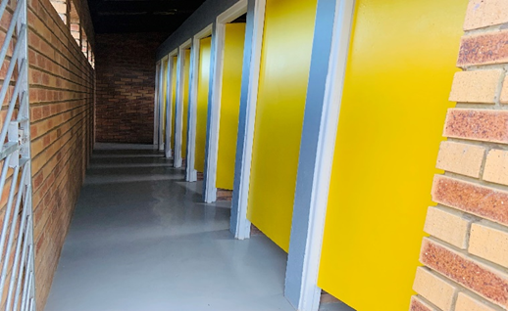
Example

Slide 17
PART G : Schools dependent on basic pit toilets

Slide 18
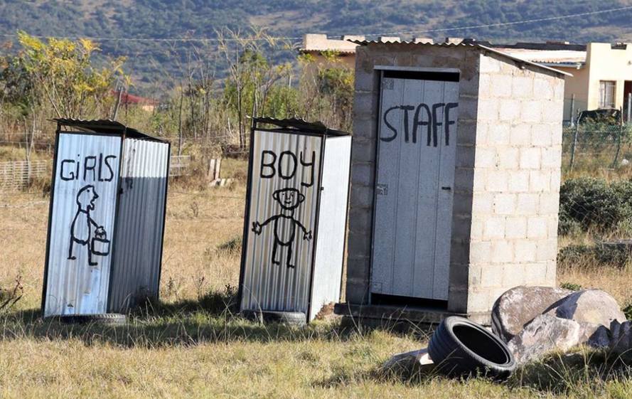
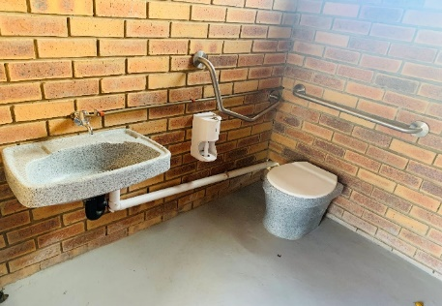

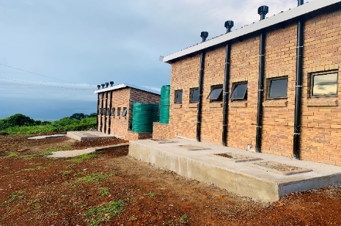
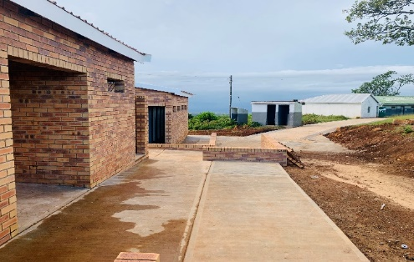
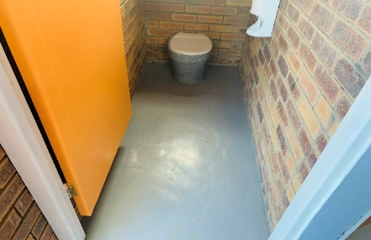
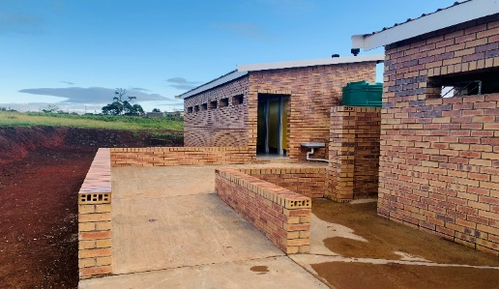
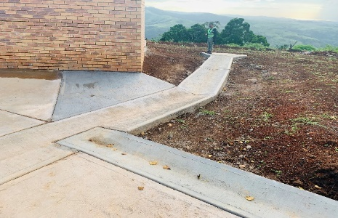
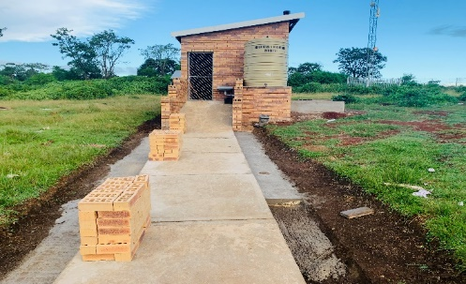
IMPORTANT : Different categories of pit toilets
Inappropriate BASIC PIT TOILETS
Appropriate VENTILATED IMPROVED PIT TOILETS

Slide 19
SAFE work breakdown structure
1. Initial list of schools
2. Schools that require intervention

Slide 20
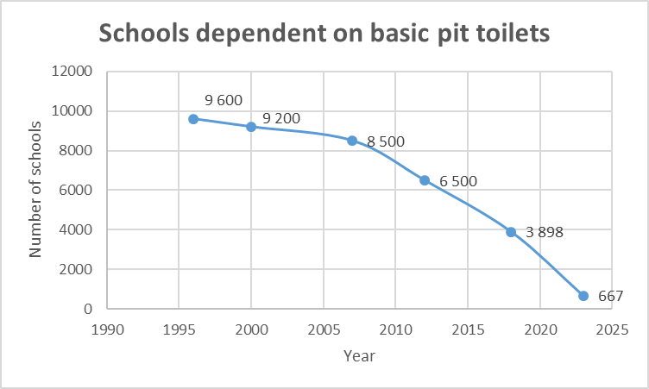
Schools dependent on basic pit toilets
The SRN 2006 recorded 9 600 schools dependent on basic pit toilets.
In 2018, there were initially 3 898 schools on the SAFE programme (This number decreased to 3 395).
Of the 3 395 sanitation projects, 2 728 have been completed.
The remaining 667 sanitation projects are scheduled for completion in 2023/24.
SAFE

Slide 21
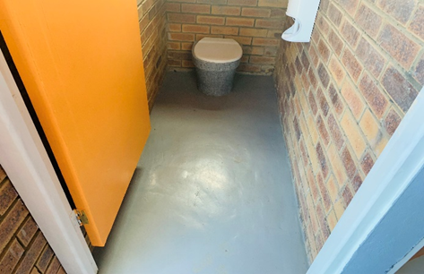
Example

Slide 22
PART H : Lessons learned

Slide 23
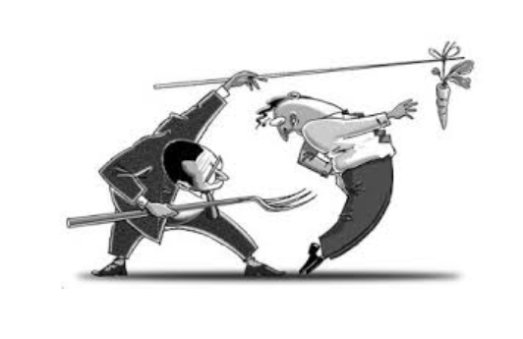
Carrot & Stick approach to performance management
STICK:
Monitor progress against agreed baseline programme.
Apply penalties for late completion.
Restrict defaulters from doing business with Government.
CARROT:
Ensure prompt payment.
Quick response to concurrence requests.
Standard operating procedures.

Slide 24
Monitoring over the entire life-cycle of the projects
Capital investment Plan
U-AMP
Budget allocation
Norms & Standards
Checklists
Competent person sign-off
BAC report
PSU review
Concurrence
Principal Agent
Site visits
Penalties
Final account
Final payment certificate
Close-out report
Need ID
Design
Completion
Tender
Construction
One-on-one meetings
Executive oversight meetings
Ministerial oversight meetings
Ad-hoc meetings
PC tracker
Portfolio tracker
Cashflow tracker
BAS expenditure tracker

Slide 25
Number of site visits by DBE
PROVINCE | NUMBER OF VISITS INITIATED BY THE DG’S TEAM | NUMBER OF VISITS INITIATED BY THE DBE INFRASTRUCTURE TEAM | NUMBER OF VISITS INITIATED BY THE PROJECT SUPPORT UNIT
Eastern Cape | 1416 | 322 | 3140
Free State | 7 | 33 | N/A
Kwa-Zulu Natal | 1161 | 48 | 2256
Limpopo | 459 | 319 | 1426
Donor Projects |  | 67
TOTAL | 3043 | 789 | 6 822

Slide 26
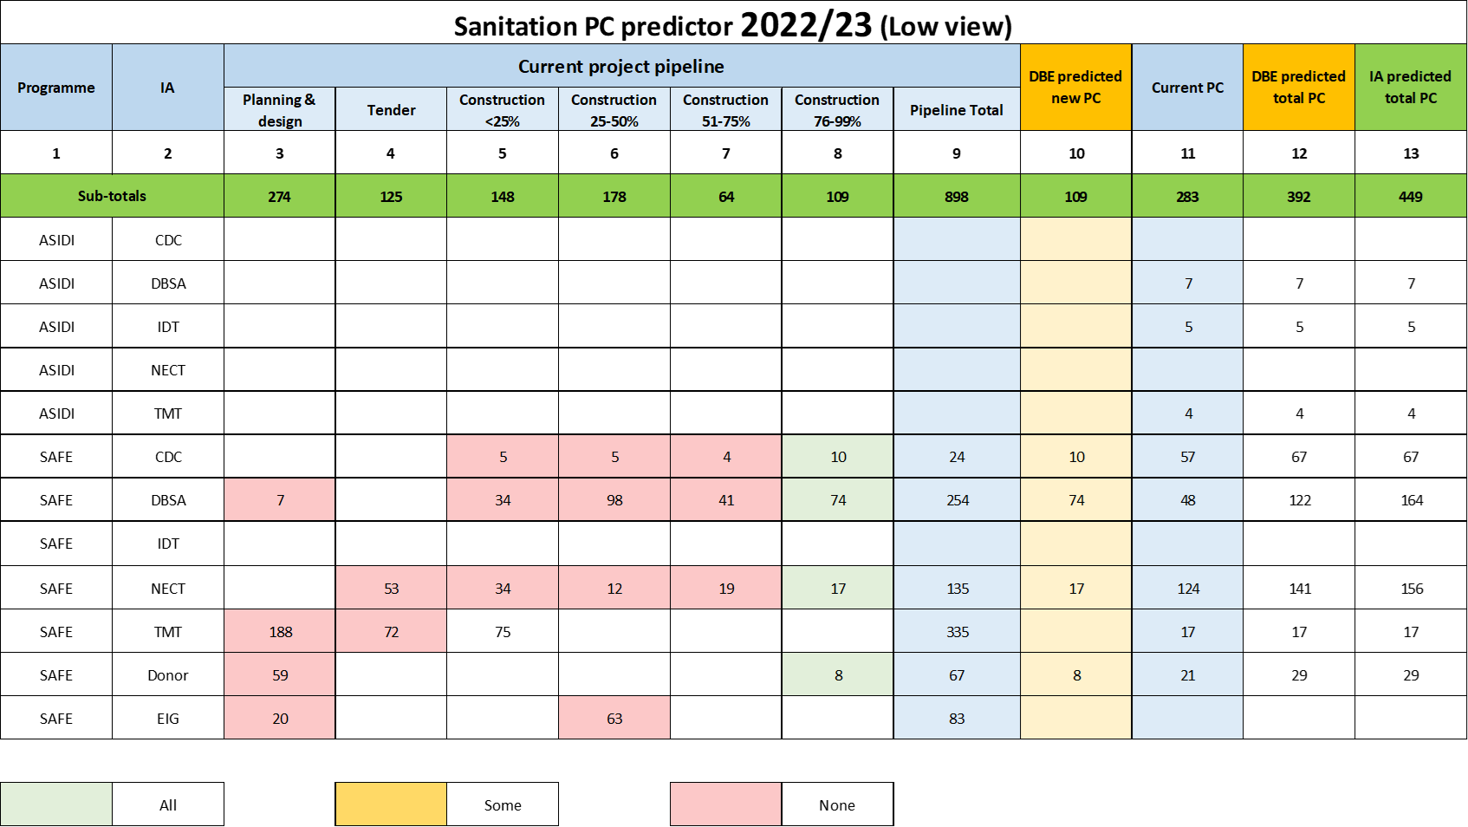
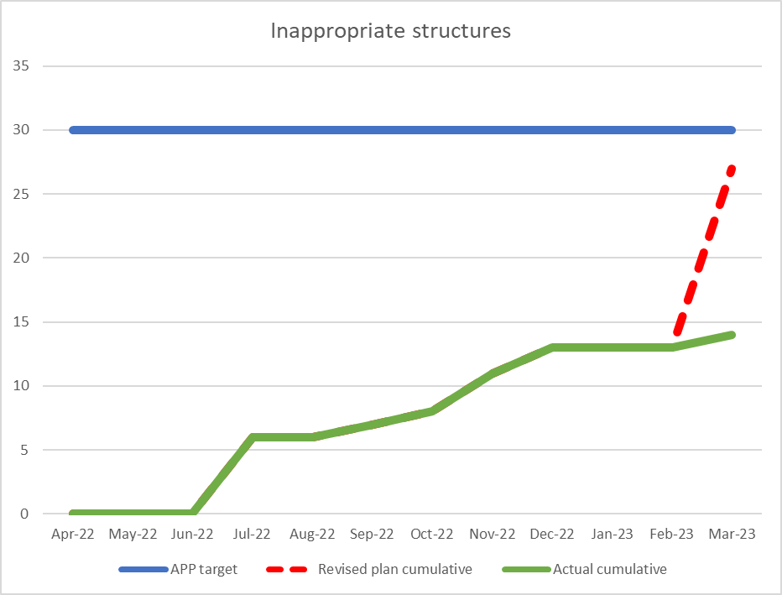
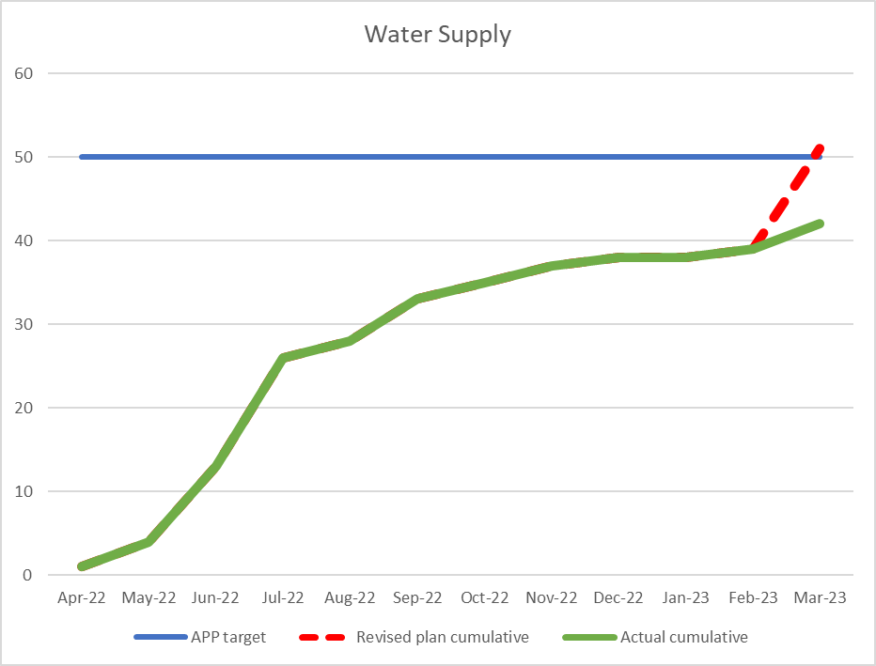
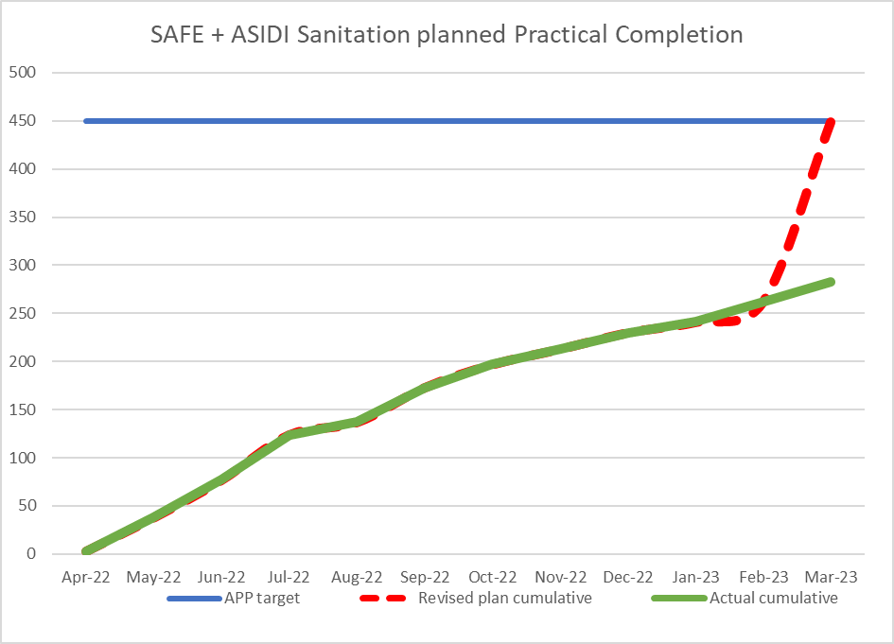
Progress review meetings
Weekly meetings with operational teams of Implementing Agents.
Weekly meetings with Executive Management of Implementing Agents.
Weekly progress reports to the Minister & Deputy Minister
26

Slide 27
Additional built-environment capacity
Pre-2018
2018
2019
Post-2019
Architect
2
Architect
2
Architect
2
Architect
3
Engineer
2
Engineer
3
Engineer
4
Engineer
5
QS
2
QS
2
QS
12
Project Manager
1
Project Manager
2
Project Manager
2
Total
4
Total
8
Total
10
Total
22

Slide 28
PART I : EIG performance in 2022/23
UPDATED

Slide 29
EIG/ES SPLIT – 2022-23
PROVINCE | EIG | ES / EPWP | ECD | TOTAL | % ES of the TOTAL Allocation
Eastern Cape | 1,829,305 | 0 | 12,907 | 1,842,212 | 0%
Free State | 999,268 | 19,029 | 9,340 | 1,027,637 | 2%
Gauteng | 2,256,620 | 194,000 | 10,092 | 2,460,712 | 8%
KwaZulu-Natal | 2,934,750 | 271,821 | 18,052 | 3,224,623 | 8%
Limpopo | 1,371,984 | 101,491 | 13,009 | 1,486,484 | 7%
Mpumalanga | 1,184,469 | 52,149 | 11,096 | 1,247,714 | 4%
Northern Cape | 717,249 | 1,396 | 6,825 | 725,470 | 0%
North West | 1,288,722 | 2,177 | 6,650 | 1,297,549 | 0%
Western Cape | 1,290,062 | 1,626,195 | 14,038 | 2,930,295 | 55%
TOTAL | 13 872 429 | 2 370 267 | 102 009 | 16 242 696 | 15%
Notes:
14 Jan R35 274 (36%)

Slide 30
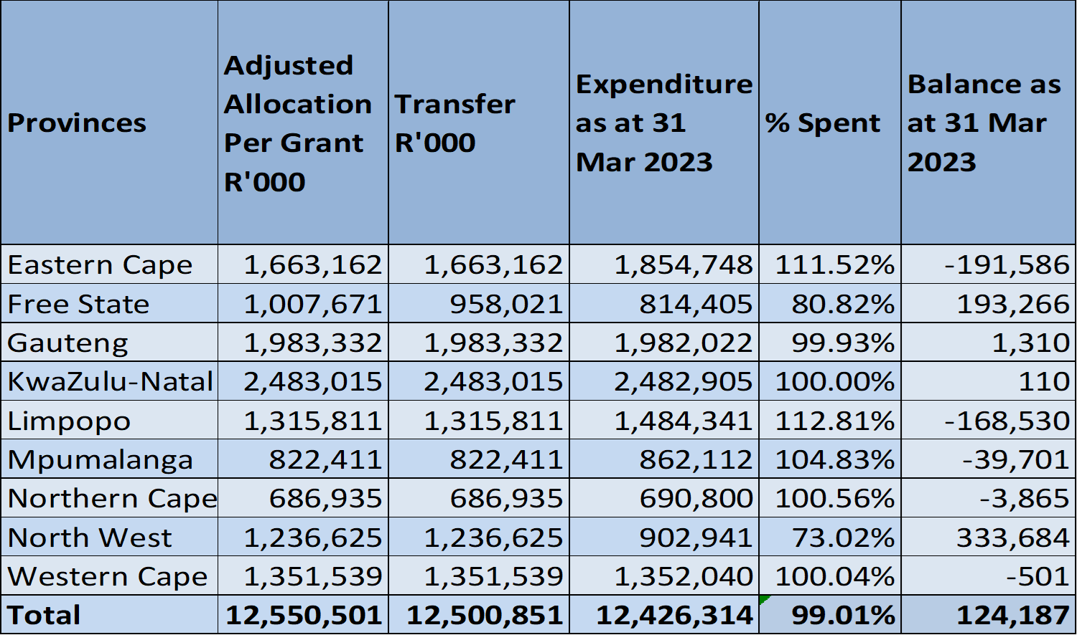
EIG expenditure 2022/23

Slide 31
PART I : SIBG performance in 2022/23
UPDATED

Slide 32
Final Summary of performance 2022/23
UPDATED
Programme | Sub-programme | APP target | Actual
ASIDI | Buildings | 30 | 27
ASIDI | Water supply | 50 | 50
SAFE & ASIDI | Sanitation | 450 | 453

Slide 33
SIBG expenditure 2022/23
Economic Classification | Budget R’000 | Expenditure R’000 | Variances R’000 | % Spent
Compensation of Employees | 6 712 | 9 025 | -2 313 | 134 .5%
Goods and Services | 358 319 | 310 826 | 47 283 | 86.8%
Interest & Rent on Land | 40 | 40 | - | 100.0%
Households | 376 | 376 | - | 100.0%
Building and Other Fixed Structures | 2 037 672 | 1 903 158 | 134 514 | 93.4%
Total | 2 403 119 | 2 223 425 | 179 694 | 92.5%

Slide 34
PART I : Challenges
UPDATED

Slide 35
Challenges
Limited reliable planning data
Over-complicated planning & approval documents & processes
Multiple designs & specifications
Time-consuming procurement processes
Limited local-economic stimulation
Significant over-crowding, sanitation, water supply & maintenance challenges
Capital projects not aligned with national priorities.
Interruption by Business Forums.
Over-reliance on Implementing Agents.
Poor performing service providers.

Slide 36
Order of magnitude backlog value
Capital investment
R 8 billion
1
2
3
Maintenance R 12 billion
4
5
6
Total investment
R 20 billion
7
8
9

Slide 37
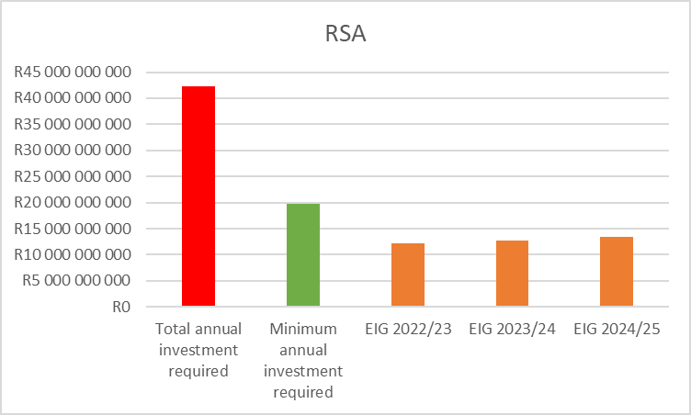
Blended finance model required
R42.4 b
8.
R42 billion
Top-up from:
SIBG
Equitable Share ?
BFI ?
Donors & Partners ?
9.
R20 billion
R19.7 b
EIG 2023/24
EIG 2024/25
EIG 2025/26
37

Slide 38
PART J : 10-Point Strategy
UPDATED

Slide 40
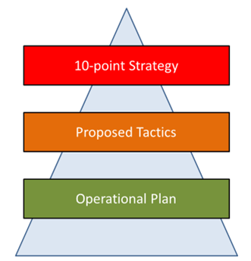
Proposed tactics (How will we get it done)
All B-5 project scope must be based on updated NEIMS data.
No investment in small & unviable schools.
All B-5 project budgets must be based on updated NEIMS data.
All B-5 projects based on a 7-year planning horizon.
B-5 capital projects must be aligned with National priorities.
B-5 maintenance projects must be aligned with National priorities.
Headhunt to fill critical built-environment vacancies.
Enforce EFMS as the sole reporting tool.
Share lessons learned across sectors.
Formalise implementation protocol agreements

Slide 41
10-Point Strategy : Roll-out Roadmap
HEDCOM approval of
10-Point Strategy
25-26 Apr 2023
CEM approval of
10-Point Strategy
4-5 May 2023
Establishment of Workstreams
May 2023
Development of Operational Plans
Jun 2023
Implement

Slide 42



