Slide 1
Efforts underway to broaden public participation in line with the Sixth Parliament’s strategic objective
Briefing on interventions in respect of increasing public participation,
JOINT STANDING COMMITTEE ON THE FINANCIAL MANAGEMENT OF PARLIAMENT
26 MAY 2023

Slide 2
Objective of the session
A. Public involvement mandate of Parliament
Constitutional imperatives, court pronouncements
The Public Participation Model
The Public Participation and Communication Strategy for 6th Parliament
Key role of the Public Education Office (PEO), Parliamentary Democracy Offices (PDOs) and Parliamentary Communication Service in facilitating public involvement in the work of Parliament
B. The role of Constituency Offices (PCOs) as envisaged in the Sixth Parliament Strategic Plan
Proposals to support Members in their Constituency Offices
C. The role of Civil Society in Public Involvement
D. Interventions to increase public participation
E. Efforts underway to broaden public participation in line with the Sixth Parliament’s strategic objective
F. Closing the gaps

Slide 3
A. Public involvement mandate of Parliament

Slide 4
1. Constitutional Imperatives
The facilitation of public participation and involvement is central to Parliament’s mandate.
Sections 59(1) and 72(1) of the Constitution enjoins the National Assembly and the National Council of Provinces to facilitate the involvement of the public in their legislative and other processes respectively
Furthermore, Sections 56(d) and 69(d) of the Constitution authorises the NA and the NCOP or any of their Committees, to receive petitions, representations or submissions from the public

Slide 5
Court Pronouncements
Right to participate in the law-making process
Supreme Court of Appeal in King and Others v Attorneys Fidelity Fund Board of Control and Another
Constitutional Court in Doctors for Life International v Speaker of the National Assembly and Others and Matatiele Municipality and Others v President of the RSA and Others
Afford public a reasonable opportunity to participate effectively in the law making process
1. provide meaningful opportunities for public participation in law making
2.take measures to ensure that people have the ability to take advantage of the opportunities provided

Slide 6
Court Pronouncements
Land Access Movement of South Africa and others v Chairperson of the National Council of Provinces and Others CCT 40/15 – public should be afforded a meaningful chance of participating in the legislative processes (reasonableness test)
What would be reasonable and/or sufficient public participation process to be followed by the committee?
“The forms of facilitating an appropriate degree of participation in the law-making process are indeed capable of infinite variation. What matters is that at the end of the day a reasonable opportunity is offered to members of the public and all interested parties to know about the issues and to have adequate say.”
Reasonableness test
Criteria :
What did Parliamentary committee consider appropriate in the context?
Time constraints
Potential expense
Nature and importance of legislation
Impact of legislation on public
Meaningful chance of participating in legislative process

Slide 7
2. The Public Participation Model

Slide 8
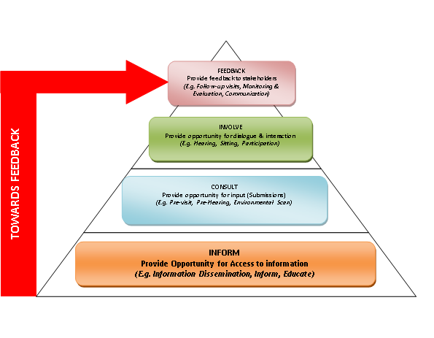
Public Participation Model
“The Model aims to provide a written guideline and opportunities for alignment of public participation activities of Parliament and all its stakeholders; provide minimum norms and standards for public participation in Parliament and improve performance and the practice thereof in Parliament.” - PP Model
The key objectives of the Model:
To develop a “Best Fit” model for public participation in Parliament;
Mainstreaming public participation in all Committees of Parliament and the Houses including all public participation structures;
To detail the mechanisms for public participation in Parliament;
To detail the required institutional arrangements and resourcing for public participation in the Legislative Sector; and
To clarify the roles and responsibilities for public participation and the processing of submissions and petitions in Parliament.
ACCESS

Slide 9
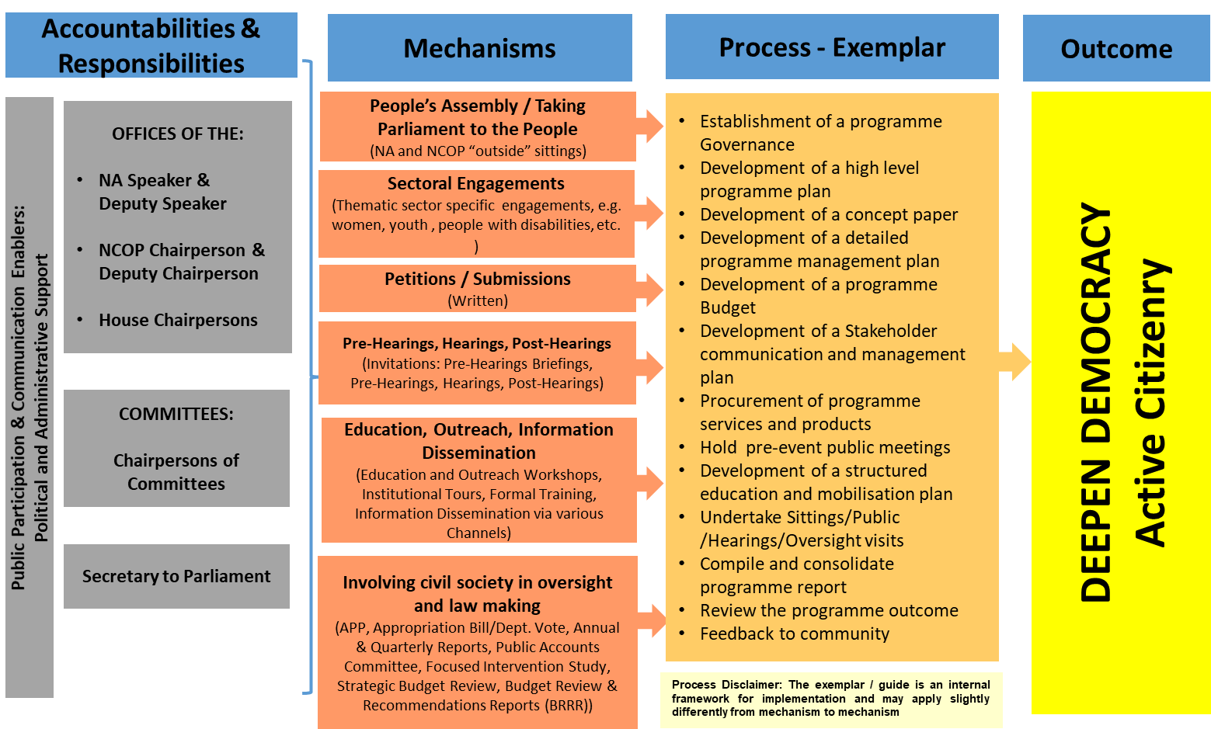
PPM – Best Fit Model

Slide 10
Public Participation Mechanisms
NA & NCOP
COMMITTEES
CONSTITUENCY OFFICES
State of the Nation
Budget Cycle
Oversight Activities
Public Hearings
Access to Information & Services
Member Engagement
Plenaries
Taking Parliament to the People
Submissions
Petitions
Local Government Week
Provincial Week
Integrated Public Participation Service
Oversight
Law-making
International Engagements
Co-operative Government and Inter Governmental Relations
Sectoral Parliaments
Commemorative Days

Slide 11
Our PP Goals
To capacitate citizens to be active agents, not passive recipients of policy
To feedback on the outcomes of the thematic campaigns and programme to build greater accountability to women, through cooperative relationships between Government, civil society and business
To heighten advocacy about the oversight thematic areas through new campaigns or supporting existing campaigns
To understand and respond to the experiences of ordinary citizens relating to the various oversight themes
To develop sustainable mechanisms for the implementation of legislation and policy, in collaboration with civil society

Slide 12
Sixth Parliament Strategy Map
Impact 2030
Reduce poverty, unemployment and inequality
Outcome 2024
Increase government’s responsiveness & accountability
Improved oversight over
budget legislation
Outputs
Constituency oversight work
Committee oversight work
Plenary oversight work
Activities
Individual Member activities
Deeper scrutiny
More effective involvement
More effective recommendations
Questions, debates, statements
Oversight plan
Time for committees
Enhanced Member capacity
Deeper insights
Public submissions
Inputs
Change in programme
Capacity-building Programmes
Better analysis, synthesis
Public info and access
Better tracking, monitoring
Data and systems
Technology & social media
12

Slide 13
3. Public Participation and Communication Strategy of 6th Parliament
Institutional strategic initiatives:
Oversight Plan/Programme to coordinate oversight priorities and activities of Committees, Houses, and Legislatures;
Public participation strategy to enhance public information, access and participation;
A knowledge management strategy to manage information and knowledge for the benefit of Members, the institution and stakeholders;
Digital technology strategy allowing the implementation of e-Parliament principles;
A human capital strategy to unleash capacity and skills;
Governance framework to ensure effective institutional governance and decision-making.

Slide 14
3. Public Participation and Communication Strategy of 6th Parliament
In order to ensure improved public involvement, the Parliamentary Service will need to address the following issues:
Implement interventions focusing on the delivery of public education and information programmes, empowering people to participate in parliamentary processes, mobilising public stakeholders, and capitalising on the use of digital and preferred platforms,
Implementing virtual public meetings, e-hearings, e-petitions ,
Broaden cooperation with partners and stakeholders including the legislative sector, government, community organisations and institutions,
Improved co-ordination of programmes with that of constituency offices,
Consolidate current programmes, capacities and resources into a single service to support public participation activities. – a single public participation and communication service to Members

Slide 15
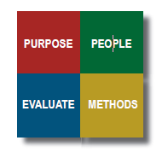
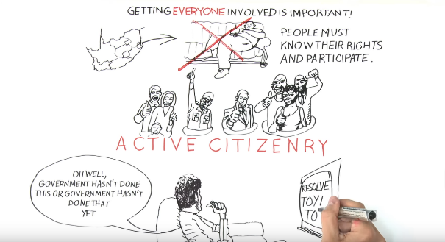
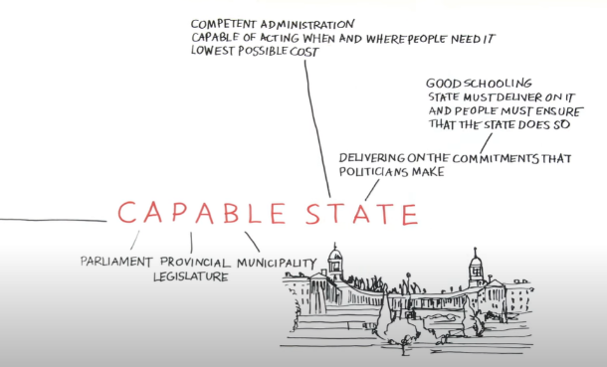
A deeper understanding of PP as an Institution-Wide mandate
Integrated ways of working ito:
Informing, involving and Consulting with Stakeholders (internally and externally) when planning
Stakeholder Analysis (Research on Public Involvement Structures governed by legislation & civil society)
Accessible Responsive Public Service: Sharing Public Officials’ Contact Details on the website
‘Mixed’ Methods
Documentation and Evaluation Protocols
Integrated Participation Strategy
Ongoing Review, Monitoring and Evaluation of Public Participation Activities

Slide 16
4. The role of the
Public Education Office (PEO)
Parliamentary Democracy Offices (PDO)
Parliamentary Communication Service (PCS)

Slide 17
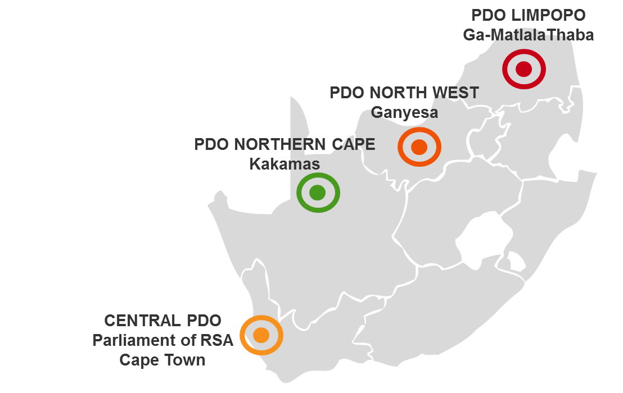
PEO (Public Education Office) & PDO (Parliamentary Democracy Offices)
PEO & PDO Central | PDO North West
X 1 Unit Manager X 1Secretary X 1 Tours Administrator X 2 Specialists X 8 PE Practitioners X2 Tour Guides x1 PDO National Coordinator | X 1 Team leader X 1 Receptionist X 1 Administrator X 1 Service officer
Vacancies: X 1 PE Practitioner X 1 PE Specialist | Vacancies: X 1 Coordinator
PDO Northern Cape | PDO Limpopo
X1 Coordinator X1 Receptionist X1 Service Officer | X 1 Administrator X 1 Service officer X 1 Receptionist
Vacancies X1 Team leader X1 Administrator | Vacancies X 1 Team leader X 1 Coordinator
PEO &

Slide 18
Roles and Functions
Our approach to public education involves implementing Parliament’s Public Participation Model (PPM) that embraces four inter-connected pillars of public engagement: inform, consult, involve and feedback. The Model is an enabling tool to strengthen the work of Members of Parliament (MPs) in the House, Committees and Constituencies and to improve public access to Parliament and its Members to fully represent the people of South Africa.
PEO
PDOs
To educate the public on and promote public participation in the processes and activities of Parliament
Provide regular and relevant information to citizens on what is happening in Parliament and how to get involved
Educate citizens about Parliament and how to actively and meaningfully participate in relevant parliamentary processes
Provide public education and information aimed at creating an informed citizenry, who can actively and meaningfully participate in decision-making that affects their lives.
Increase public access and participation in parliamentary processes to strengthen participatory democracy
Ensure a greater level of efficiency in accessing communities and providing ground support for parliamentary programmes
Develop education material and content for parliamentary programmes
Increase Parliament’s outreach and create an immediate awareness of a parliamentary presence in the provinces
Provide feedback to citizens and communities on matters before Parliament which impact their lives.

Slide 19
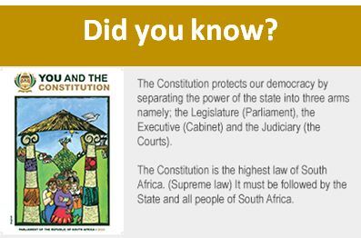
Products and Services (update)
To fulfil these objectives, PEO and PDO render a package of integrated services
Content Development for Different Parliamentary Platforms
Virtual & Physical
Workshops
Bite-Size Messages
Edit Text
Edit Text
Interactive learning tools
Electronic & Courier Distribution of Learning Materials
Edit Text
Edit Text
Edit Text
Edit Text
Virtual Tours of Parliament
Stakeholder Engagements
Notes:
Public participation is one of the hallmarks of a democratic government
South is in a unique position in that public participation is constitutionally entrenched in the country and there are mechanisms to ensure that the public is included in all processes of law making
South African Parliament has sought to increase access and improve the quality of participation through various programmes such as public hearings, petitions, lobbying, submissions, “Taking Parliament to the People” and sectoral engagements
With the aim of deepening participatory democracy, the South African National Parliament has since developed its own Model that seeks to outline and mainstream norms and standards for public participation processes in Parliament.

Slide 20
B) The role of Parliamentary Constituency Offices (PCOs) as envisaged in the Sixth Parliament Strategic Plan

Slide 21
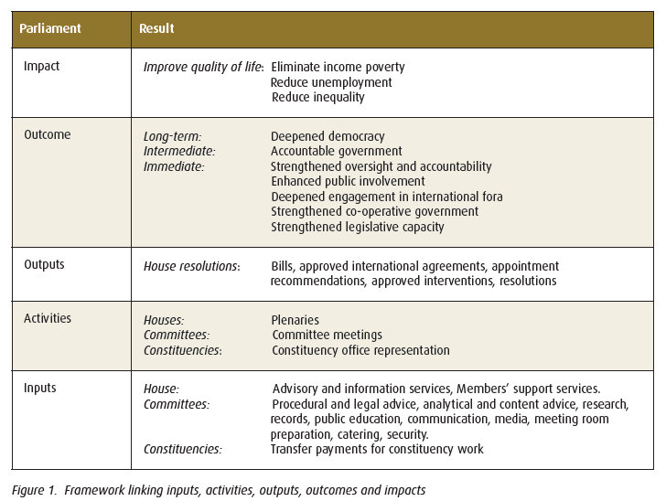
The Strategic Plan on Constituency Offices
Programme 5: Associated Services – Programme 5 provides travel, communication and other facilities for Members of Parliament to fulfill their duties as elected public representatives. It also provides financial support to political parties represented in Parliament, their leaders, and constituency offices.
The work of Parliament is realised through the main activities of plenary, committee and constituency work.

Slide 22
Monitoring and Evaluation

Slide 23
Rationale: Key Considerations for Strengthening PCOs
Planning across the institution should provide for public education prior to public participation in all the activities and programmes of Parliament
This transfer of knowledge and understanding remains key to ensuring that Parliament evolves into a truly representative people’s Parliament. Specifically, where all South African citizens can actively exercise their right to meaningfully participate in Parliament and influence the direction of the institution from an informed perspective.
This understanding remains key to ensuring that all South African citizens can actively exercise their right to meaningfully participate in Parliament and directly influence the law-making and oversight functions of the institution.
“a better understanding of Parliament’s role in society; and the role of society in Parliament is needed
The key objective is to educate the public on the role of Parliament and promote public participation in the processes and activities of Parliament then Parliamentary Constituency Offices (PCOs) are fundamental to this approach …..”
Notes:
And then into the three PPPs

Slide 24
Rationale: Key HLP Recommendation…..
Parliament should provide the public with information regarding constituency offices, such as:
the address and contact details of constituency offices,
the names and contact details of Members of Parliament assigned to specific constituency offices, and
the boundaries of constituency areas.
Step 1: Map the PCO locations
https://my.atlistmaps.com/map/923fe467-5e72-4ab3-99ba-695e1be6a363?marker_id=efd77a4b-97e1-4630-8a10-eb143a2a48b2

Slide 25
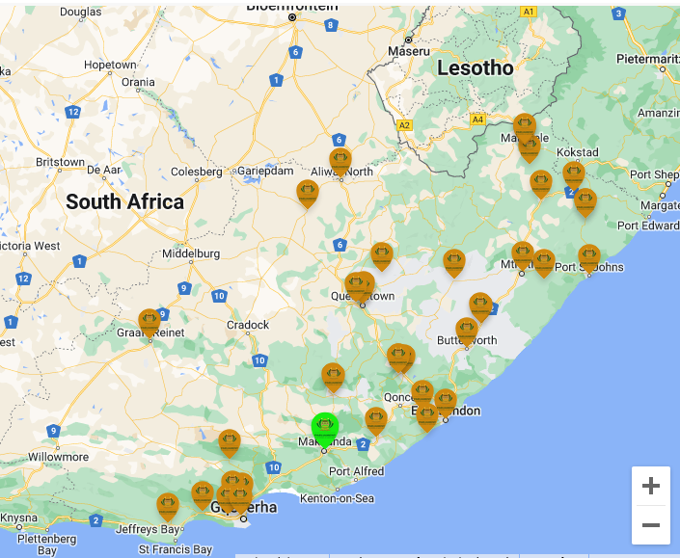
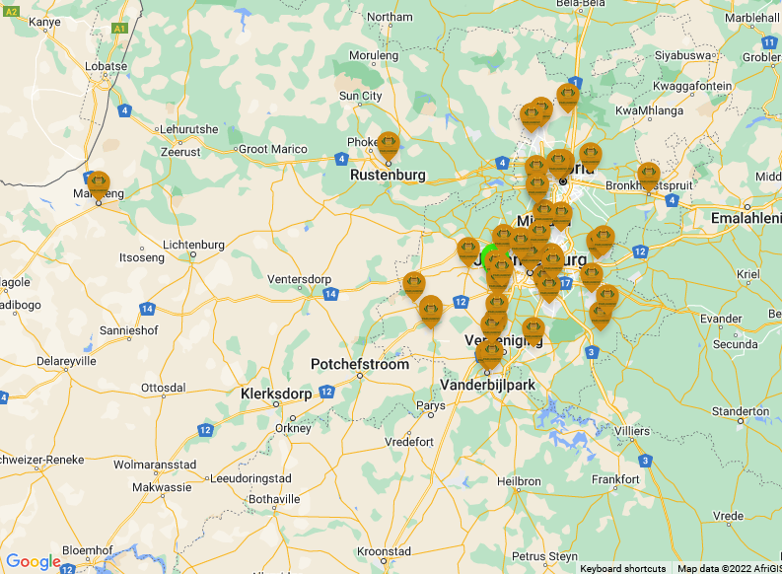
PCOs: Eastern Cape & Gauteng

Slide 27
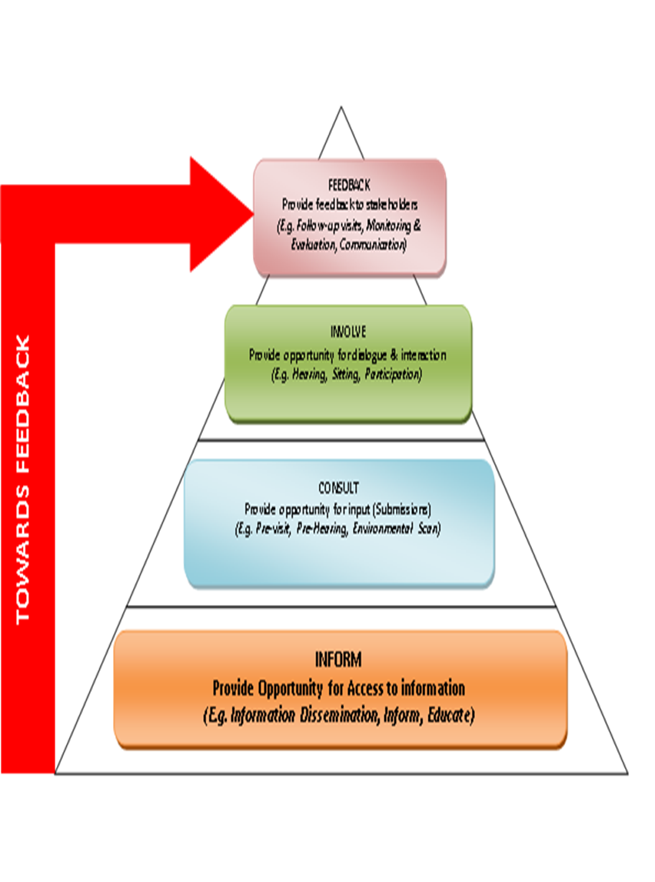
Leveraging PCOs
Information centres
Parliamentary corner
Public Education material, Bills before Committees, etc.
Education programme for all PCO staff
Assist with Petitions, submissions and representations
Serve as feedback mechanism to constituents

Slide 28
C) The role of Civil Society Organisations in Public Involvement

Slide 29
Collaborating with CSO
Collaborating with CSO to reach key stakeholders, particularly in the law-making process
Draft MOU with CSO working group to cement collaboration – key focus is to create greater access to key stakeholders represented by CSO such as disabled, vulnerable, youth and women.
Blind SA translates all public education pamphlets into Braille and make it available to their members

Slide 30
D. Interventions to increase public participation

Slide 31
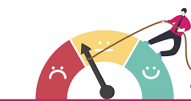
Interventions to increase public participation: 4IR– Innovations since Covid-19

Slide 32
PPM – Innovations during Covid-19
Public participation tool | Details
Advertise for written submissions | Traditional approach to source public inputs by advertising in mainstream media
E-mail submissions | Written submissions e-mail to e-mail address of Committee Secretary/ Bill
SMS | SMS to a cell phone allocated to a Committee staff member. The sms’s are transferred to an e-mail account linked to the Bill
WhatsApp | Similar to SMS process
Video recording of input | In the same way SMS and WhatsApp is used, video clips can be considered as an alternative submission mode.
Oral submissions via community radio stations | PCS books a slot with Community Radio station. Chairperson of the Committee or committee member encourage citizens to phone in and submit their inputs.
Use of virtual platforms to host public hearings | Participants who indicate that they want to make an oral submission are invited to the virtual platform to make these inputs.
Virtual “imbizo” public hearings | Virtual engagement in which participants can engage through community radio stations, TV channels and social media
Social media: Facebook, Twitter | Inputs can be submitted via these social media

Slide 33
Public Participation Model and 4IR - Innovations
Parliament is currently implementing and continuing to explore innovation, digital tools and measures to enhance oversight and accountability and to enhance public access, involvement and participation and feedback. These include amongst others:
Virtual Committee meetings/ sittings/ oversight visits, drone visits/ oversight through holograms;
PCS - Parliament Interface Nerve Centre (Call Centre, Central Electronic data management system: capturing, analysis, reporting, feedback);
Electronic channeling of submissions and petition analysis;
Live data dashboard of sectors, wards, constituencies;
Interactive website; (Websites can include text and multimedia or interactive content, they are incredibly versatile and can be developed in a variety of ways. Websites bring together a number of different features depending upon their purpose, enabling people to find information, to communicate, or to contribute content)
Electronic and Social media – On demand media (Facebook, Instagram, Twitter, YouTube, WhatsApp, Radio, TV, etc.)
“Legislation and oversight combined are powerful tools/mechanisms with which to ensure that the Executive accounts on legislation passed by Parliament and commitments made by South Africa to international bodies. Public participation and involvement in legislation and oversight would thus allow for deepened scrutiny and oversight and accountability between the three spheres of Government.” – PP Model

Slide 34
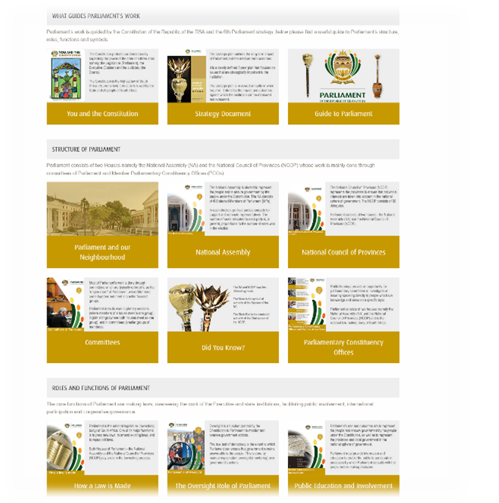
Public participation webpage

Slide 35
E. Efforts under way to broaden public participation in line with the Sixth Parliament strategic objective

Slide 36
Increased platforms
The platforms through which Parliament’s proceedings is shared, has been increased from two to six including Twitter, Facebook, and iono.fm. Initially only Parliament TV and YouTube channels broadcast the work of Parliament, and YouTube was exclusively for House Sittings.
Not only the House Sittings but also Committee Meetings are broadcast live.
Currently, we are able to broadcast or live stream 20 Committees meetings on YouTube, Face Book and Twitter and up to 10 meetings on iono.fm.
We are also able to repeat more than four meetings on Parliament TV as opposed to the period before 2020 because we are now able to receive recordings of virtual meetings that we were not able to cover live or record for Parliament TV.

Slide 37
YouTube
https://www.youtube.com/ParliamentofRSA
Notes:
The updated stats have to be included – similarly for the slides hereafter

Slide 38
Broadcasting and streaming of public hearings
We have introduced the live streaming live broadcast of Public Hearings on Parliament TV and on our YouTube, Face Book and Twitter Channels.
For example, if the public hearing is from Friday to Sunday, we stream all the hearings live on social media platforms and chose one meeting that can be live on Parliament TV.
This is to afford the public an opportunity to follow if they are not able to attend hearings in person. We also promote the hearings on Parliament TV and social media platforms.

Slide 39
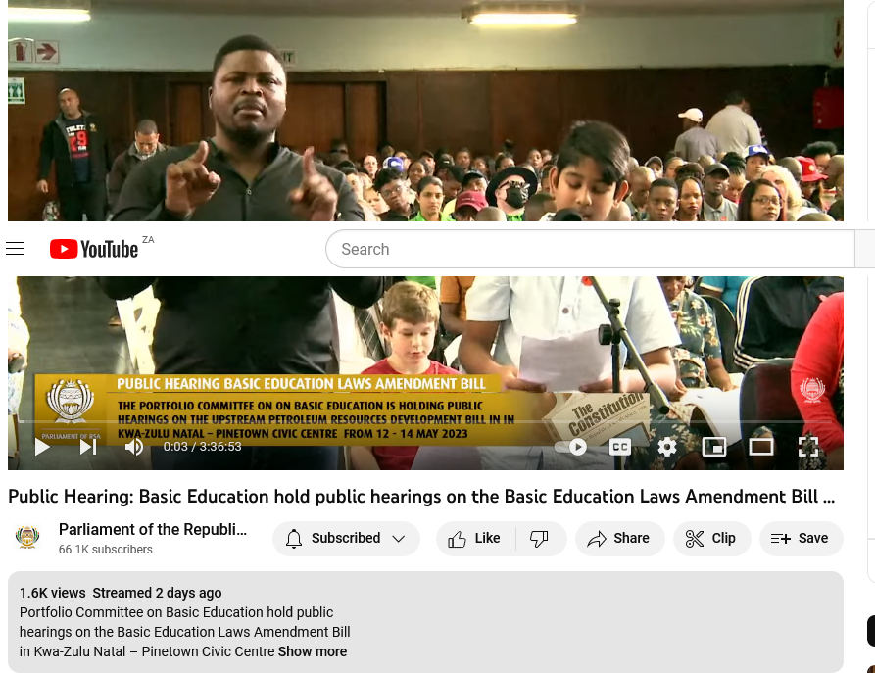
Increased Broadcasting and live streaming of Public Hearings
https://www.youtube.com/ParliamentofRSA

Slide 40
Website
The Parliament website has been upgraded to be more user-friendly and for the public to access information easily. Public hearings and the calls for submissions are also publicised on the website. Videos produced and uploaded on social media platforms are also uploaded onto the website.
We are in process of arranging a Reverse billing on the website by the major cellular/data network providers so that the public can access the website for free. Telkom is currently zero-rating the website which means that the people who are on Telkom network can access Parliament website for free.

Slide 41
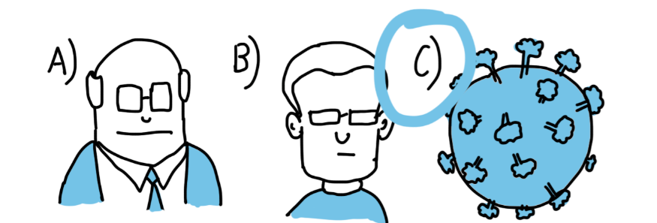
Interactive website; (Websites can include text and multimedia or interactive content and Chatbots, they are incredibly versatile and can be developed in a variety of ways. Websites bring together a number of different features depending upon their purpose, enabling people to find information, to communicate, or to contribute content)
IN 2022/3
IN 2021 WHO LED THE DIGITAL TRANSFORMATION?
CITIZENS?
THE LEGISLATURE?
COVID-19?

Slide 42
Fresh content on the Parliament channel
Live shows of important events of Parliament have been introduced through Parliament TV studios, where interviews are conducted with the Presiding Officers, Chairpersons of Committees, MPs, experts from academic institutions and other institutions, etc.
To continue to add more fresh content on TV by having regular live shows, weekly and quarterly.
To continue educate and inform the public about the work of Parliament which intends to encourage public participation in the work of Parliament.
This will be content driven by the Chairpersons of the Committees mostly on the work Committees as well as the Presiding Officers on the work of Parliament as a whole.
This will be possible with the provision of financial and human resources for Parliament TV and Parliament TV studios.

Slide 43
Increased Access via Virtual Platforms & Social Media:
PLATFORMS | 2020/2021 | 2021/22
Twitter followers | 747,419 | 857,332
Facebook followers | 75,697 | 91,452
Instagram follows | 22,864 | 32,526
YouTube views | 862,705 | 961,158
Unique Website Visitors | 795,634 | 1,094,571
The work of Parliament is currently promoted on social media platforms as well as the marketing of Parliament platforms so that the public is aware in terms of where to find information
We will continue to leverage the available technology and forge partnerships with strategic partners to ensure that public access the information and proceedings of Parliament for meaningful participation.

Slide 44
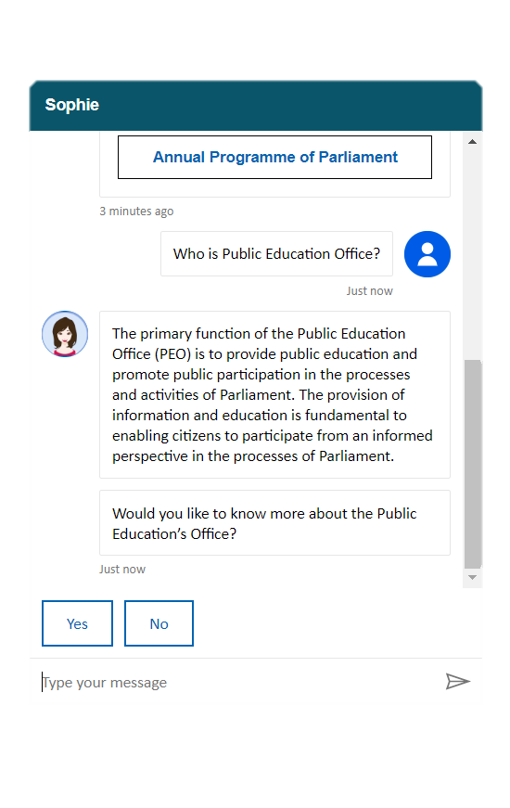
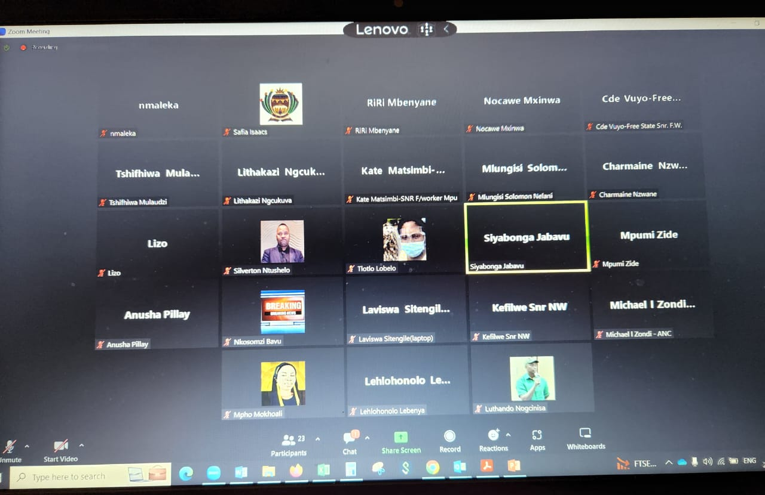
Increased Access via Virtual Platforms & Social Media:
https://www.youtube.com/ParliamentofRSA
https://www.parliament.gov.za/public-education-webpage
Zoom Virtual Meeting
Parliament’s Chatbot: Sophie

Slide 45
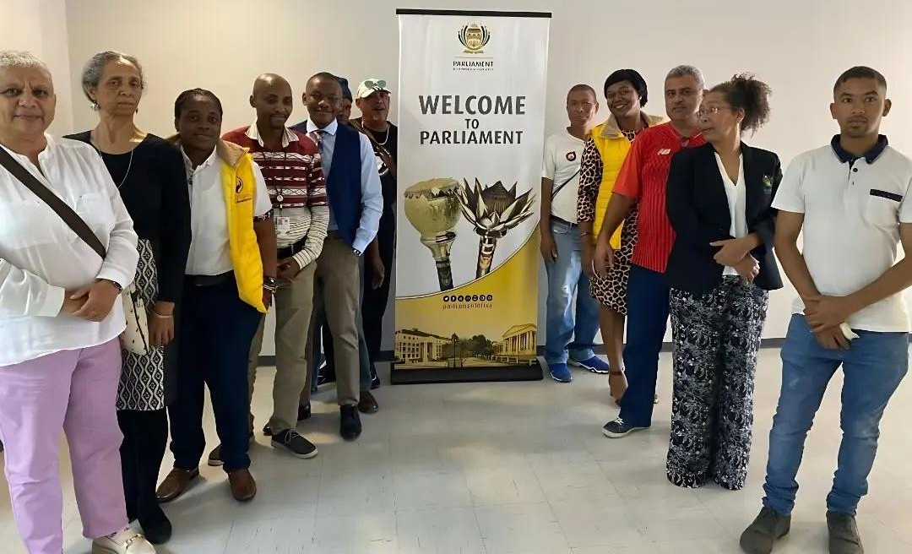
Increasingly closing the 360 degree feedback loop: Public face to face engagements
Dialogues to gain public views on the Parliamentary Website and our new Chatbot: Sophie
(Office of the Speaker, Grassy Park PCO, Public Participation, ICT, NGOs and Community Members)

Slide 46
Monthly Community Radio Programmes
To strategically use GCIS’s radio programmes to proactively interact with and involve citizens in the affairs of Parliament and its Committees.
“The Parliament of Zambia uses radio to communicate with the community. In 2009, it introduced a number of question and-answer programmes into its parliamentary radio channel schedule. The schedule includes two interactive shows, during which listeners can send in questions or comments via text message. The hosts of the radio programme receive an average of 45 to 50 text messages per programme.”

Slide 47
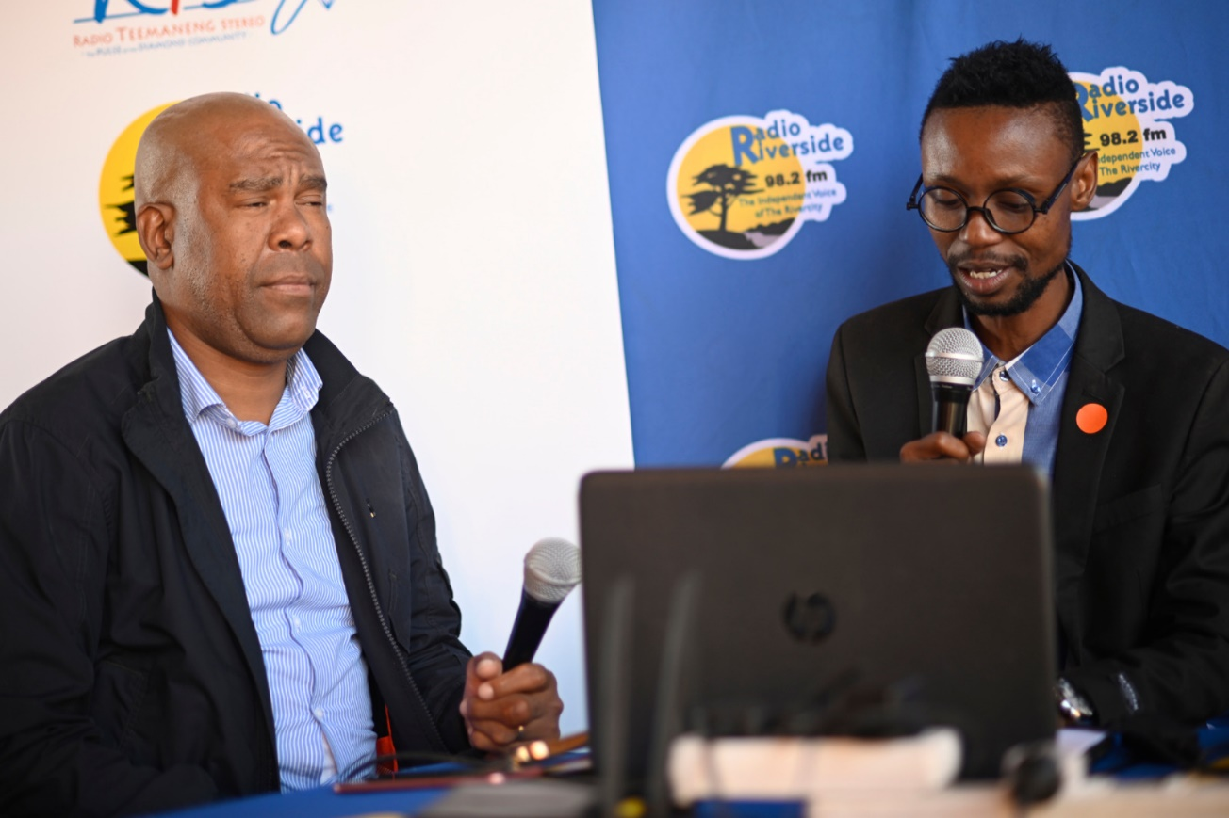
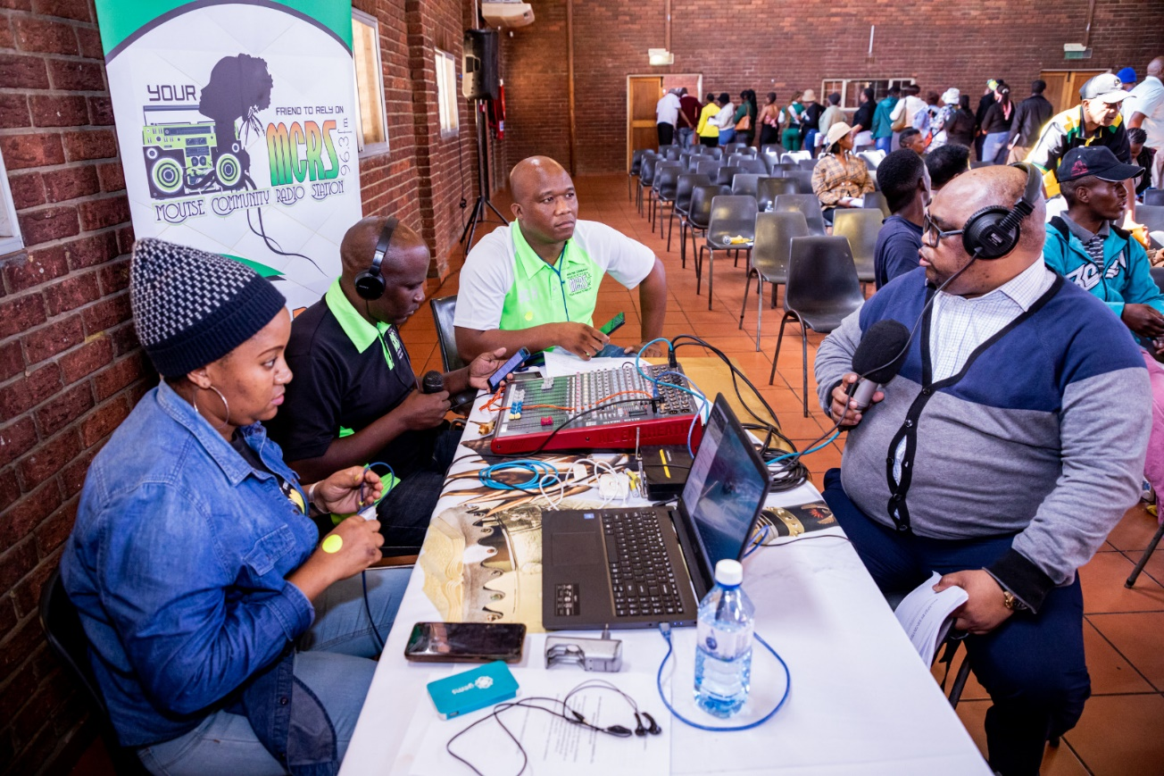
Radio: Partnering with Community Radio
Pic 1: Climate Change Bill
Pic 2: Upstream Petroleum Bill

Slide 48
Live data dashboards – Public Interface Nerve Centre
Parliamentary Constituency Offices
Municipalities
Health Committees
Ward Committees
Community Learning Centres
South African National Civic Organisations (SANCO)
South African Women Lawyers Association
School Governing Bodies
Student Representative Councils
Congress of South African Trade Unions (COSATU) Federation
Community Policing Forums
South African Women in Dialogue
Student Representative Councils
School Governing Bodies
Provincial Legislatures
Community Development Workers (CDWs)
Notes:
Parliamentary Interface Nerve Centre (Electronic data management system: capturing, analysis, reporting, feedback);

Slide 49
Increase use of social media platforms: Petitions
To introduce more petitions via social media platforms. “Petitions are the most widespread tool for public participation, with 79 % of Global Parliamentary Report survey respondents stating that they have a submission process.”
We should be launching an e-petition webpage linked to Parliament’s webpage. “The National Assembly of South Korea launched an e-petitions website, Sinmungo, in early 2020. Petitions that reach over 100,000 signatures within 30 days are referred by the National Assembly to a Committee. As of January 2021, 18 such petitions submitted via the e-petitions platform had been referred to relevant committees. “
ICT currently engaging on an e-petitions and e-submissions solution for Parliament

Slide 50
https://www.youtube.com/watch?v=Bt1pl4SYPc4
National Planning Commission

Slide 51
Comprehensive public education programme
Understand the Separation of Powers
Be able to distinguish between the three arms of government
Understand the role of Parliament
How to participate in Parliament

Slide 52
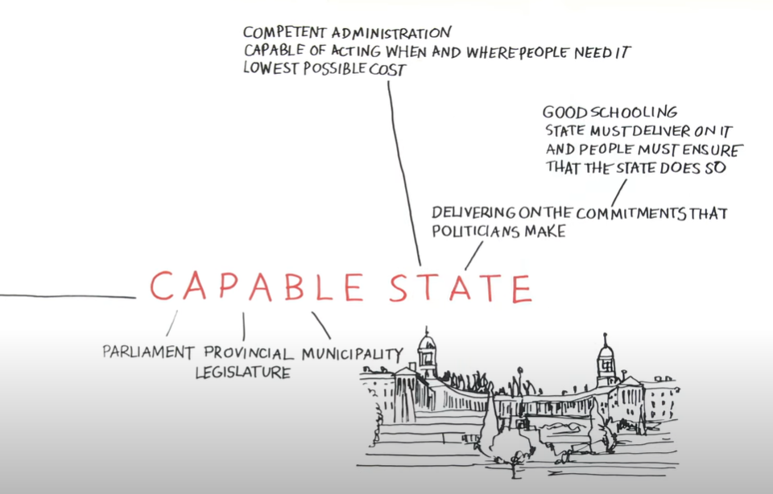
https://www.youtube.com/watch?v=Bt1pl4SYPc4
National Planning Commission
Notes:
https://www.youtube.com/watch?v=Bt1pl4SYPc4
National Planning Commission

Slide 53
Thank you
Ke a leboga
Ndiyabulela
Ndza nkhensa
Ndi ya livhuwa
Ke a Leboha
Ke a leboga kudu
Gangans
Ngiyabonga
Ndo livhuwa
Ndzi khense ngopfu
Dankie
Enkosi
Ngiyathokoza
53

