Slide 1
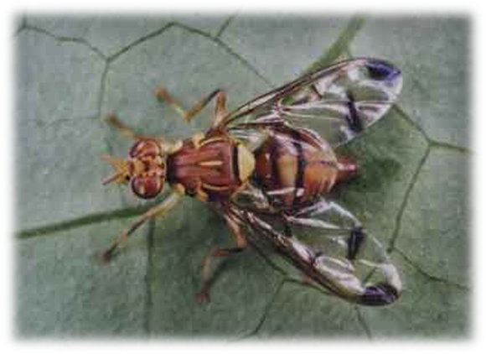
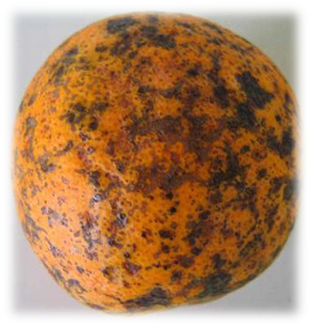
PLANT HEALTH (PHYTOSANITARY) BILL [B14-2021] PRESENTATION TO THE PORTFOLIO COMMITTEE ON AGRICULTURE, LAND REFORM AND RURAL DEVELOPMENT 19 MAY 2023

Slide 2
1. PURPOSE
To brief the Portfolio Committee (PC) on Agriculture, Land Reform and Rural Development on the Plant Health (Phytosanitary) Bill

Slide 3
2. Introduction
Key concepts/ Definitions
Phytosanitary measures- refers to official measures, regulations or procedures aimed at:
preventing introduction and/or spread of quarantine pests, and
limiting the economic impact of regulated non-quarantine pests.
Quarantine pest- means a pest of potential economic importance to the area endangered thereby and not yet present there or present but not widely distributed and being officially controlled.
Regulated pest- means a quarantine pest or a regulated non-quarantine pest.
South Africa is a signatory member of:
The World Trade Organization Agreement on the Application of Sanitary & Phytosanitary Measures (WTO-SPS Agreement) and
The International Plant Protection Convention (IPPC).

Slide 4
3. PROBLEM STATEMENT
The introduction and spread of potentially damaging pests in South Africa could have a significantly negative impact on South African bio-security, agricultural production and food security as well as on market access.
Deficiencies of the existing Agricultural Pests Act, 1983 (Act No.36 of 1983):
Predates the Constitution of the Republic of South Africa;
Predates the International Plant Protection Convention (IPPC, 1997);
Definitions not aligned to the IPPC standards;
No provision for the National Plant Protection Organisation of SA (NPPOZA) in accordance with the IPPC (Article IV), and its functions
No provision for export control, re-export and in-transit control (emphasis was on import- and national control).

Slide 5
4. TIMELINE FOR PROCESSING THE PLANT HEALTH BILL
MILESTONE OF THE PLANT HEALTH BILL | DATE ACCOMPLISHED
Publication in the Government Gazette for public comments | 26 Oct. 2012
National Workshop with key stakeholders | 12 March 2013
Notification via WTO-SPS transparency system: 60 days for comment | December 2013
1st precertification of the Bill: OCSLA | July 2014
Presentation to DG Cluster and recommendation | 01 Oct. 2014
Socio-Economic Impact Assessment (SEIAs) certification to proceed with parliamentary process | 20 Oct. 2015
Cabinet approval of the Plant Health (Phytosanitary) Bill to proceed with the Parliamentary process | 17 Feb. 2016
Final certification: OCSLA | 24 Oct. 2016
Introduction of the Bill in the National Assembly | 06 March 2017
Withdrawal of the Bill in accordance with Rule 334: to allow the portfolio committee in order to conclude on business before it ahead of the National election | 06 May 2018
2nd certification of the Bill by OCSLA: the Bill was found to be constitutional and that it does not conflict any other national law | 20 Sept. 2019
Presentation to the ESIEID DG Cluster for recommendation. The Bill was again fully recommended and supported to be submitted to Cabinet. | 19 Oct. 2020
Socio Economic Impact Assessment: Certificate | Nov. 2020
Presentation of the Bill to Cabinet for approval and Recommendation | May 2021
Bill introduced in the National Assembly | July 2021

Slide 6
5. OVERVIEW OF THE AGRICULTURAL PESTS ACT, 1983 (ACT NO.36 OF 1983): being repealed

Slide 7
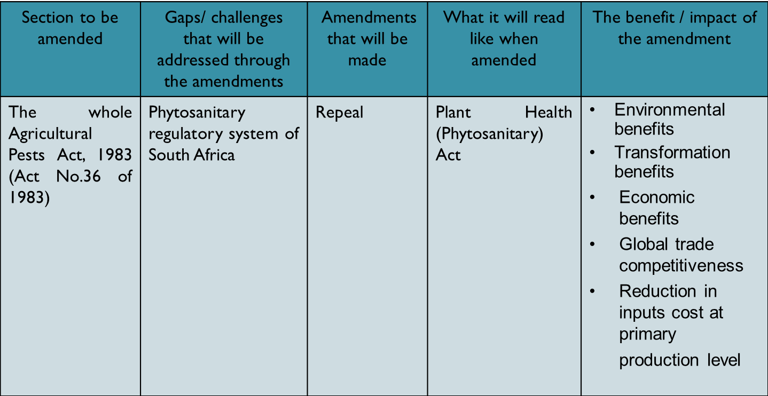
6. PROPOSED AMENDMENTS

Slide 8
7. OBJECTIVES OF THE BILL
To provide for phytosanitary measures to prevent the introduction, establishment and spread of regulated pests in order to safeguard South African agriculture and plant natural resources .
In turn, this supports:
Safe and fair international and domestic trade
Maintenance of current export markets and establishment of new markets
Crop production/Food security programmes
Economic growth and development
Job creation

Slide 9
8. SUMMARY OF THE PLANT HEALTH BILL: OVERVIEW
Plant Health (Phytosanitary) Bill
Import control of plants and plants products in order prevent the introduction, establishment and spread of regulated pests.
Import permit will be required.
National control of plant pests provides for restriction of infested plant material from infested areas to non-infested areas as well as quarantining an area .
Export control of plants and plants products in order to comply with import requirements of the importing country.
Phytosanitary certificate will be required .
Establishment
of the National Plant Protection Organization of South Africa in items of the international obligations
Directorates Plant Health, Inspection Services , and Food Import and Export Standards (Within the DALRRD).
Re-export control provides for re-export of consignments imported into South Africa for further export to another country.
Re-export phytosanitary certificate will be required to maintain consignment integrity and security.
Definitions in accordance with the International Plant Protection Convention (IPPC): International Standards for Phytosanitary Measures (ISPMs).
To provide for phytosanitary measures to prevent the introduction, establishment and spread of regulated pests.

Slide 10
9. CLAUSE BY CLAUSE ANALYSIS
Relevant sections | Provision subject | Explanatory summary
Section 1 | Definition | Definition are aligned to the International Plant Protection Convention, glossary of phytosanitary terms International Standards for Phytosanitary Measures (ISPMs 5). In this clause certain terms and expressions are defined so that the contents of the Bill may be more clear.
Section 2 | Responsibility of the administration of the Act | The Minister of Agriculture, Land Reform & Rural Development is responsible for the administration of this Act.
Section 3 | Power of the Minister | Provides for power of minister to make regulations and control measures to further the objectives of the Act
Section 4 | Prescribing of the control measures | The Minister may prescribe control measures which must be complied with by users of land in order to achieve the objectives of the Bill. These control measures may include quarantine measures and restriction movement of infested material.

Slide 11
10. CLAUSE BY CLAUSE ANALYSIS
Relevant sections | Provision subject | Explanatory summary
Section 5 | Designation of the executive officer | Provides for the designation of the executive officer wherein the Minister must designate the Director in the department responsible for phytosanitary measures as the executive officer.
Section 6 | Power of the executive officer | This section empowers an executive officer to instruct a user of land by written order to comply with a control measure in respect of a quarantine area or regulated area determined in that order. These powers include confiscating and destroying of the controlled goods.
Section 7 | Order with regard to land | Provides for orders with regard to land which must be served in the prescribed manner. The order may include quarantining and areas, restricting movement and that something be destroyed.

Slide 12
CLAUSE BY CLAUSE ANALYSIS
Relevant sections | Provision subject | Explanation summary
Section 8 | Power of entry, search, inspection and seizure | Provides that an authorised person may on the authority of a warrant enter, search and inspect any land to combat pests or to carry out a control measure.
Section 9, 8 and 11 | Establishment of the National Plant Protection Organization of South Africa | Provides for the establishment of the National Plant Protection Organisation of South Africa and the composition of the National Plant Protection Organisation of South Africa (NPPOZA), required in terms of membership of the IPPC. It also provides for the functions of the NPPOZA in accordance with the IPPC.
Section 12 | Import regulations | Provides for import regulations in order to prevent the introduction and spread of regulated pests.

Slide 13
CLAUSE BY CLAUSE ANALYSIS
Relevant sections | Provision subject | Explanatory summary
Sections 13 | Import of regulated articles | Provides that regulated articles may be imported only on the authority of a permit and under certain conditions. The Minister may by notice in the Gazette make provision for certain exceptions.
Section 14 | Export of regulated articles | Sets out the conditions for exporting regulated articles. Therefore a person exporting shall comply with the import requirements of the importing country.
Section 15 | Re-export | Provides provisions for the re-export of consignments imported into the Republic for further export to another country.
Section 16 | In-Transit | Sets out the requirements and/or conditions that should be adhered to by a person transiting a consignment of regulated articles through the Republic to another country.

Slide 14
CLAUSE BY CLAUSE ANALYSIS
Relevant sections | Provision subject | Explanatory summary
Section 17 | Declaration of regulated pests | Provides for conditions under which the executive officer may declare regulated pests (quarantine pest or regulated non quarantine pest)
Section 18 | Compulsory notification of quarantine pest | Provisions are made for the compulsory notification of the presence of certain pests by a user of land. It require that individual report any occurrence of a quarantine or suspicion occurrence of a quarantine pest.
Section 19, 20 & 21 | Declaration of a quarantine areas and pests free areas, places and sites of production | Sets out conditions under which the executive officer may declare quarantine areas on the basis of pest infestation. Furthermore, the executive officer may declare certain areas as pest-free areas, or pest-free places and sites of production.
Sections 22 | Assignment of power | Gives the Minister the power to assign certain powers conferred upon him or her, or to assign any duty imposed upon him or her by this Bill, to a juristic person or organs of state.

Slide 15
CLAUSE BY CLAUSE ANALYSIS
Relevant sections | Provision subject | Explanatory summary
Section 28 | Offences and penalties | Prescribes penalties for certain offences to any person who violate the provision of this Act and related regulations.
Section 30 | Regulations | The Minister may make regulations regarding certain matters.
Section 31 | Compensation | Provides for compensation by the Minister regarding certain matters in the Bill.
Section 32 | Assistance and Cooperation | Provides for assistance and cooperation to the executive officer by different authorities and parties in order for the executive officer to perform his or her functions.

Slide 16
11. DEPARTMENTS/ STAKEHOLDERS CONSULTED
National departments (e.g. the then Department of Trade and Industry, Department of Environmental Affairs)
State Law Adviser
Provincial Departments of Agriculture
Perishable Products Export Control Board (PPECB)
Research institutes
South African Local Government Association
National House of Traditional Leaders
Agricultural industry: Deciduous, Citrus and Subtropical industry etc.
South African National Seed Organisation (SANSOR)
Grain SA
Importers and Exporters
Trading partners
General public

Slide 17
12. FINANCIAL IMPLICATIONS
The implementation of the Bill has no additional implication in terms of human and financial resources since the NPPO of South Africa has already been established and is funded.
Key activities such surveillance and response will be catered for under the current MTEF allocation and further prioritization over multiple MTEF.
The Branch has received additional MTEF allocation (2020 to 2023) to respond to biosecurity threats, strengthen inspection services at points of entry, revitalise laboratories and quarantine stations. Reprioritization of allocations continues to support the phytosanitary system.

Slide 18
13. DECISIONS REQUIRED FROM THE PC
It is recommended that:
the Portfolio Committee of Agriculture, Land Reform and Rural Development considers the briefing information on the Plant Health (Phytosanitary) Bill

Slide 19
THANK YOU

