Slide 1
Sol Plaatje Local Municipality water and wastewater management
Presented by: Department of Water and Sanitation
Date: 18 May 2023

Slide 2
CONTENTS
Background
Sewer challenges
Water challenges
Funding requirements to refurbish infrastructure

Slide 3
INFORMATION REQUESTED BY THE COMMITTEE
In the letter of invitation from the Select Committee to DWS for this meeting the Committee requested the Minister to provide the Committee with timeframes and plans, within which undertakings made to the National Council of Provinces on 12 May 2022 will be implemented.
The undertakings made by Minister to the NCOP on 12 May 2022 were to:
Address the challenges caused by the lakes that have formed along the R31 road between Kimberley and Barkley-West due to severe water and sewage leaks which have contributed to the obstruction of the R31 road and access to the surrounding areas
Conduct an investigation analysis on the causes of the formation of the lakes and report to the NCOP what is being done to address the resulting challenges
Stop sewer spillages in all communities in Platfontein
Assess whether the work done (by the Sol Plaatjie Municipality) on the sewer spillages is satisfactory
Conduct water quality tests and share the outcomes of interventions by the DWS with the NCOP

Slide 4
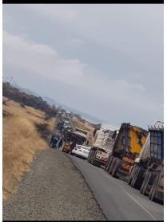
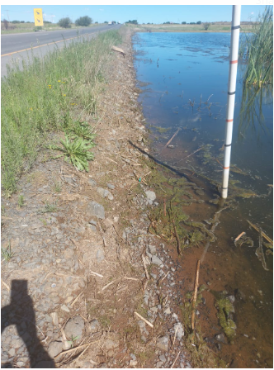
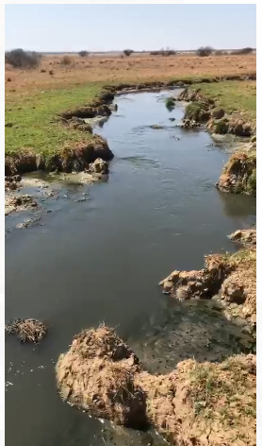
BACKGROUND (1)
Sewer and water leaks along the R31 road between Kimberley and Barkley-West has been a concern for road users; community members and land owners in the affected areas.
DWS conducted routine inspections and engaged the Municipality on the non compliances as at the time the levels of the pans were rising rapidly.

Slide 5
BACKGROUND (2)
Routine inspections and interactions that were done by DWS with Sol Plaatje Municipality indicated poor operation and maintenance of both water and sanitation infrastructure.
DWS initiated administrative enforcement actions which resulted in the refurbishment of the wastewater infrastructure by SPLM through DWS grant funding and COGHSTA municipal support:
Refurbishment of the 33ml/day Homevale WWTW and construction of a 15ml/day extension to existing WWTW to upgrade capacity to 48ml/day.
Replacement of sewer outfall pipeline between Gogga pump station and Homevale WWTW.
Leak repairs at Gogga Pump station.
After refurbishments, complaints continued to be lodged to DWS for sewer spillages as a result of failure by SPLM to maintain and secure the infrastructure effectively.
Investigations and monitoring by DWS observed that the spillages of wastewater from the overflowing sewer network and pump stations were ponding inside the Kamfersdam and Platfontein pans.
The Homevale WWTW was discharging untreated effluent to the environment as the 33ml/day plant was non-functional.

Slide 6
BACKGROUND (3)
Complaints were also received regarding water leaks and water service interruption emanating from the bulk supply line.
Furthermore, potable water leaking from the bulk supply line had also contributed to the accumulation of water ponding inside the Kamfersdam and Platfontein pan.
In this period the water levels inside the Kamferdam and Platfontein pan continued to rise, which led to the flooding of the R31 road.
The provincial department of Roads stepped in with a project amounting to R32 million to lift 800m of the R31 in 2022 to make the road accessible to traffic.
This presentation describes the problems and their causes from the point of view of DWS and indicates what DWS has done to date as the regulator and through its grants
The municipality would need to account for itself as to what it is doing to address the problems.

Slide 7
above normal Rainfall CONTRIBUTION TO THE ACCUMULATION OF WATER IN THE PANS
The rainfall of the past 4 years has been above normal rainfall by 152% which equates to 2100mm
The municipal infrastructure is not designed to accommodate the additional flows, which then results in localized flooding
From August 2021 to July 2022 the cumulative rainfall was 657 mm
Average annual rainfall for Kimberley is 420 mm
The high rainfall resulted in increased run-off to the Platfontein Pans which interferes with the rail and road infrastructure - R31 flooded, N12 and railway at risk, basements of buildings flooded and properties were water-logged.
All 4 pans are full, groundwater level have increased 2-5 m
The Municipality annually identifies and repairs major leaks in the bulk water supply lines, but despite this intervention the Wildebeeskuil pan was still rising at 12 mm per day due to high rainfall.
Directives were issued in March 22, July 2022, with response from SPLM which covered short- and long-term interventions reflected on slide 14 and 15.

Slide 8
CAUSES OF WATER AND SANITATION CHALLENGES IN SOL PLAATJE
Poor governance and management at the municipality
Poor operation and maintenance of infrastructure
Lack of appropriate skills at all levels in the municipality
Weak billing and revenue collection resulting in inadequate budget for operation and maintenance
Inadequate and dilapidated bulk water infrastructure
Dilapidated sewer collector infrastructure
Theft and vandalism of critical infrastructure
In-migration into the municipality which leads to increased water services demand
Blockages of sewer systems caused by citizens disposing foreign objects into the sewer systems
8

Slide 9
Sewer challenges
9

Slide 10
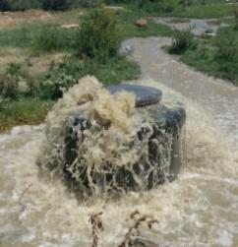
Sewer sPILLAGES in Sol Plaatje
Homevale and Beaconsfield WWTWs are failing to meet compliance standards for effluent discharge into the environment
Spillages from Gogga Pump Station and adjacent manholes; and from Main Shaft Pump Station, due to the pumpstations being dysfunctional
Spillages from manholes and conveyance pipelines into residential areas
Blocked drains resulting in sewer spillages into plots, streets and the environment
Sewage water from the above spillages runs into the Kamfersdam and Platfontein pans near residential settlements
Pans flooding rail and road infrastructure renders the infrastructure not fit for use - refurbishment required for 800m of R31 road to be lifted at R32m
10

Slide 11
ENFORCEMENT ADMINISTRATIVE ACTIONS AGAINST SPLM
Notices of Intention were issued in August 2015 and November 2015 to inform the municipality of the department’s intention to issue directives to the municipality to address the sewage pollution issues
Directives were issued in February 2016, September 2016, January 2018 and December 2018, February 2021, March 2022 and July 2022 to direct the municipality to stop pollution and rectify the infrastructure as well as rehabilitate the polluted areas.
Representations were received by DWS from the municipality for some of the issued Directives.
DWS scheduled meetings on 31 October 2018; 31 January 2019; 26 February 2019 and 30 August 2019 where action plans were discussed to monitor progress.
For all administrative actions taken against SPLM, the municipality has informed DWS that it is unable to comply due to financial challenges.
Furthermore, theft and vandalism was identified by SPLM as one of the reasons why the infrastructure is non-functional.
To ensure that SPLM operates and maintains its infrastructure in accordance with the legislative requirements, DWS has instituted further enforcement actions.
Civil enforcement action in the form of a court interdict application through the office of the State Attorney is underway. This action, if favourable by the court, will result in the issuance of a court order to SPLM which will have both legal and criminal implications should they fail to comply.

Slide 12
UPGRADE OF HOMEVALE WASTE WATER TREATMENT WORKS
In 2013 the DWS supported the Sol Plaatjie Municipality by providing RBIG grant funding (R300 million) to the municipality to upgrade the Homevale WWTW which was over-capacitated and could not treat effluent
The funding involved increasing the capacity of the Homevale WWTW from 33 to 48 ML/d to reduce the net flow into the Kamfersdam pan and so control the water level in the pan
The project was completed in 2017
Subsequent to the upgrade of the plant, the municipality failed to secure the plant properly and it was vandalised, and, as a result the plant was rendered dysfunctional
As a result, for a number of years the WWTW was discharging untreated effluent into the pan
Since 2022 the municipality has refurbished a portion of the plant and is still discharging partially treated effluent into the pan

Slide 13
SEWER PUMPSTATION REFURBISHMENT
Following the repairs to the Homevale WWTW, from 2019 the DWS also provided funding through the Water Services Infrastructure Grant for the projects below:
Replacement of Sewer Outfall Pipeline (between Gogga Sewer Pumpstation and Homevale WWTW) at the cost of R 25 000 000
Repair leak at Gogga pumpstation at the cost of R315 000
New Sewer Pump Station for Carters Ridge at the cost of R 31 000 000
The Carters Ridge is implemented in two phases, of which phase 1 is completed and phase 2 is still under construction and due to be completed December 2023
The completion of this project will reduce the number of pumpstations that the municipality operates which will improve efficiency
The refurbishment of pumpstations was crucial to ensure that sewer in conveyed to WWTW and not discharged into the environment.
There was a significant increase in volumes of effluent conveyed to the WWTW and decrease in discharges to the environment.
It is required that waste water be treated to discharge standards to allow discharge to the Vaal River. Beefmaster is supporting SPLM in this regard.

Slide 14
Water challenges

Slide 15
ADDRESSING KEY WATER CHALLENGES IN SOL PLAATJIE
Water from the domestic water supply system is lost into the environment as a result of infrastructure and operational challenges due to poor management
The municipality is experiencing water losses on their main supply pipeline to the town and in their internal connector services. This has contributed to the problem of the flooded pans.
The main supply line carries water from Riverton WTW which is 26 km from Sol Plaatjie, to the town
The leaks coupled with a WTW with inadequate capacity resulted in insufficient water being supplied to the town
DWS wrote to the Sol Plaatjie Municipality on several occasions advising the municipality to address these issues

Slide 16
FUNDING ALLOCATION FROM THE BUDGET FACILITY FOR INFRASTRUCTURE
Consequently, with DWS support, the municipality applied to the Budget Facility for Infrastructure in National Treasury for funding to refurbish the main supply line, replace the old asbestos distribution pipes, to upgrade the Riverton WTW and to refurbish pumpstations. The total application was for R1,9 billion
The BFI subsequently approved R86 million for the 2023/24 financial year, R492 million for the 2024/25 financial year, and R574 million for the 2025/26 financial year, through DWS
The allocations in the outer years will be dependent on adequate expenditure of the allocation for this year – if the municipality is unable to spend the full allocation this year, and indicate its readiness to successfully spend the outer year allocations, it is likely that the outer year allocations will be reduced
DWS will therefore be engaging with Sol Plaatje Municipality to advise them on measures which would be taken to ensure that the allocation is spent timeously and the money is not taken away

Slide 17
Funding requirements to refurbish infrastructure

Slide 18
SHORT TERM FUNDING REQUIREMENTS
Items | Intervention required | Cost implications | Duration
Repairs at Homevale WWTW | To get the new plant operational | R 15 000 000.00 | 12 Months
Replacement of 965mm section | To replace the dilapidated pipe behind 3SAI | R 30 000 000.00 | 9 Months
Water pipe replacements | Dalham Road, Carrington Road, Broadway Street Installation of pressure reducing valves | R 20 000 000.00 | 12 Months
Appointment of security at SPS and WWTW | Installation of security surveillance to prevent further vandalism of infrastructure. | R 15 000 000.00 | 12 Months
Riverton WPP: Installation of new cables to commission the two 10MVA transformers | The current cables is dilapidated and is unreliable and prone to failure. This must be installed immediately to improve reliability | R 10 000 000.00 | 6 Months
Refurbishment of Filters on the Old and New Plants | To improve efficiency of the filtration at the plant | R 15 500 000.00 | 12 Months
Reclamation dam | Construction of a reclamation dam at Riverton | R 10 000 000.00 | 12 Months
Repairs at Ritchie WWTW | The plant is out of operation for more than a year | R 3 000 000.00 | 9 Months
 | TOTAL | R 118 500 000.00

Slide 19
MEDIUM TO LONG TERM FUNDING REQUIREMENTS
Items | Intervention required | Cost implications | Duration
Newton pump station | Construction of a new pump station at Newton | R 50 000 000.00 | 36 Months
Sewer pipe replacement | Kagisho Area at Roodepan | R 50 000 000.00 | 36 Months
Bulk Water Supply line | Construction of a new 1.2m diameter bulk water supply line from Riverton to Kimberley | R 400 000 000.00 | 60 Months
Refurbishing oval and round tower | Increasing of abstraction capacity at Riverton | R 10 000 000.00 | 24 Months
Construction of reservoirs | Construction of bulk storage reservoirs at Carters Ridge, Roodepan and Galeshewe | R 120 000 000.00 | 60 Months
Upgrading of Riverton & Ritchie WPP (Membrane Technology) | To augment purification/production capacity, and improve quality of purified water. | R 160 000 000.00 | 24 Months
TOTAL |  | R 790 000 000.00

Slide 20
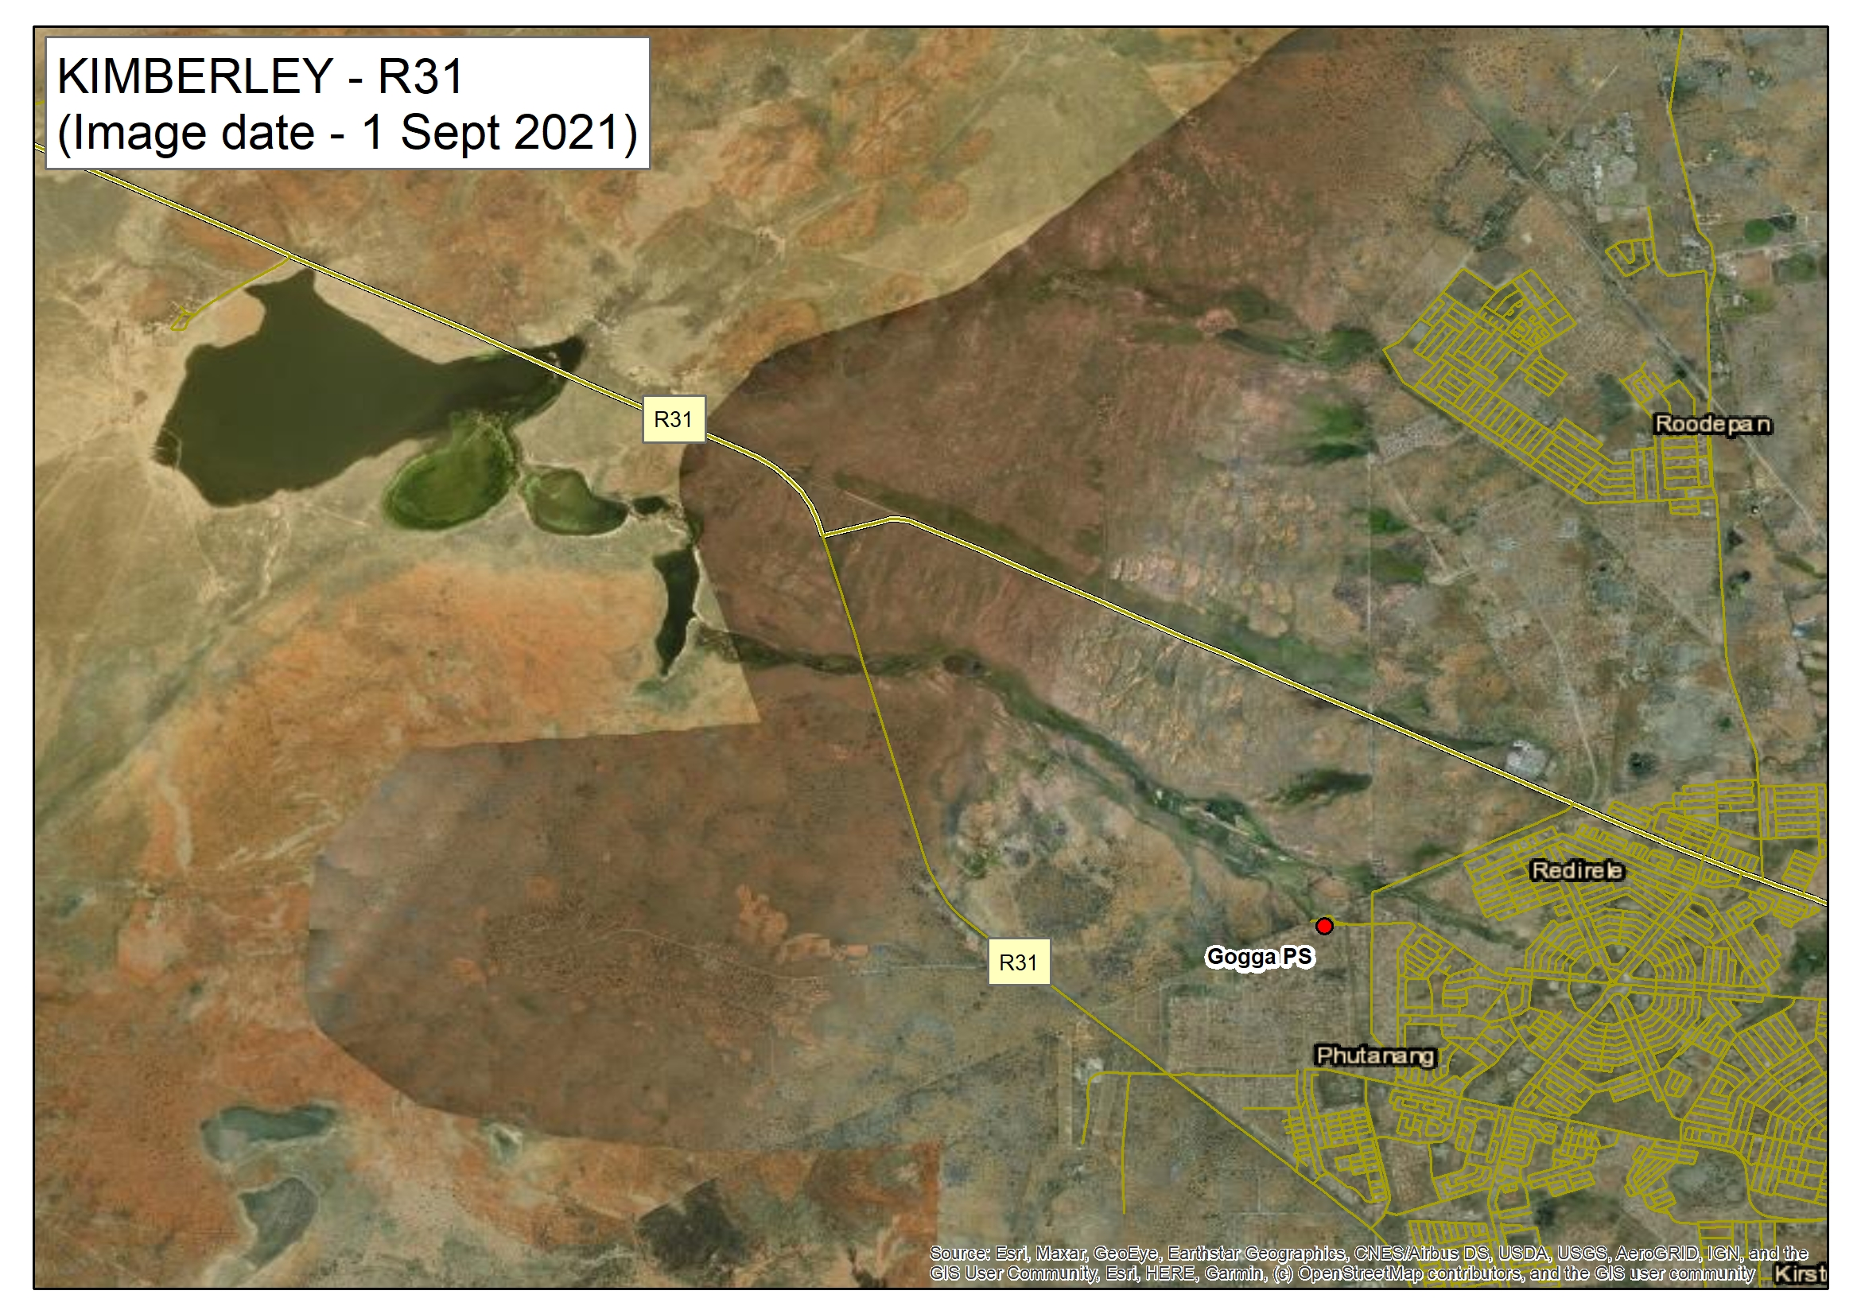
Platfontein PANS Water quality
Google image shows the extent of the flooding in the pans and the water cause that contributes to the flooding
Six water samples were taken at the localities indicated and analysed with E.Coli as indicator of pollution (22 November 2022 and 17 January 2023)
Sewer and drinking water and storm water mix to give a dirty water footprint into the pans
This water is not suitable for discharge into the environment
This is why the Department intervened to address the sources of this water, rather than focusing on discharging this water into the Vaal River
GG5 28/12/22 10H00
Total Coliform >2420 cfu
E.Coli 15 cfu
GG2 28/12/22 09H00
Total Coliform >2420 cfu
E.Coli >2420 cfu
GG6 28/12/22 10H30
Total Coliform >2420 cfu
E.Coli 2 cfu
GG1 28/12/22 08H30
Total Coliform >2420 cfu
E.Coli >2420 cfu
GG4 28/12/22 09H30
Total Coliform >2420 cfu
E.Coli 2420 cfu
GG3 28/12/22 09H30
Total Coliform >2420 cfu
E.Coli >2420 cfu

Slide 21
RESULTS OF INTERVENTIONS IMPLEMENTED TO REDUCE SPILLAGES AND LEAKS TO PLATFONTEIN PANS
Gogga pumpstation inflow repairs have reduced the spill volume by 10 Ml/d
The annual pipeline leak repairs have reduced the flow volume from estimated 40 Ml/d
Measurement has indicated significant decline to the inflow in the water course towards the Platfontein pans. The decline is from 94l/s (8.1Ml/d) to 22 l/s (1.9Ml/d)
There is up to 1 m water level decline in the Platfontein pans and the water level is more than 2 m below the R31 road surface which has significantly reduced the risk to the road
The excess flow towards Platfontien is now directed towards Kamfersdam pan and Vaal River.
The Minister and DWS will be engaging further with the municipality with a view to getting the municipality to accelerate its measures to address the pollution issues.
21

Slide 22
THANK YOU
22

