Slide 1
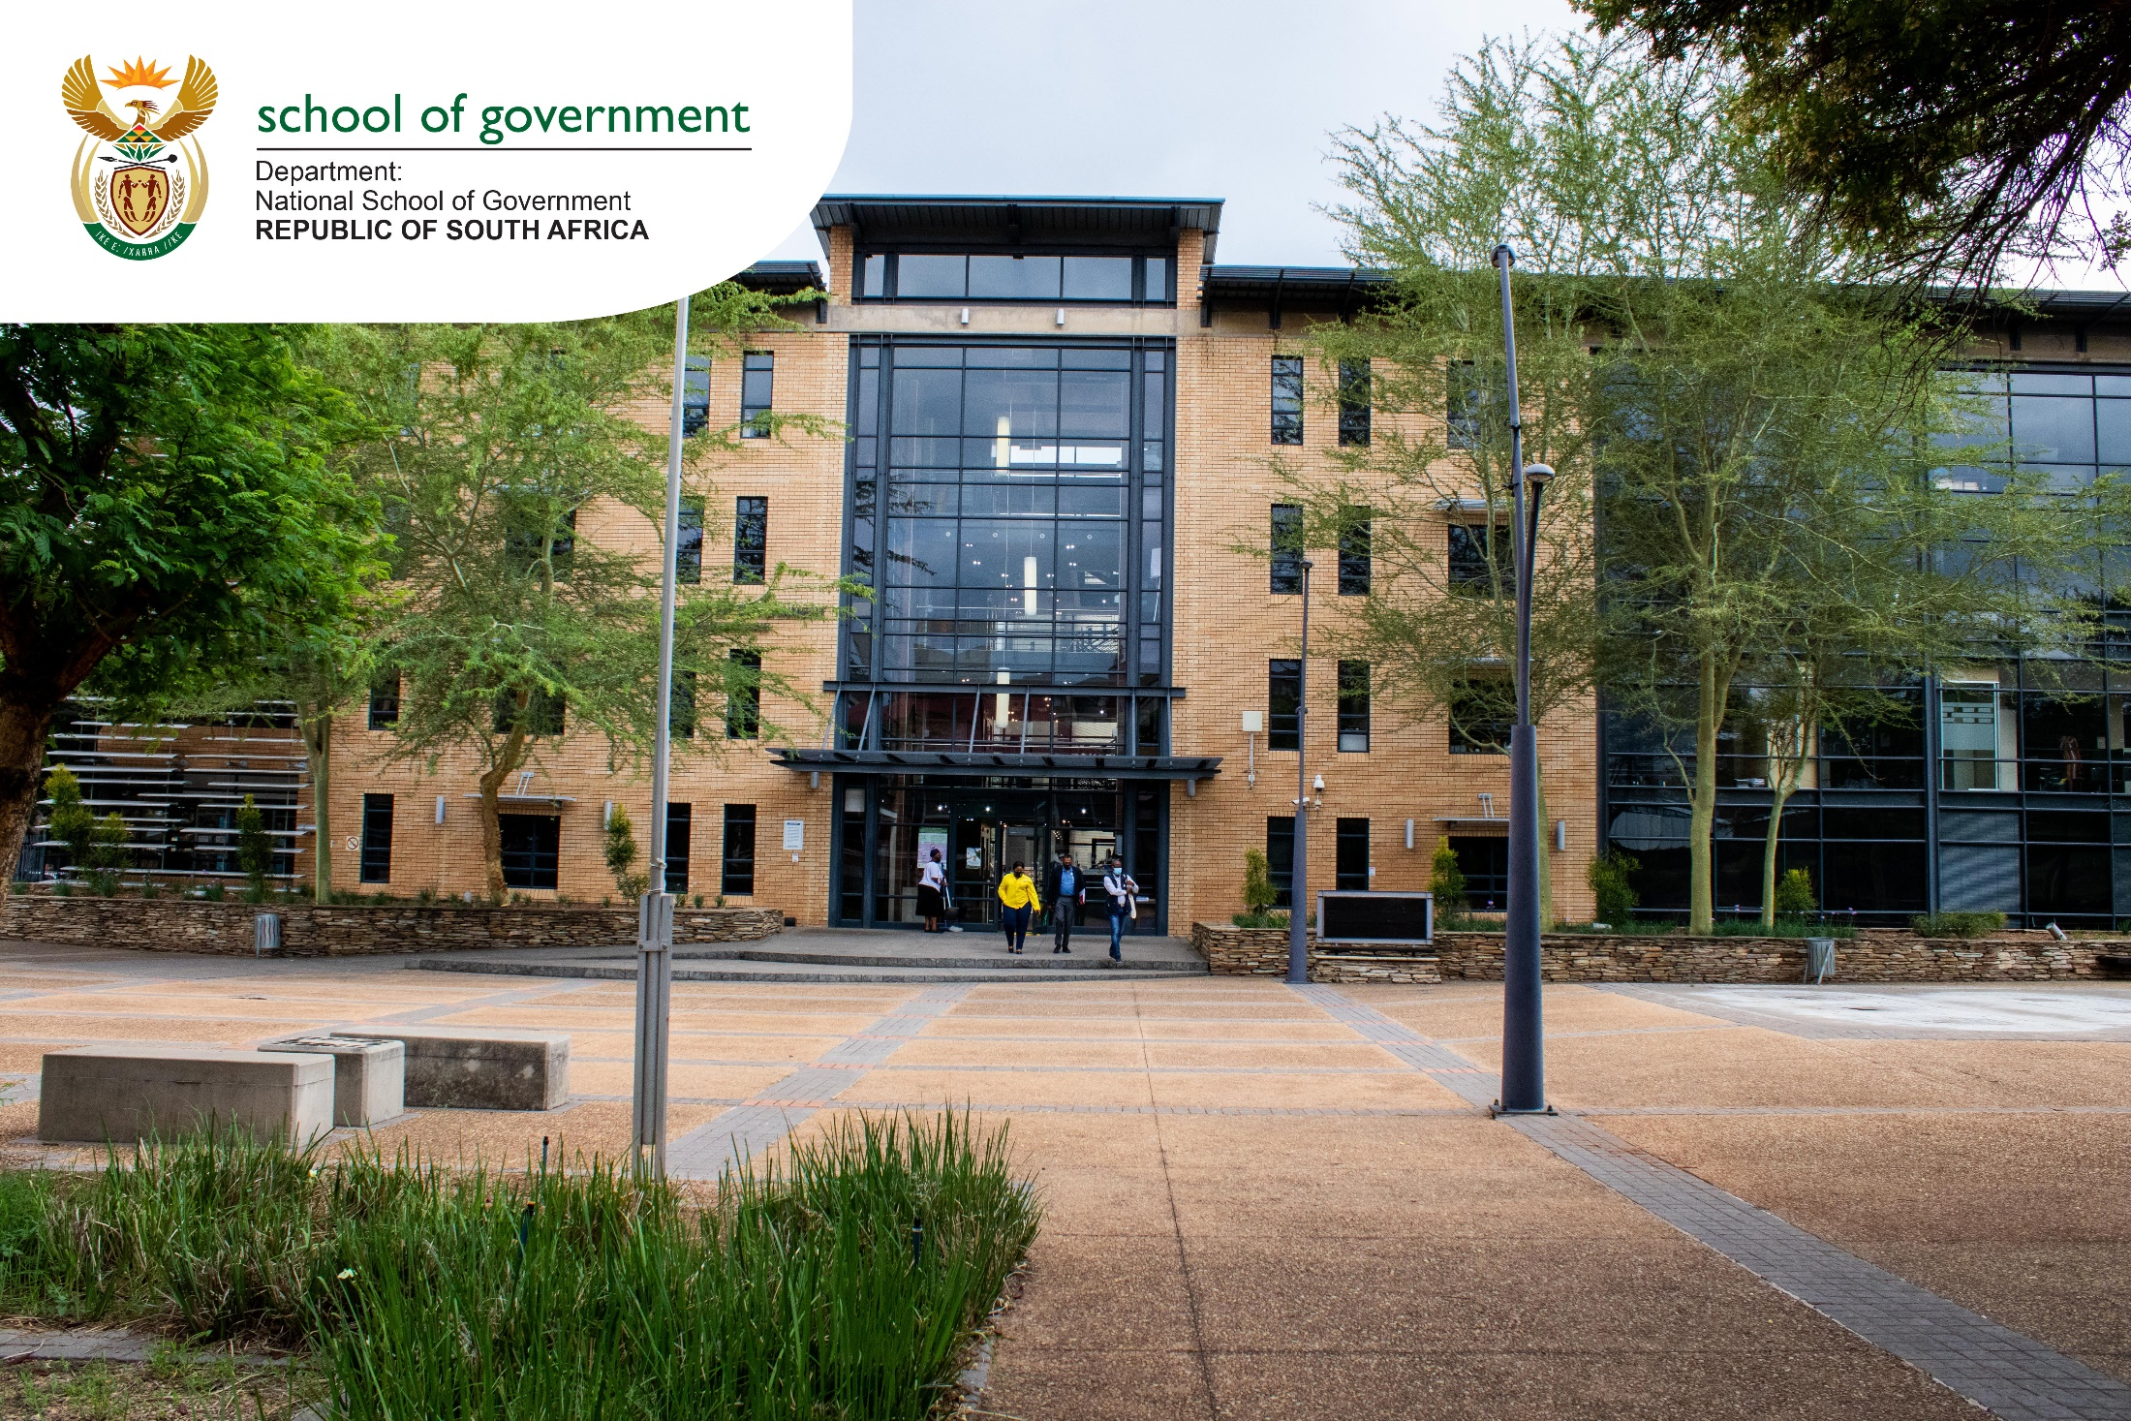
NATIONAL FRAMEWORK TOWARDS THE PROFESSIONALISATION OF THE PUBLIC SECTOR: PORTFOLIO COMMITTEE MEETING
17 May 2023

Slide 2
Overview: Priority 1 of the 6th Administration
CAPABLE STATE
ETHICAL STATE
DEVELOPMENTAL
STATE
A capable state has the
required human capabilities,
institutional capacity, service processes and technological platforms
An ethical state is driven by the constitutional values and principles of public administration and the rule of law, focused on the progressive realisation of socio-economic rights and social justice as outlined in the Bill of Rights.
Meet people’s needs through interventionist, developmental, participatory public administration.

Slide 3
Overview of the framework
Entrench a dynamic system of professionalisation in the Public Sector
Strengthen and enable legal and policy instruments to professionalise categories of occupations in the Public Sector
Enhance and build partnerships and relationships with higher education institutions and professional bodies
Ensure meritocracy in public servants' recruitment, selection, and career management in line with the NDP and the MTSF
Initiate consequence management for material irregularities through the transgression mechanisms and various pieces of legislation

Slide 4
Responsibilities of the Lead Departments
SALGA
Adopted the framework for implementation in local government & should develop an implementation plan
STATE OWNED ENTITIES
through shareholder ministers, must adopt the framework for implementation through shareholder compacts
LEAD DEPARTMENTS & INSTITUTIONS
Should develop the implementation plans:
NSG, DPSA, PSC, National Treasury, DPME, AG
LEGISLATIVE SECTOR Should adopt the framework for implementation by all 10 legislatures
NOTE:
Implementation Plans must indicate short term, medium term & long term goals.
Various departments are expected to develop their implementation plans.
The DPME will monitor and report on the implementation - DPSA will set norms and standard expressed through regulations, policy directives etc. DPSA will co-ordinate and monitor implementation as part of its mandate.
AG – will audit the implementation & report about its findings

Slide 5
Public Service Commission: Developments on Legislative Mandate & Policy Mandates
Public Service Commission Bill:
Significant progress on the review of the Public Service Commission Act of 1997 has been made.
The primary objectives of the PSC Bill are to:
Facilitate the establishment of the PSC as a Secretariat to replace the OPSC. This is to ensure that the PSC executes its mandate fully as an independent and impartial constitutional entity.

Slide 6
Developments on Legislative Mandate & Policy Mandates
The primary objectives of the PSC Bill continued
Convert the OPSC from a government department in terms of the Public Service Act of 1994, onto a function shift to the PSC as a Secretariat established in terms of the Public Service Commission Act.
Reinforce the PSC mandate in terms of local government and public entities in line with section 196(2) of the Constitution.
It is envisaged that the current PSC Act of 1997 will be repealed and replaced by a new Act.

Slide 7
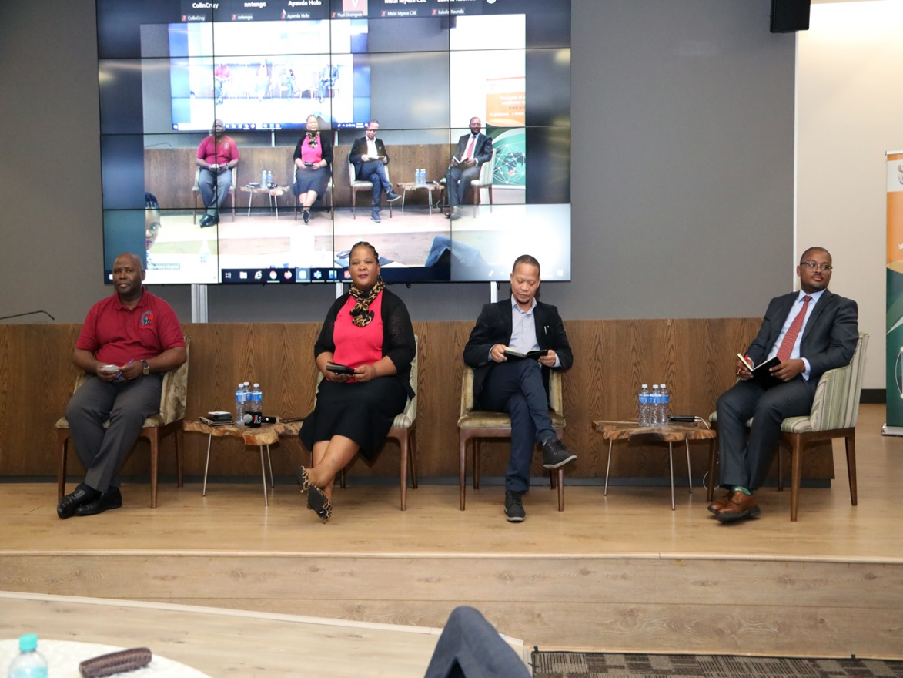
Developments on Legislative Mandate & Policy Mandates
In terms of the State of the Nation Address –
The PSC is amending legislation to strengthen the role of the Public Service Commission to ensure that qualified people are appointed to senior management positions;
PSC is working with the NSG and DPSA to oversee the implementation of the National Framework for Professionalisation of the Public Sector; and
To move towards creating a single, harmonised public service is a key priority for 2023/24

Slide 8
National School of Government:
Advocacy & Support to other Departments:
Advocacy
10 Legislatures
Higher Education Institutions
Quality Councils & SAQA
Premiers Offices: All Provinces)
SAQA - Professional Bodies & Key
Departments
Civil Society
National Departments
SOEs through DPE & Shareholder Departments
Key leading Departments

Slide 9
Advocacy & Support to other Departments:
Progress …
NSG Implementation & Advocacy Plan developed:
NSG/SAAPAM Webinars: CPUT, UP, UNISA & TUT
SAAPAM/DPSA/NSG HoDs of Public Admin Dept HEI
DPE (2 engagements)
DPME (2 engagements)
National Treasury (2 engagements and a very successful webinar on 4/5/2023)
Limpopo Office of the Premier (11/5/2023)
KZN HRDC (1 meeting) per quarter
Image: https://www.thecampaignworkshop.com/effective-advocacy-campaign-tips

Slide 10
Skills Audit Project
Concept document developed by the NSG and HSRC
Project plan and timelines finalised for a phased implementation approach – responding to all 5 pillars of the Framework
Engagements with the Directors-General of the departments to share the skills audit methodology, project plan, timeframes
8 identified frontline and service delivery departments will participate in the first phase, i.e., Transport, Human Settlements, Water and Sanitation, Cooperative Governance, Public Works and Investments, Home Affairs, SASSA, and Employment and Labour.
Image: https://www.roberthalf.co.uk/advice/human-resource-management/how-conduct-skills-audit-your-employees

Slide 11
5
5 Pillars for Implementation
Continuing Learning & Professional Development
Career Progression, Succession Planning & Management of Career Incidence of Heads of Department
Recruitment & Selection
Induction & Onboarding
Planning & Performance Management
Pillar 1
Pillar 2
Pillar 3
Pillar 4
Pillar 5

Slide 12
NSG:
Pillar 1: Pre-entry, Recruitment and Selection
Review of Nyukela:
Levels 13 -14 & 15-16
Review in progress &
planned implementation
Introduction of Nyukela to:
Military, Correctional Services, State Security, Police &
Staff appointed into political Office
2023/2024
2023/24
2024/25
2025/2026
2023/2024
Extend Nyukela to Middle Management
Customisation in progress & planned implementation
Collaboration with HE &
Professional Bodies:
NSG signed MOUs with 10 Universities
Extend Nyukela to Local Government & SOEs
Planned implementation

Slide 13
DPSA
Pillar 1: Pre-entry, Recruitment and Selection
By 2025, review the academic qualifications entry requirements into SMS level 14-16
Review of the SMS Handbook
Research on review of entry requirements to be done in 24/25 FY
SMS Handbook review part of the 23/24 FY deliverables
2023/2024
2023/24
2023/2024
Compulsory occupation-based competency & Integrity assessment for SMS
Psychometric integrity testing tool under development.
Merit-based recruitment and appointments:
DPSA/PSETA/TUT Project:
Skills for the future of work in the Public Service
Address the aging Public Service and increase youth representation through strengthening internship pipeline and enabling specialist skills recruitment.

Slide 14
OPSC
Pillar 1: Pre-entry, Recruitment and Selection
Recruitment of Municipal Managers:
PSC- To create a pool of technical experts
Recruitment of DGs and DDGs:
PSC- To create a pool of technical experts
2023/2024
2023/24
2024/25
2025/2026
Recruitment of the Commissioners to the PSC:
Use external experts from academia, professional associations, or bodies to be part of a selection committee

Slide 15
Pillar 2: Induction & On-Boarding
Participation in Compulsory Induction Programme by Prospective Public Servants:
Immediately after appointment or within 90 days of appointment
NSG: (43) Boards of SoEs inducted
2. Compulsory reorientation programme for serving public servants.
NSG:
Re-orientation of traditional leaders is in progress.
DPSA: Review of the Directive for induction and onboarding in progress to be implemented in 2023/2024.
NSG: Induction of Institutes of Traditional leaders (Two completed KZN & EC)
Phased in approach to be implemented for: Local Government (2024), (2024) & Security Cluster & Officials appointed into political office (2025)
DPSA: Roll out Coaching and Mentorship program for public service leaders (SMS) and emerging leaders (young people)

Slide 16
Public Entities and Organisations Enrolled in the NSG Induction Programme to Date

Slide 17
Pillar 3: Performance Planning & Management
DPSA:
Review of the Performance Management System & Development (PMDS)
Link performance of HODs and DDGs to that of the Institution.
2 DPSA:
Align performance management with professional bodies’ registration
Review the Guidelines for Advisors – Introduce minimum requirements per category; performance management system, code of conduct for Advisors
Develop framework to incentivize performers
DPSA:
Introduce independent triggers for exit of non-performing HoDs.
Improve the competency of politicians to manage performance.
Address the systemic challenges that result in instability and poor relations between Executive Authorities and HoDs.
PSC : Their role in performance evaluation of HoDs

Slide 18
NSG:
Pillar 4: Continuing Learning & Professional Development
DPSA &
DCOGTA
NATIONAL
TREASURY
DPME
DoJ &CD
AGSA
DPW & CBE
to professionalise
Professionalise
BUILD ENVRIOMENT
Reform SCM (Cabinet
Resolution 2014)
Establish SCM Council
POLICY & PLANNING OCCUPATION
Establish a Council
LEGAL PROFESSION
AUDIT & RISK PROFESSION
ICT & HR
NSG has signed MoU with CBE and the draft MoU with IIASA
DPSA is working towards setting guidelines and standards for professional registration of targeted functions within the public service.
Planned to sign additional MOUs with the other professional bodies/councils by 2023/2024

Slide 19
NSG: Pillar 5: Career Progression & Career Incidents
Engaged the Minister of HEST
To declare NSG as an organ of state to offer Higher Education qualifications.
The DPSA is developing RPL Policy for the Public Service
Accreditation of 5 learning programmes against OQSF qualifications at NQF Levels 5-8
Review RPL Policy for optimal use in recruitment in the public service
NSG nominated staff to participate in the RPL Steering Committee

Slide 20
DPSA: Pillar 5: Career Progression & Career Incidents
A strategy for Discipline Management is being finalized in the 2022/2023 FY and will be implemented in the 2023/2024, which will include a review of the relevant disciplinary codes and the tracking of criminal offences by public servants for consequence management
Political Administrative Interface
Review the Revolving Door Policy
To enable exchange of skills and knowledge between the public sector and other sectors like academia, private sector, civil society
Tenure of HoDs & DDGs

Slide 21
Conclusion
SALGA adopted the framework after several engagements with the NSG
NSG & HSRC- Skills Audit project plan finalised and implementation in progress
NSG will provide continued support to:
SALGA in the development and implementation of its plan for professionalising the local government;
DPE and other shareholder departments to adopt and implement the framework for SOEs;
National Treasury in the professionalisation of SCM & Finance occupation.

Slide 22
Conclusion
The following role players will ensure successful implementation of the framework:
DPSA - lead the implementation of the framework & issue directives for implementation. Co-ordinate and support departments for implementation. Work with partners to develop professionalisation standards for HR and ICT professions in Public Service.
NSG - provide advocacy to the public sector & lead the skills audit project. DPSA has developed a Skills Audit Methodology in partnership with PSETA and is rolling out implementation. The Minister has tasked the DPSA to immediately pilot the rollout of this Skills Audit Methodology within the portfolio.
OPSC - coordinate the key leading departments in the implementation of the framework.
DPME - planning, monitoring and reporting on the implementation.
AGSA - audit the implementation and compliance.

Slide 23
Thank you
Ke a leboha
Ke a leboga
Ngiyabonga
Ndzi khense ngopfu
Ngiyathokoza
Ngiyabonga
Baie dankie
Ndi a livhuwa
The NSG:
Learn: expanding learning opportunities for public servants to master state craft
Serve: building the capacity (and culture) of public servants to serve society effectively
Grow: helping public servants to combine learning & service (experience) to grow professionally
Busani Ngcaweni, Principal, The National School of Government

