Slide 1
Annual Performance Plan and Budget for 2023/24 Financial Year
Briefing to the Select Committee on
Education and Technology, Sports, Arts and Culture
Date: 17 May 2023

Slide 2
OUTLINE OF THE PRESENTATION
Constitutional Provisions
Medium-Term Strategic Framework outcomes – What we aim to achieve
Highlights of Achievements
Sector priorities prescribed by the Presidency
Key outputs per outcome: 2023/24 financial year
Budget information: 2023/24 MTEF

Slide 3
CONSTITUTIONAL PROVISIONS
The Department derives its mandate from Section 29 of the Constitution of the Republic of South Africa Act 108 of 1996, which states Education – (1) Everyone has a right – (a) to a basic education, including adult basic education, (b) to further education, which the state, through reasonable measures, must make progressively available and accessible. (2) Everyone has the right to receive education in the official language or languages of their choice in public educational institutions where that education is reasonably practicable. In order to ensure effective access to, and implementation of this right, the state must consider all reasonable educational alternatives, including single medium institutions, taking into account – (a) equity, (b) practicability and (c) the need to redress the results of past racially-discriminatory laws and practices.

Slide 4
MEDIUM-TERM STRATEGIC FRAMEWORK OUTCOMES
(WHAT WE AIM TO ACHIEVE)
Increasing participation as a result of expanded opportunities
Ensuring excellent teaching and learning
Improved social and economic development through the PSET system
Access to PSET opportunities
Quality provisioning
IMPACT
Addressing education and training needs of individuals, employers and society
Optimal use of resources in the PSET system
Success and efficiency
Responsiveness

Slide 5
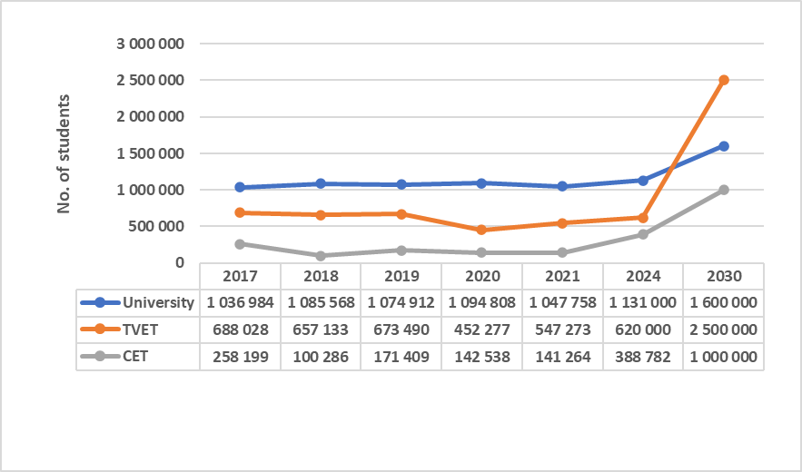
HIGHLIGHTS OF ACHIEVEMENTS

Slide 6
HIGHLIGHTS OF ACHIEVEMENTS

Slide 7
HIGHLIGHTS OF ACHIEVEMENTS

Slide 8
HIGHLIGHTS OF ACHIEVEMENTS

Slide 9
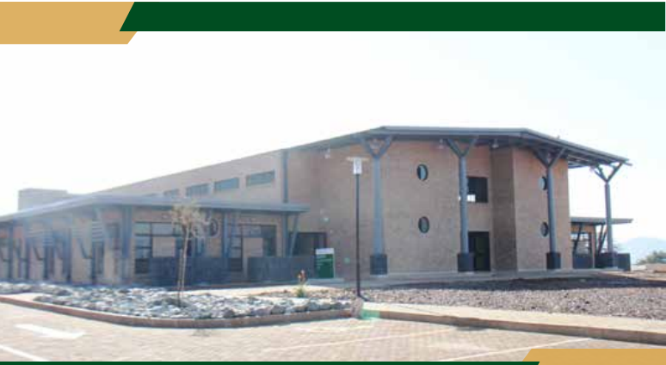
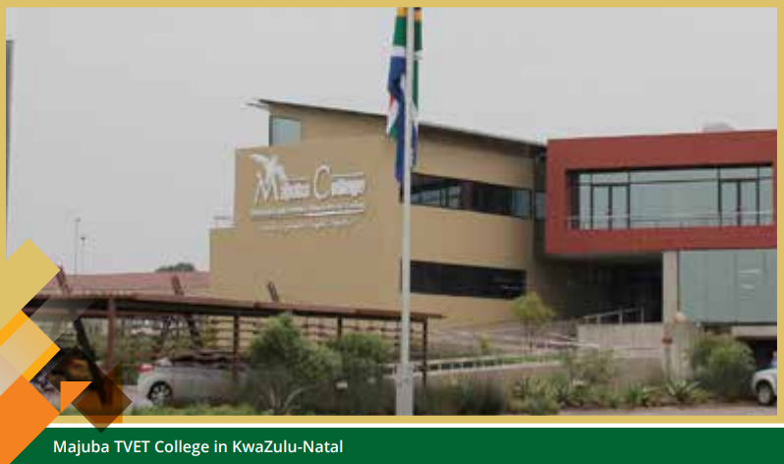
HIGHLIGHTS OF ACHIEVEMENTS
TVET INFRASRUCTURE (Completed)
NAME OF FACILITY | PROVINCE | PROGRESS | COMMENT
Mgungundlovu TVET College (Msinga) | KwaZulu-Natal | 100% | Snag-list in process
Esayidi TVET College (Umzimkhulu) | KwaZulu-Natal | 100% | Complete
Mthashana TVET College (Nongoma) | KwaZulu-Natal | 100% | Complete
Mthashana TVET College (Kwagqikazi) | KwaZulu-Natal | 100% | Complete
Ikhala TVET College (Aliwal North) | Eastern Cape | 100% | Complete
Ingwe TVET College (Ngqungqushe) | Eastern Cape | 100% | Pending the bulk connections by the municipality
Eastcape Midlands TVET College (Graff Reinet) | Eastern cape | 100% | Complete
Thabazimbi | Limpopo | 100% | Complete
Mfolozi TVET College (Nkandla A) | KwaZulu- Natal | 100% | Complete

Slide 10
HIGHLIGHTS OF ACHIEVEMENTS
TVETINFRASRUCTURE (Under Construction and still in planning)
NAME OF FACILITY | CAMPUS NAME | Local Municipality | Province | Status
Ikhala TVET College | New Sterkspruit Campus | Senqu | Eastern Cape | Under Construction
Ingwe TVET College | Ntabankulu Campus | Umzimvubu | Eastern Cape | Feasibility
Mopani TVET College | New Giyani Campus | Greater Giyani | Limpopo | Feasibility
Gert Sibande TVET College | New Balfour Campus | Dipaleseng | Mpumalanga | Under construction
Umgungundlovu TVET College | Greytown (Completion) | Umvoti | KwaZulu-Natal | Planning
uMfolozi TVET College | Bhambanana (Completion) | Jozini | KwaZulu-Natal | Planning
uMfolozi TVET College | Nkandla B Campus | Nkandla | KwaZulu-Natal | Planning
Mnambithi TVET College | Berville Campus | Alfred Duma | KwaZulu-Natal | Planning
False Bay TVET College | Mitchels Plain | Cape Metro | Western Cape | Planning
False Bay TVET College | Swartklip | Cape Metro | Western Cape | Planning
Mthashana TVET College | Vryheid Campus | Abaqulusi | KwaZulu-Natal | Under construction

Slide 11
PRIORITIES FOR 2023/24 FINANCIAL YEAR
(PRESCRIBED BY THE PRESIDENCY)
Changing the size and shape of the PSET sector
Finalising Comprehensive Student Funding Model for Higher Education
Establishment of the two new universities
Placement of students through a funding scheme in collaboration with the NSF (targeting young people trained and placed in workplaces through various learning programmes including skills in digital and technology sector)
Ensuring that TVET graduates undertake workplace experience to complete their qualifications

Slide 12
EXPANSION OF ACCESS
Increase enrolments:
Universities - from 1 110 360 (2023/24) to 1 133 864 (2025/26)
TVET colleges - from 520 000 (2023/24) to 640 000 (2025/26)
CET colleges - from 321 841 (2023/24) to 469 649 (2025/26)
Increase the number of students receiving funding through NSFAS bursaries:
Universities: from 439 659 (2023/24) to 559 884 (2025/26)
TVET colleges - from 346 258 (2023/24) to 420 000 (2025/26)
Increase first-time students entering university by 2.1% from 204 000 to 208 200

Slide 13
EXPANSION OF ACCESS
Increase artisan learners trained in TVET colleges from 30 000 (2023/24) to 36 000 (2025/26)
Increase learners placed in Work-based Learning programmes from 110 500 (2022/23) to 200 300 (2025/26)
Increase learners registered in skills development programmes from 149 000 (2022/23) to 155 500 (2025/26)
Increase learners entering artisanal programmes from 23 000 (2022/23) to 37 000 (2025/26)
Submit to the Minister Student Funding Implementation Framework for approval (31 October 2023)
Submit to the Minister revised daft Fee Increase Regulatory Framework for approval (31 October 2023).

Slide 14
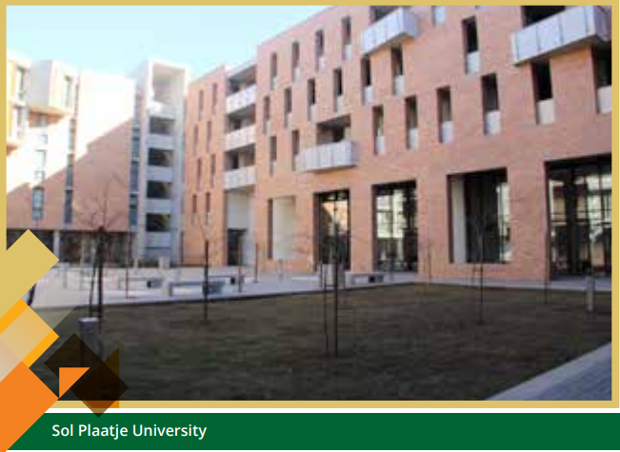
PLANNED INFRASTRUCTURE TO SUPPORT EXPANSION
Development of concept designs in 2023/24 up to 30% completion of the construction of the two new universities in Ekurhuleni and Hammanskraal in 2025/26
Implement 9 projects for the provision of 28 000 student beds over the MTEF period
2/3000 (2023/24)
3/10 000 (2024/25)
4/15 000 (2025/26)
Build 12 Community Learning Centres over the MTEF, starting with 3 in the 2023/24 financial year:
Tswinyane in Heidelberg - Gauteng
Kwa-Guqa in eMalahleni - Mpumalanga
Eersterivier - Western Cape

Slide 15
Planned Infrastructure to Support Expansion
Build 8 TVET college campuses over the MTEF, 2 of which will be built in 2023/24:
uMfolozi-Bhambanana Campus
uMgungundlovu-Greytown Campus
Work with DUT to complete an Engineering Building as part of the Imbali Precinct project
Develop concept designs for:
the Multi-Purpose Centre in Giyani and
a Satellite campus in Ulundi
Ensure 6 000 students participate in work integrated learning for practical application in construction over the MTEF

Slide 16
Success and Efficiency
Increase the number of students completing a university qualification from 232 000 (2023/24) to 249 509 (2025/26)
Increase university graduates in:
engineering from 14 477 (2023/24) to 14 735 (2025/26)
Initial teacher education from 29 500 (2023/24) to 33 094 (2025/26)
Master’s graduates (all master’s) will increase from 14 500 to 15 079
Doctoral graduates will increase from 3 350 to 3 477

Slide 17
Success and Efficiency
The number of graduates in the following fields will decrease over the MTEF period:
Natural and physical sciences - from 11 516 (2023/24) to 10 943 (2025/26)
Human health sciences - from 10 200 (2023/24) to 9 950 (2025/26)
Animal health sciences - from 1 013 (2023/24) to 925 (2025/26)
Reason for the decline in targets: Universities have been registering less students from the 2021 academic year deviating from the 2020 to 2025 Enrolment Plan approved by the Minister. During the midterm review of the 2023 to 2025, some of the universities which had projected high numbers have reduced them – thereby affecting the number of students graduating

Slide 18
Success and Efficiency
Increase TVET college students completing N6 qualifications from 73 743 (2023/24) to 78 000 (2025/26)
Increase TVET college students completing NC(V) Level 4 from 13 823 (2023/24) to 15 099 (2025/26)
Ensure 4 500 students are enrolled in Pre-vocational Learning Programme in 2023/24 to improve success and increase by 1 000 over the MTEF
Increase the placement of unemployed TVET students in workplaces from 10 616 in 2022/23 to 20 000 in 2023/24

Slide 19
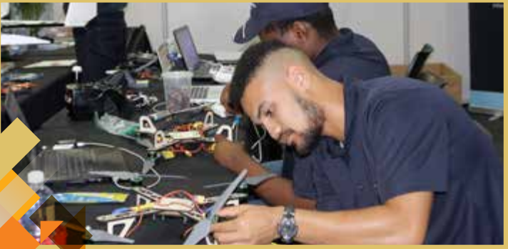
Success and Efficiency
Ensure certificates are issued to qualifying candidates within 3 months following publication of results
Increase artisans development from 21 000 (2023/24) to 28 000 (2025/26)
Increase learners who complete learnerships from 32 550 (2023/24) to 56 000 (2025/26)
Learners who complete internships will also increase from 6 450 (2023/24) to 11 770 (2025/26)

Slide 20
Success and Efficiency
Learners who complete skills programmes will increase from 105 000 (2023/24) to 130 960 (2025/26)
Process qualifying trade test applications within 40 days of receipt for trade testing annually over the MTEF
Increase the number of CET college students completing GETC: Level 4 from 41 200 (2023/24) to 55 000 (2025/26)

Slide 21
Improving the Quality of Provisioning
Fill 85 new Generations of Academics Programme (nGAP) posts at universities every year
Allocate 40 scholarship or internship positions to universities through the Nurturing Emerging Scholars Programme annually
Allocate 40 Doctoral scholarships to universities through the Universities Staff Doctoral Programme for award to permanent instructional or research staff members
25 awards to permanent instructional or research staff at universities to participate in the Future Professors Programme in 2023/24

Slide 22
Improving the Quality of Provisioning
Increase the proportion of university lecturers who hold doctoral degrees from 51% in 2023/24 to 55% (2025/26)
Establish an Advisory Panel on the implementation of Language Policy in 2023/24
Increase the percentage of TVET college lecturers holding a professional qualification from 75% (2023/24) to 95% (2025/26)

Slide 23
Improving the Quality of Provisioning
Increase the support for TVET lecturers who hold appropriate qualifications to acquire professional qualifications from 300 (2023/24) to 1 000 (2025/26)
Increase the placement of TVET college lecturing staff in industry or exchange programmes from 16% (2023/24) to 20% (2025/26)
Increase lecturers participating in project-based lecturer capacity building programmes in engineering (electrical, plumbing and mechanical) from 200 (2023/24) to 400 (2025/26)

Slide 24
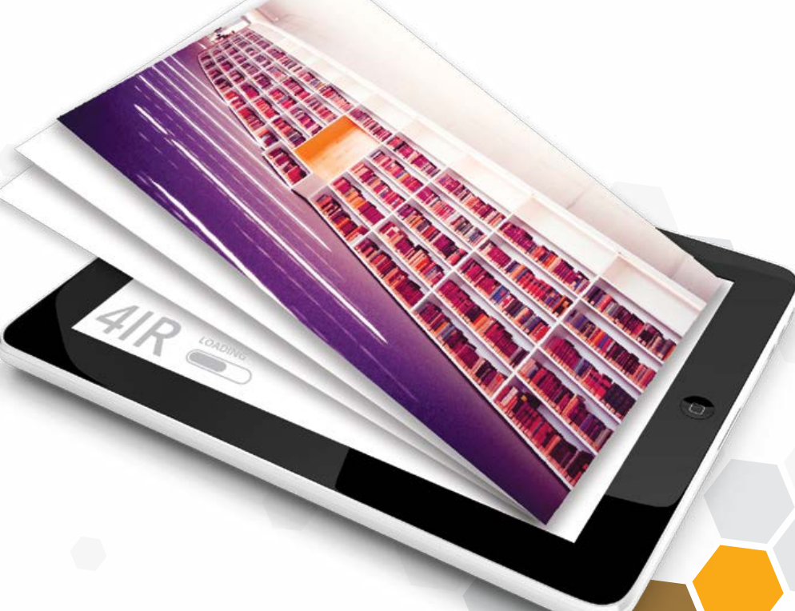
Improving the responsiveness PSET System
Increase the number of TVET colleges offering 4th Industrial Revolution aligned skills training from 35 in 2023/24 to 50 in 2024/25
Increase the number of lecturers participate in digital literacy programmes from 4 500 (2023/24) to 6 500 2025/26
Ensure that all public TVET colleges sign at least two protocols with industry to place lecturers and learners for workplace experience over the MTEF period

Slide 25
Improving the responsiveness PSET System
Ensure all public TVET colleges implement student-focussed entrepreneurship development programmes
Increase new accredited programmes and part-qualifications to be offered in CET colleges from 5 (2023/24) to 11 (2025/26)
Increase the number of CET college lecturers trained in accredited training programmes from 1 000 (2023/24) to 2 500 (2025/26 cumulatively)

Slide 26
Policy and Legislative programme
Publish the National Qualification Framework Amendment Act, 2019 by 31 March 2024
Draft National Qualification Framework Amendment Bill approved by the Minister by 31 March 2024 for public comments
Draft revised Higher Education Act approved by the Minister by 31 March 2024 for public comments
Develop a Country-Wide Master Skills Plan for approval by the Minister by 30 September 2023
Develop and implement a Plan for the integration of Information Management Systems by 31 March 2024
Launch the ‘’Transforming MENtalities ‘’ Programme by 31 August 2023

Slide 27
Administration
Payment of valid invoices within 30 days
Set aside procurement for:
Women: 40%,
Youth 30%,
SMME’s 30% and
People living with disabilities: 7%.
Clean audit
A vacancy rate that is below 10%
Develop a Business Continuity Plan

Slide 28
Financial Information
The financial information of the Department is presented as follows:
An explanation of the Department’s budget structure and budget trends over the 2023 MTEF period
A summary of the allocations over the 2023 MTEF
A summary of the allocations for the 2023/24 financial year

Slide 29
Budget Structure
The budget for the Department is distributed between six Programmes as follows:
1) Administration
The Director-General and Departmental support functions
2) Planning, Policy and Strategy
Mainly responsible for the development, implementation and monitoring of Departmental plans and policies, SAQA, Higher Health, the transfers of Infrastructure and Efficiency funds to Universities and TVET colleges and the HRD strategy for South Africa, International Relations and Stakeholder Engagement.
3) University Education
Mainly responsible for the university sector, NSFAS, CHE and national institutes for higher education
4) Technical and Vocational Education and Training
Mainly responsible for the TVET sector
5) Skills Development
Mainly responsible for the skills sector, including the national skills development strategy, skills development policy and the management of the skills levy
6) Community Education and Training
Mainly responsible for the Community Education and Training sector

Slide 30
Budget Trends
Post-School Education and Training budget has an annual average increase of 4.6% over the 2023 MTEF
The 2023 MTEF baseline includes budget baseline reductions and increases.
The net change to the budget vote baseline amounts are:
R1.8 billion decrease in 2023/24;
R2.7 billion increase in 2024/25; and
R104.9 million increase in 2024/25.
The baseline decrease in 2023/24 is due mainly to:
Reprioritisation of infrastructure grants from Mpumalanga and Sol Plaatje (DHET) to fund Early Childhood Development (DBE);
Reprioritisation of infrastructure and efficiency grants to Community Education and Training to be distributed over the MTEF; and
Realignment of the Higher Education Infrastructure budget with the institutions’ revised plans and deferred 2023/24 budget to 2024/25 financial year.

Slide 31
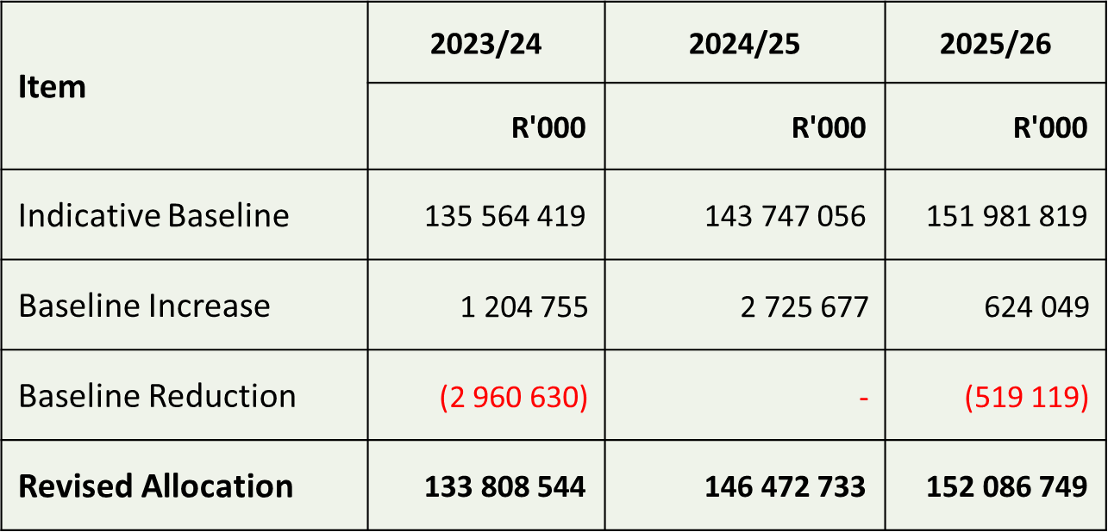
Budget Trends
The budget allocation over the medium-term are as follows:

Slide 32
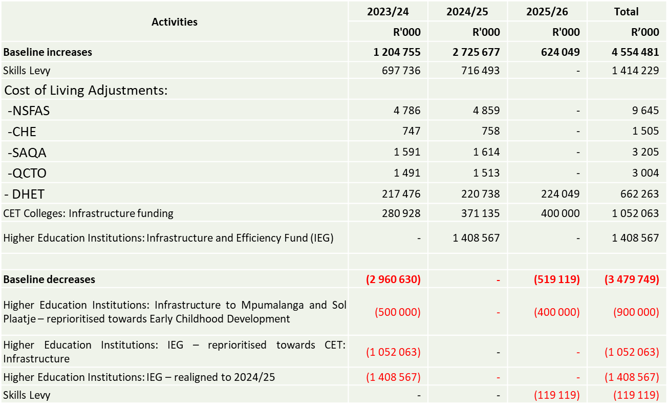
Details of Budget movement over the MTEF
The net increased baseline adjustments can be summarised as follows:

Slide 33
Budget trends
The projected average funding rate for institutions over the 2023 MTEF:
TVET Colleges: 15.2% over the 2023 MTEF (8.9% over the 2022 MTEF).
CET Colleges: 2.1% over the 2023 MTEF (1.8% over the 2022 MTEF).
Universities: 61.2% over the 2023 MTEF (65.5% over the 2022 MTEF).
Skills Levy: 17.3% over the 2023 MTEF (16.4% over the 2022 MTEF).
There is a substantial funding support to Colleges (CET and TVET) from the Skill Levy through SETAs and the National Skills Fund (NSF). For example:
NSF: allocated R 2.8. billion to build 13 new TVET campuses;
NSF: allocated R 200 million for digital skills to CET colleges over the MTEF;
SETAs: allocated R 300 million in 2022/23 for TVET graduate placement;
SETAs: allocated more R 100 million in 2022/23 to CET colleges for various initiatives.

Slide 34
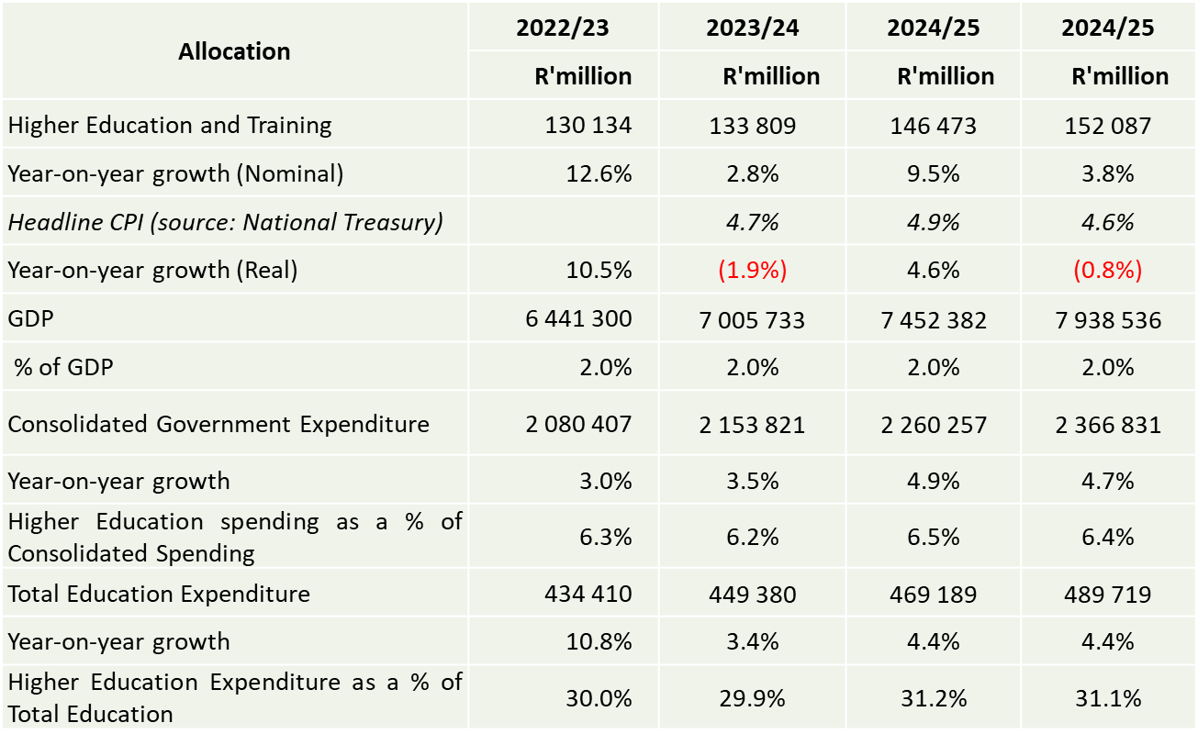
Budget trends

Slide 35
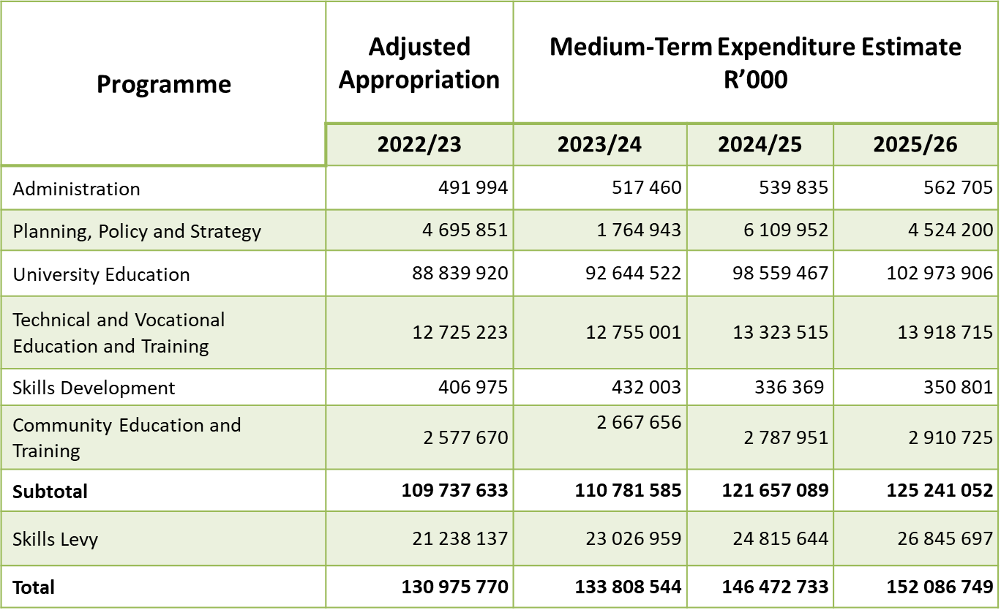
Allocations per Budget Programme

Slide 36
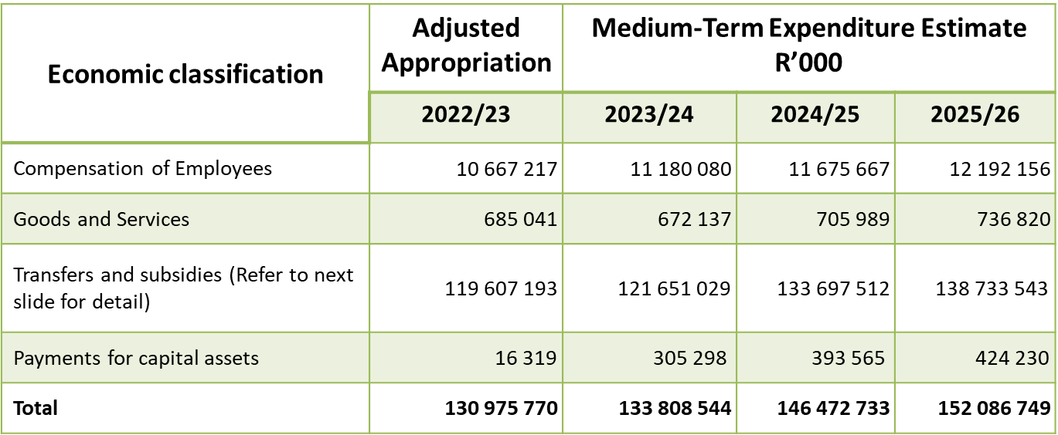
Allocations per Economic classification

Slide 37
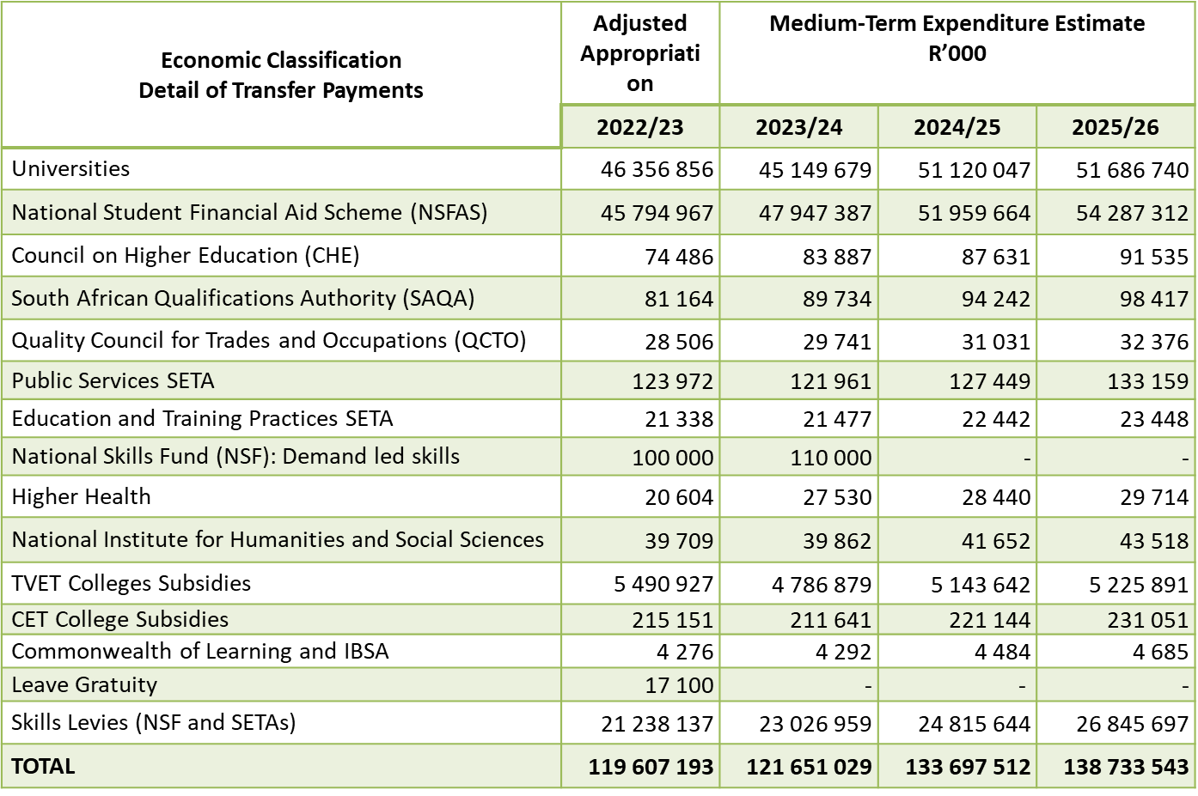
Detail of Transfer Payments

Slide 38
Budget Trends/Skills Levy
The “direct charges” reflected in the budget consist of the direct commitment from the National Revenue Fund namely the skills levy revenue collected by SARS for the SETAs and the NSF
For the 2023 MTEF period, the skills levy increases from R21.2 billion (revised estimated levy collections by National Treasury) in 2022/23 to reach R26.8 billion in 2025/26
The skills levy allocations based on the revised collection trend over the 2023 MTEF are as follows:
2023/24: SETAs R18.422 billion
NSF R4.605 billion
2024/25: SETAs R19.853 billion
NSF R4.963 billion
2025/26: SETAs R21.506 billion
NSF R5.339 billion

Slide 39
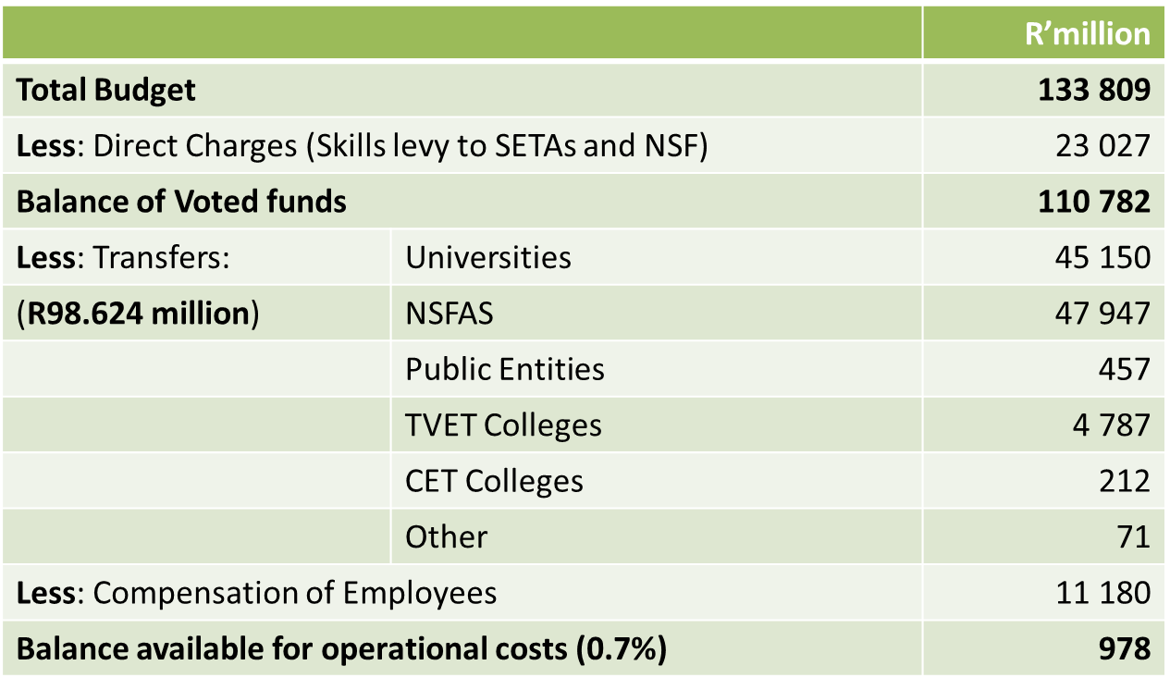
Operations Budget for 2023/24
Within the Department, funding distribution is as follows:

Slide 40
Operations Budget for 2023/24
For the 2023/24, compensation of employees amounts to R11.180 billion (92 per cent) of Departmental operations as follows: r’000000
Departmental: R1 006.485 million
TVET colleges: R7 453.084 million
CET colleges: R2 407.287 million
Examiners and Moderators: R313.224 million
The operational budget for 2023/24 is R977.435 million and increases to R1.161 billion in 2025/26. Included in this budget are provision for office accommodation, infrastructure for CET colleges and examination services
The Department continues to be innovative and efficient as well as ensuring that the required monitoring, evaluation and control of the system as a whole are taking place

