Slide 1

SASCOC STRATEGIC PLAN APRIL 2023 – MARCH 2024 (Quadrennial)
PORTFOLIO COMMITTEE PRESENTATION – 16 May 2023

Slide 2

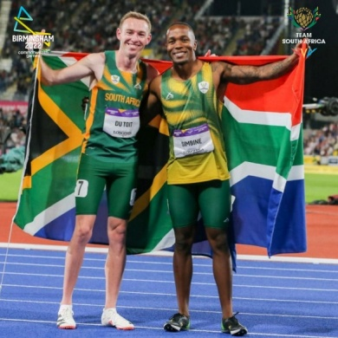


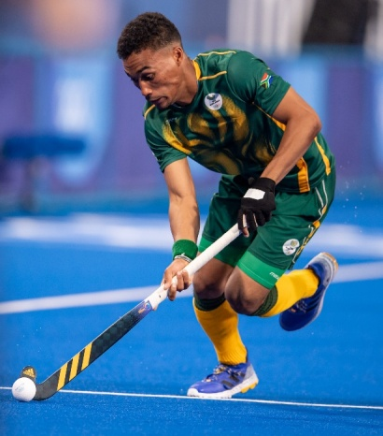
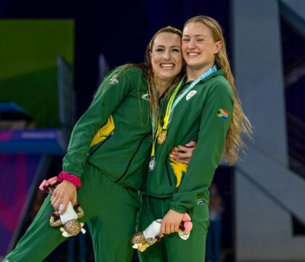
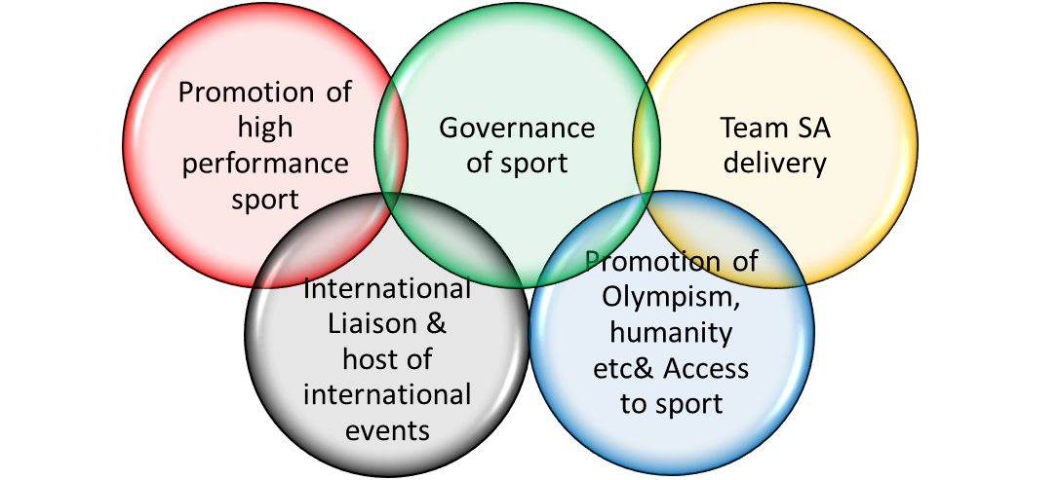
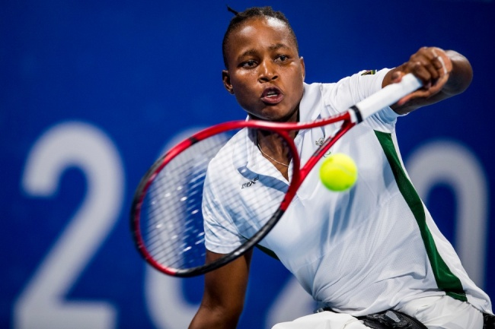

Our Mandate
It is South Africa’s only national multi-coded sporting body responsible for the preparation, presentation and performance of teams to multi-coded events, including but not limited to the Olympic Games, Paralympic Games, Commonwealth Games, World Games, African Games, Youth Olympic Games, Commonwealth Youth Games and AUSC Region V.
Over and above this, our remit is to create a system that enables the identification and development of the holistic high-performance sporting potential of all South Africans and ensures fundamental transformation in sport, in support of nation building.
In summary as the macro body of sport we:
  Act as the co-ordinating and controlling body of sport and represent the interest of sport (advocacy) across the board
  Promote Talent Identification and High-Performance Sports
  Successfully deliver Team South Africa to multicoded games.

Slide 3




Our Vision, Mission and Pillars
Vision
To be the enabling leaders in sport and capacitate South African athletes to achieve sustained competitive excellence, whilst inspiring South Africans.
Mission
To harness and develop South Africa's high performance sporting talent, advancing Team South Africa successfully and consistently, as we promote equitable access to sport throughout the country and facilitating good governance in the sports sector.
Strategy Pillars

Slide 4
STRATEGIC FOCUS AND KEY DELIVERABLES
APRIL 23- MARCH 2024

Slide 5
Strategic Focus 2023 – 2025
Strategic Pillar
Strategic Objective
Key Initiatives
1
Brand and Reputation Management
Rebuild Brand Trust and Brand Image
Reputation, Brand Management and Brand Repositioning of Team SA
Tell our own Story – PR Campaign
Market Research driven campaigns
Formulation of a Marketing and Communication Strategy
Media and Stakeholder Engagement
2
Human Capital
Attract, develop and retain talent
Talent Acquisition
Skills Development and Succession Planning
Drive High Performance
POPIA Compliance
Employee Wellness
3
Good Corporate Governance
Strengthen internal controls
Comply with applicable Legislation
Strengthen Company Secretariat function
Review and Adopt the new Constitution
Compliance to Norms and standards
Communicate clear, transparent, relevant and updated Governance policies.
Manage and support Board and Board Commissions
Promote transparency and accountability through Independent audit and risk management
Strengthen Internal controls
4
Financial Sustainability
Strengthen the financial position of the organisation and implement high standards of Financial management.
Review of Finance Policies and Procedures
Revenue generation through sponsorships, grants and donations
Cost Management and Containment
Unqualified Audit
Strategic Procurement
Technology

Slide 6
Strategic Focus 2023 – 2025
Strategic Pillar
Strategic Objective
Key Initiatives
5
Stakeholder Relations
Rebuild Stakeholder Confidence and Trust
Attract new Sponsors and funders
Adherence by NF’s to Constitutional Requirements
National Federations’ liaison and support
Establishing Stakeholder Confidence
Effective Contribution to Sport Development
6
High Performance
Promote High Performance and
Successfully Deliver Team South Africa
Talent identification, development and retention of athletes
Accreditation of HP facilities, services and equipment
Implementation and maintaining integrated systems for the audit and monitoring of HP programmes
Relaunch of Operational Excellence
Team South Africa Delivery
Engagement with Stakeholders to ensure Effective delivery.
7
Advocacy for Sports Transformation
Collaborate with the National Federations to create an inclusive and accessible sporting environment
Create an inclusive and accessible environment for all in sports
Access to sports from foundation to participation followed by performance and then Elite (Developmental pyramid)
Talent Identification and pathway
Sustainability and legacy
8
Lead a Sports Movement
Use Sports as a vehicle for social cohesion
Encourage Sports for All
Set up a Sports Foundation
Promote principles and values of Olympism in Sports and Education
Technology

Slide 7
TEAMSA DELIVERY CALENDER APRIL 2023- MARCH 2024

Slide 8
QUARTER ONE - APRIL – JUNE 2023 ACTIVITIES
APRIL
SASCOC General Assembly :
Our Constitution states that SASCOC shall hold at least two General Meetings of Members during a financial year, of which one shall be the Annual General Meeting. The first General Assembly for this financial year is in April.
MAY
Launch of the Operation Excellence Programme (OPEX) - OPEX is designed to offer support to athletes who have the potential to qualify for participation and returning medals at a higher level in the multi-coded events under the organisation’s umbrella of sports.
OPEX/Special Support Programmes, athletes are nominated through their NFs. Currently finalising the Opex contracts
SASCOC has signed a sponsor to help fund the programme
South African launch of the sponsorship and the Opex athletes announcement will be in May 2023
JUNE
Games Delivery
African Beach Games 24 -30 June 2023
These are a continental multi-sport event held among athletes on the African continent. The Games are organised under the governance of the Association of National Olympic Committees of Africa (ANOCA).
A total of 11 sports have been named on the programme, with the event poised to be a qualifier for the Bali 2023 World Beach. We are awaiting the qualification process for these sports in order to know which sports Team SA qualify for
Tunisia will be hosting the Games

Slide 9
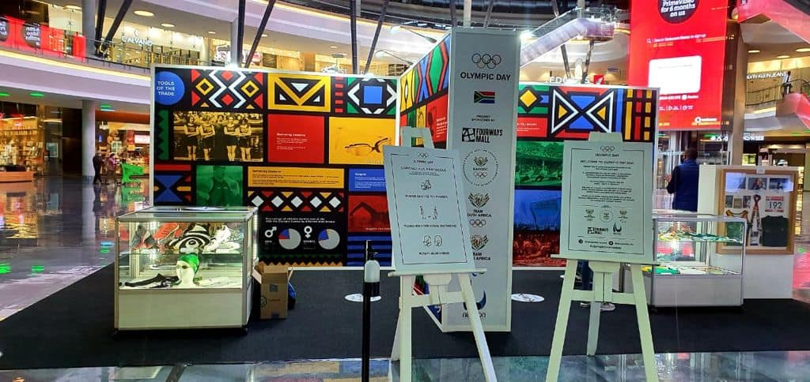
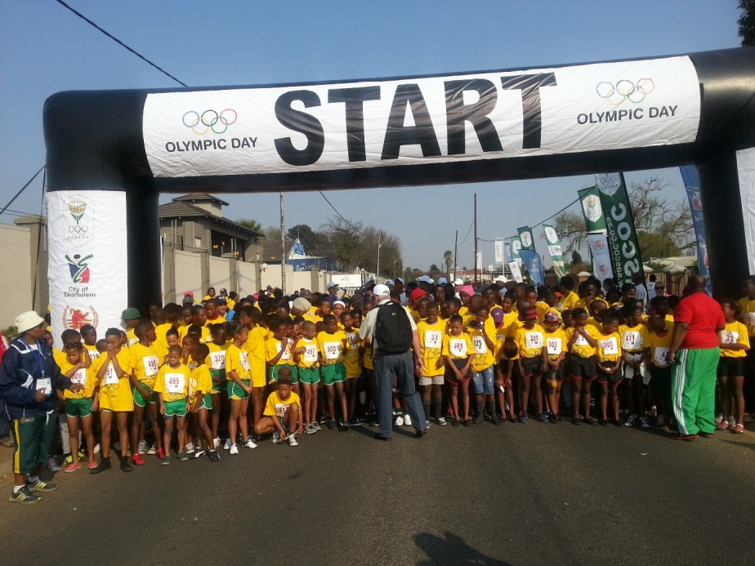
QUARTER ONE - APRIL – JUNE 2023 ACTIVITIES (cont.)
JUNE
International Olympic Day : An annual event created by the International Olympic Committee (IOC) to commemorate the establishment of the Olympics and to educate the sport loving people and the society about Olympism.
SASCOC will host various sporting activities in selected communities which include: a fun run, golf day, exhibition to educate citizens on Olympic Values which include: Excellence, Friendship, Respect, Equality, Determination, Inspiration, and Courage.
Olympic Day is celebrated on 23 June annually and internationally

Slide 10
QUARTER TWO - JULY – SEPTEMBER 2023 ACTIVITIES (cont.)
JULY
World Para Athletics Championships – France , Paris
World Para Swimming Championships – Manchester, United Kingdom

Slide 11


QUARTER TWO: JULY – SEPT 2023 ACTIVITIES
AUGUST
Commonwealth Youth Games
The 2023 Commonwealth Youth Games, officially known as the VII Commonwealth Youth Games and informally
as Trinidad & Tobago 2023, is a youth sporting event to be held in Port of Spain, Trinidad and Tobago in 2023
To take place from 4-11 August 2023
A total of seven sports have been named on the programme
2. World Beach Games
The ANOC World Beach Games is a global multi-sport event created by ANOC.
It is a young and inclusive event that combines the informality and vibrancy of the beach with elite sport to create highly attractive Games.
A total of 14 sports have been named on the programme

Slide 12
QUARTERD TWO: JULY – SEPT 2023 ACTIVITIES
SEPTEMBER
Games delivery
African Para Games
The 2023 African Para Games are to be the first edition of the African Para Games
Being held from 3 -12 September 2023 in Accra, Ghana
The Games will feature eight para sporting disciplines
2. SASCOC Annual General Meeting
As part of our Corporate governance, the SASCOC Annual General Meeting will be held in September to present and adopt the Annual Audited Financial Statements and review the financial year.
All SASCOC Membership is invited

Slide 13
QUARTER FOUR JANUARY – MARCH 2024 ACTIVITIES
JANUARY 2024
Winter Youth Olympic Games
The 2024 Winter Youth Olympics are a youth winter multi-sport event scheduled to be held between 19 January and 2 February 2024 in Gangwon Province, South Korea.
African nations are not regular participants in Winter Olympic Games mainly due to geographical reasons with very little snow of competition quality experienced on the continent.
South Africa has qualified a few athletes in the past Winter Youth Olympic Games
MARCH 2024
African Games
The African Games, formally known as the All-Africa Games, are a continental multi-sport event held every four years, organised by the African Union with the Association of National Olympic Committees of Africa and the Association of African Sports Confederations.
There are an important Games which are a qualifier for Paris Olympics for some sports
Being held from 8 - 23 March 2024 in Accra Ghana
A total of 24 sports are proposed for the programme

Slide 14
OTHER PIVOTAL FOCUS AREAS
SAFEGUARDING
The SASCOC Board through its sub committee - Safeguarding working group has been working hard to ensure that Safeguarding in sport remains top priority
SASCOC has been working in collaboration with the Department of Sport, Arts and Culture to ensure that we drive the call for safer sport
SASCOC would like to ensure that it manages Safeguarding cases that are reported effectively together with its Members.
The General Assembly has resolved that Safeguarding will form part of the Membership requirements and non compliance will lead to the membership being revoked.
A two-day Safeguarding conference was held mid February 2023 to amplify the roles that each stakeholder plays and the importance of the Safeguarding policy.

Slide 15

ROAD TO PARIS 2024
Paris 2024 Olympic and Paralympic Games
The Paris 2024 Olympic Games’ preparations are underway
A lot of ground work in terms of logistics, athletes training and qualification will be done during this financial year
Olympics will be held in Paris, France from 26 July -11 August 2024
Paralympic Games will be held 28 August - 8 September 2024

Slide 17
Cashflow statement
Revenue Streams 2022/23
DESCRIPTION | 2022/2023(APPROVED)
Bank Opening Balance | 28 651 543
Projected Income | 66 960 851
TOTAL INCOME | 95 612 394
Total Projects costs | 42 719 944
Operating Expenses | 13 643 197
Employee Costs | 16 311 008
Board Fees | 2 493 402
 | (75 167 551)
BANK CLOSING BALANCES | 20 444 843
Descriptions | 2022/2023 (Approved)
DSAC Sascoc grant | 12 000 900
DSAC Addendum grant | 7 764 552
IOC Top Sponsors
IOC Olympic Solidarity
National Lotteries Commission (NLC) | 6 600 000
ANOCA
IPC Citibank
IPC - TOYOTA
IPC - AIR BNB
Sponsorship - NEW
Commonwealth Games Federation
Paris Athletes Support
2022/23 Budgeted projects
Projects Prioritisation | Dates | Country
World Para Swimming Championships | 12 - 18 June 2022 | Madeira, Portugal
World Games | 7 - 17 July 2022 | Birmingham, USA
Commonwealth Games | 28 July - 8 August 2022 | Birmingham, United Kingdom
Region V U/20 Games | 2022 | Malawi

Slide 18
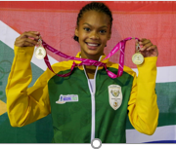
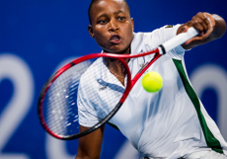
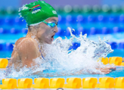
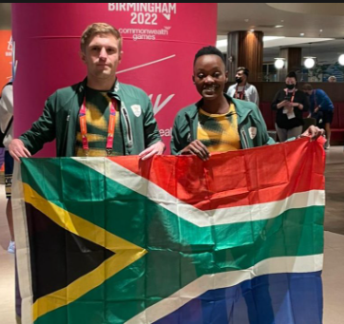
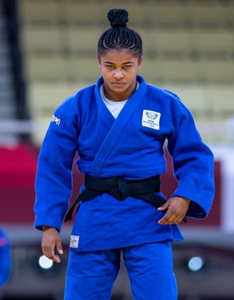




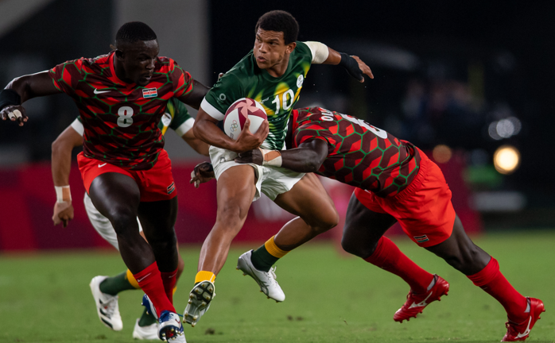
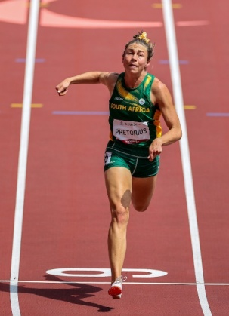
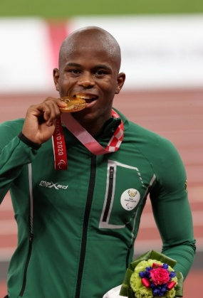
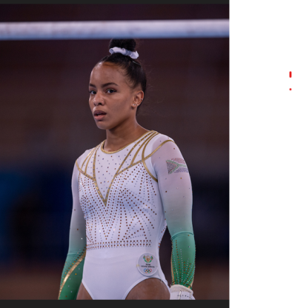
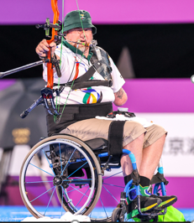
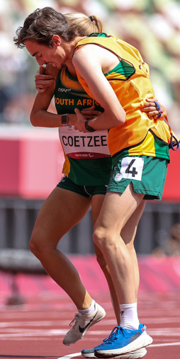
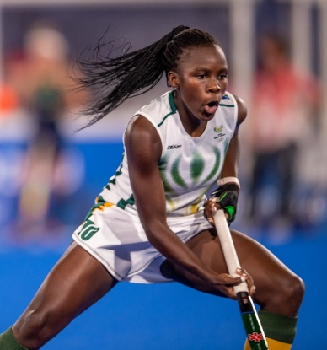
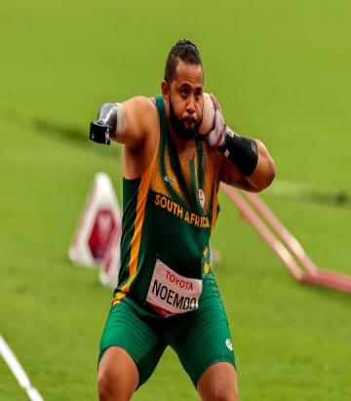
THANK YOU

