Slide 1
Portfolio Committee on Basic Education
06 May 2023

Slide 2


Mission and vision
MISSION
The Auditor-General of South Africa has a constitutional mandate and, as the Supreme Audit Institution of South Africa, exists to strengthen our country’s democracy by enabling oversight, accountability and governance in the public sector through auditing, thereby building public confidence.
VISION
To be recognised by all our stakeholders as a relevant supreme audit institution that enhances public sector accountability.

Slide 3
AGSA
#CultureShift2030
Notes:
The first few slides will be touching on us as the office of the auditor general, our strategic aspirations and strategic goal. Then I will go through the work that we did on the pro-active review of the APPs and end off by touching on preventative controls.

Slide 4


Our strategic context
We have a constitutional and professional mandate as South Africa’s supreme audit institution to not just be satisfied with producing reports, but to keep working and persevering in making a difference to the lives of citizens
+
INTOSAI – P 12
Public sector audit, as championed by the supreme audit institution (SAI), is an important factor in making a difference in the lives of citizens … an independent, effective and credible SAI is an essential component in a democratic system where accountability, transparency and integrity are indispensable parts of a stable democracy
+
Chapter 3 : Section 41
All organs of state must secure the well-being of the people of the republic
+
Chapter 3 : Section 41
All organs of state must provide effective, transparent, accountable and coherent government for the republic as a whole
+
UN Resolution A/RES/69/228
The ultimate role of an SAI is to make a difference in the lives of citizens
+
Chapter 9
Strengthen constitutional democracy in the republic
Notes:
Now as an office we have a constitutional and professional mandate as the supreme audit institution of South Africa to not just be satisfied with producing reports but to also work at making a difference in the lives of the south African citizens.
Section 41 of Chapter 3 of the constitution highlights the responsibility of all organs of state in ensuring the well-being of the people of South Africa
As the chapter 9 institution, ours is to strengthen constitutional democracy in the republic
Speak to Michelle about INTOSAI

Slide 5
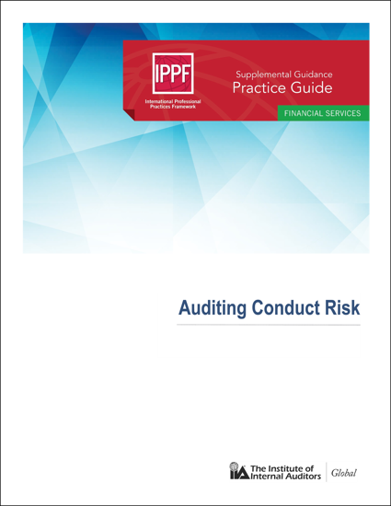
Our call to action
Having reflected on our South African context and the root causes of the persistent regressive outcomes, we have resolved that in order to see a material change in outcomes, we have to focus on shifting public sector culture
+
Institute of Internal Auditors (IIA) : Practice Guide on Auditing Conduct Risk
“Organisational culture – and how an organisation comports itself with regard to conduct – drives how business is done. It also underlies the effectiveness of the control environment, which supports the achievement of an organisation’s objectives. Poor culture and ineffective management of employee conduct has contributed to numerous business failures and has been identified as a root cause of a number of serious issues.”
Notes:
So having reflected on where we are as a country and looked into the root causes of the persistent regressive audit outcomes we resolved that in order to see material changes in outcomes we have to focus on shifting public sector culture

Slide 6
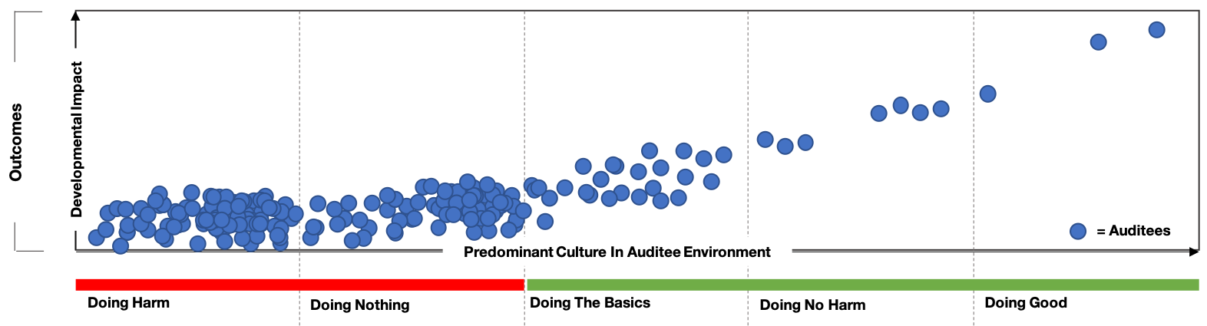
Our strategy
We are committing ourselves to making a more direct, consistent and meaningful impact on improving the lived reality of ordinary South Africans over the next seven years
+
Strategic Aspiration
Stronger, more direct and consistent impact on improving the lived reality of ordinary South Africans
Today
+
Theory of Change
Sustainably and efficiently shift public sector culture through insight, influence and enforcement
+
Accountability Ecosystem
Broad-based, effective network of stakeholders driving and deepening public sector accountability
Illustrative Diagram
Notes:
We are therefore committing to a more direct, consistent and meaningful impact on improving the lived reality of the South African citizens over the next seven years. We intend on doing this by sustainably and efficiently shifting the public sector culture through the insights that we will get, through influencing our stakeholders and enforcing our expanded mandate through the Public Audit Act.

Slide 7
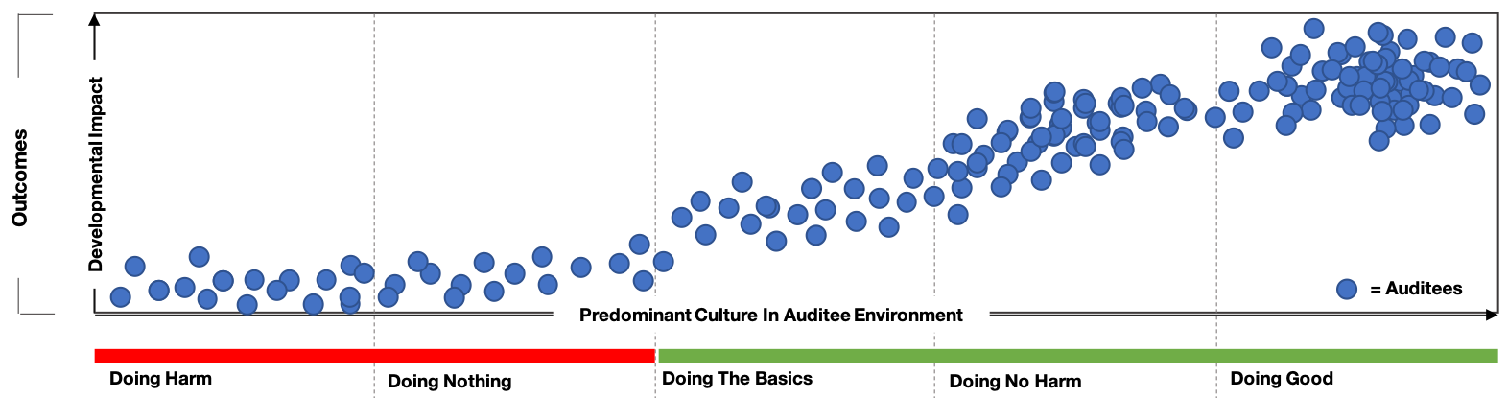
Our strategy
We are committing ourselves to making a more direct, consistent and meaningful impact on improving the lived reality of ordinary South Africans over the next seven years
+
Strategic Aspiration
Stronger, more direct and consistent impact on improving the lived reality of ordinary South Africans
2030
A critical mass of our auditees moved towards cultures characterised by performance, accountability, transparency and integrity
+
Theory of Change
Sustainably and efficiently shift public sector culture through insight, influence and enforcement
+
Accountability Ecosystem
Broad-based, effective network of stakeholders driving and deepening public sector accountability
Notes:
Our vision for 2030 is that a critical mass of our auditees will be under the category of doing no hard or doing good and under these categories the cultures are characterised by performance, accountability, transparency and integrity.

Slide 8
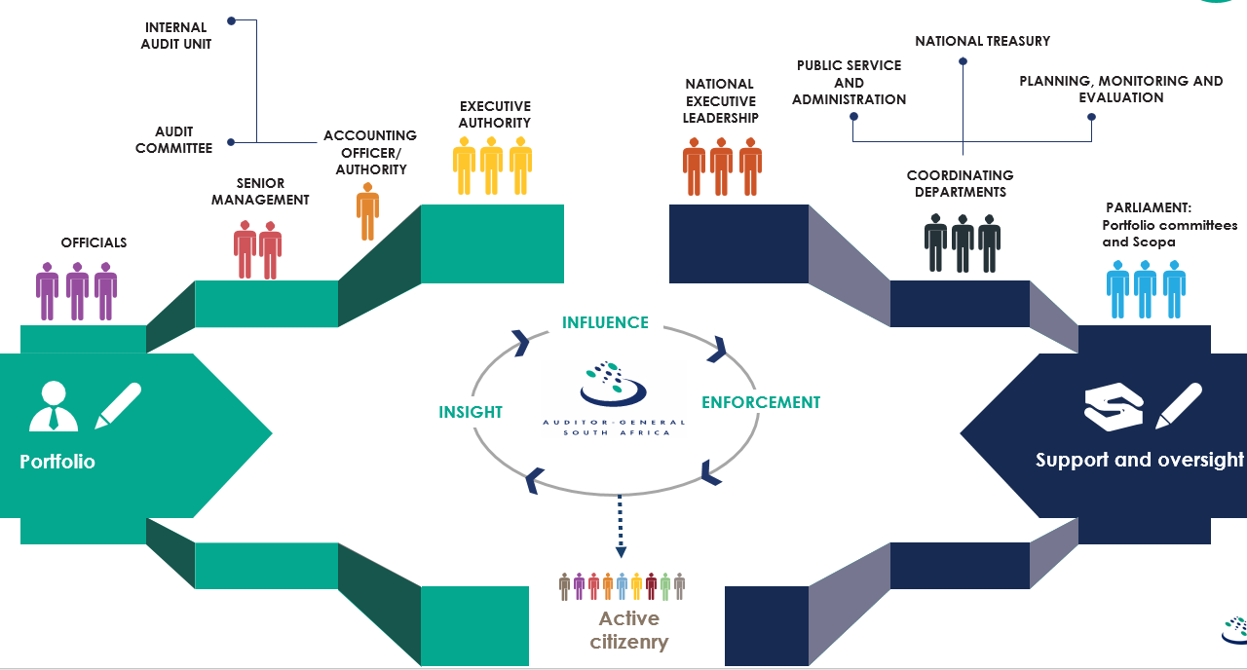
Our strategy
We are committing ourselves to making a more direct, consistent and meaningful impact on improving the lived reality of ordinary South Africans over the next seven years
+
Strategic Aspiration
Stronger, more direct and consistent impact on improving the lived reality of ordinary South Africans
+
Theory of Change
Sustainably and efficiently shift public sector culture through insight, influence and enforcement
+
Accountability Ecosystem
Broad-based, effective network of stakeholders driving and deepening public sector accountability
Notes:
We also look at effective networking of the different stakeholders which will drive and deepen public sector accountability. As you see on the graph there are different stakeholders playing their part in the ecosystem with the ultimate goal of improving the lived reality of the SA citizen

Slide 9






STRATEGY 2030
We will realise our strategic aspiration by focusing on six strategic goals
Sustainably
Insight
Efficiently
Shift public sector culture
Influence
Enforcement
Acquire, develop and maintain the quantity, quality and configuration of people, resources and capabilities to safely achieve and sustain our desired levels of impact
Generate audit insights that illuminate understanding, drive action and yield results
Unlock latent capacity in the existing resource base and our people and lower the cost and effort with which we derive each marginal unit of quality, insight, influence and enforcement
Move stakeholders from mere awareness of our messaging to action on and advocacy of our messaging
Move a critical mass of auditees towards organisational cultures charcterised by transparency, integrity and accountability
Apply powers to directly and indirectly recover resources lost to the state and taxpayers and ensure application of consequences for wrongdoing
Notes:
1, Sustainably which speaks to the quantity,quality and configuration of the people + resources that we have and will need to safely achieve and also sustain our desired level of impact
2, Insights which speaks to the audits insights that we will generate to illuminate understanding, drive action and yield results. We a;lready started with this in the higher education portfolio where we did an analysis if the SETA data, we intend on continuing with that and also expanding on other areas to generate insights
3, Efficiently – unlocking latent capacity in the existing resource base
4, Influence- where we want to move our stakeholders from mere awareness of our messages to action
5,Shifting the public sector culture- moving a critical mass of our auditees towards an organisational culture characterised by transperancy, intergrity and accountability as I indicated on the graph in the slide before
6, Enforcement- apply our expanded mandate to recover lost resources and ensure adequate consequence management for wrong doing

Slide 10
Pro-active Reviews of APPs

Slide 11
Purpose of Pro-active Reviews
PROGRAMME SELECTION
Selected programmes linked to the mandate
Understand preparation and revision process of updated five-year plans and final draft annual performance plans .
Assess the completeness of relevant indicators relating to core functions prioritized for the scoped-in subject matter.
​
REVIEW
Assessed the usefulness of the planned indicators and targets
Enable insights to AO, executive authorities and oversight through discussions of the pro-active findings
01
02
Determine whether the prior year's material misstatements were
considered in new draft plan​
Assess the measurability, relevance and quality of the indicators and targets planned (per scoped-in subject matter)​
03
COMMUNICATE
Communicated findings with recommendations to DBE.

Slide 12
SMART TARGETS
MEASURABLE
RELEVANT
Required performance can be measured
Required performance is linked to achievement of goal
S
M
A
R
T
SPECIFIC
ACHIEVABLE
TIME BOUND
Nature and required level of performance can be clearly identified
Realistic given existing capacity
.
Time period/deadline for delivery is specified

Slide 13
Characters of good performance indicators
Reliable
Must be accurate enough for its intended use and respond to changes
Well defined
Clear, unambiguous definition so that data will be collected consistently and will be easy to understand and use
Verifiable
Possible to validate the processes and systems
Cost-effective
Usefulness of the indicator must justify the cost of collecting the data
Good performance indicators
Appropriate
Avoid unintended consequences and encourage service delivery improvements
Relevant
Must relate logically and directly to an aspect of the institution's mandate

Slide 14
Key programmes and indicators
2
Curriculum Policy, Support and Monitoring
3
Teachers, Education Human Resources and Institutional Development
4
Planning, Information and Assessment
Key Indicators:
2.1.3 Number of Children/ Learners with Profound Intellectual Disability (C/LPID) using the Learning Programme for C/LPID.
2.1.5 An Annual National Report is produced on the development of a new funding model for ECD.
2.3.2 Percentage of public schools with Home Language workbooks for learners in Grades 1 to 6 per year, after having placed an order.
2.3.3 Percentage of public schools with Mathematics workbooks for learners in Grades 1 to 9 per year, after having placed an order.
2.3.4 Percentage of public schools with workbooks for learners in Grades R per year, after having placed an order.
Key Indicators:
4.1.1 Number of new schools built and completed through ASIDI.
4.1.2 Number of schools provided with sanitation facilities.
4.1.3 Number of schools provided with water facilities through ASIDI.
Key Indicators:
3.1.3 Number of Funza Lushaka bursaries awarded to students enrolled for Initial Teacher Education per year.
3.1.4 Number of quarterly monitoring reports tracking the percentage of Funza Lushaka graduates placed within six (6) months
upon confirmation that the bursar has completed studies.
3.1.5 An Annual National Report is produced on the number of qualified teachers aged 30 and below entering the public service as teachers.

Slide 15
Observation on usefulness of indicators
Measurability: Performance indicators are well defined and verifiable, and targets are specific, measurable and time bound:
A performance indicator is well defined when it has a clear definition so that data will be collected consistently and is easy to understand and use.
A performance indicator is verifiable when it is possible to validate or verify the processes and systems that produce the indicator.
A target is specific when the nature and required level of performance of the target is clearly identifiable.
A target is measurable when the required performance can be measured.
A target is time bound when the timeframes for achievement of targets are indicated.
Performance indicators not well defined
Some output indicators were not clearly defined and not specific i.e the technical indicator definitions (TIDs) were not clear.
Targets not specific
The TID did not specify the period covered by the target set
The set target did not specify the level of official to approve the achieved deliverables
Enable insights to AO, executive authorities and oversight through discussions of the pro-active findings
The TIDs provide important details that facilitates the measurability and verifiability of indicators and targets. It is important that the TID adequately supports the reliable reporting of the indicators and targets.
Performance indicators were not verifiable
For some indicators, the means of verification were not clear and not complete on the TIDs
Definition of indicators were not aligned to the method of calculation
An output indicator was not verifiable as it was possible to validate or verify the processes and systems that produce the indicator.
We have raised observations related to measurability of indicators and targets set by the department on the following scoped-in programmes:
Programme 3: Teachers, Education Human Resources and Institutional Development
Programme 4: Planning, Information and Assessment
Programme 5: Educational Enrichment Services

Slide 16
Observation on completeness of indicators against MTSF
MTSF 3: Education, Skills and Health
Number of unemployed youths trained in an accredited course in general maintenance of school buildings
Digitised text book
Education facility management system is developed at Provincial level
03
MTSF 4: Consolidating the Social wage through reliable and quality basic services
MTSF output indicators
MTSF output indicators that were not included in the APPs of the departments
Percentage of indigent women and girls in quintile 1, 2 and 3; farm schools and special schools; TVET colleges and public universities receiving free sanitary towels
04
MTSF 6: Social Cohesion and Safer Communities
Distribute an annual circular statement to all 9 provinces to inculcate the culture of recital of the Preamble of the Constitution at all school assemblies and gatherings
Number of Programmes that promote history, culture and national heritage
Revise History Curriculum and Assessment Policy Statement for Grades 4-9
Revise History Curriculum and Assessment Policy Statement for Grades 10-12
Conduct master training for History Curriculum Specialists in each province on the revised History Curriculum
Develop exemplar question papers on the revised History curriculum for Grades 10-12
Conduct training for History examiners on the revised History Curriculum for standardization of Grade 12 examination
06
If department exclude indicators from their annual performance plans, they risk not being able to achieve the MTSF indicators targets as well as the priority goals. This means the administration may not be able to deliver on its promised services and improve the quality teaching and learning in South Africa. A target that is not measured or accounted for, is unlikely to be delivered

Slide 17
Preventative controls

Slide 18




Implement suitable risk management
Establish and communicate policies and procedures
Demonstrate commitment to competence
Use assessments of independent assurance providers
A demonstrated commitment to integrity and ethical values
Accounting officers and authorities provide independent oversight
Building and maintaining a strong control culture
Implementing effective consequences
Use procurement plans to enable proper planning
Ensure adequate capacity and skills for supply chain management
Implement standardised, effective procurement processes
Safeguard against conflicts of interest

Slide 19


Ensure adequate capacity and skills to perform accounting and reporting activities
Implement standardised, effective accounting processes
Ensure proper record keeping and document control
Independently review and reconcile accounting records
Carry out in-year reporting and monitoring
Perform timely and accurate year-end reporting and monitoring
Keep proper records of assets and perform conditional assessments
Implement controls to safeguard and maintain assets
Ensure segregation of duties in management of assets

Slide 20
AVAILABLE RESOURCES
Reports available on our website
Report on the material irregularities identified and their status
RESOURCES
Preventative control guidelines available on our website
Importance of preventative controls
Tone and control culture
Institutionalised internal controls
Procurement of goods and services
Preparation of financial statements
Asset management
Infrastructure delivery process
www.agsa.co.za

Slide 21
Some key areas the committee may consider when reviewing the APP
Are the indicators and targets set by the department aligned with the expectations of the committee and strategies of government?
NDP
MTSF
Action Plan 2024
DBE SP/APP
With the limited fiscus, will the target set achieve the maximum impact in relation to the mandate?
#Cultureshift
Are there systems in place to enable achievement?
Will the targets achieve the best results for the citizens

Slide 22


We recommend to the committee
INCLUSION OF MTSF INDICATORS
1
The committee monitor the inclusion of the MTSF indicators in the APP of the department
The committee implement the accelerated interventions for realisation of MTSF aspirations.
MONITORING OF APPs
2
The committee to monitor the progress made on implementation of the APP and assess the impact of the non-achievement has on service delivery.

Slide 23
THANK YOU

