Slide 1

PARLIAMENT RESTORATION AND PRECINCT REDESIGN PROJECT
STATUS REPORT AS AT 9 May 2023

Slide 2
BACKGROUND
Parliament engaged DBSA as an IA and handover from NDPWI took place on 6 March 2023.
The handover was based on a condition assessment report for restoration of the Old Assembly and the New Wing.
The programme was broken down into work packages for early, medium and long term deliverables.
Asset Verification at burnt buildings
Column repairs at Old Assembly
Temporary roof at Old Assembly
Furniture removal from burnt buildings

Slide 3
SCOPE DEFINITION
Early Work Packages
Medium & Long Term Works
WP A 1.1. Safe access route:- to allow asset verification.
WP A 1.2. Get 3D perspective on buildings affected by fire for viability analysis, design optimisation and documentation
WP A 2. Rubble & debris removal: to allow detailed structural analysis. Will include recovery of furniture, fixing columns in Old Assembly and temporary roof.
WP A 3. Reconfiguration of floors 4 and 5 on 90 Plein for Members that lost offices.
  Includes IT network, telephony, fire detection, CCTV, access control and HVAC
WP B :- Old Assembly and New Wing to include redesign to alignment to NBR, transformative themes and sustainability concepts.
WP C :- Master Plan aimed to integrate all Parliament buildings to improve functionality, allow Members and other users to get better experience, improve barad equity and improve safety.
WP D : - The TFM work package will develop a concept for an integrated system to:
  Improve user experience and interface;
  Systems to be integrated for better control and operability
  Align to technical advancements and security protocol

Slide 4
PROGRAMME MILESTONE CHART
Project Handover to DBSA on 6 Mar 2023

Slide 5
CBE MANDATORY STAGES FOR PROJECTS
Stage 1
Inception
Needs Assessment Preliminary scope & Programme
Stage 2
Concept & Viability
Layouts
Detailed Feasibility (options) & Baseline Risk Assessment
Stage 3
Design Development
Co-ordinate and integrate detailed designs
Stage 4
Documentation
Procurement Plan & Documents.
Manage tender process
Stage 5
Construction
Execution of works & supervision & Contract Administration
Stage 6
Closeout
Commissioning
Final Account, closeout, as-builts & Manuals

Slide 6
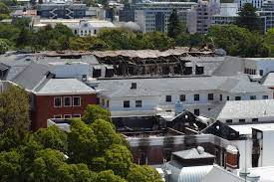
SAFE ACCESS ROUTE
100%
Complete
1
2
3
4
5
6
Stage 1
Stage 2
Stage 3
Stage 4
Stage 5
Stage 6
Engaged PSPs.
Gave detailed brief
Conducted assessments
Prepared execution plan
Assessed structural safety risk.
Mapped areas on layout based on colour coding
Stage not applicable
Demarcated unsafe areas & put signage
Prepared report
Prepared & signed off reports
01/03/2023
15/03/2023
23/03/2023

Slide 7
SAFE ACCESS ROUTES
Green: Areas with little to no damage. Access with standard PPE.
Yellow: Areas with minor non-structural damage and could have hanging obstacles or trip hazards.
Orange: Areas where there is either structural damage or potential for collapse ceilings, plasterwork and brickwork.
Red: These are NO-GO areas that are unsafe due to potential collapse of the loadbearing structures, brickwork or finishes. These areas may also be hazardous surface due to damp ingress that have caused excessive mold.

Slide 8
SAFE ACCESS ROUTES

Slide 9
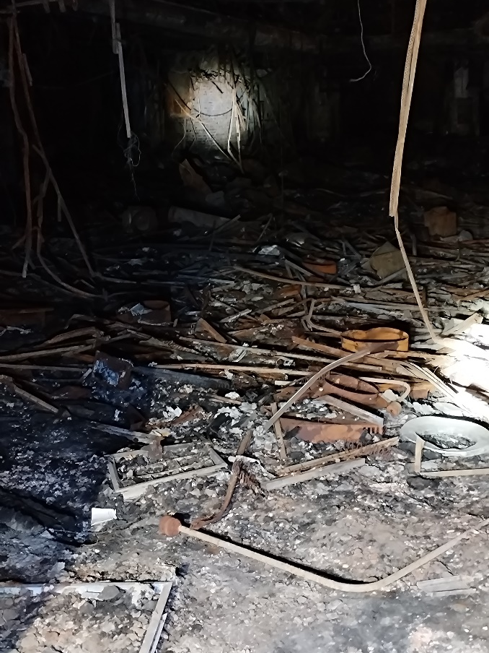
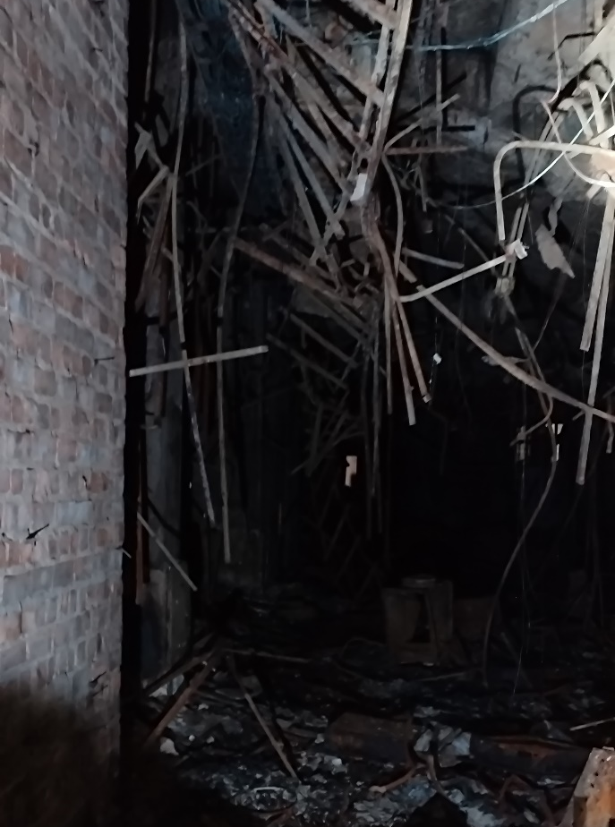
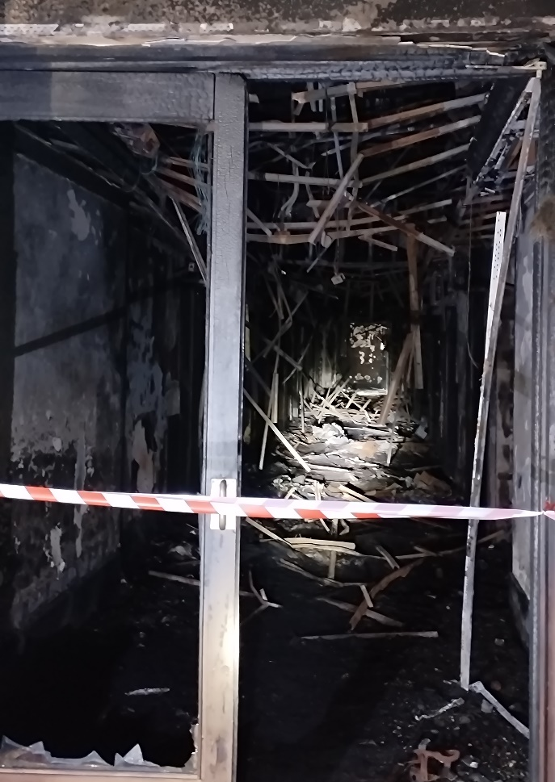
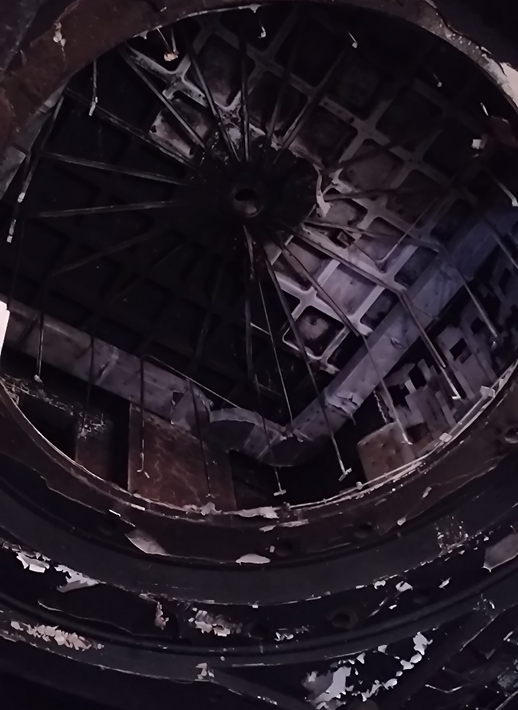

NO GO AREAS - RED

Slide 10
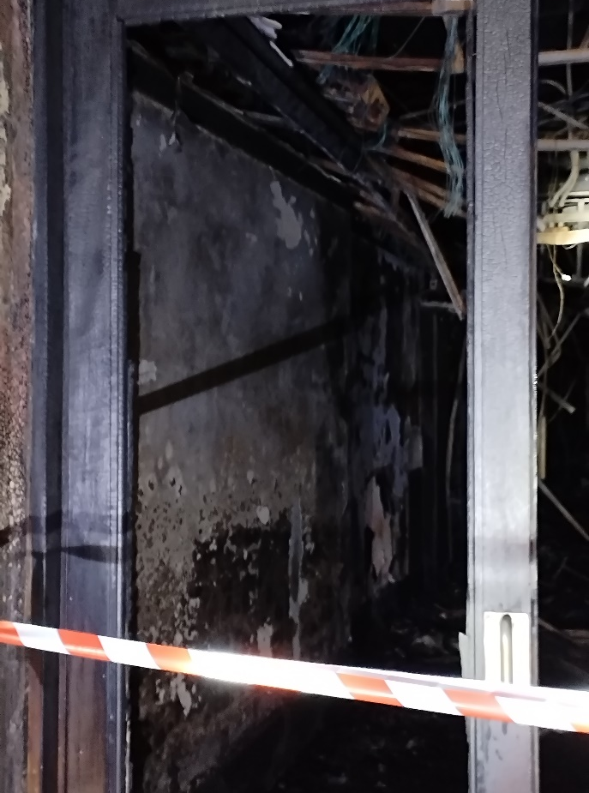
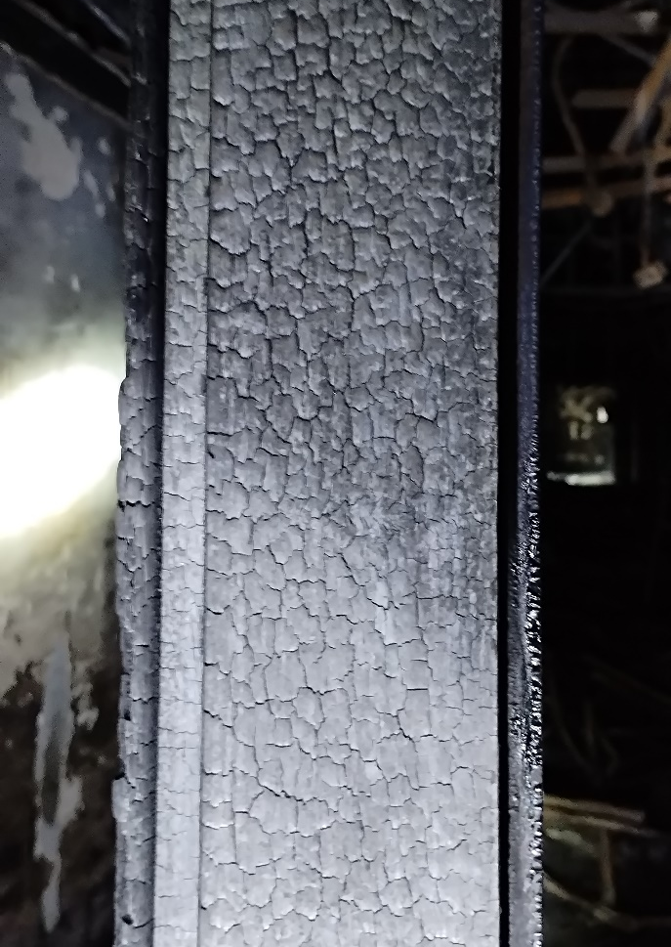
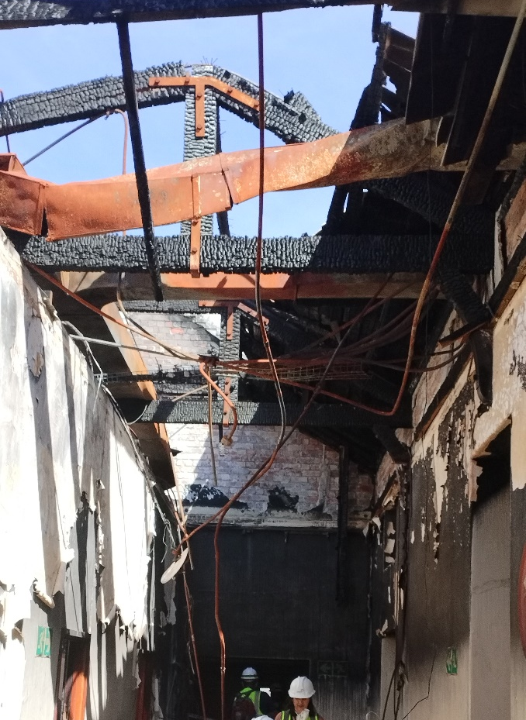
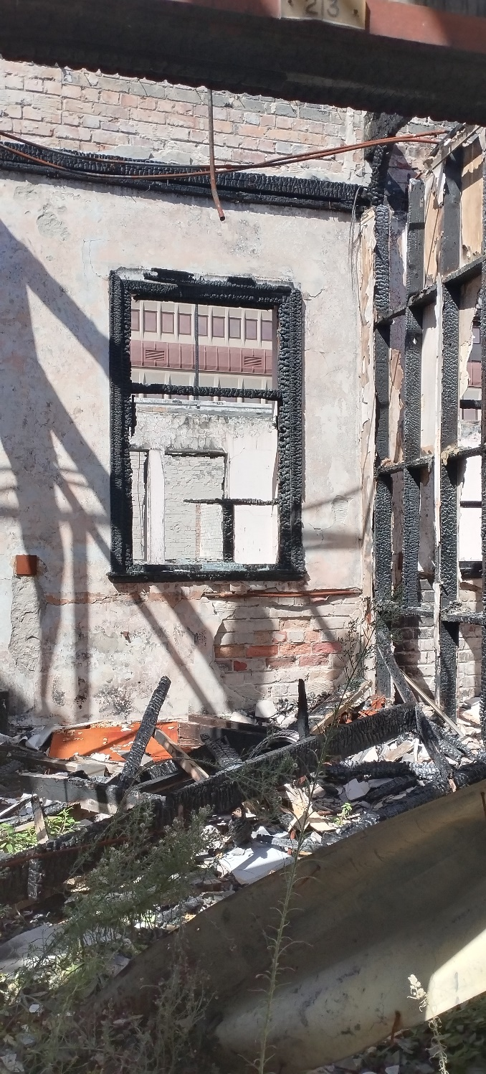
NO GO AREAS - RED

Slide 11
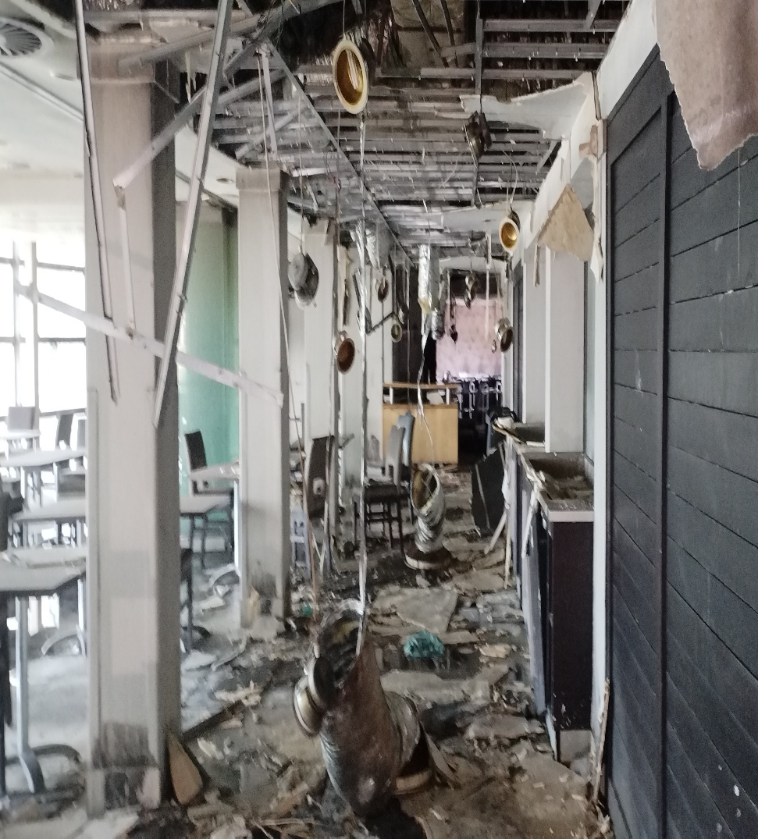
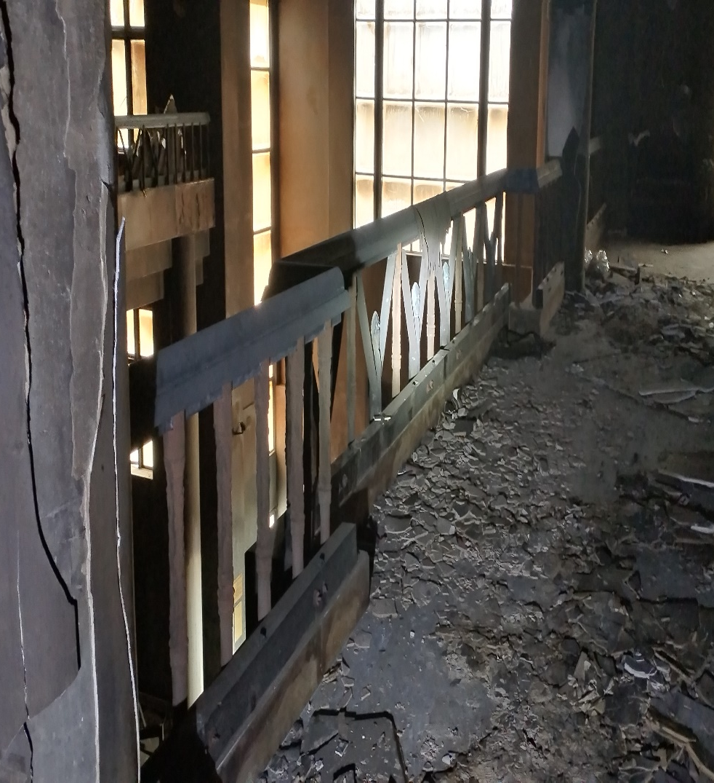

SAFE ACCESS ROUTES - ORANGE

Slide 12
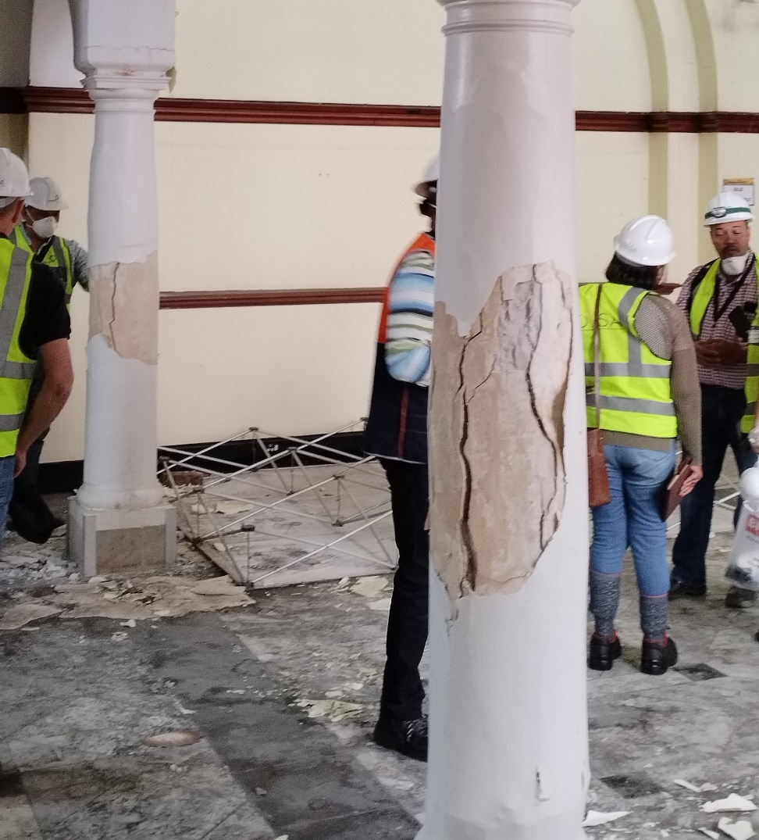
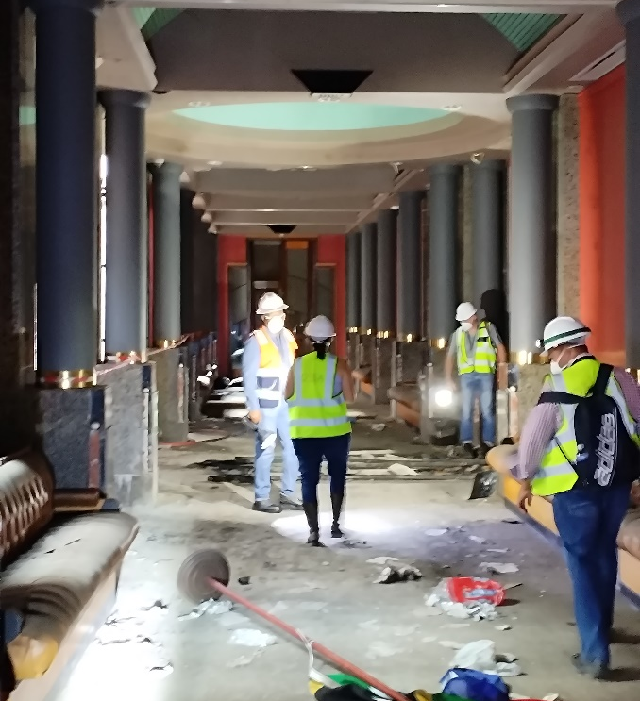
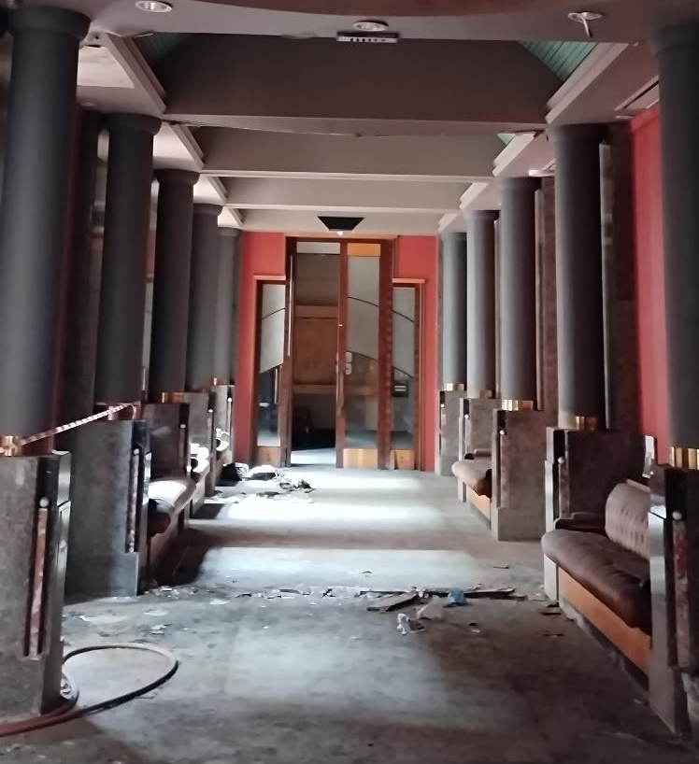
SAFE ACCESS ROUTES - YELLOW

Slide 13
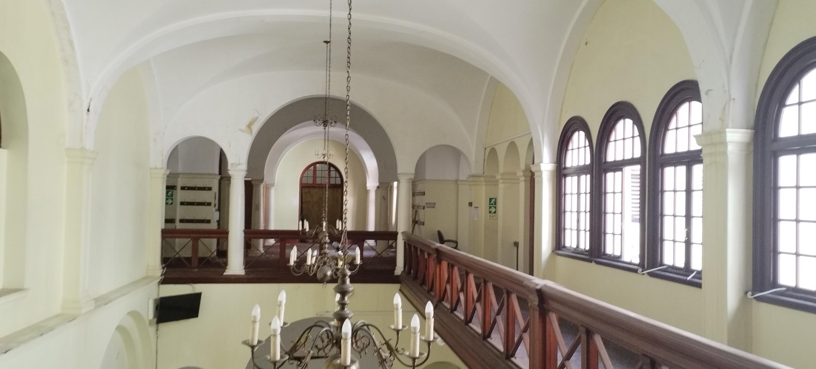
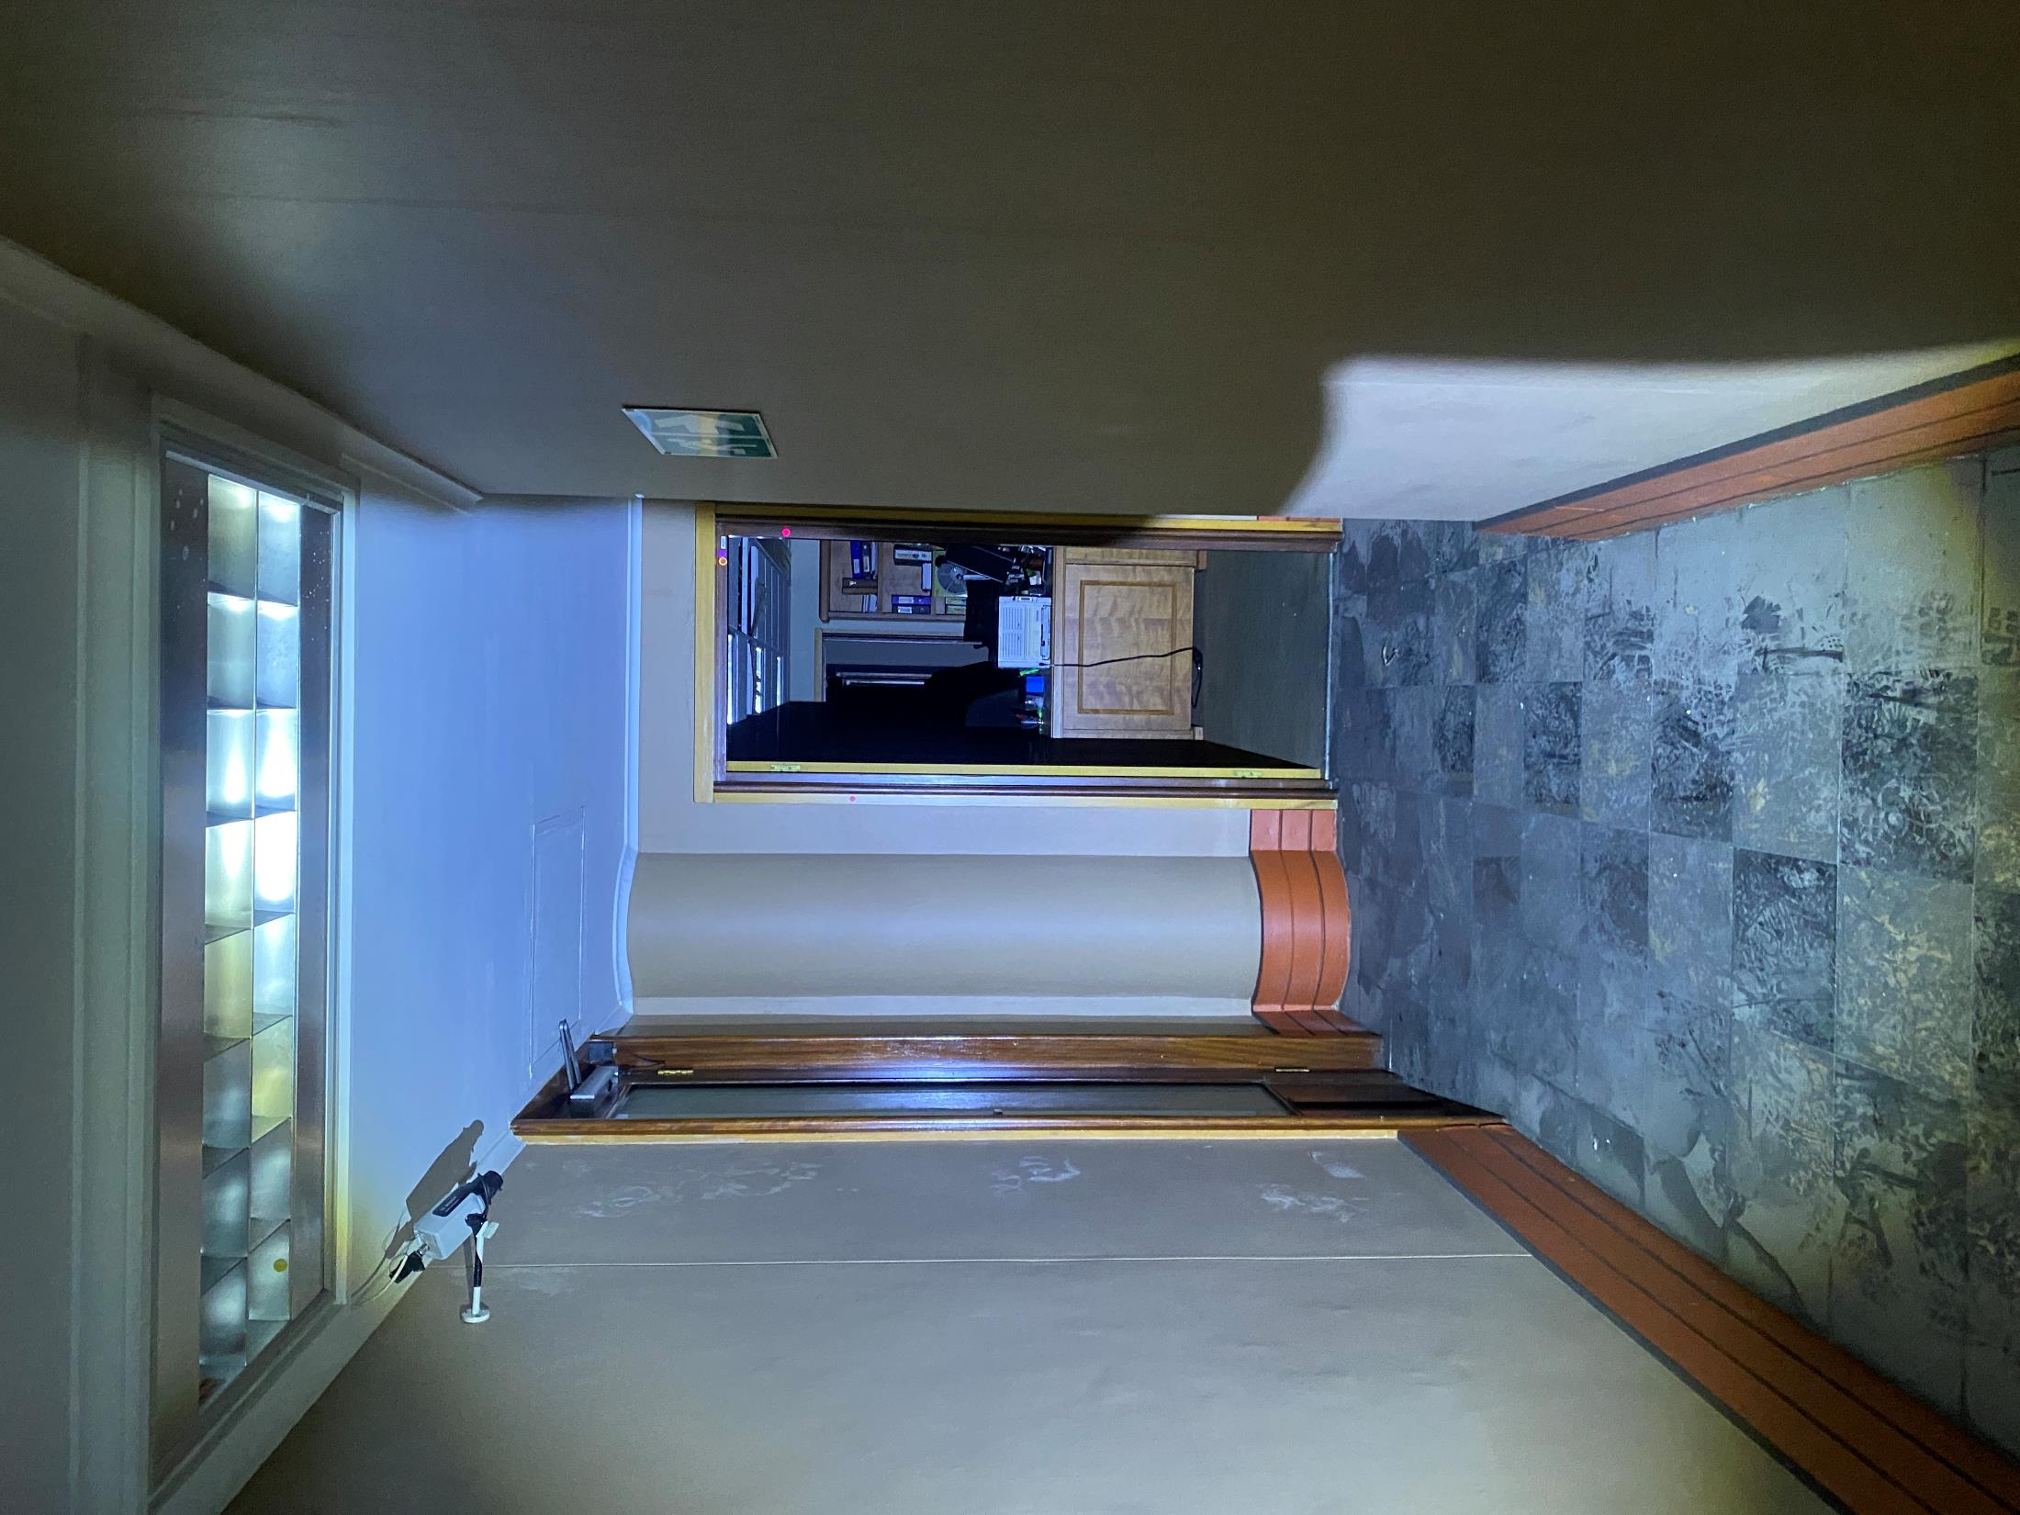
SAFE ACCESS ROUTES - GREEN

Slide 14
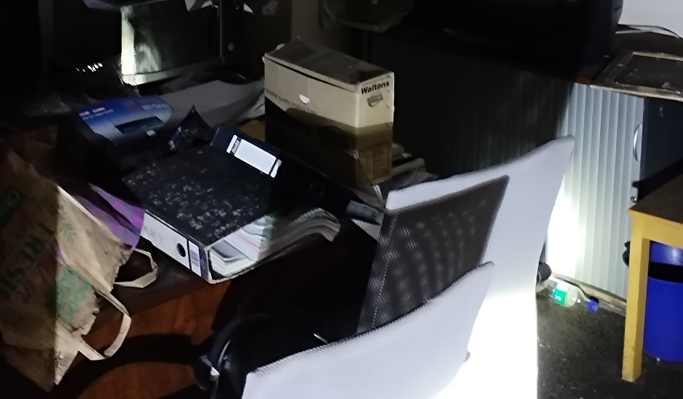
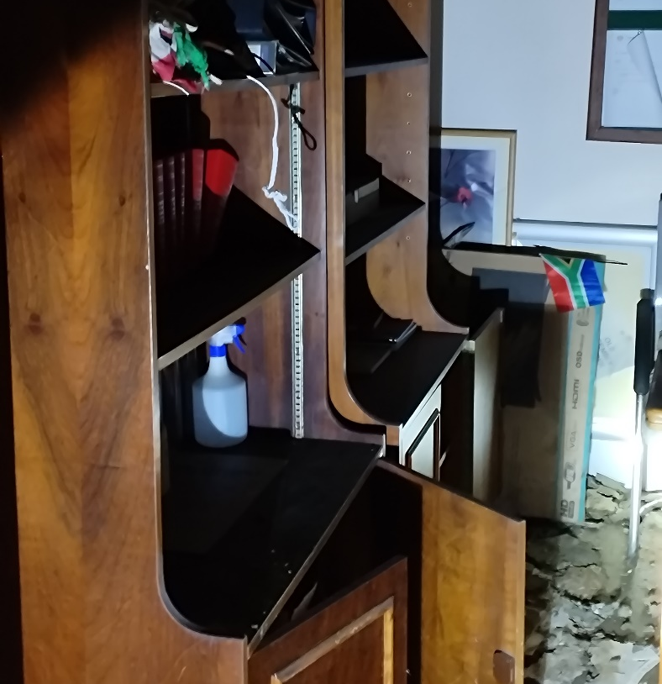
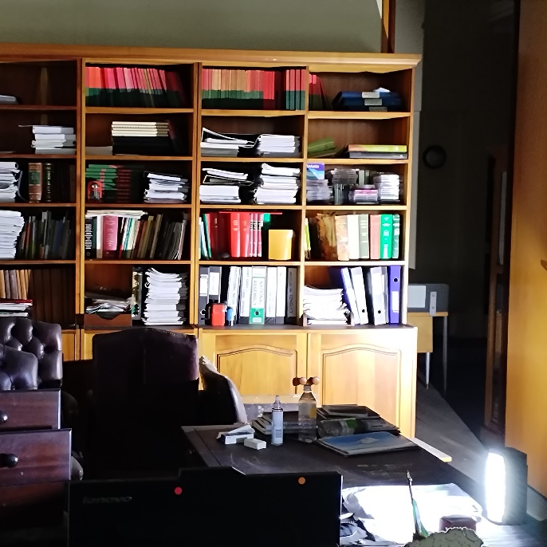
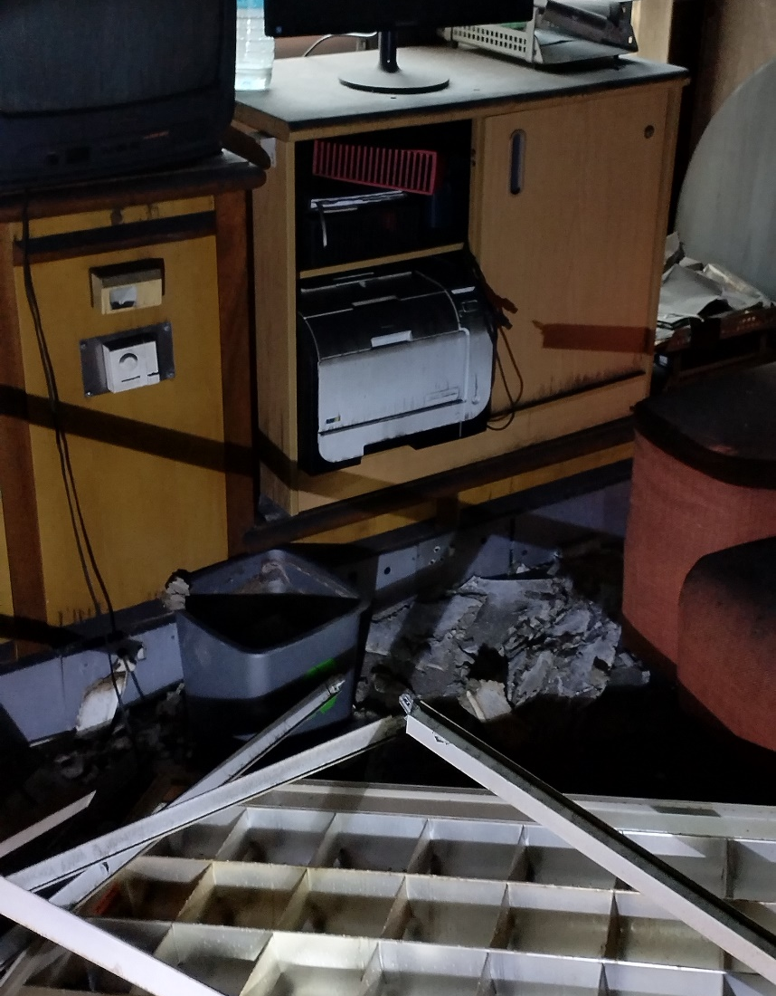
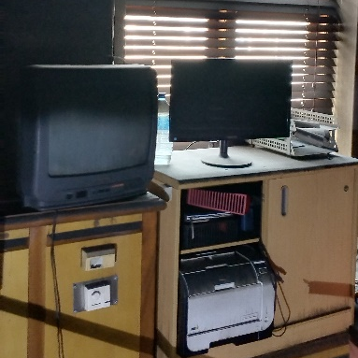
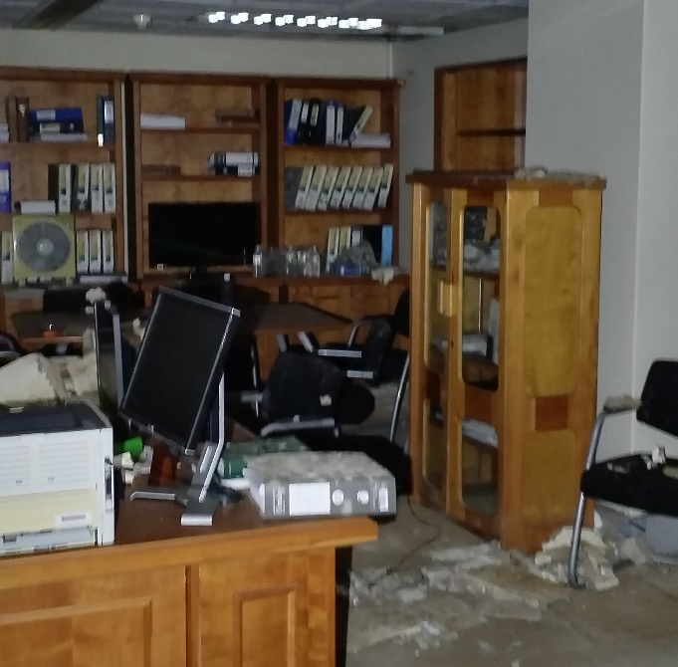
ASSETS VERIFICATION

Slide 15
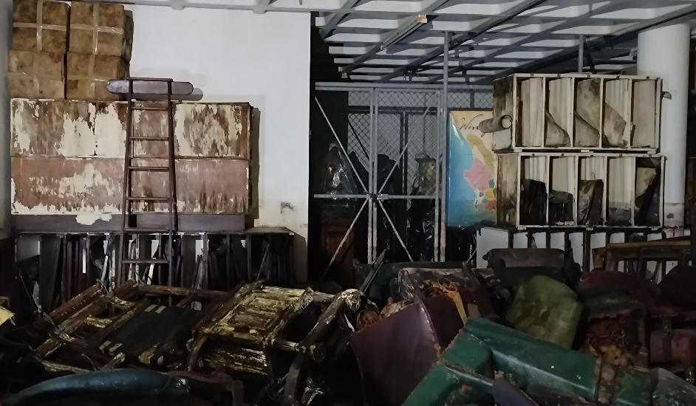
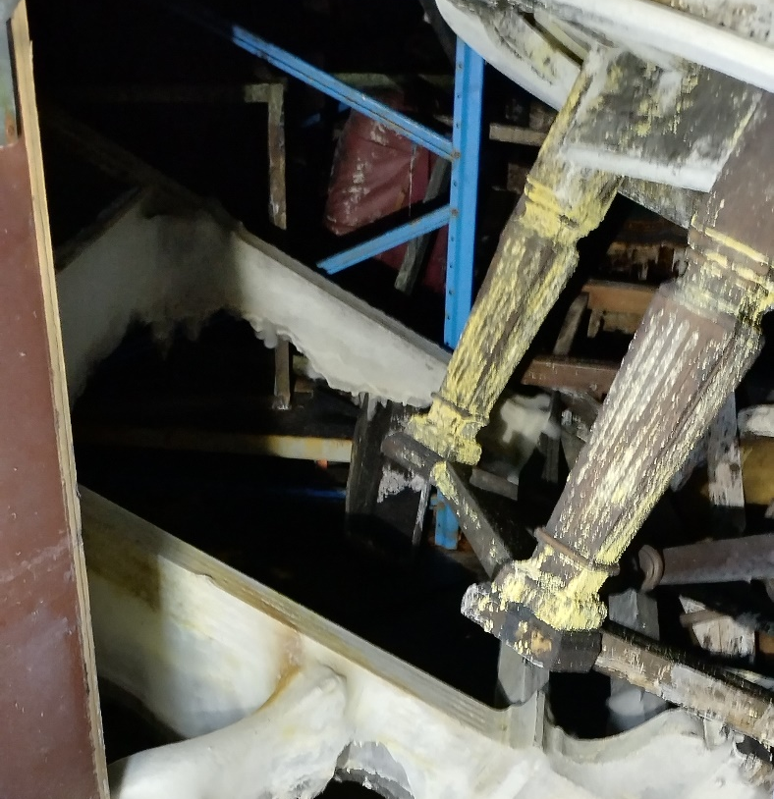
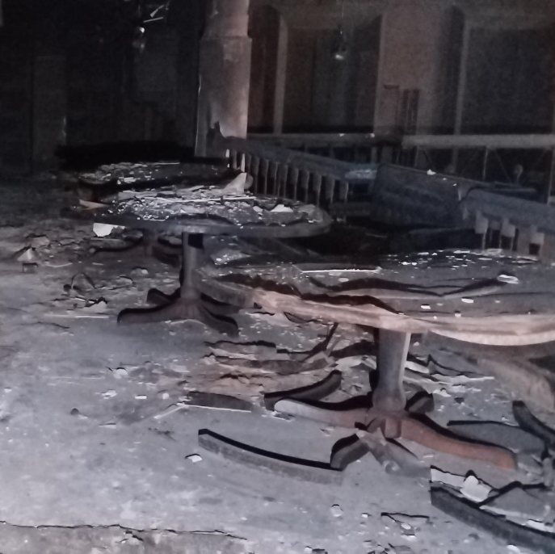
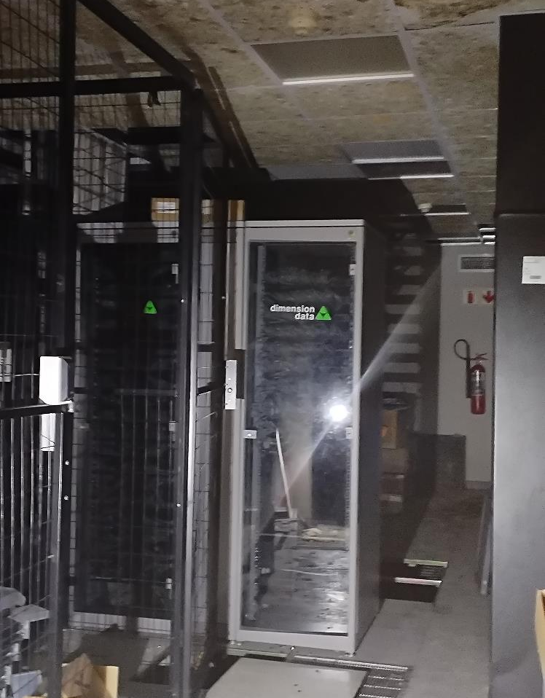
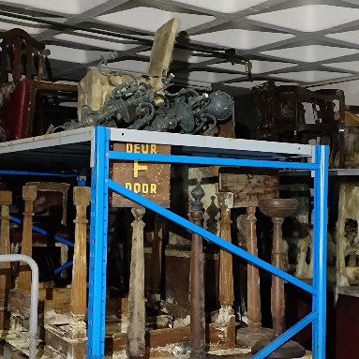
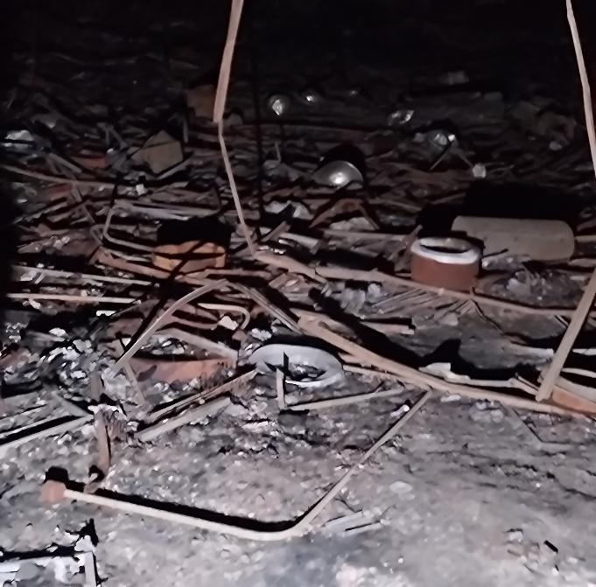
ASSETS VERIFICATION

Slide 16



KEY POINTS ON SAFE ACCESS ROUTES
Overall outlook
Risks and Issues
Safe access route complete
Asset verification commenced on 2/05/2023.
100% completed based on asset count
Not applicable as activity is complete
Resources deployed
Planned Activities
2 x Structural Engineers
1 x Health & Safety Specialist
Asset verification team:
  7 Asset Verifiers
  2 Accountants
Submit the asset verification report by 16/05/2023.

Slide 17
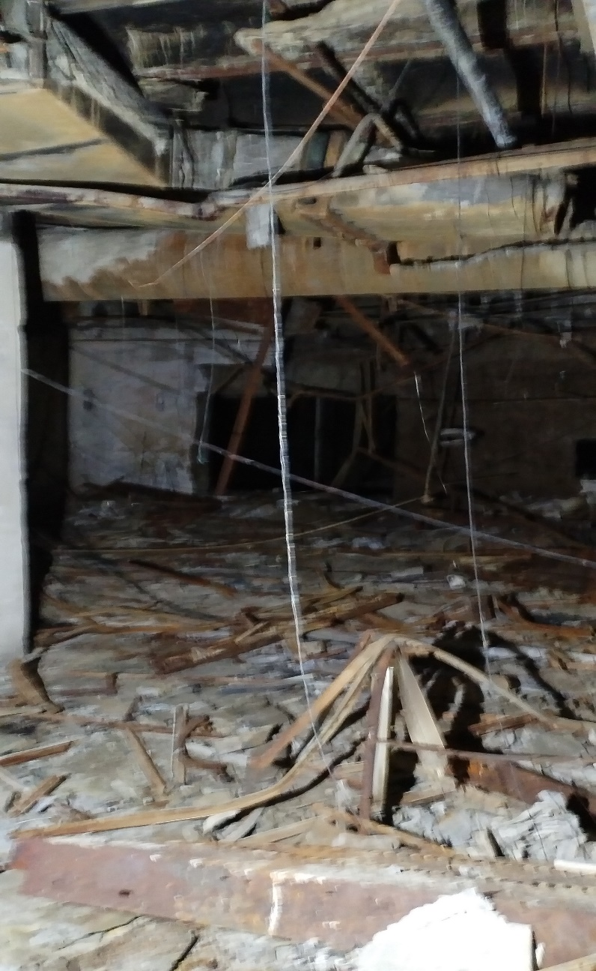
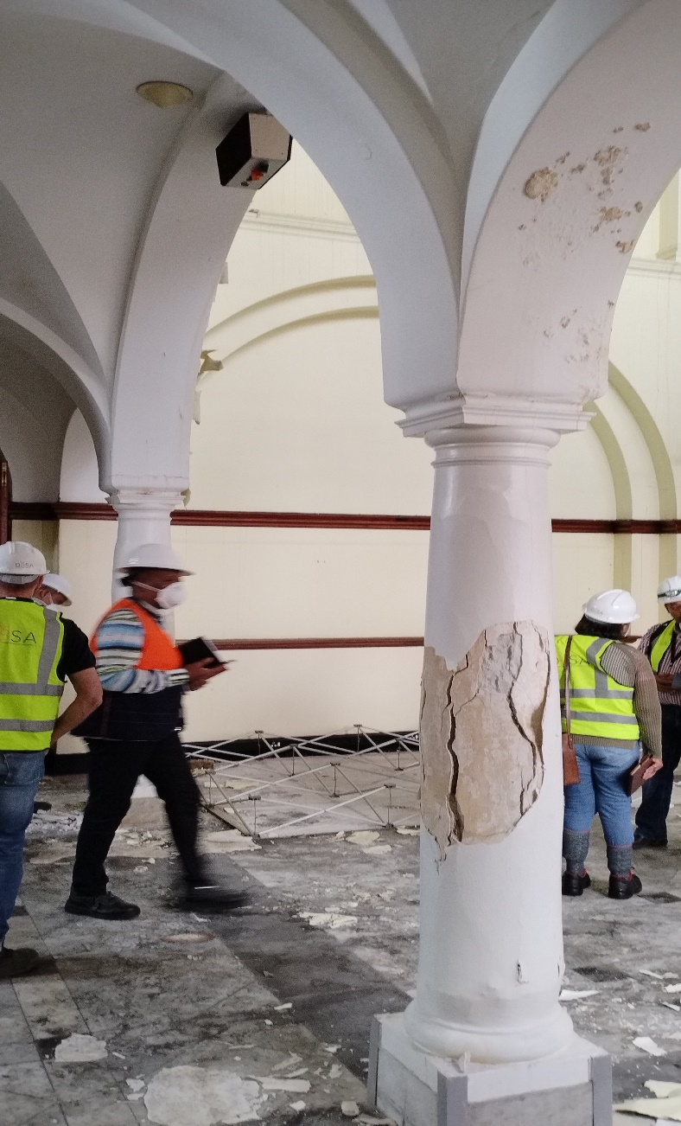
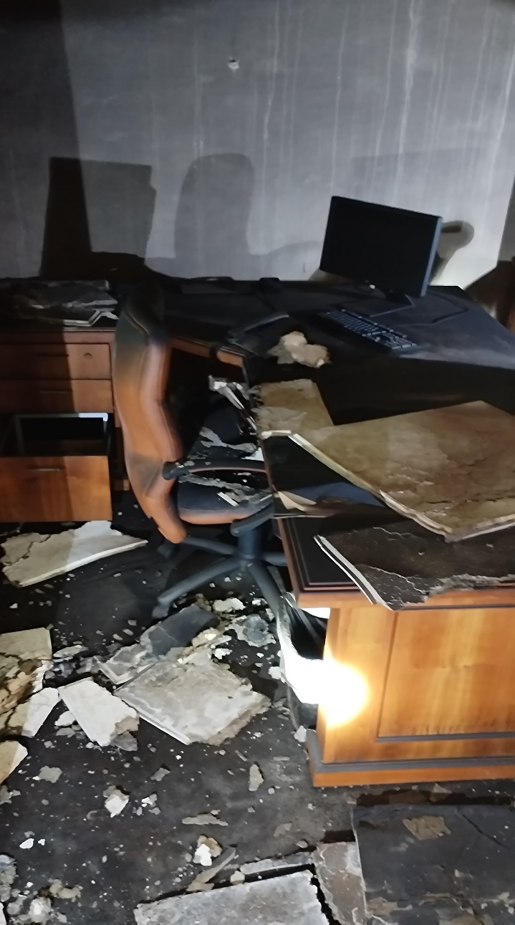
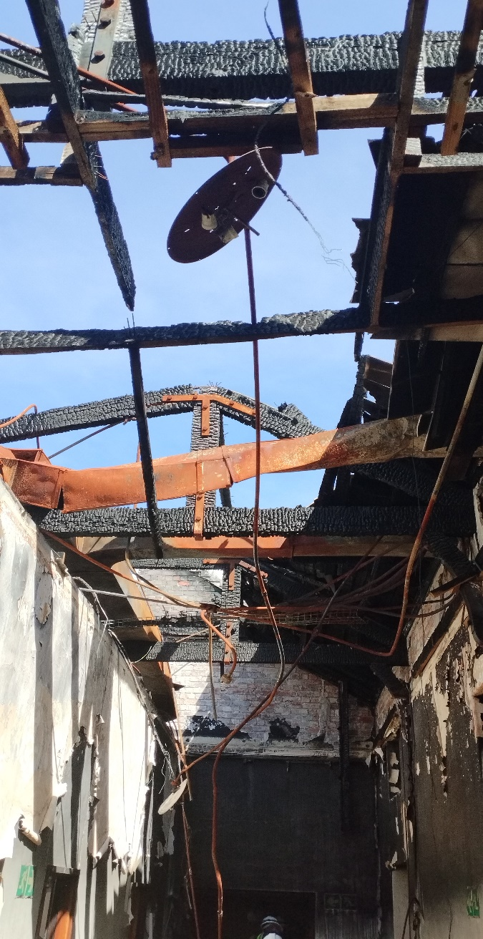
RUBBLE & DEBRIS REMOVAL & ALLIED WORK
Planning
Planning
Planning
Planning
Assessments completed
Columns deemed to be safe
Assessments were conducted & risks identified
Assessments completed
Design
Design
Design
Design
Engineering specifications & drawings developed
Not applicable
Design & documentation in progress
Safe access route mapped out
Removal
Repair Work
Construction
Execution
Start: 9 Jun 2023
Completion: 31 July 2023
To be done by roof contractor: 20 June to 26 June 2023
20 June 2023 to 17 Jul 2023
To follow Audit 20 Jun 2023 to 31 Jul 2023
Remove Rubble & Debris
Fix Columns
Remove Assets & store offsite
Install a temporary roof
APR
MAY
JUN
JUL
AUG
SEP
OCT
NOV
DEC
Rubble Removal
Repairs to columns
Temporary roof on Old Assembly
Recovery of Assets
Deliverables
Remove burnt fixtures, rubble, debris and scum
Rebar and concrete are intact. Only plaster required with bonding a agent
A mono pitch corrugated iron roof to be erected including window shields
To be carried out with rubble removal by a demolishing contractor

Slide 18


KEY POINTS ON RUBBLE & DEBRIS REMOVAL
Overall outlook
Risks and Issues
Walls and metals may collapse during removal. Demolishing contractor to be engaged.
Delays from security screening
On track
Attended to heritage requirements
Completed engineering specs
Resources deployed
Planned Activities
Work on 3D Scanning: 17/05/2023 to 26/07/20 23
Award bid for Rubble Removal on 9/06/2023
Construction: 20/06/2023
Completion: 31/07/2023
2 x Structural Engineers
1 Quantity Surveyor
1 x Mechanical Engineer
1 x Health & Safety Specialist

Slide 19
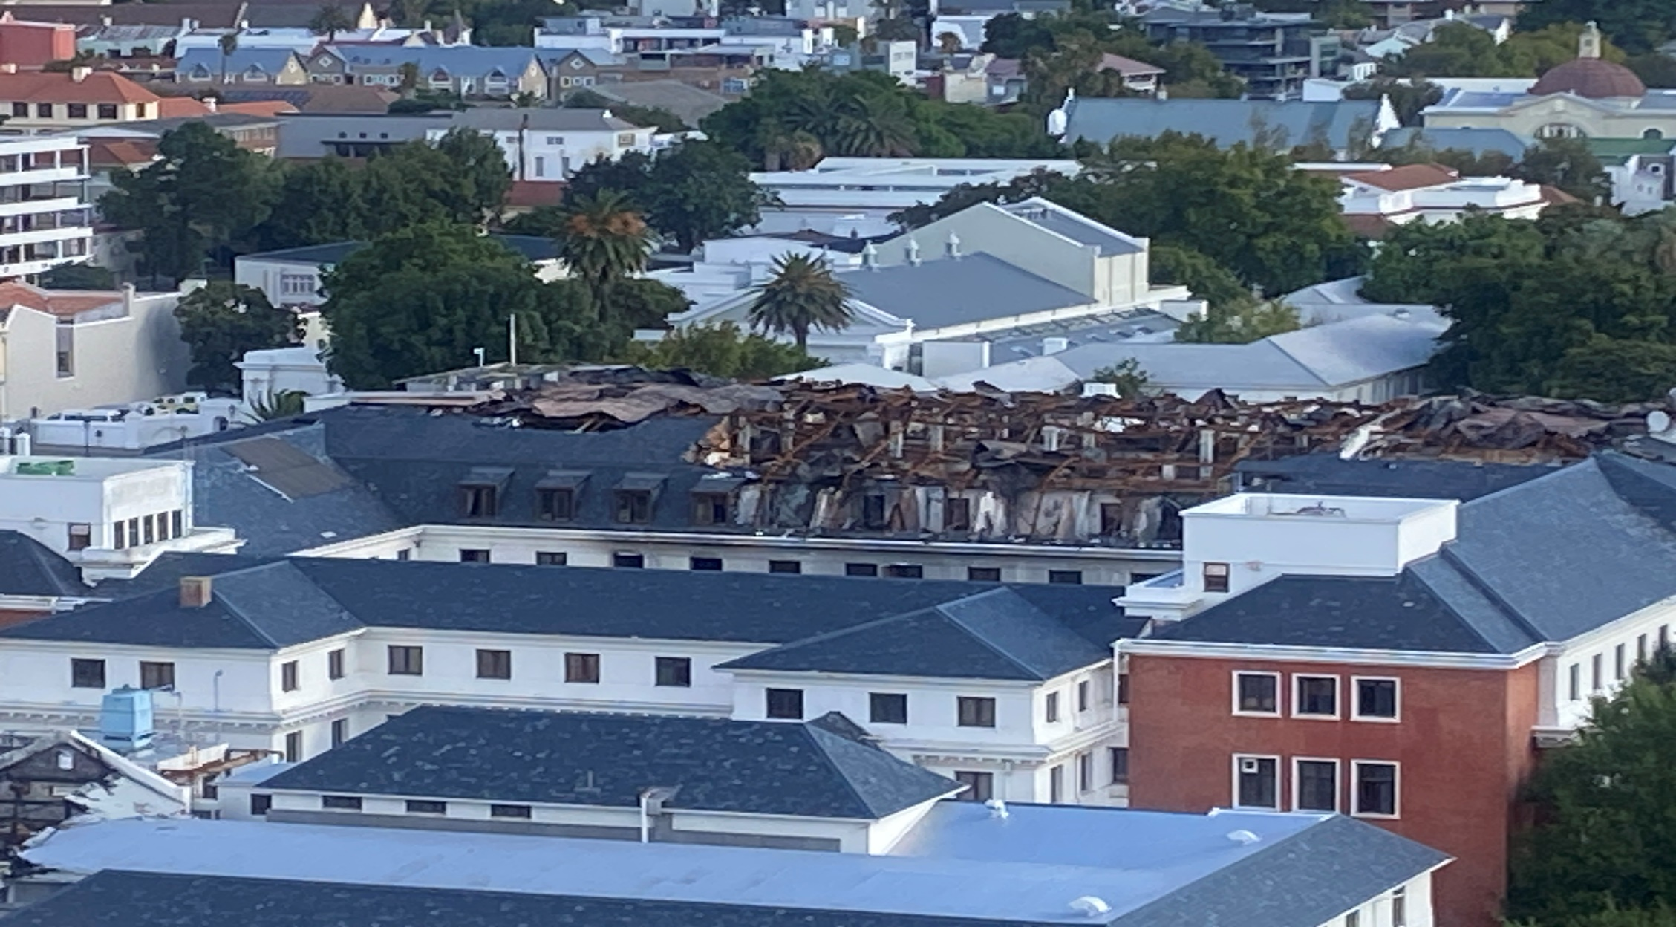
RESTORATION OF OLD ASSEMBLY & NEW WING

Slide 20

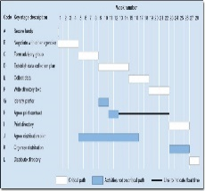
RESTORATION OF OLD ASSEMBLY & NEW WING
Overall outlook
Risks and Issues
1 week behind
Time to be recovered on evaluation stage
Heritage interest groups may interdict some activities.
Structural integrity of the New Win may be affected during demolishing
Resources to be deployed
Planned Activities
2 x PM/Lead consultants
2 x Architects
2 x Structural Engineers
2 Quantity Surveyor
2 x Mechanical Engineer
Electrical Engineer
1 x Heritage Architect
1 x Health & Safety Specialist
Appoint PSPs by 13/06/2023
Pre-qualify construction firms before documentation stage
Pre-qualified firms to compete on prices and B-BBEE
Site Handover: 4/12/2023

Slide 21

RECONFIGURATION OF 4TH & 5TH FLOORS
48%
0%
% Complete
Physical progress:
1
2
3
4
5
6
Stage 1
Stage 2
Stage 3
Stage 4
Stage 5
Stage 6
Engaged PSPs on 6/03/2023.
Gave detailed brief
Sourced as-builts
Conducted assessments
Presented options
Prepared layouts
Prepared execution plan
Prepared detailed designs
Prepared design reports
Prepared BoQs
Prepared tender documents
Advertised bid on shortened tender
Construction to start on 18/05/2023
To run on 3 shifts
Practical completion: 13//06/2023
Final account: pending
As-builts: pending
O&M Manuals: pending
Handover: 22/06/2023
1/03/2023
1/04/2023
1/05/2023
1/06/2023

Slide 22
KEY POINTS ON RECONFIGUARATION OF 4TH & 5TH FLOORS
Overall outlook
Risks and Issues
Delays from security screening
Behind schedule – due to HVAC options analysis
Tender issued on: 17/04/2023 & to close on 3 May 2023
Resources deployed
Planned Activities
1 X Architect
1 Quantity Surveyor
1 x Mechanical Engineer
1 x Electrical Engineer
1 x Electronics Engineer
1 x Health & Safety Specialist
Award bid on 12/05/2023
Construction: 18/05/2023
Completion: 13/06/2023
Handover: 22/06/2023

Slide 23
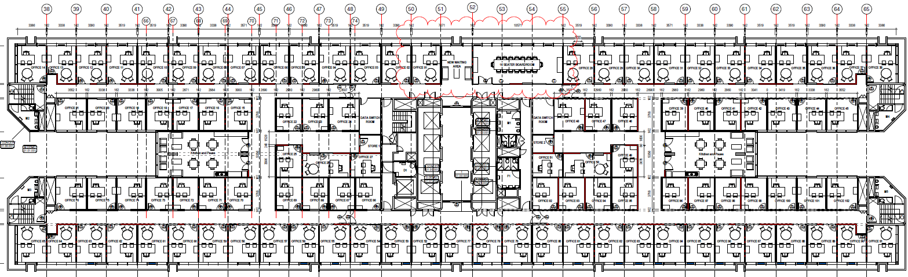
LAYOUT FOR 4th FLOOR OFFICES

Slide 24
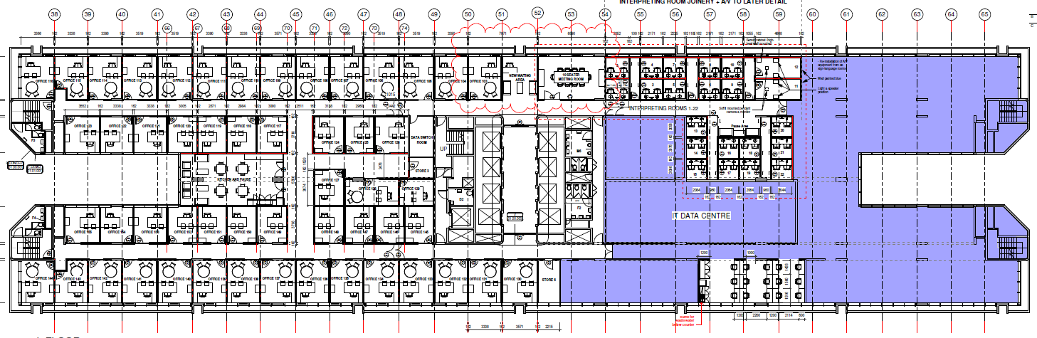
LAYOUT FOR 5TH FLOOR OFFICES

Slide 25
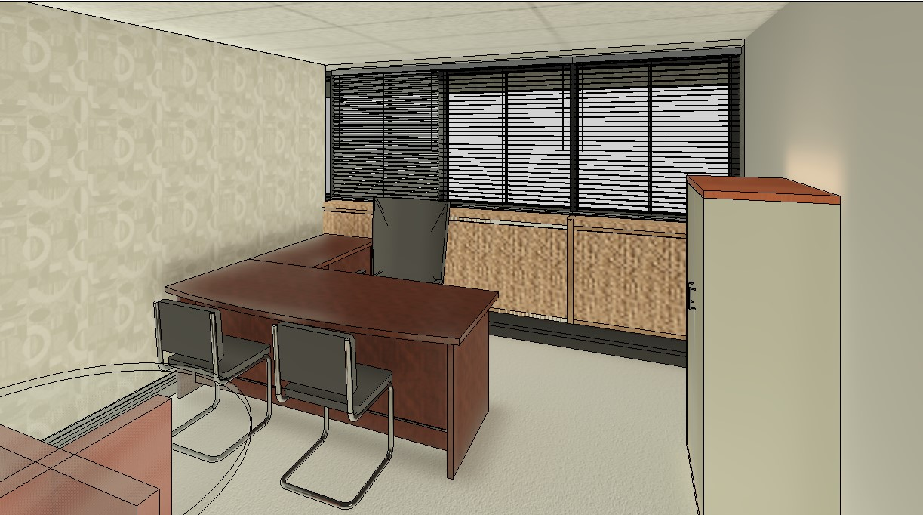
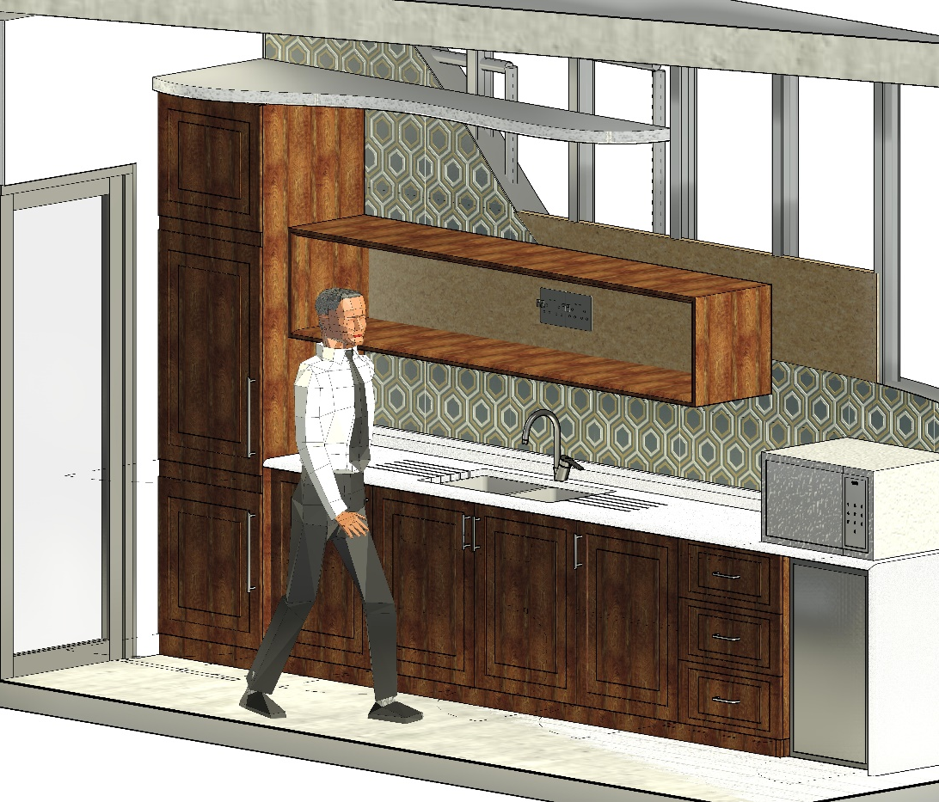
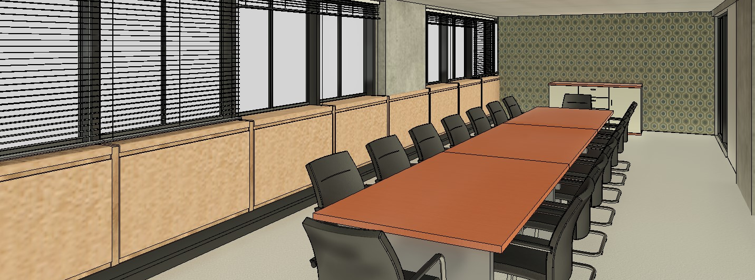
4th and 5th Floors Impressions

Slide 26
FURNITURE OUT ON TENDER
Current furniture on 6th floor
New spec out on tender for tender. Size limited by space

Slide 27
PLANNED AWARD VALUE FOR 4TH & 5TH FLOORS
Item | Budget | Projected 2023/24
Construction Costs | R55 978 600.00 | R55 978 600.00
Construction IA Fees | R2 519 037.00 | R2 519 037.00
New Office Furniture | R10 242 545.78 | R10 242 545.78
New Office Furniture IA Fees | R460 914.56 | R460 914.56
Total Excluding Fees | R69 201 097.34 | R69 201 097.34

Slide 28
MASTER PLAN FOR PARLIAMENT PRECINT
  Stage 1: Procurement of a Professional Team: 80% complete
    Project Manager / Lead Consultant
    Architect
    Heritage Architect
    Space/Urban Planner
    Interior Designer
    Quantity Surveyor
    Civil & Structural Engineer
    Electrical Engineer
    Mechanical Engineer
    Environmental Specialist
    Health & Safety Agent
  DBSA developed a concept document for the envisioned parliament precinct.
    Key domains include:
      Space optimisation
      Functionality of buildings
      Alignment to NBR
      Security in line with NKP dictates
      Green building concepts
      Alignment to transformative parliament theme

Slide 29
TRANSITIONAL AND LONG-TERM ARRANGEMENTS
  Working with NDPWI on TFM for transitional arrangements and handover for long term.
  Heritage Agreement to be established with SAHRA.
  Continue to work closely with SAHRA and Western Cape Heritage.
    To prepare a Heritage Conservation Management Plan which will reduce the need for permit applications for future maintenance and minor works.
    Get quick approvals on reconfiguration and upgrades to burnt buildings and introduction of new themes.

Slide 30
PROGRAMME GOVERNANCE
The Programme will be managed based on the following governance framework:
  Joint Standing Committee on Financial Management of Parliament for Oversight.
  Project Steering Committee comprising DGs of Parliament, National Treasury, DPWI and Senior Management from Parliament.
    Provide strategic direction and oversight.
  Technical and Compliance Committee.
    Review and approve project implementations plans.
    Adjudicate and approve variation orders and extension of time claims.
    Provide guidance on contractual dispute resolution.
  An independent Gateway Review Committee comprising sector experts as required by the National Treasury.

Slide 31
FINANCIAL IMPLICATIONS
R118 Million is committed for the 2023/2024 financial year which will include office accommodation and ancillary work.
R2 Billion is the estimated project cost for restoration work.
DBSA submitted projected cash flows.
These give indicative budgets and set a baseline.
The cash flows exclude work on the master plan and TFM as the process require extensive stakeholder consultation and engagement with NDPWI.
The project management fees of 4.5% of the total project cost for the implementing agent.

Slide 32
Thank you!

