Slide 1
CSIR support to the DSI Advanced Manufacturing Strategy (AMTS) and related initiatives on the future of production
12 May 2023

Slide 2
Scope of CSIR’s manufacturing activities
CSIR is actively supporting the DSI in its Advanced Manufacturing Technology Strategy
  Hosted Programmes
    Collaborative Programme in Additive Manufacturing (CPAM) {DSI initiative}
    Technology Localisation & Implementation Initiative (TLIU) {DSI initiative}
    National cleaner production technologies {DTIC initiative}
    National Foundry Technology Network {DTIC initiative}
    Aerospace Industry Support Initiative (DTIC initiative)
  Technology development
    Advanced Materials & Manufacturing Programme (AMP)
    Aeroswift metal additive manufacturing platform
Technology diffusion/ extension
  Learning Factory {CSIR initiative}, financially supported by Merseta (and not DSI directly), aligns to some of the objectives of the AMTS, including the DSI Technology Stations initiative

Slide 3
Hosted Programmes: Collaborative Programme in Additive Manufacturing (CPAM)

Slide 4

CPAM Strategic Objectives
Manage implementation of this strategic initiative on behalf of the DSI (Hosted Programme)
  Leverages CSIR expertise for active management of KPIs
  Direct (agile) technical support available to beneficiaries
  Utilises existing CSIR support structures that are aligned to the PFMA
Advance the knowledge base in South Africa in selected focus areas of aligned with the SA Additive Manufacturing (AM) strategy.
Increase the Technology Readiness Levels (TRLs) of AM to ease adoption by industry.
Development of Human Capital
New, industrially relevant, knowledge generation aimed an increased AM industry in South Africa
Focus areas
  Metal AM value chain
  Polymer AM value chain
  Design for AM
  Industry Development

Slide 5

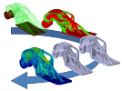

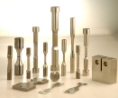
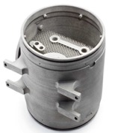

CPAM Phase 3 – Metal AM program & Polymer AM
Material
Markets
Design
AM process
Post processing
Testing and certification
- Powder characterisation
- New Ti alloys, MMCs, Nano composites
- Powder recycling / reconditioning
Powder production (PGMs), spheriodisation
South African produced polymers
alternative materials / composites
biocompatiable materials for PAM
South African sand for applications in the casting industry
- Design approaches
- Support structure strategies
High speed AM
Scaffolding structures
- Process monitoring
- DED Process optimization
- Process dev new alloys
PGM processing
New laser sources for PAM
- Medical implants / Dental prosthetics
- Wind turbine parts
- Acid resistant & impact resistant parts
- Heat exchanger / Energy app
- Automotive engine comp.
- Railway components
- Rocket motor comp.
- Applications of PGMs, Pt
- In-situ stress relieve
- Electro polishing
- Vibratory polishing
- Centrifugal barrel polish
- HIPing
- Laser shock peening
- Upscaling studies
- Effects of post processing on fatigue properties
- HT studies of new alloys
Post processing of PGMS
Post processing and surface finish improvement
- Mechanical testing
- Accelerated
Qualification process
- NDT for qualification
- Design of material supply chains to support qualification
- Process modelling
- Development of predictive models for materials properties
- Understanding the effect of defects
- Understanding fatigue / fracture mechanisms
- Process environment effects on metal AM
Notes:
Materials:
Ti6Al4V; Ti5Al3V;
Cr-Mo-Co;
Ti-Cu; NiTi;
Ni based alloys; Stainless steel, 17-4 PH
Al alloys (Al10SiMg; Scalmalloy; AlSi12 alloys), PGMs (Pt)

Slide 6
CPAM Phase 3 – Design for AM program
Design and Engineering analysis capabilities
Novel design approaches
Design rules for AM
DfAM – Application development
FEA as design tool
Comparative analysis of topology optimization approaches for functional mechanical components manufactured with AM
Design rules for AM in tooling
Tooling and casting applications
Reverse Engineering
Optimisation of support structures for metal AM and HSAM
Medical implants and prosthesis
Evaluation of design software systems
Prismatic and biomimetic design approaches
Aerospace applications
Lattice and scaffolding structures for AM
Biomedical engineering
Light weighting and structural reliability
Transport applications
Development of design for AM courses
Workshops
Renewable energy applications
Quality assurance and techno economic assessment frameworks

Slide 7

CPAM Phase 3 – Industry Development Program
Pre-industrial AM Platforms
Material and AM safety
Industrialisation of AM
RAPDASA support
Framework of implementation of AM in Aerospace industry
Physiological effects of AM materials and AM processes
Development program for low cost AAVs
Annual Conference
Ti Seminar
Sand casting technologies
Localisation of feedstock
SA design approach for sand moulds
Financial model for AM in SA foundries
Industrialisation framework, metrics for AM
SMME support
Access to AM design and production expertise facilities

Slide 8

CPAM KPIs Phase 3
Category | CPAM Phase 3 (Y1) Contractual target | 2020/21* | 2021/22* | CPAM Phase 3 (Y2) Contractual Target | 2022/23*
Students supported (PhD level) | 22 | 24 | 33 | 19 | 31
Students supported (M level) | 41 | 60 | 60 | 34 | 50
Students graduated (PhD level) | 1 | 0 | 4 | 5 | 2
Students graduated (M level) | 15 | 10 | 10 | 22 | 15
Papers published | 24 | 38 | 51 | 37 | 34
Conference papers presented | 48 | 49 | 61 | 44 | 42
Technology Demonstrators | 8 | 0 | 6 | 18 | 4**
Process documents | 8 | 6 | 2 | 12 | 0
Patents | 1 | 0 | 0 | 1 | 0
* Only students with Proof of Registration / Graduation approved by DSI
There are students who have graduated, but for who graduation ceremonies will happen in later 2023
** More are in the pipeline, waiting confirmation letters from HEI TT offices

Slide 9
CPAM Highlights
Created broad skills base & AM ecosystem
  Design for AM
  Ability to modify existing AM machines – EOA conversion to make platinum jewelry
  New AM materials – sand, platinum, polymers
  Materials analysis capability
  RAPDASA (Rapid Prototyping Association of SA) – one of oldest AM conferences
  Substantial student involvement & Bursaries (±100 pa)
New manufacturing capability
  Platinum jewelry
  Medical AM – MedAdd at CUT
    Dental implants
    Maxio-facial implants
    Spinal implants
    NRF awarded a SA Research Chair in Medical Products awarded (May 2023)
Notes:
Pics of Aditiv, platinum ring, Cut medical (it will be covered under DSI TSP)

Slide 10
Future of CPAM
Present contract (signed in Nov 2022) runs up to end of Dec 2024
Intention is to keep the focus on the opportunities identified in the SA AM Roadmap approved by DSI in 2016, however strengthening the following aspects of the program:
  Accessibility.
  Industry participation.
  Industry support.
  Post graduate support.
Notes:
Accessibility.
It is a proposed to rather move CPAM to a competitive open call for proposals in specific focus areas with a strong independent review process (academic and industrial) to support funding decisions made by CSIR on which projects to support.
Industry participation.
At the start of Phase 3 plans were proposed to have a program focused on Industry lead projects. Due to budget constraints this could not be implemented. It is proposed that this be formally launched in a next phase.
Industry support.
Strengthen the SMME support program further with learnings from the Industry Connect Impact Area in the Manufacturing Cluster, to increase the direct industrial impact of CPAM.
Post graduate support.
Presently the program is constructed around post-graduate research projects, addressing the full value chain of metal and polymer AM. Going forward a mechanism needs to be developed to keeping on supporting the post-graduate students involved, and continue building the HC pipeline.

Slide 11
Aeroswift

Slide 12
Aeroswift Objectives
The development of the Aeroswift technology for metal additive manufacturing started with the intention to expand the local capability in an emerging field of advanced manufacturing
The initial intention was to apply the technology within the aerospace sector but the rapid maturity of the technology and the adoption rate in industry has created opportunities in multiple sectors
The key focus for Financial Year (FY) 2022/23-2023/24 is to move into industrialisation of the Aeroswift technology by putting the product into the market, focusing on the following 3 objectives:
  System maturity management;
  Product development and preproduction machine design validation; and
  Business model finalisation and preparations for the pre-product machine manufacturing and qualification.
Additional KPIs
  Support undergraduate and postgraduate students
  Develop IP (Mature and apply the intellectual property in the pre-production version)
  Disseminate knowledge through publications and conferences
  Establish a network of key stakeholders

Slide 13
Aeroswift Implementation Plan
Make Aeroswift technology more reliable/robust through simplifying the maintenance processes. ​
Develop a modular reactive (?) pre-production Machine​
‘AM on demand’ or ‘AM as a Service’ Business model requires a larger, consistent market demand​. This is being explored.
Niche customer demands will be met through optimised custom machines for the required application. ​
Lead-users for Aeroswift technology is being finalized.

Slide 14

Route to Industrialisation/Commercialization
Define User Requirement Statement
Industrial Machine Development
Provide Ecosystem Support
Industrialisation Partner build and deliver local machines to newly developed markets
Support new companies based on :
    Diagnostic services
    Lasers
    Scanning/Delivery Systems
    Monitoring Systems etc.
Terms of reference based on DSI investment
Market & Business Plan development
Design Specification
Bill of Quantities/Material
Production scheduling
Manufacturing
Evaluation & testing
Publication
Information sessions
Evaluation
Appointment of Industrialisation Partner
Prepare publication for request of OEM Agreement
Established Markets for local MAM
Industrialization Plan
Commercialization Partnerships
Demand Creation & Market Growth
Build up sufficient volume and mix of parts to be financially viable for SMME
Use existing locally available commercial systems
Targeting multiple industries

Slide 15
‘Go to Market’ Plan
Automotive
Aerospace
Chemicals
Mining and OEMs
Maritime

Slide 16
Aeroswift KPI Achievements
 | Plan 2021/22 | Achieved 2021/22 | Plan 2022/23 | Achieved 2022/23 | Comments
Support of undergraduates and interns | 2 | 3 | 2 | 2 | 3 interns were dedicated to the project for mechanical & electrical support (1 resigned)
Support of Masters students (staff) | 2 | 2 | 1 | 1 | 3 M student fully supported by AEROSWIFT. 2 graduated in 2021 and were absorbed to full time staff
Support of Doctoral students (full-time) | 1 | 1 | 1 | 1 | 1 D student on DST-NRF scholarship
Support of Doctoral students (staff) | 3 | 3 | 4 | 4
IP: granted patents | 1 | 0 | 1 | 2 | Preheating of materials in AM Apparatus patent granted in USA and Japan
Technology Demonstrators | 2 | 0 | 0 | 0
Peer-reviewed journal publications | 3 | 3 | 2 | 2
Peer-reviewed conference presentations | 4 | 4 | 3 | 3
Collaboration network (Int) | 3 | 2 | 3 | 3

Slide 17
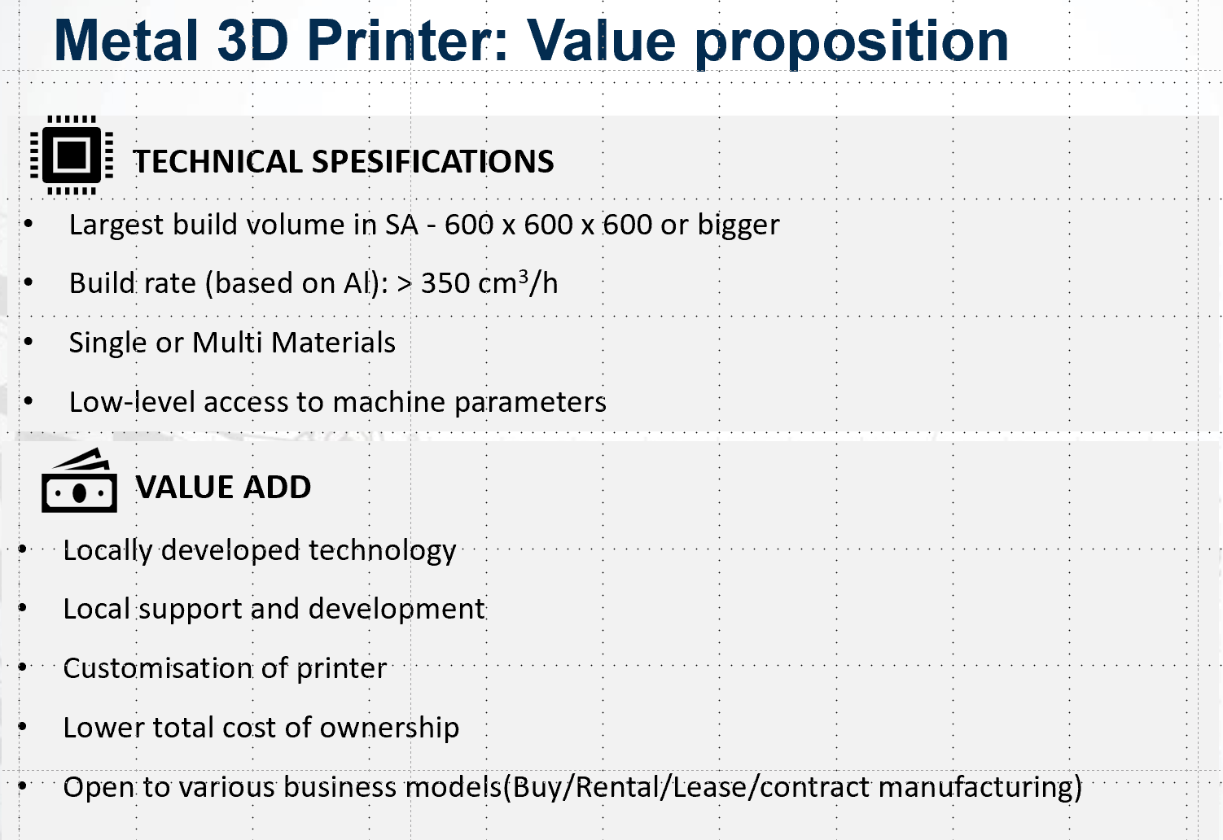
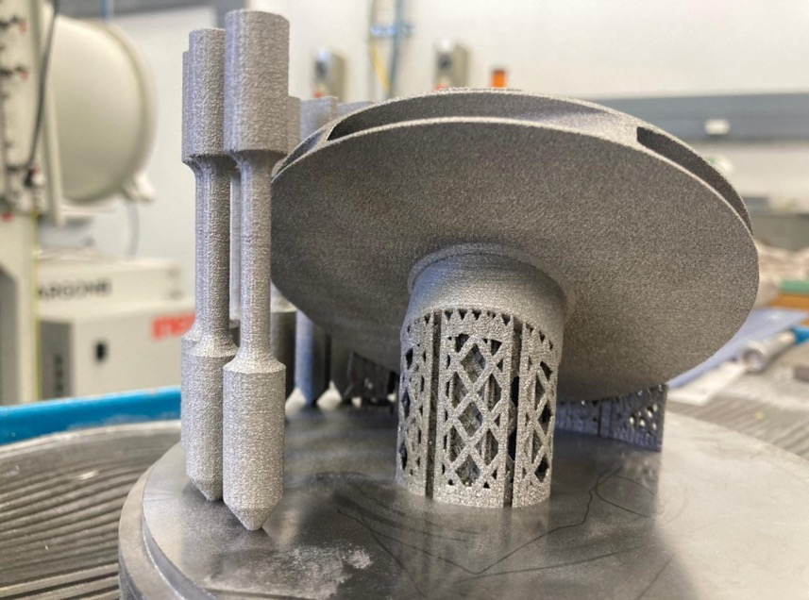




Future of Aeroswift: Commercialisation
Expressions of commercial intent from
Notes:
Check spelling of “Specifications”
‘Single or multi materials’ – rather say ‘able to be used for a variety of metal materials’

Slide 18
Advanced Materials & Manufacturing Programme (AMP)

Slide 19
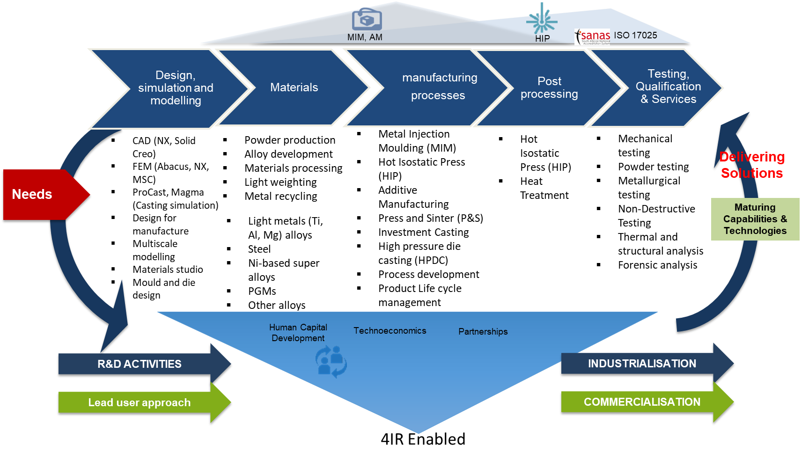
AMP Intent
Design, develop, manufacture and test metallic materials, mill products, components and manufacturing systems through powder metallurgy, casting and fabrication processes. Provide tailor made innovative solutions for government and industry across the whole value chain of metal extraction to final manufactured products

Slide 20
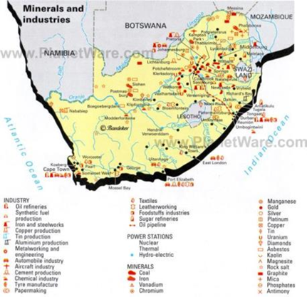
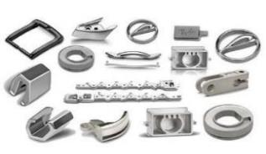
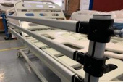

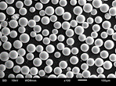
AMP Objectives
Value addition/Downstream beneficiation of strategic minerals/materials through;
Product development, localisation & competitiveness improvement
Establishing high end/smart infrastructure/facilities for skills development, training and as pillars for Manufacturing as a Service (MaaS)
Assisting SMMEs by launching industry incubation platforms that produce feedstocks, components and systems for various sectors
Offering material development, design, testing and qualification expertise to industry
Human Capital Development

Slide 21
AMP KPIs
Table for KPI Targets (2022/23-2024/25)
Key Performance Indicator | Targets: 2022/23 | Targets: 2023/24 | Targets: 2024/25 | Total Targets/ 3yrs
Industry Facing Outputs and Outcomes
KPI 01: Number of Companies/SMME supported (Service, R&D, Consultancy) | 6 | 15 | 30 | 51
KPI 02: Number of Technologies commercialised | 0 | 2 | 3 | 5
KPI 03: Number of Industry people trained (manufacturing activities) | 2 | 5 | 9 | 16
KPI 04: Number of SPV formed or Incubated (companies incubated or spun out) | 1 | 1 | 2 | 4
KPI 05: Number of piloting and scaling up activities | 2 | 2 | 4 | 8
KPI 06: Number of localised technologies | 1 | 2 | 2 | 5
KPI 07: Number of SMMEs day hosted (networking with industry) | 3 | 6 | 6 | 15
KPI 08: Number of business cases developed | 1 | 0 | 2 | 3
Research Development and Innovation Outputs
KPI 09: Number of Masters/PhDs students or Post docs supported | 7 | 8 | 8 | 23
KPI 10: Number of Publications(Articles and conferences) | 7 | 10 | 10 | 27
KPI 11: Number of IP generated | 1 | 1 | 3 | 5

Slide 22
AMP KPI Achievements
KPI Achievement (2022/23)
Key Performance Indicator | Targets: 2022/23 | Actual 2022/23 | Comments
Industry Facing Outputs and Outcomes
KPI 01: Number of Companies/SMME supported (Service, R&D, Consultancy) | 6 | 9 | Hulamin, Shopright, Micromax, Got Ya Hook, Joelwena Holdings, Mars Steel, STM Link, Grey Yachting, Struksol
KPI 02: Number of Technologies commercialised | 0 | 0 | In the process of commercializing UVC technology with an SMME (FarUVC Africa)
KPI 03: Number of Industry people trained (manufacturing activities) | 2 | 2 | RCS employees (x2)
KPI 04: Number of SPV formed or Incubated (companies incubated or spun out) | 1 | 1 | Rapid Casting Solutions (RCS)
KPI 05: Number of piloting and scaling up activities | 2 | 2 | Piloted Al alloy development with Hulamin, Scaling up the manufacture of fishhooks with Got Ya Hooks
KPI 06: Number of localised technologies | 1 | 1 | Aluminium alloy development process or technique used to produce Al alloys, in the form of slabs (within required specifications), for Hulamin
KPI 07: Number of SMMEs day hosted (networking with industry) | 3 | 6 | Successfully hosted SMME days which led to collaborative activities with Mars Steel, Micromax, RCS etc.
KPI 08: Number of business cases developed | 1 | 1 | MIM business case
Research Development and Innovation Outputs
KPI 09: Number of Masters/PhDs students or Post docs supported | 7 | 7 | PhD 6, MSc 1
KPI 10: Number of Publications(Articles and conferences) | 7 | 16 | Journal articles (7), conference contribution (9)
KPI 11: Number of IP generated | 1 | 1 | Titanium billets manufacturing
Target Met
Target Exceeded
Notes:
Consider removing the company names from this list

Slide 23
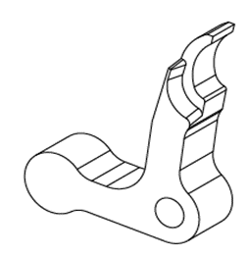
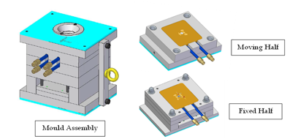
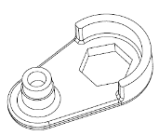
AMP Highlights- Industry Support
SMT Link
To improve the process that STM Link uses to produce the glass and epoxy samples
CSIR introduced a mechanism to control the sizes of the crushed bottles
The method significantly improved the quality of the glass and epoxy samples
Micromax
A joint technology development project with CSIR
Design and manufacture parts for defense applications
Safety base and pressure actuator parts selected
MIM mold for manufacture of parts complete
Manufacturing activities ongoing
CAD 3D model of MIM mould for manufacture of the parts.
(a)Safety base
(b) Pressure actuator
Shoprite
Investigate their damaged food cans (e.g. canned fish).
To establish the safety and reusability of these cans
Work has been completed
Client informed of the results

Slide 24
AMP Highlights- Industry Support
Mars Steel
To develop a process to produce fly ash reinforced metal matrix composites (MMCs) for Mars Steel
CSIR addressed scale up issues from 2kg to 20kg with improved repeatability
A pre-processing technique for the fly ash received from Mars Steel (Fine, Coarse and Weathered) was successfully developed
An increase in wt.% of fly ash resulted in an increase in the hardness of the fly ash reinforced MMCs.
Scaled up process
Joelwen Holding
To do analysis on a recycled plastic fence post as there is a high demand for fence posts made from recycled plastic material (globally and South Africa).
Compare results with the Kenya Bureau of Standards (KEBS), which focuses on plastic post specifications
Visual examination showed that the post did not have a consistently smooth finish on the outside surface and some porosity was identified when the post was sectioned
Recommended that multiple fence posts from different batches should be analyzed.
Specimens before testing

Slide 25




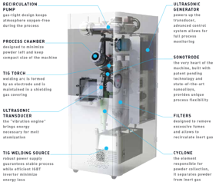
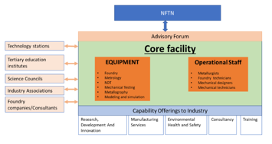

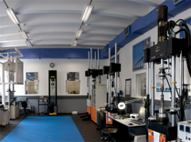

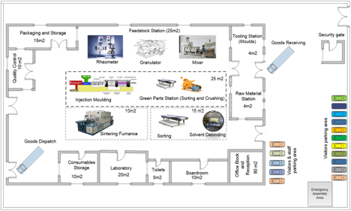
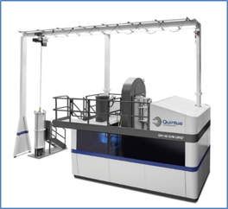
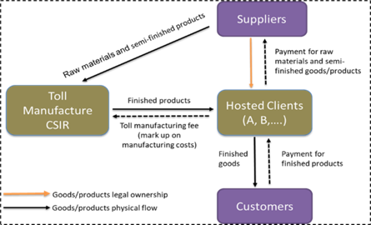

Future of AMP
MIM, AM
HIP
ISO 17025
Design, simulation and modelling
Materials
manufacturing
processes
Post processing
Testing, Qualification& Services
Vibrant digital Manufacturing industry
Atomizer
FTC
Testing Facilities
ISO 17025
Toll manufacturing
MIM
HIP
Mechanical Testing
Powder Testing
Non-Destructive Testing
NPV= R62m; IRR=52.36%; Payback period= 4.6yrs
Short to Medium
Industrial Scale Facility Development
Medium to Long
De-risking/Incubation
Long Term
Spin Out Companies

Slide 26
CSIR Learning Factory

Slide 27
Learning Factory Objectives
OUTCOME
To provide an environment which facilitates skills development and innovation applied to the Research, Design and Operation of 4IR technologies
PURPOSE
Demonstrator of 4IR Technologies
  Industry touch points
  Research contributions
  Opportunities
Build and Leverage Human Capital
  Training on 4IR technologies
  Use of 4IR technologies to train
  Applied to introductory training, upskilling and reskilling
Support Research and Innovation across CSIR and Industry
  4IR benchmarking, assessments and roadmapping
  Reference model for LF implementation at TVETs
  Product development for 4IR training applications
  De-risking 4IR technologies
  Industry consulting
Awareness of 4IR in SA context
Enable workforce readiness
Leverage opportunities in the 4IR
Notes:
The core objectives of the Learning Factory are to serve as a demonstrator of 4IR technologies, build and leverage human capital, and support research and innovation across CSIR and industry.

Slide 28
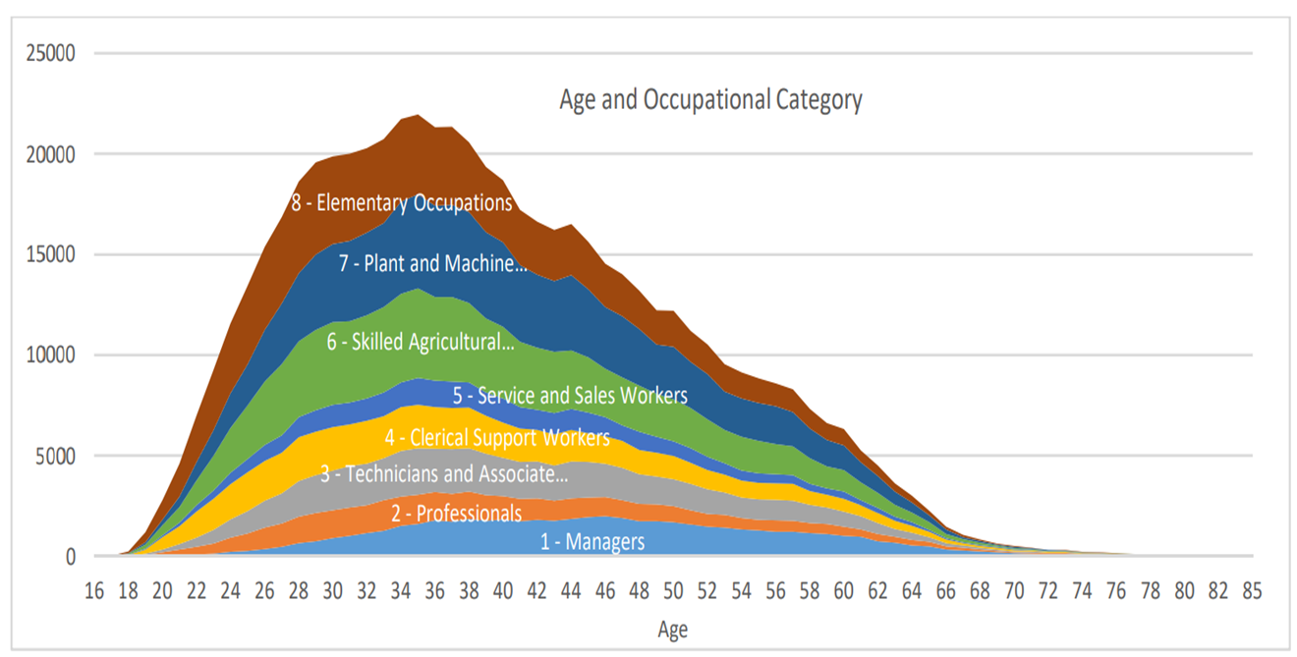
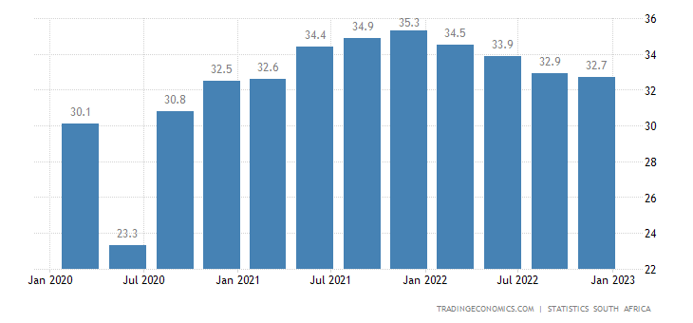
Learning Factory Context: Drivers
  Unemployment is at an all-time high (32.7% in Q4:2022)
  The lack of relevant skills in the labour market
  Upskilling and Reskilling: There is an urgent need to upskill students and the current workforce on 4IR technologies to prepare them for new jobs.
Workforce majority fits under Elementary Occupations
Labour market shows a demand for high-skilled workers, but there is a surplus of low-skilled potential workers
SA Unemployment Rate [32.7%] in Q4:2022
Need to use technology to create jobs – Low literacy levels
Implement systems that support low-skilled labour to perform
skilled work
Notes:
https://tradingeconomics.com/south-africa/unemployment-rate
The lack of relevant skills in the labour market-Misalignment of skills to what the job requirements are in the industry
Reskilling: Industry 4.0 is expected to result in job displacement to a certain extent. Several jobs cease to exist and another number of new jobs are created; therefore, reskilling will prepare the workforce for new jobs.

Slide 29
Learning Factory Context: Approach
Development of expert content to enable the LF
Existing and
future job skills
LF
Job Market
Situational assessment
Opportunity identification
Solution conceptualisation
Solutions implementation
Reskilling
Agriculture
Upskilling
Manufacturing
Mining
No
Existing skillset
Yes
Etc.
Does it meet industry needs
Direct uptake

Slide 30
Learning Factory Value Model
COURSEWARE-AS-A-SERVICE
Development of new courseware as needed by industry (in partnership)
4IR SKILLS DEVELOPMENT
TRAINING-AS-A-SERVICE
INDUSTRY/COMMUNITY DEVELOPMENT
TRAINING-AS-A-SERVICE
Presentation of courses via various channels, online and face-to-face, using the latest technologies and learning approaches
COURSEWARE-AS-A-SERVICE
EXPERTISE-AS-A-SERVICE
EXPERTISE-AS-A-SERVICE
Provide consulting expertise to help solve your most challenging 4IR and digital transformation problems
INFRASTRUCTURE-AS-A-SERVICE
CSIR LF offerings
INFRASTRUCTURE-AS-A-SERVICE
Provide multiple infrastructure options:
LF-IN-A-BOX – Supporting design and implementing client’s own LF technologies and infrastructure
Provide practical training environments (at our network of LFs across South Africa) to supplement the theoretical training process
Pilot production of commercial products using advanced CSIR infrastructure (e.g., Smart Factory)
4IR TESTING AND EXPERIMENTATION
INNOVATION

Slide 31
Implementation framework for Industry-partnered LFs
Stakeholder Landscape
Digital Roadmap
Implement Digital Roadmap
Monitor and Evaluate
Skills and Innovation Gap Analysis
Evaluated and Validated LF
1. Stakeholder Landscape
Identify relevant stakeholders and their requirements, challenges and opportunities
Establish governance structure
5. Monitor and Evaluate
Evaluation and validation
Continuous improvement
Sustainability assessment
Stakeholder Requirements; PSC; PMC
Established Facility
4. Implement Digital Roadmap
Establish a digital transformation facility
Commissioning
2. Skills and Innovation Gap Analysis
Assessment of relevant stakeholders
Gap analysis
Identify required developments in terms of skills and innovation
Gap analysis
Phased roadmap
3. Digital Roadmap
Develop evolving digital roadmap (skills and technologies)
Digital roadmap will include all phases and steps in each phase

Slide 32







Resultant LF Ecosystem Implementation Model
Hosting portal
Online Learning Portal
Master LF Support
Contribute courseware
Access to Master LF Learning Portal
Funding
Contribute courseware
Hosting LF
Hardware/Equipment
Learning Factory: Automotive
Provide TVET accredited Lecture Training in Mechatronics
Accredited Mechatronics course
Provide Mechatronic Accredited Courseware in Mechatronics
AIDC EC Incubator
Technology and Engineering Support
LF: Industry Maker Space
Automotive Components Technology Station
Industry
Support to Industry
Support to Industry
Support to Industry

Slide 33
Learning Factory Highlights
CSIR Master Learning Factory
Online Learning Portal
Wits, TUT, NMU
Expleo, Siemens, Jendamark
Learning Factory: Automotive
Learning Factory: Mining
Learning Factory: Foundries
Learning Factory: New
Future Skills Development in:
EV Technologies
Mechatronics
Fitting
Mechanics
Electrical
Panel Beating and Spray painting
Assembly
Welding
Partners:
East Cape Midland College
AIDC Eastern Cape and AIDC Gauteng
Siemens
Jendamark
merSETA
Nelson Mandela University
Tshwane University of Technology
Future Skills Development in:
Mining Modernisation and Mechanisation technologies
3D Printing
Industrial Internet of Things
Renewable Energy Technologies
Digital Twin Technologies
Agriculture technologies
Partners:
Angloamerican
Anglo Platinum
CSIR
Impact Catalyst
Future Skills Development in:
High Pressure Die Casting
3D Printing
Investment Casting
Gravity Die Casting
Metal Injection Moulding
Partners:
SA Foundries
National Foundry Technology Network
National Cleaner Production Center
Far East Rand TVET

Slide 34
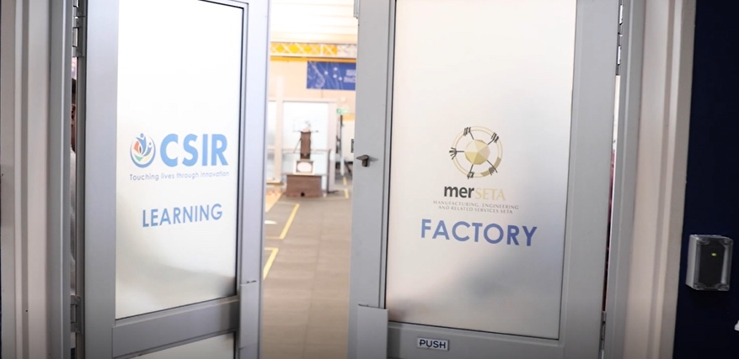
Learning Factory Video
Notes:
https://www.youtube.com/watch?v=eSPw9_ZH2jk

Slide 35
Generating Impact using the Advanced Materials & Manufacturing Capability Base

Slide 36
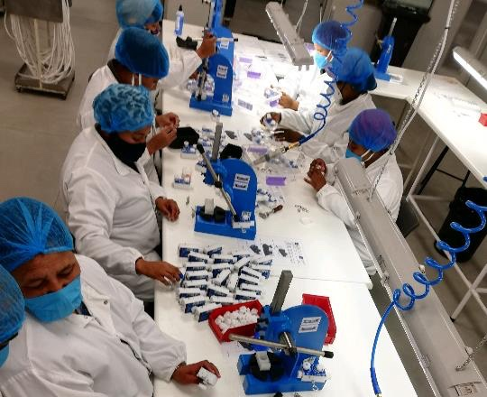
Application of the Capability Base in a Time of Need
COVID-19 Ventilators
Continuous Positive Airway Pressure ventilator
Bi-Level Positive Airway Pressure ventilator
Full Digital Lifecycle Management
  Product development (CAE, prototyping, testing and qualification)
  Production process development (Tooling, process parameters, optimised assembly,..)
  Industrialisation (work instructions, accessories localisation)
  Production (Training, automated QA, digital inventory management)
  Support (Integrated change control and supply chain management, incl. digital operator training content, spares and consumables supply, technical call centre)

Slide 37
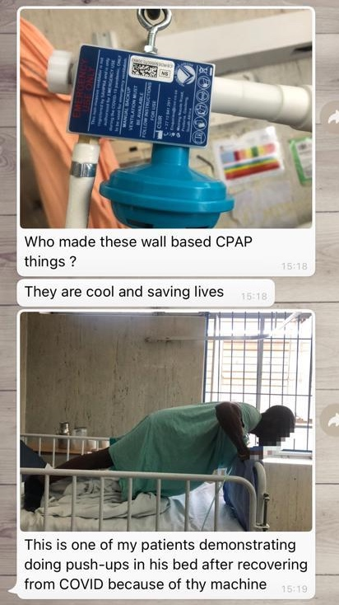
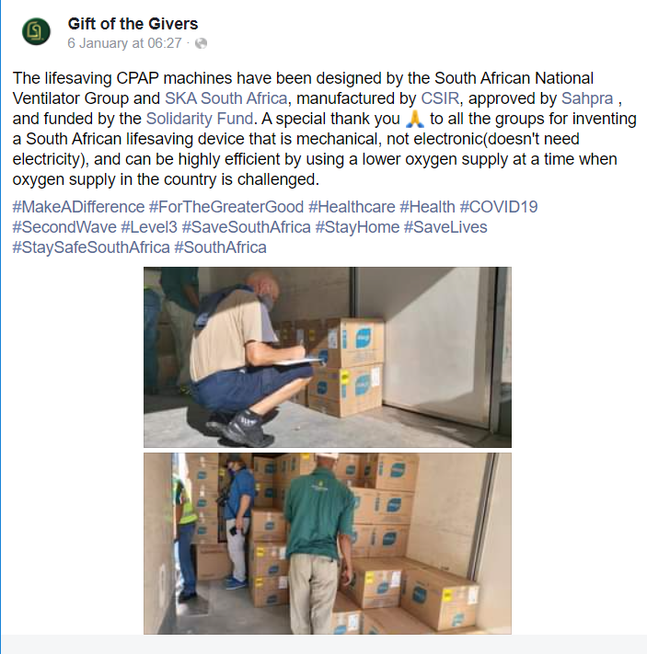
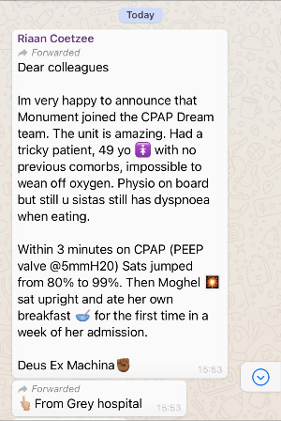
Application of the Capability Base in a Time of Need

Slide 38
Thank you

