Slide 1
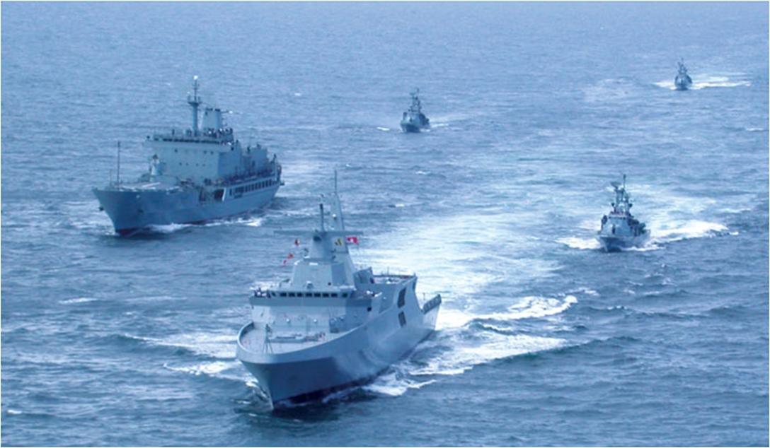
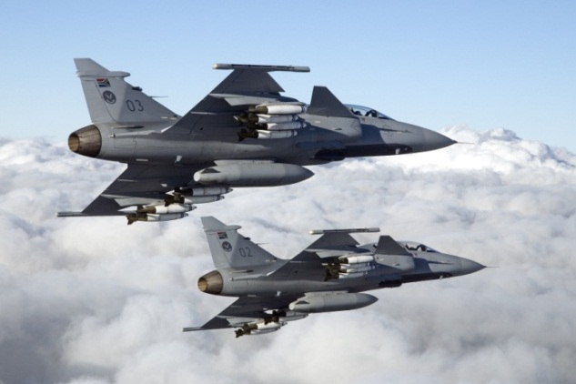
Briefing to the Joint Standing Committee on Defence regarding the level of satisfaction with services rendered by Denel and efforts to improve cooperation

Slide 2
INTRODUCTION
Denel SOC presented to the JSCD on 16 March 2023. The crux of the presentation was Denel’s Turn Around Strategy and its ability to provide life-cycle maintenance support for the prime mission equipment of its main client, the SANDF.
The JSCD noted that there was a disjuncture between the SANDF and Denel regarding the ability to maintain and sustainment the SANDF’s prime mission equipment as required for operational readiness.
Thus the JSCD directed that the Defence Force and Denel has to consult to seek alignment and to report back to the Committee to report on the service and level of satisfaction from Denel to Defence.
On the 27 March 2023, Armscor, Denel and the MCC met to discuss the Turn Around Strategy and operational support which Denel can provide to the SANDF.
This was followed by an MCC visit to Denel plants on the 3rd and 4th April 2023.

Slide 3
INTRODUCTION…
On the 2nd May 2023, Denel met with the Minister of Defence and Military Veterans for a briefing on the State of Denel and progress made on their Turn Around Strategy.
Over the years, there has been a symbiotic relationship between the SANDF and Denel as the original equipment manufacturer.
The Prime Mission Equipment (PME) in service with the SANDF, for which Denel is the Original Equipment Manufacturer (OEM), remain largely unserviceable, which impact severely on the Readiness Levels of the SANDF
The underfunding of the SANDF does contribute to the situation in which the Defence Force finds itself in.
Assumptions on Projects HOEFYSTER and KAMAS, remains key for Denel’s survival.

Slide 4
AIM OF THE PRESENTATION
To brief the Joint Standing Committee on Defence regarding the level of satisfaction with services rendered by Denel and efforts to improve cooperation

Slide 5
SCOPE
Operating Contract Categories
Level of Satisfaction Criteria
Summary of Denel OPERATING contracts allocated to Denel and the level of satisfaction
Active CAPITAL & TECHNOLOGY contracts allocated to Denel and the level of satisfaction
Roll overs
Efforts to improve cooperation
Conclusion
Discussion

Slide 6
OPERATING CONTRACT CATEGORIES
Maintenance and Repair (M&R)
Maintenance and Support (M&S)
Spares
Other
General

Slide 7
LEVEL OF SATISFACTION CRITERIA
Green (Satisfactory)
Contract delivered and paid
Contract delivery date from 01 May 2023 and later
Yellow (Moderate)
Contract delivery date between 01 January 2023 to 28 April 2023 (not yet delivered and paid)
Red (Unsatisfactory)
Contract delivery date prior to 31 December 2022 (not yet delivered)

Slide 8
SUMMARY OF DENEL OPERATING CONTRACTS LEVEL OF SATISFACTION
SUMMARY
 | G | Y | R | TOTAL
MAINT & REPAIR | 3 | 5 | 7 | 15
MAINT & SUPPORT | 12 | 3 | 1 | 16
SPARES | 10 | 0 | 13 | 23
OTHER | 8 | 6 | 13 | 27
GENERAL | 1 | 0 | 1 | 2
TOTALS | 34 | 14 | 35 | 83
PRECENTAGE | 40,964 | 16,867 | 42,169
TOTAL ORDERS | 91
TOTAL N/A | 8

Slide 9
OUTSTANDING % PER DENEL ENTITY
SER | OPERATING CONTRACTS | TOTAL VALUE | AMOUNT PAID | AMOUNT OUTSTANDING | %OUTSTANDING
1 | Denel Aeronautics | 1,996,962,284.40 | -1,715,277,812.99 | 281,684,471.41 | 14.11%
2 | Denel Dynamics | 634,161,451.98 | -557,177,254.67 | 76,984,197.31 | 12.14%
3 | Denel Land Systems | 179,545,085.47 | -141,181,672.29 | 38,363,413.18 | 21.37%
4 | Denel Mechatronics | 19,539,790.31 | -15,045,555.07 | 4,494,235.24 | 23.00%
5 | Denel PMP | 100,666,790.27 | -24,224,101.81 | 76,442,688.46 | 75.94%
6 | Denel Vehicle Systems | 232,544,537.95 | -167,680,555.39 | 64,863,982.56 | 27.89%
7 | Hensoldt Optronics | 102,785,530.72 | -84,774,312.21 | 18,011,218.51 | 17.52%
8 | Rheinmettall Munitions | 280,304,392.64 | -277,004,031.22 | 3,300,361.42 | 1.18%
 |  | 3,546,509,863.74 | -2,982,365,295.65 | 564,144,568.09

Slide 10
CAPITAL & TECHNOLOGY ACTIVE CONTRACTS
Contract Categories
Capital Acquisition Projects Contracts
Technology Projects Contracts

Slide 11
LEVEL OF SATISFACTION CRITERIA
Green (Satisfactory)
Contract delivered and paid
Contract delivery date from 01 May 2023 and later
Yellow (Moderate)
Contract delivery date between 01 January 2023 to 28 April 2023 (not yet delivered and paid)
Red (Unsatisfactory)
Contract delivery date prior to 31 December 2022 (not yet delivered)

Slide 12
CAPITAL & TECHNOLOGY ACTIVE DATABASE
SUMMARY
 | G | Y | R | TOTAL
TOTALS | 8 | 2 | 11 | 21
PERCENTAGE | 38,10% | 9,52% | 52,38%
TOTAL ORDERS | 21
TOTAL N/A | 0

Slide 13
OUTSTANDING % PER DENEL ENTITY (CAPITAL)
SER | OPERATING CONTRACTS | TOTAL VALUE | AMOUNT PAID | AMOUNT OUTSTANDING | %OUTSTANDING
1 | Denel Aeronautics | 56,690,119.00 | -11,167,530.34 | 45,522,588.66 | 80.30%
2 | Denel Dynamics | 1,782,643,876.37 | -1,153,934,465.08 | 628,709,411.29 | 35.27%
3 | Denel Land Systems | 15,789,349,460.00 | -6,995,176,085.20 | 8,794,173,374.80 | 55.70%
4 | Overberg Test Range | 413,642,104.52 | -366,588,477.17 | 47,053,627.35 | 11.38%
5 | Denel PMP | 16,711,801.00 | -7,634,051.65 | 9,077,749.35 | 54.32%
6 | Denel Vehicle Systems | 2,000,000.00 | 0.00 | 2,000,000.00 | 100.00%
7 | Hensoldt Optronics | 268,559,206.50 | -160,620,977.38 | 107,938,229.12 | 40.19%
8 | Rheinmettall Munitions | 47,794,840.00 | -7,183,482.00 | 40,611,358.00 | 84.97%
 |  | 18,377,391,407.39 | -8,702,305,068.82 | 9,675,086,338.57

Slide 14
DOD ROLL-OVER HISTORY
Notes:
This slide reflects level of satisfaction with the capital contracts look like.

Slide 15
EFFORTS TO IMPROVE COOPERATION
A DoD-, Armscor-, Denel Steering Committee was established and is operational to monitor progress (Chairman of the Armscor BoD chair)
The DoD and Armscor are part of the Monthly Monitoring/Reporting meeting during which Denel provide feedback reporting on all matters to DPE and NT (Chaired by DPE)

Slide 16
CONCLUSION
Denel is a strategic asset of the State for all intents and purposes. The survival of Denel is important for purposes of national security ensuring a sovereign state.
If Denel’s performance may not drastically improve soonest. The impact of the new Denel Turn Around Strategy is not yet felt in the Readiness Levels of the DoD’s PME.
The country can no longer afford to lose the remainder of the skills sets vested within the employees at Denel. Employees with scarce skills that form part of the manufacturing of arms for the SANDF should as far as possible be retained.

Slide 17
Questions/Discussion

