Slide 1



BRIEFING TO SELECT COMMITTEE ON SECURITY AND JUSTICE ON THE CIVILIAN SECRETARIAT FOR POLICE SERVICE (CSPS) ANNUAL PERFORMANCE PLAN AND BUDGET ALLOCATION FOR VOTE 21
10 May 2023

Slide 2

CSPS BUDGET ALLOCATION
CIVILIAN SECRETARIAT FOR POLICE SERVICE
Programme |  | Audited Outcomes |  |  | Adjusted Appropriation | Medium-Term Expenditure Estimate
 |  | 2019/20 | 2020/21 | 2021/22 | 2022/23 | 2023/24 | 2024/25 | 2025/26
 |  | R'000 | R'000 | R'000 | R'000 | R'000 | R’000 | R’000
1 | Administration | 61 844 | 61 937 | 67 518 | 68 755 | 68 238 | 71 252 | 74 440
2 | Inter-Sectoral Coordination and Strategic Partnerships | 26 807 | 22 637 | 25 999 | 27 004 | 26 276 | 27 467 | 28 696
3 | Legislation and Policy Development | 20 000 | 18 639 | 23 437 | 23 376 | 23 186 | 24 237 | 25 323
4 | Civilian Oversight, Monitoring and Evaluation | 28 783 | 28 331 | 34 089 | 33 176 | 32 789 | 34 289 | 35 825
TOTAL |  | 137 434 | 131 544 | 151 043 | 152 311 | 150 489 | 157 245 | 164 284
Total Change to 2022/23 budget and MTEF estimates |  | - | - | - | - | - | - | -
Current payments |  | 135 472 | 125 188 | 148 869 | 147 088 | 145 027 | 151 533 | 158 316
Compensation of employees |  | 97 997 | 99 336 | 105 781 | 107 222 | 105 189 | 109 906 | 114 831
Goods and services |  | 37 475 | 25 852 | 43 088 | 39 866 | 39 838 | 41 627 | 43 485
Interest and rent on land |  | - | - | - | - | - | - | -
 | Interest (incl. interest on unitary payments (PPP) | - | - | - | - | - | - | -
Transfers and subsidies |  | 597 | 658 | 688 | 129 | 140 | 151 | 158
 | Municipalities: Vehicle license | 6 | 6 | 6 | 19 | 20 | 21 | 22
 | Departmental agencies | 189 | 121 | 204 | 110 | 120 | 130 | 136
 | Households | 402 | 531 | - | - | - | - | -
Purchase of capital assets |  | 1 339 | 5 637 | 1 921 | 5094 | 5323 | 5561 | 5810
 | Buildings and other fixed structures | - | - | - | - | - | - | -
 | Machinery and equipment including vehicles | 1 339 | 5 632 | 1 586 | 5022 | 4958 | 5181 | 5413
 | Software and other intangible assets | - | - | 335 | 72 | 364 | 380 | 397
Payment for financial assets |  | - | 26 | 66 | - | - | - | -
TOTAL |  | 137 434 | 131 544 | 151 043 | 152 311 | 150 489 | 157 245 | 164 284

Slide 3
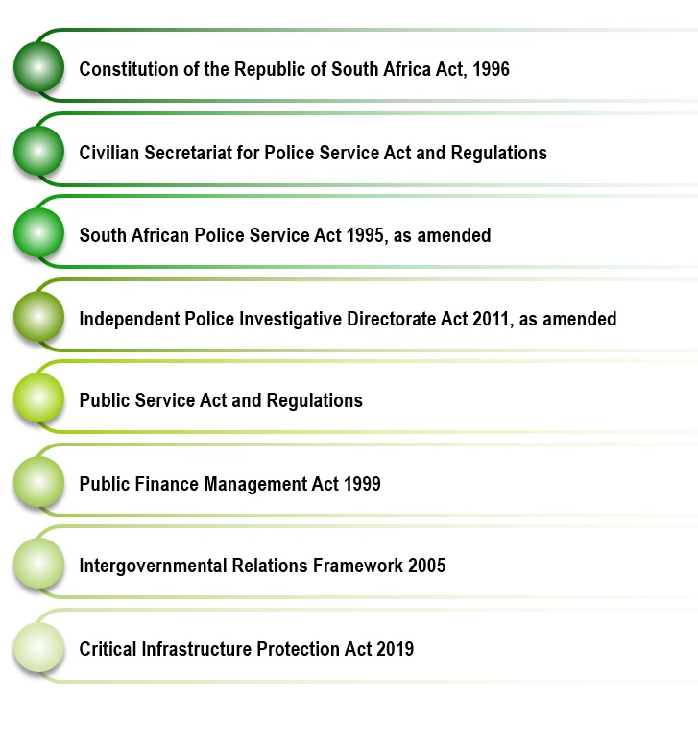
CSPS MANDATE
Section 208 of the Constitution provides for the establishment of a civilian secretariat for the police service, which is set to function under the direction of the Cabinet member responsible for policing. The Civilian Secretariat for Police Service further derives its mandate from the following legislative frameworks:
As the strategic policy advisor to the Minister of Police, the legislated objects of the Civilian Secretariat are to:
exercise civilian oversight over the Police Service;
give strategic advice to the Minister in respect of developing and implementing policies;
provide administrative support services to the Minister to ensure South Africa’s engagement with relevant international obligations;
liaise and communicate with stakeholders;
implement a partnership strategy to mobilise role-players and stakeholders to strengthen service delivery by the police service to ensure the safety and security of communities;
implement, promote and align the operations of the Civilian Secretariat in the national and provincial spheres of Government;
co-ordinate the functions and powers of the Civilian Secretariat in the national and provincial spheres of Government;
promote co-operation between the Civilian Secretariat, the Police Service and the Directorate; and
provide guidance to community police fora and associated structures and facilitate their proper functioning.

Slide 4
INSTITUTIONAL POLICIES and STRATEGIES
GOVERNING THE 5-YEAR PLANNING PERIOD
Integrated Crime and Violence Prevention Strategy
Panel of Experts: Farlam Commission of Inquiry Report
e-Policing Policy
White Paper on Safety and Security
POLICIES AND STRATEGIES
Guidelines to Enhance SAPS Performance Indicators
White Paper on Policing
Communication Strategy
Community Policing Policy
Partnership Strategy and Framework
Policy Framework on the Establishment of an Integrated Model of Policing
Information and Communication Technology Strategy
Oversight Monitoring and Evaluation Framework
Integrated Human Capital Strategy
Knowledge Management Strategy

Slide 5

RELEVANT COURT RULINGS
Case CCT 32/18
Mlungwana and Others v the State and Others, CCT 32/18
Case CCT 315/16 and CCT 193/17
S v Okah [2018] ZACC 3 (Case CCT 315/16 and CCT 193/17)
Case CCT 174/18
Moyo and Another v Minister of Police and Others (Case CCT 174/18) and Sonti and Another v. Minister of Police and Others
Cases CCT 07/14 and CCT 09/14
Helen Suzmann Foundation v President of the Republic of South Africa and Others Case CCT 07/14, Glenister v President of the Republic of South Africa and Others Case No. CCT 09/14
Case CCT 255/15
McBride v Minister of Police and Another Case No. CCT 255/15 [2016] ZACC 30; 2016 (2) SACR 585 (CC); 2016 (11) BCLR 1398 (CC)
Case CCT 177/17
Minister of Safety and Security v SA Hunters and Game Conservation Association and Others Case No. CCT 177/17
Case 18205/2018
The Residents of: Industry House, 5 Davies Street, New Doornfontein, Johannesburg and Others v The Minister of Police and Others
Case 56/2019
National Commissioner of Police v Gun Owners of South Africa Case No 561/19
Case CCT 195/21
Minister of Police and Others v Fidelity Security Services (Pty) Limited (CCT195/21 [2022} ZACC 16

Slide 6
CSPS STRATEGIC FOCUS
GOVERNMENT PRIORITIES
MINISTERIAL PRIORITIES
IMPACT
“Communities are and feel safe”
Strengthened community-police relations
Transformed and accountable police
Strengthened community participation in the fight against crime responsive policing
EMERGENT THEORY OF CHANGE:
CSPS as a centre of excellence for policing policies and strategies
Strengthened collaboration, coordination and integration towards the implementation of the ICVPS
Strengthened relationship between SAPS and CSPS to ensure responsive policing
5-YEAR OUTCOMES
5-YEAR OUTCOMES
CLUSTER PRIORITIES

Slide 7
KEY ACHIEVEMENTS FOR 2022/23
Progress on Outcomes
Progress on Outputs
Development of the second draft National Policing Policy, which provides policy direction for responding to the current policing, crime and violence challenges in the country
Finalisation of key legislation (DNA Bill and POCDATARA)
Facilitation of CPF training in various district municipalities across the country
Coordination of the Khayelitsha Crisis Response Summit in Western Cape Conducting of anti-crime campaigns on GBVF in various provinces
Conclusion of a study on the monitoring of Exhibit Stores (SAPS 13), focusing on Top 30 police stations nationally and provincially
Finalisation of a report on the assessment of members’ perception, accessibility and utilisation of the SAPS Employee Health and Wellness Programme
Finalisation, approval and implementation of the revised Performance Information Management Policy to synchronise planning, budgeting, reporting and risk management processes in order to enhance service delivery within the Department
MTSF Target
MTSF Target

Slide 8

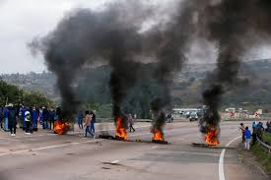

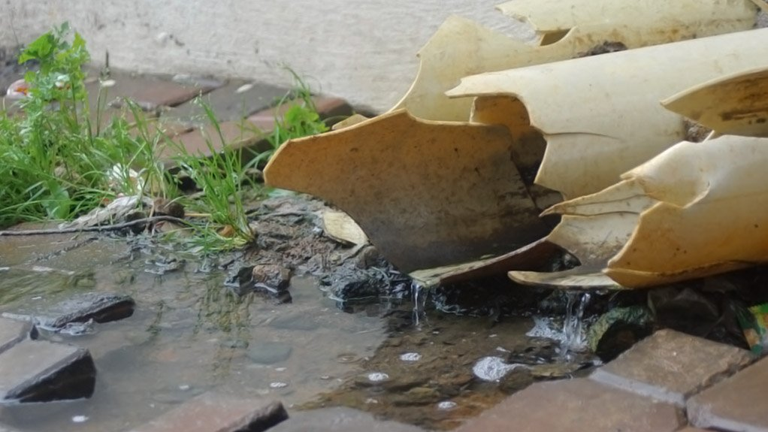
FACTORS CONTRIBUTING TO THE PERFORMANCE OF POLICY
Inadequate coordination within CJS
High crime rate
Social discontent expressed as protests
Service delivery failures
Impact of socio-economic challenges on crime
Energy crisis
Perceptions of police performance

Slide 9

POLICING PRIORITIES
KEY PRIORITIES
Enhancement of police visibility
Thorough and responsive investigation of crime
NATIONAL POLICING STRATEGY
Response to threats to the territorial integrity of the State
Prevention and investigation of crime that threatens the economy
CSPS SUPPORT
Participation in the review of the District One-Plans for the DDM
Improvement of frontline service delivery
Response to threats to the authority of the State
Prevention and investigation of crime that threatens citizens’ wellbeing
Stakeholder management and active citizenry
Capacitation of SAPS
Assessment of the establishment of GBV Desks and the status / state of dedicated VFRs at all police stations
Assessment of the extent of feedback to complainants by investigating officers (service standards)
Implementation of the ICVPS
Continued collaboration with the monitoring and evaluation of the Ministerial Crime Retreat POA

Slide 10
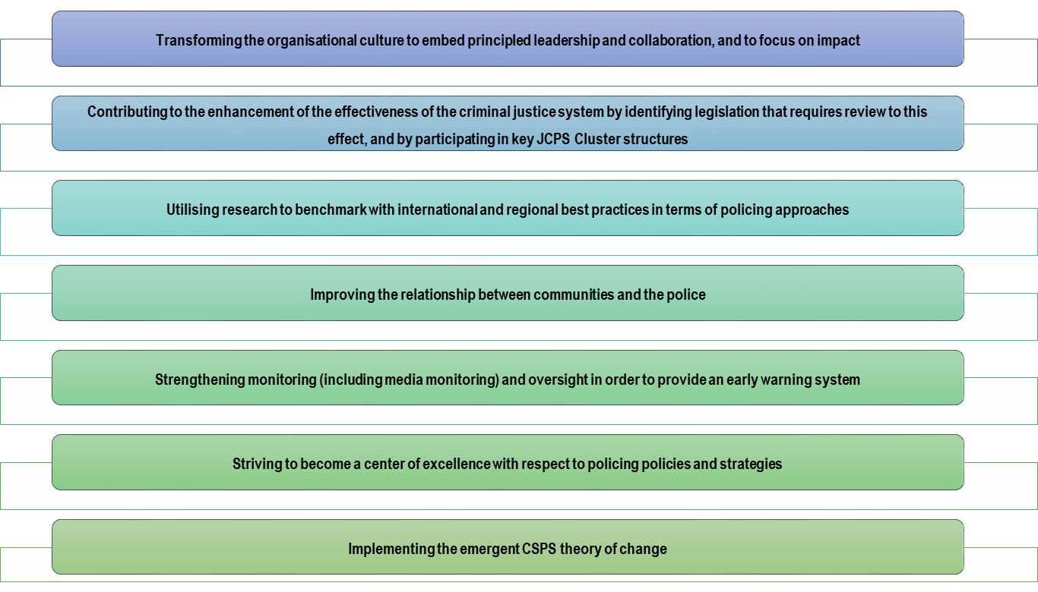
CSPS PRIORITIES FOR 2023/24
Based on the direction provided by the Minister of Police during the review of the CSPS strategy in 2022/23, the Department identified the following emerging priorities for the remainder of the planning period which remain unchanged for 2023/24:

Slide 11
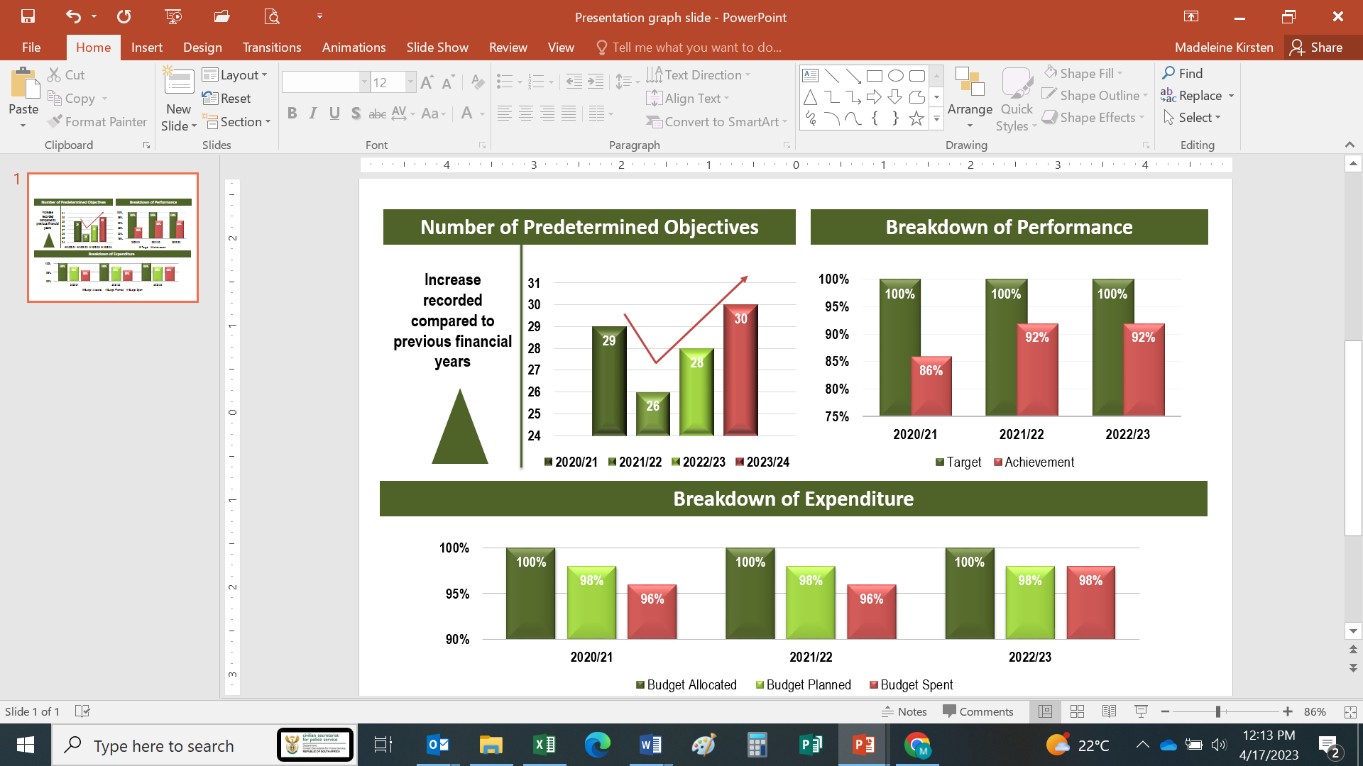
MEASURING OUR PERFORMANCE

Slide 12
2023/24 PERFORMANCE MEASURES
Programme 1: Administration
Purpose: Provide strategic leadership, management and support services to the Department.
Database on recommendations developed
Strengthened relationship between SAPS and CSPS to ensure responsive policing
Department Management
Implementation report on the role of CSPS in the ICVPS
Strengthened collaboration, coordination and Integration towards the implementation of the ICVPS

Slide 13
2023/24 PERFORMANCE MEASURES
Programme 1: Administration
Purpose: Provide strategic leadership, management and support services to the Department.
CSPS as a centre of excellence for policing policies and strategies
Vacancy Rate
Human Capital Strategy
ICT Strategy
Corporate Services

Slide 14
2023/24 PERFORMANCE MEASURES
Programme 1: Administration
Purpose: Provide strategic leadership, management and support services to the Department.
CSPS as a centre of excellence for policing policies and strategies
30-Day Payments to Creditors
Expenditure Trends Analysis
Finance Administration

Slide 15
2023/24 PERFORMANCE MEASURES
Programme 2: Inter-Sectoral Coordination and Strategic Partnerships
Purpose: To manage and encourage national dialogue on community safety and crime prevention
Strengthened collaboration, coordination and integration towards the implementation of the ICVPS
Establishment of Partnerships through MOUs
Capacity-Building Workshops & CSF Assessments
Anti-Crime Campaigns
IGR, Civil Society & PPPs

Slide 16
2023/24 PERFORMANCE MEASURES
Programme 2: Inter-Sectoral Coordination and Strategic Partnerships
Purpose: To manage and encourage national dialogue on community safety and crime prevention
Strengthened community police relations
CPF Functionality Assessments
CPF Training Workshops
IGR, Civil Society & PPPs

Slide 17
2023/24 PERFORMANCE MEASURES
Programme 2: Inter-Sectoral Coordination and Strategic Partnerships
Purpose: To manage and encourage national dialogue on community safety and crime prevention
Strengthened community participation in the fight against crime
Izimbizo / Public Participation Programmes
Response Plans
Community Outreach

Slide 18
2023/24 PERFORMANCE MEASURES
Programme 3: Legislation and Policy Development
Purpose: Develop policy and legislation for the police sector and conduct research on policing and crime
Transformed and Accountable Police Service
National Policing Policy
Joint Research Project
Knowledge Management Strategy
Policy Development and Research

Slide 19
2023/24 PERFORMANCE MEASURES
Programme 3: Legislation and Policy Development
Purpose: Develop policy and legislation for the police sector and conduct research on policing and crime
Strengthened relationship between SAPS and CSPS to ensure responsive policing
SAPS Amendment Bill
IPID Amendment Bill
FCA, SHGA and Stock-Theft Amendment Bills
Legislation

Slide 20
2023/24 PERFORMANCE MEASURES
Programme 4: Civilian Oversight, Monitoring and Evaluation
Purpose: Oversee, monitor and report on the performance of the South African Police Service
Transformed and Accountable Police Service
Police Oversight Initiatives
Budget and Performance Assessment
Complaints Management
IPID Recommendations
Police Performance, Conduct & Compliance Monitoring

Slide 21
2023/24 PERFORMANCE MEASURES
Programme 4: Civilian Oversight, Monitoring and Evaluation
Purpose: Oversee, monitor and report on the performance of the South African Police Service
Strengthened Relationship between SAPS and CSPS to ensure responsive policing
Assessment of SAPS Programmes
Evaluations on Legislation and Policies
Policy and Programme Evaluations

Slide 22










MANDATE OF PROVINCIAL SECRETARIATS
Section 16 of the CSPS Act provides for the establishment of Provincial Secretariats to support and align their mandate with the mandate of the Civilian Secretariat for Police Service.
The Provincial Secretariats are, therefore, established by the MECs for Safety in the various provinces and fall within the provincial departments of Community Safety, to which they are accountable.
The Provincial Secretariats are obligated to align their plans and operations with plans, policies and operations of the Civilian Secretariat; and integrate their strategies and systems at the provincial sphere of government.

Slide 23
PROVINCIAL BUDGET ALLOCATIONS
The table below shows comparison in budget allocation for the Provincial Secretariats during the 2021/22 and the 2022/23 financial years.
The variances in allocations can be attributed to the following:
The GP Government has allocated a budget of R60 million per annum to the Department of Community Safety to ensure implementation of the GSP on GBVF aligned to NSP on GBVF.
In WC, there were some additional amounts transferred to the Department to enhance crime fighting initiatives and these include – R350 mil for the Law Enforcement Advancement Plan (LEAP), which is a decrease of R50mil from the previous year, R6mil for neighbourhood watches, R9.5mil for Rural Safety Programme and R10mil towards supporting the K9 units.
EC had the least amount allocated to the Provincial Secretariat which deals with police station monitoring and the Court Watch Briefs Programme.
Some minimal increases have been observed in FS, MP, NC and NW.
PROV | 2022/23 | 2023/24
EC | 44 087 | 752 (for civilian oversight)
FS | 22 976 | 23 583
GP | 132 627 | 280 699
KZN | 129 549 | 126 966
LP | 62 316 | 56 563
MP | 57 957 | 60 047
NC | 32 354 | 32 908
NW | 52 795 | 56 998
WC | 561 324 | 745 160

Slide 24
KEY PROVINCIAL ACHIEVEMENTS AND CHALLENGES
ACHIEVEMENTS
CHALLENGES
All provinces have been working to improve relations between the police and communities through strengthening capacity of the CPFs.
Provinces adopted a Court Watch Brief Programme with specific focus on GBVF cases, which is yielding some good results as it has seen cases that had been withdrawn being re-enrolled.
  In EC for example 112 court cases which were re- enrolled by the end of the previous financial year and 124 cases from April to December 2023 which gives a total of 236 cases.
  The status is as follows: 116 cases were successfully finalised, 120 pending court processes (on trial). Some of the convictions from the finalized cases included a 20, 10, 6 and 5 years imprisonment in 6 cases.
Despite limited resources, provinces are able to meet their targets in terms of police station oversight and community awareness programmes.
Some provinces like EC, NC, MP, FS, NW and WC generally have insufficient resources within their monitoring and evaluation units.
Unavailability of funds is the major contributing factor that negatively impacts on the ability of Provincial Secretariats to increase their human capacity and on effective implementation of crime prevention programmes.

Slide 25
OVERVIEW OF PROVINCIAL BUDGET ALLOCATIONS
TO MONITOR DVA COMPLIANCE
Provincial budgets in terms of monitoring DVA compliance are included in the overall civilian oversight budget, which encompasses monitoring and evaluation, crime prevention and research programmes.
The only province with a ring-fenced budget is Gauteng, with the R60mil allocated for GBV&F.

Slide 26
UPDATE ON DVA COMPLIANCE
The CSPS together with Provincial Secretariats determine SAPS’ compliance levels through a monitoring tool administered during police station oversight visits. The table below depicts compliance levels based on SAPS regulatory requirements in 461 police stations visited during first and second quarter of the 2022/23 financial year.
The oversight visits include the following:
Checking whether inspections are conducted and frequency thereof
Checking the availability of documents in the Community Service Centres (CSC)
Checking record-keeping with specific focus on the maintenance of registers and proper filling of documents (DV forms and protection orders)
Checking accessibility and functionality of VFR or designated facilities
PROV | No. of stations visited | Non Compliance (49% and below) | Partial Compliance (50%-69%) | Significant Compliance (70%-99%) | Full Compliance (100%)
EC | 7 | 1 | 5 | 1 | 0
FS | 37 | 1 | 13 | 23 | 0
GP | 249 | 11 | 163 | 75 | 0
KZN | 50 | 3 | 36 | 11 | 0
LP | 32 | 13 | 17 | 2 | 0
MP | 5 | 1 | 3 | 1 | 0
NW | 11 | 5 | 3 | 3 | 0
NC | 42 | 3 | 37 | 2 | 0
WC | 28 | 0 | 9 | 19 | 0
Total | 461 | 38 | 286 | 137 | 0

Slide 27
STEPS TO ADDRESS DVA NON-COMPLIANCE
Section 23 (b)(a) of the DV Amendment Act (2021), and the SAPS DVA National Instruction 7/1999 requires that SAPS reports all non-compliance complaints against its members to the CSPS in order for CSPS to make recommendations on what steps to be taken.
In order to coordinate this reporting process, a Compliance Forum was established between the CSPS and SAPS and both national and provincial levels.
The National and Provincial Compliance Forums (Accountability Sessions) convene on a quarterly basis to report and address areas of non-compliance.
Additionally, police station-focused improvement plans are developed and monitored continuously in order to improve SAPS compliance.
Capacity building workshops are regularly held with DV Coordinators by provinces to improve levels of understanding of the DVA and the National Instruction.

Slide 28
MONITORING SAPS IMPLEMENTATION OF
IPID RECOMMENDATIONS
Section 31(2) of the CSPS Act requires the CSPS to monitor implementation of recommendations made by IPID to SAPS and to provide the Minister with regular reports on steps taken by SAPS to ensure compliance.
For proper coordination of monitoring implementation of IPID recommendations, an IPID Recommendations Forum has been established at the National and Provincial levels, comprising the CSPS, SAPS and IPID.
The Recommendations Forum is complemented by the establishment of the Consultative Forum, which is the legislated structure that seeks to promote policy coordination between CSPS and IPID at a higher level.
The Consultative Forum sits quarterly and is chaired by the Secretary for Police Service and Executive Director of IPID on a rotational basis.

Slide 30
MONITORING SAPS IMPLEMENTATION OF
IPID RECOMMENDATIONS
The CSPS addresses non-compliance as follows:
The Department monitors implementation of recommendations through tracking progress on disciplinary investigations, hearings, and outcomes of finalised disciplinary procedures.
This is conducted as part of the monthly recommendations forum.
Bi-annual assessment reports on the implementation of IPID recommendations by the SAPS are also produced.
The CSPS has further conducted a diagnostic evaluation on the management of discipline by the SAPS in order to identify the potential factors that undermine the effectiveness of the disciplinary system, and to recommend interventions to strengthen the system and its implementation.

Slide 31
GIVING EFFECT TO GOVERNMENT PRIORITY TO FIGHT GBVF
The CSPS continues to implement pillar 1, 2 and 3 of the National Strategic Plan on GBVF and report on its implementation to the Department of Women Youth and Person with Disabilities on a monthly basis.
The budgets of the CSPS and Provincial Secretariats have catered for GBVF programmes as part of funds allocated for monitoring and evaluation, and crime prevention / anti-crime campaigns focusing on GBVF.
The following are prioritised and budgeted for in order to give effect to the Government priority on GBVF:
  Continuous monitoring of SAPS compliance to and implementation of the DVA.
  Oversight over the top 30 police stations with high levels of GBV related crimes (nationally and provincially).
  Court watching briefs to identify systemic issues that lead to the withdrawal of GBVF related cases – with particular focus on police responsibilities.
  Awareness campaigns involving community and faith based organisations, institutions of higher learning and other government departments.

Slide 32
EFFICACY OF FORENSIC SCIENCE LABORATORIES
During the 2022/23, the DNA Board and its Secretariat embarked on oversight visits to the three regional FSLs in EC, WC and KZN, and the national headquarters in PTA.
The visits were primarily aimed at conducting assessments of the effectiveness of the FSLs. The assessments focused on human and resource capacity factors, as well as gaps and challenges in SCM processes, technical management services, etc., which could directly impact the overall throughput of the SAPS Forensic Science Laboratories Biology Department.
A consolidated report with findings and suggestions for improvement was compiled for the attention of the Minister.
The overall results of the study suggest that the FSL environment is generally plagued by an array of challenges. Some of the challenges include:
  Inadequate infrastructural facilities for the accommodation of personnel, and shortages of storage for equipment and casework;
  Inadequate IT infrastructure, systems and software;
  Supply chain management process challenges;
  Staffing shortages;
Despite these identified challenges, the DNA Board noted the overall improvement in clearing the earmarked backlog of over 98% from project inception to date.

Slide 33
UPDATES STRATEGY TO REDUCE CIVIL CLAIMS AGAINST SAPS
The CSPS has developed a policy brief focusing on the Analysis of the Policy Framework on SAPS civil litigation.
The policy brief was informed by the several studies conducted by the Civilian Oversight, Monitoring and Evaluation Unit from 2015/16 to 2020/2021 financial years, focusing on the management of civil litigation by the SAPS.
The Policy Brief reflects on the findings in respect of the SAPS policy framework for managing civil claims and provides recommendations for effective, efficient and proactive management of civil claims.
Amongst the recommendations made in the study, was the need for a policy to guide the management of civil claims against the Minister; and these recommendations must be considered when SAPS implements its strategy to reduce civil claims.
Furthermore, the CSPS in its revised Strategic Plan, under the outcome “transformed and accountable police service” has developed a new outcome indicator focusing on how to reduce the number of civil claims against the police.

Slide 34
UPDATES ON POLICY PROVISIONS ON CROWD CONTROL
The CSPS developed policies which were approved in 2011 and 2018 respectively to guide the SAPS in their operations and towards crowd management; i.e.
  Policy and Guidelines on Policing of Public Protests, Gatherings and Major Events (2011)
  Policy and Guidelines on Professional use of force (2018)
These policies exists in conjunction with a range of initiatives to strengthen and professionalise the police in South Africa, the objectives of which are to improve the performance of the SAPS by professionalising the use of force.
The CSPS will continue to ensure the policy proposals and recommendations are implemented in accordance and alignment to the implementation of the 2015 Farlam Commission’s recommendations.

Slide 35
UPDATE ON THE FUNCTIONALITY OF CPFs
According to Section 5(i) 6(2) (viii) of the CSPS Act, the Department should:
  Develop frameworks and strategies to ensure uniformity, accountability and enhancement of community police fora and associated structures; and
  Provide guidance to community police fora and associated structures and facilitate their proper functioning.
In giving effect to the above mandate, the CSPS and Provincial Secretariats continuously conduct capacity-building sessions for newly elected CPF members and existing members.
An MoU was concluded with WITS University to provide accredited training to the CPFs through a SASSETA funded programme, and this programme has been running since 2021 with 3 cohorts of CPF members trained to date.
During the 1st and 3rd quarters of the 2022/23 financial year, CSPS, together with Provincial Secretariats, conducted assessments on the functionality of CPFs.

Slide 36
UPDATE ON THE FUNCTIONALITY OF CPFs
The assessment of CPFs focuses on, amongst others, checking whether there is a functional Executive Committee that sits as prescribed; meetings with the communities are taking place; and whether there are programmes that seek to address the identified challenges within the policing precinct. The table herein depicts the status of functionality on the assessed CPFs.
PROV | Total no. of CPFs | Number of CPFs assessed by Provincial Secretariats as at 31 Dec 2022 | Number of functional CPFs based on assessments | Number of non- functional CPFs | Number of trained CPFs | CPFs still to be assessed
EC | 197 | 71 | 09 | 62 | 0 | 126
FS | 111 | 83 | 63 | 20 | 0 | 28
GP | 143 | 108 | 107 | 01 | 3 | 35
KZN | 184 | 33 | 28 | 05 | 0 | 151
LP | 103 | 60 | 60 | 0 | 103 | 43
MP | 90 | 70 | 65 | 05 | 0 | 20
NC | 91 | 31 | 31 | 0 | 55 | 60
NW | 84 | 40 | 20 | 20 | 34 | 44
WC | 151 | 82 | 81 | 1 | 151 | 69
TOTAL | 1154 | 578 | 464 | 114 | 346 | 576

Slide 37

UPDATE ON UPCOMING LEGISLATION
  IPID AMENDMENT BILL
  The Department is working on finalising the Independent Police Investigative Directorate (IPID) Amendment Bill
  The Bill was prepared for consultation through the JCPS Cluster to endorse for Cabinet approval in order to introduce the Bill in Parliament during this financial year

Slide 38

FINANCIAL MANAGEMENT OF THE DEPARTMENT
Whether the previous financial statements of departments and their budgets show material losses
The Department did not have material losses in the 2022/23 financial year. However there was one case confirmed as irregular expenditure for R35 000.00 – and the process of disciplinary/corrective action is in process. There is also two cases referred to the Judicial Service Commission related to the DPCI Judge for confirmation of irregular expenditure or not.
Whether the Department has taken any reasonable measures to recover any material losses
The Department has processes and procedures in place to prevent material losses as well as recovery there-off in case of such an occurrence.

Slide 39

THANK YOU

