Slide 1
BRIEFING TO THE PORTFOLIO COMMITTEE
Presentation on 2023/24 Annual Performance Plan & Budget

Slide 2
TABLE OF CONTENTS
1. Vision and Mission
2. Constitutional Mandate
3. CGE Values
4. General Remarks
5. Reasons for late submission of APP
6. Previously asked questions
7. Strategic Outcomes
8. Strategic Role of Commissioners
9. Budget for 2023/24
10. Auditor General of South Africa

Slide 3
VISION AND MISSION
VISION:
A society free from all forms of gender oppression and inequality.
MISSION:
To promote, protect, monitor and evaluate gender equality through research, public education, policy development, legislative initiatives, effective monitoring and litigation.

Slide 4
CONSTITUTIONAL MANDATE
Established in terms of Section 187 of the Constitution of the Republic of South Africa in order to promote respect for gender equality and the protection, development and attainment of gender equality.
The CGE shall advance promote and protect gender equality in South Africa through undertaking research, public education, policy development, legislative initiatives, effective monitoring and litigation.

Slide 5
OUR VALUES

Slide 6
General Remarks
Institution Building
Strengthening Strategic foundation of CGE intervention
Rebuilding human rights organizational culture
Building CGE Brand Equity
Explore alternative sources of income while protecting institutional independence
Recruit staff with requisite expertise
Strategic alignment – for the next 5years 2024-2029
CGE Business Case

Slide 7
2023/24 Annual performance plan
 | REASONS FOR LATE SUBMISSION OF APP
1. | Commission for Gender Equality (CGE)has missed several other statutory submissions : CGE missed DPME submission deadline which was due in October 2022 – meaning that the CGE strategic planning session that was held in December 2022 was already late in terms public sector planning cycle
2. | Submission to Parliament in January was late Reason for late submission : Leadership transition at CGE between July 2022 to March 2023 affected compliance of the organisation as well as lack of internal capacity on compliance, governance and risk.
3. | Interventions : Training : DPME will be training all CGE management on compliance reporting CGE is recruiting Compliance, governance risk Co-ordinator

Slide 8
1. CGE strategic outcomes
# | OUTCOMES | PURPOSE
 | An enabling legislative environment for gender equality. | To evaluate legislation, policies, practices and mechanisms within public and private institutions and make recommendations to advance the gender transformation agenda.
2. | Gender equality promoted through information & education to foster public understanding. | To conduct advocacy initiatives and public education interventions in the promotion of public understanding of gender equality and access to gender justice.
3. | Monitoring and Research investigations on issues that undermine the attainment of gender equality. | To identify and monitor key issues that impact on gender equality, evaluate contributions by role-players to gender equality and make recommendations to promote and attain gender equality.
 | A renewed, efficient and effective organisation that is sustainable. | To build and sustain efficient and effective organisational systems, operations and governance processes, for the optimal performance of the institution in executing its mandate.

Slide 9
OUTCOME 1
ANNUAL PERFORMANCE PLAN: 2023/2024
Output | Output Indicators | Annual Targets |  |  |  | MTEF Period
 |  | Audited Performance |  |  | Estimated Performance
 |  | 19/20 | 20/21 | 21/22 | 22/23 | 23/24 | 24/25 | 25/26
OUTPUT 1: Enabling Legislative Environment for Gender Equality. | Number of legislative inputs provided. | 16 | 16 | 13 | 16 | 16 | 16 | 16
 | Number of legal proposals made to parliament for new legislation. | - | - | - | New indicator | 2 | 2 | 2
 | Number of systemic investigations conducted. | 3 | 3 | 3 | 2 | 1 | 2 | 2
 | Number of compliance monitoring projects undertaken. | - | - | - | New indicator | 2 | 2 | 2
 | Percentage complaints received and attended to, in accordance with the complaints' manual. | - | - | - | New indicator | 100 | 100 | 100
 | Number of transformation hearings conducted. | - | - | - | New indicator | 10 | 10 | 10
 | Number of CGE Act review reports submitted. | - | - | - | New indicator | 1 | 1 | 1

Slide 10
Explanation OF a New Indicators
OUTCOME 2: Parliamentary Liaison Unit (PLU)
Indicator 1.2 Number of Legal proposals made to parliament for new legislation
The indicator requires the Parliamentary Liaison Unit (PLU) to propose to parliament two new legislations during this financial year . This would be done in Q2 and Q4. Q1 and Q3 would be utilised for research on areas that need legislative development.
Indicator 1.3 Systemic investigations
The Legal department received 9 complaints of intersex Genital Mutilation. The complaints center around systemic sexual and reproductive rights violations. The Commission will be embarking on this investigation during the current financial year.
Indicator 1.5 Percentage of complaints attended to in accordance with the complaints handling manual versus received
This indicator requires the legal department to achieve 100% compliance with the complaints handling manual in the handling of complaints lodged with the Commission.

Slide 11
Explanation OF a New Indicators
OUTCOME 2: Legal Department
Indicator 1.6 Number of transformation hearings conducted
The indicator requires the legal department to hold 10 transformation hearings during this financial year. The hearings will focus on different sectors and this includes inter alia, Mining sector, fishing sector, clothing sector, local government, Institutions of higher learning, Parliament, Private health care and food and retail sector. A total of 40 entities will appear during the hearings.
Indicator 1.7 Number of CGE Act review reports submitted
This indicator is carried from the 2022/2023 financial year. This indicator requires the Commission to prepare a review report on the amendment of the CGE Act. This indicator requires the Commission to have extensive consultation with key stakeholders around the amendment of the CGE Act.

Slide 12
Explanation OF a New Indicators
OUTCOME 4: Internal Audit Department
Indicator Number of Internal Audit report issued.
This indicator requires Internal Audit department to perform its internal audit tasks. The total planned audits for the year being 13 and quarterly broken down as follows:
3 Audits for quarter 1
4 Audits for quarter 2
3 Audits for quarter 3
3 Audits for quarter 4

Slide 13
QUARTERLY TARGETS
Output Indicators | Annual Target | Q1 | Q2 | Q3 | Q4
Number of legislative inputs provided. | 16 | 4 | 4 | 4 | 4
Number of legal proposals made to parliament for new legislation. | 2 | - | 1 | - | 1
Number of systemic investigations conducted. | 1 | - | - | - | 1
Number of compliance monitoring projects undertaken. | 2 | - | 1 | - | 1
Percentage complaints attended to in accordance with the complaints manual versus received. | 100% | 100% | 100% | 100% | 100%
Number of transformation hearings conducted. | 10 | - | - | 10 | -
Number of CGE Act review reports submitted. | 1 | - | - | - | 1

Slide 14
OUTCOME 2 – pUBLIC eDUCATION & INFORMATION
ANNUAL PERFORMANCE PLAN: 2023/2024
Output​ | Output Indicators​ | Annual Targets​ |  |  |  | MTEF Period​ ​ ​
 |  | Audited Performance​ |  |  | Estimated Performance​
 |  | 19/20​ | 20/21​ | 21/22​ | 22/23​ | 23/24​ | 24/25​ | 25/26​
OUTPUT 2:​ Gender Equality​Promoted Through Information & Education to foster public understanding.​ ​ | No of gender mainstreaming sessions conducted. ​ | 27​ | 46​ | 36​ | 18​ | 18​ | 18​ | 18​
 | No of public education outreach sessions conducted.​ | 72​ | 72​ | 108​ | 108​ | 108​ | 108​ | 108​
 | No of community radio education outreach & extensive stakeholder engagement to support CGE strategic plan deliverables​ | 72​ | 72​ | 72​ | 72​ | 72​ | 72​ | 72​
 | No of gender & development (GAD) workshops conducted.​ | 36​ | 36​ | 36​ | 36​ | 36​ | 36​ | 36​
 | No of stakeholder engagements. ​ | -​ | -​ | -​ | New indicator​ | 36​ | 36​ | 36​
 | Public Education & Stakeholder Strategy ​ |  |  |  | New Indicator

Slide 15
Explanation of a new indicators
OUTCOME 2: PUBLIC EDUCATION & INFORMATION
Indicator 2.6: Number Of Stakeholder Engagements with institutions of interest
Strategic transformative engagements with stakeholders on various public discourse issues related with the CGE mandate as well as full-fill CGE internal strategic planning requirements
Develop a strategic foundation and ethos of the CGE public education and information to guide the organisational thinking and approach in public education.
Develop a stakeholder strategy to guide the nature of partnership CGE should be pursuing, the transformational conversations and setting the gender equity/ equality agenda in South Africa.

Slide 16
QUARTERLY TARGETS
Output Indicators | Annual Target | Q1 | Q2 | Q3 | Q4
Number of gender mainstreaming sessions conducted. | 18 | 4 | 5 | 5 | 4
Number of public education outreach sessions conducted. | 108 | 27 | 27 | 27 | 27
Number of community radio education outreach & extensive stakeholder engagement to support CGE strategic plan deliverables | 72 | 18 | 18 | 18 | 18
Number of gender and development (GAD) workshops conducted. | 36 | 9 | 9 | 9 | 9
Number of stakeholder engagements – Development of Public Education Strategy and Stakeholder strategy | 36 | 9 | 9 | 9 | 9

Slide 17
OUTCOME 2 – communication
ANNUAL PERFORMANCE PLAN: 2023/2024​
Output​ | Output Indicators​ | Annual Targets​ |  |  |  | MTEF Period​
 |  | Audited Performance​ |  |  | Estimated Performance​
 |  | 20/21​ | 21/22​ | 22/23​ | 2023/2024​ | 24/25​ | 25/26​ | 26/27
OUTPUT 2:​ Gender Equality​Promoted Through Information & Education to foster public understanding.​ | Communication Strategy ​ | -​ | -​ | -​ | 1​ | 1​ | 1​ | -
 | Media Engagement ​ | -​ | -​ | -​ | 24​ | 24​ | 24​ | -
 | Gender Dialogue TV Talk Show Episodes​ | -​ | -​ | -​ | 12​ | 12​ | 12​ | -
 | Content Development for Digital Platforms​ | -​ | -​ | -​ | 800​ | 800​ | 800​ | -
 | Provincial Office Branding​ | -​ | -​ | -​ | 3​ | 3​ | 3​ | -
 | Website Revamp project | - | - | - | 1 | 1 | 1 | -
 | Intranet Content Building | - | - | - | 1 | 1 | 1 | -

Slide 18
Explanation of a new indicator
Indicator title | Media and Communications initiatives conducted/implemented.
Definition | Media & communication related interventions and projects that are conceptualised/created, planned and executed to achieve communication objectives.
Source of data | CGE Communication Strategy and Media & Communication reports from the 2022/2023 financial year.
Method of calculation or assessment | Qualitative.
Assumptions | Submissions for approval of initiatives that have a cost bearing will be approved by CFO and CEO. Possible, unforeseen operational developments may occur within the CGE to alter the planned targets.
Disaggregation of beneficiaries (where applicable) | N/A
Spatial Transformation (where applicable) | N/A
Desired performance | Successful completion of the planned number target by end of 2023/2024 financial year.
Indicator responsibility | Communications Unit.

Slide 19
QUARTERLY TARGETS
Output Indicators | Annual Target | Q1 | Q2 | Q3 | Q4
Number of media statements written and issued. | 24 | 6 | 6 | 6 | 6
Number of media interviews conducted. | 48 | 12 | 12 | 12 | 12
Number of CGE TV talk shows conducted. | 12 | 3 | 3 | 3 | 3
Number of content posts published on digital platforms. | 800 | 200 | 200 | 200 | 200
Website Revamp. | 1 | - | 1 | - | -
Intranet Content Revamp. | 1 | - | 1 | - | -

Slide 20
OUTCOME 3
ANNUAL PERFORMANCE PLAN: 2023/2024
Outputs​ | Output Indicators​ | Annual Targets​ |  |  |  | MTEF Period​ ​ ​
 |  | Audited Performance​ |  |  | Estimated Performance​
 |  | 19/20​ | 20/21​ | 21/22​ | 22/23​ | 23/24​ | 24/25​ | 25/26​
OUTPUT 3:​ Monitoring and Research investigations on issues that undermine attainment of gender equality.​ | Number of planned research projects conducted. ​ | -​ | -​ | -​ | 8​ | 6​ | 6​ | 6​
 | Number of gender equality research reports published. ​ | -​ | -​ | -​ | New indicator​ | 6​ | 6​ | 6​
 | Number of research reports disseminated through other initiatives (policy brief, media, dialogue, etc.)​ | -​ | -​ | -​ | New indicator​ | 6​ | 6​ | 6​

Slide 21
Explanation of a new indicator
Indicator title | Number of gender equality research reports published + Number of research reports disseminated through other initiatives (policy brief, media, dialogue, etc.)
Definition | As part of dissemination of research findings, the research reports will be published as hard and electronic copies. The other component of dissemination includes stakeholder engagement (e.g. policy dialogues) and media, policy briefs, etc.
Source of data | Research reports
Method of calculation or assessment | Qualitative.
Assumptions | It is assumed that there will be research report findings to be disseminated through the means outlined above.
Disaggregation of beneficiaries (where applicable) | N/A
Spatial Transformation (where applicable) | The dialogues, policy briefs, etc will contribute in transforming the gender space.
Desired performance | Transformation of the gender discourse in South Africa
Indicator responsibility | Research Department

Slide 22
QUARTERLY TARGETS
Output Indicators | Annual Target | Q1 | Q2 | Q3 | Q4
Number of planned research projects conducted. | 6 | - | - | - | 6
Number of gender equality research reports published. | 6 | - | - | - | 6
Number of research reports disseminated through other initiatives (policy brief, media, dialogue, etc.) | 6 | 2 | 2 | 2 | -

Slide 23
OUTCOME 4
ANNUL PERFORMANCE PLAN: 2023/2024​​
Outputs​​ | Output Indicators​​ | Annual Targets​​ |  |  |  | MTEF Period​​ ​​ ​​
 |  | Audited Performance​​ |  |  | Estimated ​ Performance​​
 |  | 19/20​​ | 20/21​​ | 21/22​​ | 2022/23​​ | 23/24​​ | 24/25​​ | 25/26​​
OUTPUT 4:​​ A renewed, effective and efficient organisation that is sustainable.​​ ​​ ​​ | Percentage compliance to standard operating procedures.​​ | -​​ | -​​ | -​​ | New indic​ | 100%​​ | 100%​​ | 100%​​
 | Number of stakeholder relations management reports.​​ | -​​ | -​​ | -​​ | New indic​ | 6​​ | 6​​ | 6​​
 | Human Capital strategy, Wage Negotiations strategy, HR Policy and filling of vacancy​​ | -​​ | -​​ | -​​ | 85%​ | 100%​​ | 100%​​ | 100%​​
 | Percentage of WSP implemented.​​ | -​​ | -​​ | -​​ | 100%​ | 100%​​ | 100%​​ | 100%​​
 | Percentage variance on budget spent.​​ | -​​ | -​​ | -​​ | New indic​ | 0%​​ | 0%​​ | 0%​​
 | Percentage progress on implementation of procurement plan.​​ | -​​ | -​​ | -​​ | New indic​ | 100%​​ | 100%​​ | 100%​​
 | Number of operations digitised. ​​ | -​​ | -​​ | -​​ | New indic​ | 2​​ | 2​​ | 2​​
 | Percentage of network uptime.​​ | -​​ | -​​ | -​​ | New indic​ | 100%​​ | 100%​​ | 100%​​

Slide 24
OUTCOME 4- Internal audit
ANNUAL PERFORMANCE PLAN: 2023/2024​​
Outputs​​ | Output Indicators​​ | Annual Targets​​ |  |  |  | MTEF Period​​ ​​ ​​
 |  | Audited Performance​​ |  |  | Estimated ​ Performance​​
 |  | 19/20​​ | 20/21​​ | 21/22​​ | 2022/23​​ | 23/24​​ | 24/25​​ | 25/26​​
OUTPUT 4:​​ A renewed, effective and efficient organisation that is sustainable.​​ ​​ ​​ | Number of Internal Audit Reports Issued | -​​ | -​​ | -​​ | New indic​​ | 13​ | 13​​ | 13

Slide 25
Explanation of a new indicator
Human Resources Department
Human Capital Strategy
This indicator is meant to deliver the human capital strategy that is concomitant to the expertise required at CGE in line required expertise in line Gender Equality mandate.
HR Policy Review
CGE Human Resource policies are outdate and have not been reviewed for years. The human resource department will be reviewing policies in consultation with staff and management. To also ensure that they relevant to the current legislation.
Positions (vacancies) filled
This indicator keeps an updated information on the number of position filled and the percentage of vacancy rate reduced. This is to ensure that all departments are capacitated to deliver on their plans.
Percentage of WSP Implemented
Work Skills Plan – ensures that training is provided and aligned to all departmental training needs.

Slide 26
Explanation of a new indicator
Budget spent variance percentage
This indicator has been introduced to account for the budget under-spending that CGE has been experiencing over a number of years. This will encourage Secretariat to implement all APP activities as planned for the financial year, in carrying out CGE’s mandate.
Procurement plan implementation percentage
To encourage full implementation of the annual procurement plan & promotes continuous monitoring of it. This indicator has an impact on the goods & services’ budget being spent in full or not.

Slide 27
QUARTERLY TARGETS
Output Indicators | Annual Target | Q1 | Q2 | Q3 | Q4
Percentage compliance to standard operating procedures | 100% | 100% | 100% | 100% | 100%
No of stakeholder relations management reports. | 4 | 1 | 1 | 1 | 1
Human Capital Strategy, HR Policy Review & position filled | 100% | 25% | 25% | 25% | 100%
Percentage of WSP implemented | 80% | 20% | 20% | 20% | 100%
Percentage variance on budget spent. | 0% | 0% | 0% | 0% | 0%
Percentage progress on implementation of procurement plan. | 100% | 10% | 40% | 40% | 10%
No of operations digitised. | 2 | - | - | - | 2
Percentage network uptime. | 98% | 98% | 98% | 98% | 98%

Slide 28
QUARTERLY TARGETS
Output Indicators | Annual Target | Q1 | Q2 | Q3 | Q4
Number of planned research projects conducted. | 6 | - | - | - | 6
Number of gender equality research reports published. | 6 | - | - | - | 6
Number of research reports disseminated through other initiatives (policy brief, media, dialogue, etc.) | 6 | 2 | 2 | 2 | -

Slide 30
2023/24 BUDGET
EXECUTIVE SUMMARY
CGE is mandated to monitor compliance and play an oversight role in public and private sectors. By virtue of this, CGE must monitor and not provide direct services to communities and organisations.
CGE programmes are mainly funded by National Treasury through allocations made under a Budget Vote for the National Department of Women, Youth and Persons with Disabilities.
The baseline allocation for the 2023/24 financial year reduced to R94.1 million (R100.7 million in 2022/23). This reduction requires efficiency and economical effectiveness when implementing activities of the CGE.

Slide 31
FINANCIAL MATTERS
We are at the end of the five-year Strategic Plan.
The new Strategic planning process will be finalized by end of June 2023.
Strategic objectives and the breakdown per programme were costed for the current APP period:
Office accommodation – Lease schedule is depicted on following slides.
Costs of employment per programme is detailed on following slides.
Consultants' usage budget provision is detailed on following slides.
Laptops have been procured for all employees (excluding cleaners) to accommodate loadshedding and COVID impact.

Slide 32
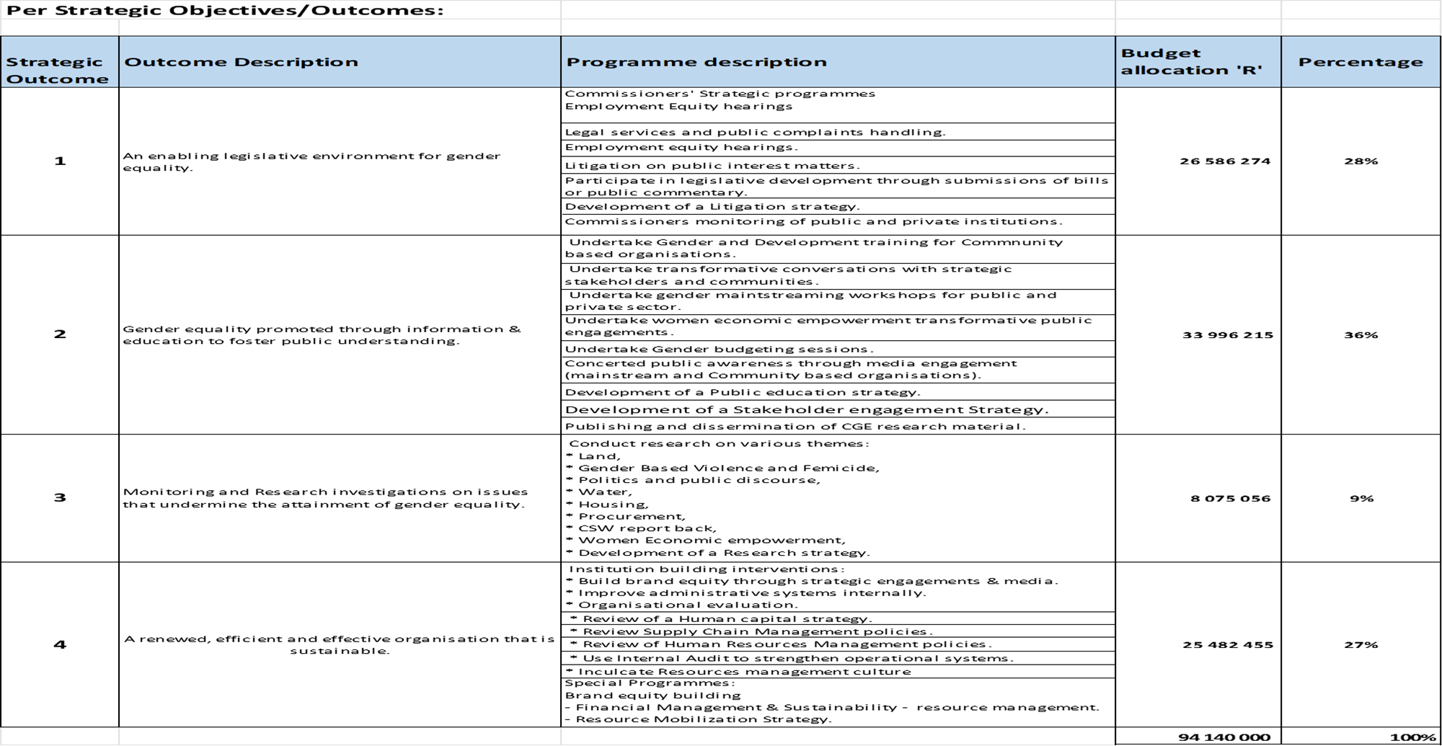
BUDGET: 2023/24 FINANCIAL YEAR – PER STRATEGIC OUTCOMES

Slide 33
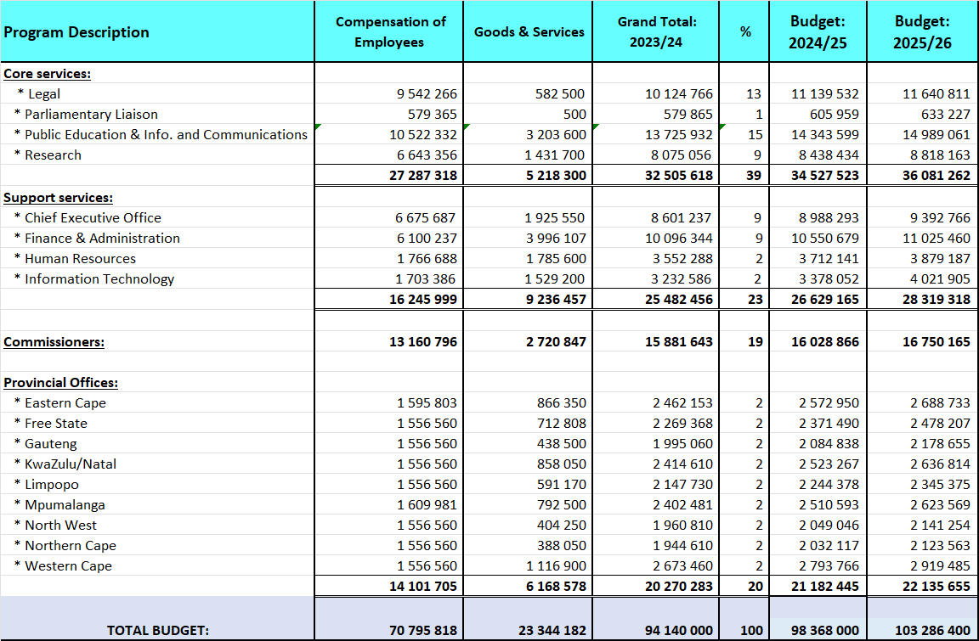
Budget: 2023/24 per Programme

Slide 34
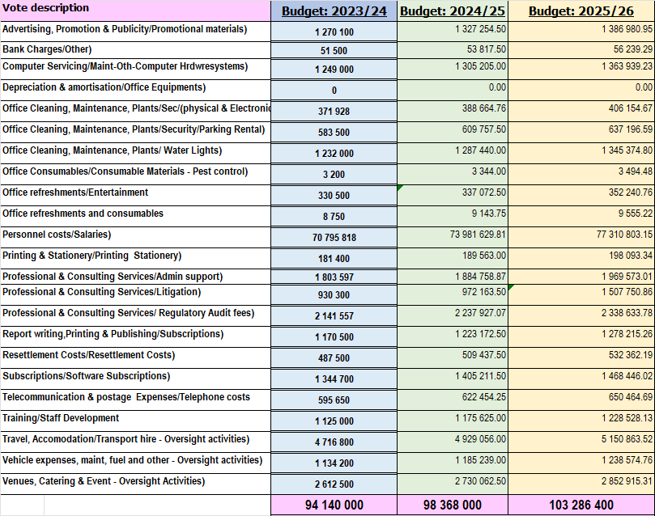
FINANCIAL MATTERS
Budget: 2023/24 - Per Expenditure Type

Slide 35
CGE LEASED OFFICE ACCOMMODATION PROGRESS REPORT AS AT 31 MARCH 2023
PROPERTY DESCRIPTION | LEASE START DATE | LEASE END DATE
Bloemfontein: Fedsure Building | 29-01-2019 | 31-08- 2024
Cape Town: Absa Building | 01-01-2022 | 31-12-2022
Durban: 40 Commercial Road | 01-09-2019 | 31-08- 2023
Kimberley: 143 Du Toitspan Rd | 04-01-2022 | 31-03 -2025
Mmabatho: 38 Molopo Road | 01-09-2019 | 31-08- 2024
Nelspruit: 32 Bell Street | 01-05-2019 | 30-04- 2023
Polokwane: Library Gardens | 01-05-2019 | 30-04- 2025
East London: Waverly Office Park, | 01-07-2019 | 30-06- 2024
Pretoria: Preator Forum Building | 01-05-2016 | 31-07- 2025
Johannesburg: Constitutional Hill | 02-01-2022 | 31-01-2025

Slide 36
AUDITOR gENERAL OF SA
Audit Findings – Audit plan to address repetitive audit findings – Chief Financial Officer
Whistleblowing cases that implicated Internal Chief Auditor were never reported to Auditor General for probing or further investigate
Internal Chief Auditor – Suspended.

Slide 37
Audit Action Plan: 2021/22 Financial year
There were 59 audit findings issued for this financial year.
# (44) 75% were resolved by the 31 March 2023
# (15) 25% are in progress, mainly due to the following:
Outstanding response from the Office of the Chief Procurement Officer (OCPO), regarding the rotation of appointed panel of attorneys;
Outstanding response from the Office of the Accountant-General (OAG) regarding the 100 hours matter;
The Human Resources policies changes on housing allowance.
Notes:
# There were 59 audit findings issued for this financial year.
# 75% were resolved by the 31 March 2023
# 25% are in progress, mainly due to rhe following:
Outstanding response from the Office of the Chief Procurement Officer (OCPO), regarding the rotation of appointed panel of attorneys;
Outstanding response from the Office of the Accountant-General(OAG) regarding the 100 hours matter;
The Human Resources policies changes on housing

Slide 38
THANK YOU
www.cge.org.za
FOLLOW US ON SOCIAL MEDIA
SOCIAL MEDIA CONTACTS

