Slide 1
PRESENTATION TO THE PORTFOLIO COMMITTEE ON HOME AFFAIRS
DATE: 09 MAY 2023
STATUS UPDATE ON BIOMETRIC MOVEMENT CONTROL SYSTEM (BMCS) & AUTOMATED BIOMETRIC IDENTIFICATION SYSTEM (ABIS)

Slide 2
PURPOSE
PURPOSE
The purpose of this presentation is to:
1. Update the Portfolio Committee on the roll-out status of the Biometric Movement Control System(BMCS).
2. Provide an update on the status of the Automated Biometric Identification System (ABIS)

Slide 3
BIOMETRIC MOVEMENT CONTROL SYSTEM
(BMCS)

Slide 4
BIOMETRIC MOVEMENT CONTROL SYSTEM
The objective of this project is to roll-out the Biometrics Movement Control System (BMCS) at all Ports of Entry in the country to replace the enhanced Movement Control System (eMCS) which has reached its end of life.
The BMCS system enables the capturing of fingerprint and facial biometric data of all travellers who enter or exit South Africa.
The fingerprint and facial biometric data will also be used to trace the movement of travellers in the country and to identify both citizens and foreigners, thus improving national security.

Slide 5
BIOMETRIC MOVEMENT CONTROL SYSTEM
The development of the system was completed in 2021 and released into production at four airports as a pilot (OR Tambo, King Shaka, Cape Town and Lanseria).
Performance has improved and the system is now stable, as majority of the bugs/issues experienced during the pilot were resolved by the developers.
In the 2022/23 financial year the system was rolled out to 34 Ports of Entry and up to 30% of the immigration counters and is still running parallel to eMCS.
In the 2023/24 financial year we will increase the system coverage in all ports.
The roll-out of the BMCS included the creation of user profiles, training of users, and change management.
We envisage 100% deployment of BMCS to 72 ports by 31 March 2024.

Slide 6
BIOMETRIC MOVEMENT CONTROL SYSTEM
In the 2023/24 financial year the system will be rolled out in the remaining 38 Ports of Entry and they are:.
Alexander Bay, Makgobistad, Makhaleen Bridge, Pafuri, Bothashoop, Bray, Kruger Mpumalanga International Airport, Rietfontein, McCarthy’s Rest, Platjan, Pontdrift, Josefsdal, Ramatseliso’s Gate, Daniel Stuurman International Airport(Port Elizabeth) , Mossel Bay, Saldanha, East London, Ngqura, Ongeluksnek | Port Elizabeth Harbour, Waterkloof Military Airbase, Gemsbok, Onverwacht, Derdepoort, Peka Bridge, Middelputs, Twee Rivieren, Waverley, Zanzibar, Sendelingsdrift Sepapus Gate, Polokwane International Airport, Makopong, Bram Fischer International Airport (Bloemfontein), Pilanesberg International Airport, Upington International Airport, Boesmansnek, Onskeepkans

Slide 7
BIOMETRIC MOVEMENT CONTROL SYSTEM
Challenges | Intervention measures
Inadequate network bandwidth in the ports of entry due to delays in the SITA procurement processes. | For ports of entry where timelines are not met by 15 September 2023, the Department will request deviation from SITA processes and approach service providers directly in order to deliver on the project.
Negative impact of load shedding on the rollout due to lack of backup power. | BMA is working on obtaining alternative power solutions i.e. installation of generators and UPS in all ports of entry.
Change Management - fear of utilising new system. | Change Management and training of users.
Insufficient capacity of staff at ports of entry. | Capacitation Business Case will be developed by the BMA and submitted to National Treasury for funding.

Slide 8
AUTOMATED BIOMETRIC IDENTIFICATION SYSTEM
(ABIS)

Slide 9
BACKGROUND
The DHA entered into a Amended and Restated Master Turnkey Solutions Agreement with IDEMIA in line with all the necessary conditions and scope of the project as per the initial tender requirements on 31 March 2021; after EOH Mthembo (Pty)Ltd indicated its inability to deliver the project.
Hand over process between EOH and IDEMIA took place during the month of April 2021.
IDEMIA also commenced with following tasks in April 2021: Project scoping & planning, establishment of Project structures/Work Streams, Governance and on-boarding of technical resources;
The project execution under IDEMIA commenced on 01 May 2021 for completion of Phase 1 and was estimated for completion within a period of seven (7) months ie. By 1 November 2021;
IDEMIA will utilize all the hardware and software procured by EOH with the possibility of enhancing in certain areas as per DHA ABIS Technical Implementation Audit Report .

Slide 10
DHA HANIS TECH REFRESH - ABIS
IDEMIA undertook to deliver the ABIS Project ceded on “voetstoots” by EOH in accordance with the following phase 1 deliverables and time-lines as stated in the MSA:
Phase1 – 01 May 2021 to December 2021
On completion of Phase 1, the ABIS should be fully functional and operational with all the functionalities currently enjoyed by the DHA under HANIS as detailed in the Tender.
Additional features and capabilities to perform facial recognition and latent searches as detailed in the Tender.
All the DHA Data previously stored on HANIS to be migrated to the ABIS in its totality and in a readily usable form, with no duplication of data, and no compromise on the integrity of that data. At the completion of Phase 1, the provision of the Maintenance and Support services will commence in respect of Phase 1 Deliverables.
Engagements at technical and Business level including Governance commenced May 2021 and to date

Slide 11
ABIS PROJECT (PHASE 1 ) TIME LINE UNDER IDEMIA

Slide 12
ABIS PROJECT PHASE 1 TIMELINES HIGHLEVEL
PHASE | DELIVERABLE | PERIOD
1 | Fully functional and operational with all the functionalities currently enjoyed by the DHA under HANIS. Additional features and capabilities to perform facial recognition and latent searches All the DHA Data previously stored on HANIS to be migrated to the ABIS in its totality and in a readily usable form, with no duplication of data, and no compromise on the integrity of that data | Contractual Phase 1 Completion Date: 01 May 2021 to 30 November 2021 with an additional one month grace period
 |  | 1st Extension Date: Go-Live: 28 February 2022
 |  | 2nd Extension: Go-Live: 31 March 2022.
 |  | 3rd Extension: Go-Live: 18 April 2022
 |  | 4th Extension: Go-Live: 20 June 2022
 |  | 5th Extension: Introduction of Staggered Approach (Phase 1A & Phase 1B) Go-Live Phase 1A: 22 November 2022 Go-Live Phase 1B: 17 March 2023

Slide 13
ABIS PHASE 1 GO-LIVE HISTORY
Go-Live Date | Reason for extension request
November 2021 | Request for extension as per the MSA (1 Month grace period) provided the project is at 85% completion. Idemia Letter - Reference Number: 2021- 41080 Observation: Stage 2 testing not completed and all data not migrated when extension was requested.
December 2021 | IDEMIA and the DHA unable to conclude the Stage 3 testing during the month of December 2021. Idemia Letter- Reference Number: 2021-41279 and 2021-41285 Observation: Stage 2 testing not successfully tested: Only connectivity and functionality tested; End-to-End Testing (in particular for Live Capture) not done. Migrated HANIS data was at 97% but the migrated data was not synchronized.
February 2022 to April 2022 | Delay of certain activities during February 2022 to April 2022. Idemia Letter Reference Numbers: 2022-41373, 2022-41450 and 2022-41514 Observation: Commercial Online Verification (CONLV) stage 3 testing deviated from Stage 2 testing; ABIS Online Verification (ONLV) was used as a web browser. ABIS not performing the same or better than HANIS for Live Capture Interface due to the following: End-to-End Testing (in particular for Live Capture) not done. Incomplete data migration Outdated (not supported) web browser

Slide 14
ABIS PHASE 1 GO-LIVE HISTORY
Go-Live Date | Reason for extension request
20 June 2022 | Delays on several activities allocated to the DHA, during June 2022. Idemia Letter - Reference Number: 2022- 41865 Observation: Omission of End-to-End testing during Stage 2 on Live Capture Interface; Implementation of Phase 1 excluding Facial Recognition, Latent Search and incomplete Data Migration (MSA 7.2); The deferral of the Live Capture, NIIS and NPR interfaces due to data migration and synchronisation concerns; Staggered approach was introduced and a plan for each release was drafted, which included among others Gap analysis and performance of end-to-end testing of Live Capture.
Phase 1A: 22 November 2022 | Phase 1A was released with ABIS being primary for Live Capture and some banks while HANIS remained primary for Image Capture/MCC, NIIS, other entities and banks not migrated to ABIS. Observation: Some Applications for the business process search and register stuck; Misalignment of registered fingerprints between ABIS and HANIS; Attempt to resolve the impasses on phase 1 penalties – Delay in the start of Phase 2

Slide 15
ABIS PHASE 1 GO-LIVE HISTORY
Go-Live Date | Reason for extension request
Phase 1B: 17 March 2023 | Development and testing of Facial Recognition and Latent Search capabilities concluded in March 2023 Release of Facial Recognition and Latent search at backend (MBIS) done in April 2023- after ABIS database technical issues on 17 March 2023. ABIS switched to secondary system due to operational issues (stuck applications) experienced when it was primary system in the past 4 months. Attempt to resolve the impasses on phase 1 penalties and switch of ABIS to primary– Delay in the start of Phase 2
20 April 2023 | IDEMIA letter- Reference number: 2022-42253 In the letter IDEMIA accepted full responsibility for the failure of their system on 17 March 2023 which led to a decision to switch back to HANIS as a primary database for all our transactions. IDEMIA confirmed that the ABIS Database index has been fixed / corrected, and that ABIS is ready to switch back as the primary database. DHA requested IDEMIA to also fix the stuck applications and provide the evidence that all the transaction errors are resolved. A meeting held on 26 April 2023 agreed that both IDEMIA and DHA technical teams must review progress made by IDEMIA on the stuck applications and report back in two weeks time before a decision is taken to switch back to ABIS as a primary database.

Slide 16
CONCLUSION
The Department has levied penalties on the delays caused by IDEMIA. Payment has been withheld as part of penalties.
IDEMIA is disputing the amount levied against them for penalties and the matter is being dealt with in terms of an Informal Dispute Resolution provided for in the Agreement entered into between DHA and IDEMIA.
In a letter dated 8 March 2023, IDEMIA made a Settlement Proposal on the penalties levied against them.
DHA considered the Settlement Proposal and advised IDEMIA to reconsider its proposal and revert to the DHA with an improved settlement offer.
ABIS Phase 2 was set to commence on 01 April 2023 but due to failure to complete phase 1 by the 18 March 2023 discussions between DHA and IDEMIA are ongoing to agree on a way forward

Slide 17
Ndo livhuwa
Ndiyabulela
Ke a leboga
Thank you
Dankie
Inkomu
Ke a leboha
Ngiyabonga
17

Slide 18
Status
ABIS Phase1 –
Fingerprint, Facial Recognition and Latent Search biometric modalities:
Concluded the development of Fingerprint functionality into ABIS.
Fingerprint functionality released into production- November 2022.
Concluded the development and testing of Facial Recognition and Latent Search capabilities – March 2023.
Release of Facial Recognition and Latent search - rolled back due to ABIS database technical issues.
ABIS Facial recognition and latent Search are de-activated pending a decision to elevate ABIS as a primary system.

Slide 19
Technical Deliverables for Phase2
Delivery timelines -12 months (April 2023-March 2024)
ABIS Phase2 – Iris, Infant Footprint and Palm biometric modalities:
Technical Deliverables:
1. Business process mapping.
Business requirements gathering- internal and external stakeholders
Functional Requirements
System design
Development
Testing
2. Applications and interfaces:
Technical requirements.
Draft and approval of specifications.
Design and Development.
Testing.

Slide 20
Technical Deliverables for Phase2
Technical Deliverables:
3. Enterprise Architecture:
Definition of Enterprise Architecture requirements from business requirements, SODD and interface specifications.
conduct technical impact analysis of requirements on Enterprise Architecture.
Update applications and business architecture documents.
4. Testing and deployment:
Prepare test data sets.
Development of test plans and test cases.
Perform Stage1 testing.
Perform Stage 2 testing – QA and Pre-prod.
Joint Stage 2 testing.
5. Deployment / release into production and perform stability testing.

Slide 21
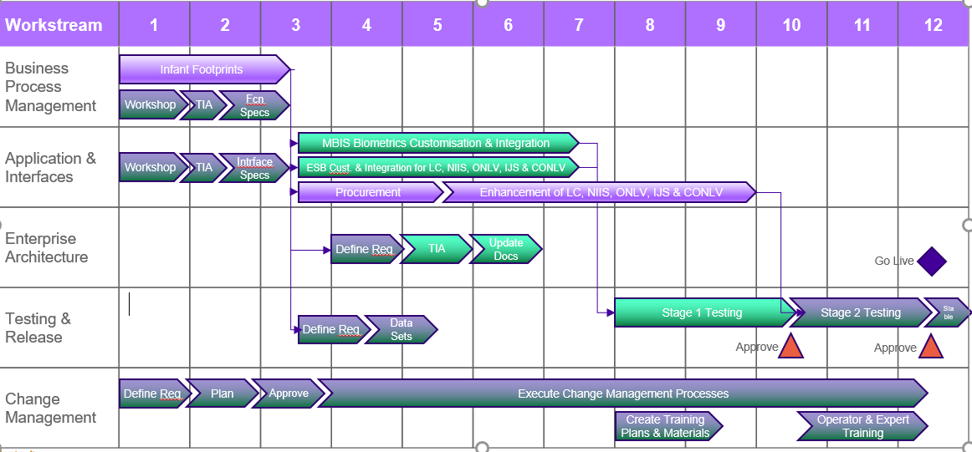
High level Plan for Phase2
12 Months

Slide 22
Thank you
Ndiyabulela
Ngiyabonga
Ke a leboga
Ndo livhuwa
Inkomu
Dankie

